Slide 1
Adaptive Parameter Tuning in KENDA-CH1 and ICON-CH1-EPS
COSMO GM 2025, WGDA, 01.09.2025
Valentin Hässig, Lukas Jansing, David Leutwyler, Daniel Leuenberger, Claire Merker and Marco Arpagaus
Adaptive parameter tuning following Zängl 2023 https://doi.org/10.1002/qj.4535

Slide 2
Results from first experiments
Master’s thesis Valentin Hässig

Slide 3
Experiment setup
ID 854 (reference)
opr. ICON CH1-EPS setup
opr. KENDA setup
+ rhtsat = 1, ilocv_sfc = 1
30.05.2023 – 14.06.2023
ID 852 (with APT)
opr. ICON CH1-EPS setup
opr. KENDA setup
+ rhtsat = 1, ilocv_sfc = 1
+ assimilation of 10m wind (obs_err=3.6)
+ adaptive parameter tuning
30.05.2023 – 14.06.2023

Slide 4
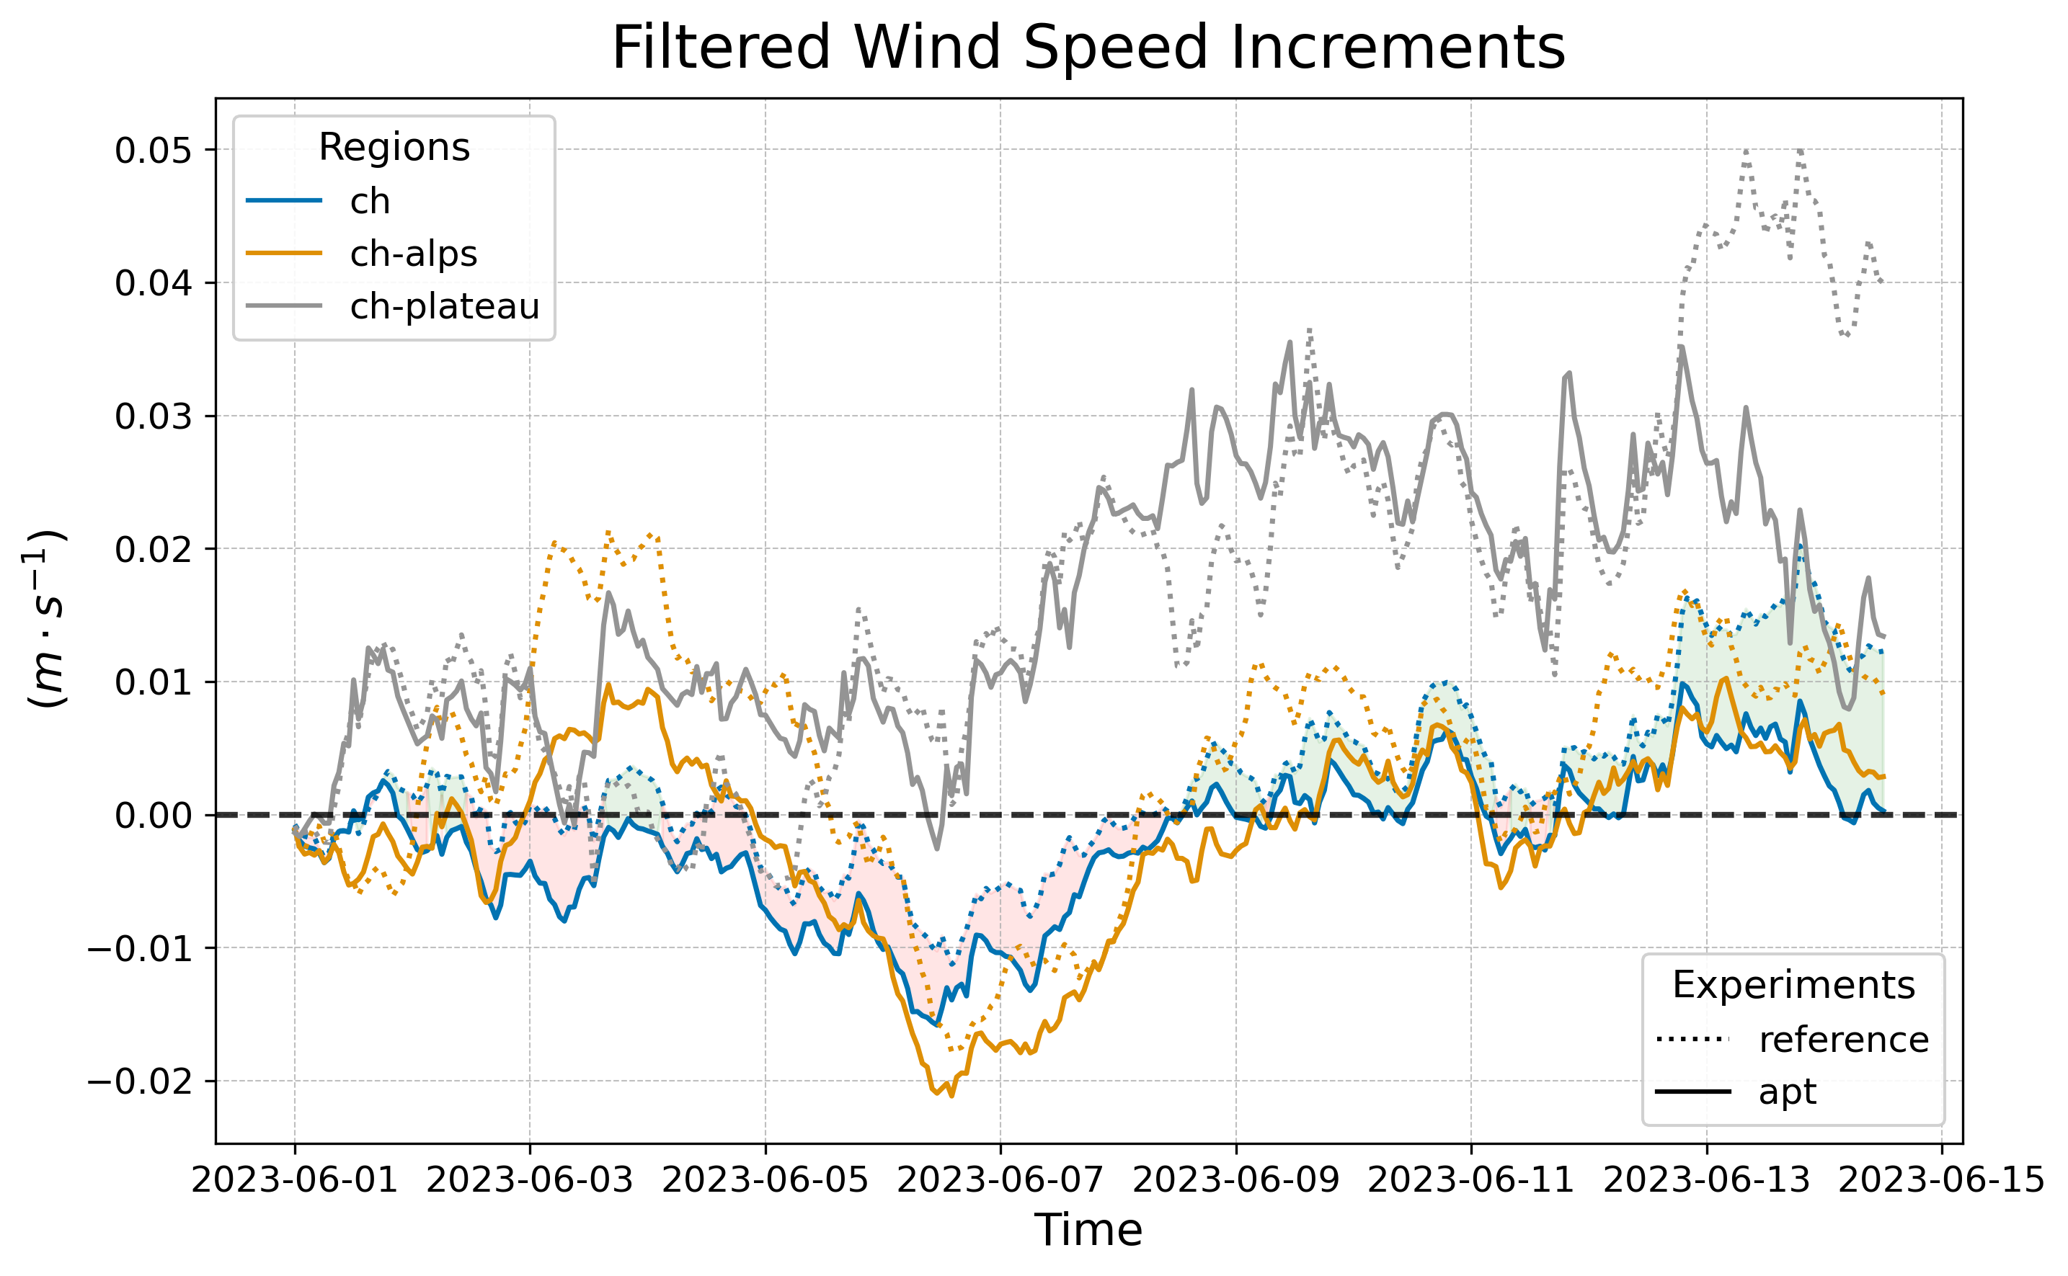
Time-filtered increments: wind speed
APT experiment has smaller KENDA increments
APT experiment has larger KENDA increments

Slide 5
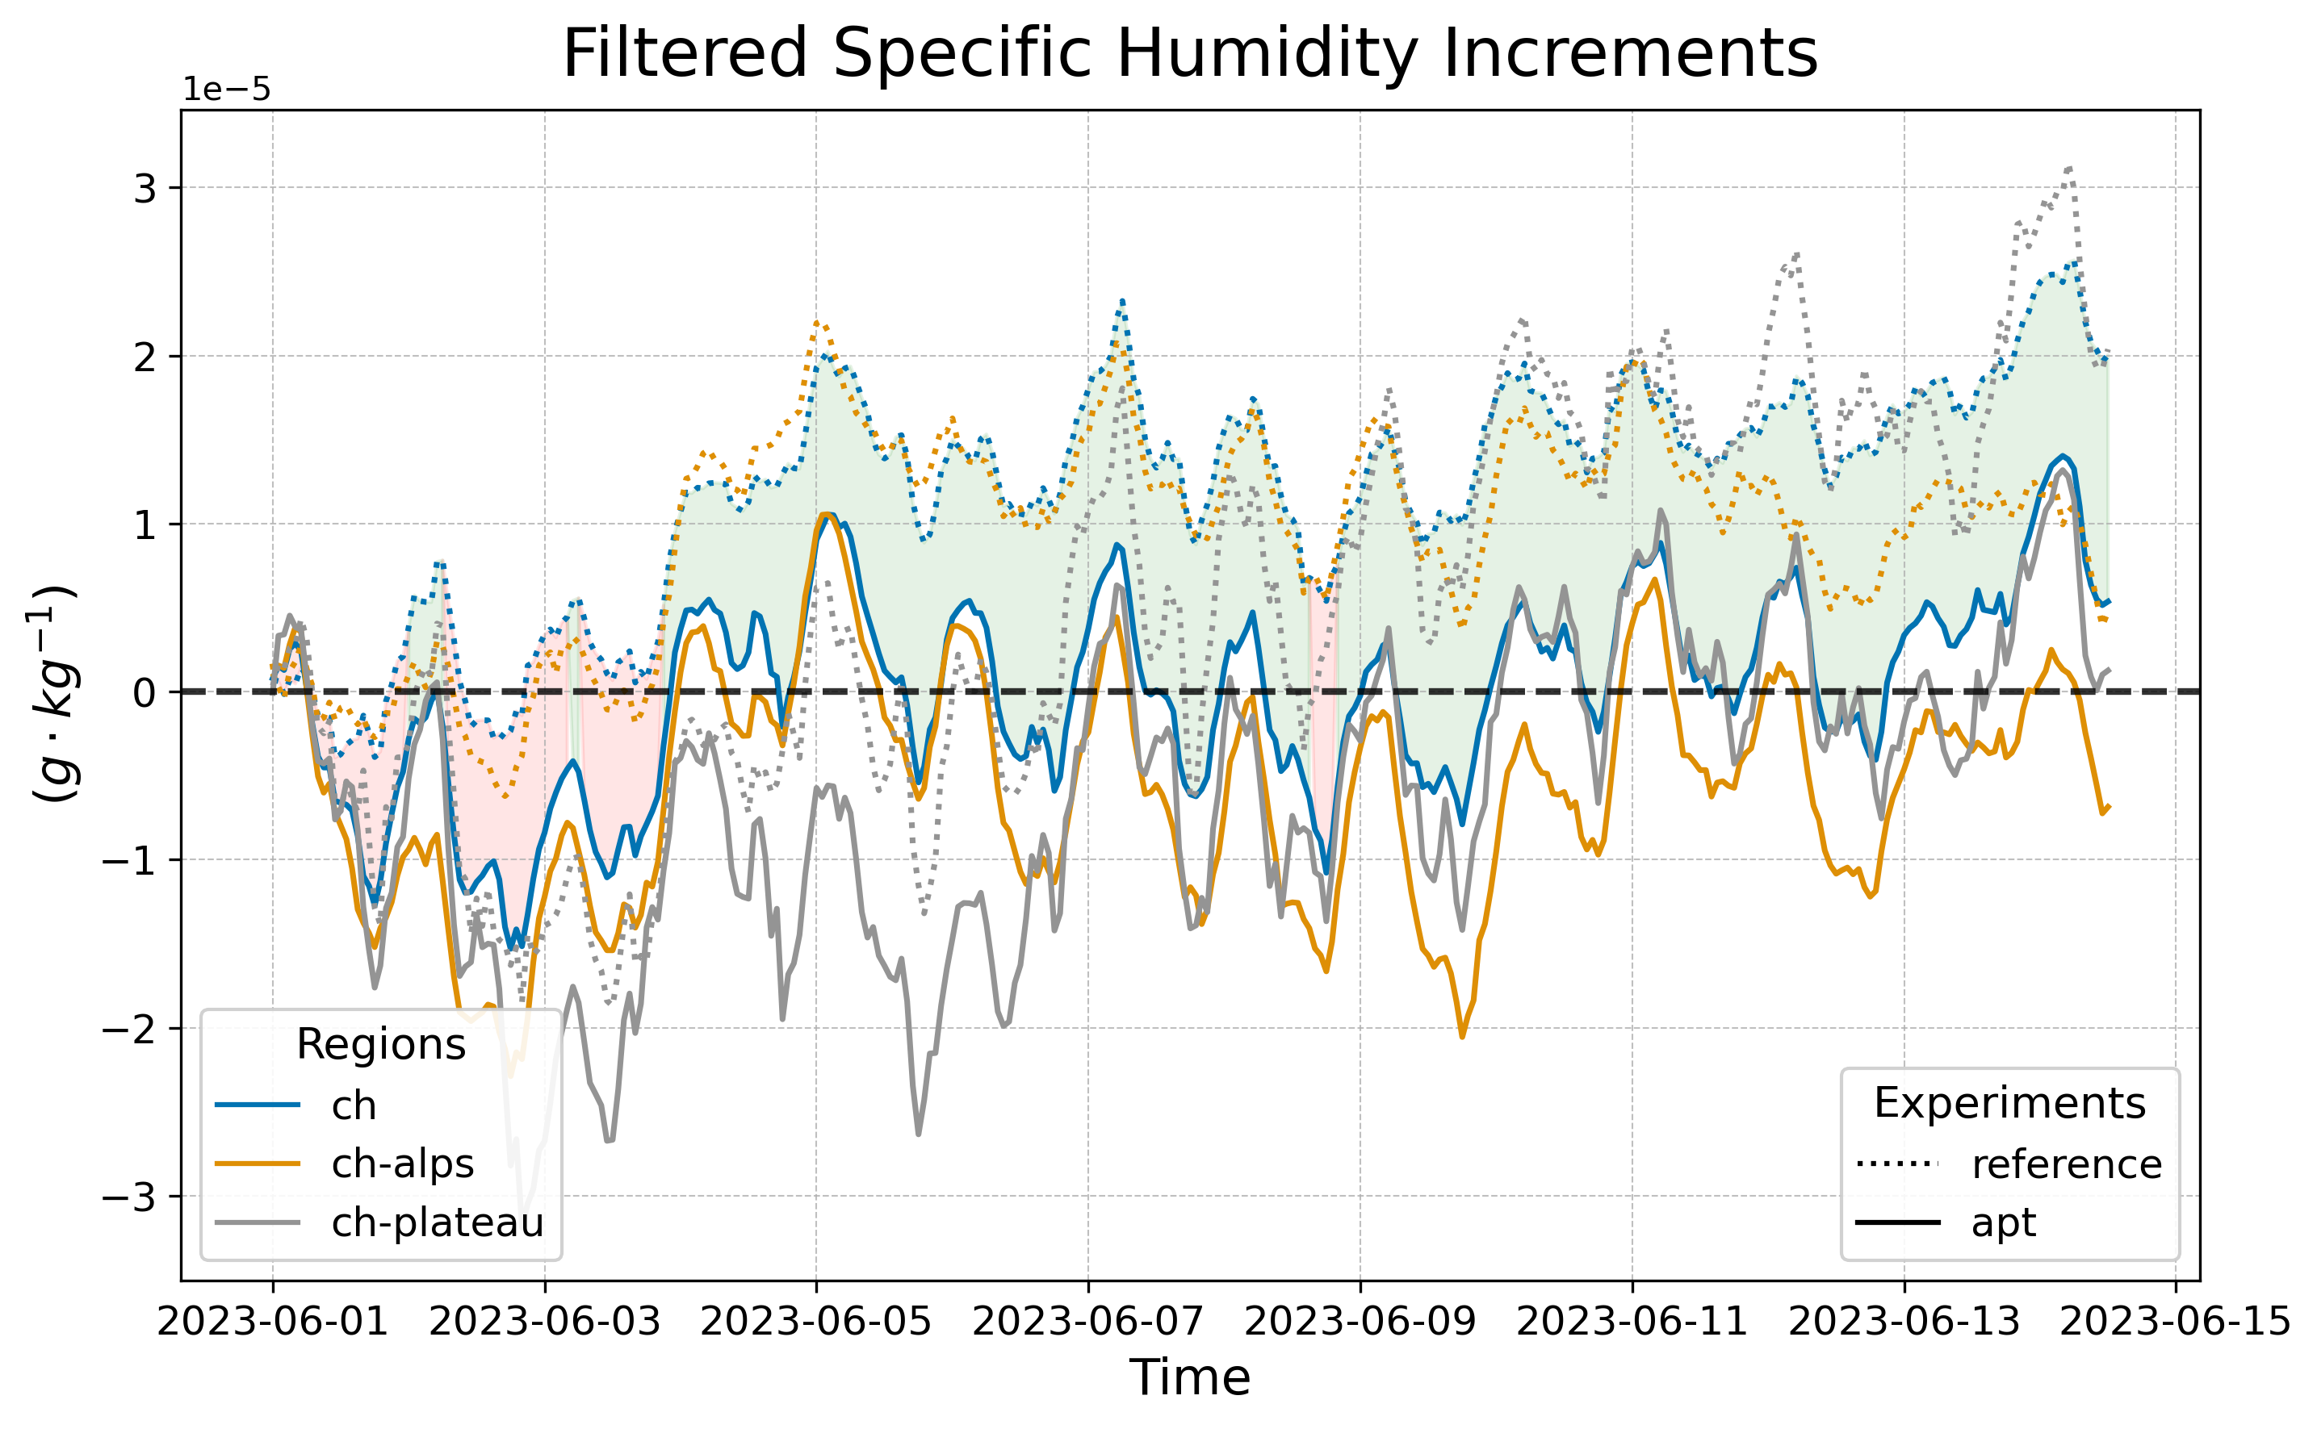
Time-filtered increments: specific hum.
APT experiment has smaller KENDA increments
APT experiment has larger KENDA increments

Slide 6
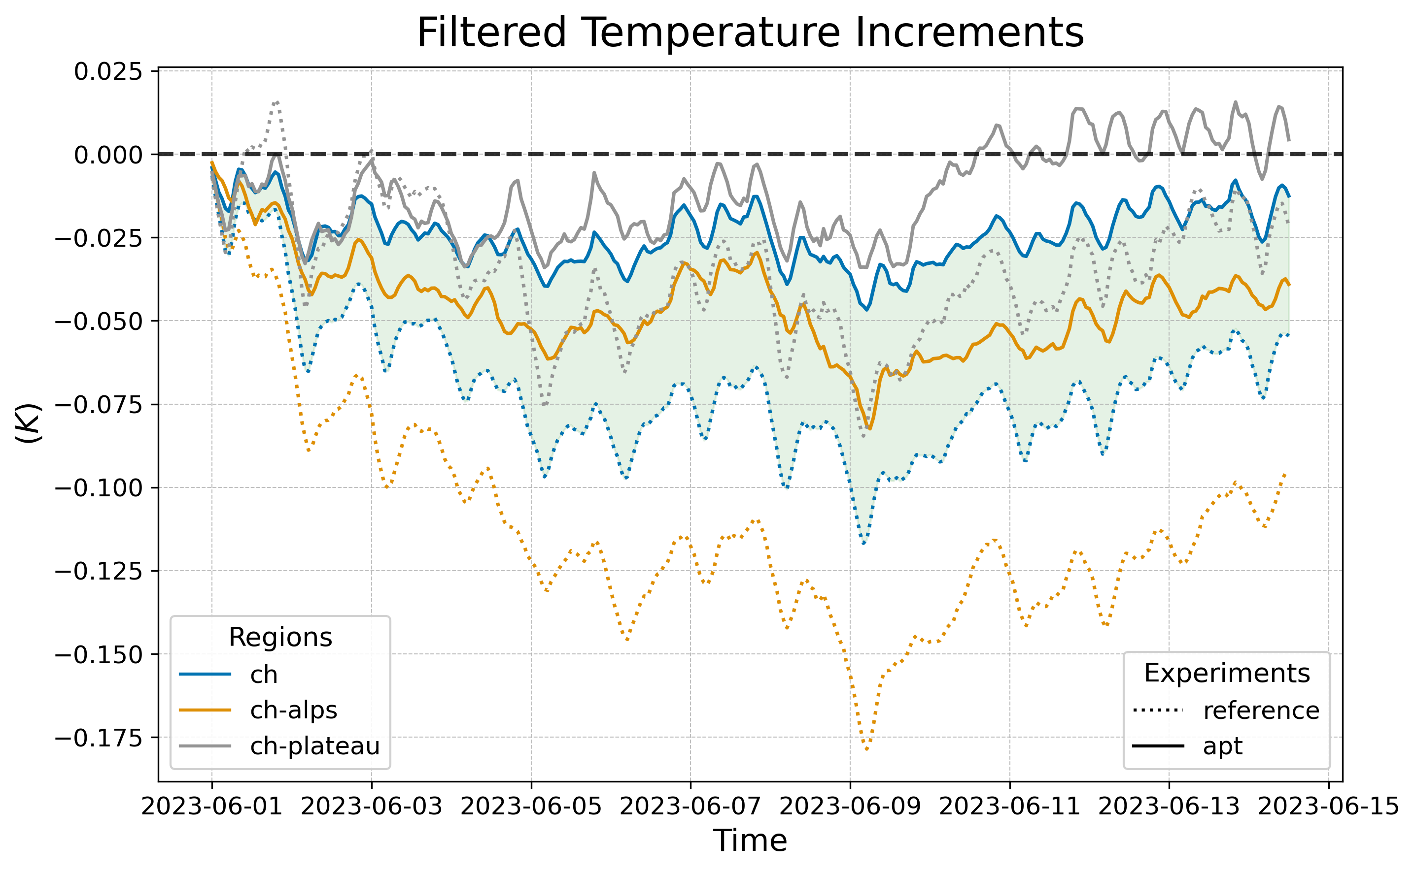
Time-filtered increments: temperature
APT experiment has smaller KENDA increments
APT experiment has larger KENDA increments

Slide 7
Results from the parallel suite

Slide 8
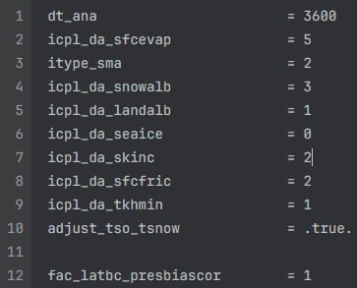
Adaptive Parameter Tuning settings
Parallel KENDA-CH1 suite running since 15.05.25
Parallel suite also contains topographic shading and 1-moment microphysics tuning → comparison with operational suite does not only show APT impact!
Deactivated SSO to evaluate the interaction of SSO and APT on 12.06.25 07 UTC

Slide 9
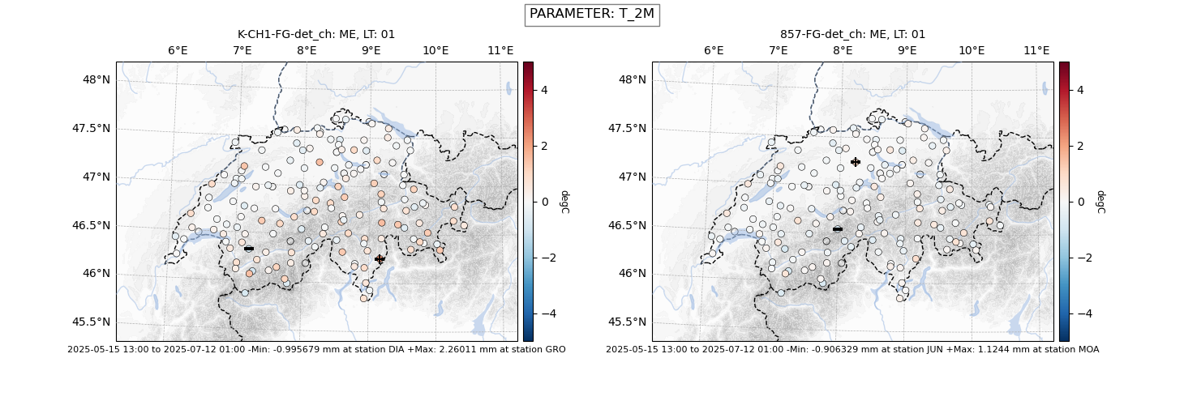
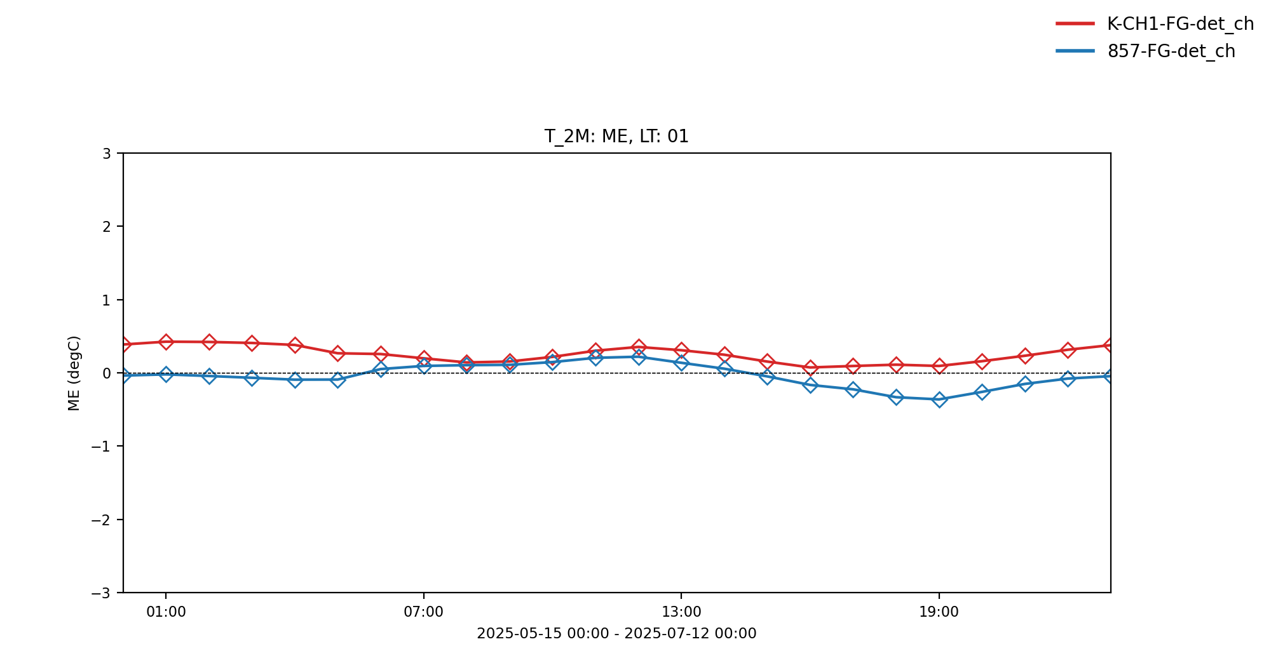
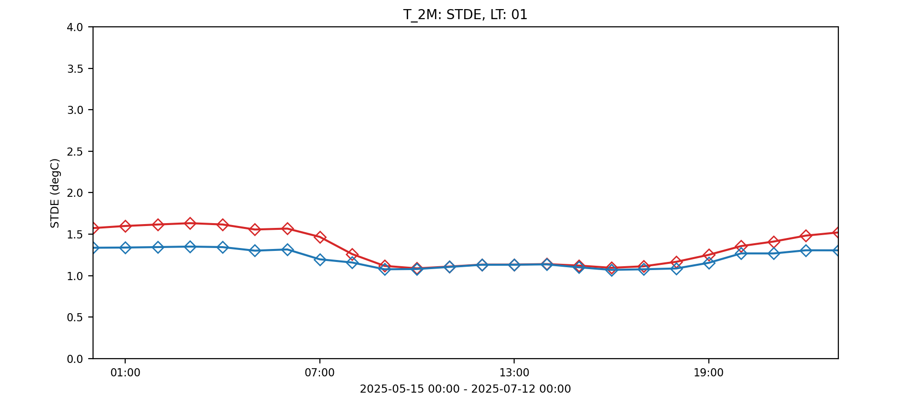
KENDA-CH1: T_2m (15.5.25 - 14.07.25)
opr
APT
opr
APT

Slide 10
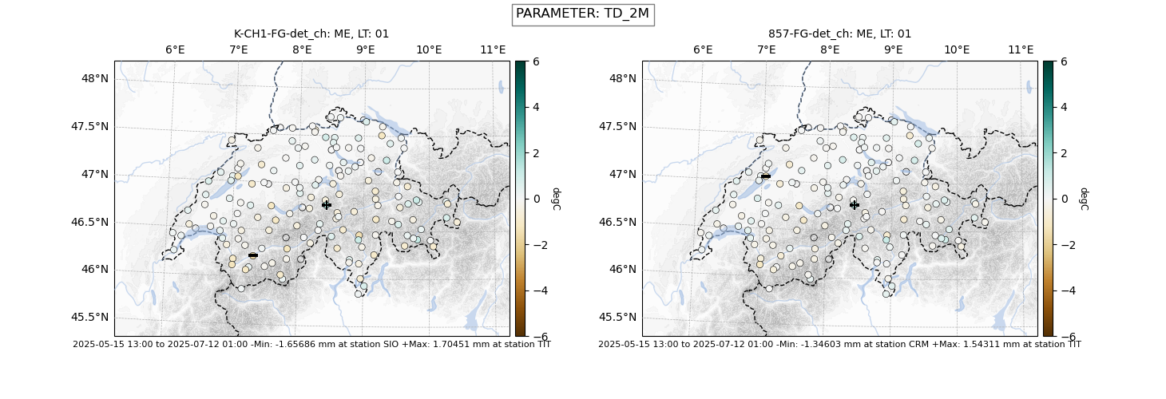
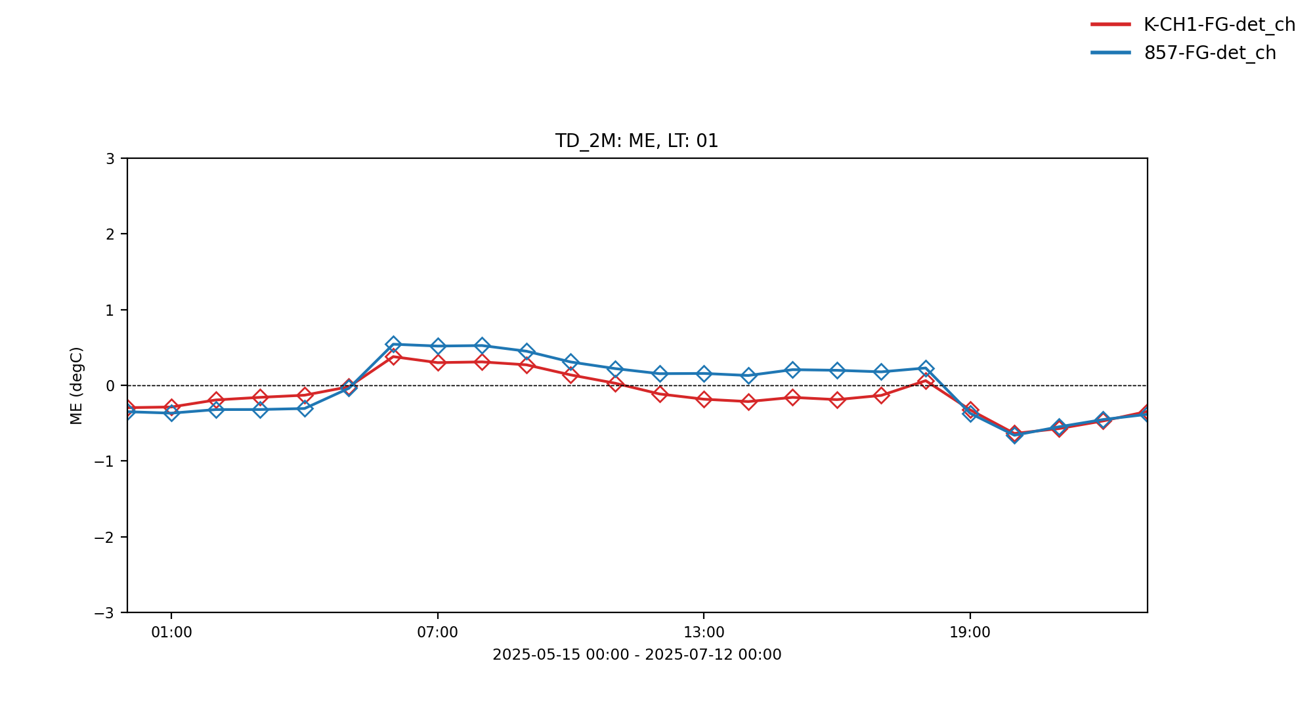
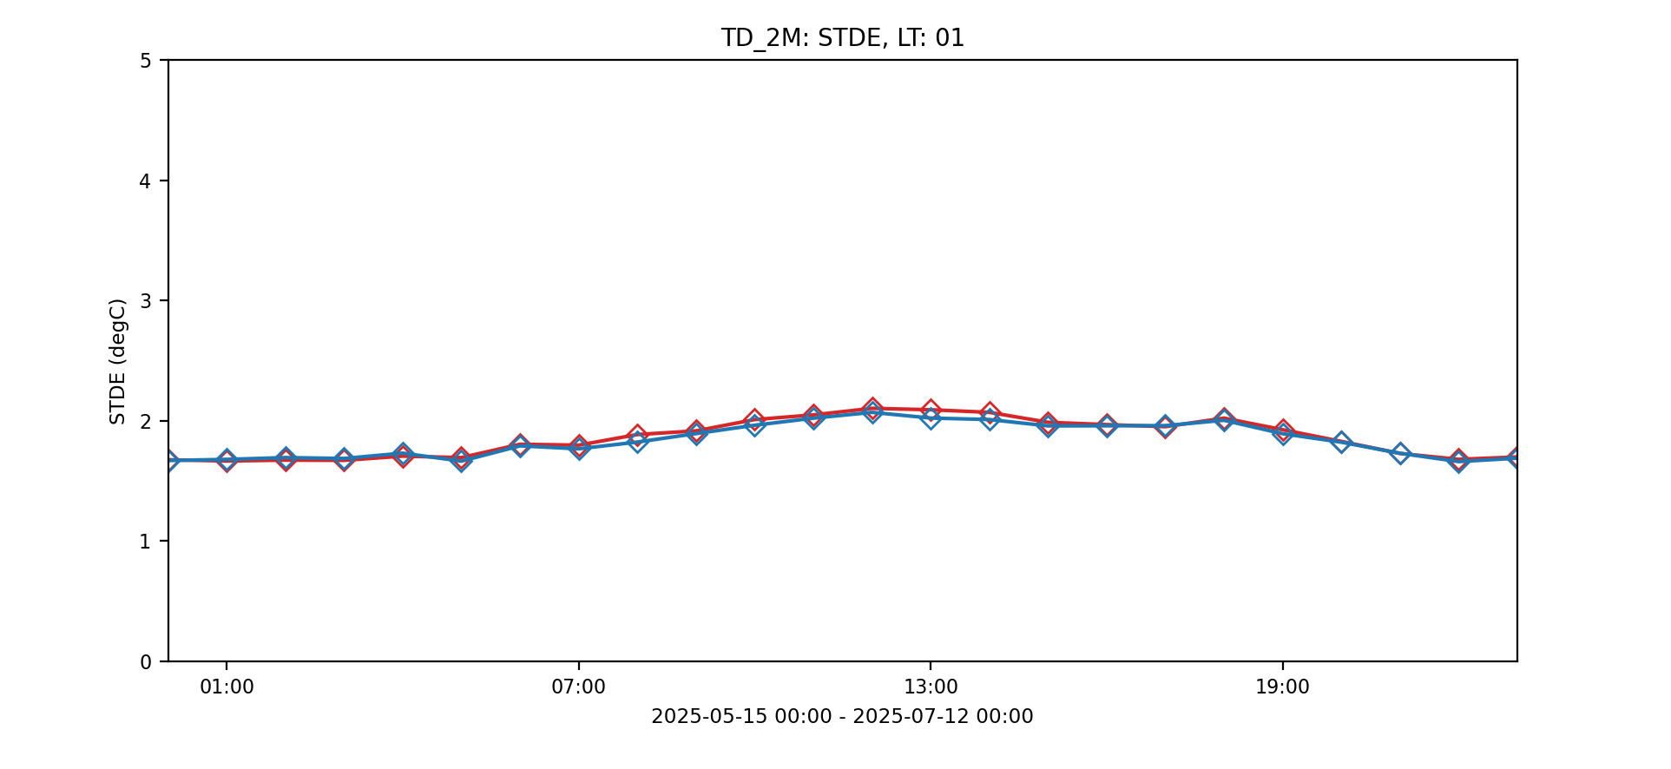
KENDA-CH1: Td_2m (15.5.25 - 14.07.25)
opr
APT
opr
APT

Slide 11

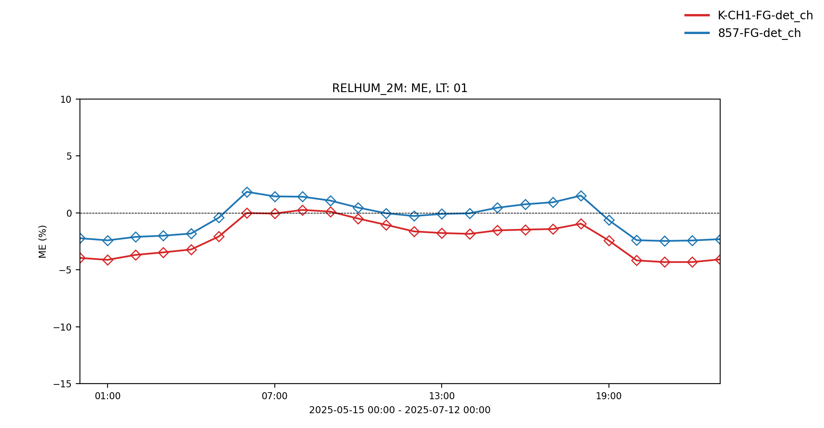
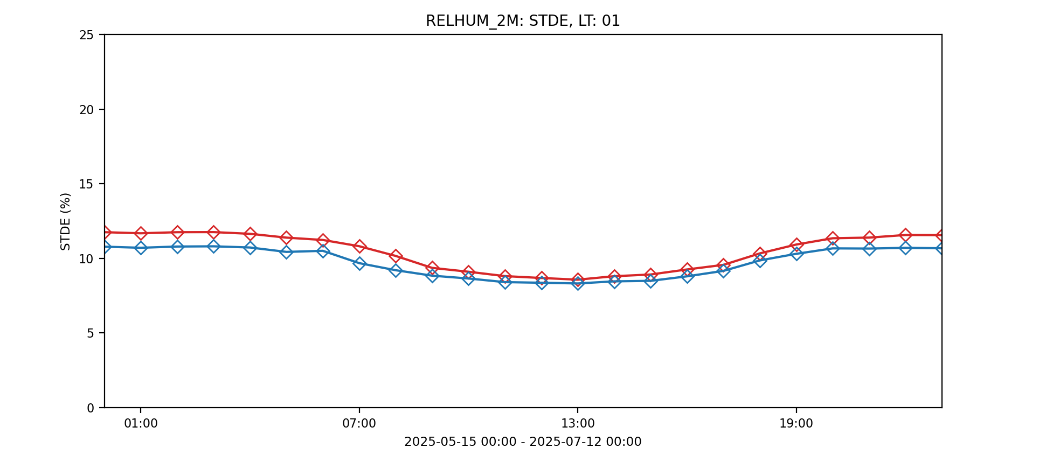
KENDA-CH1: RH_2m (15.5.25 - 14.07.25)
opr
APT
opr
APT

Slide 12
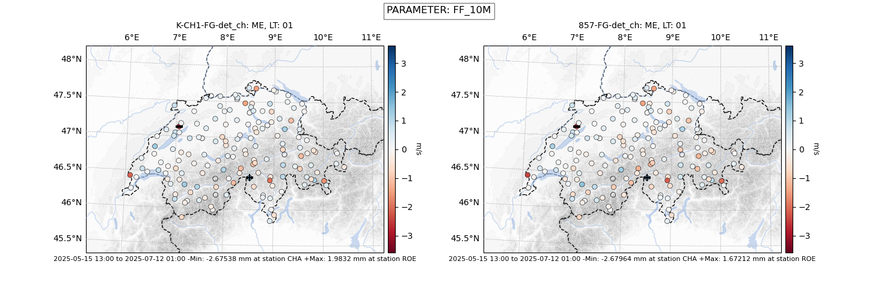
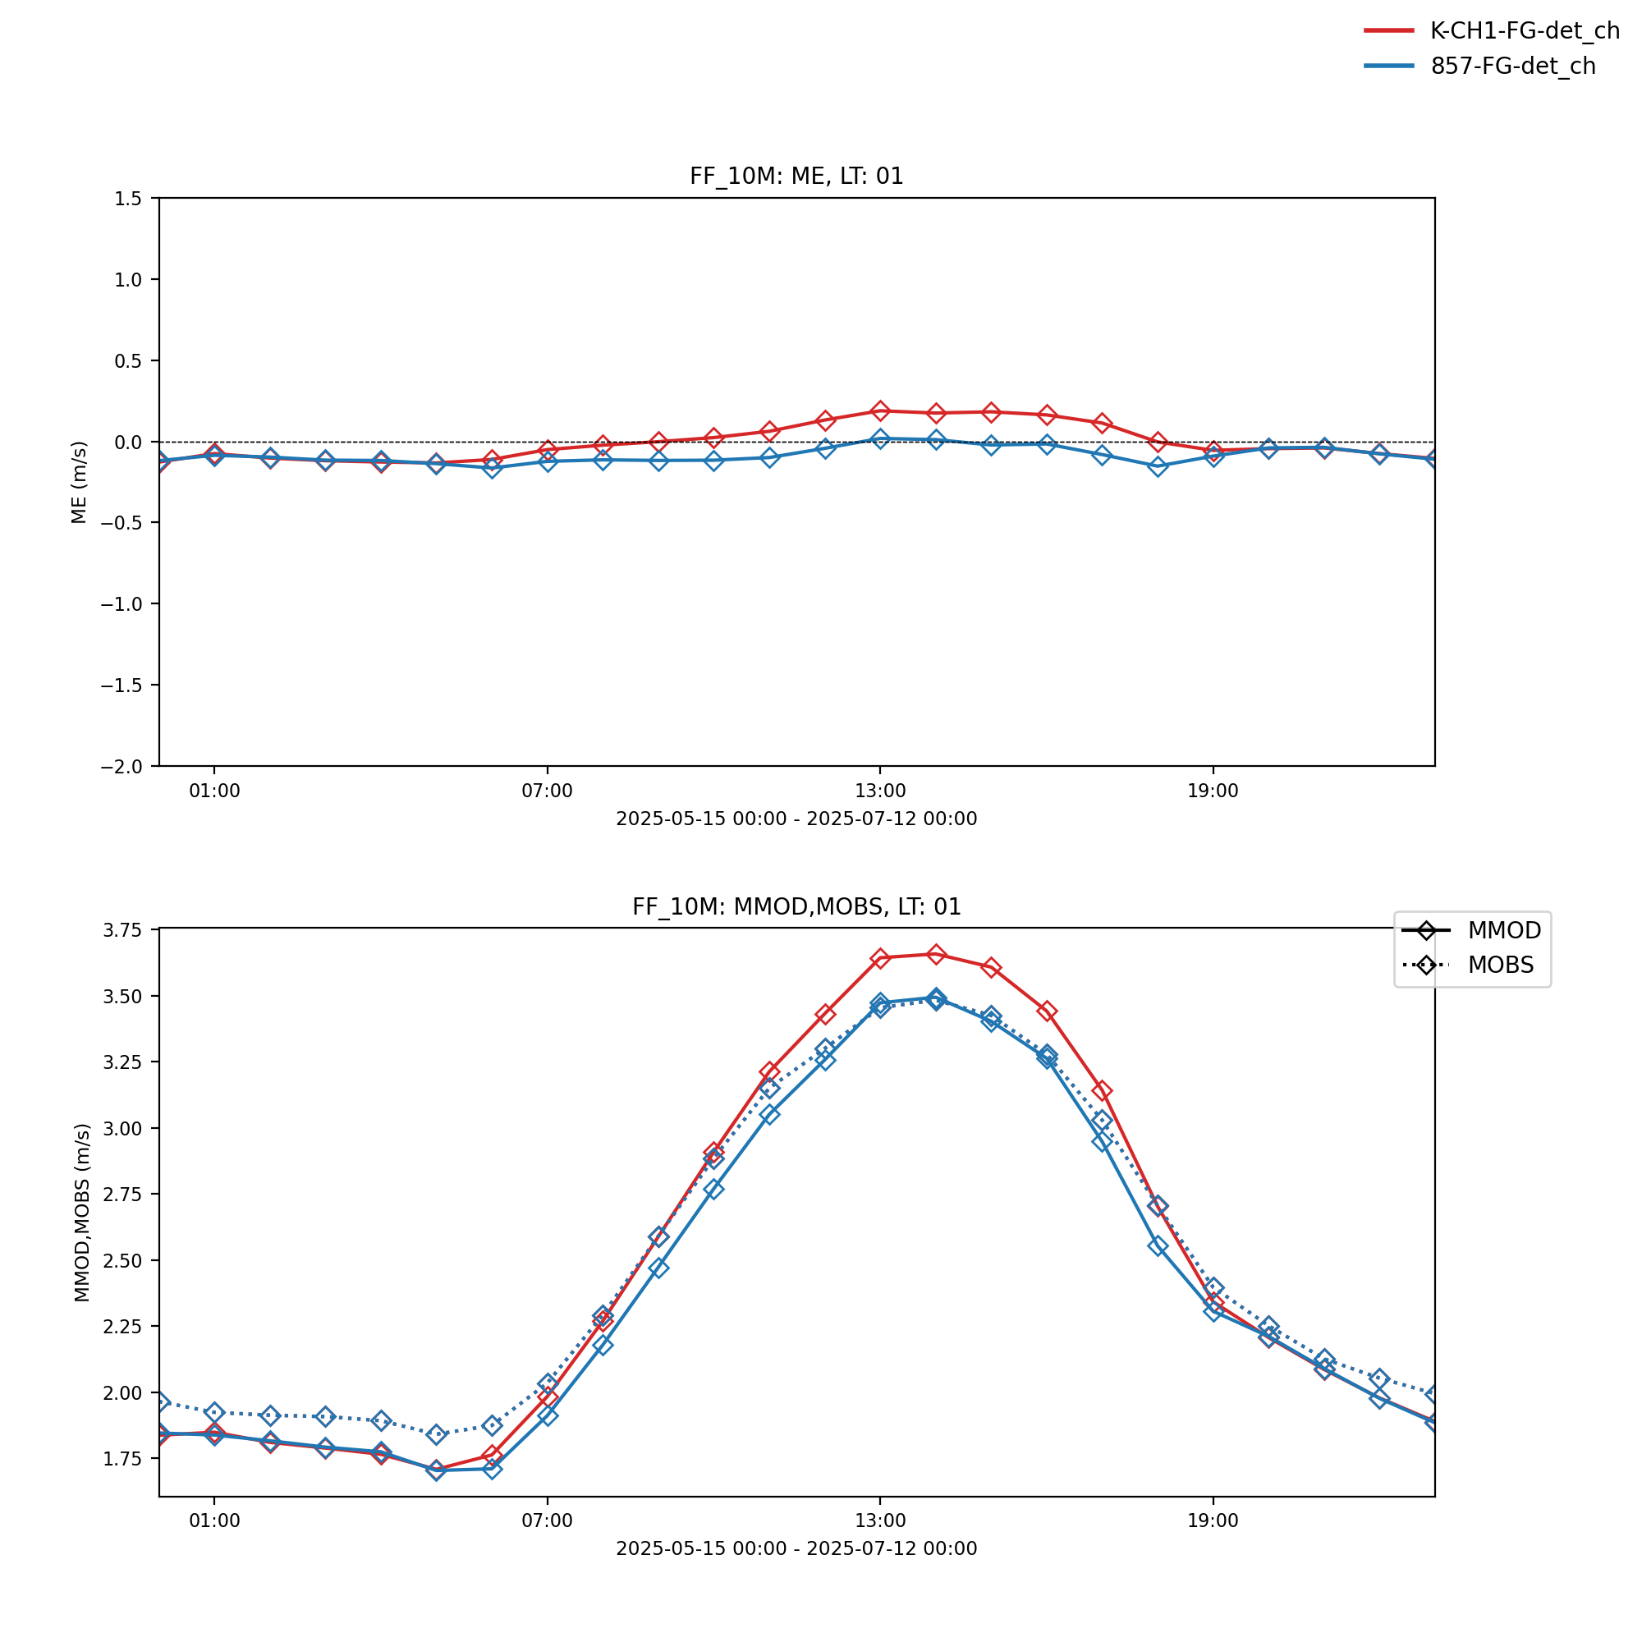
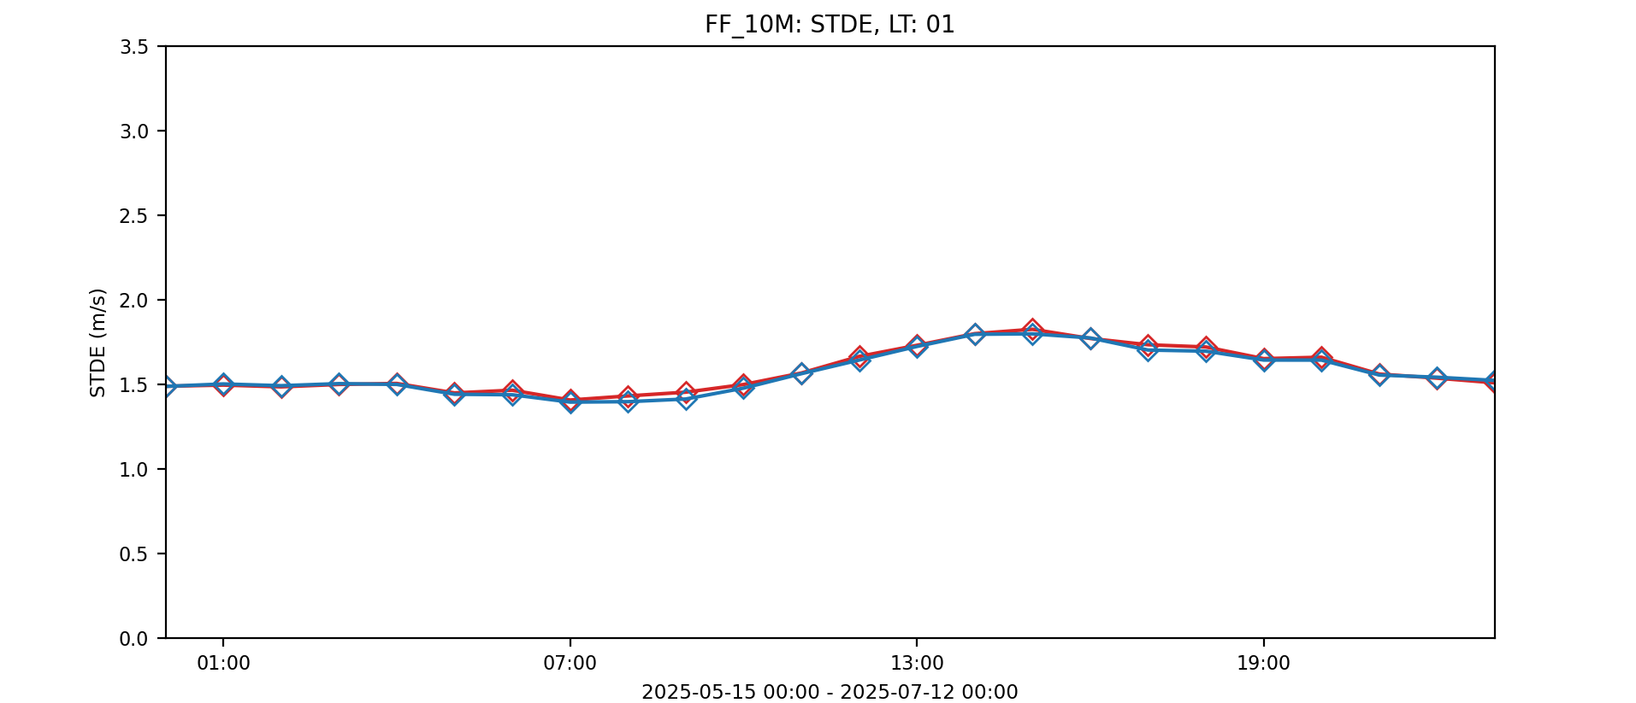
KENDA-CH1: FF_10m(15.5.25 - 14.07.25)
opr
APT
opr
APT

Slide 13
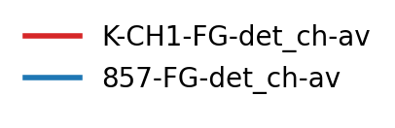
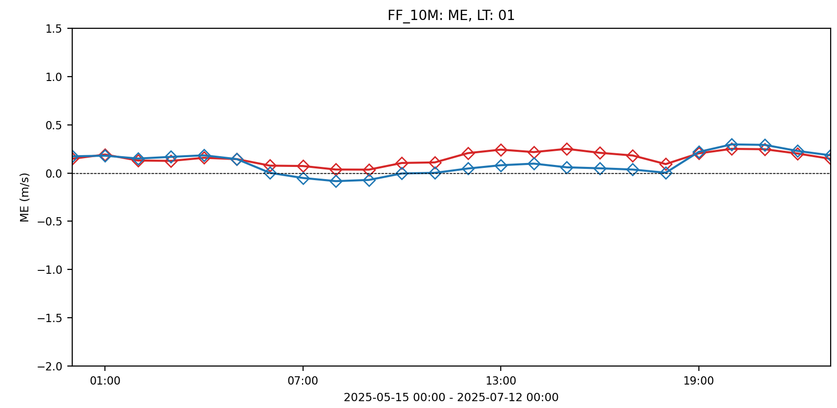
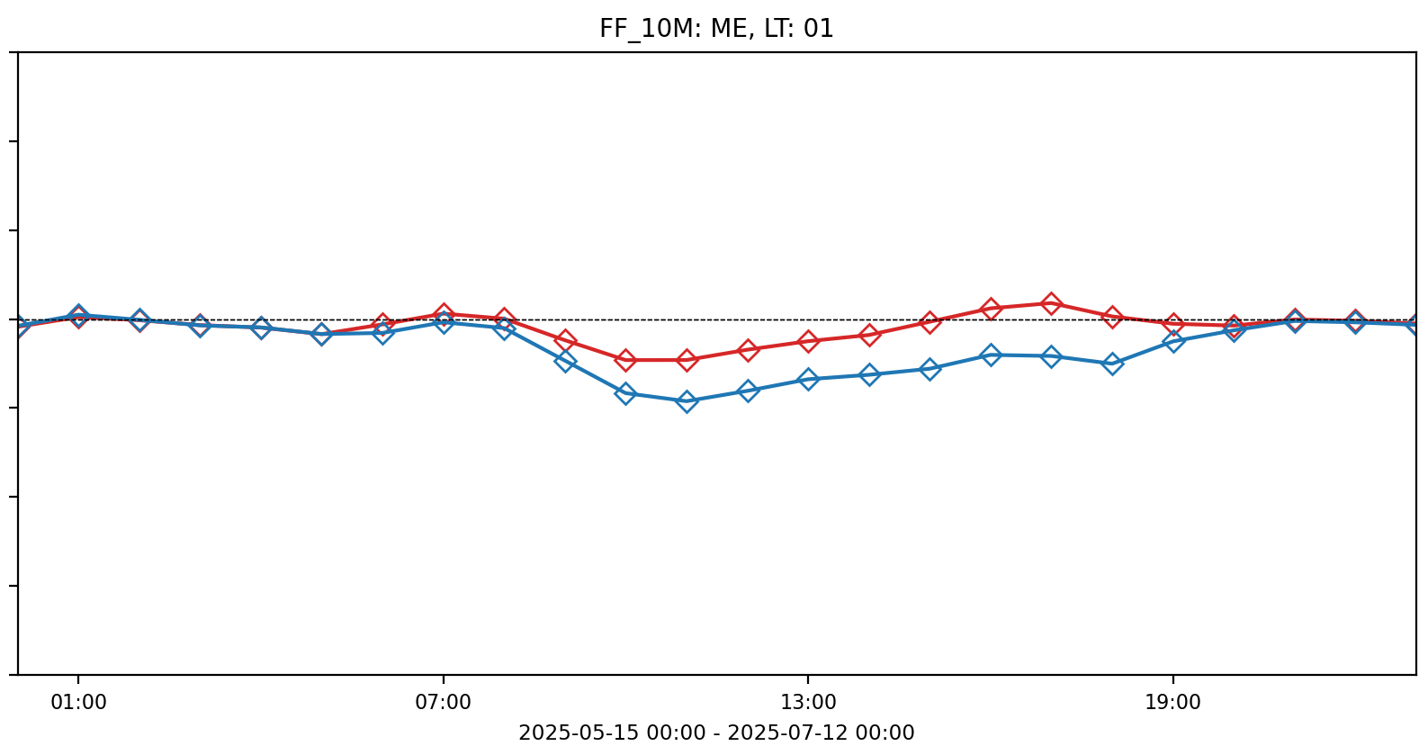
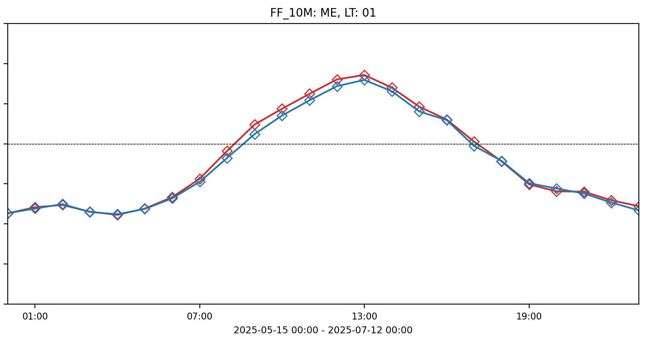
Compensation of Errors for FF_10m
opr
APT
Switzerland
Swiss Plateau
Alpine Valleys
Alpine Mountains
Too much friction for diurnal valley winds (consistent with results from V. Hässig’s Master’s thesis).

Slide 14
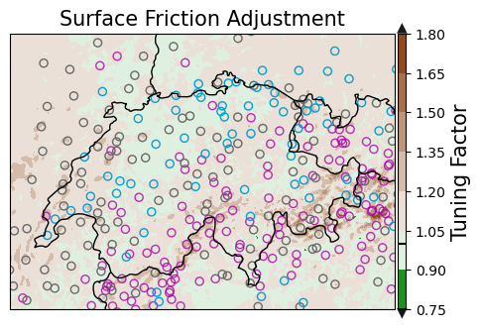
Wind: Station Representativity Hypothesis
always
assimilated
rarely
assimilated
often
assimilated
Less stations available in complex terrain.
Tuning factor highest in complex terrain, often where no stations are available.
Increments mainly coming from correlations might not be skillfull in complex terrain.
Plot updated based on Master’s thesis by V. Hässig

Slide 15
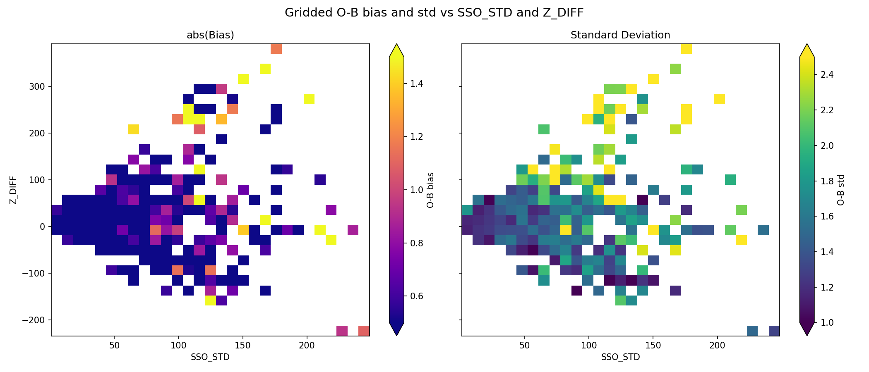
Are the limiters well chosen?
Limiters seem ok.
Some potential for additional stations.
Manual station list would have maintenance burden.

Slide 16
Soil Moisture Index
SMI=1 -> field capacity
SMI=0 -> wilting point
Moister Soil with APT
Rapid adjustment to weather in uppermost layers.
Results vary strongly accross stations (not shown).

Slide 17
Conclusions
Work in progress and need for evaluating the parallel suite once topographic shading and 1-moment microphysics tuning are introduced
First results for T and RH are promising
Wind results are promising over Swiss Plateau but issues over mountains
    maybe use it without wind APT
    or exclude alpine range
    or try to assimilate more stations in mountains (relax limiters)

