Slide 1
Survey on monitoring for KENDA
Klaus Stephan

Slide 2
Answers of the Survey (by ARPAE, MeteoSwiss & DWD):
Do you runing monitoring tools for your operational KENDA system, permanently?
  Yes (all three)
What do you monitor?
  Availability of all obs types (all), error statistics (MS, DWD)
  Spread and Increments (MS, DWD (sporadically)
  LHN statistics (all)
Do you visualize the monitoring?
  Time series (all), 2d area plots & profiles (MS, DWD)
Do you get an automatic alert?
  Yes (ARPAE, DWD)

Slide 3
Answers of the Survey (by ARPAE, MeteoSwiss & DWD):
Which script language do you use for your monitoring tools?
  Python (all)
  obs_err_stat (Fortran) (MS, DWD (sporadically))
Do you apply a special plotting software?
  Inhouse Python tools (all), gnuplot (DWD)
What is your opinion about the goal of a unification the monitoring?
  Get a unified system and a unified set of pictures (all)
Do you have additional comments?
  We are particularly interested in robust python code to read and process feedback files. We can commit to engage in developing and maintaining a common python monitoring package. (MS)
  We are interested in developing a common tool and we are happy to contribute. (ARPAE)

Slide 4
Next possible steps…
Create a git repository in gitlab under DACE.
Collect python scripts and start to discuss how to unify this codes.
  ekf Files:
    Create one uniform python tool, which can read ekf and produce a source for plotting tool.
    Create a set of pyhthon tools, for different kinds of plots (time series, vertical profiles)
  Grib files:
    Create one uniform python tool, which can read grib files and create different kinds of plots (spread, increments)
  lhn.log files:
    Create one uniform python tool, which can read log files and create different kinds of plots (spread, increments)
  (EMVORADO output files)

Slide 5
Work by Michael Bender (DWD)
Python tool to extract time series from ekf files. Those time series are then plotted but also stored in long time archive at DWD for further investigations
Separate plotting tool for time series (and others) for all obs types down to all separate observations:

Slide 6
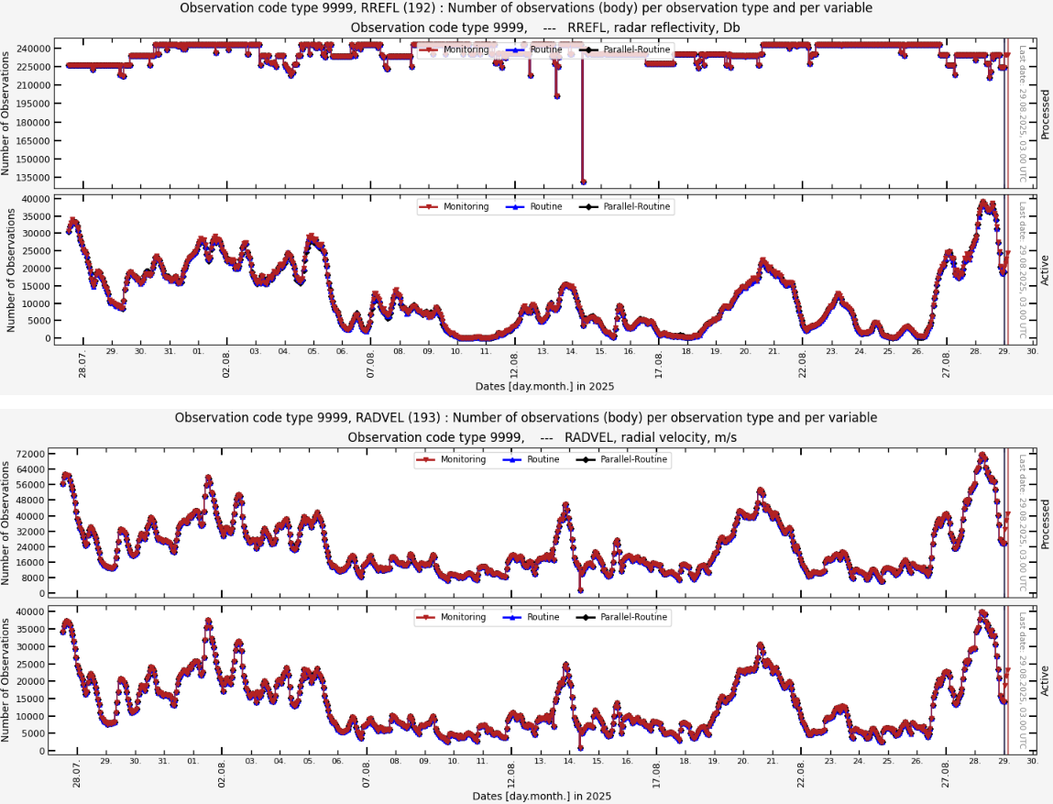
Monitoring of Radar Observations

Slide 7
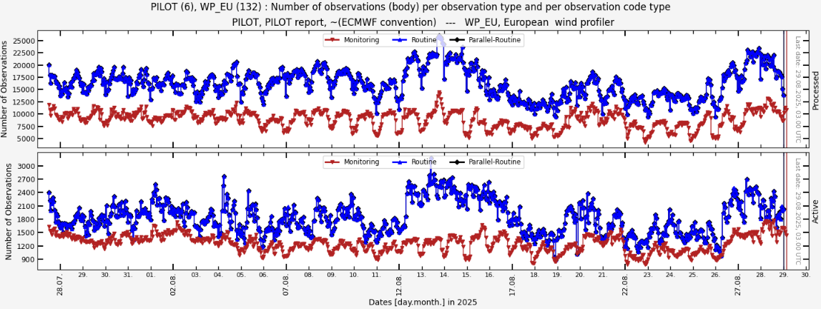
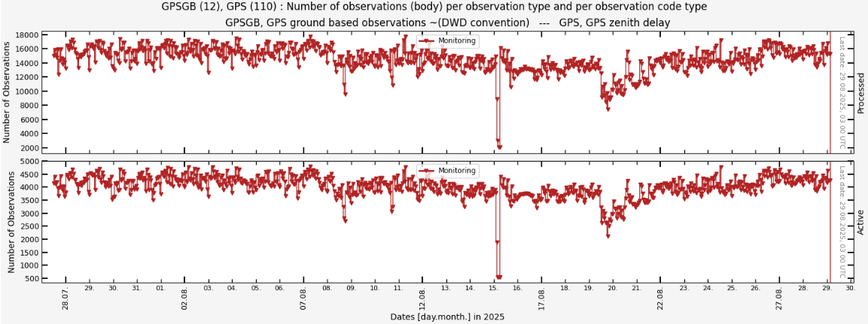
Monitoring of Wind Profiler (above) and Wind Lidar (below)

Slide 8
Additional slides of last meeting…

Slide 9
DA scheme at the reginal scale
40 +1 ensemble runs
Observations in KENDA
(at DWD)
SYNOP
manual stations
automatic stations
AIREP
AMDAR
MODE-S
Some others
TEMP
Accent and decent measurements
RADAR
PILOT
DRIBU
RAD (Seviri-VIS and Seviri IR)
….
Kalman Filter
Model+ LHN
Model states
+
Observations
Model+ LHN
Model+ LHN
Model+LHN
Model+ LHN
Model + LHN
Forward operator
24 times per day
Obs
Analysis
Analysis
Analysis
Analysis
Monitoring can be done of several parts:
Observations (i.e. OmB)
Increments
DACE (LETKF) monitoring
LHN monitoring
…

Slide 10
Monitoring aspects:
Mandatory tasks:
  Check that all relevant observations are processed correctly
    Count for actively used observations and compare against expected number (once per day or even per any DA cycle)
  Monitor error characteristics for most relevant observation types
Real Useful:
  Monitor error characteristics for all observations
  Monitor increments on monthly basis
  Perform Obs-Err-Stat on monthly basis
Nice to have:
  Get knowledge about spread, increments, performance of analysis …
  Get knowledge of interactions between obs systems (tools by Olaf Stiller)

Slide 11
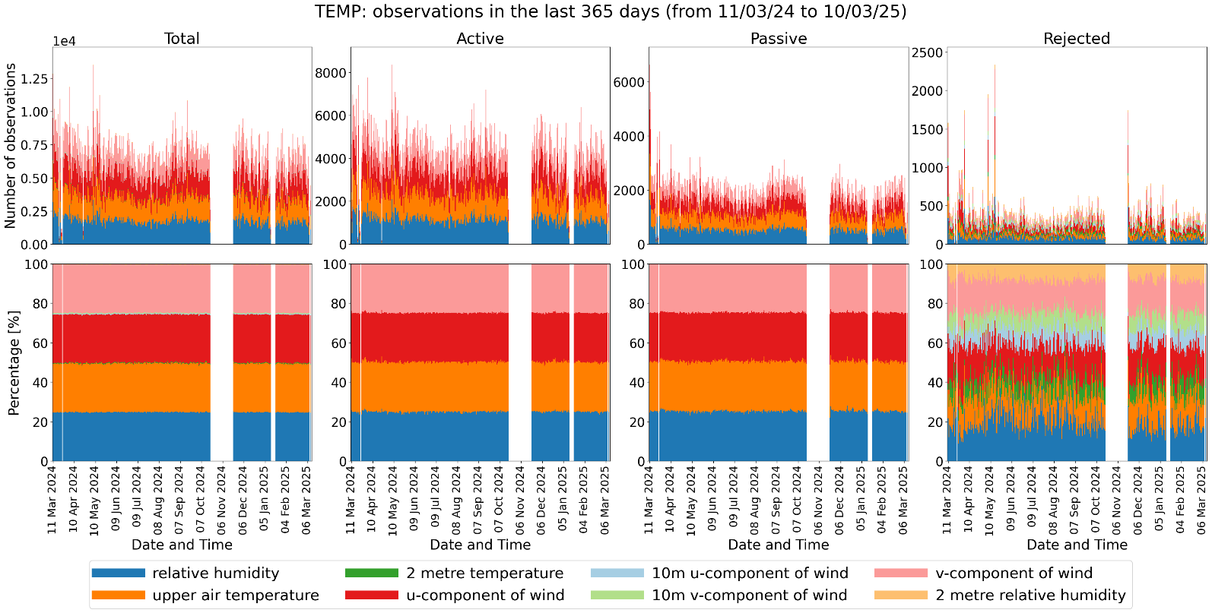
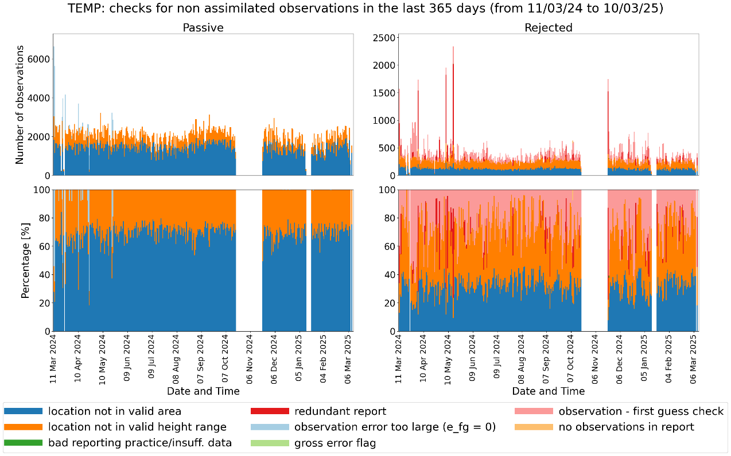
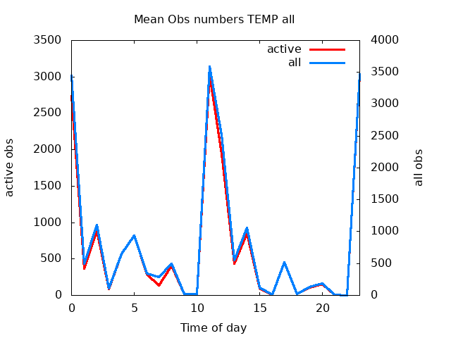
Monitoring of TEMP
asc.
desc.

Slide 12
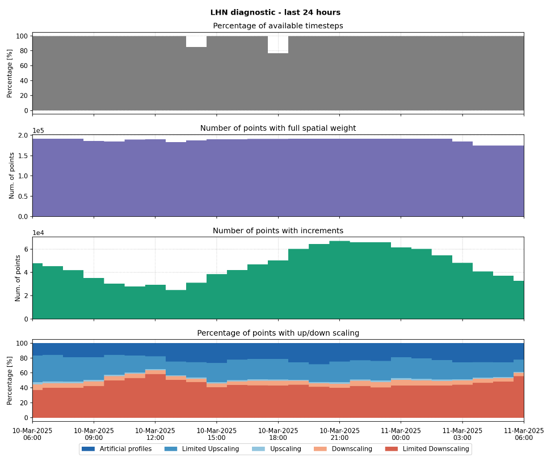
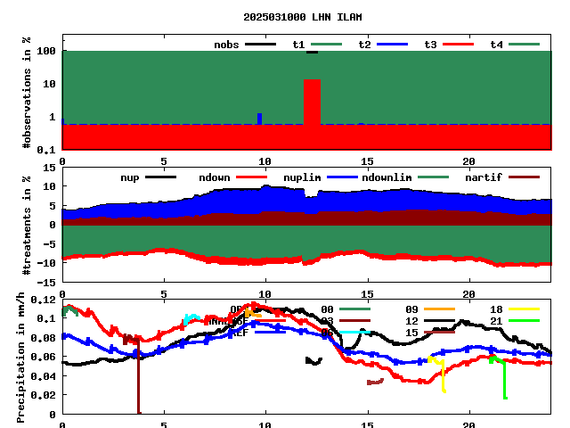
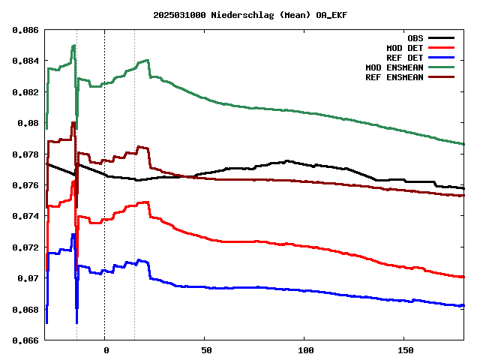
Monitoring of LHN

Slide 13
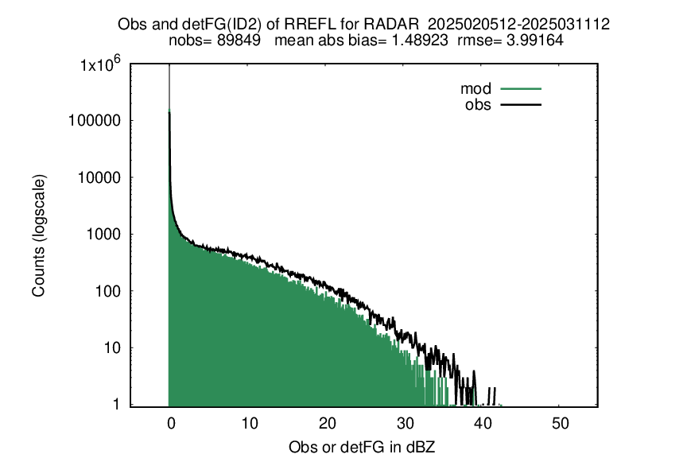
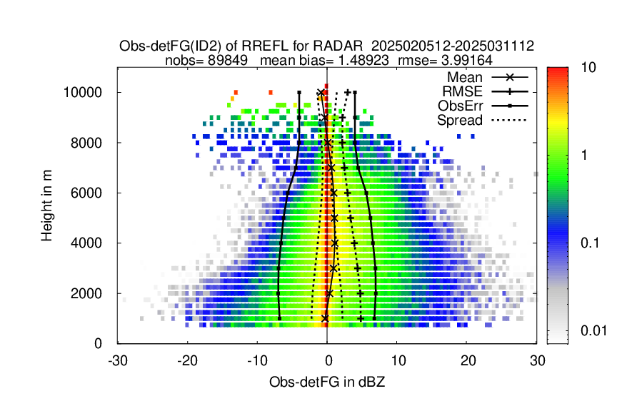
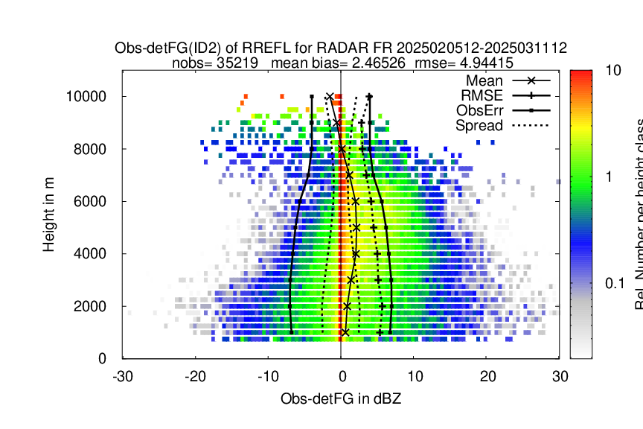
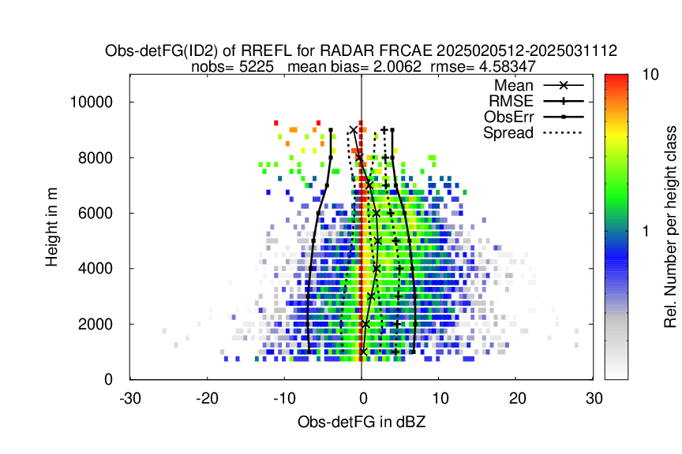
Monitoring of Reflectivity
Active data within
last 35 days
Active French data within
last 35 days
Active data of FRCAE within
last 35 days

