Slide 1
Information on activities in COSMO Working Group 4
Andrzej Mazur

Slide 2
Contents
PP MILEPOST ↓
PP COMFORT ↑
PP AWARE →○
Other issues

Slide 3
Activities in PP MILEPOST
- RHM (Ph. Bykov)
experiments with COSMO-De2EE database – 3 years are sufficient for training methods of post-proc
pre-operational tests for 2D near-sfc fields from post-proc of COSMO-Ru and ICON-Ru13
correction of vertical fields with convolutional NN may improve (vertical) fcsts quality from boundary layer up to the tropopause

Slide 4
Activities in PP MILEPOST
Vertical CNN correction: MAE reduction compared to the DMO, 6x10^5 pairs of model and radiosonde profiles (Ph. Bykov, RHM)
 | Boundary layer | 5000 m
Temperature | 0.26°C | 0.08°C
Specific humidity | 1.8 g/kg | 1.2 g/kg
Pressure | 1 hPa in the lower 1000 m | not significant
Wind speed | not significant | 0.7 m/s in the layer between the boundary layer and the tropopause

Slide 5
Activities in PP MILEPOST
RHM (A. Kolker)
Combining Decision Trees and NN increases efficiency of thunderstorm fcsts. Number of false alarms was also reduced.
Positive/Unlabeled (PU) approach tested for use with noisy/incomplete data for thunderstorms or turbulence events.
(*) Based on original paper Charles Elkan, Keith Noto “Learning Classifiers from Only Positive and Unlabeled Data” https://cseweb.ucsd.edu/~elkan/posonly.pdf

Slide 6
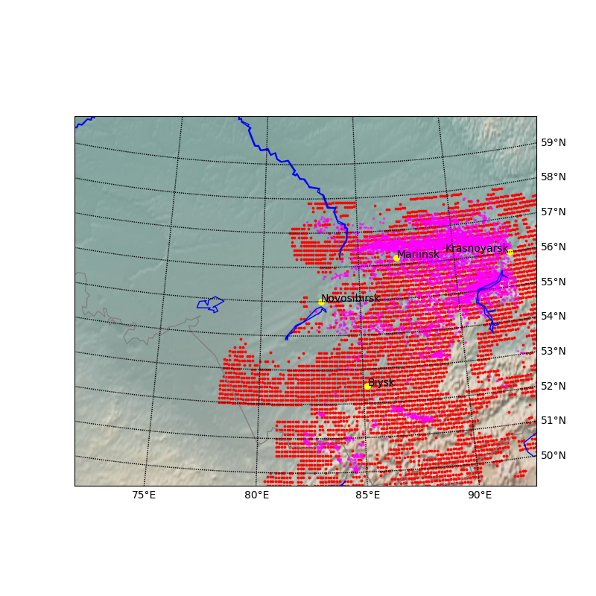
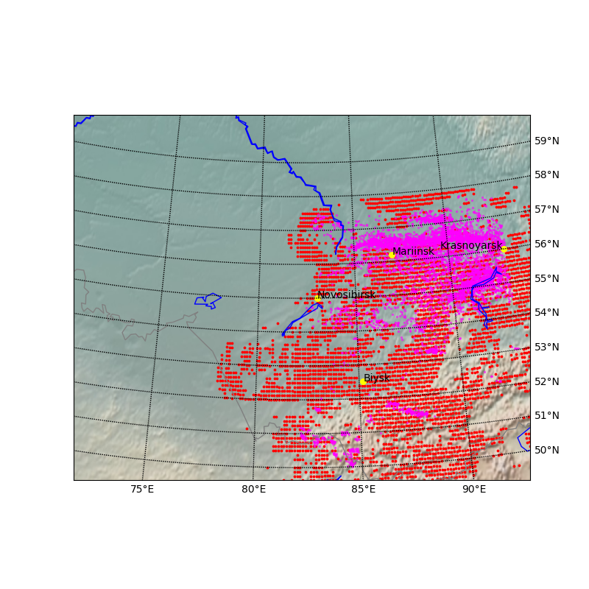
Activities in PP MILEPOST
25.05.2020 example (magenta points: WWLN observations, red points: forecast)
PU can be used for noisy data and data with incomplete labeling (e.g. reporting events only)
No changes/news from Russian colleagues since ICCARUS 2022,
cooperation with RHM suspended for an unspecified period.

Slide 8
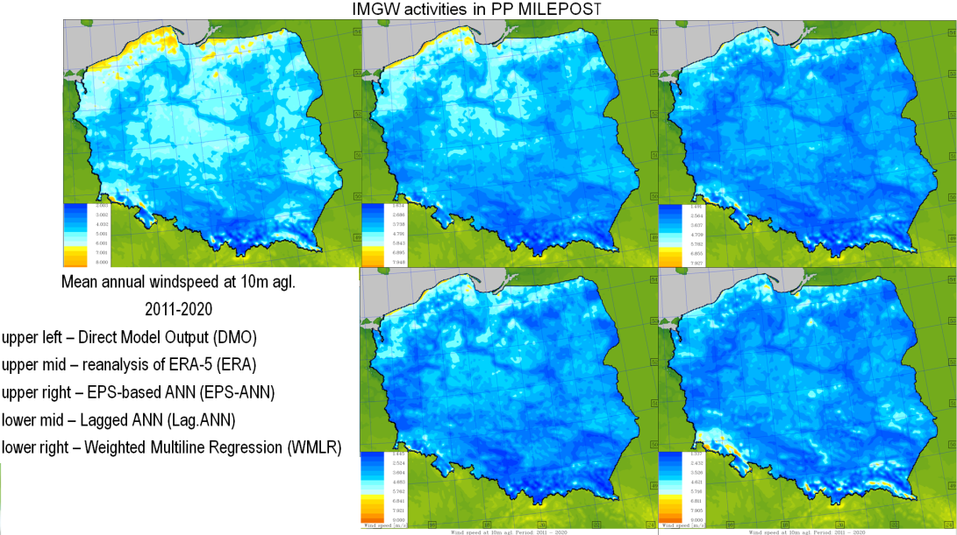
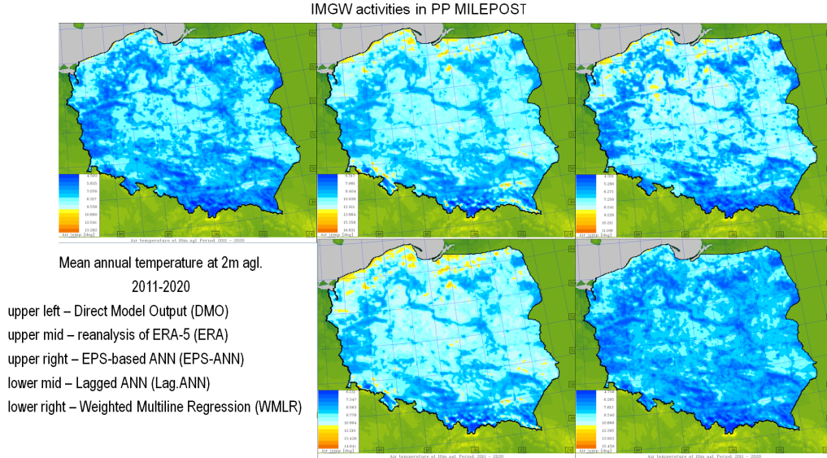
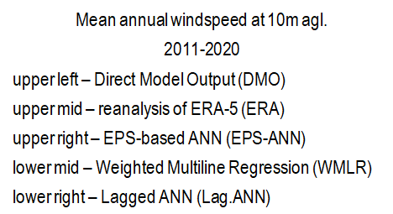
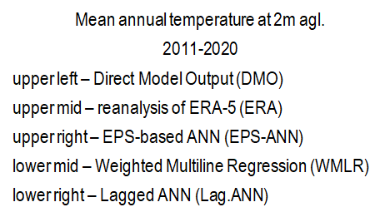
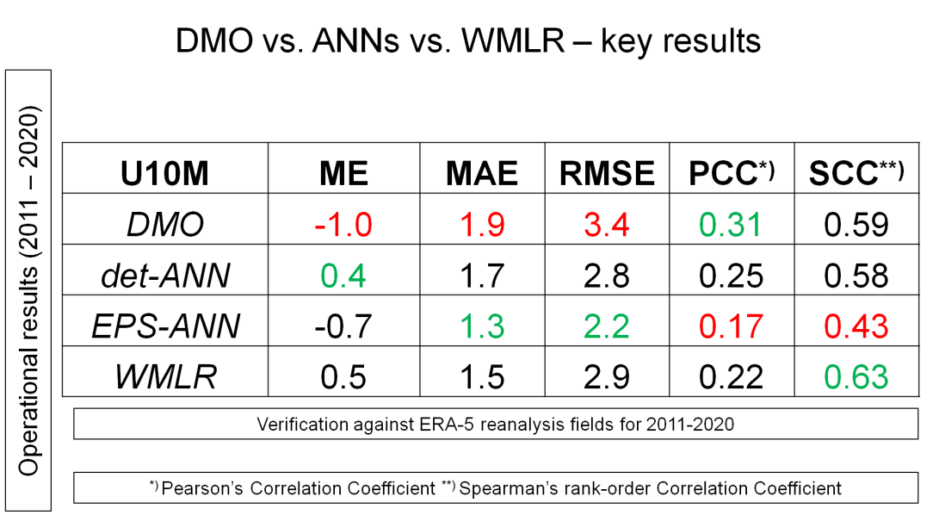
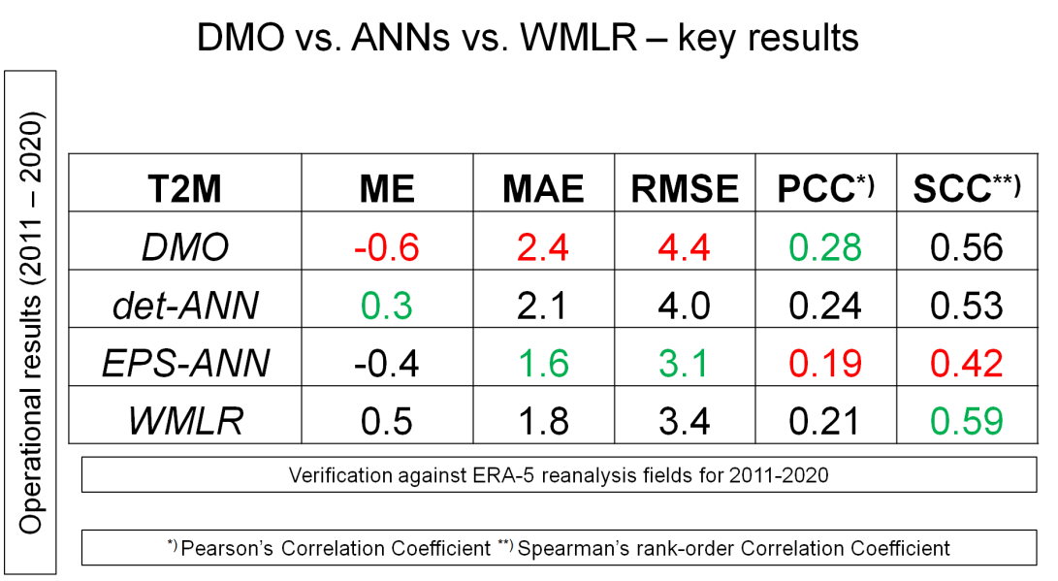

Slide 9
Activities in PP MILEPOST
MeteoSwiss
Introducing physical constrains in ML-based postprocessing of air temperature and humidity.
Fine tuning approaches explored to account for data drifts in a real-time setup.
Daniel Cattani left MeteoSwiss in June; his replacement, Josue Gehring, mostly focused on implementation and maintenance, less so on pure development.
Two recent publications describe the development work done in MCH post-processing team in the previous period:
”Seamless Multimodel Postprocessing for Air Temperature Forecasts in Complex Topography” (Keller et al., DOI: https://doi.org/10.1175/WAF-D-20-0141.1) and
”Spatially Coherent Postprocessing of Cloud Cover Ensemble Forecasts” (Dai and Hemri, https://doi.org/10.1175/MWR-D-21-0046.1)

Slide 10
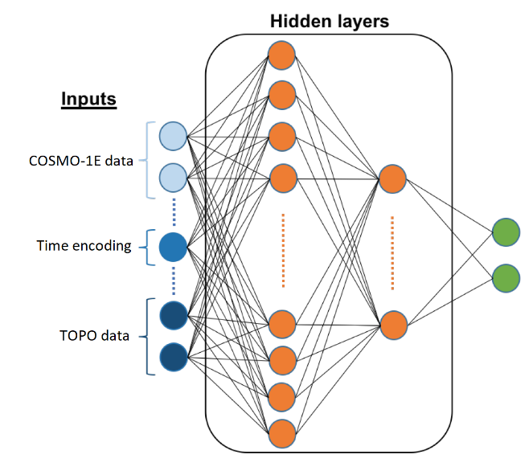
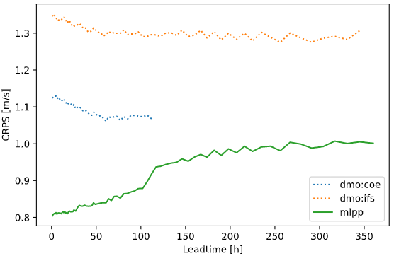
Activities in PP MILEPOST
- MeteoSwiss – general activities in post-processing
Postprocessing NWP ensemble forecasts of surface winds
Goals: Improve accuracy and resolution of numerical weather predictions. Leverage high-quality, long-record archives of meteorological observations.
NWP sources: COSMO-1 (regional, 1km, +33h, det.); COSMO-E (regional, 2 km, +120h, 21 memb.); IFS-ENS (global, 18 km, +360h, 51);
IFS-ENS
NWPs
features
COSMO-E
POSTPROC
Time
encodings
µ
σ
DEM
descriptors

Slide 11
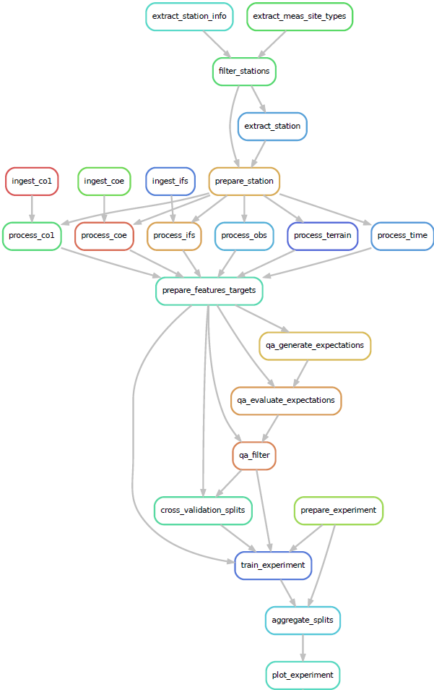
Activities in PP MILEPOST
MLOps: ML pipelines for production.
Implement reproducible and scalable ML pipelines.
Log experiments in a SQL database.
Store and manage models in a central registry.
Orchestrate jobs and allocate resources on HPC/cloud.
Monitor quality in realtime.
- MeteoSwiss – general activities in post-processing
Data extraction
Preprocessing
Data quality
Run experiments

Slide 12
Additional information about PP MILEPOST:
Works on common verification was suspended; unlikely to be resumed in terms of the overall project (see below).
As quick as a wink, the human resources of the project (and of the WG4) decreased by 50%...
Sorry to say, the Project has ended with no possibility for now to extend it. For the moment, no report may be prepared.

Slide 13
New PP: ICON-COMFORT (ICON-COMPETENCE in FORECASTING).
Leader: D. Boucouvala, HNMS
Main goals of ICON-COMFORT
The subjective evaluation of ICON-LAM forecasts by forecasting departments, and the translation of this feedback to the COSMO-ICON community.
The expected results are the forecasters’ feedback on ICON-LAM performance in respect to COSMO forecasts, and detection of ICON deficiencies for different weather conditions by means of regular surveys and analysis of representative test cases.
Participants: HNMS, MCH, CNMA, NMA, RHM, IMS, ARPA-P, IMGW...

Slide 14
New PP: ICON-COMFORT (ICON-COMPETENCE in FORECASTING).
Leader: D. Boucouvala, HNMS
Main goals of ICON-COMFORT
2) The evaluation of COSMO licensees NMHS’s satisfaction from COSMO forecasts and support activities, together with their special needs for the transition to ICON-LAM by means of a survey.
The expected results include the feedback analyses and suggestions to improve the support. The conclusions will also deal with the plan for migration from COSMO to ICON-LAM.
Participants: HNMS, IMS,NMA, DWD

Slide 15
Status of PP AWARE (joint project with WG5)
All the research has basically been done.
The final report is to be prepared by the end of the year.
Some additional information was obtained, mainly related to AWARE tasks verification issues.
Most likely the Project cannot be continued to the spatial verification applications due to lack of participation (main contributors were from RHM and DWD).
Details presented by the head of WG5 (as the co-leader of PP).

Slide 16
Status and future of WG4
MILEPOST has is actually finished in September
ICON-COMFORT starts in September
Crowdsourcing, PWS, opportunistic sensors (Quality Control)?
Further investigations of AI/ANN/ML?
Anything else?...
Suggestions?

Slide 17
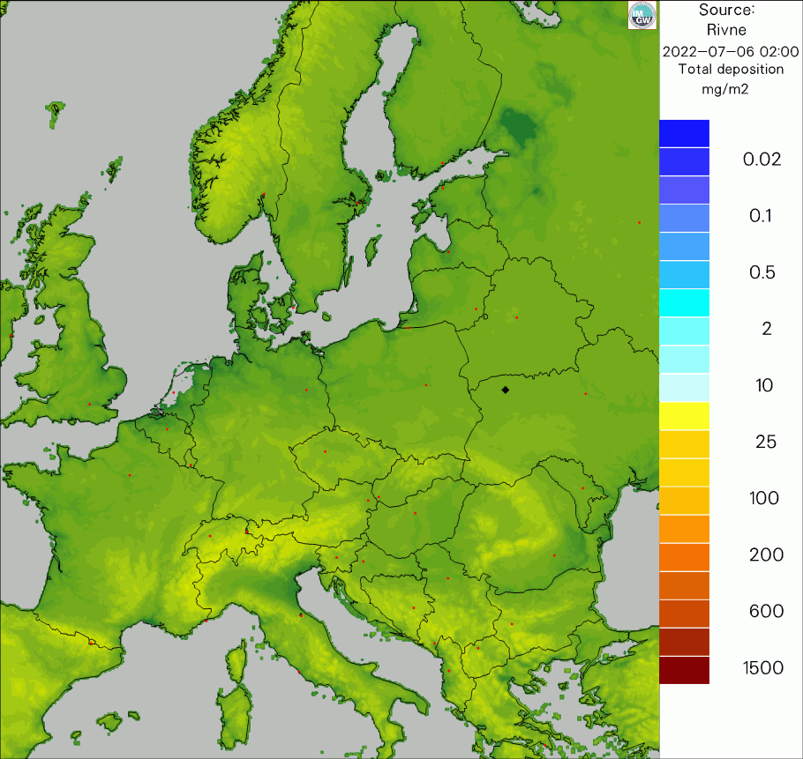
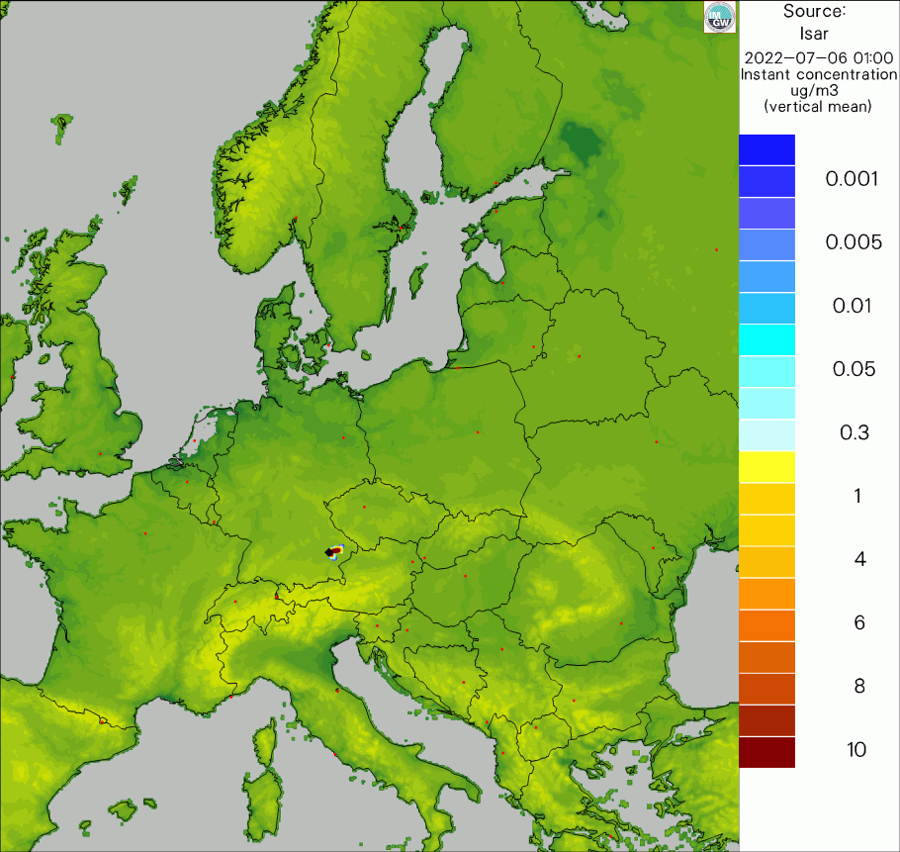
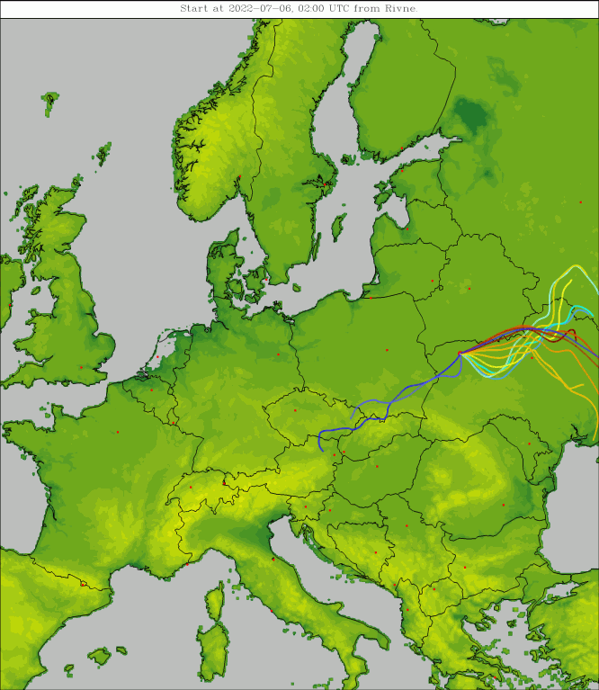
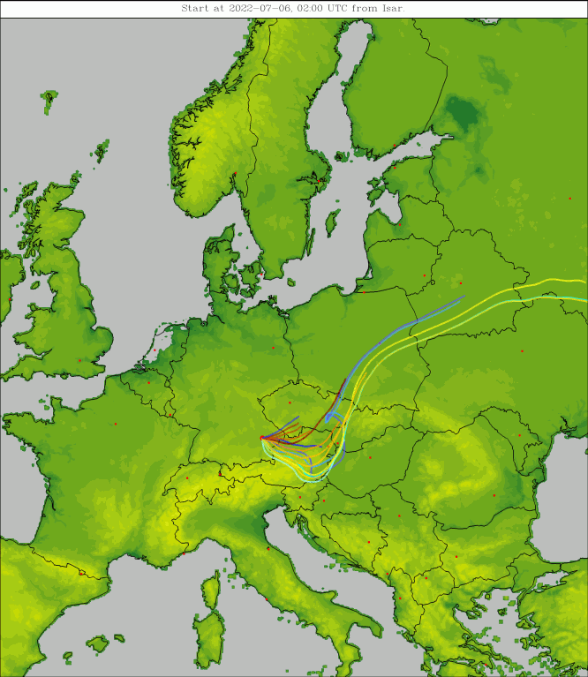
Status and future of WG4 – cnt.
Forecasts for hypothetical accidents
in selected NPPs
Anything else?...
Suggestions?

Slide 18
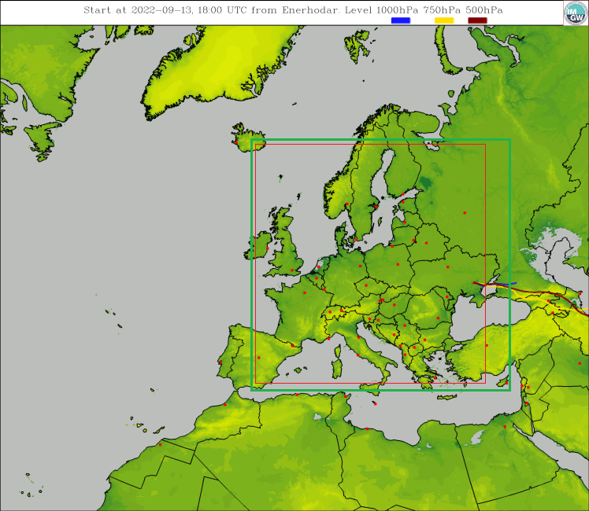
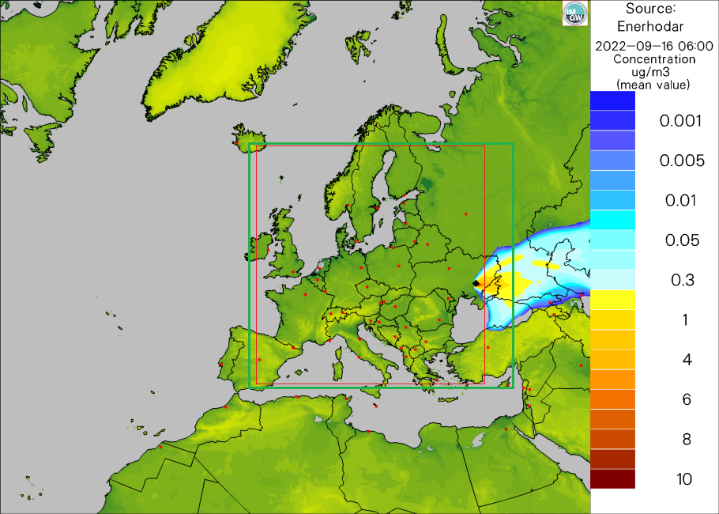
Status and future of WG4 – cnt.
Forecasts for hypothetical accidents in selected NPPs – Enerhodar, eastern UA

Slide 19
Status and future of WG4
Lack of human resources!
If you want to join us, today we have session in
Calliste room (room 3)
Session starts at 16:00

Slide 21
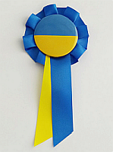
#StandWithUkraine

