Slide 1
STC meeting report
Yoav Levi
Chairman of COSMO STC

Slide 2
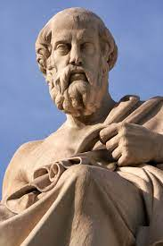
A virtuous human - the three parts of the soul are in harmony with one another.
Plato's theory of soul
logistikon (reason)
thymoeides (spirit)
epithymetikon (appetite)

Slide 3
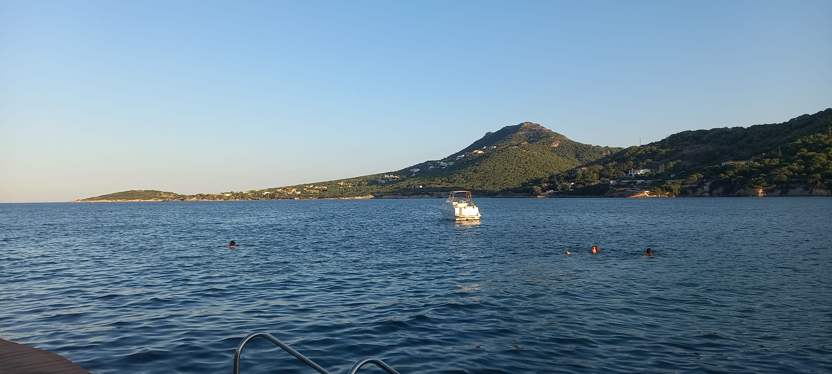
Thanks to HNMS
For a harmonious excursion that balanced the GM in mind and body

Slide 4
Help the organizers
http://www.cosmo-model.org/view/repository/GM2022
Please upload all presentation
Add your name to the file name

Slide 5
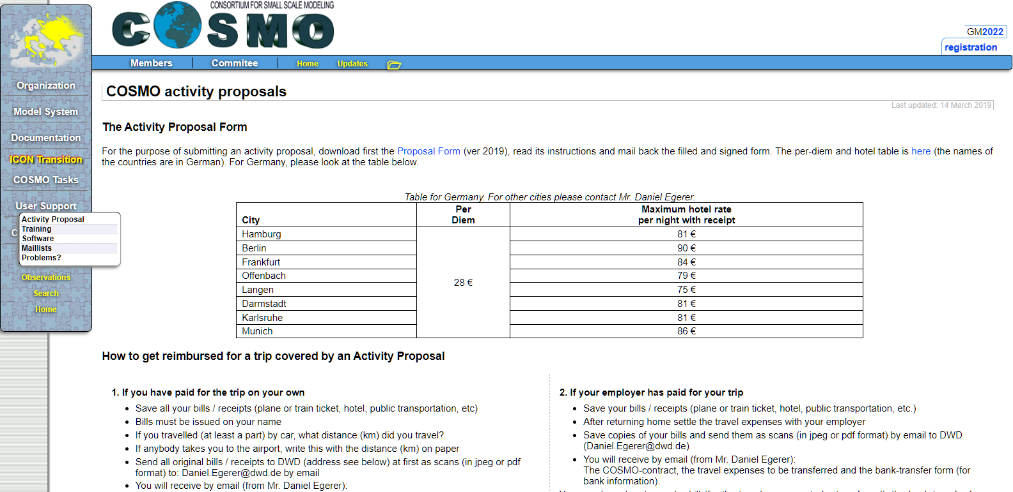
Activity proposals
Please read carefully the page:

Slide 6
Roshydromet - temporarily suspended condition
Gdaliy confirmed Roshydromet is not going to participate in COSMO activities
De facto Roshydromet is temporarily suspended from COSMO, in line with other European agencies.
Due the conditions of a) and b) the official decision on Rushydromet status from STC or COSMO NWS directors is not required at this time.

Slide 7
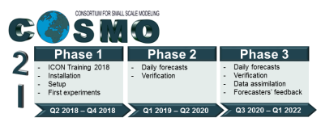
C2I
The Priority Project ’Transition of COSMO to ICON’ (PP C2I) was launched in 2018 and concluded in 2022. The aim of the project is to ensure a smooth transition for the Consortium for Small Scale Modelling (COSMO) national meteorological services (NMS) to the ICON model.
Thanks to Daniel Rieger's dedicated support
successfully

Slide 8
Licensing and Support of ICON for NMHS’s

Slide 9
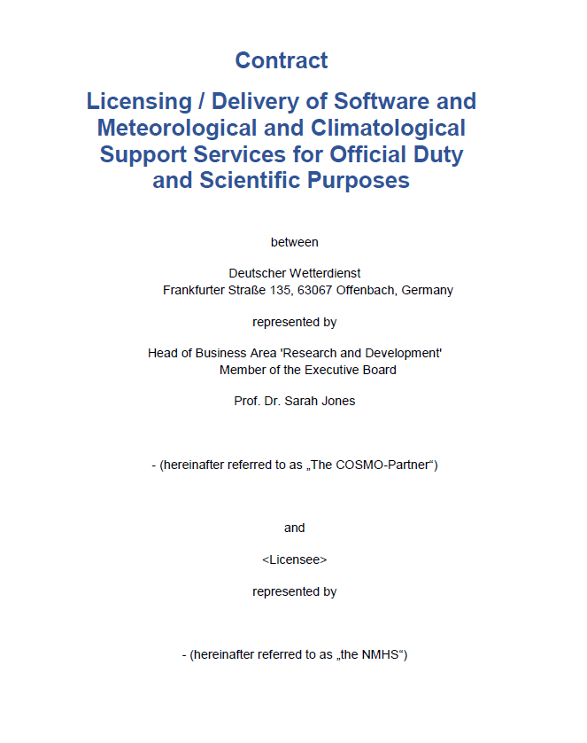
Licensing and Support of ICON for NMHS’s
ICON_Licence_Use_NMHS
ICON_Licence_Support_NMHS

Slide 10
PP C2I4LC
Annual ICON releases
As we would like that all countries will run the same version after it passed the test suite, It would be good to have at least a yearly release that will be finalized before the GM.

Slide 11
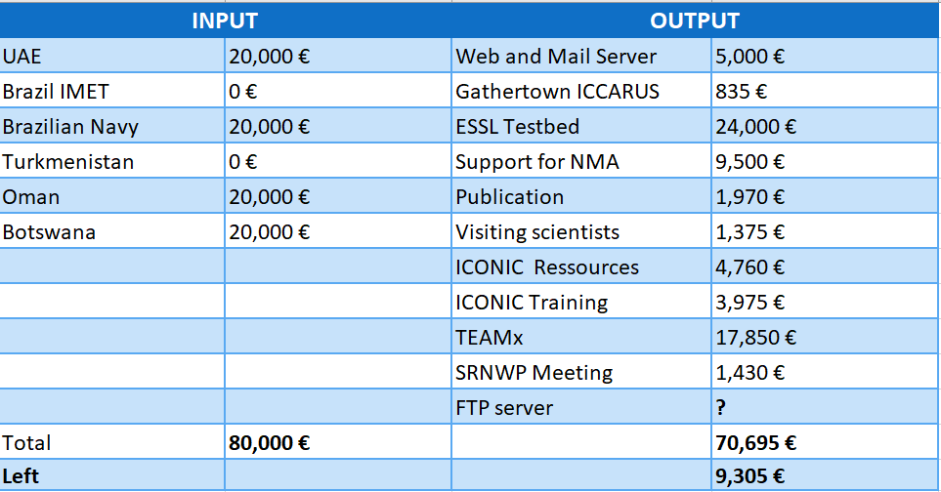
COSMO budget 2022
The STC would like to promote small ad-hoc meetings of experts to solve problems

Slide 12
ICON-LEPS, Future
2002 - 2022 COSMO-LEPS 7 km/40ML/20mem
2022: Ines Cerenzia migration ICON-LEPS
2023 - We need to decide what COSMO wants to invest in terms of SBUs and FTEs in science and GUI.
Consult with other consortia.
COSMO-LEPS

Slide 13
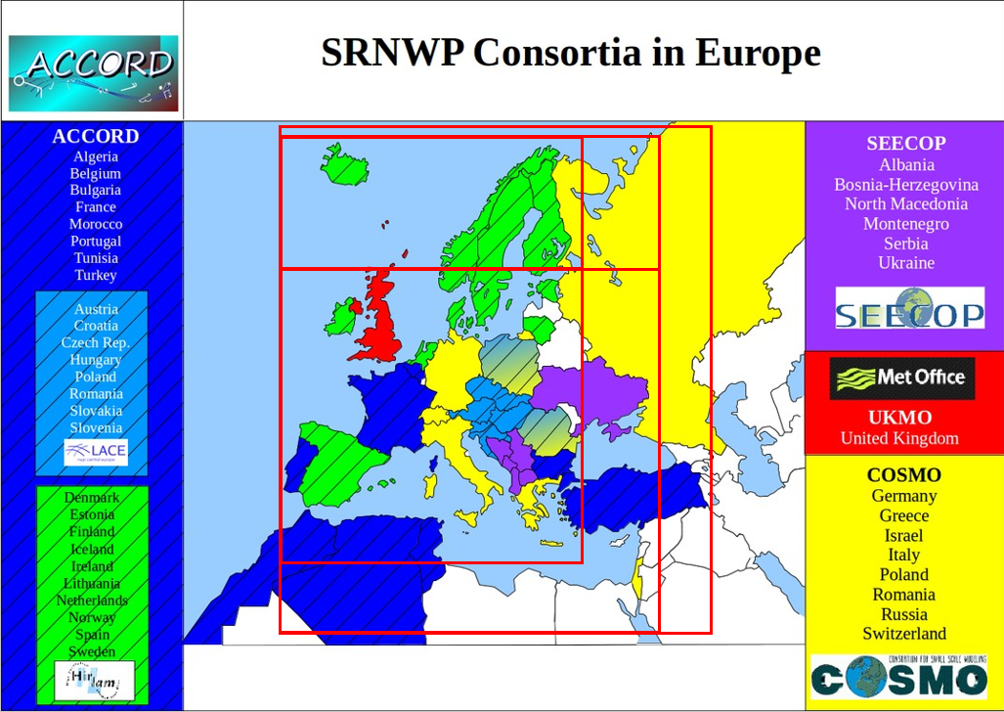
ICON-LEPS, Pan-European EPS
Playing with the idea of a pan-European- multi-model regional EPS?
COSMO-LEPS

Slide 14
FTEs evolution with time

Slide 15
FTEs evolution by country

Slide 16
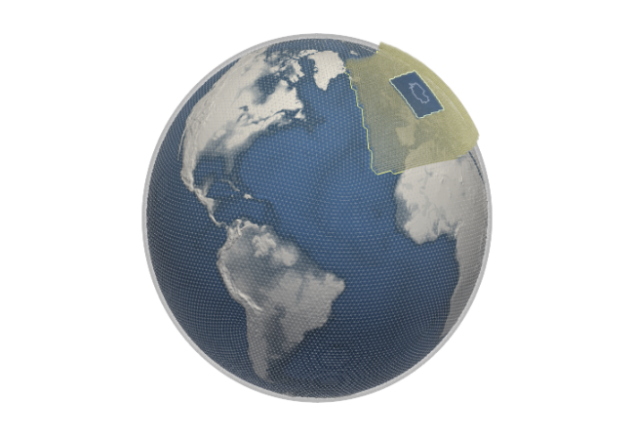
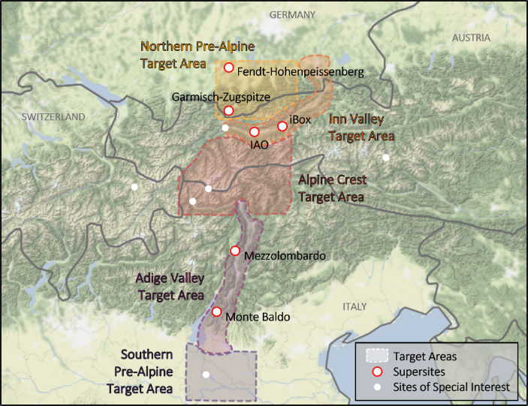
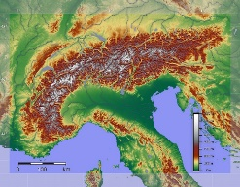
endeavour
Global-to-Regional ICON (GLORI) Digital Twin
Sub-km resolution
KENDAScope
WG1 DA
WG2 Numerical Aspects
WG3 Physical Aspects
CITTA'
CAIIR
WG4 Interpretation and Applications
MILEPOST
PROPHECY
WG5 Verification
COMFORT
WG7 LEPS
CARMENs
IMPACT
C2I4LC
WG6 Support activities
Convection-permitting, regional tuned, saving 1-minute precip. output

Slide 17
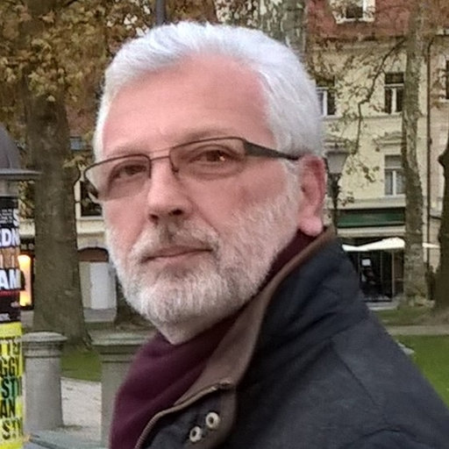
New STC chair
Terms of Reference
The STC is responsible for: electing the Chair of the Steering Committee to be selected among the members of the Committee on a rotation basis among the Partners for a period of 2 (two) years. In specific situations the STC can decide a reelection for a period of 1 (one) year, with a maximum of two reelections possible.
STC elected Panagiotis Skrimizeas (HNMS) to serve as the new COSMO STC chair.

Slide 18
Next GM in Gdańsk
11-15 September 2023
But before Gdańsk

Slide 19
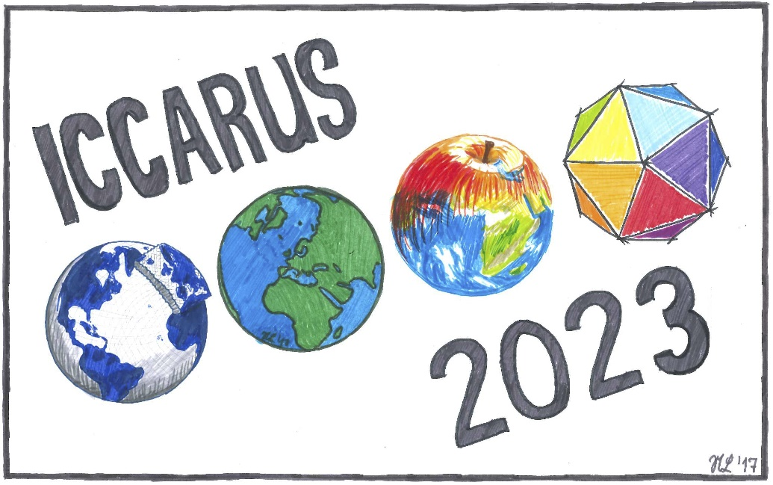
D. Rieger, C. Steger, A. Thomas, D. Egerer, B. Kress
ICCARUS 2023 Hybrid Meeting Concept

Slide 20
Boundary Conditions
Switching to a full online ICCARUS has to be possible within a few days if necessary.
Remote participants may not be excluded from presenting their work.
Mixture of plenary sessions incl. Keynote Speeches and poster sessions shall be retained.
Plenary Sessions
Hybrid mode; speakers and participants have to choice to participate in person or remotely
Poster Sessions
In-person poster session are without doubt the best possible option
But: The poster sessions have to be open without any restriction to the online audience
Gathertown turned out to be an amazing tool for online poster sessions
Only reasonable option: Fully online
Short introduction to each poster at plenary?

Slide 21
Working Group Meetings / STC meeting
No technical equipment for multiple high-quality hybrid meetings
Purely online in the week before or after ICCARUS?
Alternating pattern with in-person meetings at COSMO-GM/CLM-Assembly
Time considerations
Monday 6 March –Wednesday 8 March: Plenary Sessions
Thursday, 9 March, afternoon (everyone should be home again): Online Poster Session in Gathertown
Ice Breaker & Coffee Breaks
Only exception to ‘Remote participants may not be excluded’
Provide a platform for in-person discussions

Slide 22
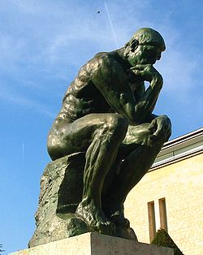
Final discussion
The Thinker, Auguste Rodin

Slide 23
as a polis (πόλις)
Aristotle was not only a physicist he also dealt with humans affairs:
Ethics (ηθος) - a rational response to the question of how humans should best live.
Politics (Πολιτικά) - literally means "the things concerning the city-state - polis (πόλις)
“Man is a political animal” - rubbing shoulders (associate) with each other in cities and communities
At the final discussion, we will continue with the question of how COSMO as a polis of NWP, should best live.

Slide 24
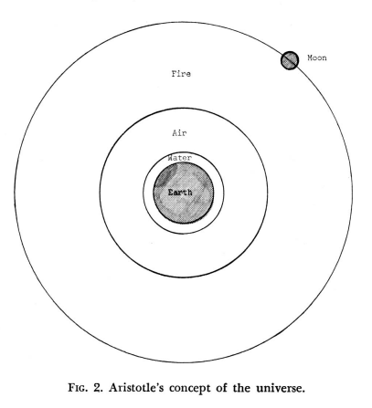
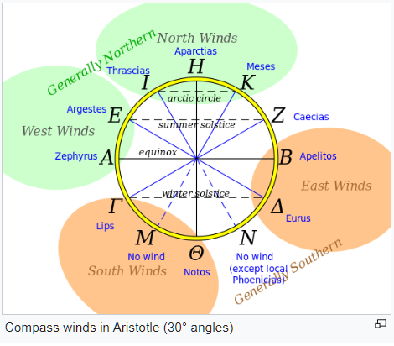
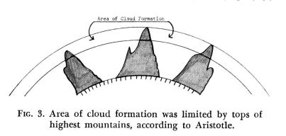
Conceptions
Aristotle hand many misconceptions
During the GM and the final discussion, we need to think if COSMO is not trapped in any misconception.
Athens centred model
Cloud model
geocentric model

Slide 25
endeavour
Global-to-Regional ICON (GLORI) Digital Twin
Sub-km resolution
KENDAScope
WG1 DA
WG2 Numerical Aspects
WG3 Physical Aspects
CITTA'
CAIIR
WG4 Interpretation and Applications
MILEPOST
PROPHECY
WG5 Verification
COMFORT
WG7 LEPS
CARMENs
IMPACT
C2I4LC
WG6 Support activities
Convection-permitting, regional tuned, saving 1-minute precip. output

