Slide 1
WG7 and PROPHECY report
Chiara Marsigli
Deutscher Wetterdienst (DWD)
Arpae-SIMC

Slide 2
Outline
Model perturbations
  SPPT
  Parameter Perturbation
  Physically based stochastic perturbations for subgrid turbulence (PSP2)
  Soil temperature perturbations
Towards ICON-LEPS

Slide 3
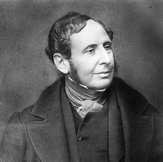
Prediction or forecast?
Forecast:
  “a statement of what is judged likely to happen in the future, especially in connection with a particular situation, or the expected weather conditions”
  “to indicate as likely to occur”
  “a forecast is a statement of what is expected to happen in the future, especially in relation to a particular event or situation”
  “to calculate or predict (some future event or condition) usually as a result of study and analysis of available pertinent data”
Robert Fitzroy (1805-1865)
include uncertainties in the available information!

Slide 4
SPPT in ICON at MeteoSwiss
André Walser, Sascha Bellaire, Matthias Röthlin
Acknowledgement: Daniel Reinert, Axel Seifert, Carlos Osuna
COSMO GM 2022, Athen, WG7

Slide 5
SPPT implementation in ICON
Available features:
Implement only a subset of switches (those which are used)
random numbers: gaussian and interpolated in space and time
one pattern only, i.e. no overlay with different scales
tapering: prescribed for stratosphere (itype_vtaper_rn=2)
Still to be done:
seed: use of valid date/time besides member id
→ specific random pattern for a given valid time to ensure temporal correlations between subsequent KENDA cycles and between KENDA and subsequent forecast (imode_rn=1)

Slide 6
Implementation strategy
Stochastic Perturbation of Physics Tendencies Temperature (T), Wind (U,V) as well as all water tracers (QV, QC, QI, QS, QR, QG)
Separate procedures to get tendencies for fast & slow physics
Random Number Generator adapted from ‘ecrad’; external generation (fieldextra) and internal generation
Adding of perturbed tendencies to prognostic fields
Source: ICON-Tutorial

Slide 7
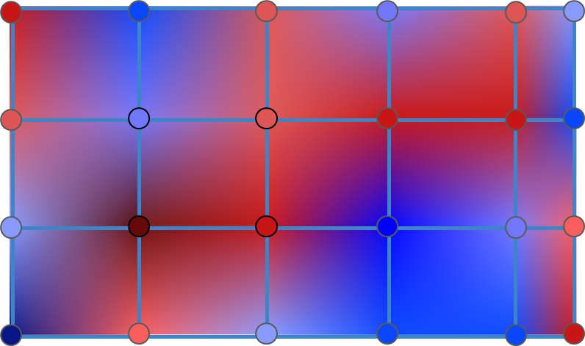
Random pattern field
Implementation in ICON of a random pattern field with horizontal correlation:
ask A. Walser for details!

Slide 8
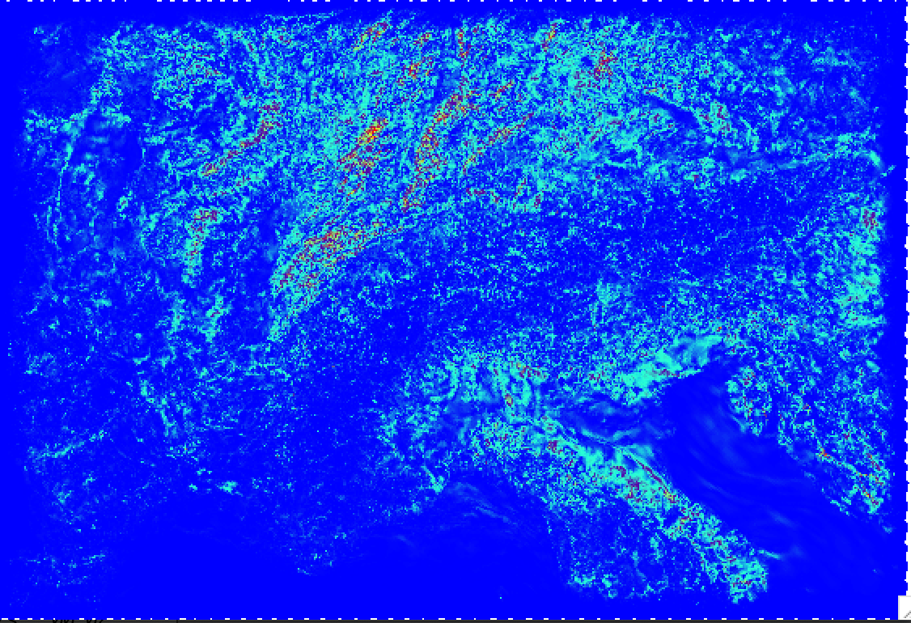
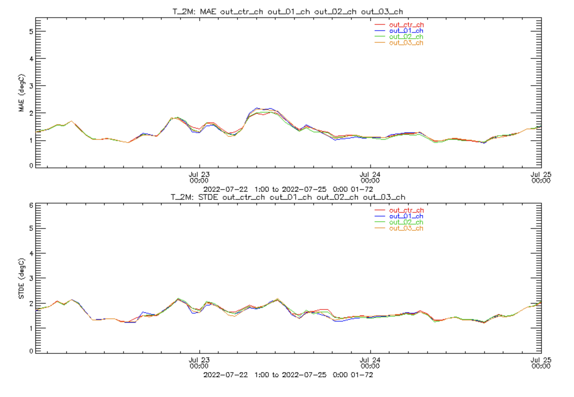
Spread and verification of test case
Ensemble spread +72h as expected
scores for all members similar
T2m
MAE (℃)
D. Reinert found bug in calculation of tendencies!
New test with fix pending
Latitude
STDE (℃)
T_2m
Longitude
K
Time
Fig. 1: Standard deviation of the 2-m air temperature for a three member ensemble after a 72 hour forecast. Bounding box represents the ICON-2 domain, marginally larger than the current COSMO-2E domain operationally used at MeteoSwiss.
Fig 2: Surface verification of three a ensemble members (blue, green, brown) plus control run (i.e. SPPT switched off, red) for 2-m air temperature. Shown are mean absolute error (MAE, top) and standard deviation (STDE, bottom) .

Slide 9
Next steps
test of fixed version
implementation of seed as a function of valid date & time for random numbers
review for merge into master ongoing
output variables for random field and tendencies
porting to GPU
extensive validation (contribution by IMS too)

Slide 10

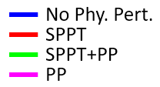
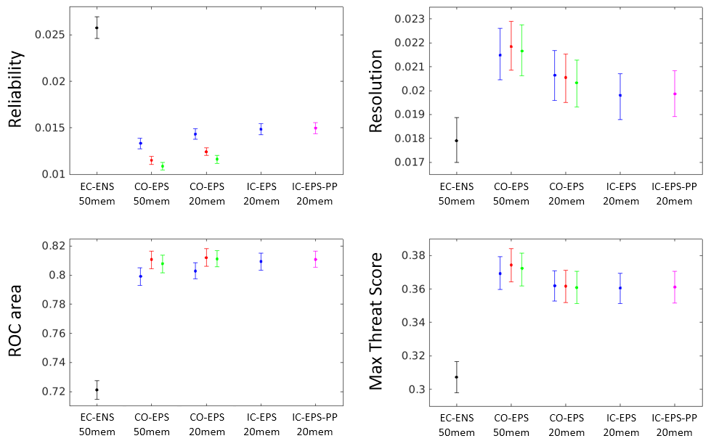
ICON ensemble verification
61 winter runs verified against the Quantitative Precipitation Estimation (QPE) composite.
Average score for 6 hourly precipitation forecast ranges 12- 78h not up-scaled thresholds of 0.5, 1, 2 and 5 mm/6h, and up-scaled thresholds of 10 and 20 mm/6h.
The error bars were obtained using boot strap method. Lower reliability, higher Resolution, higher ROC area and higher TSmax indicate better forecast.
lower is better
Higher is better
“Optimizing convection-permitting ensemble via selection of the coarse ensemble driving members”, Atmos. Res. 2022 (under revision)
Higher is better
Higher is better
SPPT tests in ICON are planned
P. Khain

Slide 11
Parameter Perturbation
A set of parameters (18) of the model physics schemes are perturbed in ICON-D2-EPS
The parameters receive a value from a distribution (including the default value), different at each forecast start and for each member (the value is kept fix during the run):
pert_param=ref_param+2.∗(rand_num−0.5)∗range
rand_num∈[0,1]is drawn from a uniform distribution
the random number is always set either to 0 or1, i.e. only the boundary values of the specified range are used besides the default value
PP test: increase the amplitude of the perturbation for a small set of parameters (as in ICON-EPS):
  tkhmin, tkmmin -> scaling factor for minimum vertical diffusion coefficient for heat and moisture and momentum, respectively
  rlam_heat -> scaling factor of the laminar boundary layer for heat
  tur_len -> asymptotic maximal turbulent distance
  rain_n0_fac -> intercept parameter of raindrop size distribution
C. Gebhardt, C. Marsigli

Slide 12
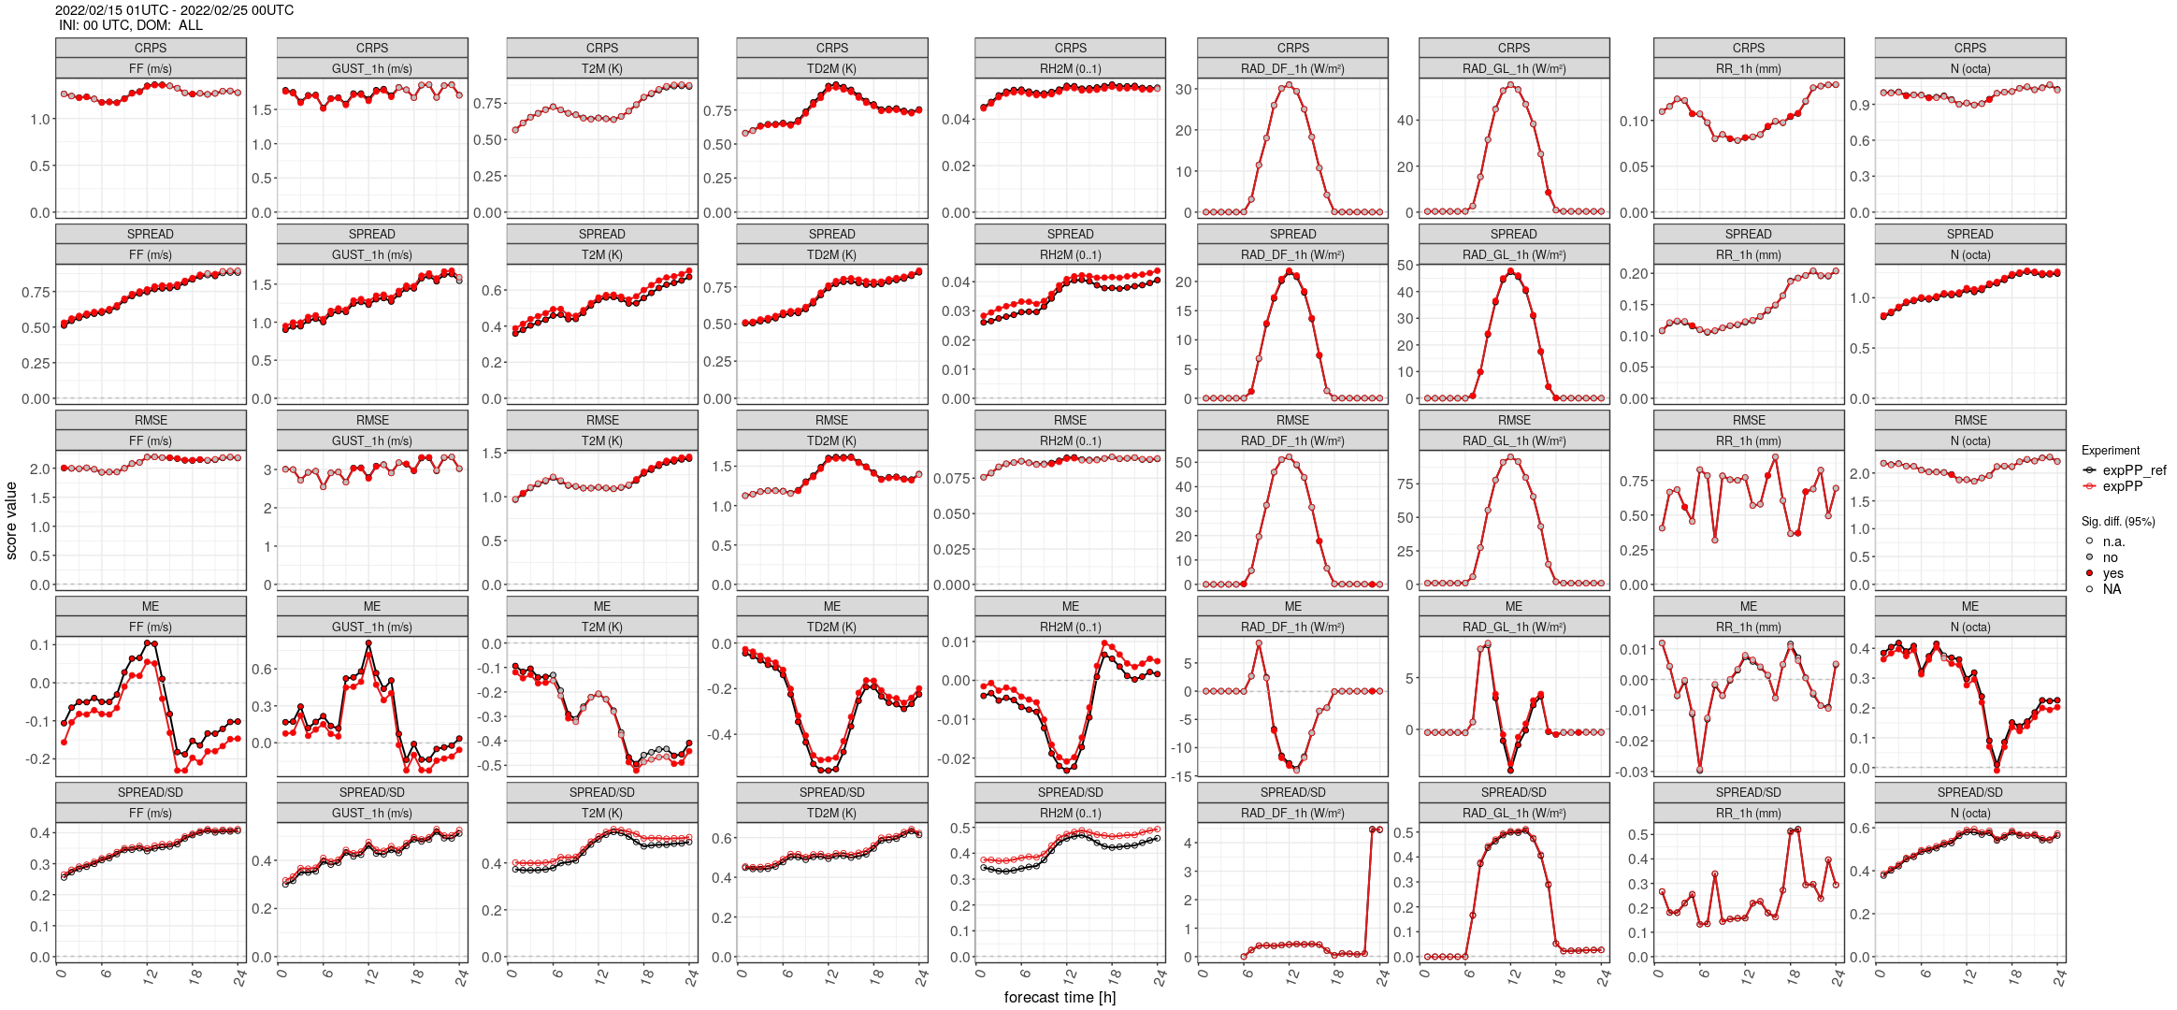
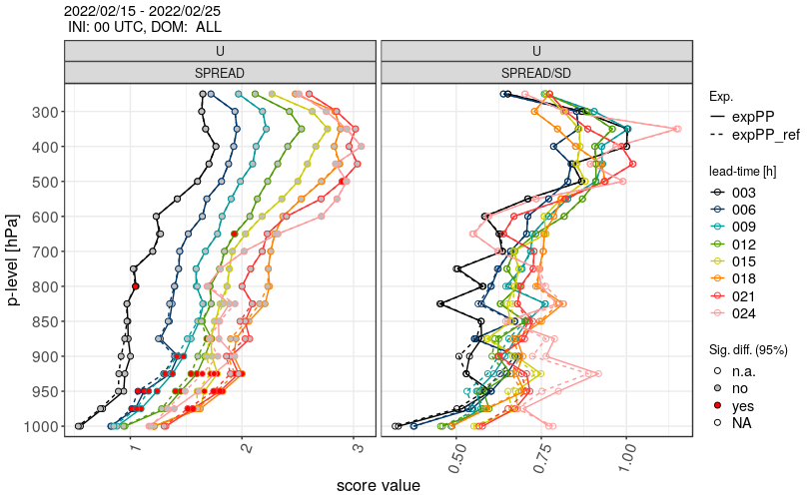
Results: increase perturbation amplitude
February 2022
Verification against SYNOP and TEMP
ref
expPP
C. Gebhardt, C. Marsigli
ref
expPP

Slide 13
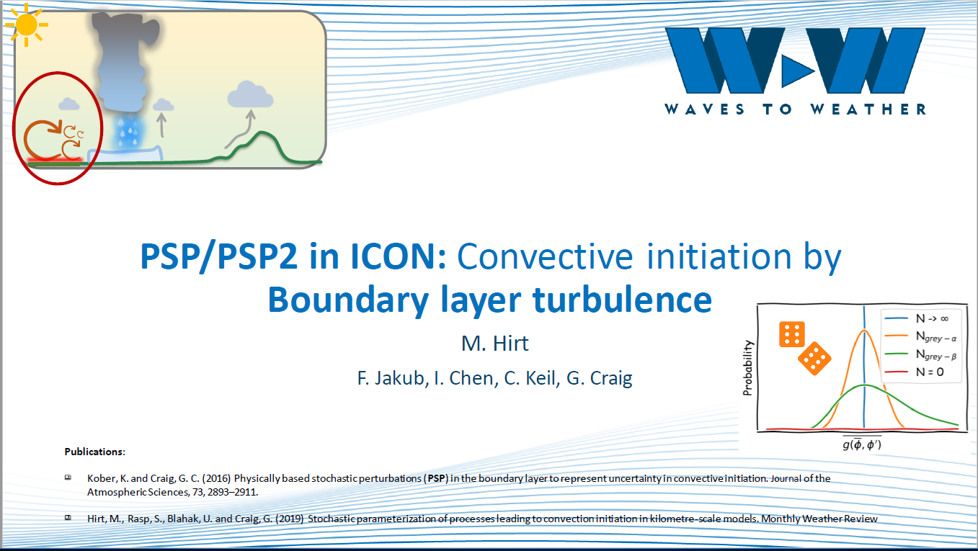
Physically based model perturbation: PSP2
Hirt et al., 2021
Aim: to address the under-representation of the variability on the smallest resolved scales in the model, which are especially important for convection triggering in the absence of synoptic forcing.

Slide 14
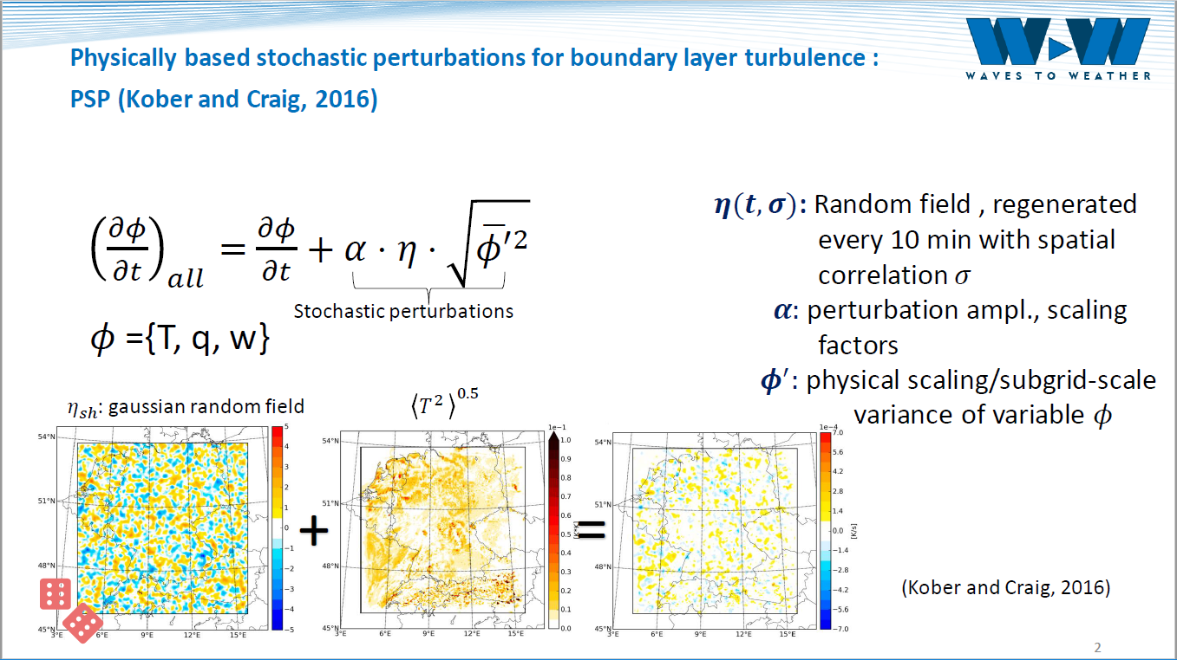
Physically based model perturbation: PSP2

Slide 15
Results: PSP2
June-July-Aug 2022
Verification against SYNOP
C. Gebhardt, C. Marsigli

Slide 16
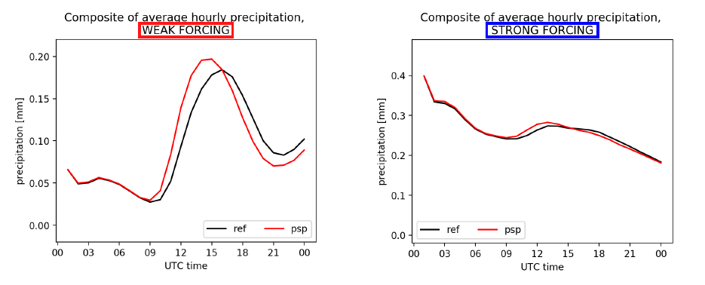
PSP2: impact on convection initiation
M. Puh, C. Keil (LMU)

Slide 17
PSP2: impact on weakly forced cases
Fractions Skill Score
ref ens members
psp2 ens members
mean of FSSs ref
mean of FSSs psp2
C. Gebhardt, C. Marsigli

Slide 18
Subtask 2.2
Influence of various methods of perturbation of soil temperature’s initial field.
Spotlight on how deep into the ground the temperature perturbation should be introduced for significant/positive impact.
Dataset used for verification – ERA-5 reanalysis fields for 2011-2020 (https://cds.climate.copernicus.eu), 0.25x0.25 degree, hourly data.

Slide 19
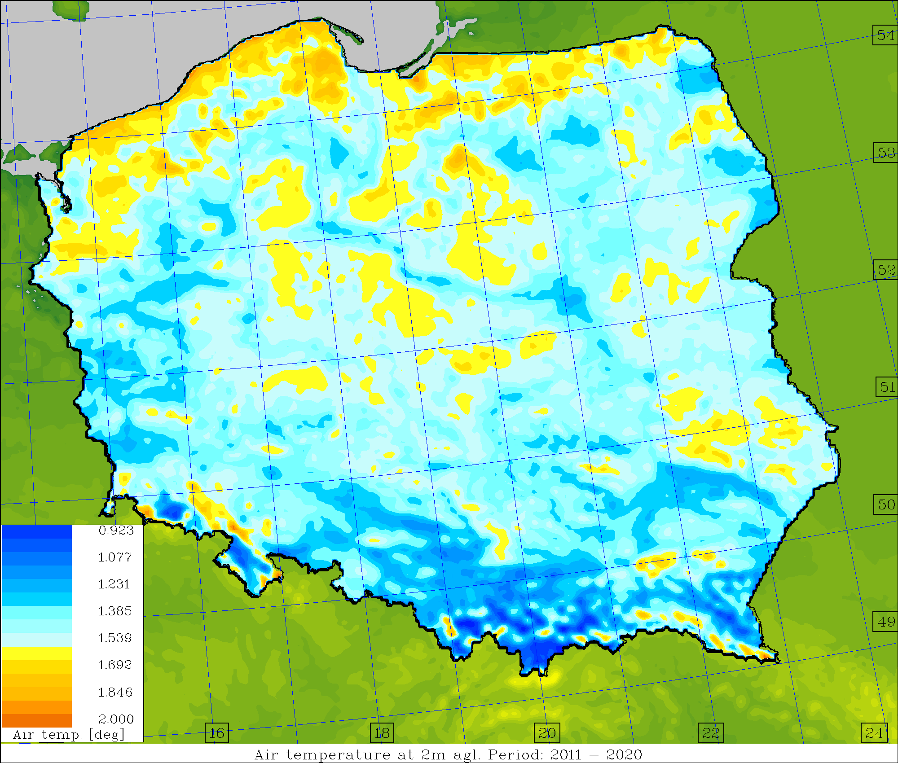
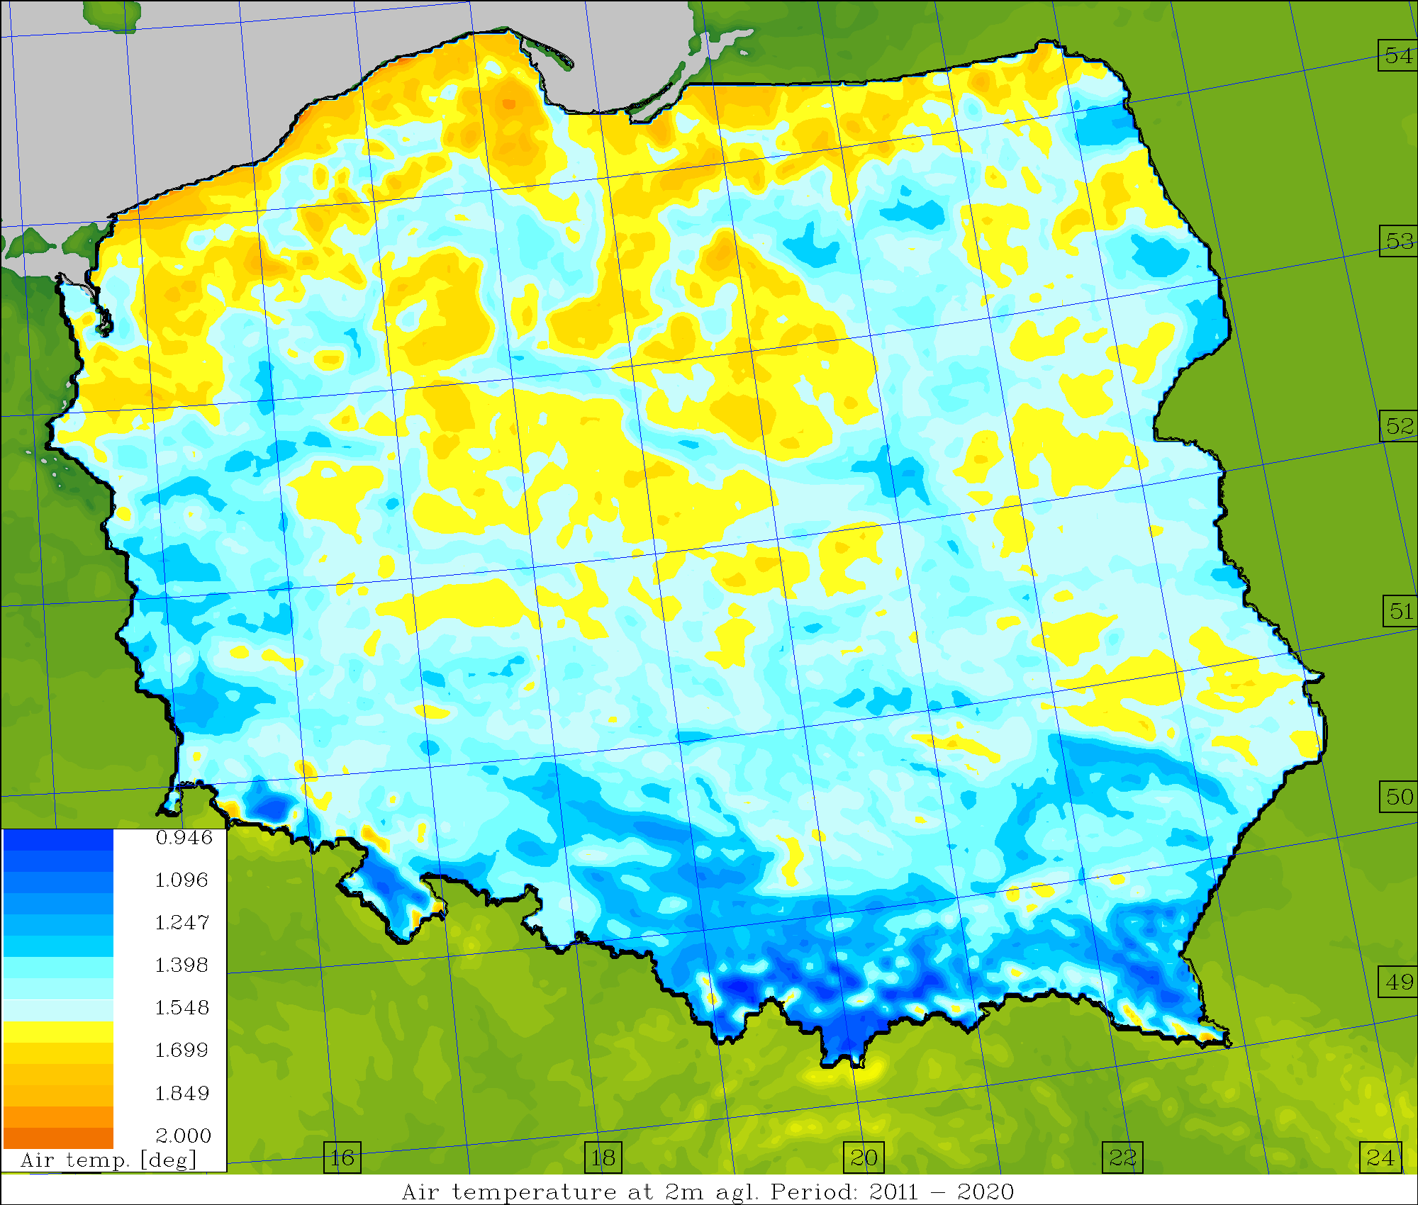
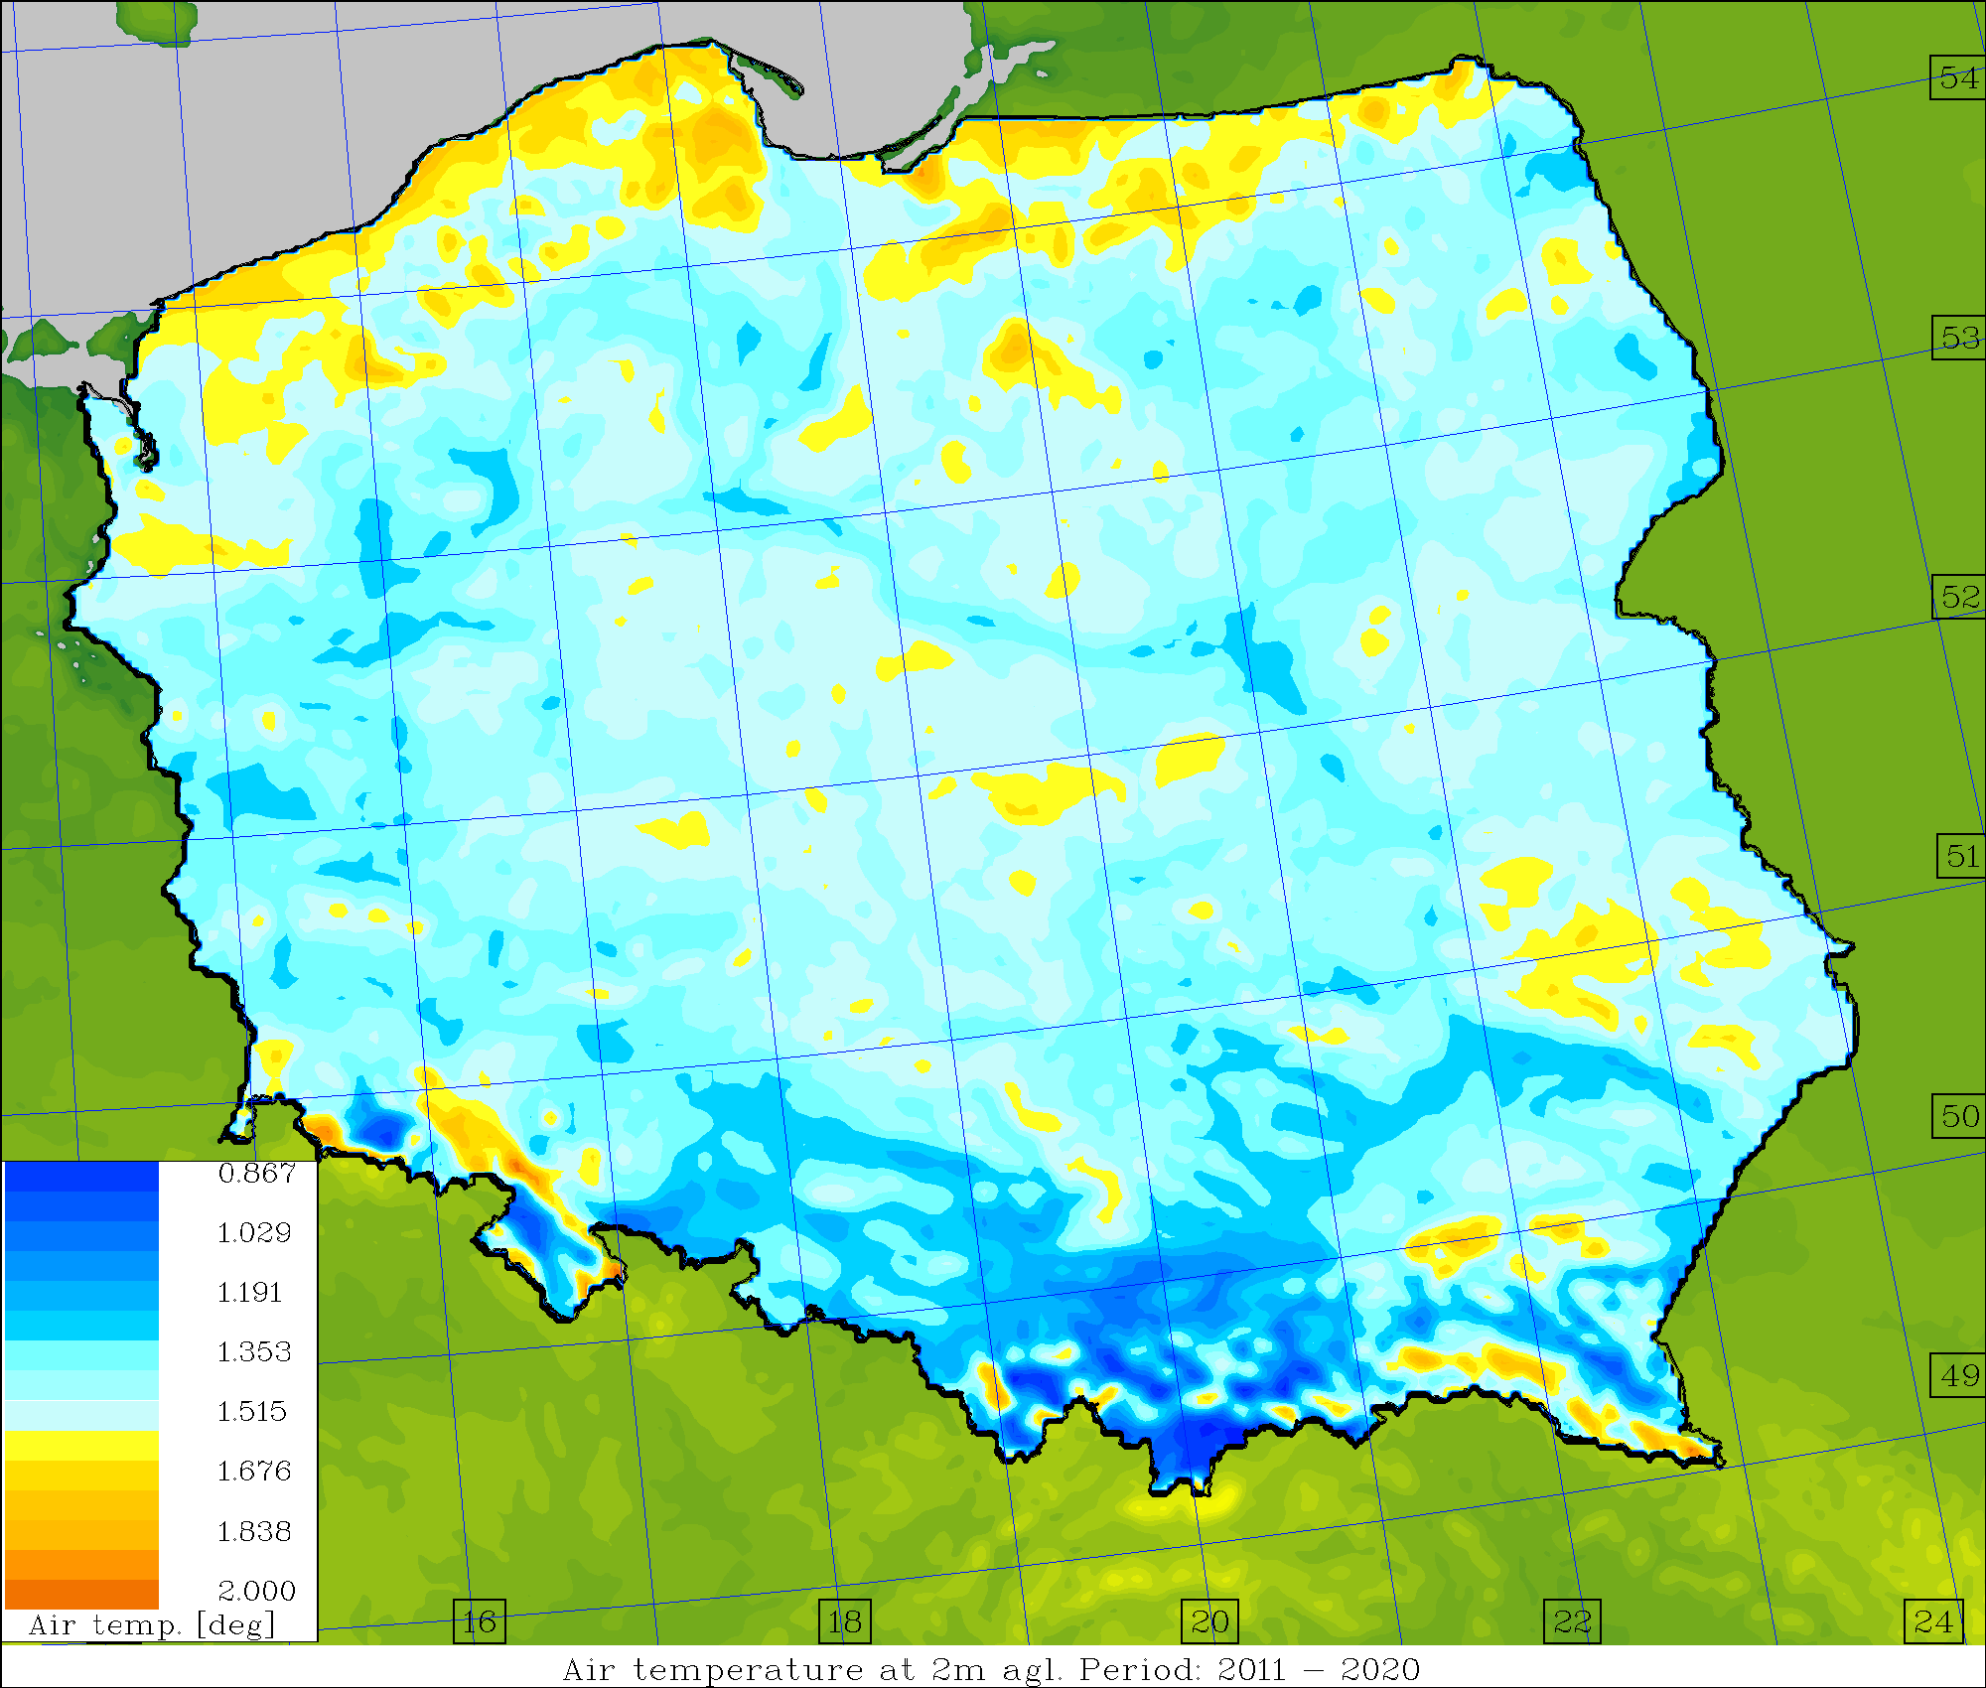
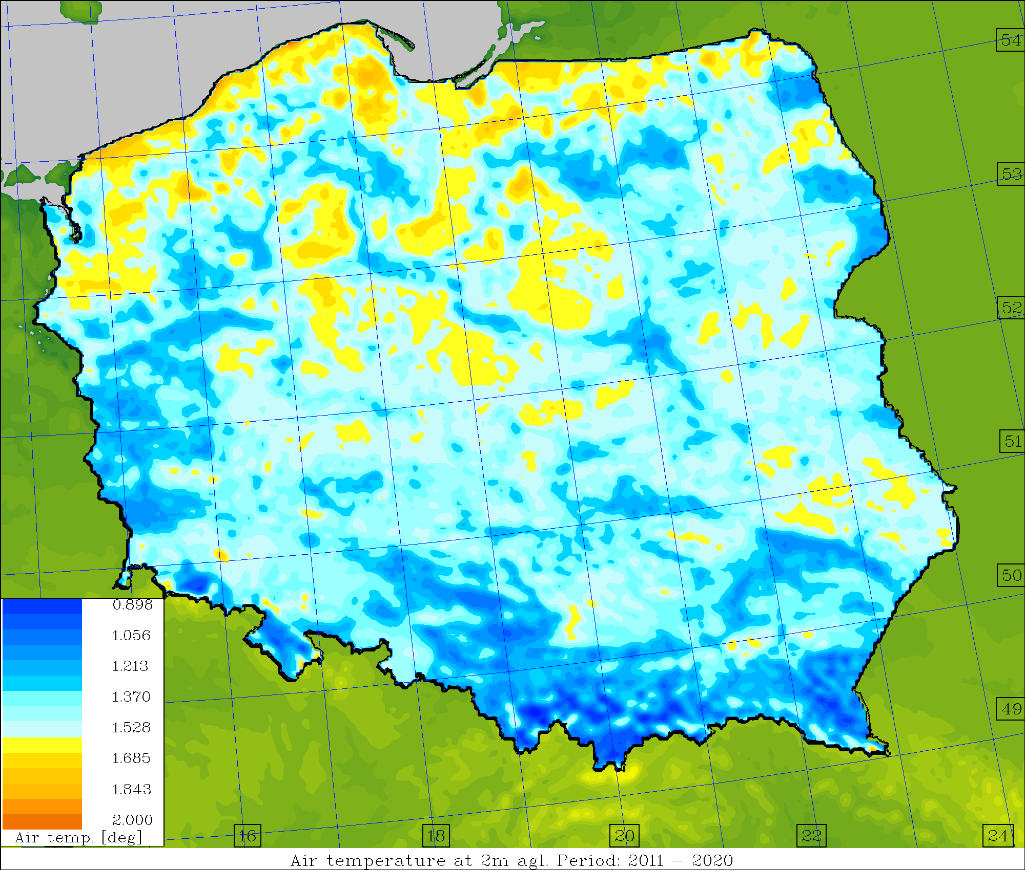
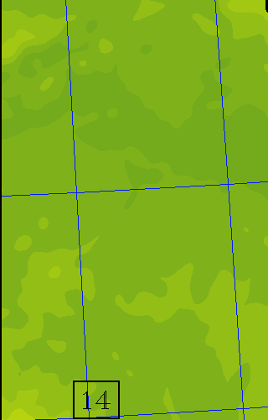
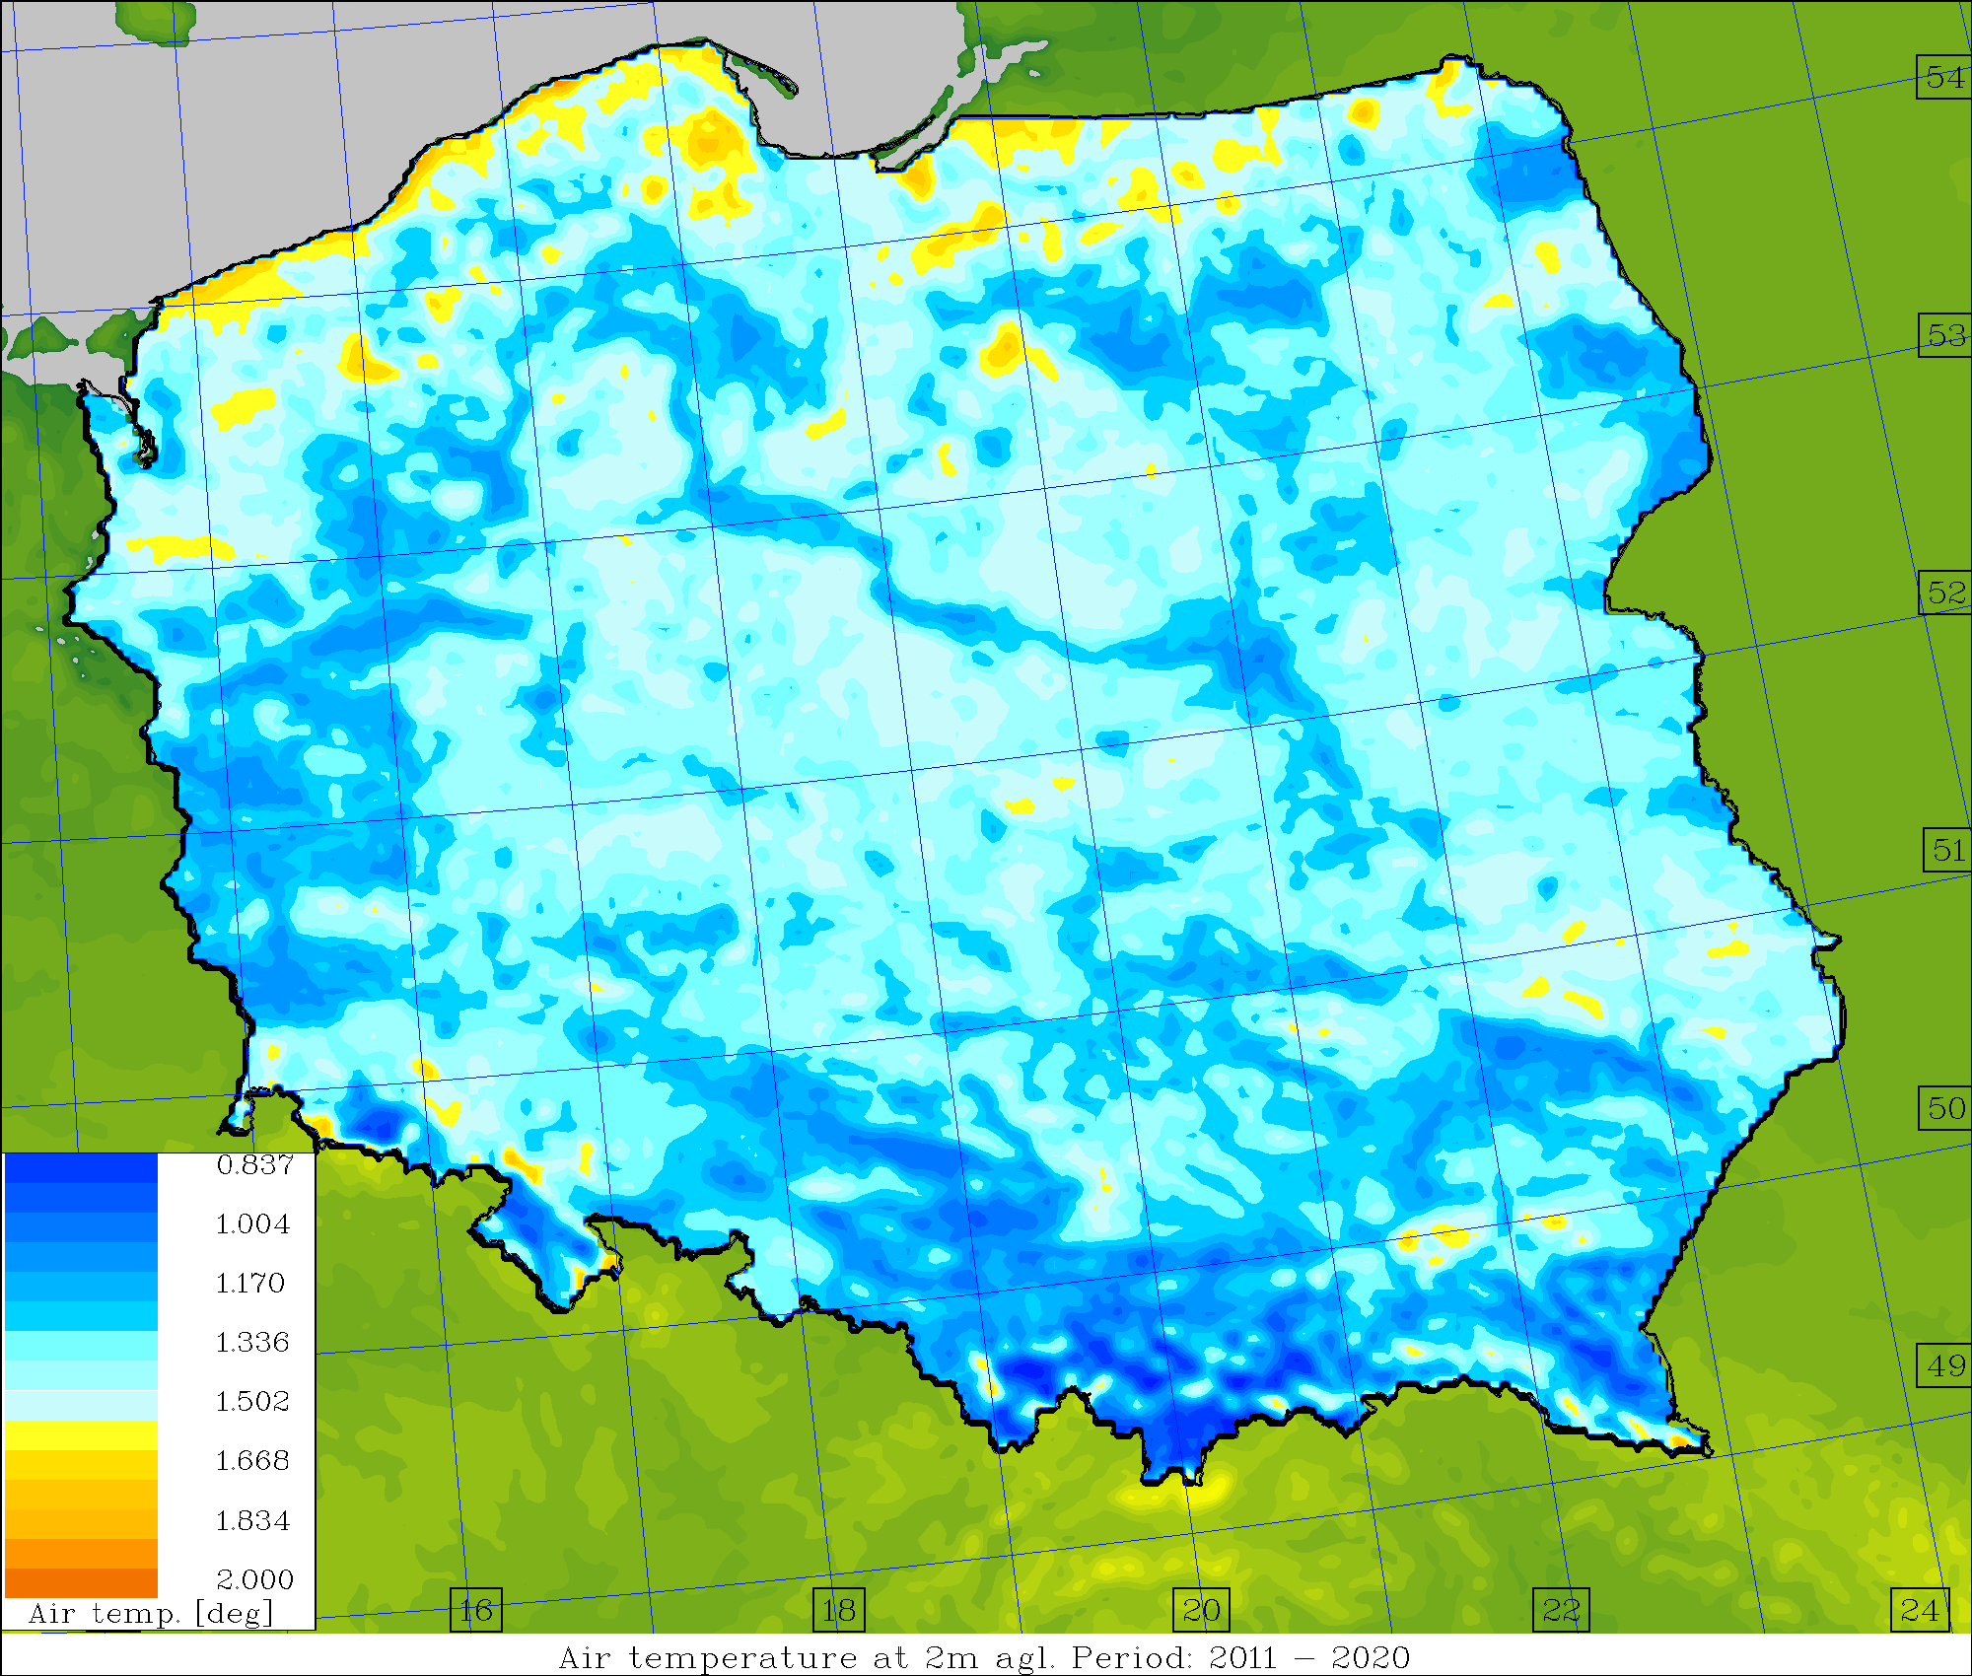
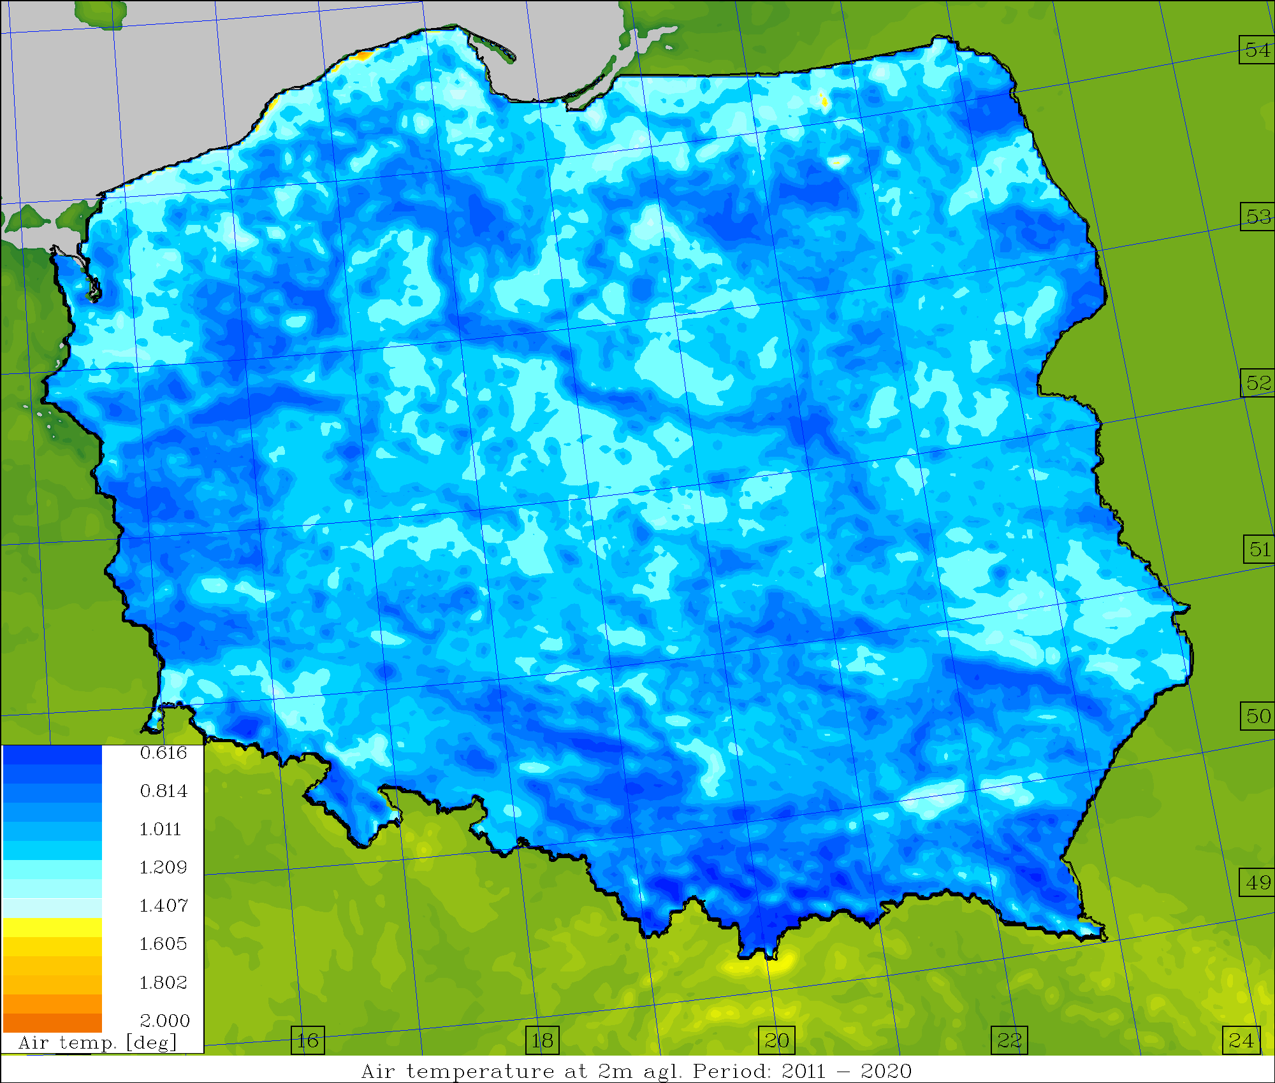
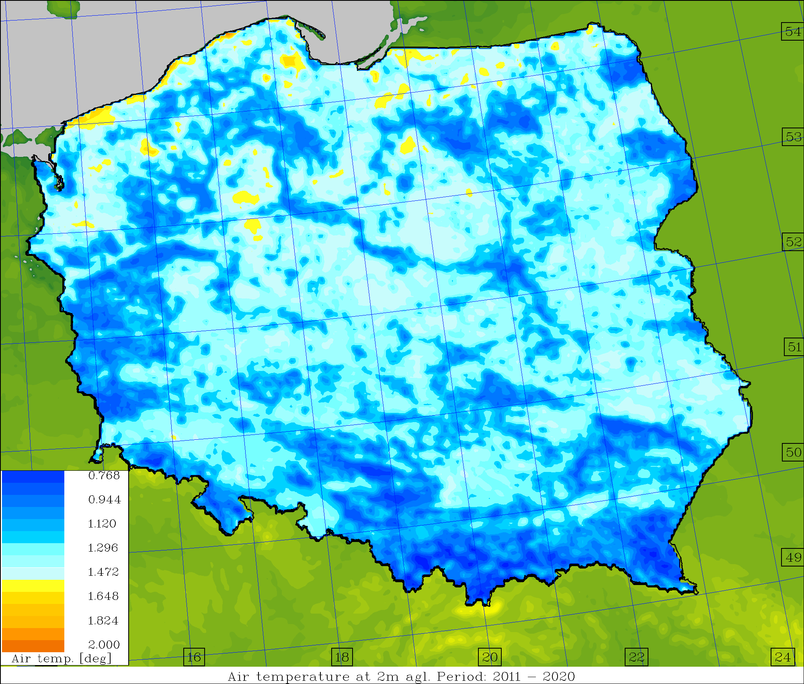
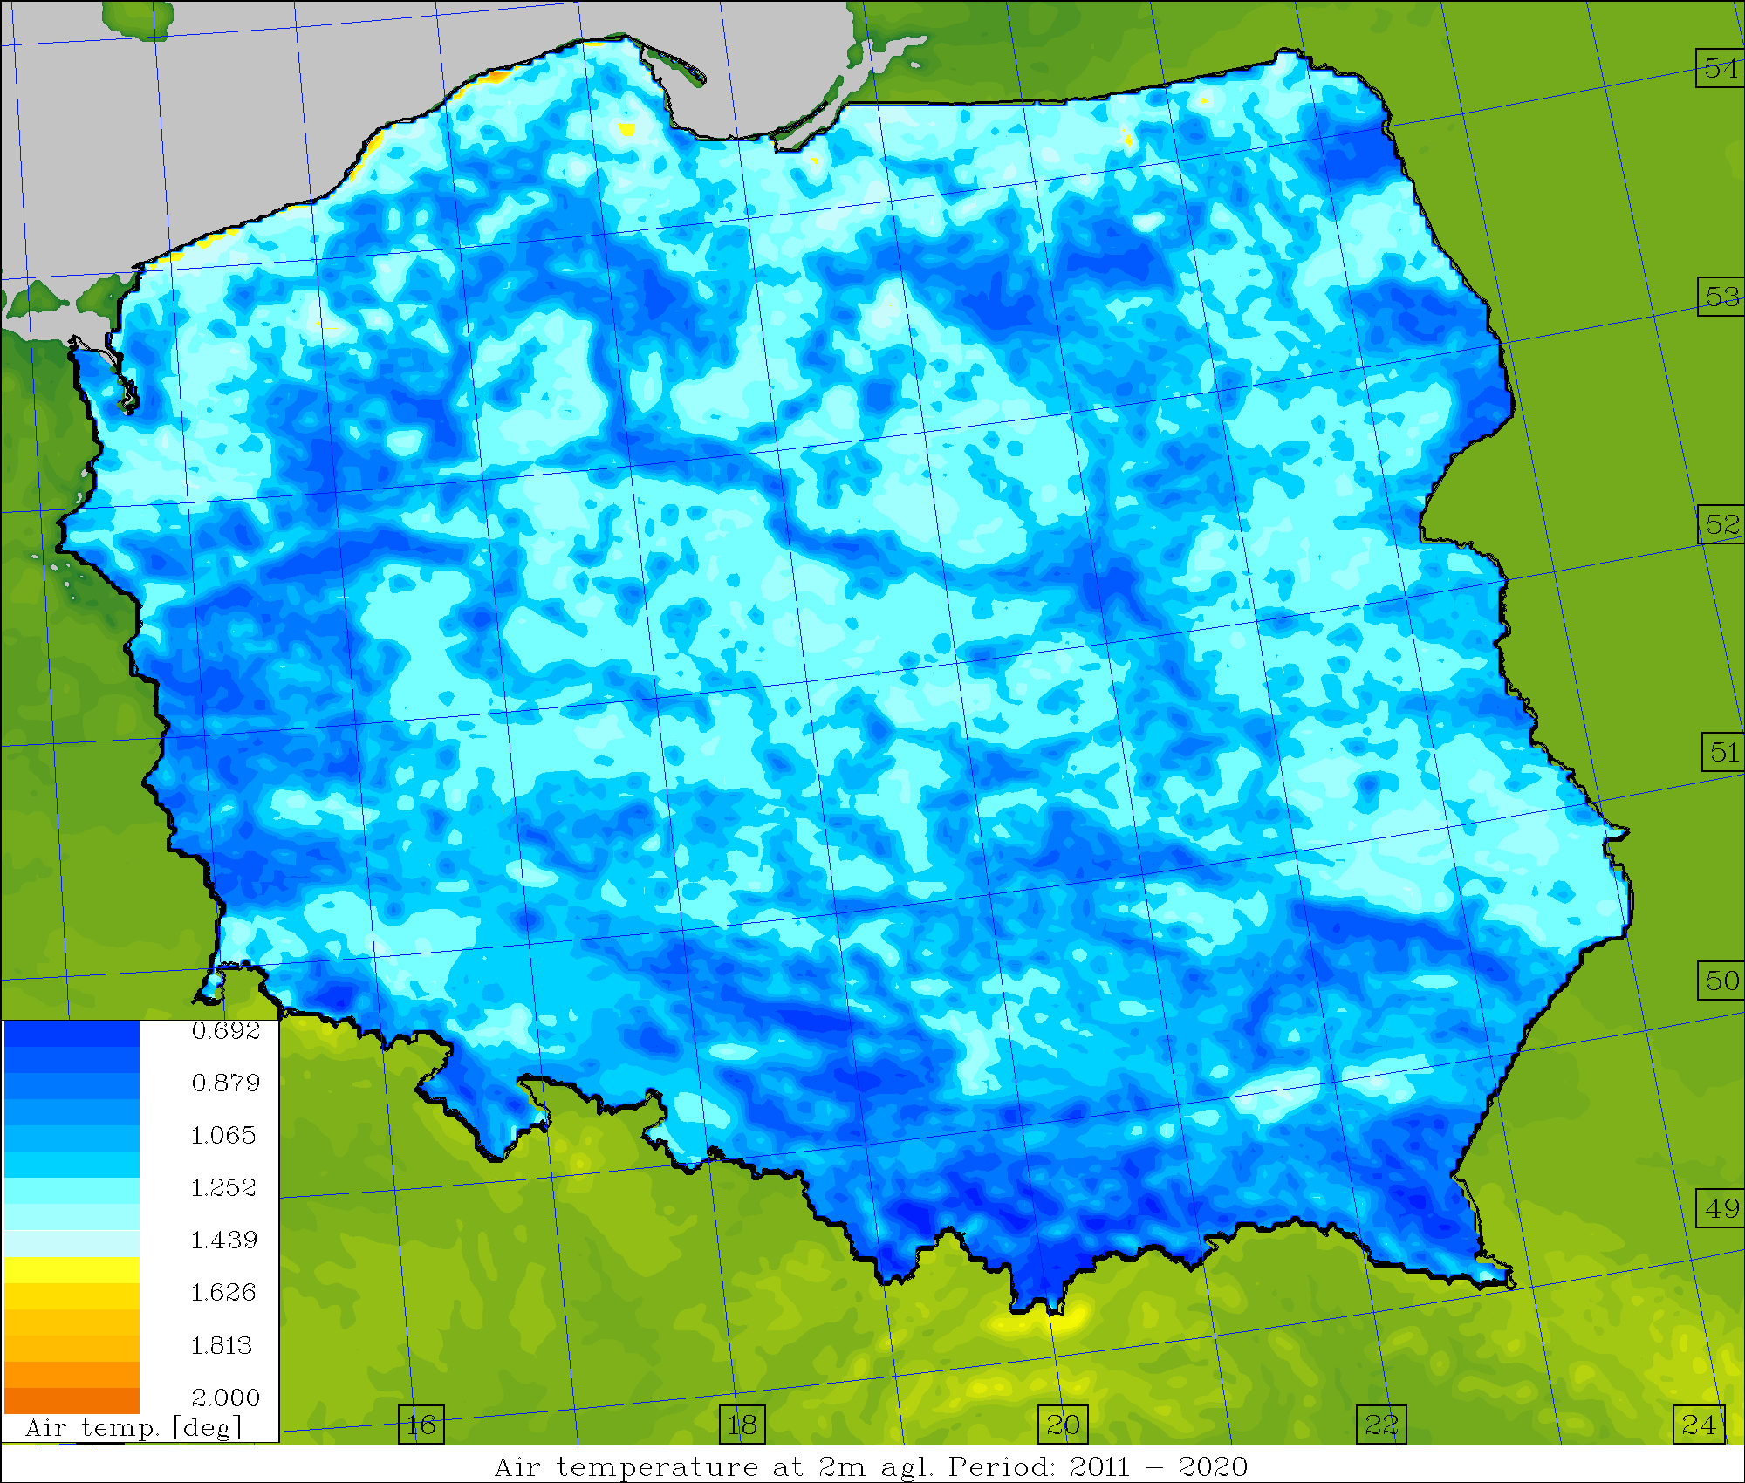
Average skill/spread values, T2M [deg.] (2011-2020)
Operational Surface pert. Down to ~1.0m Down to ~2.5m

Slide 20
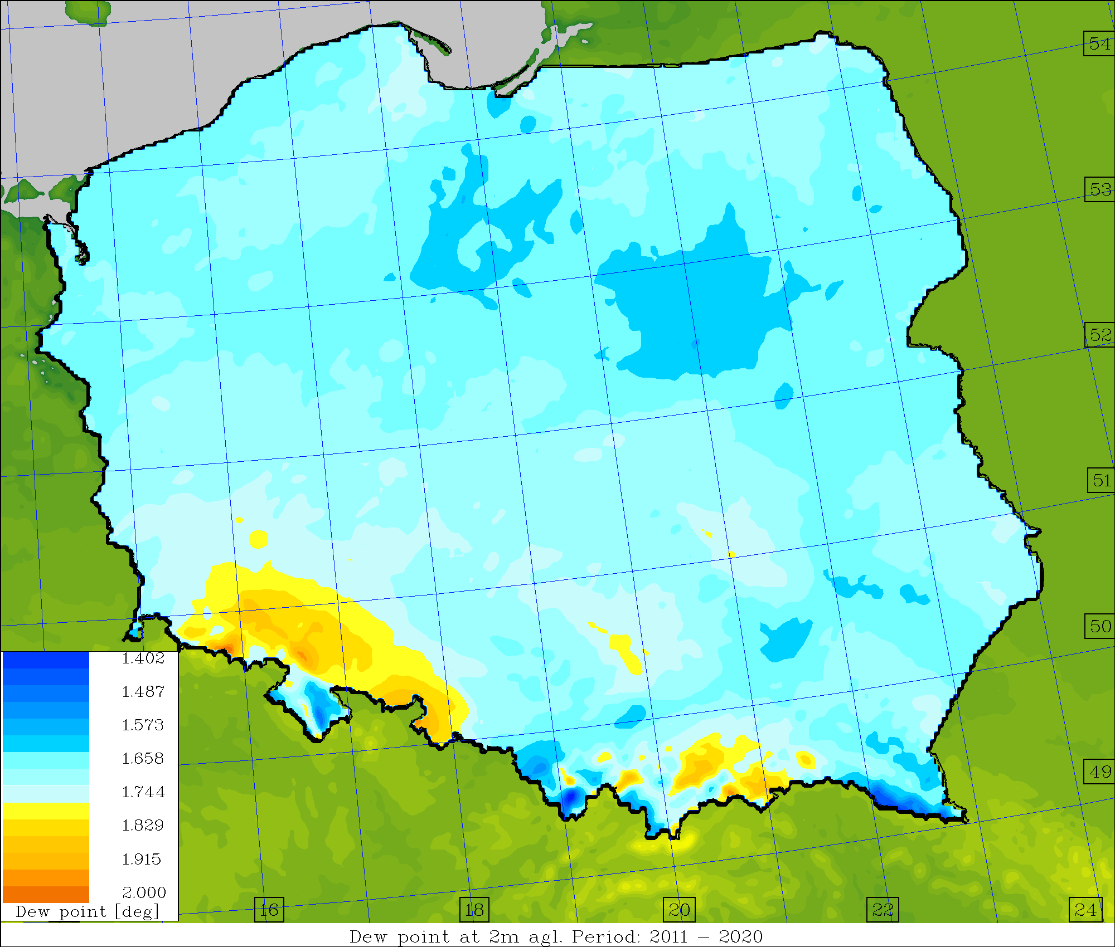
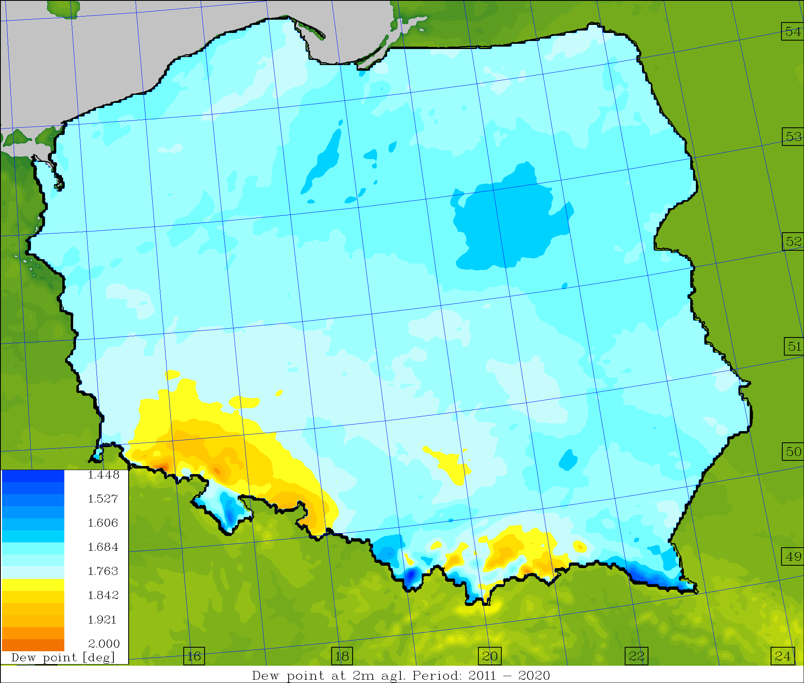
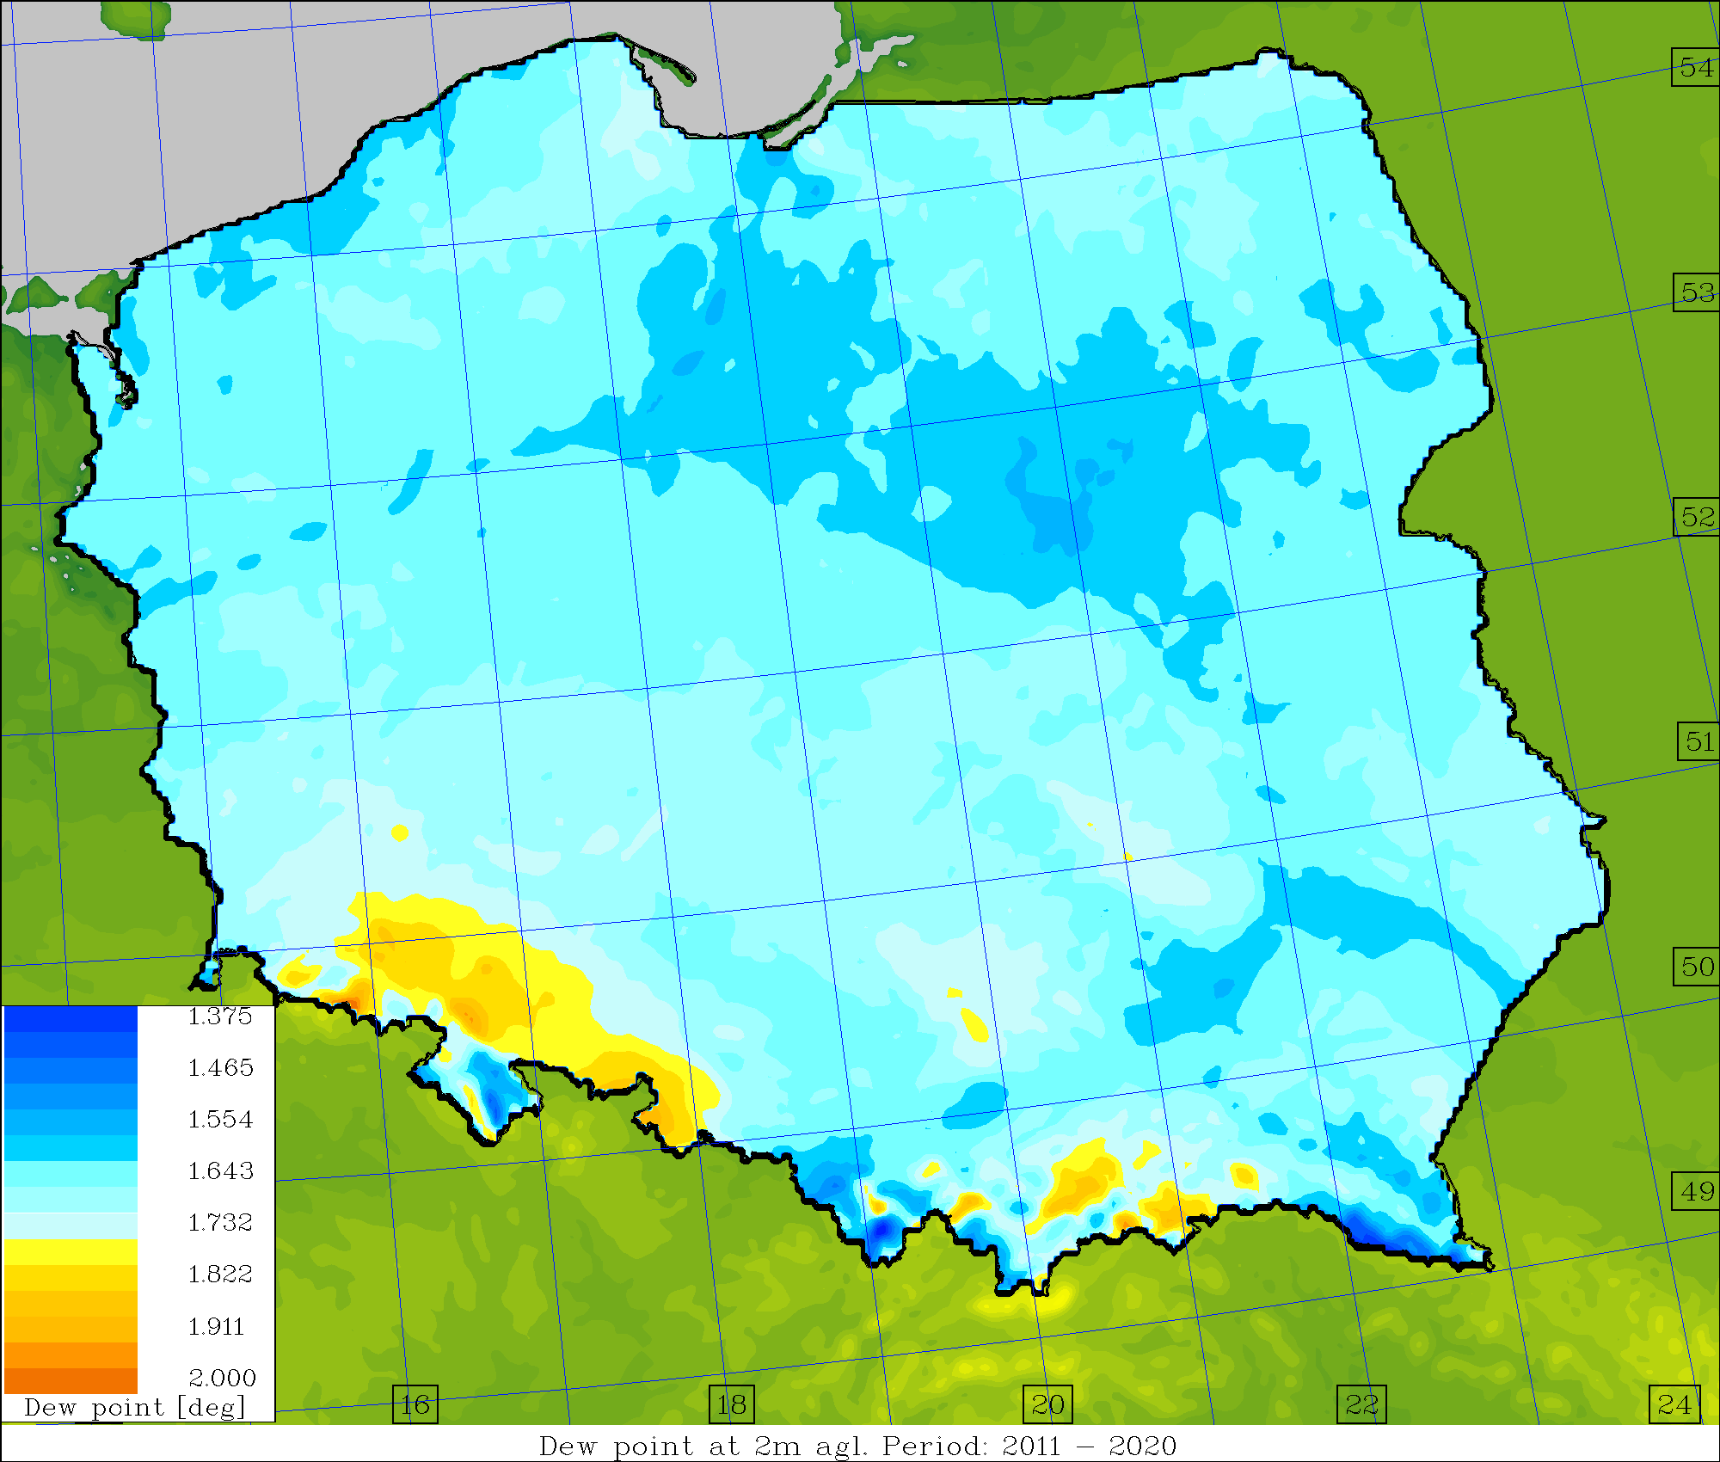

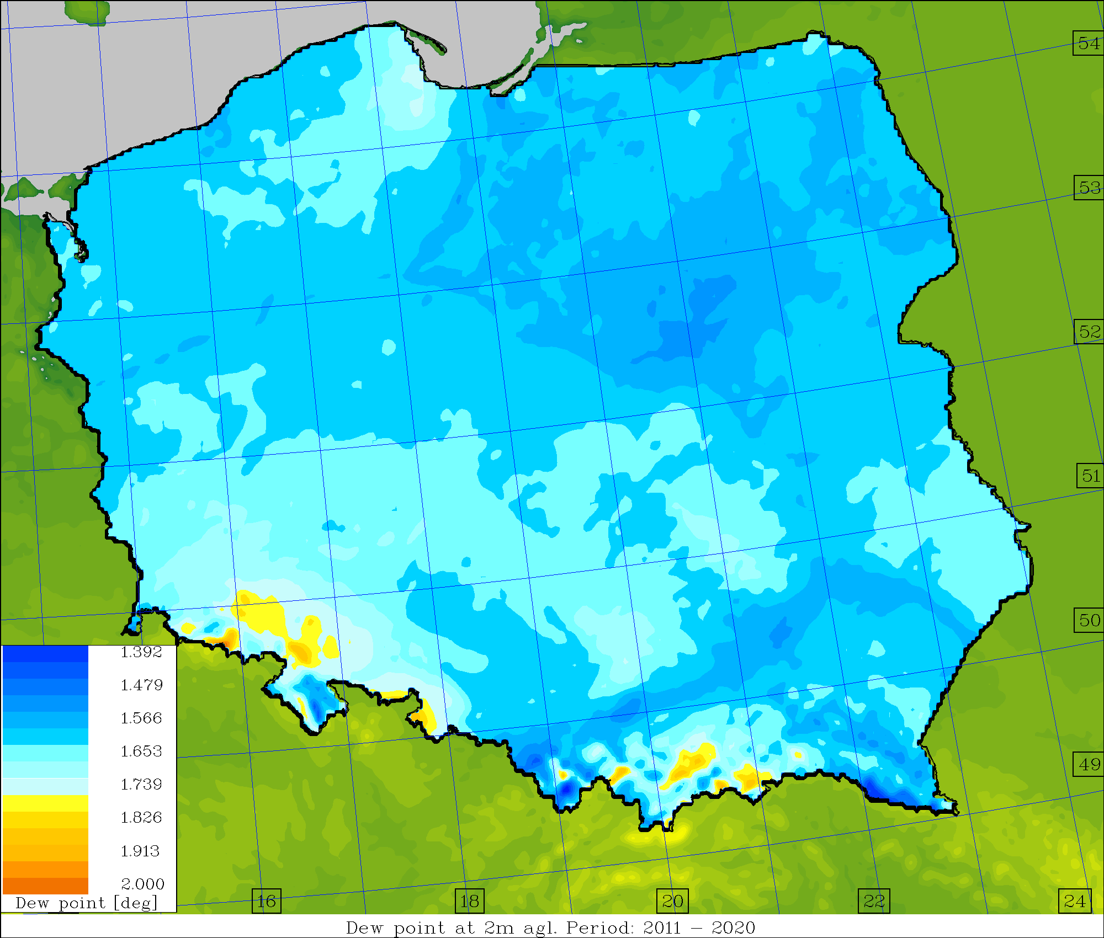
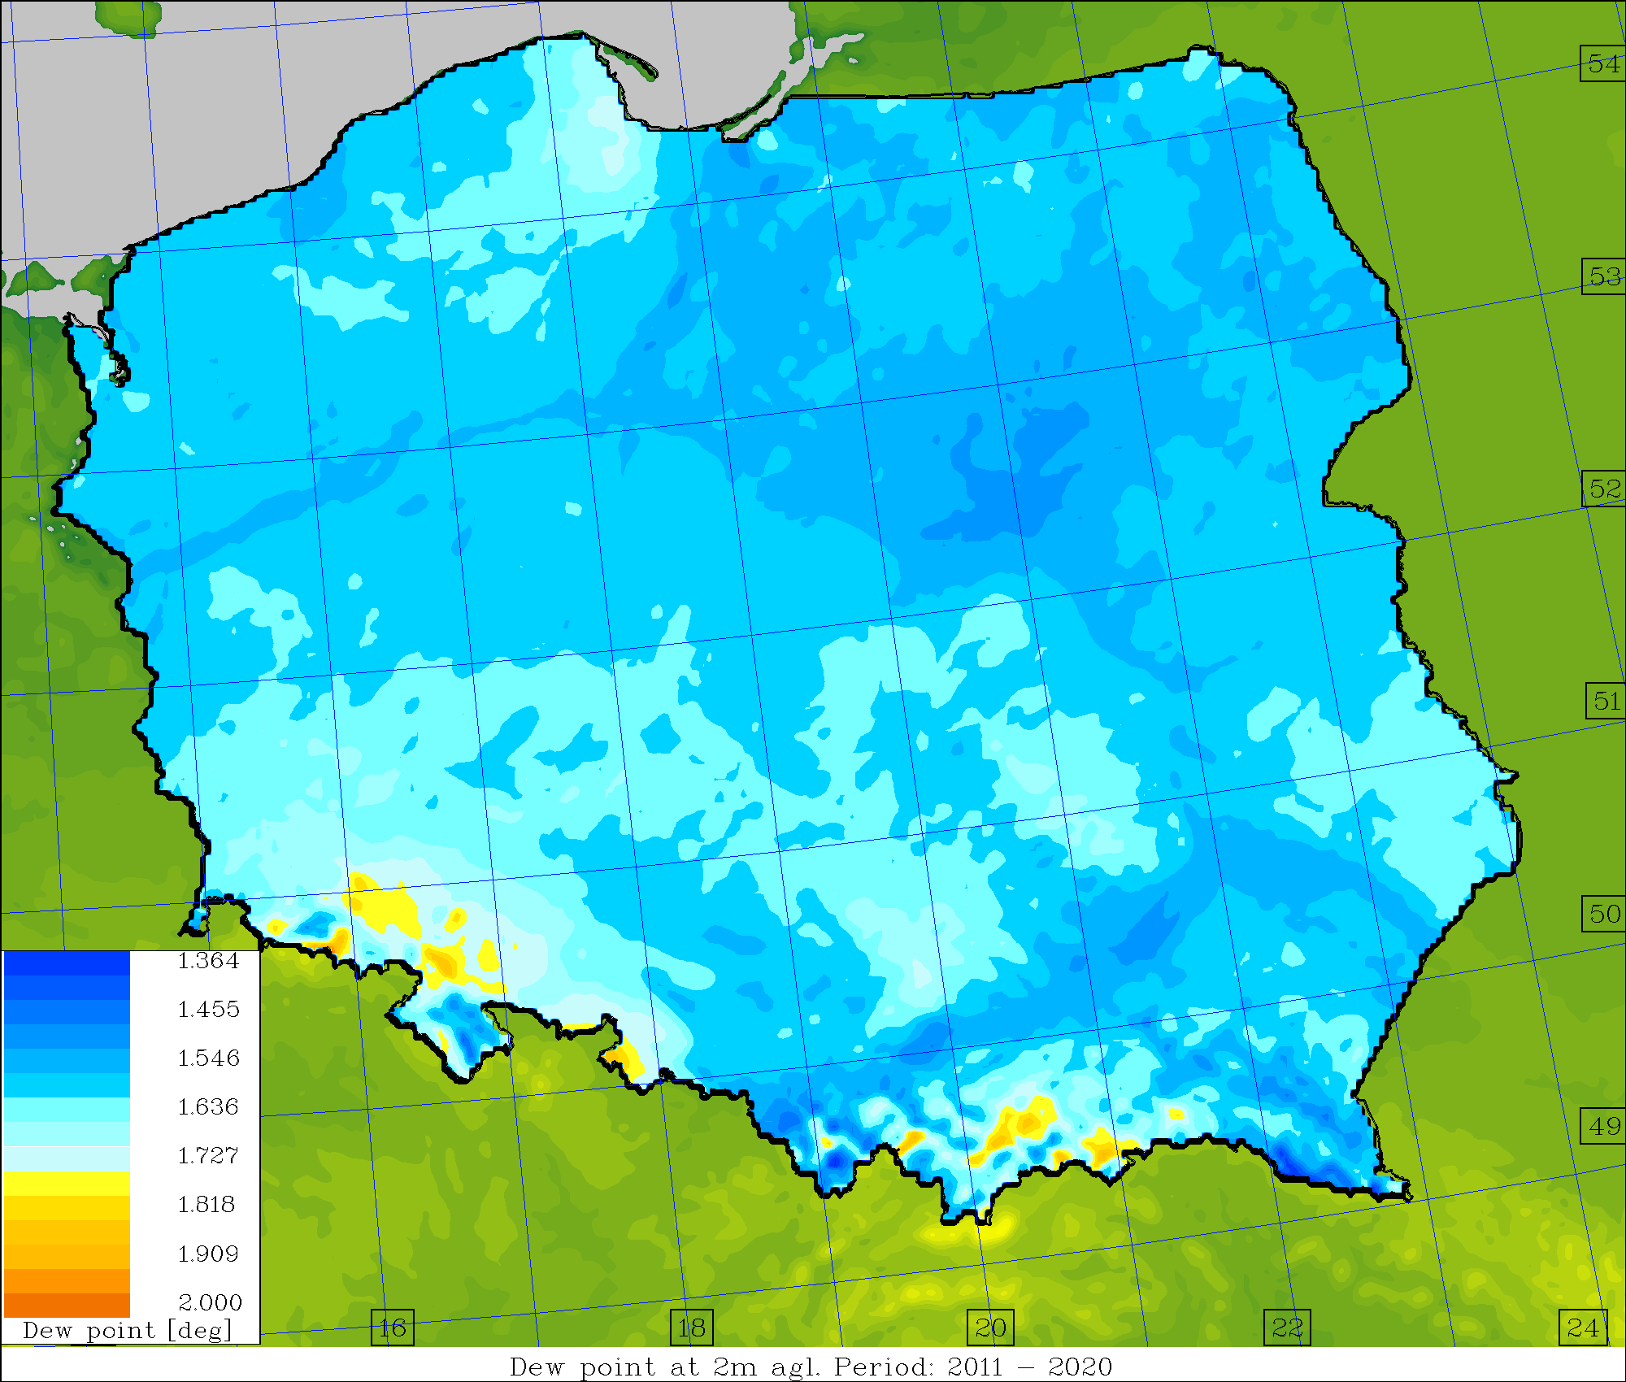
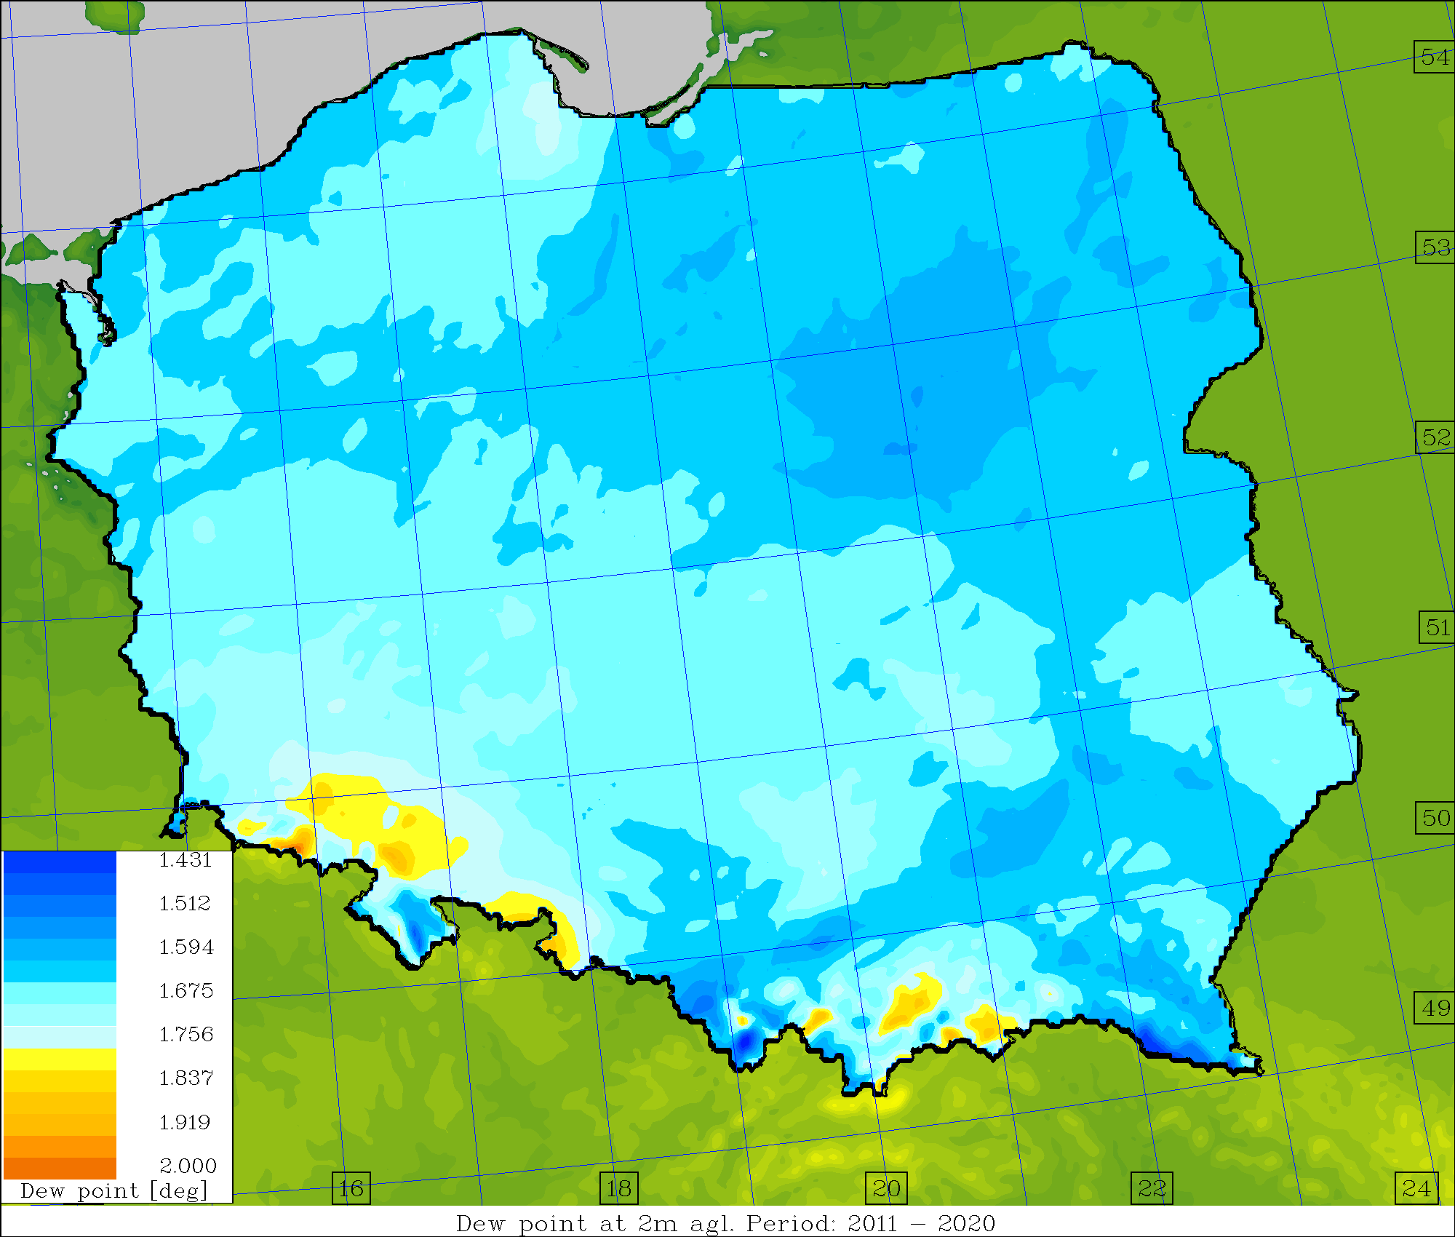
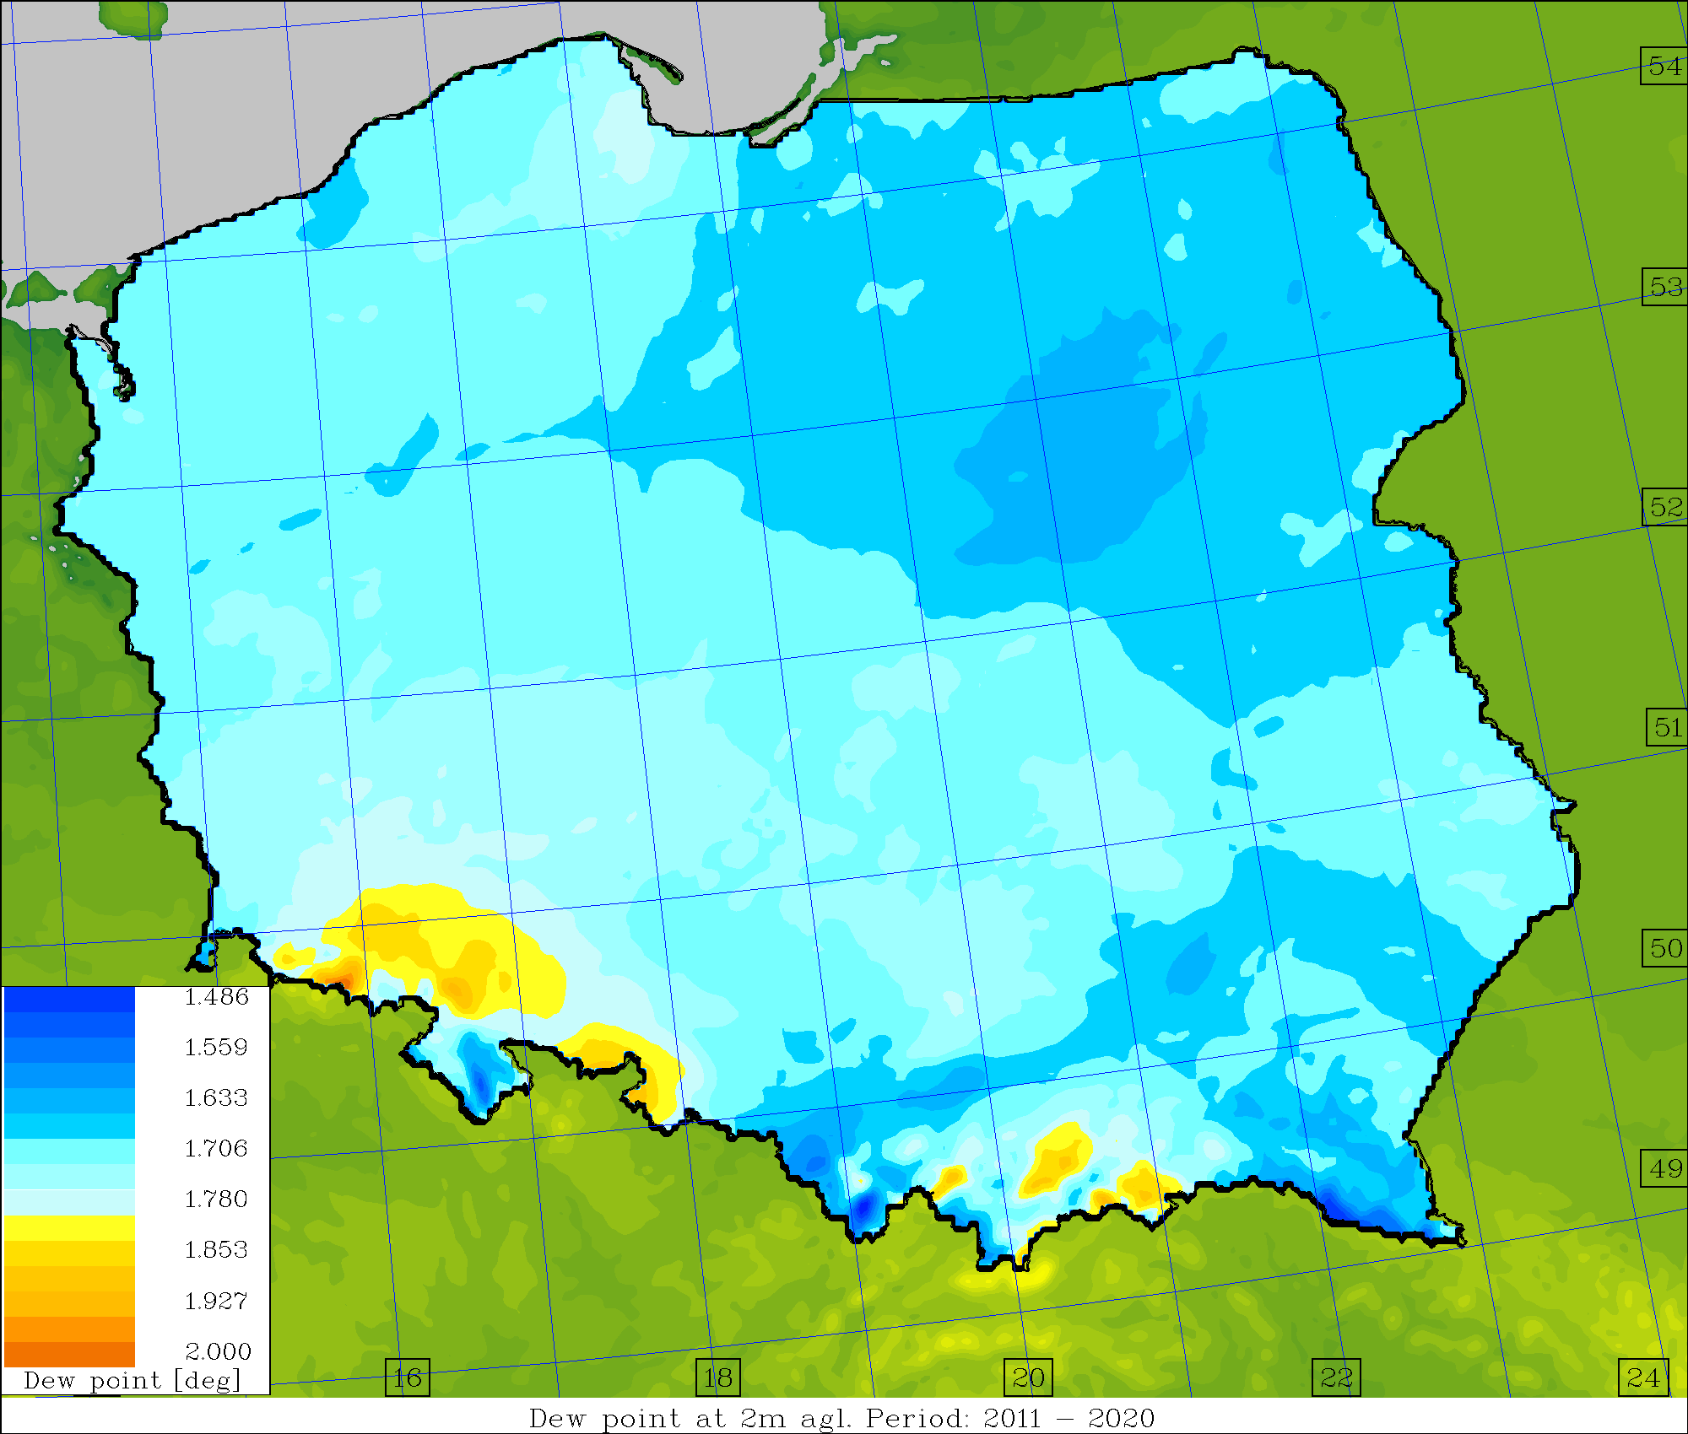
Average skill/spread values, TD2M [deg.] (2011-2020)
Operational Surface pert. Down to ~1.0m Down to ~2.5m

Slide 21



Towards ICON-LEPS,
Sensitivity of ICON-IMS in Reference to Greek SYNOP Observations
Euripides Avgoustoglou
Hellenic National Meteorological Service
24th COSMO General Meeting, Athens, September 12, 2022
Euripides Avgoustoglou, Hellenic National Meteotological Service, 24th COSMO GM , Athens, September 12, 2022
01

Slide 22
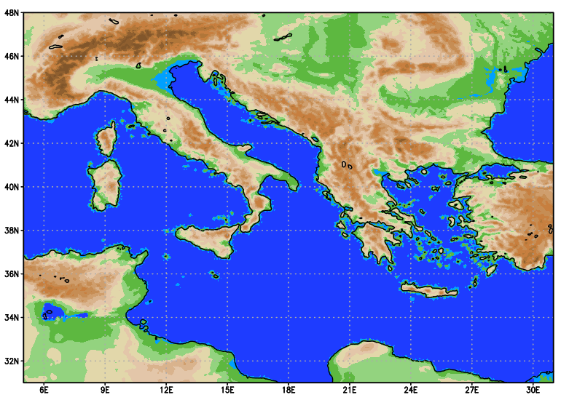
SENSITIVITY TESTS BLUEPRINT
24 parameters are considerd.
3 values/parameter including default.
The evaluation period consisted of the year 2020 (366 days).
≈
~26500 runs based on ICON-IMS:
Horizontal grid size: R3B08 (~6.5km).
417x273 grid points (wider area of Greece and Italy), 65 levels.
Integration time-step: 60 secs.
Integration period: 132 hs. ( An equivalent period of two centuries of model runs)
Boundary conditions : 3hr IFS Forecast.
Computational Cost ~ 10⁷-10⁸ b.u. on Cray X C40 of ECMWF (Gratis HNMS).
Euripides Avgoustoglou, Hellenic National Meteotological Service, 24th COSMO GM , Athens, September 12, 2022
03

Slide 23
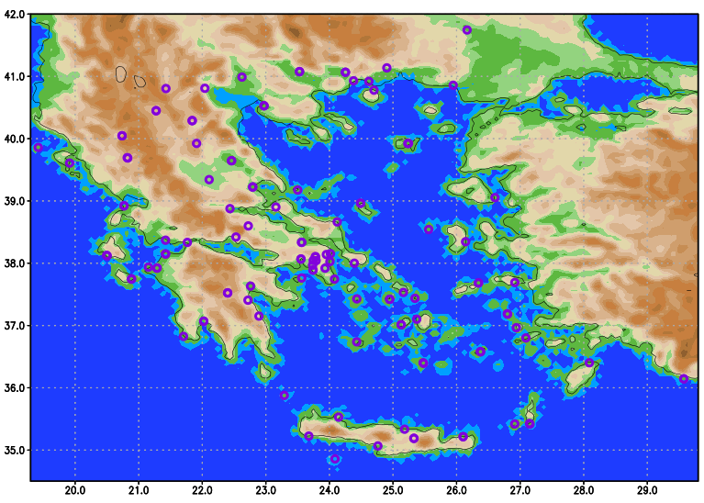
Station Positions
Euripides Avgoustoglou, Hellenic National Meteotological Service, 24th COSMO GM , Athens, September 12, 2022
05

Slide 24
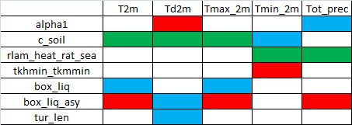
On Most Sensitive Parameters (contd)
 |  | pmsl
 | pmsl | Td_2m
 | Td_2m | T2m_max |  |  | W10m | pmsl |  | T2m_max |  | pmsl | pmsl
 | T2m_min | T2m_min |  |  | pmsl | T2m |  | T2m_min | T2m_min | T2m_max | T2m_max
T2m | preci | T2m | preci | preci | T2m_min | preci | preci | T2m | T2m | T2m_min | T2m_min
a_hshr p01 | alpha1 p04 | c_soil p06 | capdcfac_et p07 | entrorg p09 | gkwake p10 | rain_n0_ f actor p13 | rdepths p14 | rlam_heat rat_sea p17 | tkhmin tkmmin p20 | box_liq p21 | box_liq_ asy p22
!
!
!
!
Recommended list of the parameters optimized and/or perturbed based on domain averages at 132 hr
!
!
Avgoustoglou Et al., ICCARUS Meeting, March 11, 2022
!
!
Euripides Avgoustoglou, Hellenic National Meteotological Service, 24th COSMO GM , Athens, September 12, 2022
25

Slide 25

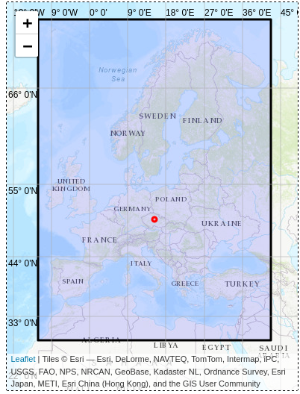
ICON-LEPS
Possible domain and resolution
CUR (closest to COSMO-LEPS)
MED (+ Is, full UK)
PAN-EU (+ Scandinavia, Ukraina but not Turkey)
I. Cerenzia

Slide 26
ICON-LEPS: how should it look like?
Dedicated meeting with WG6, WG7 and the STC
Identify few scenarios -> re-design the system according to our needs as well as to the needs of the users
It is desirable and feasible to propose a panEuropean ensemble?
Re-activate the operational verification -> COSMO activity?
Upgrade the dissemination: consider the usage of a web portal
Scientific developments which can be considered:
  Data assimilation at high-resolution (radar data)
  Add on-demand high-resolution scenarios
  => Possible only if enough FTEs are available

Slide 27
Concluding remarks
SPPT has been implemented in ICON, tests start soon
enlarging the amplitude of few parameter perturbations has a positive effect: the spread is increased while the RMS error is unchanged
in the convection-dominated season, the physically based stochastic perturbation for subgrid turbulence (PSP2 scheme) has a positive impact on the diurnal cycle of the precipitation (earlier onset of the convection) and determine an increase of the precipitation amount
physically-based schemes, like PSP2, seems to be promising as additional perturbations, to complement the effect of the parameter perturbation method
ICON-LEPS: what are our main needs toward it? This transition can give us the occasion to re-design the system according to our current strategy and plans

Slide 28
Thank you for your attention!

Slide 29

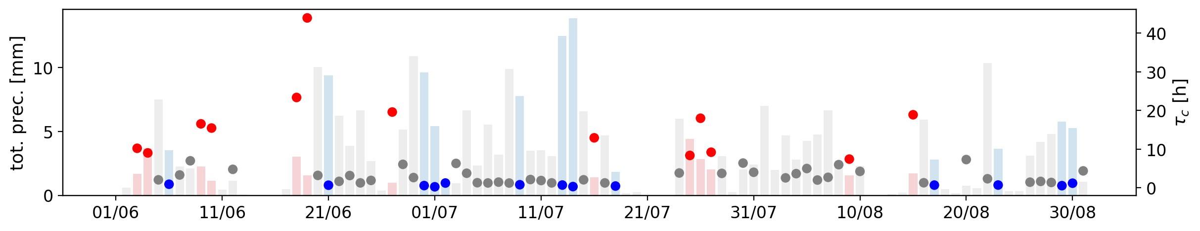
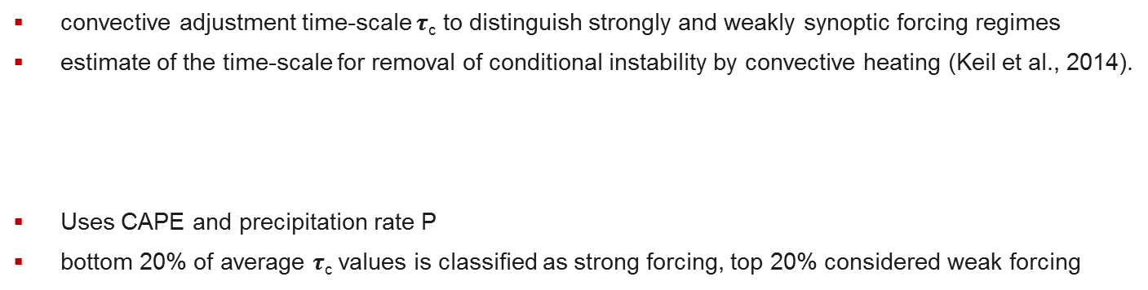
Convective Adjustment timescale
convective adjustment time-scale $τ$_{c} to distinguish strongly and weakly synoptic forcing regimes
estimate of the time-scale for removal of conditional instability by convective heating (Keil et al., 2014).
Uses CAPE and precipitation rate P
bottom 20% of average $τ$_{c} values is classified as strong forcing, top 20% considered weak forcing

Slide 30

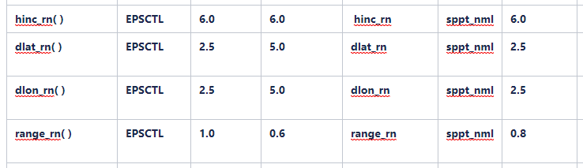
SPPT namelist switches in ICON
Subset of supported switches (besides lsppt):

