Slide 1
Status of WG2 - the BRIDGE project
COSMO GM
12-16 September 2022
Michael Baldauf, Florian Prill (DWD)
1

Slide 2
The BRIDGE project (Basic Research for ICON with DG Extension)
BRIDGE is an informal project at DWD.
currently: F. Prill, M. Baldauf
joining later: D. Reinert, U. Schättler, S. Borchert, …
Goals:
develop a prototype for a Discontinuous Galerkin (DG) implementation of the 3D Euler equations (‚DG-HEVI on the sphere‘)
together with a minimal set of physical parameterizations
using ICON infrastructure (parallelisation, I/O, ...)
more object-orientation and use of standard software (e.g. YAC coupler, ...)
→ BRIDGE is an intermediate step to a full–fledged ICON implementation.
M. Baldauf (DWD)
2

Slide 3
DG development at DWD
COSMO-DG ~2009-2014
- 3D Euler eqns, explicit time integr., structured grid
2D toy model (C++ code) ~2014 – 2020
How to bring DG on the sphere/ellipsoid (Baldauf (2020) JCP)
HEVI scheme with DG (Baldauf (2021) JCP)
BRIDGE 2020 - ~2023
(Basic Research for ICON with DG Extension)
- Shallow water on the sphere/ellipsoid (explicit)
3D Euler equations (HEVI) + parametr.
ICON-DG ~ 2024 (?) - ~ 2028 (?)
M. Baldauf (DWD)
3

Slide 4
Discontinuous Galerkin (DG) methods in a nutshell (I)
e.g.
Cockburn, Shu (1989) Math. Comput.
Cockburn et al. (1989) JCP
Hesthaven, Warburton (2008)
1.) weak formulation
→
2.) Finite-element ingredient
Galerkin-idea: identify v ≡ p_{l}
Modal base: orthogonal functions e.g. Legendre-Polynomials
Nodal base: interpolation (Lagrange) polynomials
From Nair et al. (2011) in ‚Numerical techniques for global atm. models'
M. Baldauf (DWD)
4

Slide 5
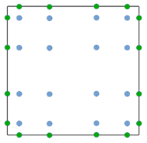
Discontinuous Galerkin (DG) methods in a nutshell (II)
Weak formulation
3.) Finite-volume ingredient:
Replace physical flux by a numerical flux in the surface integral
→ couple two neighbouring cells
Often used: simple Lax-Friedrichs flux
4.) Gaussian quadrature for the volume and surface integrals
→ ODE-system for q^{(k)}_{jl}(t)
5.) Use a time-integration scheme (Runge-Kutta, …)
M. Baldauf (DWD)
5

Slide 6
DG – Pros …
local conservation of every prognostic variable ← ‚FV heritage‘
any order of approximation (convergence) possible ← ‚FE heritage‘
flexible application on unstructured grids (also dynamic adaptation is possible, h-/p-adaptivity)
very good scalability on massively-parallel computers (compact data transfer and no extensive halos)
separation between (analytical) equations and numerical implementation
boundary conditions are easily prescribed (fluxes or values in weak form) → coupling with other subcomponents (ocean model, …) should be easy
higher accuracy helps to avoid several awkward approaches of standard 2nd order schemes: staggered grids (on triangles/hexagons, vertically heavily stretched), numerical hydrostatic balancing, grid imprints by pentagon points or along cubed sphere lines, …
unified numerical treatment of all flux terms and source terms
explicit schemes are relatively easy to build and are quite well understood
M. Baldauf (DWD)
6

Slide 7
DG – … and Cons
high computational costs due to
(apparently) small Courant numbers → small time steps
higher number of degrees of freedom
variables ‚live‘ both on interior and on edge quadrature points
this holds additionally for parabolic problems (diffusion)
HEVI approach leads to block tridiagonal matrices with larger blocks
well-balancing (hydrostatic, perhaps also geostrophic?) in Euler equations is an issue → can be solved!
basically ‚only‘ an A-grid-method →however, the ‚spurious pressure mode‘ is very selectively damped!
→ All these expenses must be outperformed by: higher convergence order, better computational intensity, and better parallelization!
M. Baldauf (DWD)
7

Slide 8
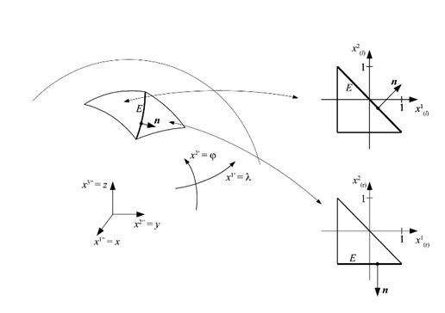
Sequence of coordinates and their transformations in BRIDGE
1.) Geographical coordinate → for external data and general I/O purposes
2.) Local (gnomonial) coordinate → maps to ICON triangle grid
for sphere or ellipsoid; alternatively: flat plane (torus grid gen.)
3.) Unit coordinate → compatible to standard FE codes
4.) Terrain-following coordinate → treat orography
5.) Submapping coordinate → reduce number of flux transf. at edges
affine transf.
Remark: this whole procedure avoids any singularity both in coordinates and in base vectors! (uses the concept of a differentiable manifold, Baldauf (2020) JCP)
M. Baldauf (DWD)
8

Slide 9
A general remark about this talk:
at the last COSMO GM-meeting 2021, all results shown
still have been generated by the toy model (C++ code, only 2D, …)
Now, all results are generated by the BRIDGE code …
M. Baldauf (DWD)
9

Slide 10
Shallow water equations on the sphere
M. Baldauf (DWD)
10

Slide 11
Milestones of the BRIDGE-project (I) (detailed)
0. first version of a FE/DG framework available, MPI parallelized (Florian) Q2/2021✓
Quadrature classes for 1D lines, 2D triangles and 2D squares → 3D prism by tensor products
FE classes for cells, hfaces and vfaces; nodal, interpolation points can be ≠ from quadrature points tensor product, „iterator through gid cells“ Mass matrix classes (metric weight J can destroy tensor product structure)
Output via YAC coupler
shallow water equations on the sphere, explicit time integration (RK) Q3/2021 ✓
Implement 2D coordinate transforms (local gnomonial proj.) for sphere and ellipsoid
Explicit RK schemes of order 1…5
Numerical flux calculations (horizontal)
Determine flux surface integrals (with flux transformations), flux volume integrals and source term integrals for
Shallow-water equations with bathymetry, 2D advection in covariant form (Baldauf, 2020)
Implement test case init. and diagnostics: 2D advection tests, Läuter et al. (2005), Galewsky et al. (2004), …
M. Baldauf (DWD)
11

Slide 12
More object orientation with the BRIDGE code
Helps in keeping things as transparent as possible
Example: quadrature classes for the numerical integration
over prism volumes or prism faces
UML diagrams of all quadrature classes:
(F. Prill)
Integration over plane triangles
Integration
over
lateral faces
Integration
over prism
volume
M. Baldauf (DWD)
12

Slide 13
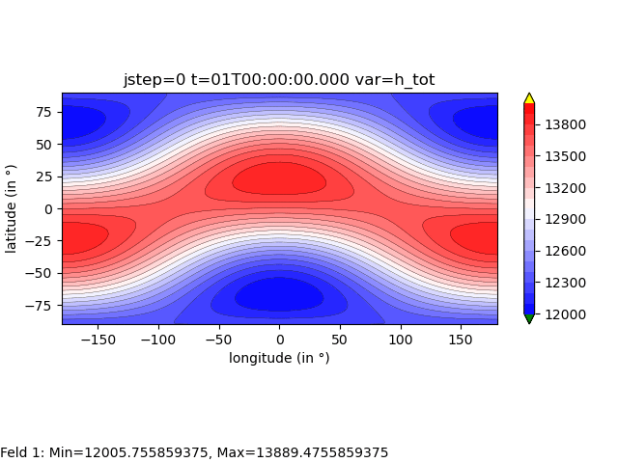
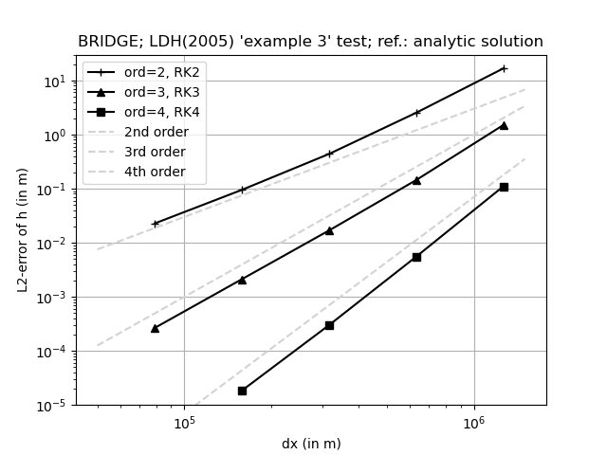
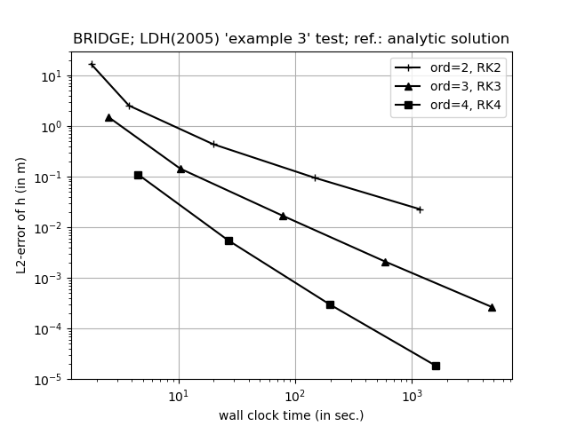
Unsteady solid body rotation
Läuter et al. (2005) JCP
Exact analytic solution available! → calculate error measures L₂ (=RMSE)
DG: combine polynomials of degree n-1 with n-th order Runge-Kutta scheme
Convergence plot:
Work-precision diagram:
n=2
n=2
n=3
n=3
n=4
n=4
R2B5
dx (in m)
CPU wall clock time (in sec.)
R2B4
R2B3
R2B2
True solution is very smooth → higher order scheme wins by far
R2B1
M. Baldauf (DWD)
13
Notes:
13

Slide 14
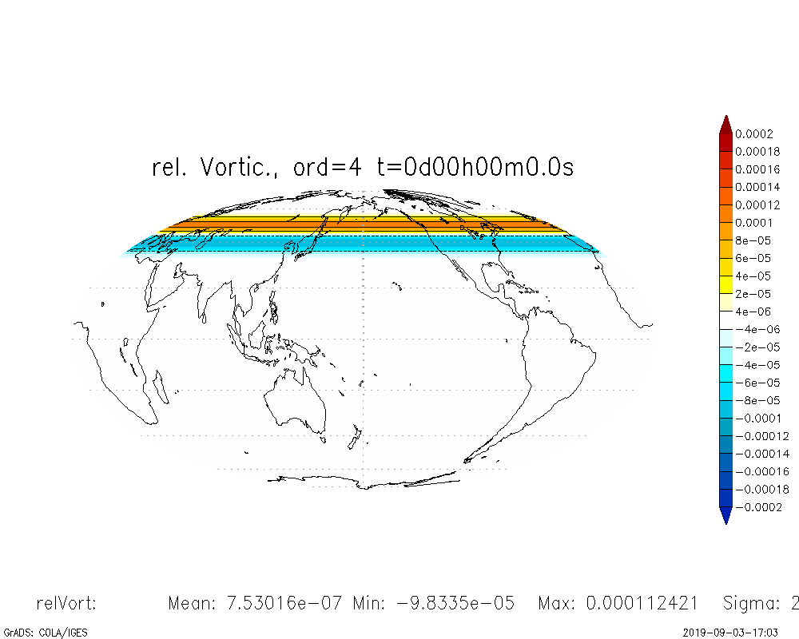
Barotropic instability test
Galewsky et al. (2004)
4th order DG scheme
without additional diffusion
dx~67 km, dt=15 sec.
M. Baldauf (DWD)
14

Slide 15
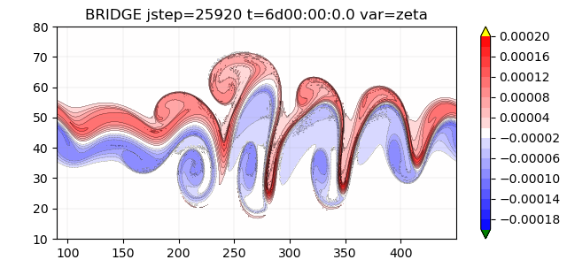
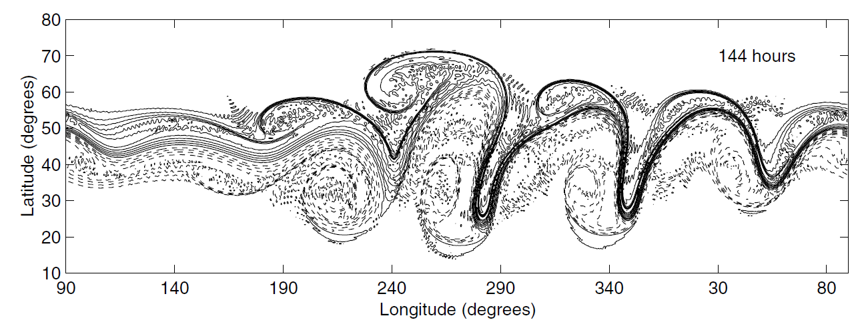
relative vorticity
Barotropic instability test
Galewsky et al. (2004)
BRIDGE
4th order DG scheme
without additional diffusion
R2B5: dx~79 km, dt=20 sec.
FMS-SWM (Geophys. Fl. Dyn. Lab.)
without additional diffusion
dx~60 km (T341), dt=30 sec.
Fig. 4 from Galewsky et al. (2004)
M. Baldauf (DWD)
15

Slide 16
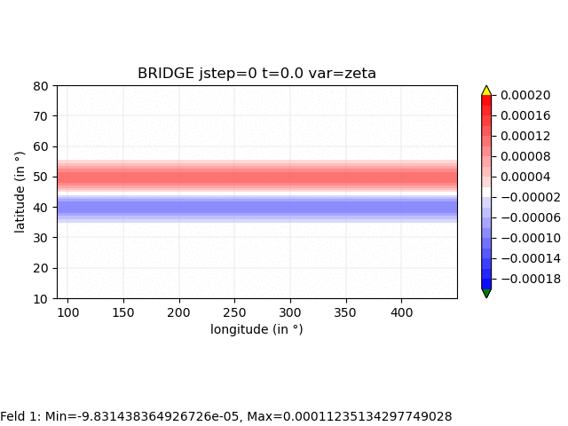
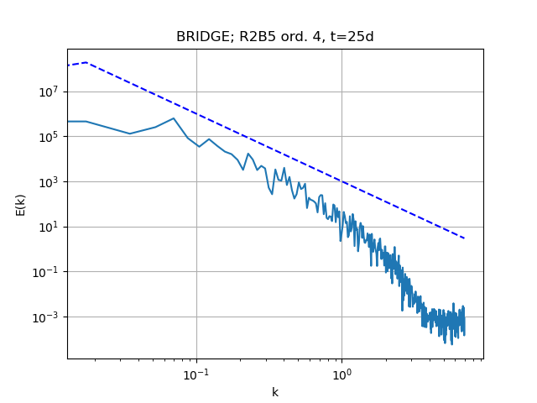
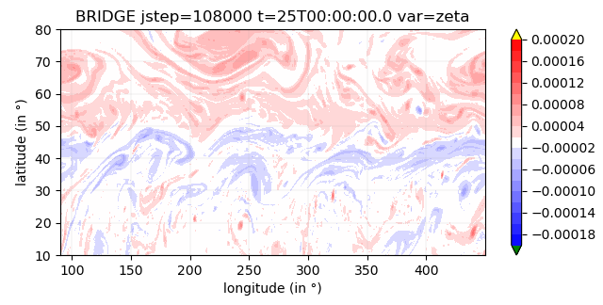
Barotropic instability test
Galewsky et al. (2004)
Generation of 2D turbulence
4th order DG scheme
without additional diffusion
dx~67 km, dt=15 sec.
Power spectrum of KE along 45°:
enstrophy
cascade
~k ⁻³
M. Baldauf (DWD)
16

Slide 17
Euler equations
M. Baldauf (DWD)
17

Slide 18
Extension to the 3D Euler equations on the sphere together with
terrain-following coordinates
Additional metric terms of terrain-following coordinates can destroy numerical local conservation → use strong conservation form of the equations,
i.e. use both base vectors for a smooth (e.g. spherical) coordinate system K‘
and for the terrain-following system K (Wedi, Smolarkiewicz (2003), Baldauf (2021) )
example: strong cons. form of the momentum equation:
now: additional metric terms only from the smooth system K‘
momentum flux for Euler eqns.
for diffusion (D^{ik} = deformation tensor), add
Additionally: Continuity eq. (for ρ) and energy equation (for ρθ)
M. Baldauf (DWD)
18

Slide 19
Milestones of the BRIDGE-project (II) (detailed)
3D Euler equations on the sphere, explicit time integration (RK) Q1/2022 ✓
3D coordinate transforms (local gnomonial, terrain-following) for sphere and flat plane (torus grid generator)
Numerical flux calc. in vertical direction and integrals; source term filtering
Euler equations in covariant, strong conservation form (Baldauf, 2021), deep or shallow atmosphere approx.
Classes for BCs, ICs, invariant fields, diagnostic fields, …
Quasi-1D-quadratures on triangles for x-z slice models
Test cases init. and diagnostic: BRZ2014, Schär et al. (2002), …
2.b … with 3D diffusion (+ a simple turbulence scheme) Q2/2022
1.) Bassi, Rebay (1997) (BR1): introduce derivative variables and extend time integration sequence ✓
Scalar and vectorial diffusion equations in covariant form
Test cases and diagnostics: Baldauf, Brdar (2016)
2.) BR2 compact scheme (Florian) 
2.c grid refinement works (Florian) Q2/2022 ✓
M. Baldauf (DWD)
19

Slide 20
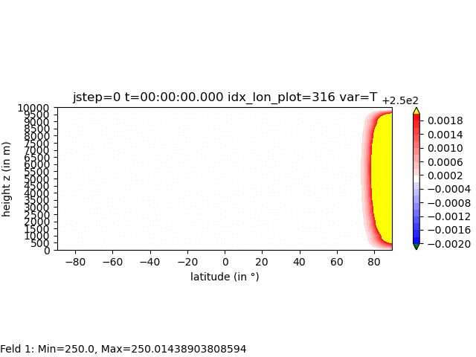
3D Euler equations:
quasi-linear expansion of gravity and sound waves in a spherical shell
Baldauf, Reinert, Zängl (2014) QJRMS derive a linearized analytic solution for
test scenario (A): f = 0
test scenario (B): f = 10 * f_{geo}(45°) → f / N ~ 0.05
DG 4th order scheme with explicit time integration (4th order Runge-Kutta)
‚small planet‘:
R = R_{earth} / 50
S E N
M. Baldauf (DWD)
20

Slide 21
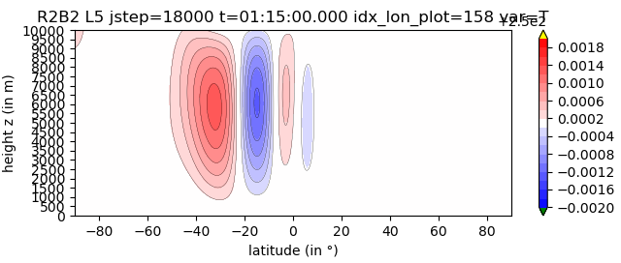
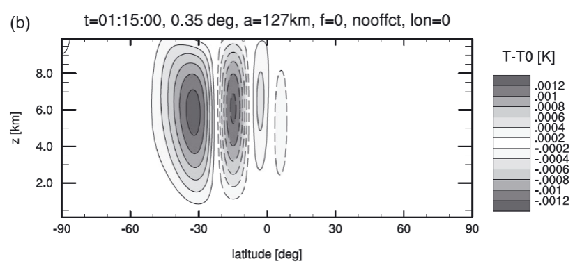
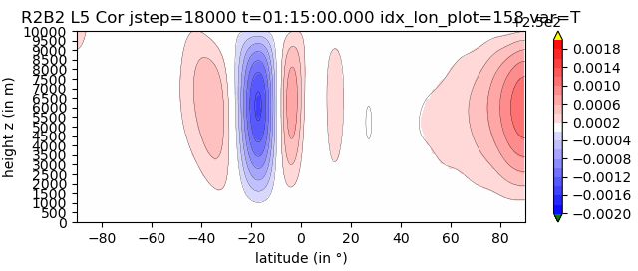
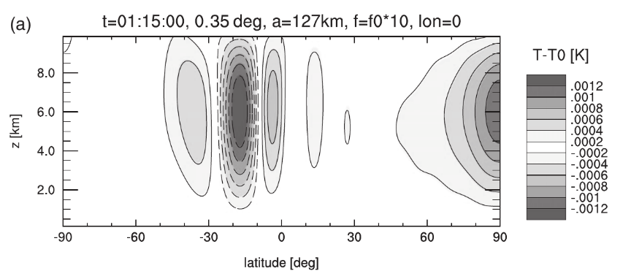
3D Euler equations:
quasi-linear expansion of gravity and sound waves in a spherical shell
Black lines : analytic solution (BRZ2014)
Color shading: BRIDGE / grey shading: ICON
BRIDGE, 4th order, R2B2 L5
ICON R2B6 L40
(A):
f=0
(B):
f=10*f(45°)
→
f / N ~ 0.05
(from Baldauf et al. (2014) QJRMS)
M. Baldauf (DWD)
21

Slide 22
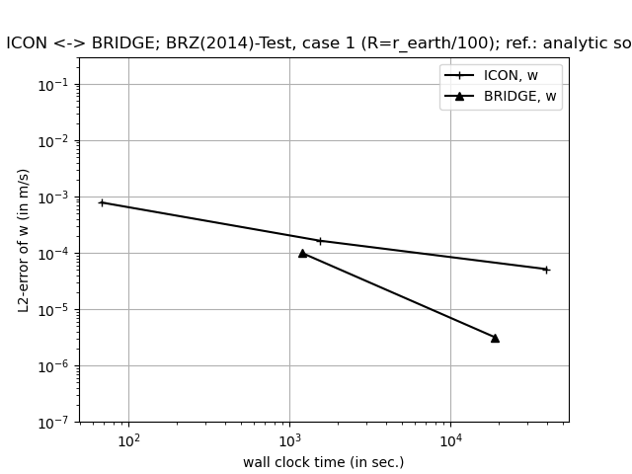
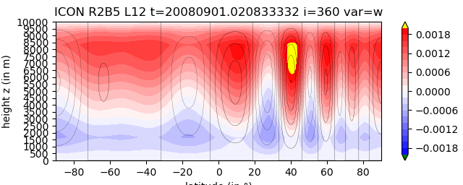
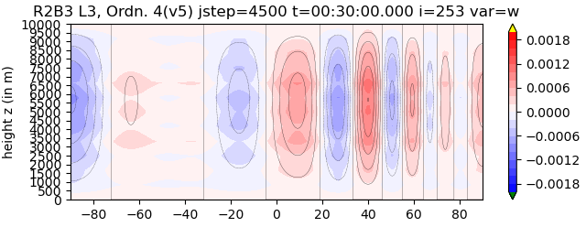
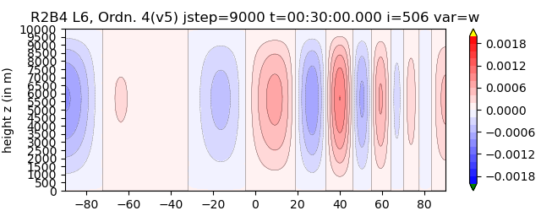
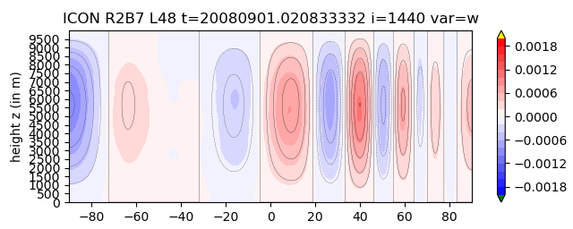
A very first (!), almost (!) fair comparison between ICON and BRIDGE
test case Baldauf, Reinert, Zängl (2014) QJRMS: expansion of sound- and gravity waves in a spherical shell (uses shallow atmosph. approx., U₀=0, f=0).
R= r_{earth} / 100 → almost isotropic grid cells → HEVI- (ICON) and purely expl. time integration (BRIDGE) are comparable!
all simul. on our RCL (ICON: 32, 64, 384 proc. (thanks to D. Reinert!), BRIDGE: 16 proc.)
R2B5L12
R2B3L3
R2B5L12
ICON
R2B6L24
ICON
R2B7L48
BRIDGE
R2B3L3
R2B4L6
R2B7L48
BRIDGE
R2B4L6
M. Baldauf (DWD)
22

Slide 23
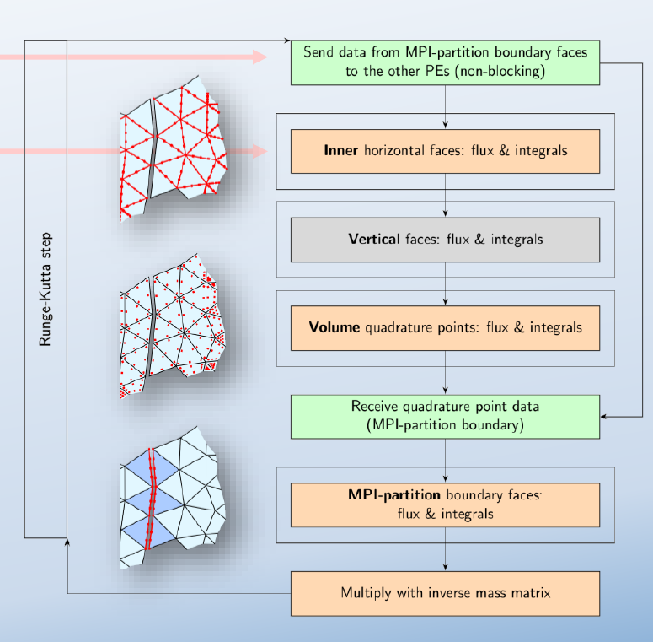
Parallelization in BRIDGE
Goals:
Minimum number of MPI synchronizations
Do as much as possible calculations between a send and a receive
DG allows to achieve these goals!
M. Baldauf, F. Prill (DWD)
23

Slide 24
Diffusion in a DG scheme
It is a basic result of FE schemes that the 2nd order diffusion operator
requires continuous base functions (through the whole domain!).
This seems to be in contradiction to the DG method…
→ several approaches exist in the literature
Bassi, Rebay (1997) [BR1]:
determine (spatial) derivative variables q_{,i} = e_{i} ⋅ grad q = div (e_{i} q)
of the prognostic variables q and treat them by a DG scheme
(for inclusion of metric properties see Baldauf (2021) JCP).
This needs:
implementation of surface- and volume integrals of the above mentioned ‚pseudo-fluxes‘
additional source term integrals,
an externsion of the FE-data structures.
Implementation of test cases described in Baldauf, Brdar (2016) QJRMS
24

Slide 25
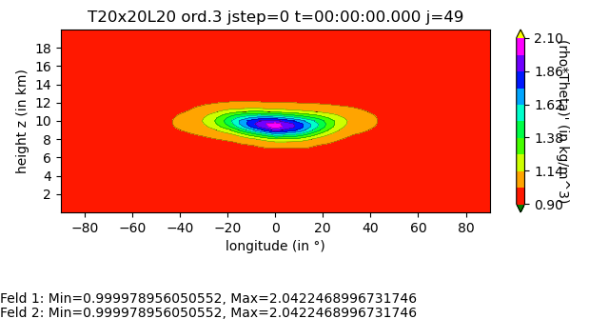
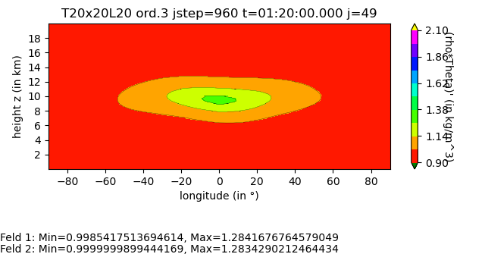
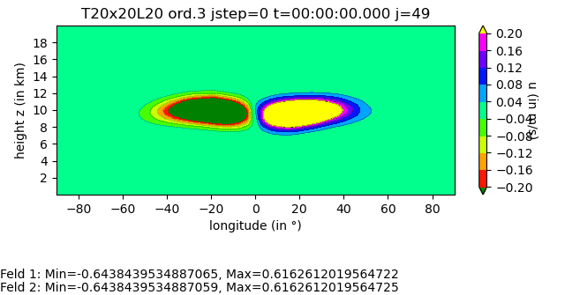
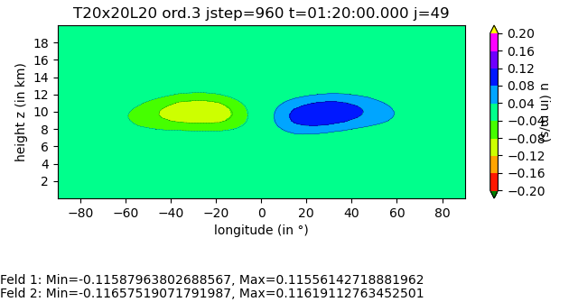
Scalar diffusion over flat plane, with orography (analyt.sol.: black contours):
correct convergence behaviour ☺
Vectorial diffusion over flat plane, with orography
correct convergence behaviour ☺
20.05.2022
25

Slide 26
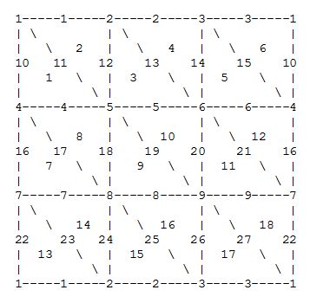
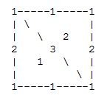
To perform simulations an a flat plane → use a torus grid that needs:
Coordinates (vlat/vlon) of the triange vertices
Edges defined by 2 vertices
Cells defined by 3 edges (right oriented sequence)
Orientation of the normal
→ torus_gridgen.py (only ~300 lines of code)
What is the smallest grid for a square with periodic BCs (=torus-topology)?
No simplicial complex!
Nevertheless is a useful numerical
grid for a FV-scheme.
In particular, allows a single-column model.
This is now used in BRIDGE!
A simplicial complex needs at least 14 triangles
(18 triangles are needed for a more regular grid)
20.05.2022
26

Slide 27
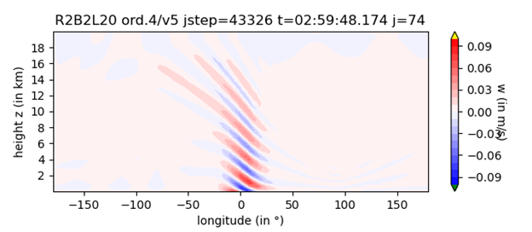
DG-Entwicklung, BRIDGE (mit Florian)
Euler-Gln. mit geländefolgenden Koord. (Rayleigh-damp., Quelltermfilterung, Randbed.) Bsp. Bergüberströmung auf ‚kleinem Planet‘:
→ Meilensteinplan: Euler, explizit ✓

Slide 28
Flow over mountain with the HEVI-solver
Setup : Schär et al. (2002)
Orography:
h₀=10m, b=5km, λ=4km → Fr_{h} =100, Fr_{a} =0.1 … 0.5
u₀=10m/s, N=0.01 1/s, T(z=0)=288K
compare with analytic linear solution: Baldauf, 2008, COSMO-NL
(uses only a few further approximations, e.g. it is a fully compressible solution)
M. Baldauf (DWD)
28

Slide 29
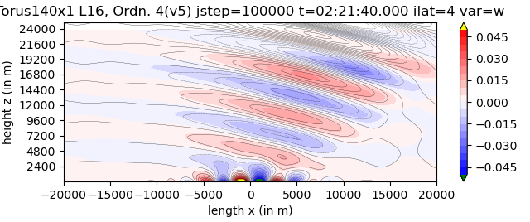
Flow over mountains
setup from Schär et al. (2002), N=0.01 1/s, …, no vertical grid stretching
Colors: BRIDGE, DG 4th order, explicit RK4
Contours: analytic solution (Baldauf (2008) COSM-NL)
Uses a torus grid T140x1 L16 (with only one triangle row)
M. Baldauf (DWD)
29

Slide 30
Horizontally explicit - vertically implicit (HEVI)-scheme with DG
Motivation: get rid of the strong time step restriction by vertical sound wave
expansion in flat grid cells (in particular near the ground)
explicit
implicit
explicit
implicit
The implicit part leads to several block-tridiagonal matrices → here a direct solver is used (expensive!)
Use of IMEX-Runge-Kutta (SDIRK) schemes: SSP3(3,3,2), SSP3(4,3,3) (Pareschi, Russo (2005) JSC)
Baldauf, M. (2021): A horizontally explicit, vertically implicit (HEVI) discontinuous Galerkin scheme for the 2-dim. Euler and Navier-Stokes equations using terrain-following coordinates, J. Comp. Phys. 446
M. Baldauf (DWD)
30

Slide 31
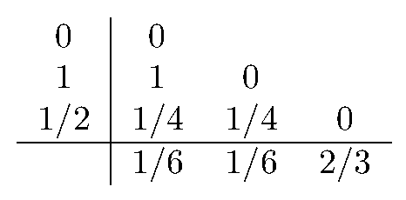
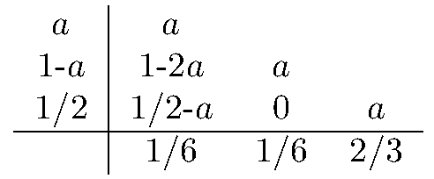
IMEX-Runge-Kutta
RK stages:
+ a final step that combines all tendencies S^{(j)} and F^{(j)} → q^{n+1}
coefficients β are described by double Butcher tableaus e.g. SSP3(3,3,2) by Pareschi, Russo (2005) JSC:
general stability function for the Dahlquist problem is known
general order conditions are known
practically SDIRK schemes are preferred
Lock, Wood, Weller (2014) QJRMS
Pareschi, Russo (2005) JSC: SSP3(3,3,2), SSP3(4,3,3)
Giraldo et al. (2012) Siam JSC: ARK2(2,3,2)
Kang, Giraldo, Bui-Thanh (2020) JCP: IMEX-RK in hybridiz. DG
M. Baldauf (DWD)
31

Slide 32
Milestones of the BRIDGE-project (III) (detailed)
Euler equations, HEVI time integration (IMEX-RK) Q3/2022 (✓)
IMEX-RK schemes and whole time integration sequence
Calculate coefficient matrix elements and rhs (Baldauf, 2021)
Solver for LSE with block-tridiagonal matrices
3.b optimization of the vertically implicit solver (Schur compl.,...) Q4/2022 
3.c with 3D diffusion (+ a simple turbulence scheme), HEVI Q1/2023
M. Baldauf (DWD)
32

Slide 33
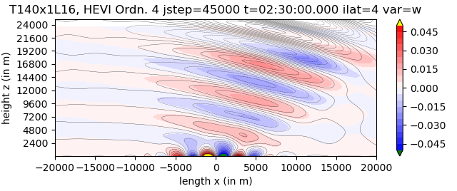
Flow over mountains
setup from Schär et al. (2002), N=0.01 1/s, …, with vertical grid stretching
HEVI-solver, 4th order, SSP3-4-3-3 RK scheme, dx=1km, dt=0.2s
Colors: BRIDGE (1 proc. on rcl, t_wall=21.5h)
Contours: analytic solution (Baldauf (2008) COSMO-NL)
M. Baldauf (DWD)
33
Notes:
Compare: after t_wall=21.5h the explicit solver ‚only‘ simulated until 1h55m…

Slide 34
Current state of the efficiency of the HEVI solver
In a full 3D simulation with DG 4th order, currently 95% of computation time
is spent in the HEVI solver!
Generation of coefficient matrix elements (26%)
LU decomposition (22%)
Solve LSE (23%)
Calculate implicit tendency (24%)
Of course, these numbers must be heavily reduced!
There exist ideas in the literature using the so called ‚Schur complement‘
or ‚static condensation‘, which must be tested…
We currently are in contact with the University of Cologne,
who have experience with such methods.
The block-tridiagonal coefficient matrices contain ~75% zeros and ~25% non-zeros
(i.e. they are not sparsely occupied)
called every 50 time steps
called every RK substep
M. Baldauf (DWD)
34

Slide 35
Milestones of the BRIDGE-project (IV) (detailed)
4. cloud microphysics (Kessler) + tracer advection (positive definit)
+ explicit sedimentation scheme Q4/2022
4.b cloud microphysics (cloud ice, Graupel) + vertically implicit sedimentation scheme Q1/2023
5. limited area version available Q1/2023
5.b vectorized version available Q2/2023
6. coupling of a full fledged turbulence + BL scheme Q2/2023
M. Baldauf (DWD)
35

Slide 36
Milestones of the BRIDGE-project (status Sept. 2022)
0. first version of a FE/DG framework available, MPI parallelized Q2/2021 ✓
1. shallow water equations on the sphere, explicit time integration (RK) Q3/2021 ✓
2. 3D Euler equations on the sphere, explicit time integration (RK) Q1/2022 ✓
2.b with 3D diffusion (+ a simple turbulence scheme) Q2/2022 ✓/
2.c grid refinement works Q2/2022 ✓
3. Euler equations, HEVI time integration (IMEX-RK) Q3/2022 (✓)
3.b optimization of the vertically implicit solver (Schur compl.,...) Q4/2022
3.c with 3D diffusion (+ a simple turbulence scheme), HEVI Q1/2023
4. cloud microphysics (Kessler) + tracer advection (positive definit)
+ explicit sedimentation scheme Q4/2022
4.b cloud microphysics (cloud ice, Graupel) + vertically implicit sedimentation scheme Q1/2023
5. limited area version available Q1/2023
5.b vectorized version available Q2/2023
6. coupling of a full fledged turbulence + BL scheme Q2/2023
During all these stages, additional optimization will take place …
M. Baldauf (DWD)
36

Slide 37
Outlook: building blocks for turbulence parameterizations (I)
Keep in mind: we want to conserve prognostic variables,
therefore, the turbulence parameterization shouldn‘t deliver tendencies, but:
fluxes f ^{(s)} (for explicit time integration)
or a coefficient matrix of the form H^{ss‘} ≡ δf ^{(s)} /δq^{(s‘)} (for implicit time integration)
or a combination of both
note: don‘t bother with the time-integration itself; this takes place in a (hopefully)
stable IMEX-RK scheme.
To calculate these fluxes at a certain (quadrature) point r,
the turbulence model gets derivative variables at r from the dyn. core
(‚x-, y-, z-‘-derivatives of the prognostic variables ρ, M, ϑ=ρθ, q^{(s)}). Use the chain rule of differentiation to derive arbitrary other spatial derivatives
of a variable ϕ = f(ρ, M, ϑ, q^{(s)}).
In this ideal world, a turbulence modeler wouldn‘t need any grid information!
M. Baldauf (DWD)
37

Slide 38
Outlook: building blocks for turbulence parameterizations (II)
Problems to solve:
In ϕ = f(ρ, M, ϑ, q^{(s)}), the function f may contain non-differentiable Heaviside-functions (i.e. ‚if-conditions‘) (?). Replace these by ‚relaxation expressions‘?
How to treat non-local closures? (length scales, smoothing operations, spatial integrations, …)
Planned steps from the ‚DG developers‘ side for the turbulence modelers:
Deliver a Smagorinsky model
Implement a prognostic TKE equation as an example
Deliver diffusion coefficients from this TKE
M. Baldauf (DWD)
38

Slide 39
(Folien von ICCARUS 2022 WG2 meeting)
M. Baldauf (DWD)
39

Slide 40
How to treat orography?
DG scheme needs 1st and 2nd derivatives of orography :
use of a filter function g
consistent relation between h_{f} (x,y), ∂h_{f} /∂x^{i}, ∂²h_{f} /∂x^{i}∂x^{j}
metric terms can be calculated for Gal-Chen coordinate with arbitrary vertical stretching functions
SLEVE coordinate can be used as well (by using two different filter functions)
Klemp (2011) vertical coordinate smoothing would need additional considerations…
M. Baldauf (DWD)
40

Slide 41
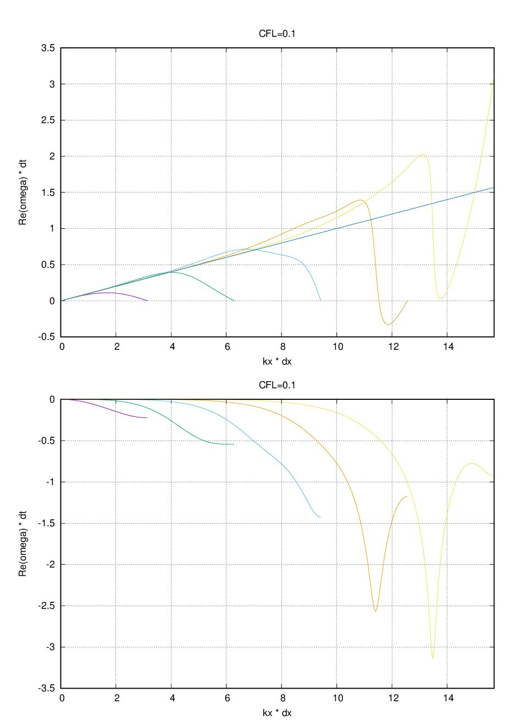
Re ω
Dispersionrelation der
1D-Advektionsgleichung
mit DG n-ter Ordnung (n=1..5)
Im ω
k Δx
12.11.2021
Beitrag von Michael B.

Slide 42
Step 1:
to bring DG on the sphere …
M. Baldauf (DWD)
42

Slide 43
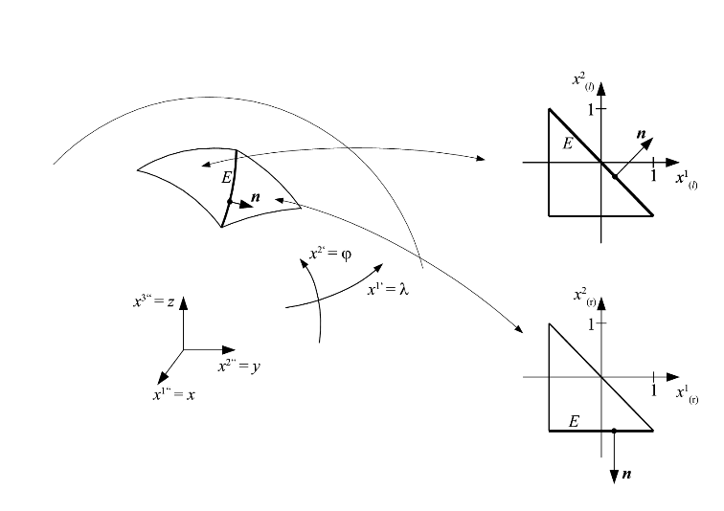
How to construct a higher order numerical scheme on the sphere
annoying: the sphere doesn‘t allow a single coordinate system without singularities ☹
Straightforward approach to avoid this (for any 2D manifold!)
generate a triangulation for an arbitrary set of points on the manifold and by connecting them
by geodetic lines (=great circle arcs on the sphere) → curved triangles
and by straight lines in the embedding Euclidean space → flat triangles → unit triangles
map every unit triangle (with local coordinates x¹, x²) to the related curved triangle; this can be done exactly (and without any ‚holes‘ or overlappings) for the
sphere: by gnomonial projection (e.g. Läuter, Giraldo, … (2008) JCP)
ellipsoid: by gnomonial + affine projection
all geometric properties (g_{ij}, Γ^{i}_{jk}, ...) are treated exactly. → higher order discretizations are straightforward.
In a FV scheme, one only has to transform the fluxes between neighboring unit triangles by
This is simplified by using the covariant form of the equations ...
M. Baldauf (DWD)
43

Slide 44
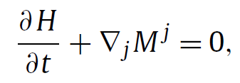
Some basics on manifolds
Shallow-water equations in covariant form, i.e. only tensors occur
→ equations are valid on any 2D manifold (at least from a mathematical viewpoint)
momentum flux tensor:
source vector of momentum:
E_{jl} : 2nd rank Levi-Civita pseudo tensor,
f_{c} : Coriolis parameter (a pseudo scalar field)
express covariant derviative ∇_{j}
by partial derivative and Christoffel symbols
→ accessible to a numerical implementation:
Baldauf, M. (2020): Discontinuous Galerkin solver for the shallow-water equations in covariant form on the sphere and the ellipsoid, J. Comp. Phys. 410
M. Baldauf (DWD)
44

Slide 45
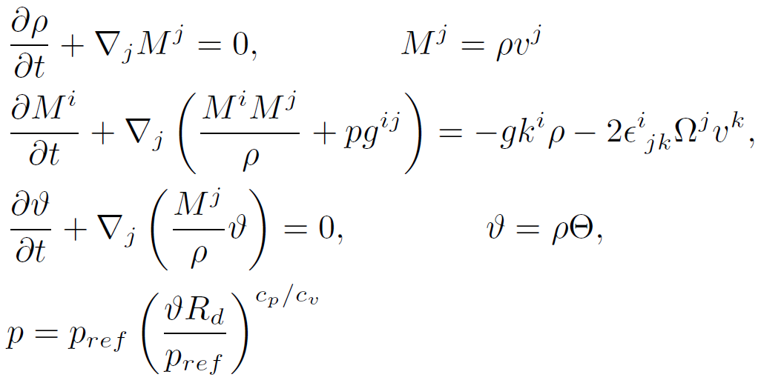
Step 2:
extension for the Euler equations in terrain-following coordinates
and a HEVI time integration
Dry Euler equations:
M. Baldauf (DWD)
45

Slide 46
Extension to the 3D Euler equations on the sphere together with
terrain-following coordinates
Additional metric terms of terrain-following coordinates can destroy numerical local conservation → use strong conservation form of the equations,
i.e. use both base vectors for a smooth (e.g. spherical) coordinate system K‘
and for the terrain-following system K.
example: strong cons. form of the momentum equation:
now: additional metric terms only from the smooth system K‘
momentum flux for Euler eqns.
for diffusion (D^{ik} = deformation tensor), add
Additionally: Continuity eq. (for ρ) and energy equation (for ρθ)
M. Baldauf (DWD)
46

Slide 47
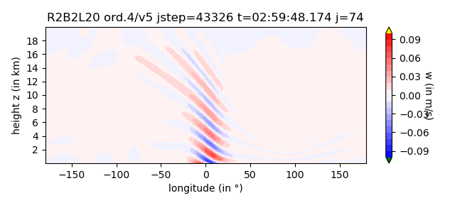
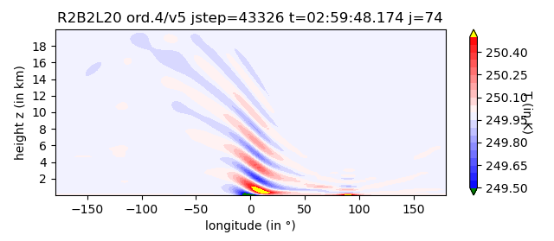
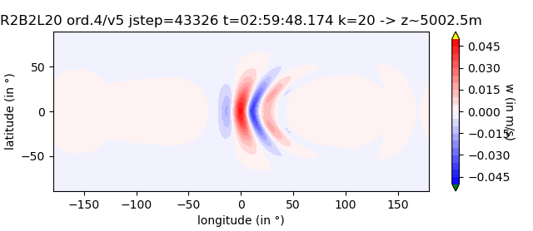
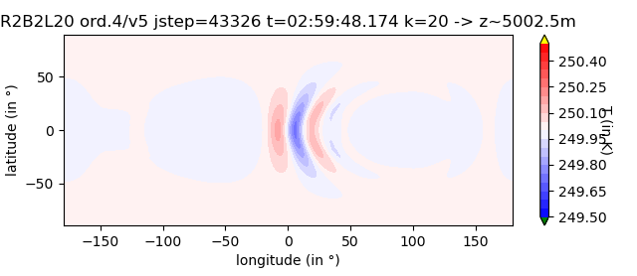
3D Euler: flow over mountain on a small planet
R=R_{earth}/100, f=0, solid body rot. wind field, T_{env}=250K
circularly shaped mountain at 0°N 0°E, width~10°, H=100m
R2B2L20 grid, ord. 4 horizontally/ ord. 5 vertically, source term filter
M. Baldauf (DWD)
47

Slide 48
Summary for the DG development
Basic questions are solved for Euler equations in 2D
DG on the sphere using local coordinates Baldauf, M. (2020): Discontinuous Galerkin solver for the shallow-water equations in covariant form on the sphere and the ellipsoid, J. Comp. Phys. 410
HEVI-DG with terrain-following coordinates and with 3D diffusion Baldauf, M. (2021): A horizontally explicit, vertically implicit (HEVI) Discontinuous Galerkin scheme for the 2-dim. Euler and Navier-Stokes equations using terrain-following coordinates, J. Comp. Phys. 446
With respect to the pure dynamical core (=solver for the Euler equations), no show–stopper occured until now. However, total efficiency is still an issue! In particular the vertically implicit solver is still too expensive.
All further work is done in the BRIDGE project, which is well on the way …
Explicit solver for shallow water and 3D Euler eqns. on the sphere works.
Further questions must be solved for coupling with parameterizations
Started a collaboration with Univ. Cologne (group Prof. Gassner)
M. Baldauf (DWD)
48

Slide 49
Thank you very much for your attention!
M. Baldauf (DWD)
49

Slide 50
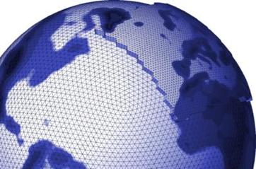
ICON (ICOsahedral Nonhydrostatic)
Properties of the dynamical core of ICON
uses non-hydrostatic, compressible Euler eqns.
exactly mass- and tracer mass-conserving.
It is a true 2nd order scheme (as long as parameterizations are switched off).
stable in very steep mountainous regions.
useable both for global and regional applications.
computationally very efficient and scales well on current parallel comp.
(Zängl et al. (2015) QJRMS, Zängl (2012) MWR)
Some numerical details:
staggering: horizontally: triangle C-grid, vertically: Lorenz-grid
mixed finite-volume / finite-difference
predictor-corrector time-integration
several damping mechanisms are used (divergence damping (2D and quasi-3D), off-centering in the vertically implicit solver, artificial horizontal diffusion…)
M. Baldauf (DWD)
50

Slide 51
A sketch ot the Discontinuous Galerkin discretization
multiply eqns. with a test fct. and integrate over one grid cell Ω → weak form
express fields in Ω as a linear combination of base functions. Here: use a nodal base (with interpolation points = quadrature points)
to couple solutions between grid cells use a numerical flux. Here: local Lax-Friedrichs flux
with Transformation of fluxes between cells is cheap due to high cache efficiency (remark: local conservation holds, when transformation matrices are inverse)
Integrals: Gaussian quadrature on the triangle by Williams et al (2014) JCAM. Integration is inexact, due to not enough quadrature points for higher order nodal bases and the additional factor √g (non-affine transformation). Nevertheless, convergence order is correct
Explicit Runge-Kutta time integration
M. Baldauf (DWD)
51

Slide 52
HEVI-solver works on terrain-following coordinates …
Boundary conditions
… are set by
reflection conditions q⁻ = -q⁺ → for a BC q=0
or mirror conditions q⁻ = q⁺ → no BC for q
In the implicit solver, these BCs arise in a weak form, too
(i.e. in boundary integrals).
M. Baldauf (DWD)
52

Slide 53
IMEX-Runge-Kutta
general stability function for the Dahlquist problem is known
general order conditions are known
described by double Butcher tableaus e.g. SSP3(3,3,2) by Pareschi, Russo (2005) JSC:
practically SDIRK schemes are preferred
Lock, Wood, Weller (2014) QJRMS
Pareschi, Russo (2005) JSC: SSP3(3,3,2), SSP3(4,3,3)
Giraldo et al. (2012) Siam JSC: ARK2(2,3,2)
Kang, Giraldo, Bui-Thanh (2020) JCP: IMEX-RK in hybridiz. DG
M. Baldauf (DWD)
53

Slide 54
2D linear advection equation – DG-HEVI
maximum Courant numbers: for a modal basis with Legendre polynomials of degree p (i.e. convergence order p+1)
RK-IMEX scheme | time order | p=0 | p=1 | p=2 | p=3
RK1-IMEX | 1 | 1.0 | 0 | 0 | 0
Trap2 | 2 | 1.0 | 0.198 | 0.081
SSP3(3,3,2) | 2 | 1.25 | 0.378 | 0.199
ARK2(2,3,2) | 2 |  | 0.219 | 0.110
SSP3(4,3,3) | 3 |  | 0.256 | 0.131 | 0.079
more specific: U₀^{slow}=1, V₀^{slow}=0, U₀^{fast}=0, V₀^{fast}=10, dx=dy=1
Compare: explicit DG p=3 /4th order RK: CFL=0.136
M. Baldauf (DWD)
54

Slide 55
General treatment of diffusion in DG
Simple replacement of a flux f(q) by f(q, ∂q/∂x), where ∂q/∂x is directly
calculated from q, does not work.
Instead (Bassi, Rebay, 1997, and similar for ‚local DG‘):
define a new variable d = ∂q/∂x
treat q as a flux and apply the DG formalism to this equation, too.
Replace f(q) → f(q) + f_{diffus}(q,d) Remark: the numerical flux for f_{diffus} does not need additional numerical diffusion.
3D-diffusion in terrain-following coordinates
New developments:
In terrain-following coord. there are several choices for d possible. here: covariant derivatives of the prognostic variables
If diffusion is treated vertically implicit (i.e. HEVI), too → extension of the band diagonal matrix necessary
Currently: ‚HEVI-diffusion‘ is done in every sound time-step → expensive! Appropriate time-integration necessary.
M. Baldauf (DWD)
55

Slide 56
How to treat orography?
DG scheme needs 1st and 2nd derivatives of orography :
use of a filter function g
consistent relation between h_{f} (x,y), ∂h_{f} /∂x^{i}, ∂²h_{f} /∂x^{i}∂x^{j}
metric terms can be calculated for Gal-Chen coordinate with arbitrary vertical stretching functions
SLEVE coordinate can be used as well (by using two different filter functions)
Klemp (2011) vertical coordinate smoothing would need additional considerations…
M. Baldauf (DWD)
56

Slide 57
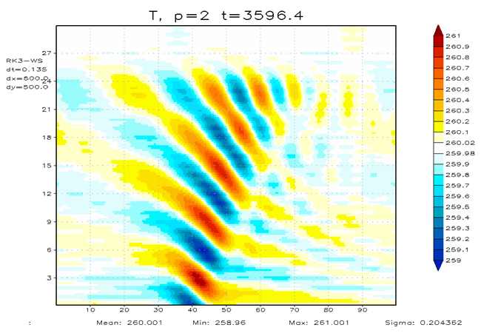
A problem with the Euler equations …
Approximate hydrostatic balance
pressure gradient (→flux div.) ≅ buoyancy term (→ source term)
is crucial for the Euler equations in the atmosphere.
However, the source term integral
contains base polynomials themselves,
whereas the flux div. term integral uses derivatives of base polynomials:
→ no proper balance possible.
… and its solution:
Blaise et al. (2016) IJNMF, Orgis et al. (2017) JCP: use vertically a reduced base (one polynomial degree less in a modal base) for the calculation of the source term.
This leads to an additional filtering procedure in the implicit solver.
M. Baldauf (DWD)
57

Slide 58
Horizontally explicit - vertically implicit (HEVI)-scheme with DG
Motivation: get rid of the strong time step restriction by vertical sound wave
expansion in flat grid cells (in particular near the ground)
explicit
implicit
explicit
implicit
The implicit part leads to several block-tridiagonal matrices → here a direct solver is used (expensive!)
Use of IMEX-Runge-Kutta (SDIRK) schemes: SSP3(3,3,2), SSP3(4,3,3) (Pareschi, Russo (2005) JSC)
References:
Giraldo et al. (2010) SIAM JSC: propose a HEVI semi-implicit scheme
Bao, Klöfkorn, Nair (2015) MWR: use of an iterative solver for HEVI-DG
Blaise et al. (2016) IJNMF: use of IMEX-RK schemes in HEVI-DG
Abdi et al. (2019) IJHighPerfCompAppl: use of multi-step or multi-stage IMEX for HEVI-DG
M. Baldauf (DWD)
58

Slide 59
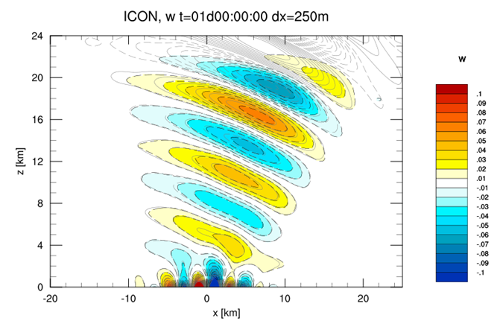
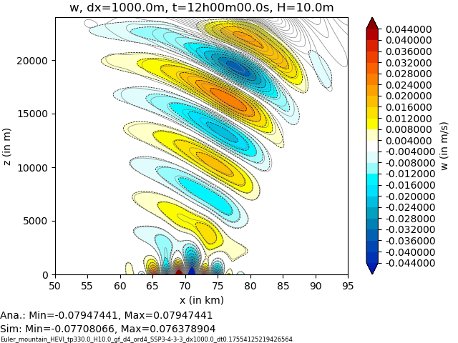
Linear flow over mountains with the HEVI-solver (2D toy model)
Δx=250m
Δz=150m
HEVI-DG 4th order
Δx=1000m
Δz= 600m
ICON
H=25m
colors and black dotted lines: model
grey lines: analytic solution (Baldauf, 2008, COSMO-Newsl.)
M. Baldauf (DWD)
59

Slide 60
Linear flow over mountains with the HEVI-solver (2D toy model)
Δx=250m
Δz=150m
HEVI-DG 4th order
Δx=1000m
Δz= 600m
ICON
H=25m
colors and black dotted lines: model
grey lines: analytic solution (Baldauf, 2008, COSMO-Newsl.)
Computing time on 160 processors
(Cray XC40 Broadwell)
for t_{total}=24h, 26min
→on 1 processor: 69h
Computing time on 1 processor:
(Intel(R) Core(TM) i7-4790 CPU @ 3.60GHz)
for t_{total}=24h, 4th order DG: 160h
But don‘t take the computing
times too serious!
M. Baldauf (DWD)
60

Slide 61
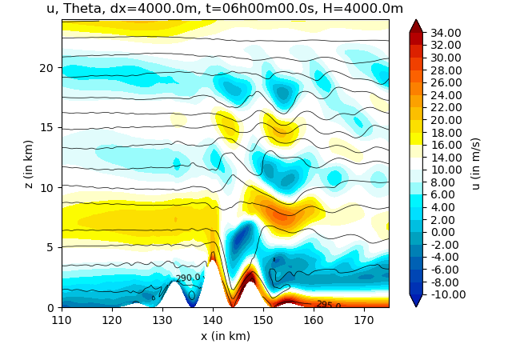
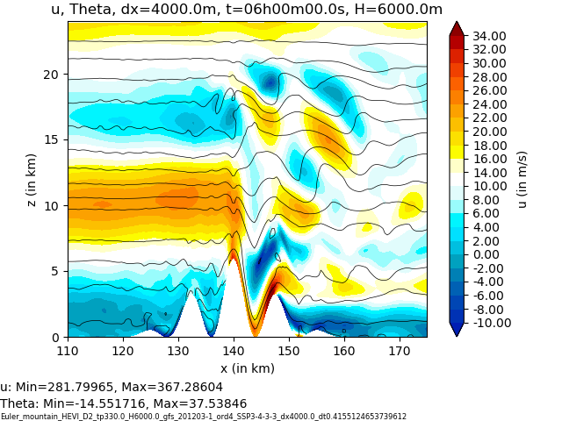
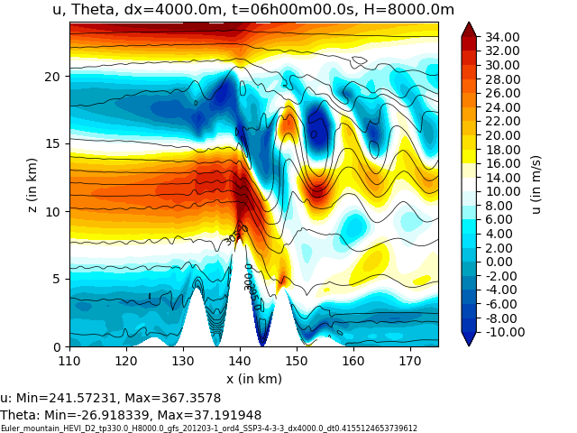
Flow over mountains with steep slopes and vertical grid stretching
Schaer et al. (2002) MWR, test case 5b: U₀=10m/s, N=0.01 1/s, but a=10km
H_{oro}= 4000m,
α_{max} = 58°
H_{oro}= 6000m,
α_{max} = 67°
H_{oro}= 8000m,
α_{max} = 72°
Δx=4 km; vertical grid stretching: Δz_{min}~46m, Δz_{max}~736m, z_{lowest QP}~10.3m
HEVI-DG simulation (4th order) remains stable even for steeper slopes!
to avoid instability by strong gravity wave breaking, vertically implicit ‚3D‘ Smagorinsky diffusion was used
M. Baldauf (DWD)
61

Slide 62
Additionally done
Method for a consistent use of real orography data (→ EXTPAR)
Treatment of diffusion in a HEVI-DG scheme with terrain-following coordinates (local DG by the Bassi, Rebay (1997) JCP approach)
Efficiency improvement of the implicit solver (perform expensive LU-decomposition only after several dozen time steps)
Formulation of boundary conditions for higher order schemes
Baldauf, M. (2021): A horizontally explicit, vertically implicit (HEVI) discontinuous Galerkin scheme for the 2-dim. Euler and Navier-Stokes equations using terrain-following coordinates, J. Comp. Phys. 446
M. Baldauf (DWD)
62

Slide 63
Difficulties in finding a Schur complement in the vertically implicit solver
In the ICON or COSMO dynamical core, an equation for only one variable w is vertically solved ←→ linear algebra analogon:
Schur complement: linear system of equations (LSE) Mx=b with a matrix
M = A B solve instead: one LSE with S = D- CA⁻¹B
C D and one LSE with A
→ efficiency gain, if A is large and can easily be inverted.
M. Baldauf (DWD)
63

Slide 64
Difficulties in finding a Schur complement in the verticall< implicit solver
In the ICON or COSMO dynamical core, an equation for only one variable w is vertically solved ←→ linear algebra analogon:
Schur complement: linear system of equations (LSE) Mx=b with a matrix
M = A B solve instead: one LSE with S = D- CA⁻¹B
C D and one LSE with A
→ efficiency gain, if A is large and can easily be inverted.
Structure of Euler equations:
In ICON / COSMO: A is diagonal!
In DG, the numerical diffusion in LF-flux
couples vertical grid points →
→ A is block-tridiagonal
→ A⁻¹ is a full matrix ☹ → S is a full matrix → no efficiency gain
ρu
ρv
ρw
ρ
ρθ
A
= rhs.
M. Baldauf (DWD)
64

Slide 65
What makes DG methods expensive (summary)
Higher number of degrees of freedom (DOF):
quadrature points inside the cell and additionally on the edges (some nodal DG methods avoid additional edge points for the price of accuracy)
Diffusion (or generally higher order derivatives) by Bassi, Rebay- or local DG-procedure needs treatment of derivative variables analogous to prognostic variables → again increases number of DOFs.
HEVI scheme needs solution of band diagonal matrices with relatively many off-diagonal bands: currently takes about 60% of the whole calculation
Small Δt
CFL numbers are smaller than one would expect; in particular for IMEX-RK ICON has CFL=0.6; for 4th order DG one would expect CFL~0.15, but SSP3(4,3,3) → 0.079
Δt is not only determined by c_{snd} but by c_{snd} + |v_{max}|
→ All these expenses must be outperformed by: higher convergence order, better computational intensity, and better parallelization!
M. Baldauf (DWD)
65

Slide 66
The BRIDGE project (Basic Research for ICON with DG Extension)
started ~mid 2020
currently: F. Prill, M. Baldauf / joining later: D. Reinert, U. Schättler, S. Borchert, …
Goals:
develop a prototype for a DG implementation of the 3D Euler equations (‚DG-HEVI on the sphere‘)
together with a minimal set of physical parameterizations
using ICON infrastructure (parallelisation, I/O, ...)
more object-orientation and use of standard software (e.g. YAC coupler, ...)
as an intermediate step to a full–fledged ICON implementation
Milestones:
Shallow-water equations on the sphere ready in Q3/2021
3D explicit Euler solver ready in Q4/2021
3D HEVI Euler solver ready in Q1/2022 → decision about prolongation of the project
Implementation into ICON (start ~2024)
choose optimal approx. order (currently I favor: p_{horiz} =4, p_{vert} =4, p_{time} =3) and grid spacing
Operationally useable version ready ~2028
M. Baldauf (DWD)
66

Slide 67
F. Prill (DWD)
BRIDGE is not just a 3D extension of the 2D toy model but allows much more flexibility and efficiency increase by
2D×1D tensor product representations of quadratures and finite elements; and consequent use of matrix-vector operations
Option to use different FE for different progn. variables (e.g. for tracer var.) → use an indexing operator and for different grid points → use of an ‚iterator over cells‘ concept
Additional MPI-parallelization
Optional use of non-conformal grids (i.e. hanging nodes are allowed)
Consequent use of existing ICON infrastructure code: triangular grid, nproma blocking, patch, mtime, …
Consequent use of standard software tools: YAC coupler (DKRZ/MPI-M), YAXT communication (DKRZ), …
However, BRIDGE is not yet ICON (no restart, no local parent grid, …)
M. Baldauf (DWD)
67

Slide 68
Urgent ToDo‘s:
Further optimizations of the vertical implicit solver (e.g. can one find a Schur complement form?)
Coupling of tracer advection (mass-consistency?)
Sedimentation by an implicit, positive-definite tracer advection scheme
Develop coupling ideas for parameterizations (time-integration, preserve pos. def., …) including adaptations of first param. (turbulence, microphys.)
Further design decisions: nodal v. modal, local DG vs. interior penalty vs. …, allow non-conformal grids?, efficient data layout, …
Real case applications probably need further stabilization mechanisms (filtering, entropy stable/conserving schemes, …)
For many of these questions there exist a large amount of literature; and we
probably don‘t have to do this alone, since there is a great interest in academia
in similar questions.
M. Baldauf (DWD)
68

Slide 69
DG and Parameterisations
General principle: spatial transport (advection, sedimentation, diffusion, …) must be treated in the DG-scheme!
Otherwise we loose local conservation.
Box-models (e.g. cloud physics, chemistry/aerosol-packages):
are evaluated and deliver tendencies in every quadrature point → at the first place no adaptations necessary!
Nevertheless, the ‚classical‘ physics/dynamics-coupling questions remain: overall time integration scheme? how to achieve positive definiteness?
Turbulence:
Remark: diffusion needs special treatment in DG (local DG, compact DG, …)
Advantage of local DG: derivatives of fields are directly available for turbulence modeling!
Analogous: convection param., gravity wave param., …
M. Baldauf (DWD)
69

Slide 70
DG and physics perturbations in ensembles
Some recommendations …
… to keep conservation properties of the DG scheme:
in the transport terms, only (physical) fluxes should be perturbed.
in the source terms: e.g. moisture var., perturb in a way that ρ_{dry} + ρ_{v} + ρ_{r} + ... + ρ_{g} is unchanged (while keeping positive def.)
DG and data assimilation
At least adaptations in the forward operators necessary:
by the modified output grid; better say: to the position of the I/O-grid points (these are probably the quadrature points in the triangle grid)
different prognostic variables (conserved var.)
M. Baldauf (DWD)
70

