Slide 1
Status and plans of the C-SRNWP module of EUMETNET
Balázs Szintai
C-SRNWP Manager
… with contributions form many of you
COSMO General Meeting
Athens / online
15 September 2022

Slide 2
Outline
News from EUMETNET
Coordination SRNWP
Obs-SET
Global Lake Database
Physiography task
EMS Annual Meeting

Slide 3
EUMETNET Strategy and next phase
Previously existing strategies:
Strategy for EUMETNET 2016 – 2025, adopted in Spring 2017
2021 – 2025 European NMHSs Strategy, adopted in Spring 2021
Accepted in May 2022 by EUMETNET Assembly:
2022 – 2028 EUMETNET Strategic guidelines (4 major goals, 32 strategic objectives)
Current EUMETNET phase ends in 2023, next EUMETNET phase will cover 2024-2028
Preparation for the next EUMETNET phase started this summer
C-SRNWP: fast track module → requirements drafted in June 2022, to be accepted by Assembly in autumn 2022 (similar requirements and resources than in current phase)

Slide 4
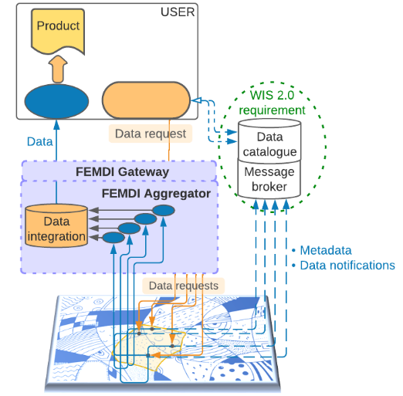
FDCM programme scope
FDCM Programme
FEMDI Implementation activity
March 2023: New Programme?
FEMDI
Federated capabilities
FEMDI architecture:
Community capabilities
Design
Local capabilities
Identify and curate
Agreements, policies
and technical standards
Slide provided by: Jane Wardle
Notes:
The FDCM Programme is establishing the agreements, standards and policies which are needed for EUMETNET Members to be able to share their data and products in a federated manner. These will form what is known as the Federated European Meteo-hydrological Data Infrastructure (FEMDI).
The implementation of FEMDI, such as the development of FEMDI community capabilities and individual NMHS infrastructure development, is outside the scope of the FDCM Programme. As the FDCM Programme is a Define and Design programme, additional details and items may be added as the Programme progresses.
---
Additional info:
FEMDI is a collection of federated capabilities, e.g. a data catalogue, which are managed and delivered by the community members to enable data sharing.
There will be Local capabilities: Specific to an NMHS, developed and managed by the participant to enable sharing of data.
Community managed capabilities, e.g. processing data on behalf of the community
-----
This collection of interoperable implementations will comply with a unified set of agreements, policies and technical standards
FEMDI will:
enable data sharing through implementation of federated capabilities.
consume capabilities implemented and managed by its members both locally and on behalf of the community.
There will be local and community managed capabilities
Local capabilities: Specific to an NMHS, developed and managed by the participant to enable sharing of data. In this instance the capability may be hosted on shared infrastructure but managed on a local level. e.g. an NMHS may store and host data on the EWC to enable data sharing but responsibility to develop and manage that capability is local
Community managed capabilities: Those consumable by all participants but potentially managed locally by a participating member. E.g. an NMHS may manage an instance of a service like a container to store and process data on the EWC on behalf of the community.
FEMDI membership depends on the conformance to the soft infrastructure agreements and policies.
FEMDI is not a single and centrally managed IT solution for data sharing,
FEMDI is a collection of federated capabilities managed and delivered by the community members to enable data sharing.
FEMDI will not provide a centralised singularly managed data store. Storage will likely be needed for some community managed components such as interim data products.

Slide 5
FEMDI: Data access options Option 3 selected as preferred option at 3rd Directors Workshop
FEMDI
Federated European Meteo-hydrological Data Infrastructure
Data consumer experience
Send one data request; Receive one response with data from lots of Members.
Less time and resources needed.
Data provider experience
Ability for others, including AI, to request and use our data is as easy as possible, increasing reach and reputation
Lower costs through pooling resources, sharing development, and cheaper build cost due to use of widely supported standards
BUT: This is a complex solution, which will require significant resources and take many years to deliver.
Slide provided by: Jane Wardle
Notes:
The ‘what’ is FEMDI
Latest information on what the Directors’ preferred during the FDCM 3rd workshop (8th and 9th Mach 2022)
Data consumer experience Less time and resources needed as:
Able to see all the available data and metadata in one place
Told when new data is available
No data integration needed
Single user agreement; Only register once at a Gateway
Uniform way of interacting
Data provider experience
Able to share data with any authorised user, including AI
Lower costs through pooling resources, sharing development, and cheaper build cost due to use of widely supported standards
NMHSs appear under common brand, e.g. EUMETNET
Information available on who the users are, and what they are requesting
FEMDI Gateway manages:
Security and compliance needs
How NMHS data is found and seen
In line with E-SOH solution
---
The diagrams are deliberately non-technical – the intent was to characterise data sharing approaches in a way that helps us to see the different business approaches that may be adopted.
… And when I mean “business”, I don’t mean commercial. I mean how we choose to operate – both as individual NMHSs and as a community.
We’ve assumed WIS2 as a pre-requisite for each of the options – providing a shared catalogue and a common message broker to support data sharing within and external to our community. The catalogue will enable Data Consumers to find search and browse in one place through all our collective data offerings to find what they need. The common message broker provides a place where Data Consumers can subscribe to updates about all datasets; for example, the availability of new observation data or new model run output. I’m happy to talk more about how WIS2 will operate – please let me know if you have any questions. I’m happy to follow up after the workshop if we run out of time here.
3 options are presented. But it’s not necessarily a “one size fits all” approach. Each “theme” of data may warrant a different option.
In the breakout session coming up, we’re going to ask you to select the data access options you think are appropriate for each of the HVD data types:
Observations – which for HVD, we think is limited to land-surface observations;
Radar;
NWP data, or simulation data;
Warnings; and
Climate data – validated observations, and digitised historical data.
Throw in a few more data themes, such as climate predictions, marine surface observations, remote sensing, and upper air observations
… and you can see we have a pretty heterogeneous collection of data themes, each of which may need different approaches.
The important thing is to consider the cost vs. benefit of each option for a given type type of data.
The E-SOH case study I presented yesterday showed how these non-technical diagrams can be mapped to a real system (or systems). Hopefully that helped you get a better understanding of things.
…
Let’s start by looking at the current state: DATA SHARING – NOW
The Data Consumer has to grapple with multiple ad-hoc mechanisms to find data as there is no common catalogue to browse
They likely have to establish bi-lateral agreement with each Data Provider.
Each data request may have a differing protocol and/or data format, meaning that the Data Consumer has to manage the complexity lots of different data access mechanisms.
The data returned by each Data Provider may be in different formats, be organised in different ways, or use different terms to describe its semantics.
All this means that the Data Consumer has a complex task of integrating all the data together into a useable collection from which they can generate their products.
Next – Option 1: “Federated Discovery and Access”
The Data Consumer can browse or search the Catalogue to find the data they need.
The Catalogue provides enough “discovery metadata” for the Data Consumer to decide if the dataset is worthy of closer inspection – and provides actionable links to where the data or more detailed information can be accessed.
Data Providers have designed their services to meet WIS2 requirements. So when new data is available, their data services publish messages to that effect. The Data Consumer can subscribe to messages from all data services from the WIS2 message broker.
The data services themselves offer common interfaces, or APIs, for Data Consumers to access the data. So each request from a Data Consumer to a different data service is the same “shape” – the same format and protocol.
The data is returned in a common format too – which makes live simpler for the Data Consumer to integrate all the necessary data for input into their products.
Data Providers can pool their resources to build software systems for data sharing – because they work the same way; and comply with the same standards. Better still, they can use off-the-shelf software from vendors or open source projects because they’re using widely adopted standards.
But the Data Consumer still needs to make multiple requests to get data if it provided by more than one Data Provider.
Each Data Provide may have different user registration and authentication mechanisms – meaning that Data Consumers may need to handle multiple sets of credentials to access the services they need.
Finally, its more challenging to get a good understanding of how data is being used because each service is operating independently – there is no coordination point where these metrics can be gathered. Metrics would need to be scraped from every Data Provier.
So – a massive improvement over the current situation. But still with a few challenges.
…
Option 2 “Federated with Unified Access”.
In this option, the Data Consumer still needs to make multiple requests if they need data from multiple Data Providers.
But it addresses some of the challenges by adding a “gateway” that provides a common set of controls for how Data Consumers can access data services.
What we’ve identified as the “FEMDI Gateway” would provide unified user management with a single “login” for all data services and a single set of credentials for the Data Consumer to manage. Based on these credentials, the FEMDI Gateway would implement access control, enforce data policies, security and compliance for all FEMDI data services. For example, by providing rate limiting, or quota-based access.
Because the FEMDI Gateway provides a common entry point, all the data services would appear to be provided from one domain – for example, eumetnet.int … obviously we’d need to agree what that should be! The Gateway would receive requests from a Data Consumer, validate the necessary controls, and if permitted pass the request onto the Data Provider’s service end-point for fulfilment. The Gateway also updates the responses to make sure everything looks like it originates from the common European domain.
Because these controls don’t affect the way each data service behaves, it is simple to put the Gateway in front of all services.
And – the Gateway is something can be procured as a service; for example, the cloud-based “Software-as-a-Service” (or SaaS) API-Management Gateway from Microsoft Azure. This means that there’s no build or deployment effort – only configuration. And it will scale as demand changes.
Members would still be able to offer their services directly – from their own domains (e.g. meteo.fr or meteofrance.com). But their data would also be available from a common European domain. The same data service end-point could be used to support both. Alternatively, Members might simply choose to use the European domain from which to publish their data, and benefit from all the functions provided by the FEMDI Gateway.
It’s also worth noting that Option 2 might be cheaper than Option 1. Consider that all the publicly accessible data services offered by each Data Provider should have an API-Management capability to protect them. It’s only in this way to guarantee their availability against some level of service commitment – which is what you need if your data is going to be used for impactful decision making. Instead of every Data Provider buying their own solution, we could share the costs across the community.
But – the Data Consumer still needs to make multiple requests and integrate data from multiple responses themselves.
…
Option 3 “Federated with Aggregation” does this for the Data Consumer – providing a so-called “one-stop-shop” where they can make a request for data. FEMDI will work out which Data Providers have the data needed to fulfil that request, it will issue multiple requests on behalf of the Data Consumer and combine all the responses together into one merged or blended answer.
This is clearly much simpler for the Data Consumer, but it’s complex for FEMDI. We use the term “aggregation” to describe this process of gathering the data from source systems and creation of a composite. E-SOH proposes aggregation for sub-hourly observations – perhaps offering a bounding box query that returns all the data from that geographical area. While simple, even this isn’t trivial. We still need to consider issues like quality control, instrument characteristics, observing intervals and frequency. EMMA, to some extent, also adopts the Option 3 approach: it defines a common “contract” for NHMSs to provide warnings, which are then made available to the community from the meteoalarm hub.
Both E-SOH and EMMA rely on “community infrastructure” for their aggregation – with all the costs associated with that.
For data themes such as NWP, what does aggregation mean? Are we considering dynamically generating a blended model output? But how do we do that in a way that meets the needs of the Data Consumer? How do we decide what’s best for them when we aggregate data? Can we predict what data is needed and how it should be combined? Or do we need some kind of AI tool that can interpret the Data Consumer’s request and determine how to respond? At which point I feel like I’m into the realms of “magic happens here”
Stuart will give us some more food for thought about aggregation in his presentation up next.
…
Finally, some thoughts on the how the three options may relate to each other.
Options 1, 2 and 3 are necessarily exclusive – that, for example, we need to aim for Option 2 for a given data theme. Instead consider the options as “transitional states”. We can build from Option 1 to Option 2, and from Option 2 to Option 3. We can keep developing the data access options as far as we see they’re providing value for our community. Data Access could be an evolutionary journey with FEMDI.
There might also be some “middle ways” that sit between two Options. For example, in an “Option 2+” we might be able to provide tools (e.g., software libraries, container images) for Data Consumers to do the aggregation themselves – possibly in the cloud, definitely configured and tuned to their specific needs.

Slide 6
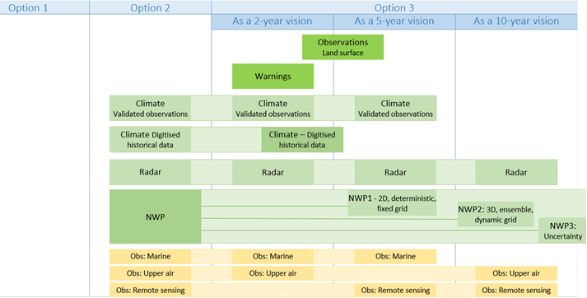
FEMDI prioritised scope (data)
- the One stop shop
Slide provided by: Jane Wardle
Notes:
3rd FDCM Director-led workshop, March 2022: Directors gave their preferred data access option – and, for Option 3, how long it might be until those data were delivered in this way]
Many of the data types, particularly NWP, had a spread of opinion. More discussion will be needed on these.
But we saw a clear signal to prioritise Warnings and Land-surface Observations

Slide 7
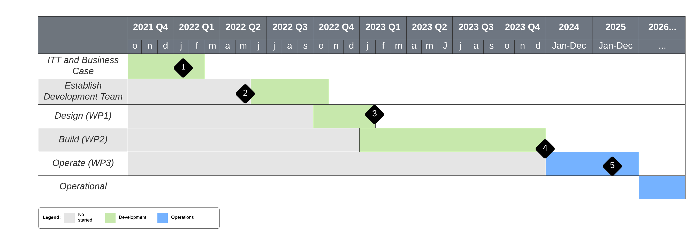
EUMETNET Supplementary Observations dataHub
Assessment period underway now
Bid Team
Met Norway, FMI, KNMI, DWD
First Phase (Sub-hourly surface observations)
Operational from January 2024
Slide provided by: Jacqueline Sugier
Notes:
Bid being prepared by Met Norway
FMI to lead WP1
Met Norway lead WP2
DWD lead WP3
KNMI part of the bidding team
EWC also offering infrastructure to host part of E-SOH

Slide 8
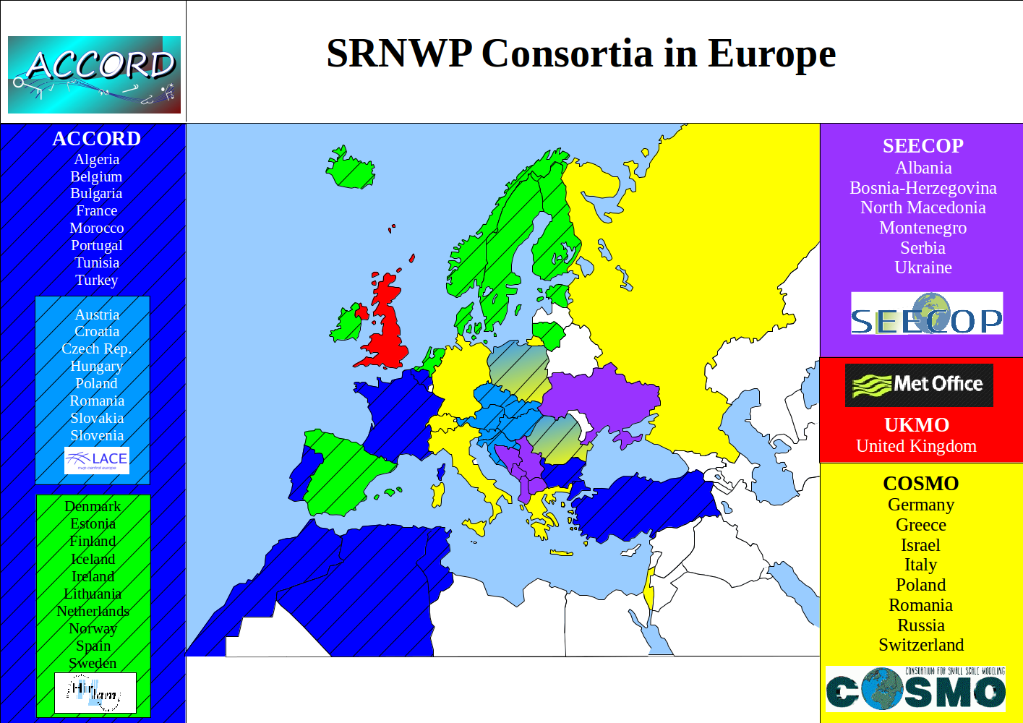
C-SRNWP Module of EUMETNET
Coordination of Short Range Numerical Weather Prediction in Europe
In the NWP Cooperation Programme
28 Member States, 2 Cooperating States
New Members: Germany, Ireland
Module Manager: 0.3 FTE
Coordinating Member: Hungary

Slide 9
C-SRNWP Expert Teams
To foster communication between Limited Area NWP groups in Europe
8 C-SRNWP Topical Expert Teams (ETs)
Data Assimilation (chair: Bruce Macpherson)
Diagnostics and verification (chair: Marion Mittermaier)
Dynamics and lateral boundary coupling
Link with applications (chair: Jeanette Onvlee)
Physical parameterisation (upper air) (chair: Mike Bush)
Predictability and EPS (chair: Chiara Marsigli)
Surface and soil processes (chair: Patrick Samuelsson)
System aspects
Advisory Expert Team (AET):
Heads of NWP consortia
C-SRNWP Topical ET Chairs
Observers: FCAM, Post-processing MM, SRNWP-EPS MM
Core Members
Additional Members

Slide 10
EWGLAM Meeting 2022
26-29 September 2022, Brussels, Belgium (hybrid)
Special subject this year: Opportunities and challenges in hectometric NWP
Special session about the future of HPC → HPC vendors and lead experts of big supercomputing centres

Slide 11
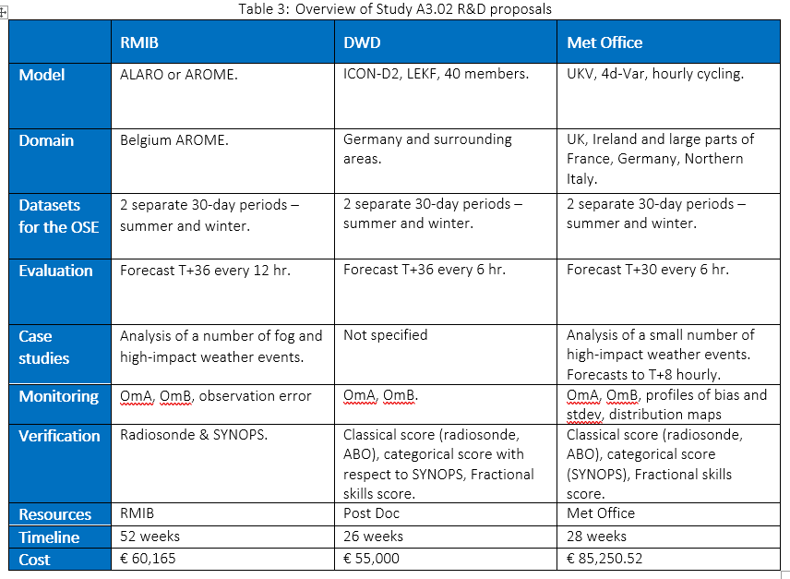
Optimizing investment in E-ABO - MODE-S versus AMDAR
Opportunity:
MODE-S is a relatively new(ish) way of getting access to observations from aircraft. It provides an opportunistic access to huge volume of data (free of charge, unlike AMDAR).
Questions:
Can we replace AMDAR data with MODE-S data? What is the optimum balance of investment for Aircraft-based observations?
How:
Running data denial experiments of limited area models (e.g. UKV).
Three NWP centre are involved running the same scenarios but on completely differently designed and operated models, to provide more robust results and inform decisions.
Total cost - 200.4 k€
Slide provided by: Jacqueline Sugier

Slide 12
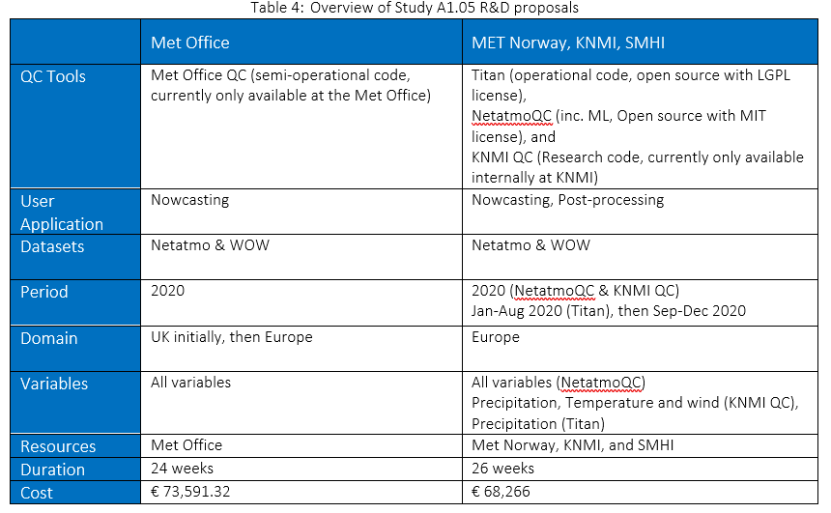
Automatic quality control for data from personal weather stations (PWS)
Opportunity:
Huge volume of observations are generated in real-time from PWS owned by members of the public. These data have demonstrated values for nowcasting and post-processing applications, and possibly many more. However, robust automatic quality controls (auto-QC) are essential.
Questions:
What are the strength and weakness of auto-QC for PWS data (for specific variable and application area)? What are the minimum requirements in terms of metadata?
How:
Run parallel trials on 5 auto-QC using common datasets from Netatmo and WOW.
Four NMHS are involved in this study.
Algorithms developed/tested will be made available to the whole EUMETNET community.
Total cost – 141.5 k€
Slide provided by: Jacqueline Sugier

Slide 13
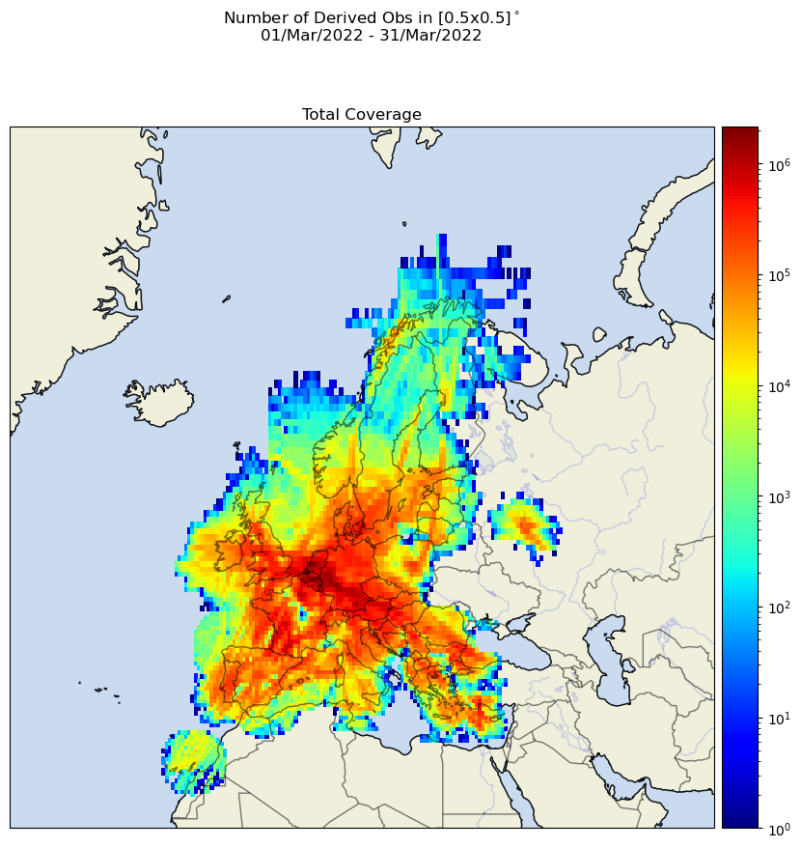
Aircraft data (E-ABO programme)
AMDAR:
Number of obs reaching around 90% of pre-covid levels
Humidity data (Lufthansa):
no obs between Oct 2021 and March 2022;
3 aircraft started again in April 2022
full (9 aircraft) humidity fleet back in April 2023
EMADDC:
EMADDC v2.2
geographical expansion
output quality control
improvement in quality
Temperature → no bias
wind → more observations

Slide 14
Sandbox Database
Members Systems
Support R&D studies, not an operational service, providing easy access to new or additional datasets that are not currently routinely shared.
Web
interface
Procured of Personal Weather Station (PWS) datasets from WOW and Netatmo.
Uploaded the datasets on CEDA, along with the necessary catalogue entries and data policy agreements.
Sandbox went live on 19 October 2021.
Catalogue
Sandbox database at CEDA
WOW
Netatmo
Data storage
‘Raw’ datasets
Data Supplier Systems
Data
Providers
Slide provided by: Jacqueline Sugier

Slide 15
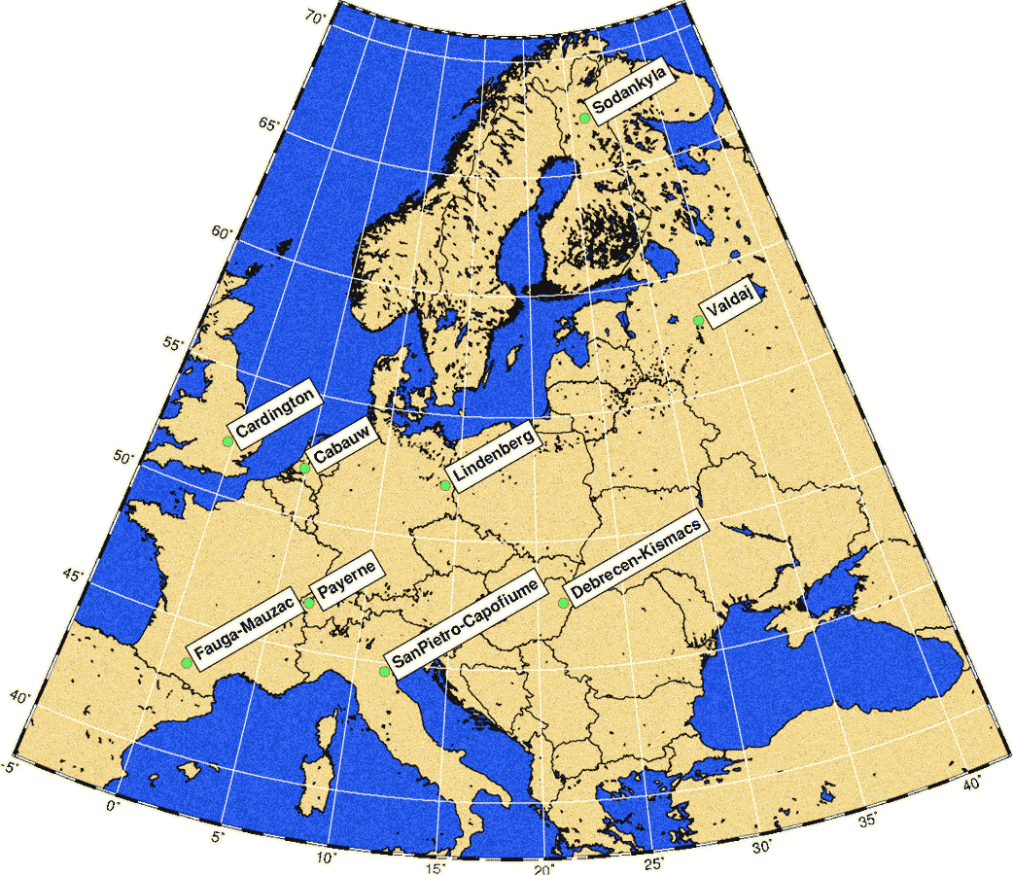
SRNWP Data Pool of surface observations
Database of surface and boundary layer observations → validation of PBL and land surface models
Freely available for EUMETNET Members and collaborating universities
Important in-kind contribution from DWD (collecting the data) and HNMS (web-site)
Statistics for Sept 2020 – Aug 2021:
4 new users
60 monthly files downloaded
Website: http://srnwp.cosmo-model.org/content/default.htm
Account request: http://srnwp.cosmo-model.org/content/register.htm

Slide 16
Global Lake Database
Database of lake location and depth
Important input for NWP models running a lake parameterization
In the past ~10 years: work financed by different LAM consortia
Financial support of EUMETNET since 2017: 8500 EUR/year (for maintenance and development) → since 2019 included in the C-SRNWP budget
Work coordinated by FMI (Ekaterina Kurzeneva), person involved: Georgy Kurzenev
Currently ongoing work:
Two land-water datasets are currently under processing for the new fine resolution version of GLDB: (i) ECOCLIMAP SG as a preliminary map and (ii) the new map based on Joint Research Centre (JRC) Global Surface Water (GSW) dataset as a final map.
Both ECOCLIMAP SG and JRC GSW - based dataset contain errors of mis-classification between inland water and sea water (river estuaries, coastal lagoons, etc.). The algorithm to treat these errors exists (see e.g. C. Fortelius et al., 2020, p. 47), but it should be adapted for the specific task, for a specific map resolution and applied globally. Georgy Kurzenev is currently working on that, using ECOCLIMAP SG as a prototype.
Finally, after correcting all mis-classification errors, the lake depth will be mapped on the JRC GSW

Slide 17
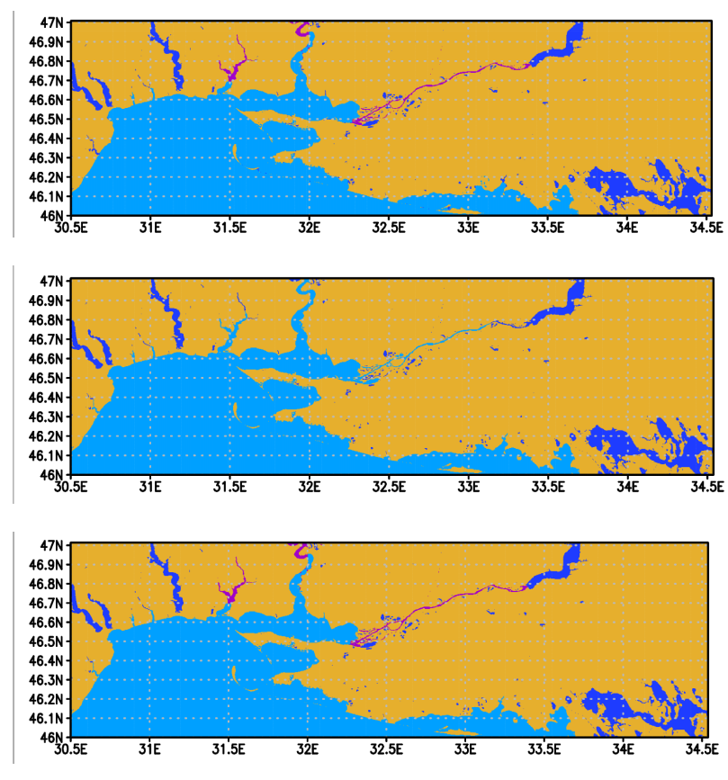
Global Lake Database
Example of processing the land-water map for the Northern coast of Black Sea.
Upper:ECOCLIMAP SG without corrected errors
Middle: ECOCLIMAP SG with corrected distinguishing between the ocean and inland water
Lower: distinguishing between the ocean and inland water with applying river information from ECOCLIMAP SG where possible.
Dark yellow – land, light blue – sea, blue – lake or reservoir, magenta – river.
Slide provided by: Ekaterina Kurzeneva

Slide 18
Physiography work
Goal: checking and correction of ESA-CCI land cover map for NWP purposes
Budget: 27.000 EUR for three years: 2021-2023 (money not spent in other C-SRNWP tasks)
Supervisory team defined on 24 February 2021:
C-SRNWP Surface ET Chair: Patrick Samuelsson (SMHI)
NWP expert: Ekaterina Kurzeneva (FMI)
GIS expert: Bolli Pálmason (IMO)
Successful application: Sandro Oswald (ZAMG) on 24 March 2021
Questionnaire to collect user needs (autumn 2021) → fine tune the goals of the work
First version of corrected dataset ready in May 2022 → distributed via C-SRNWP Surface ET

Slide 19
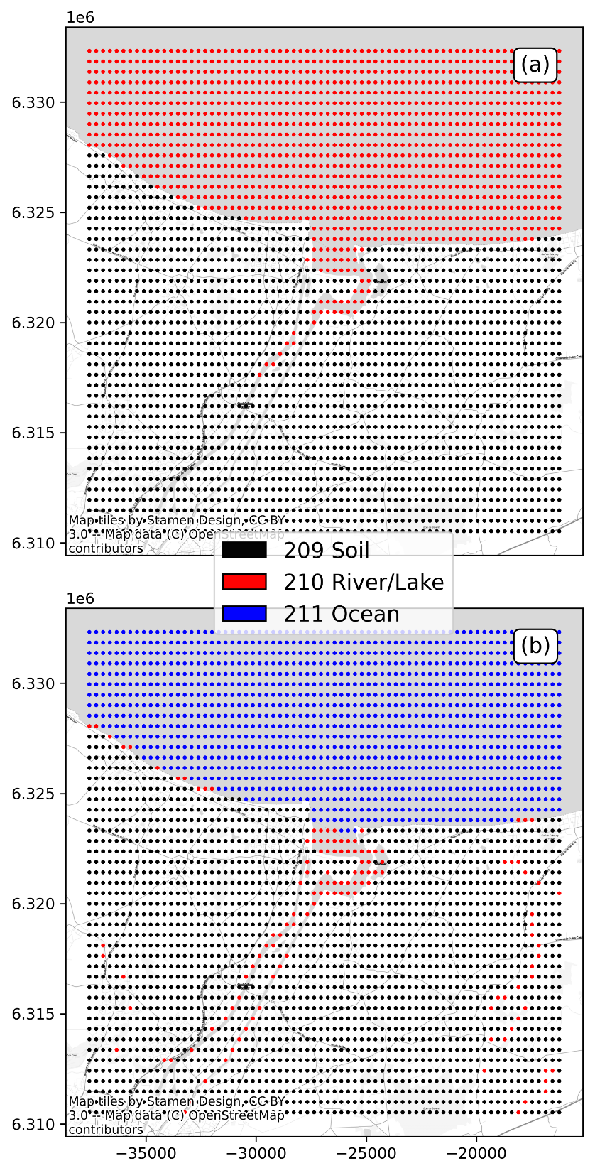
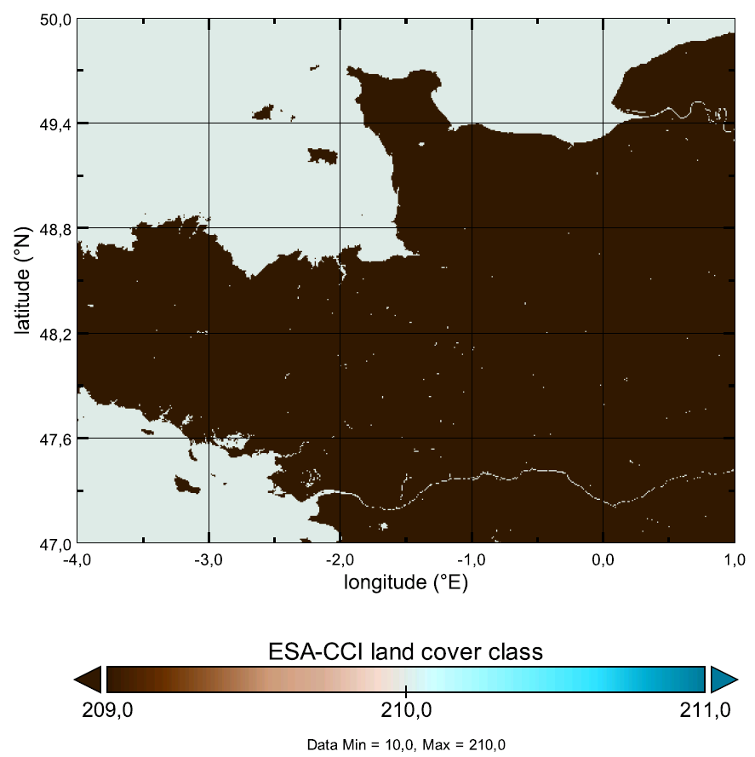
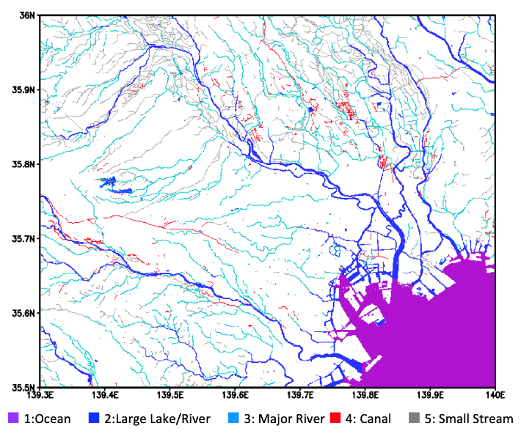
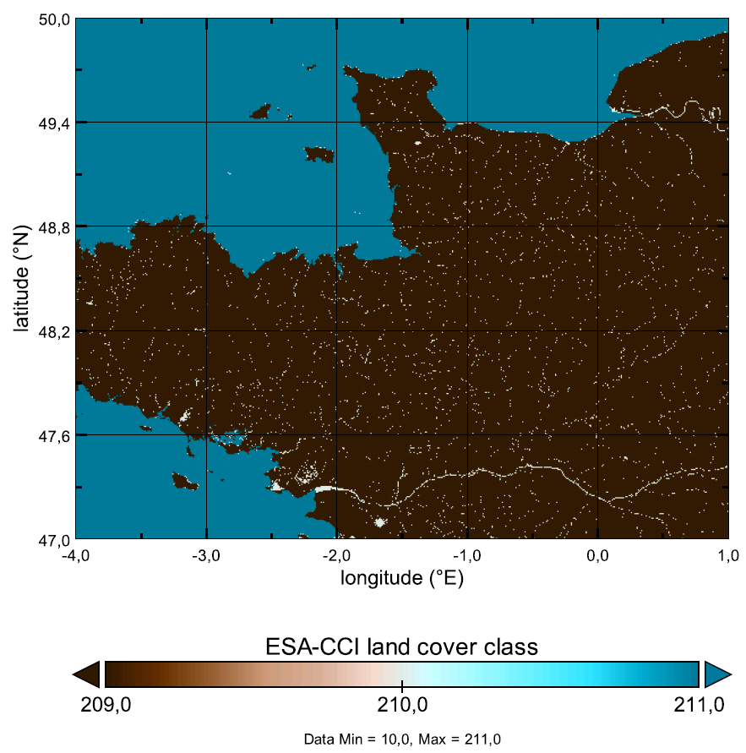
Physiography work
Use the Open Street Map to correct the land-water mask and to distinguish between fresh and salt water
Slide provided by: Sandro Oswald

Slide 20
Short Term Scientific Missions
New element in the C-SRNWP module
NWP consortia have the funds to support internal exchange, however, this is usually not applicable for travel outside the consortia
Yearly 1-2 missions (2000 EUR/year) will be funded to deal with cross-consortia issues (either technical or scientific).
A typical stay would last 1-2 weeks and participation of young scientist is encouraged.
Shared funding (EUMETNET/sending-host institute) is very welcome.
Application form have been prepared and sent to Contact Points and consortia PMs
Decision to be taken by AET
2019 autumn: Martin Imrisek (SHMU) work on GNSS STD assimilation (ALADIN-LACE-HIRLAM) at KNMI for four weeks (shared funding with LACE)
2020-2021: no travels due to COVID, funds carried forward to 2022
2022: two weeks travel by Ivan Bastak Duran (University Frankfurt) to CHMI to work on ICON and ALARO turbulence schemes

Slide 21
EMS Annual Meeting 2022
4-9 September 2022, Bonn, Germany (hybrid event)
OSA1.5 Session: Challenges in Weather and Climate Modelling: from model development via verification to operational perspectives
Conveners: Estíbaliz Gascón, Daniel Reinert, Balázs Szintai
Co-conveners: Chiara Marsigli, Manfred Dorninger
Sub-session about EUMETNET, C-SRNWP and related activities
28 abstracts received, 5 associated with EUMETNET/C-SRNWP activities

Slide 22
Thank you for your attention!

Slide 23
Balázs Szintai
C-SRNWP Manager
Phone: +36 1 346 4705
Email: szintai.b@met.hu

