Slide 1
WG3b and related activities
Fieldextra
EXTPAR
Phenology of vegetation (PT VAINT)
Snow pack model (SAINT)
Overarching activities (DWD)
Urban model (PP CITTA’) → Jan-Peter
Calibration (PP CALMO-MAX) → Euripides

Slide 2
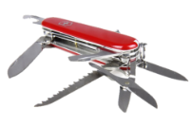
Fieldextra
Pre- and post-processing of gridded fields
Designed for production
SCA is Jean-Marie Bettems / MeteoSwiss
Latest major release v14.0.0 (17.02.2022)
https://github.com/COSMO-ORG/fieldextra
Notes:
More information…

Slide 3
Some new features of v14
  Full support of ICON triangular grid
    Including multiple subgrids in same product (cell, edges, vertices)
    Including grid subset, like frames
  Many operators are also natively available on the triangular grid
    All interpolations supported by the ICON tools are accessible through fx : ICON > ICON, ICON > regular, regular > ICON
    (note that RBF method is also available for regular > regular interpolation)
    Association of geog. locations with grid points, based in particular on generalized minimal distance (COSMO algorithm)
    Field smoothing by convolution operator
    All point and vertical operators
    All operators computing new meteorological fields (e.g. DD & FF, EDP, EPS derived)… as long as no differential operator is required
jean-marie.bettems@meteoswiss.ch, COSMO GM 2022, Athens 3

Slide 4
Some new features of v14
  Improved support of NetCDF import & export , in particular
    Production of IFS based boundary conditions for ICON
    Import of EXTPAR output (support transformation to GRIB2, incl. fields like FR_LUC & HORIZON)
    Import of ICON output on native grid (support product generation in a NetCDF based work flow)
jean-marie.bettems@meteoswiss.ch, COSMO GM 2022, Athens 4

Slide 5
Quality control
  A extensive regression suite is used for testing any new developments
    short tests, also available in deployed installations (cookbook)
    tests reflecting usage by different Consortium members (MCH, DWD, ITAF)
    tests using the full MCH production suites
  Fieldextra development is hosted on GitHub, and organized with the infinite lifetime branches
    develop : collect recent developments, code review required for external contributions
    develop_tested : all standard tests have passed, updated with weekly Jenkins plan → access to new features, stable
    master : all tests have passed (including full MCH opr suite) → official releases
jean-marie.bettems@meteoswiss.ch, COSMO GM 2022, Athens 5

Slide 6
Access
  Main releases deployed at
    ECMWF (new) : chcosmo@atos:/perm/chcosmo/projects/fieldextra/vXX_X_X (group cfxtra)
  Stable head of develop branch (develop_tested) deployed at
    CSCS : /project/s83c/fieldextra , both for tsa and daint platforms … weekly automatic deployment
    ECMWF (new) : chcosmo@atos:/perm/chcosmo/projects/fieldextra/develop (group cfxtra) … irregular on-demand deployment
  GitHub repository for latest stable features
    https://github.com/COSMO-ORG/fieldextra (clone develop_tested, requires independent access to external libraries)
  Self-contained package, main releases only, on COSMO web site as tar file
    https://www.cosmo-model.org/content/support/software/default.htm (includes all libraries & short regression suite)
jean-marie.bettems@meteoswiss.ch, COSMO GM 2022, Athens 6

Slide 7

Extpar
Production of external parameters (backend)
SCA is Jonas Jucker / C2SM
Latest major release v5.10 (08.2022)
https://github.com/C2SM-RCM/extpar/
Center for Climate Systems Modeling C2SM
05/09/2022
7
Notes:
7

Slide 8
Status Extpar v5.10 (August 2022)
Scientific updates
MERIT topography available
Revised algorithm for SGSL processing (subgrid-scale slope used by hydrology model)
Technical updates
Intel and NAG compilers not supported anymore
Small OpenMP optimizations for domains crossing the dateline
Replace Mistral with Levante at DKRZ
Python/CDO rewrite completed (reduce amount of code to maintain)
Center for Climate Systems Modeling C2SM
05/09/2022
8
Notes:
8

Slide 9
Future developments
New datasets
Urban parameters for PP CITTA‘ (ECOCLIMAP SG)
As required by JSBACH 4
Testsuite
Replace redundant namelist settings, currently about 80% of all settings identical
Use same CDO version across machines to minimize tolerance thresholds in testsuite
User interface, Webinterface
Wrapper script to setup sandbox, namelists and runscript
Pass an icon-grid (or COSMO namelists) for domain specification
Work together with P. Sommer to setup new web-interface for WebPep service
Center for Climate Systems Modeling C2SM
05/09/2022
9
Notes:
9

Slide 10
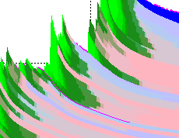
Snow model
  Goal: develop a new efficient and high quality snow model for ICON → SNOWPOLINO
    First target is NWP in Central Europe
    But large potential in data poor regions (e.g. high mountains regions in Asia)
    And even larger potential for climate applications (no possibility to correct poor parameterization with DA)
  A first implementation is available now in COSMO 6.0
    Validation shows very good quality of snow pack simulation
    Will be used for snow mask production at MeteoSwiss starting this winter
    But still issues in the coupling with the atmosphere and the diagnostic
  Current plan is to have a stable version of the new snow model in ICON by the June 2023
    Including implicit solver to support large time steps
jean-marie.bettems@meteoswiss.ch, COSMO GM 2022, Athens 10

Slide 11
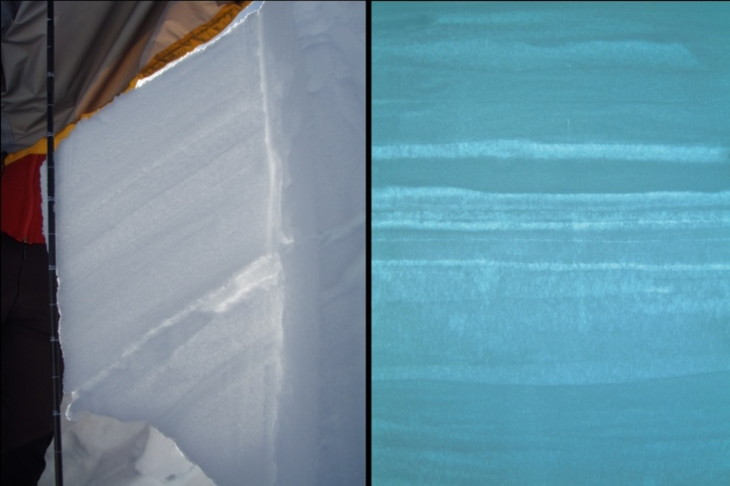
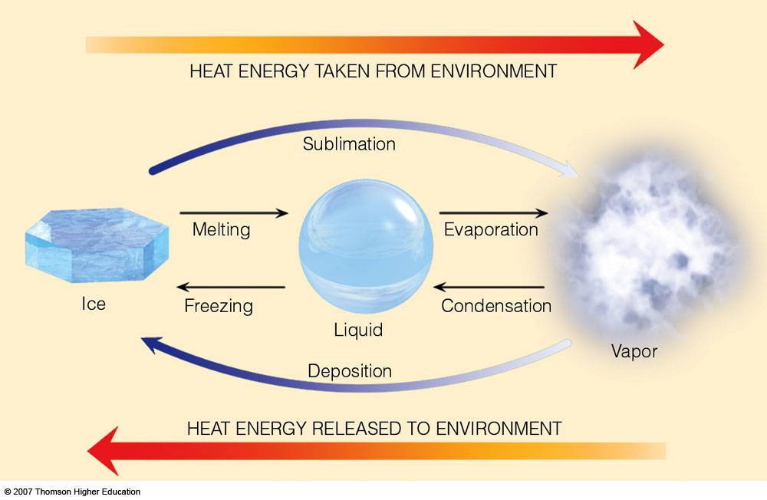
SNOWPOLINO
The SNOWPACK version for NWP and climate
Layering (n_{def.}= 10)
Phase Changes
1D heat equation
Water transport
Settling / Densification
No Metamorphism!
Photos: SLF

Slide 12
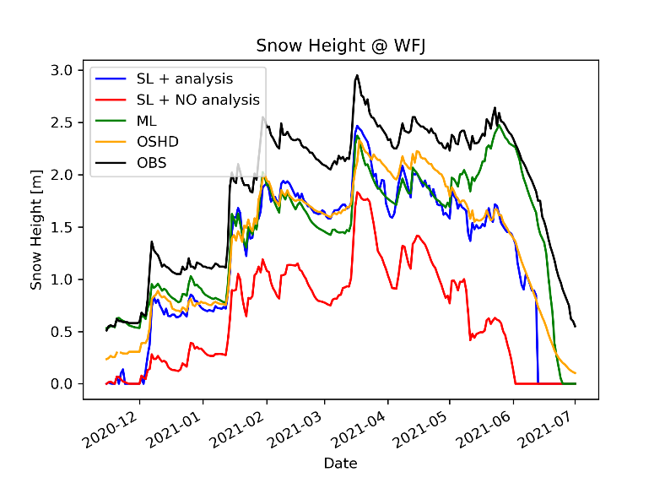
Snow model
Comparison of snow height at Weissfluhjoch using
a) observations,
b) Hindcast with the current snow scheme, as potentially used by climate runs,
c) the MCH operational snow analysis,
d) Hindcast with the new snow scheme in COSMO 6.0 (no assimilation of snow).
jean-marie.bettems@meteoswiss.ch, COSMO GM 2022, Athens 12

Slide 13
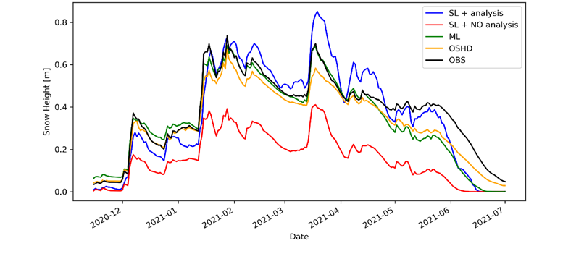
Snow model
Comparison of snow height for 300 stations across the Alps using
a) observations,
b) Hindcast with the current snow scheme, as potentially used by climate runs,
c) the MCH operational snow analysis,
d) Hindcast with the new snow scheme in COSMO 6.0 (no assimilation of snow).
jean-marie.bettems@meteoswiss.ch, COSMO GM 2022, Athens 13

Slide 14



PT VAINT
09.2020 – 05.2022
Evgenii Churiulin, Merja Tölle, Vladimir Kopeykin,
Markus Übel, Juergen Helmert and Jean-Marie Bettems

Slide 15
PT VAINT
  Improve the seasonal phenology of vegetation and the evapotranspiration in the COSMO model
    COSMO model used as demonstration vehicle.
    Algorithms adapted from the Community Land Model.
    Focus on grass.
  Project finished on May 2022, no follow-up
  Delivrables
    Code available on GitHub in COSMO-ORG, in branch cosmo_clm6.0_phenology
    Technical Report being prepared (only final revision pending)
    Paper in preparation
jean-marie.bettems@meteoswiss.ch, COSMO GM 2022, Athens 15

Slide 16



PT VAINT: model configurations
CLM 3.5, CLM 4.5 – Community Land Model
COSMO-CLM v5.16
CCLMref
COSMO
CLM V5.16
CCLMv4.5e
CCLMv3.5
CCLMv4.5
  Jarvis-Stewart approach with BATS model parameterization scheme
  Does not consider stomatal regulation and vegetation growth depending on atmospheric CO₂ concentrations
  Uses simplified Jarvis approach based on empirical dependencies between canopy and environmental variables.
  Ball-Berry approach coupled with leaf photosynthesis and calculating separately for sunlit and shaded leaves. (CLMv4.5)
  Night-time values of stomatal resistance is controlling by available soil water
  Additional changes in calculations of transpiration from dry leaf surfaces
  Ball-Berry approach coupled with leaf photosynthesis and calculating separately for sunlit and shaded leaves. (CLMv3.5)
  Night-time values of stomatal resistance is equal to 20.000 s m⁻¹
  Ball-Berry approach coupled with leaf photosynthesis and calculating separately for sunlit and shaded leaves. (CLMv4.5)
  Night-time values of stomatal resistance is controlled by available soil water

Slide 17
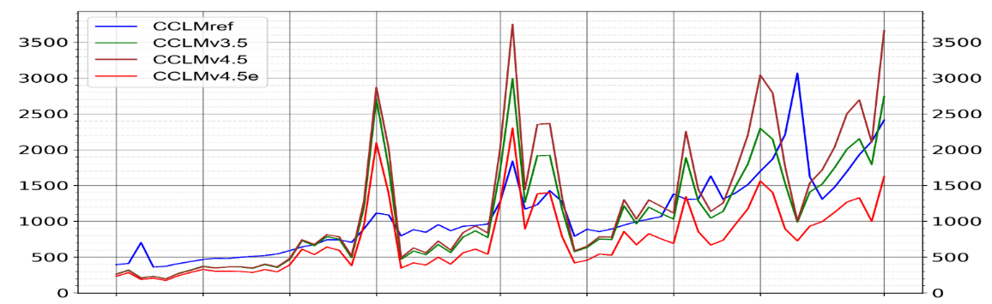
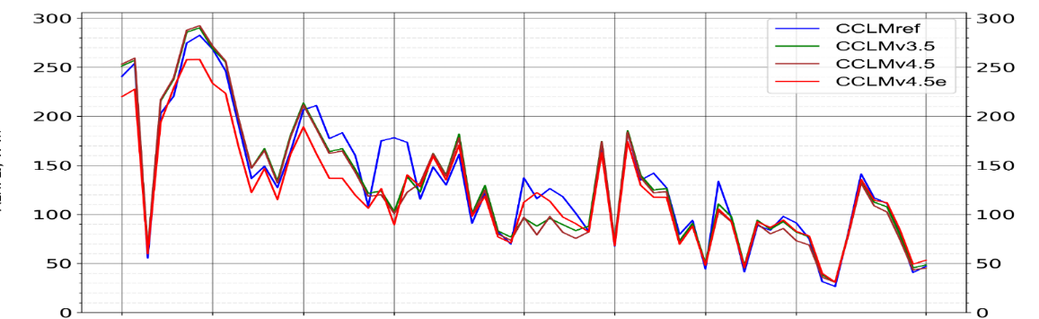

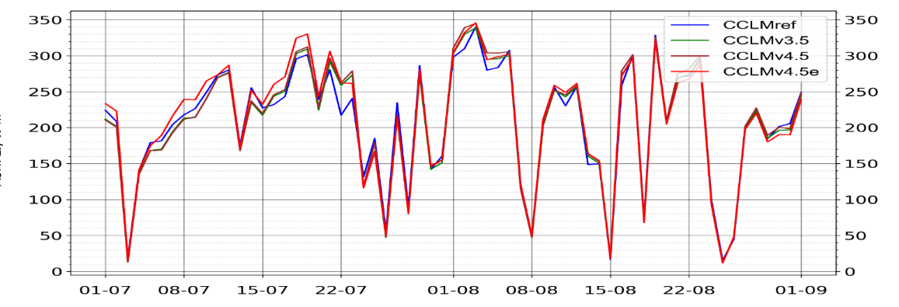
Impact of stomatal resistance on turbulent fluxes
Results are presented for 13:00 of each day during summer 2013
→ As stomatal resistance increases, latent heat decreases at the same time and sensible heat increases.
Stomatal resistance
at 1 p.m. (s m⁻¹)
Latent heat flux
at 1 p.m. (W m⁻²)
CCLMref
CCLMv3.5
CCLMv4.5
CCLMv4.5e
Sensible heat flux
at 1 p.m. (W m⁻²)

Slide 18
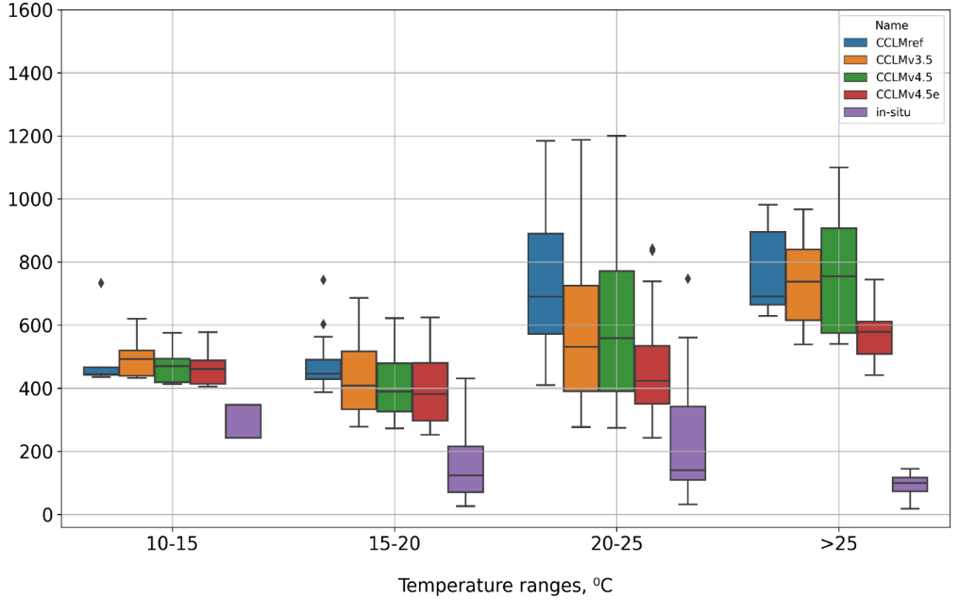
Evaluation of the new stomatal resistance (RSTOM) algorithms at the Parc domain
T_{2m} categories with daily day-time values of RSTOM
Stomatal resistance
(s m⁻¹)
Results: CCLMv4.5e experiment with the additional changes in the algorithm for calculations of transpiration from dry leaves shows the best accuracy.
CCLMref
CCLMv3.5
CCLMv4.5
CCLMv4.5e
ICCARUS 2022 - SoilVeg virtual meeting, 10.03.2022

Slide 19
PT VAINT
  Some remarks for a follow-up study
    CO₂ partial pression has been prescribed, it should be provided as external parameter.
    Climatological LAI yearly cycle has been used, a dynamical cycle depending on history should be used
    (first prototype has been implemented but not tested).
    Limited to PFT (plant fonctional type) representing grass, should be extended to other PFTs.
jean-marie.bettems@meteoswiss.ch, COSMO GM 2022, Athens 19

Slide 20
Overarching activities (DWD)

Slide 21
Ongoing & future activities at DWD
ICON seamless JSBACH + VDIFF are implemented in icon-nwp, incl. DA
  NWP-performance of JSBACH+VDIFF are being evaluated
  (in addition to seasonal and decadal scales)
  Integration of JSBACH external parameters into EXTPAR has started
  Solve output fields issues (GRIB required for production, too many diagnostic generated by JSBACH)
ICON-LAND will be the land component of ICON
  ICON-LAND as software architecture, currently holds JSBACH
  Modularize TERRA, includes restructured TERRA into ICON-LAND (target Q3 2023)
BMBF WarmWorld :
  Integration of the hydrological model ParFlow into ICON-LAND
  Redesign interface between land and atmosphere
  Provide interfaces to the larger community (biogeochemical cycles, …). Separation of concerns.

Slide 22
Coming now
Urban model (PP CITTA’)

Slide 23
Coming now
Calibration (PP CALMO-MAX)

Slide 24



Calibration of COSMO Model over the Wider Eastern Mediterranean Area under the CALMO-MAX Priority Project
Avgoustoglou E.¹, Carmona I.², Voudouri A.^{1,5} (Project Leader), Levi Y.² , Will A.³ and Bettems J.M.⁴
1. Hellenic National Meteorological Service, Hellinikon 16777, Greece
2. Israel Meteorological Service, Bet Dagan 5025001
3. Brandenburg University of Technology Cottbus – Senftenberg, Germany
4. Federal Office of Meteorology and Climatology, Zurich, Switzerland
5. Ministry of Environment and Energy, Climate Change Department
24th COSMO General Meeting, Athens, September, 14,2022.
Euripides Avgoustoglou, Hellenic National Meteotological Service, 24th COSMO GM , Athens, September 14, 2022
01

Slide 25
Outline
Domain choice
Model version and set up
Parameter list
Optimization and evaluation
Computational resources
Conclusions
Euripides Avgoustoglou, Hellenic National Meteotological Service, 24th COSMO GM , Athens, September 14, 2022
02

Slide 26
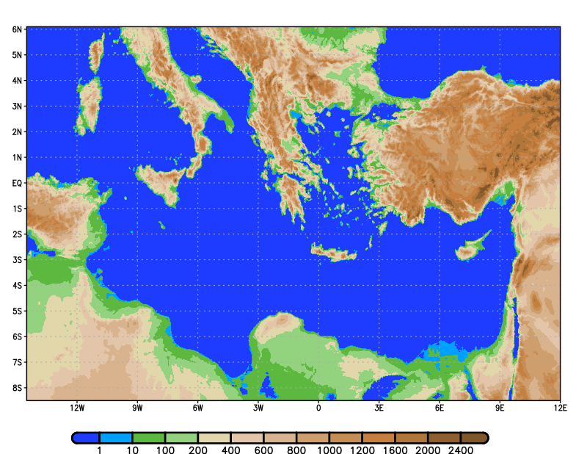
Domain choice: Wider Eastern Mediterranean Area
Euripides Avgoustoglou, Hellenic National Meteotological Service, 24th COSMO GM , Athens, September 14, 2022
03

Slide 27
Model version and set up
cosmo_190418_5.06_1
int2lm_190524_2.06
Horizontal grid size: 0.03⁰ (~3 km)
890x487 grid points
53 vertical levels (Tropopause at 33 km)
Integration time-step: 15 secs.
Time interval of radiation scheme call : 15 mins
Integration period: 42 hs.
Boundary conditions : 6hr IFS Analysis.
Euripides Avgoustoglou, Hellenic National Meteotological Service, 24th COSMO GM , Athens, September 14, 2022
04

Slide 28
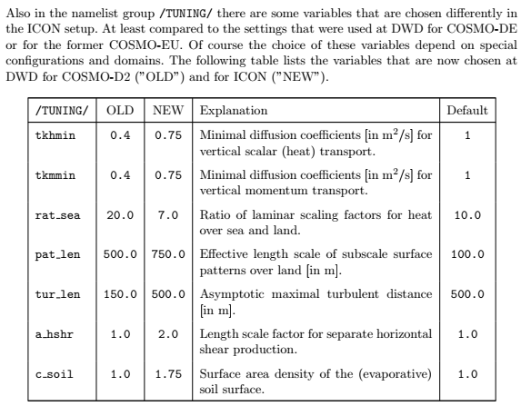
Parameter list
Parameter | INTERPRETATION | range | Test values (default)
rat_sea | ratio of laminar scaling factors for heat over sea | 1-100 | 1, 10, 50
rlam_heat | scaling factor of the laminar boundary layer for heat | 0.1 – 10.0 | 0.1, 1.0, 2.0
tkhmin tkmmin | minimal value of diffusion coefficient for heat and momentum (kept equal) | 0.0-2.0 | 0.1, 0.40, 2.0
tur_len | asymptotic maximal turbulent length scale (m) | 10 – 10000 | 100, 150, 1000
c_soil | surface area index of evaporative soil surfaces ( dependent on surface area density of the roughness elements over land , c_lnd) | 0-c_lnd(2.0) | 0, 1, 2
cosmo_userguide_5.06.pdf
Euripides Avgoustoglou, Hellenic National Meteotological Service, 24th COSMO GM , Athens, September 14, 2022
05
Notes:
The «gray» variable qi0, although it displays strong sensitivity, it is not accounted at this stage of our work due to caution regrading its use if different than its default value.

Slide 29
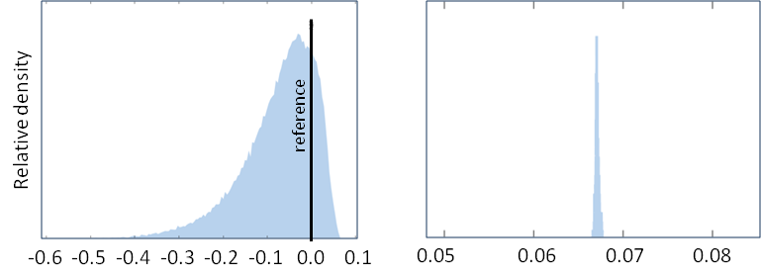
Optimization and evaluation
Selection of cases, parameters and meteorological fields
COSMO Model runs
Station observations from Greece and Israel
(Daily Tdry max, Tdry min, Tdew max, Tdew min and Precipitation)
Metamodel calibration
Derivation of optimum parameter values in reference to the default runs
MM performance score distribution difference range from the default performance score over the representative cases for the first iteration (left) and the corresponding optimum parameter distribution at the end of the iteration process right). The positive (negative) values refer to a better (worse) performance score with respect to the reference simulation with the default parameter values.
Euripides Avgoustoglou, Hellenic National Meteotological Service, 24th COSMO GM , Athens, September 14, 2022
06

Slide 30
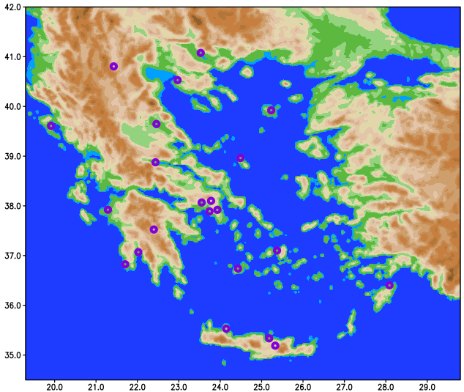
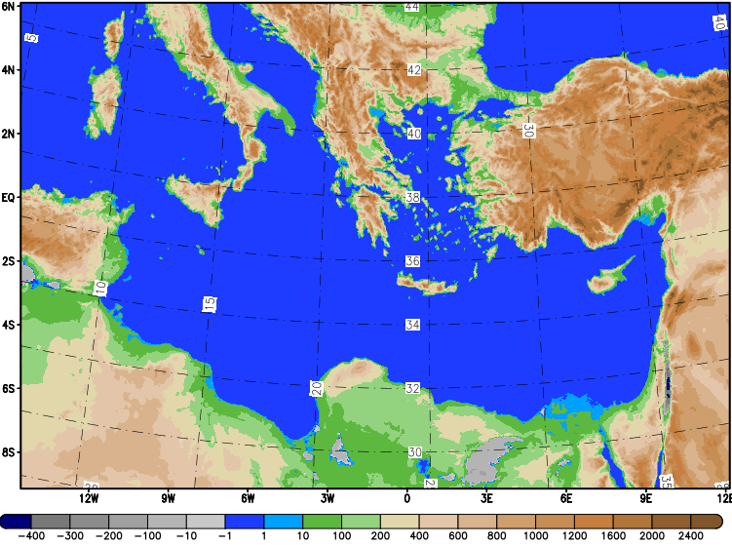
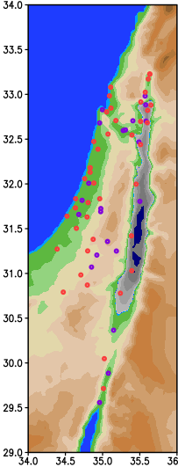
Station observations from Greece and Israel
The domain topography (m) of model runs over the Central-Eastern Mediterranean area along with the approximate areas of station locations encircled in red. Right: The positions of the 22 Greek meteorological stations under consideration. Left: The positions of the 65 Israeli meteorological stations taken into consideration. Highlighted in purple color, the 22 stations selected for additional examinations with the Greek ones.
Euripides Avgoustoglou, Hellenic National Meteotological Service, 24th COSMO GM , Athens, September 14, 2022
07

Slide 31
Case choice for optimization and model runs
60 cases were chosen from the year 2019, 5cases/month
22 runs per case according to parameter default, min/max, cross and optimum values
PARAMETER | INTERPRETATION | TEST VALUES min,def,max | OPTIMUM VALUES
c_soil | surface area index of evaporative soil | 0, 1, 2 | 0.825
rat_sea | ratio of laminar scaling factors for heat over sea | 1, 10, 50 | 5.288
rlam_heat | scaling factor of the laminar boundary layer for heat | 0.1, 1.0, 2.0 | 1.049
tkhmin tkmmin | minimum value of diffusion coefficients for heat and momentum (both are kept equal) | 0.1, 0.4, 2.0 | 1.356
tur_len | asymptotic maximum turbulent length scale (m) | 100, 150, 1000 | 524.66
Case choice for evaluation
60 different cases were chosen from the year 2019, 5cases/month
Euripides Avgoustoglou, Hellenic National Meteotological Service, 24th COSMO GM , Athens, September 14, 2022
07
Notes:
The «gray» variable qi0, although it displays strong sensitivity, it is not accounted at this stage of our work due to caution regrading its use if different than its default value.

Slide 32
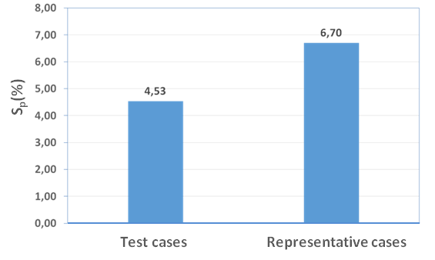
Optimization and Evaluation
Selection of a new set of cases
COSMO Model runs (default and optimum parameter values)
Station observations from Greece and Israel
(Daily Tdry max, Tdry min, Tdew max, Tdew min and Precipitation)
Evaluation of model performance scores for optimum parameter values in reference to the default runs
Euripides Avgoustoglou, Hellenic National Meteotological Service, 24th COSMO GM , Athens, September 14, 2022
08

Slide 33
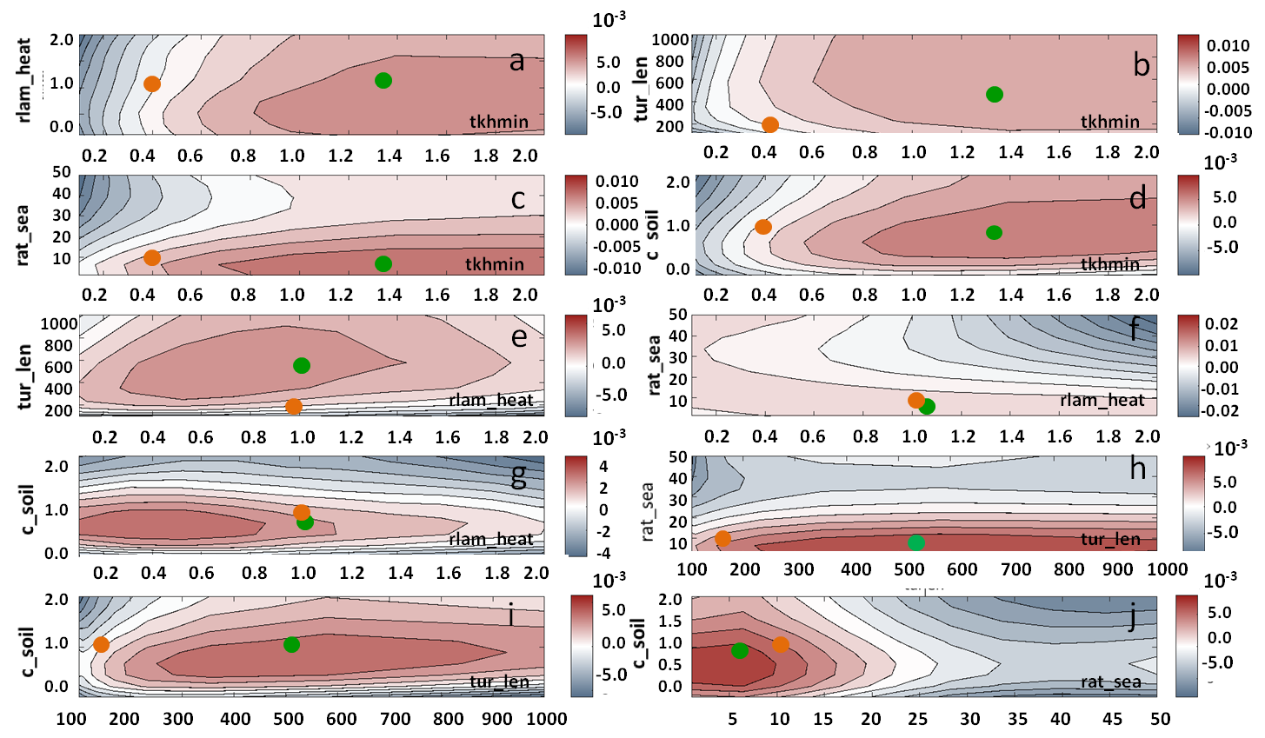
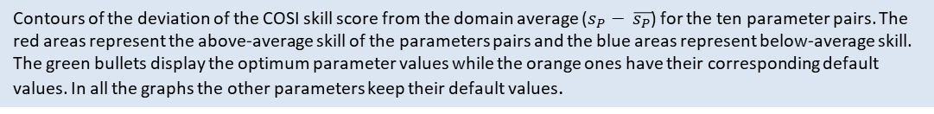
Contours of the deviation of the COSI skill score from the domain average ($s_{P}− \overline{s_{P}}$) for the ten parameter pairs. The red areas represent the above-average skill of the parameters pairs and the blue areas represent below-average skill. The green bullets display the optimum parameter values while the orange ones have their corresponding default values. In all the graphs the other parameters keep their default values.
Euripides Avgoustoglou, Hellenic National Meteotological Service, 24th COSMO GM , Athens, September 14, 2022
09

Slide 34
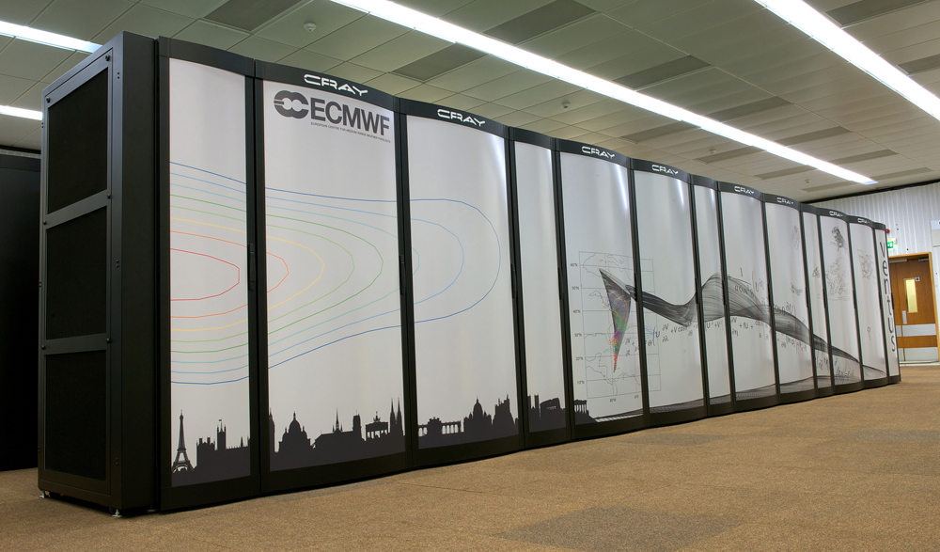
Computational resources
Computer system : ECMWF Cray XC40, Xeon E5-2695v4
18C 2.1GHz, Aries interconnect, #103 (TOP 500, June 2021).
Computational cost of model runs:
In kind provision of billing units by HNMS at ECMWF supercomputing system to run the model.
Computational cost of a single run: ~ 18000 b.us., ~3000 secs (2880 cpus).
Total use of b.us.: ~ 30 million
Volume of output storage: ~ 11.5 GB / run (*.tar.bz2), ~ 17 TB (ECFS).
https://www.ecmwf.int/en/computing/our-facilities/supercomputer
Euripides Avgoustoglou, Hellenic National Meteotological Service, 24th COSMO GM , Athens, September 14, 2022
10

Slide 35
CONCLUSIONS
Calibration of COSMO model using CALMO technology over the wider Eastern Mediterranean area should be considered a succesfull endeavor towards the benefit of COSMO, ICON and CCLM as well as the meteorological and climatological communities in general.
This work nicely completed the CALMO works over Switzerland and Northern Italy, especially under the fact that COSMO model was optimized using rather sparse station observations instead of gridded data.
Although this work was computationally expensive, it should be considered computationally quite affordable for smaller domains as well as quite adequate regarding local meteorological features.
MAIN REFERENCE:
E. Avgoustoglou , I. Carmona, A. Voudouri, Y. Levi, A. Will, J.M. Bettems: Calibration of COSMO Model in the Central-Eastern Mediterranean area adjusted over the domains of Greece and Israel, Atmospheric Research, Volume 279, 1 December 2022, 106362.
Euripides Avgoustoglou, Hellenic National Meteotological Service, 24th COSMO GM , Athens, September 14, 2022
11

