Slide 1
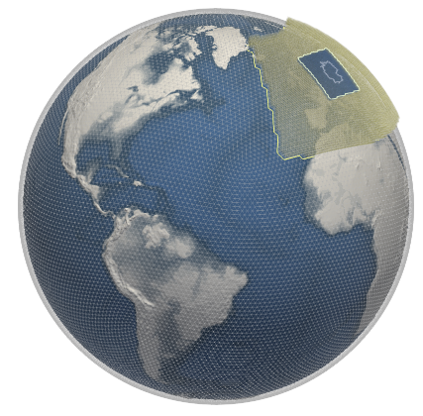
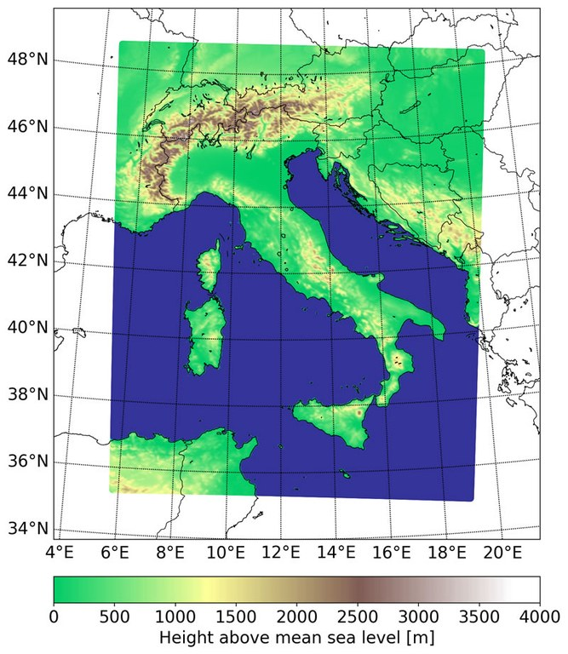
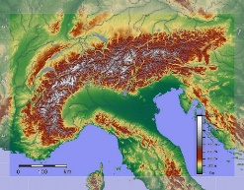
The Global-to-Regional ICON Digital Twin
Chiara Marsigli and Roland Potthast
Pier Paolo Alberoni, Harald Anlauf, Christoph Appenzeller, Hartwig Anzt, Marco Arpagaus, Carlo Cacciamani, Terry Cojean, Bas Crezee, Oliver Fuhrer, Vanessa Fundel, Christoph Gebhardt, Stefanie Hollborn, Thomas Hüther, Thomas Gastaldo, Gholamali Hoshyaripour, Marek Jacob, Jan Keller, Julia Keller, Stefan Kollet, Xavier Lapillonne, Paola Mercogliano, Claire Merker, Carlos Osuna, Virginia Poli, Adriano Raspanti, Daniel Regenass, Linda Schlemmer, Christoph Schraff, Jan-Peter Schulz, Thorsten Steinert, Antonio Vocino, Bernhard Vogel, Claudia Volosciuk, Günther Zängl

Slide 2

Global-to-Regional-ICON Digital Twin (GLORI)
Tri-lateral Cooperation
Germany, Italy, Switzerland
global-to-regional short-range high resolution Digital Twin
configurable
on-demand
based on the prediction capability of the ICON earth system model and the Data Assimilation Coding Environment DACE
Work on the Glori Twin has started

Slide 3
GLORI Characteristics
Global storm-resolving (~3km) and regional km-scale (down to 500 m)
Frequent innovation uptake though data assimilation (global and km-scale):
  Global-Nest Ensemble Data Assimilation
  KENDA at high resolution, assimilation of radar reflectivity volumes
Uncertainty estimation (global and regional ensembles), also in the data assimilation
Run on heterogeneous GPU-CPU architecture
Configurable and on-demand
ART Mineral Dust ENERGY
ART Pollen HEALTH Application
Flood forecasting as user-oriented system evaluation

Slide 4








GLORI Partners
Agenzia ItaliaMeteo
IDEA-S4S

Slide 5
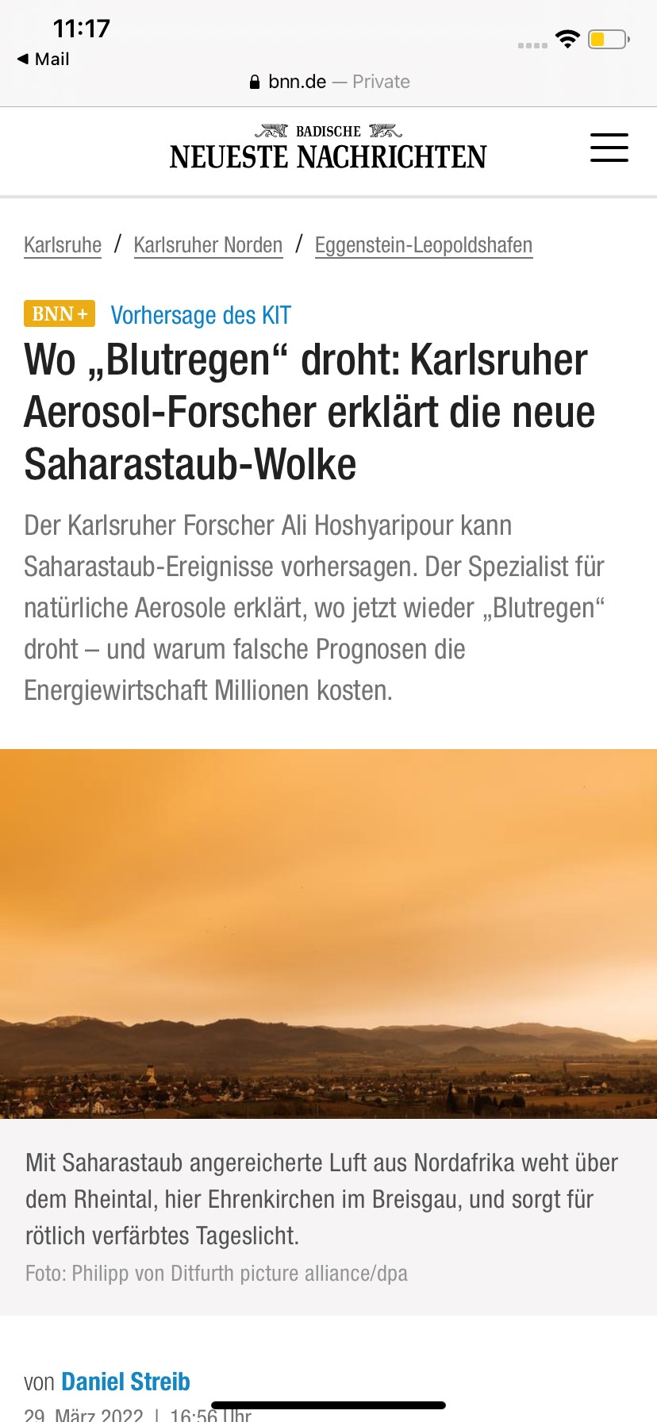
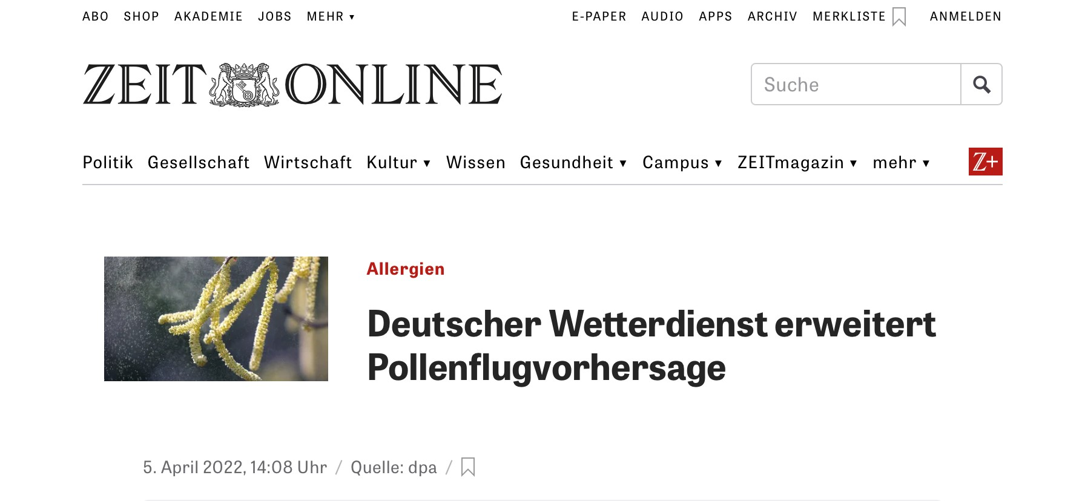
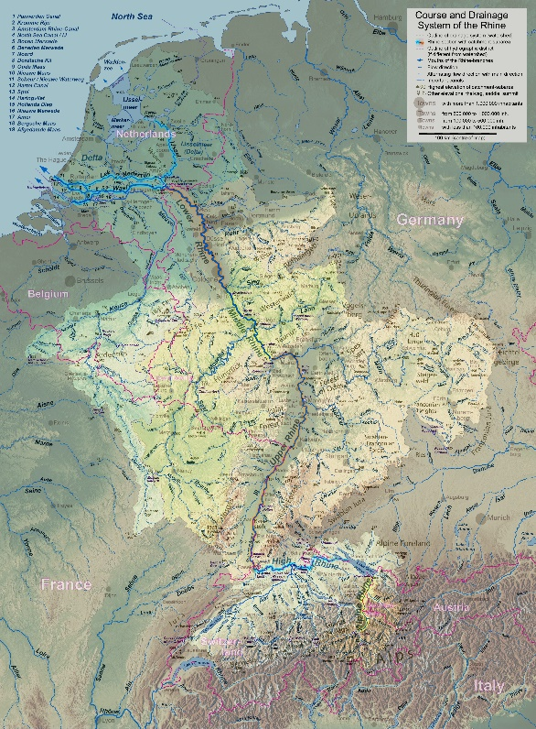
GLORI Concept
development
global2regional
applications
high-res DA
ART energy
physics at high-res
ART health
GPU porting
catchment verification
ensemble land interface
land surface
urban
data lake

Slide 6
ICON Global-2-Regional Configuration

Slide 7
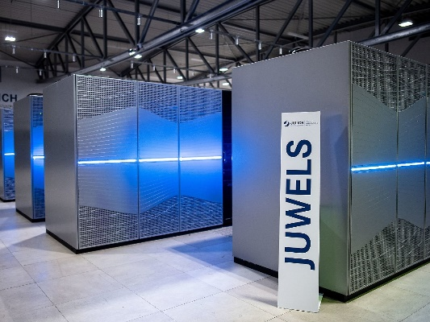
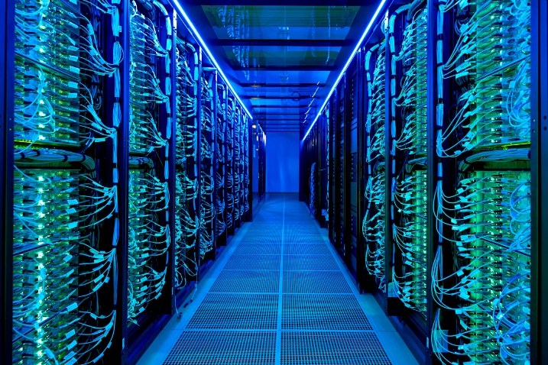
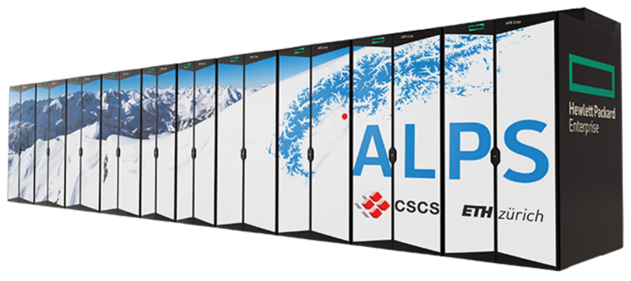
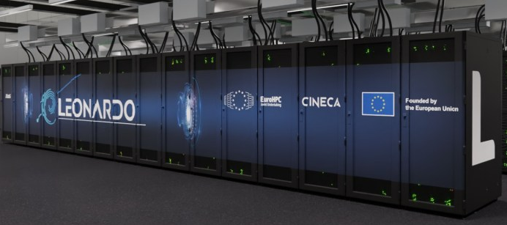
Hybrid architecture CPU-GPU
Implementation on Horeka has started
Horeka
2022
Chiara Marsigli
7

Slide 8
Data lake, data stream and cloud technologies
The GLORI project is an opportunity to adapt workflow and data exchange between different components of the NWP production
Explore adaptation of part of the NWP workflow to cloud technologies
Coordination of technology with DestinE to be compatible with data lake and data stream solution
Joint working group Glori / DestinE to establish the relation between the two projects
Possibility to use CINECA as common infrastructure
2022
Chiara Marsigli
8

Slide 9

ICON port to GPU
OpenACC directives port
Components needed for the LAM operational NWP at MeteoSwiss have been ported
Overall performance on GPU is lower than expected, investigation and optimization will be done in the coming months
Additional components needed for global NWP, as well as regional GLORI application, e.g. 2-mom microphysics, radar forward operator, sea ice … will be ported until Q4 2023
Gt4py DSL implementation
Some components are being ported to gt4py dsl, currently dycore and microphysics. These will be used for some of the GLORI applications where appropriate
Xavier Lapillonne
2022
Chiara Marsigli
9

Slide 10
Data assimilation and model physics at high-resolution

Slide 11
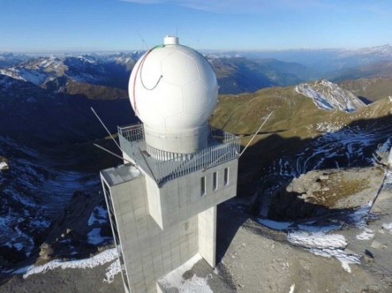
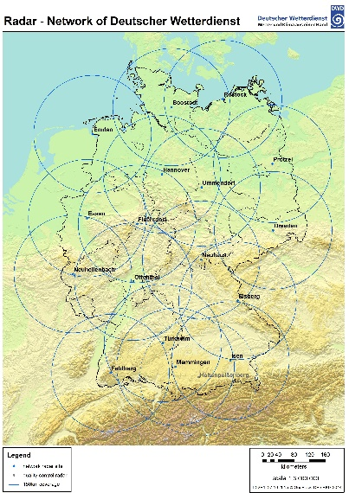
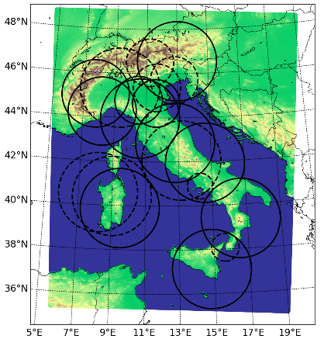
Data assimilation
Global: EnVAR+LETKF data assimilation system
Regional: LETKF (KENDA)
enhanced DA for high-resolution:
  wind lidars
  microwave radiometers
  Raman lidar
  OPERA surface precipitation rates for LHN
  radial winds and 3D radar reflectivities data from D, CH, I and near countries
  wind profiler
  near-surface station data, also crowd-sourced
  soil-moisture and wind from satellite
2022
Chiara Marsigli
11

Slide 12
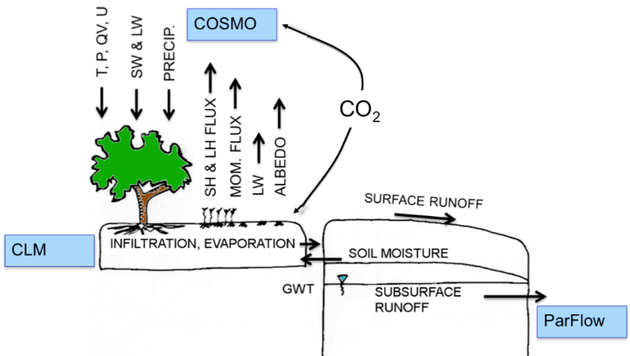
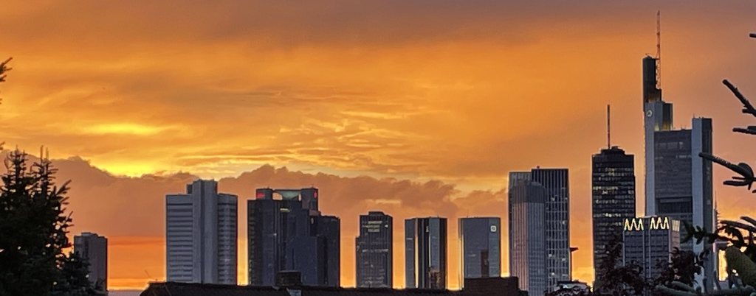
Model development for higher resolution
physical parameterization development:
  next slide
perturbation methods for improving the description of the precipitation uncertainty in the ensemble formulation
physics-based parameterization of surface and subsurface flow including groundwater and coupling to the land surface (ParFlow)
better representation of the surface energy and water balances in the model, including the urban parameterization (TERRA_URB)
2022
Chiara Marsigli
12

Slide 13
Model development for higher resolution
Global convection-permitting modelling -> not sufficient to focus on technical aspects, tacitly assuming that existing models will deliver higher forecast quality just by operating them at convection-permitting resolution and turning off the deep-convection scheme
In order to benefit from convection-permitting models in terms of forecast quality, substantial efforts in parameterization development are necessary: turbulence and convection parametrization, treatment of orographic gravity waves, representation of orographic shading effects on radiative fluxes
Günther Zängl
2022
Chiara Marsigli
13

Slide 14

Land-atmosphere feedback
Increasing spatial resolution lead to an improved representation of land surface and subsurface processes and uncertainties, which requires physics-based parameterization of surface and subsurface flow including groundwater and coupling to the land surface (ParFlow).
Assess the impact of land surface-atmosphere
interaction on precipitation
Test and develop perturbation methods
for improving the description of the precipitation
uncertainty in the ensemble formulation
Test the improved ensemble precipitation
forecast in combination with the ParFlow
hydrology modelling framework
Stefan Kollet
2022
Chiara Marsigli
14

Slide 15
Validation and impacts

Slide 16
Impacts
Verification of the forecasts, for the different components
  Based on the current operational verification
Applications: pollen and energy (ART)
Connection with flood forecasting: user-oriented verification
Connecting with the users
Communication
2022
Chiara Marsigli
16

Slide 17
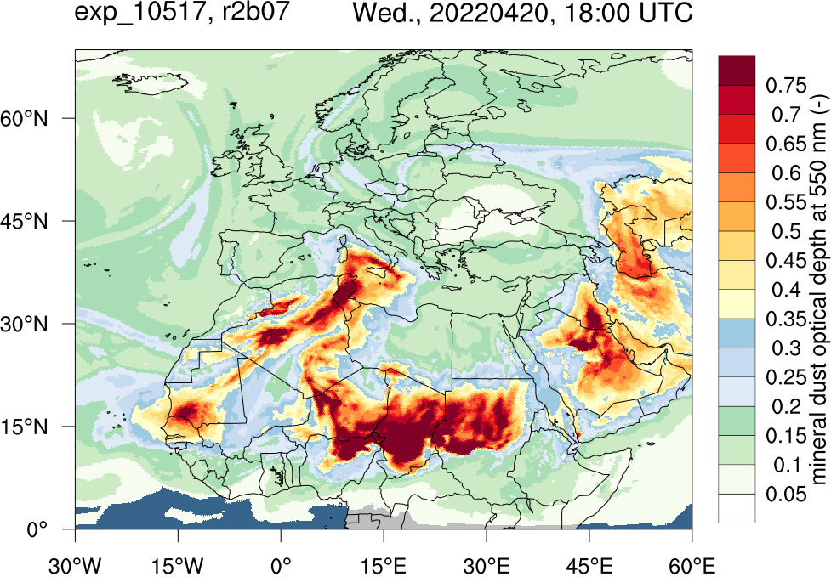
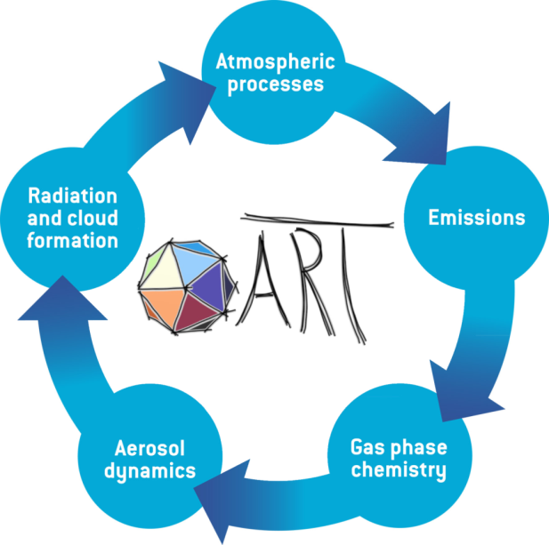
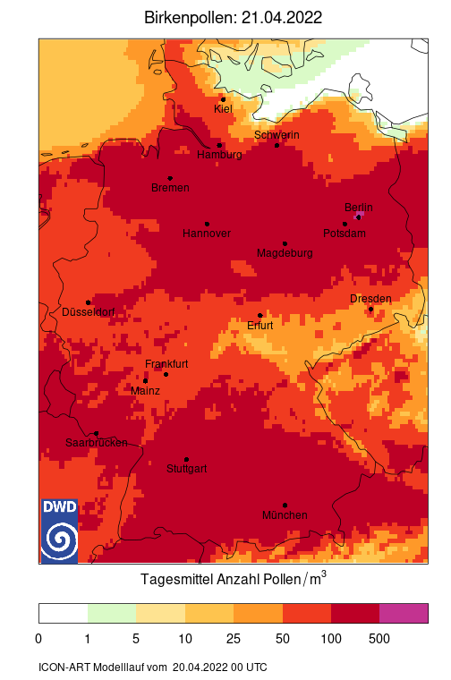

Dust and pollen forecast for energy and health
ICON-ART
Ali Hoshyaripour
Notes:
Data from operational applications of ICON-ART at DWD.
Left: Dust forecast; right: pollen forecast

Slide 18
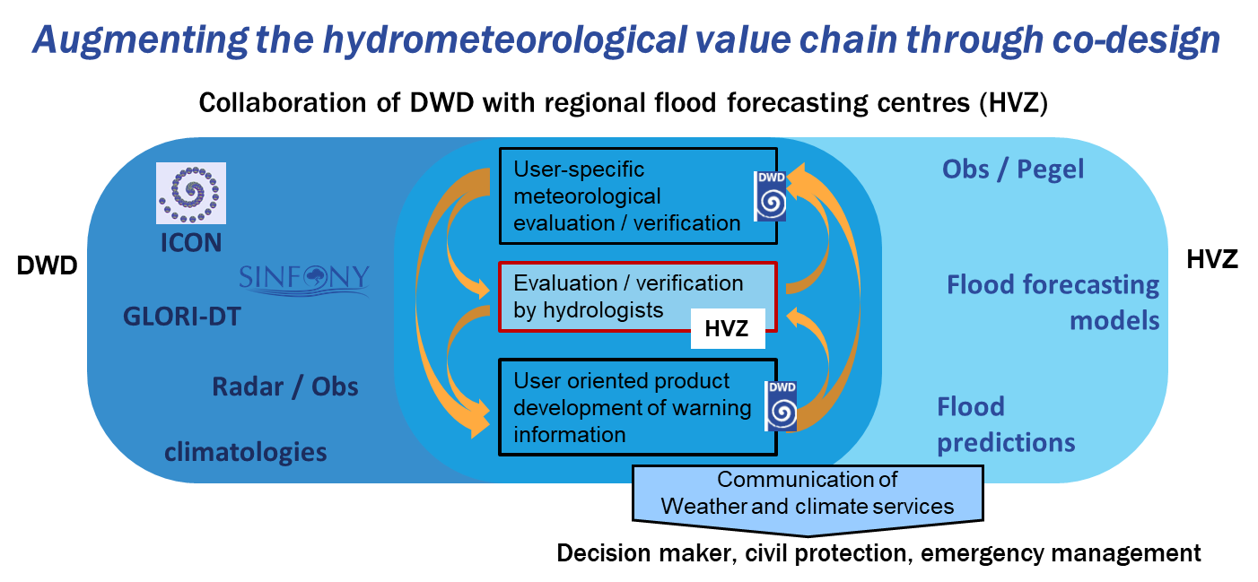
Floods: user-oriented evaluation
Vanessa Fundel
2022
Chiara Marsigli
18

Slide 19
GLORI Coordination (I)
Coordination Group:
  Chiara Marsigli (DWD)
  Marco Arpagaus (MCH)
  Pier Paolo Alberoni (ItaliaMeteo/Arpae)
  Paola Mercogliano (CMCC)
  Antonio Vocino (MeteoAM)
  Ali Hoshyaripour (KIT)
  Stefan Kollet (FZJ)
  Claudia Volosciuk (IDEA-S4S coordinator, DWD, German side)
  IDEA Italian coordinator
Task: Project coordination (check progresses and milestones, check the usage and need of resources, relation with other projects and institutions)
Meet regularly (twice per year; on-demand when needed)
For political decisions -> go to trilateral meeting
2022
Chiara Marsigli
19

Slide 20
GLORI Coordination (II)
Working Groups (with proposed WG chair):
  WG IG2R Configuration:
  T. Steinert, H. Anlauf, T. Gastaldo, M. Arpagaus, A. Vocino, A. Campanale, A. Hoshyaripour
  WG Data Assimilation:
  H. Anlauf, C. Schraff, K. Stephan, T. Gastaldo, V. Poli, C. Merker, M. Arpagaus, A. Vocino, M. Raffa, A. Hoshyaripour
  WG Infrastructure (also: link with ECMWF and DestinE):
  R. Potthast, X. Lapillonne,, A. Vocino, D. Cesari, A. Hoshyaripour, G. Scipione, G. F. Marras
  WG GPU Porting:
  X. Lapillonne, H. Anlauf, M. Jacob, T. Hüter, A. Hoshyaripour, A. Vocino
  WG Model Improvement:
  P. Mercogliano, L. Schlemmer, G. Zängl, S. Kollet, C. Marsigli, J.-P. Schulz
  WG4 Validation and Impacts + connection with users
  C. Cacciamani, A. Hoshyaripour, V. Fundel, C. Volosciuk, M. Adinolfi, A. Vocino
2022
Chiara Marsigli
20

Slide 21
GLORI Alps - Milestones
2023
Milestone 1: GLORI-Alps Basic-Version technically working (13-6.5-1 km resolution), 40 members DA-Cycle as baseline, initial higher resolution technically working
2024
Milestone 2: Higher-resolution and On-Demand GLORI-Alps and GLORI-Med working technically, selected cases of improved quality for selected scores and quantities
2025
Milestone 3: Higher-resolution cases working in case studies with improved quality on selected scores and quantities
2026
Milestone 4: Well-documented On-Demand Global-to-regional Digital Twin with high-resolution global (<= 3.25 km det) and regional (500 m) usable with clearly improved quality vs the baseline

Slide 22
GLORI Alps - Gantt

Slide 23
Thank you for your attention!

