Slide 1
SCA Report for ICON-NWP and still: COSMO-Model and INT2LM
Ulrich Schättler, Daniel Rieger
Source Code Administrators

Slide 2
Contents
COSMO 6.0 and INT2LM 3.0
Latest ICON Releases
Working with ICON
License and Support Issues
ICON Projects

Slide 3
COSMO 6.0 and INT2LM 3.0

Slide 4
The Final Steps
On December 14th, 2021, the final versions of COSMO and INT2LM have been published.
5.13 (09.11.21): Adaptations to latest COSMO-ART version
5.14 (07.12.21): Update of SNOWPOLINO; data assimilation fixes
All parts of the documentation have been updated and are available with DOIs.
Since then we are in maintenance mode.

Slide 5
Problems Already Reported
For COSMO
For INT2LM
10.12.21 | MCH | No proper domain check in LHN.
04.01.22 | CLM | Averaged fields in first output after a restart are not correct. Only occurs for settings as hcomb=24,48,1. Ok for hcomb=0,48,1 or also for hcomb=23,48,1.
04.03.22 | GPU | Removed vector index lists in Tiedtke-Bechtold convection (conv_cuascn.f90) due to a compiler problem with new PGI compiler.
30.05.22 | URB | Variable tcm in turb_transfer.f90 has to be INTENT(INOUT) instead of INTENT(OUT). Important for itype_kbmo_uf > 0 or lurbfab.
31.08.22 | LEPS | Reading GRIB 2 meta data for special local section 28: global communication problem in src_input.f90.
08.03.22 | CLM | Value, which is read for vcflat_in from a NetCDF file is not set to global value vcoord_in%vcflat (only problematic, if vcflat for driving model is not the default).

Slide 6
Actions Taken
Problems are rather „isolated“, so no official updates have been provided.
Fix for Tiedtke-Bechtold convection has been implemented in github-master (for ETH Zürich).
Fixes for LEPS, Tiedtke-Bechtold convection and Turbulence (GPU) have been implemented in ECMWF version cosmo_211214_6.00 (cca and new hpc) for interested users (on August 31st)
CLM community offers fixes for the restart problem and INT2LM.
MCH is working on consolidation of SNOWPOLINO. Together with this update we can officially implement above fixes.
How / Whether to integrate work from PT VAINT (CLM work for vegetation).

Slide 7
Latest ICON Releases from the Protocol of Release Commits

Slide 8
ICON 2.6.4 (28.09.21)
Large refactoring of infrastructure modules by DKRZ
Cleanup: Removal of Hydrostatic Core, PSRAD and RG radiation, #ifdef COSMO
Synchronize effective radius calculation between radiation and microphysics
Improved description of gravity waves emission in SSO scheme
Revised upper boundary condition for vertically nested grids: reduces spurious reflection
Optional diagnostics of lightning potential index (LPI, see Reports on ICON - Issue 010)
New option for adaptive pressure bias correction at lateral boundaries (LAM only)
Reintroduce an optimized reading of Kinne aerosols (read only the required months)
Fix for the soil water budget with snow tiles
OpenACC port for LHN code

Slide 9
ICON 2.6.5 (29.07.22)
Direct usage of netcdf instead of CDI for restart I/O (old restart files with new version works, but not vice versa)
Cleanup: Removal of Ritter-Geleyn radiation scheme, synchronous lateral boundary condition read
Optional diagnostics: sunshine duration, accumulated snow melt
Extension for upscaling additional (optional) input fields to the reduced radiation grid
Introduction of the ICON Single Column Model
Kinne aerosol climatology for ecRad
New Namelist variable czbot_w_so: user defined thickness of the hydrological active soil layer for TERRA
Bugfix for accumulated runoff
Buildbot update & integration in Gitlab (https://gitlab.dkrz.de/icon/wiki/-/wikis/How-to-use-the-new-buildbot)
Optional Transient solar radiation for ICON-NWP

Slide 10
ICON 2.6.5 (29.07.22); cont.
CSCS: introduction of more and optimized OpenACC code parts and introducing work to allow for more modularization later to improve and consolidate the ICON code => ICON-C
MCH: providing more model components of NWP physics for use on GPUs.
First Steps for ICON-SEAMLESS
allow coupled ocean/atmosphere simulations using ICON-NWP atmosphere, ICON-O ocean, TERRA land and sea-ice dynamics. Coupling is done with YAC2
JSBACH/VDIFF: provide downwelling shortwave fluxes as well as their diffuse fractions as additional fields in NWP diagnostics needed as input for JSBACH.

Slide 11
Some Comments
Release Notes are available on
https://gitlab.dkrz.de/icon/wiki/-/wikis/Protocol-of-Release-Commits
But you need gitlab access to be able to read them (see following slides)
For me it is still hard to filter out the most important informations for NWP (generally: look for DWD commits).
Often a note in the Release Commits points to the commit in icon-nwp/master.
Plan: Make NWP relevant Release Notes publicly available for all users outside the gitlab.

Slide 12
Working with ICON

Slide 13
Available Information on ICON
ICON Transition: http://cosmo-model.org/content/support/icon/default.htm
ICON Tutorial (for users and developers)
Comprehensive manual for getting started with ICON.
ICON for Developers (for developers)
Short description on how to get access to the ICON gitlab and install the model.
Reports on ICON (for all)
Series of non-peer-reviewed articles dedicated to the numerical weather prediction and climate model ICON.
https://www.dwd.de/EN/ourservices/reports_on_icon/reports_on_icon.html
Further Reading (for all)
https://code.mpimet.mpg.de/projects/iconpublic

Slide 14
Important Changes in ICON Operational Suite
Enhancement in the vertical resolution:
Number of vertical levels will be enhanced from 90 to 120 levels.
More levels added in the stratosphere, which reduces wind and temperature forecast errors in the stratosphere by about 5 %.
Requires modifications in INT2LM namelist group /GRID_IN/:
ke_in_tot = 120 was 90 before
nlevskip = 31 was 20 before
Introduction of a new orography data set for the global ICON:
Necessary change for COSMO applications:
Do not use old icon_hhl-files any more. HHL is now distributed with every data set igfff00000000 and icon_hhl files must not be used any more!

Slide 15
ICON on ECMWF Computers: Cray (cca)
Running newer ICON versions than 2.6.3 on cca is not possible due to Cray compiler problems (cce 8.7.7 is the last compiler version installed. No newer compiler version will be installed any more).
This system will be decommissioned in the next months.

Slide 16
ICON on ECMWF Computers: New hpc (ATOS)
Two config-scripts are provided on the new machine in Bologna:
atos2020.gcc-11.2.0: for GNU compiler suite with OpenMPI:
significantly slower than Intel version
atos2020.intel-2021.4: for Intel compiler with a special Mellanox OpenMPI version (hpcx-openmpi)
OpenMP without ecrad now working: export OMP_PLACES=threads
Also problems with OpenMP and ecrad seem to be solved (to be verified).
NOTE:
On the new ATOS system you will need more cores to run your application in the same time as on the Cray system.
This is most probably due to memory bandwidth.
ATOS has 4x number of cores, but only 2x memory per node compared to cca.

Slide 17
ICON on ECMWF Computers (cont.)
Things to discuss:
COSMO-LEPS has to be ported to new system because of decommission of the old Cray system (with COSMO 6.0, INT2LM 3.0, GRIB 2).
ICON-LEPS: Discussions are ongoing, how to upgrade (higher resolutions need much more Billing Units (BU).
NWP Testsuite
Buildbot tests for ICON on the new system may be possible:
Contacted User Support before summer holidays.
Discussions will go on, once Bologna Computing Center „is settled“.
But would need additional Billing Units! (Not clear, how many).

Slide 18
License and Support Issues

Slide 19
Still under Construction
Usage of ICON is for free. Even an Open Source License is under discussion.
COSMO / DWD will provide a commercial license for „Delivery of Software and Meteorological and Climatological Support Services for Official Duty and Scientific Purposes“: to be discussed by STC this week.
This license comprises
Use of COSMO Software:
MEC, DACE, Rfdbk
Services:
Provision of initial and lateral boundary data
Support for use of ICON and COSMO-Software provided by COSMO
Proposal for a new COSMO-PP: C2I4LC
Main task: set up a support infrastructure

Slide 20
ICON Projects

Slide 21
ICON Seamless
NWP plus climate forecasting with ICON-A-O-L and Data Assimilation.
Initiated by the directors of DWD, MPI-M, KIT and DKRZ in October 2020.
Expert Groups (Atmosphere, Ocean, Land, Data Assimilation) started work in 12/2020.
First prototype available in icon-nwp master:
Allows coupled ocean/atmosphere simulations using ICON-NWP atmosphere, ICON-O ocean, TERRA land and sea-ice dynamics; thermodynamics components from FESOM2. Coupling is done with YAC2.
JSBACH/VDIFF: provide downwelling shortwave fluxes as well as their diffuse fractions as additional fields in NWP diagnostics needed as input for JSBACH.

Slide 22
ICON-C (full name: ICON-Consolidated)
ICON-C is an infrastructure project with the following objectives:
Make ICON more modular: encapsulate components with clear interfaces.
Allow for more scalable development workflow: especially for an improved testing of individual components.
Define a new development process: how to implement major / minor changes and bug fixes.
The new code should allow for all needed climate and NWP operational applications.
Most work will happen in the Fortran code, but a rewrite of components in other languages is not part of ICON-C. But ICON-C should allow easier interfacing with other languages.

Slide 23
ICON-C Explained (or better: as I see it)
Encapsulate components:
Try to build a „TERRA standalone“ or a „Microphysics standalone“:
That was hard in COSMO
It is a nightmare in ICON, because of really many inter-dependencies.
ICON-C tries to find a way to encapsulate such components by finding „alternative ways“ to provide the necessary data to a special component.
How to allocate memory for fields?
How to access fields (inter-language operable)?
How to provide fields or scalar data to a component?
This will need a more modern programming style (not with USE or standard interfaces).
Hope: Such a component can be put to a different framework easily.

Slide 24
Prototype Works / Concepts
Modularization interfaces design for ICON-C
The Memory Interface
The Community Interface
Refactoring of initial conditions component
BUT:
For the next 2 years (at least) we will still work with the icon-nwp/master, as it is right now!

Slide 25
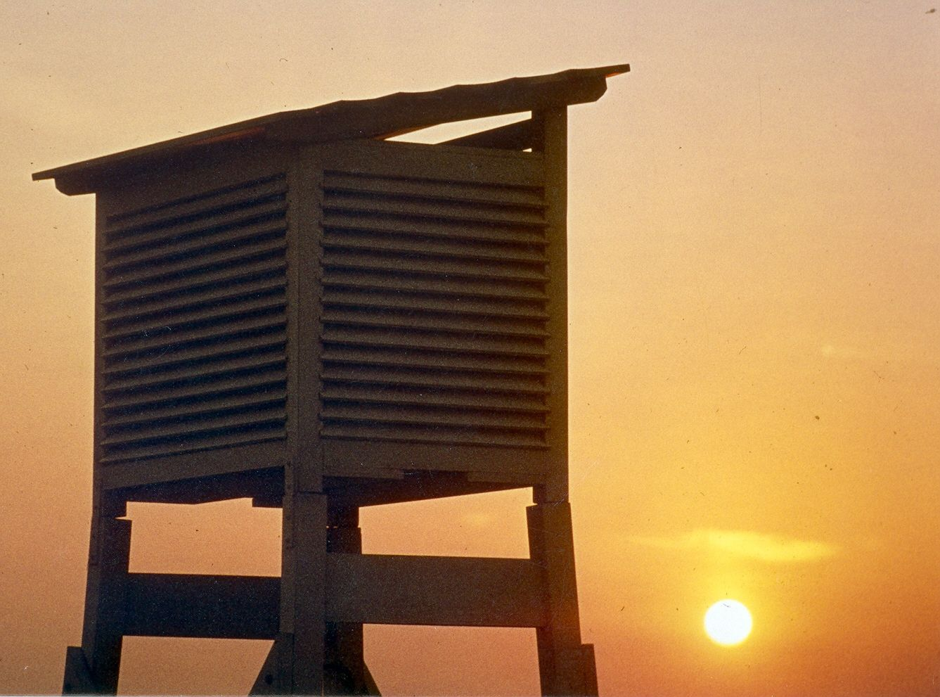
Thank you very much for your attention!

