Slide 1
Overview on KENDAscope developments
KENDAscope: KENDA from Surface to Cloud Observations Progressive Extension
(Sept. 2020 – Aug. 2025)
Task 1: algorithmic developments
  1.1 refinements of reference KENDA (currently LETKF)
  1.2 Variational DA (EnVar , CEnVar, 4D-EnVar)
  1.3 Particle Filter
Task 2: observations (from surface to clouds)
  2.1 Radar (Z + Vr)
  2.2 ground-based GNSS ZTD + STD
  2.3 all-sky IR + VIS radiances
  2.4 MTG IRS
  2.5 screen-level obs (T2M, RH2M)
  2.6 PBL profiling obs (wind lidar, MW radiometer, Raman lidar, drones, towers)
Task 3: soil / surface (satellite soil moisture, SST, …)

Slide 2
Task 1.1: Refinements on reference KENDA
Operational changes
DWD (ICON) (Hendrik Reich, Christoph Schraff, Klaus Stephan, et al.)
19.01.2022: major revision of latent heat nudging (LHN)
23.03.2022: new (v.2.2) high-density Mode-S aircraft data
04.07.2022: extension of model – DA coupling
(adaptive tuning of thermal conductivities of soil + skin layer, thermal capacity of soil, snow albedo
based on filtered T2M + RH2M analysis increments)
MeteoSwiss (COSMO) (Daniel Leuenberger, Claire Merker, Daniel Regenass, et al.)
27.09.2021: T2M + RH2M (w/o bias correction, in COSMO)
08.03.2022: wind lidar at 3 stations (Payerne, Grenchen, Schaffhausen)
30.05.2022: new (v2.2) high-density Mode-S aircraft data
10.08.2022: microwave radiometer (MWR) at Payerne
ARPAE (COSMO) (Thomas Gastaldo, Virginia Poli)
spring: radar radial velocity (Italian radars)

Slide 3
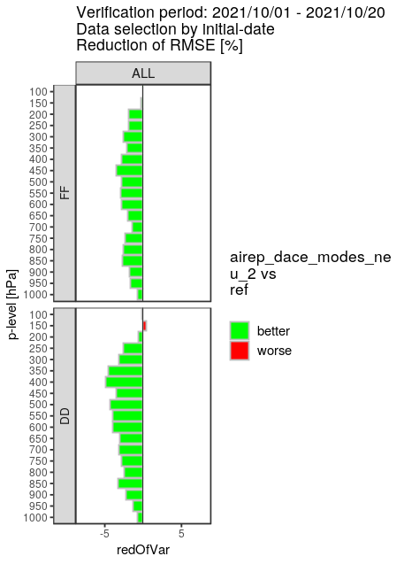
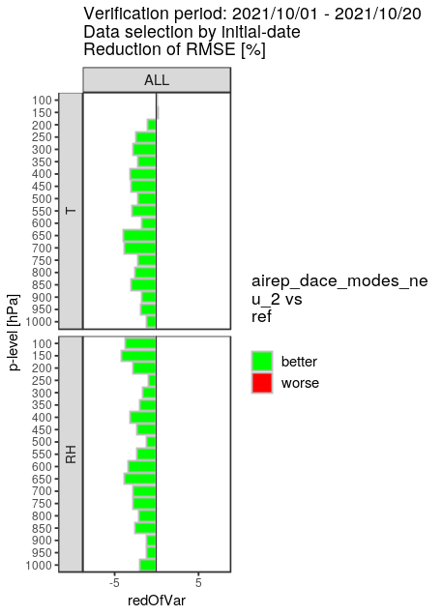
Task 1.1: Refinements on reference KENDA
operational changes
EMADDC: “European Meteorological Aircraft Derived Data Centre“
processed + quality controlled by KNMI (avail. on ftp server)
new v2.2 Mode-S aircraft obs:
~ 45 / 25 million wind / T obs per day! (> 100 times more)
at DWD only affordable
with revised
‘unified DACE obs operators
→
rmse reduced by 3 – 4 % in radiosonde verif (also on humidity despite no additional humidity obs) →
positive impact on precip,
on all variables in Synop verif,
reducing spin-down in clouds

Slide 4

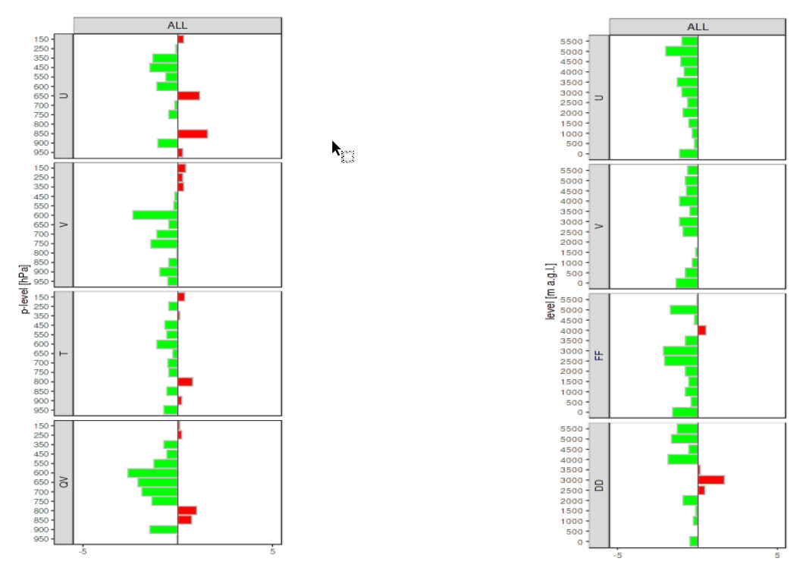
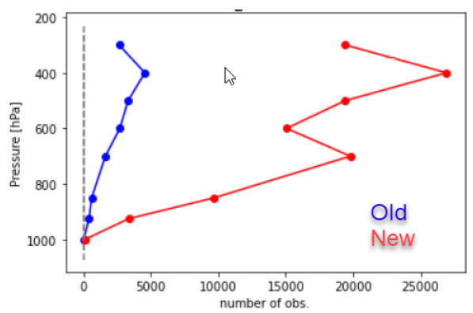
Task 1.1: Refinements on reference KENDA
operational changes
Assimilation of MODE-S v2.2 Stream
TEMP verification
WPROF verification
Operational since 30.05.2022
Number of obs (28.03 – 05.04.2022)
% change in CRPS
averaged over all LT
% change in RMSE
averaged over all LT

Slide 5
Task 1.1: Refinements on reference KENDA
MeteoSwiss outlook
Outlook at MeteoSwiss for next year
(Daniel Leuenberger, Claire Merker, Daniel Regenass, Bas Crezee, Marco Arpagaus)
Developments with COSMO
  Raman Lidar (Q4 2022)
  high-res ascent and descent TEMP observations
Introduce ICON to KENDA-1 (+ tuning of obs errors, localization radius, etc.)
Developments with ICON
  Assimilation of 3D Radar Reflectivity (particular issues with complex topography)
  Extension to OPERA composite for LHN
  Assimilation of Meteodrone Observations
  Assimilation of additional surface stations in Switzerland

Slide 6
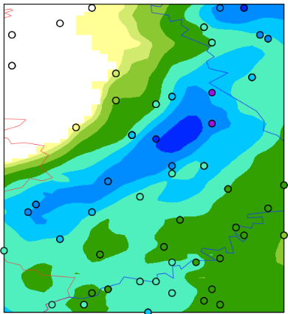
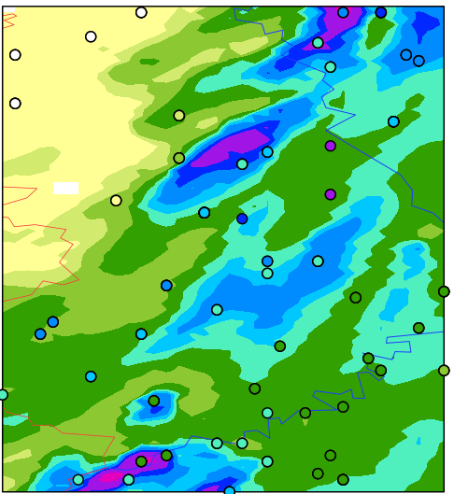
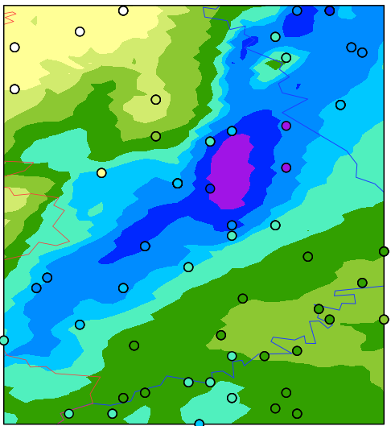

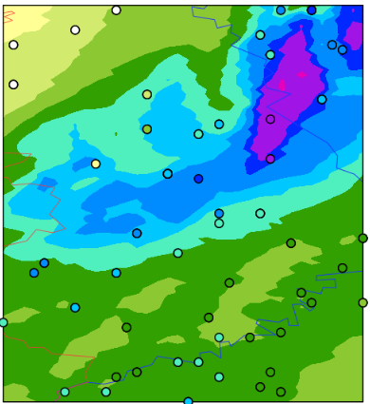
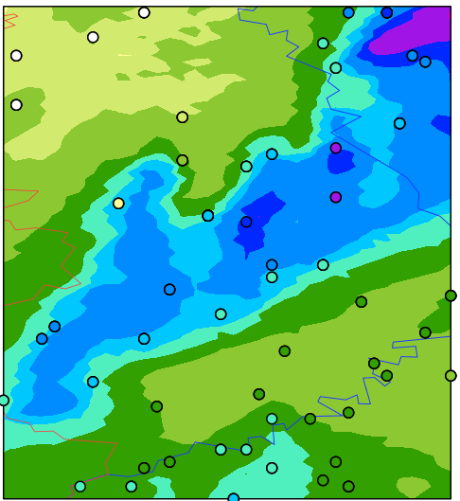
Task 1.1: Refinements on reference KENDA:
revision of Latent Heat Nudging
Obs (EW 16 UTC)
operational
noLHN
(Klaus Stephan)
15
UTC
+1h
[mm/h]
12
UTC
+4h
background: precip underestimated in very-short range forecasts for Ahr flood
event in July 2021 (precip reduced rel. to longer lead times)
bright band detection too active in summer, eliminating far too much correctly observed (strong) precip from convective cells from observation input

Slide 7
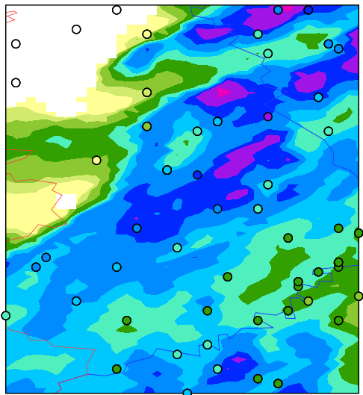
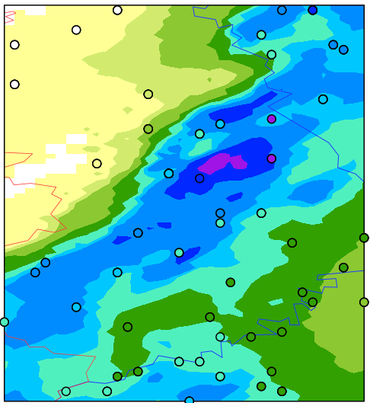
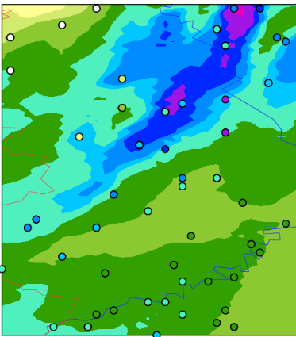
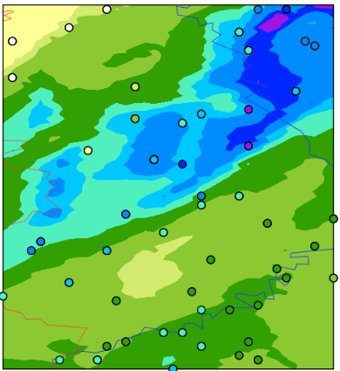
Task 1.1: Refinements on reference KENDA:
revision of Latent Heat Nudging
Obs (EW 16 UTC)
operational
noLHN
“no”brightband
newbright+retune
15
UTC
+1h
[mm/h]
12
UTC
+4h
revision of bright band detection (only active if bright band below 2000 m height)
overestimation of precip in summer, retuning of LHN required
major modification: computed T increments not added, only humidity updated!

Slide 8
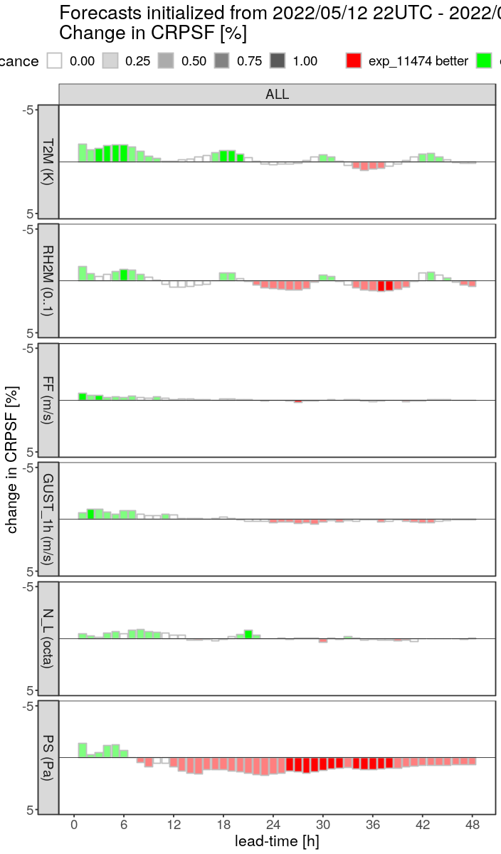
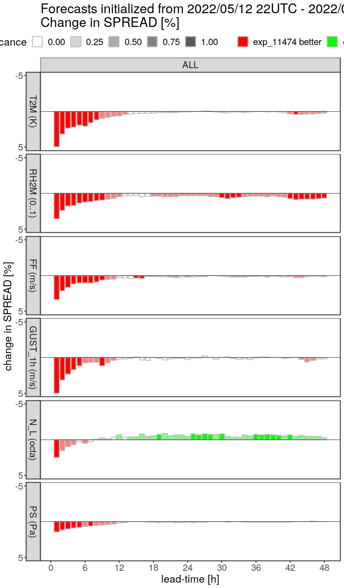
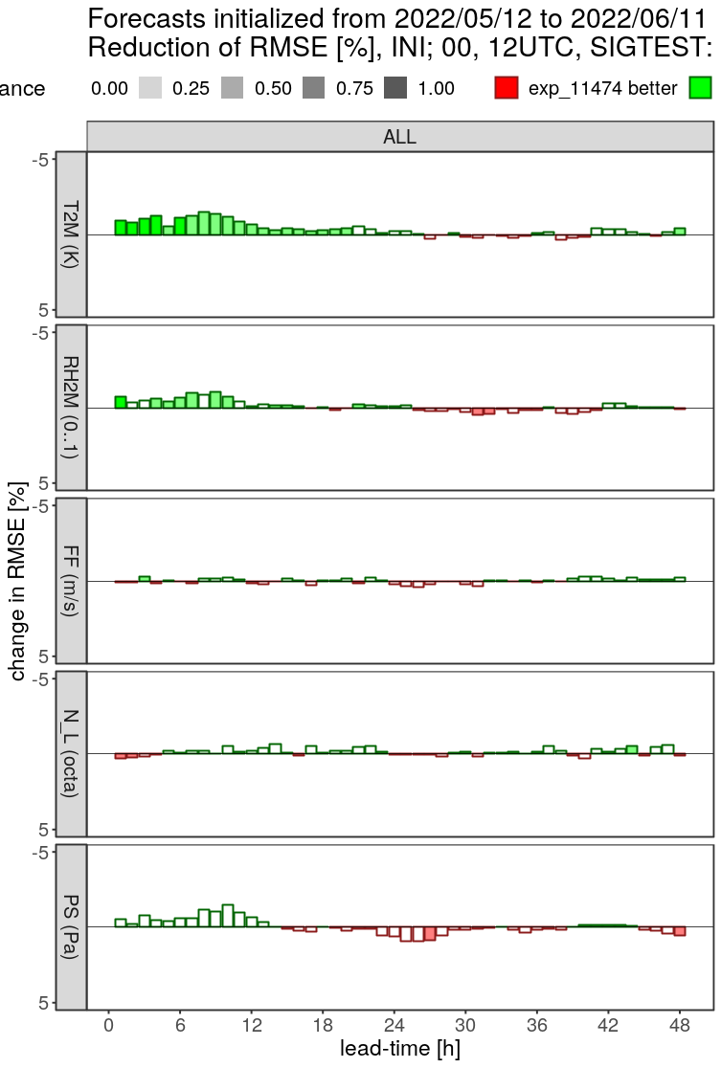
Task 1.1: Refinements on reference KENDA:
parameter perturbation in DA cycle
Perturbation of
18 physics param.
(PPP: similar to
ICON-D2-EPS)
4 LHN parameters
(LHNP)
(Klaus Stephan)
Synop verif.
EPS CRPSF
EPS spread
deterministic: rmse
T2M
T2M
  ↓ PPP ↑
  PPP (+ LHNP) ↑
  improvement !
RH2M
  ↓ PPP + LHNP ↑
RH2M
10-m wind speed
10-m wind speed
gust
low cloud cover
low cloud cover
surface pressure
  → LHNP
surface pressure

Slide 9
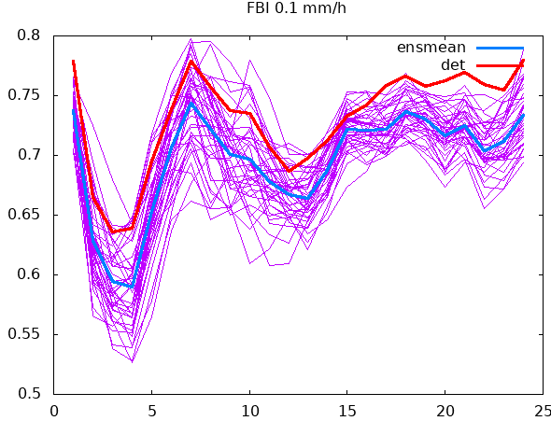
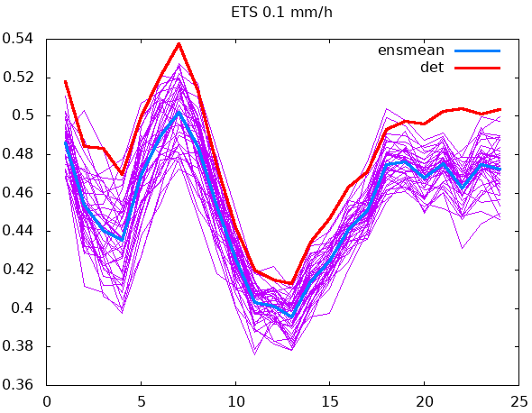
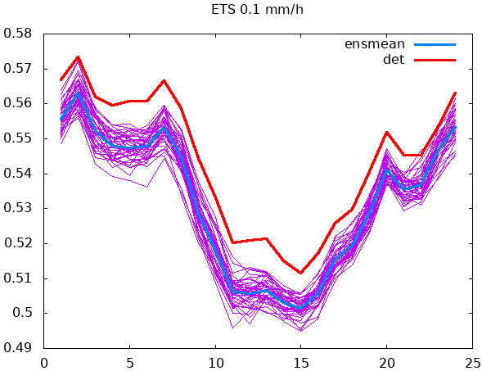
Task 1.1: Refinements on reference KENDA:
evaluation (Klaus Stephan)
systematic differences
in precip between
deterministic run and ensemble
in DA cycle
FBI 0.1 mm/h
ETS 0.1 mm/h
Why does the deterministic FG cycle have
more (frequent, strong) + more accurate precip
than the ensemble members?
covariance inflation (additive, multiplicative, RTPP)
only applied to ENS
→ tested no ACI, no RTPP: little influence
lateral boundary conditions:
resolution (6.5 km vs. 20 km), ACI
→ this has a clear impact
(low resolution: more precip is from convective param.)
ETS 0.1 mm/h
40 day period

Slide 10
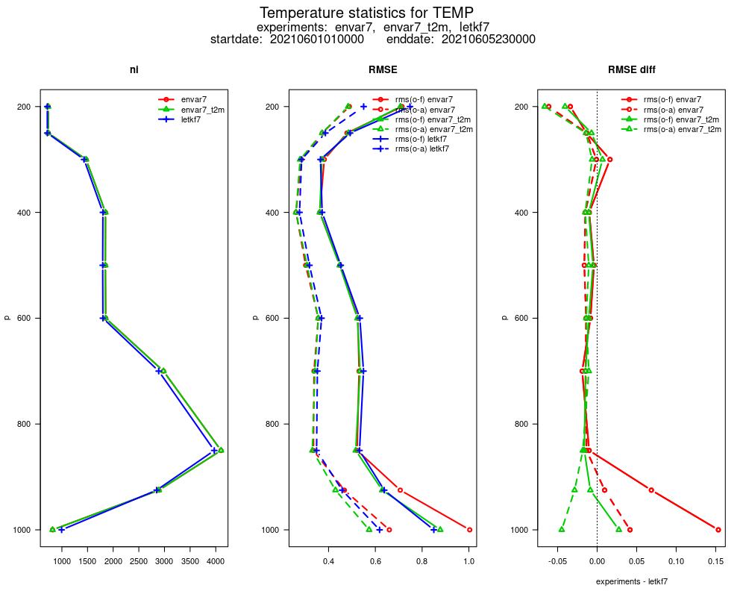
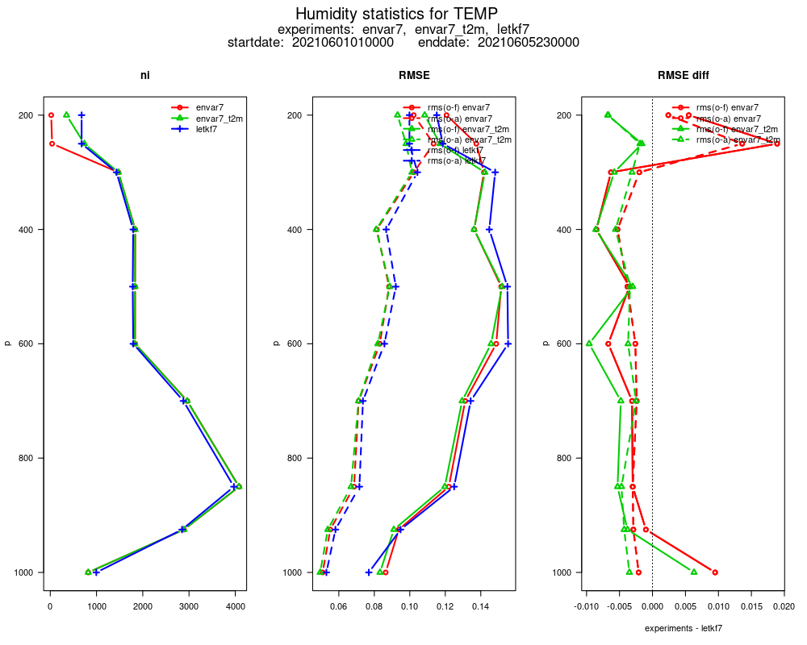
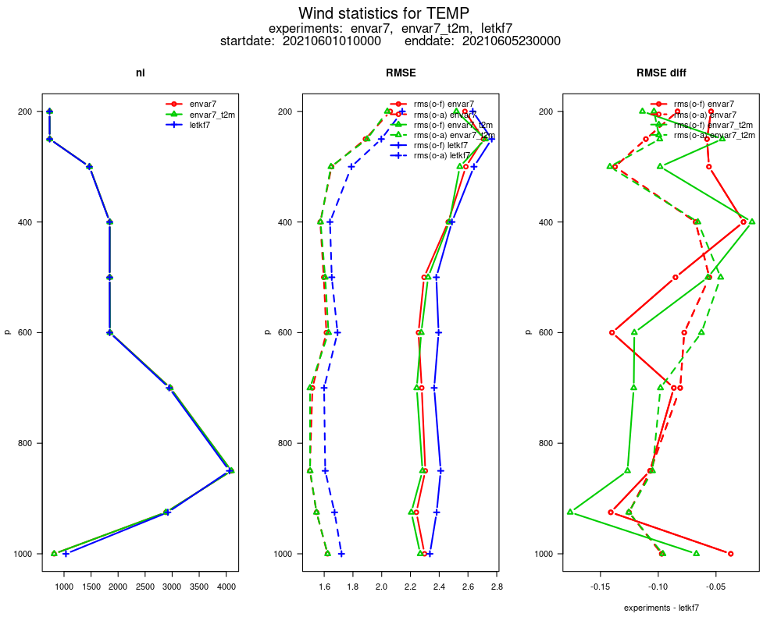
Task 1.2: Variational DA (EnVar, CEnVar)
EnVar for ILAM (Mareike Burba, Stefanie Hollborn et al.)
  runs in a preliminary
  version for
  conventional obs
  (with ‘DACE’
  obs operators)
  5-day test,
  DA of aircraft
  (w/o thinning
  for Mode-S !),
  radiosonde ascent,
  Synop obs:
RMSE
temperature humidity wind
––– FG LETKF
––– FG EnVar
––– FG EnVar
w/o T2M
EnVar has clearly smaller first guess errors (very (!) preliminary but promising result)

Slide 11
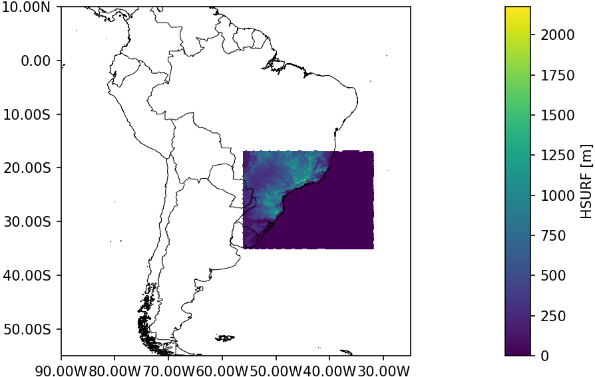
Task 1.2: Variational DA (EnVar, CEnVar)
CEnVar (Sven Ulbrich et al.)
  runs technically with ensemble-B from ICON-EU or ICON-global
  (derived from their complete model fields, or from fields cropped by ICONremap (costly),
  but not yet by ICONsub (cheap, planned for next months))
  first 6-day test
  for southern Brazil:

Slide 12
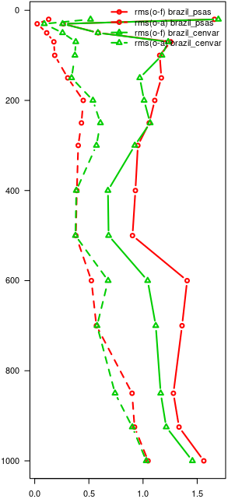
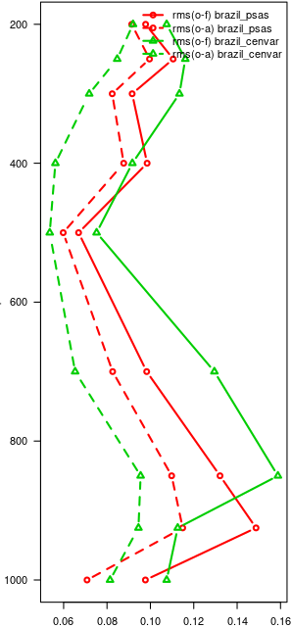
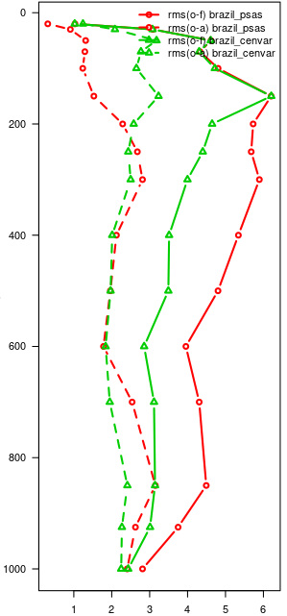
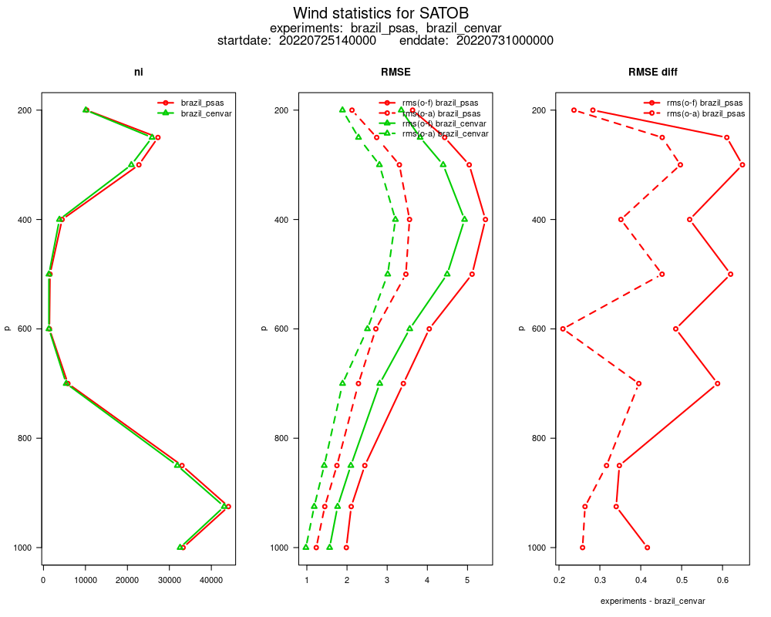
Task 1.2: Variational DA (EnVar, CEnVar)
RMSE
(radiosonde + aircraft, ~ 100 obs per RMSE value)
# obs RMSE
temperature humidity wind
AMV wind (also over ocean)
––– 3DVar FG rmse
––– CEnVar FG rmse
→ much smaller first guess errors with CEnVar (B-matrix purely from global ICON EPS)
compared to 3DVar with (global) climatological matrix (preliminary, but promising result)

Slide 13
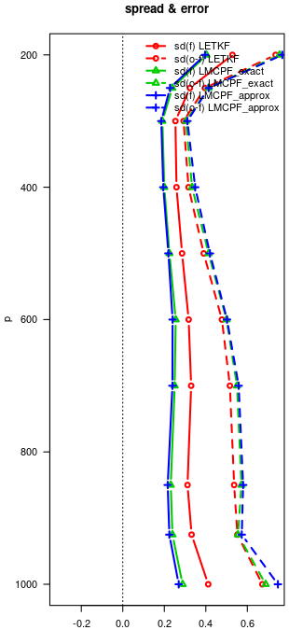
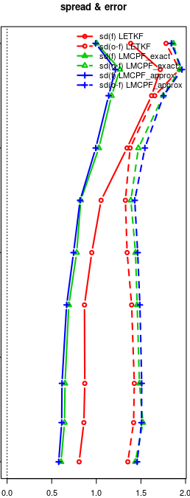
Task 1.3: Particle Filter
Particle Filter for ICON-LAM (Nora Schenk, Anne Walter, Roland Potthast)
revised new particle weights in LMCPF (Localised Mixture Coefficients PF)
→ larger ensemble spread to which PF is very sensitive,
smaller errors
8-day test with ICON-D2
(incl. use radar, T2M, RH2M obs):
  FG ensemble mean vs. LETKF (eval. 5 – 8.6.21):
  FG spread – 30 %, rmse + 5 %
1-month test with ICON-global:
rmse of ens. mean very similar to LETKF
in troposphere
next: further tuning + quality assessment
with ICON-LAM
temperature
wind
LETKF
LMCPF
LMCPF
(approx)
FG
spread
FG
rmse
FG
spread
FG
rmse

Slide 14

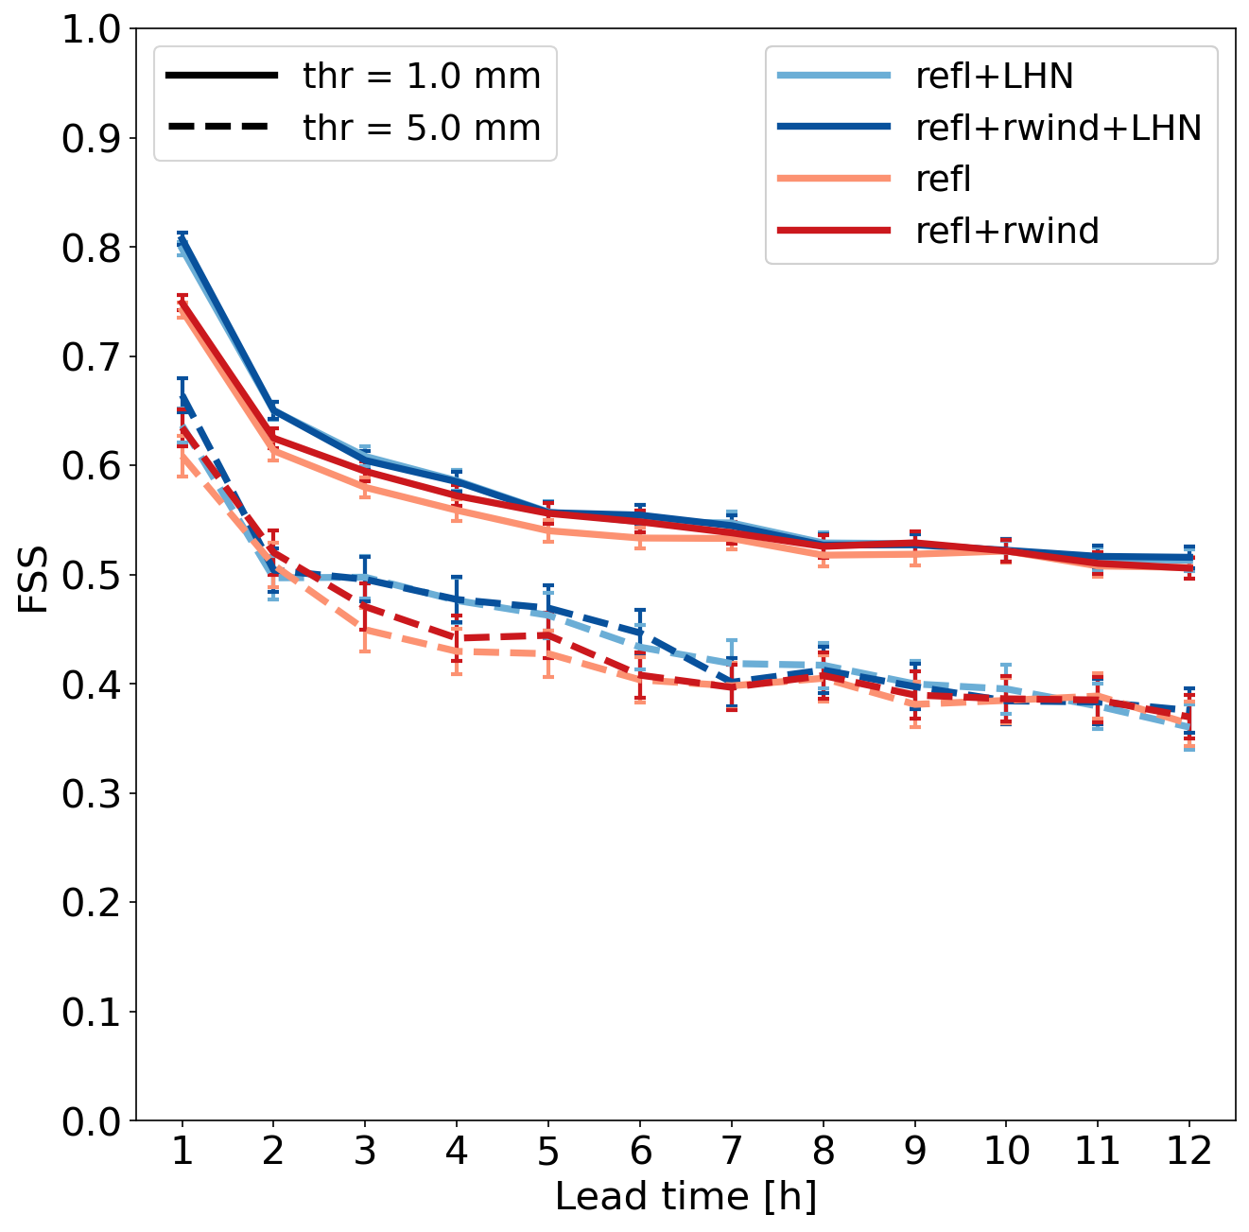
Task 2: Observations (surface to clouds)
Task 2.1: 3-D radar
ARPAE
(Thomas Gastaldo, Virginia Poli)
test (1 month in autumn)
DA of radar radial wind:
  w/o LHN:
  wind, T, humidity (up-air + sfc)
  + precip (slightly) improved
  with LHN:
  neutral, except
  wind, T (upper-air + surf.)
  slightly improved
introduced operationally in spring 2022
estimation of obs errors by Desroziers statistics (as. fn. elevation, vert./horiz. distance)
+ obs error correlations; small benefit if very large obs error in case of small Z is reduced

Slide 15
Task 2: Observations (surface to clouds)
3-D radar
DWD (Kobra Khosravian, Klaus Vobig, Lisa Neef, Jana Mendrok, Klaus Stephan, Uli Blahak…)
reflectivity:
  sensitivity tests rel. to obs errors (10 dBZ → 4 – 7 dBZ)
  testing / adjustment to 2-moment microphysics (also model tuning!)
  testing targeted covariance inflation (where missing precip / spread)
prepare for processing / use foreign radars (BUFR → ODIM HDF5)
WG1: assimilation of radar-derived objects / lightning / nowcast cell features / FSS (ongoing)
WG1: assimilation of dual-polarization moments (direct / hydrometeor mixing ratio retrieval)

Slide 16
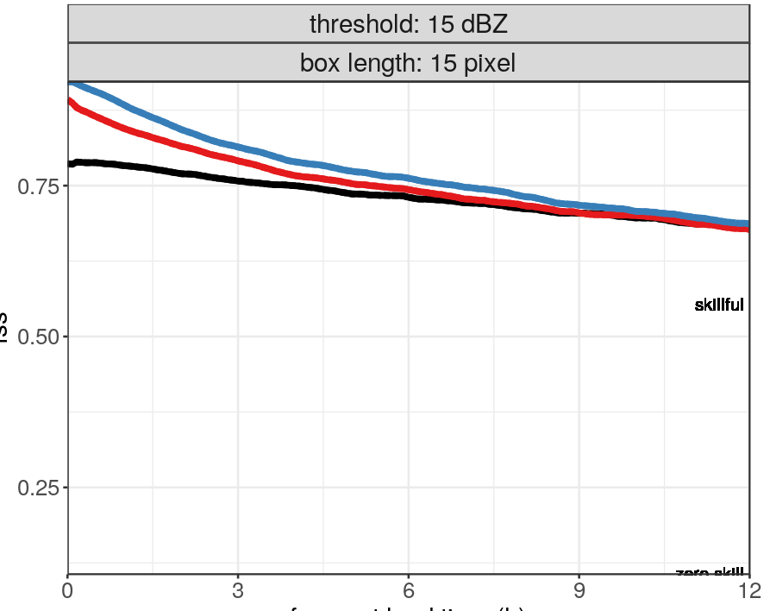
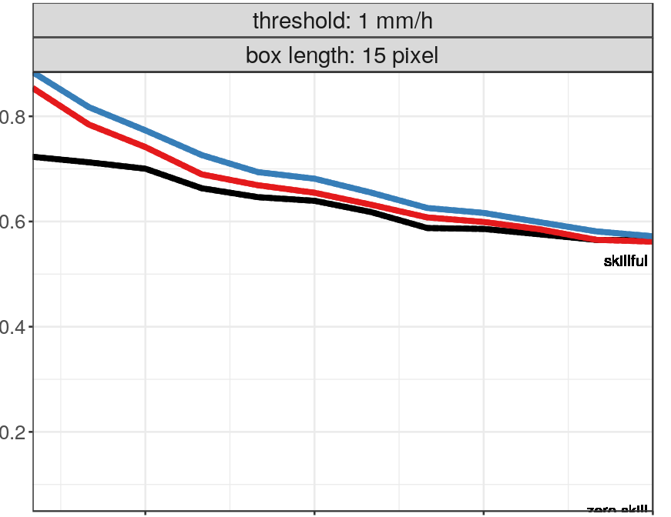
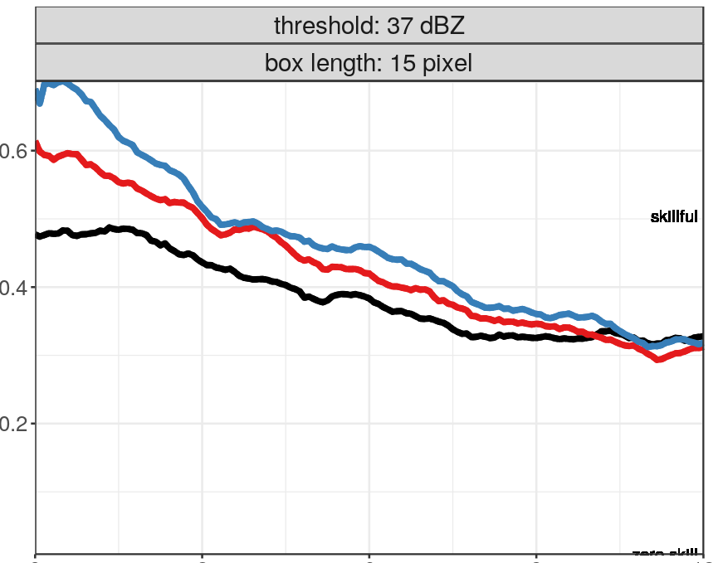
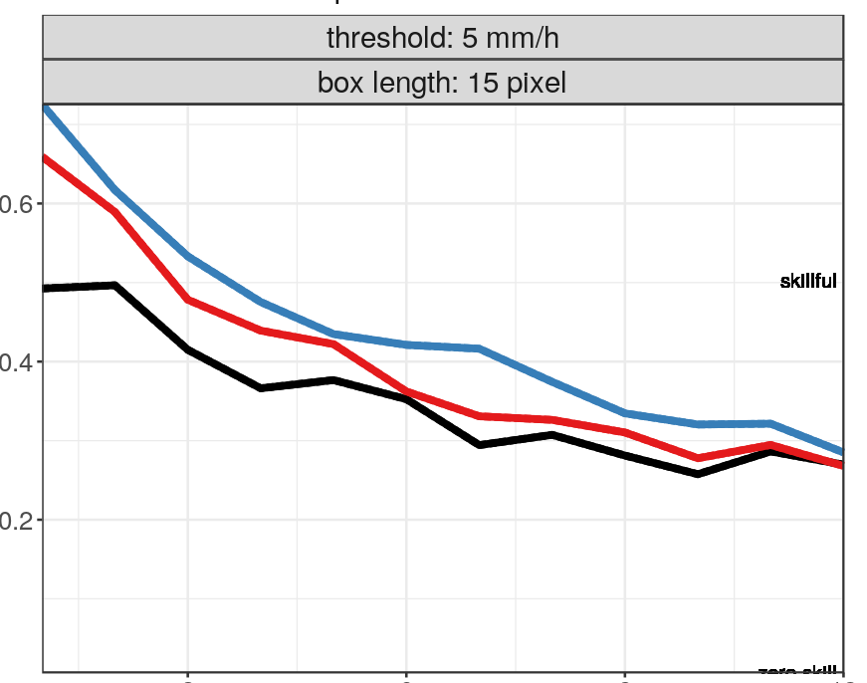
Task 2: Observations (surface to clouds)
3-D radar
testing radar DA
with 2-moment
microphysics
reflectivity
precipitation
0.8
1 – 14 July 2021
scores over Germany
averaged
over all 8 initial times
0.75
0.6
0.50
0.4
0.25
0.2
thr: 1 mm/h
thr: 15 dbz
FSS
30 km
2mom
2mom + LHN
2mom + LHN + radar
0.6
0.6
0.4
0.4
→ long-lasting
positive impact
both from LHN
and 3-D radar
0.2
0.2
thr: 37 dbz
thr: 5 mm/h
0
3
6
9
12
0
3
6
9
12
22nd EMS
5-9 Sep 2022
Kobra Khosravian
forecast lead time (h)
forecast lead time (h)
4

Slide 17
Task 2: Observations (surface to clouds)
3-D radar
obs operator EMVORADO adapted to process radar data from neighbouring countries of D
technical tests done (passive / active use), DWD settings (superobbing, etc.)
Country | Stations | Reflectivity | Radialwind
Germany | 17 | 1.5, 3.5, 5.5, 8, 12° | 0.5, 1.5, 3.5°
Switzerland | 5 | -0.2, 1.0, 1.6° | none (too low NI)
France | 20 | 0.7 – 2.2, 2.8 – 4.0, 5.0 – 8.9° | 0.4 – 2.2, 2.8 – 3.2°
Belgium | 2 | none | none | technical issues
Netherlands | 2 | 0.3, 0.8, 1.2, 2.0, 2.8° | 0.3, 0.8, 1.2, 2.0, 2.8°
Denmark | 5 | 0.7, 1.0, 1.5, 4.8, 8.5, 10° | 0.5, 0.7, 1.0, 1.5° | 120 km range for wind optimized data
Poland | 8 | 1.4, 2.1, 3.4, 5.5, 7.7, 10.6° | none (no corresponding Z)
Czech Republic | 2 | 0.1, 0.9, 1.3, 1.7, 2.2, 3.2, 6.3° | none (too low NI)
In total: 8 | 61 | ~40 elevations | ~16 elevations

Slide 18
Task 2: Observations (surface to clouds)
Task 2.2: ground-based GNSS Zenith / Slant Total Delay (M. Bender)
code developed for operational applicability
(e.g. new STD BUFR converter /reader, more accurate geoid,
selective DB retrieval, feedback file extensions, …)
new GFZ EPOS8 ultra-rapid product (ZTD + STD available 15 min after full h) stored
(more products need to be collected)
first DA experiments with ICON-D2 just started
later on also needed: improved bias correction + obs error specification

Slide 19
Task 2: Observations (surface to clouds)
SEVIRI VIS (visible channel)
  (Lilo Bach, Thomas Deppisch, a.o.; Alberto de Lozar a.o.)
  VIS: sensitive also to low cloud / to cloud properties (cloud water mass, optical properties)
  technical work → operationally applicable
  interaction DA – model physics: ICON-D2 needs too much humidity / instability
  to produce convective precip
  → too little precip + too much humidity (partly due to LHN), too much cloud (esp. DA cycle)
  → DA of VIS reflectance (strongly sensitive to water cloud) reduces cloud + humidity

Slide 20
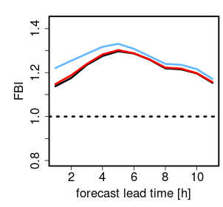
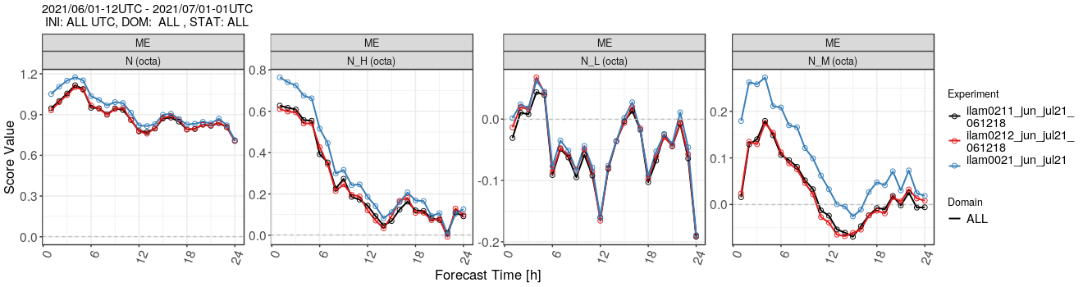
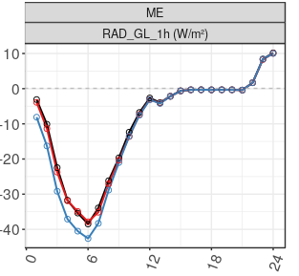
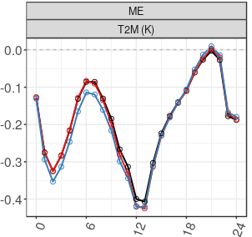
Task 2: Observations (surface to clouds)
SEVIRI VIS
impact on forecast bias
reduced number of clouds & reflectance
SEVIRI
SEVIRI-BC
REFERENCE
frequency bias: reflectance
bias
high cloud cover
mid-level cloud cover
reduced cloud cover bias
reduced negative bias in global radiation
reduced cold bias in 2m altitude
global radiation
2m temperature

Slide 21
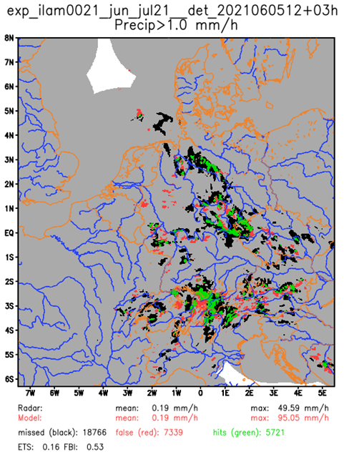
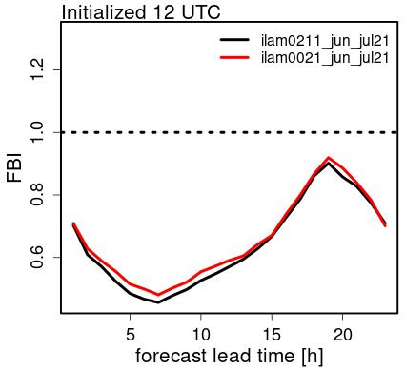
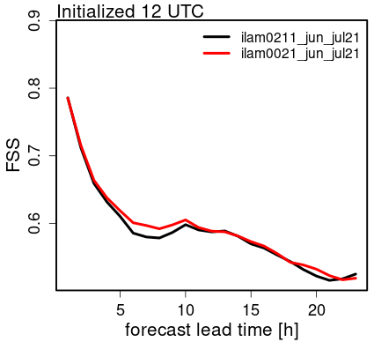
Task 2: Observations (surface to clouds)
SEVIRI VIS
by reducing humidity / clouds, VIS tends to reduce precipitation events even more
precip (thresh. 1 mm/h , 11 g.p., June 2021)
False Alarms
Misses
Hits
precip
FBI
precip
FSS
ref. DA
with VIS
ref. DA
with VIS
no solution without reduction of model biases
→ adjusting parameter (‘tune_box_liq’) of cloud cover scheme (less cloud at same RH)

Slide 22
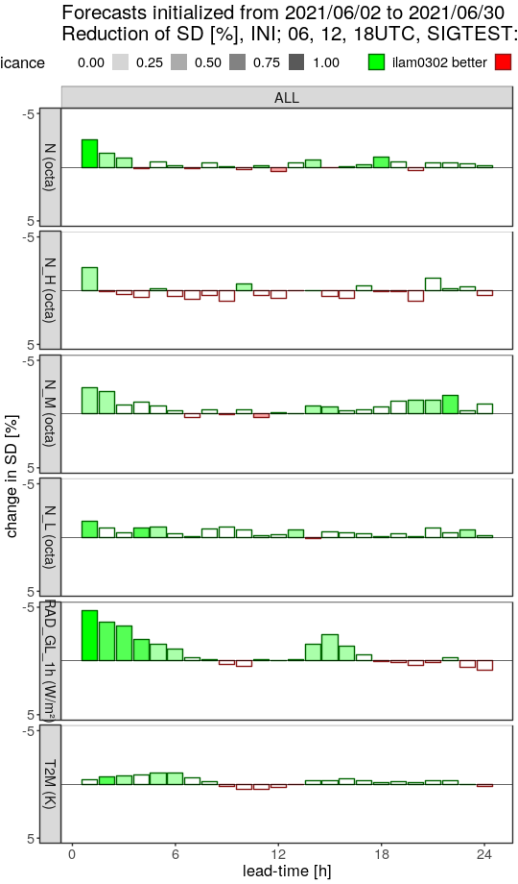
Task 2: Observations (surface to clouds)
SEVIRI VIS
Synop verif.
June 2021
06, 12, 18-UTC runs
tune_box_liq = 0.035
adjusting parameter (‘tune_box_liq’)
of cloud cover scheme (reduces cloud)
→ VIS DA: less impact on biases
still positive impact on cloud etc.
negative impact on precip clearly reduced
→ further re-tuning required (global radiation too small
in summer, but too large in winter)
std. dev.
change [%]
total cloud cover
high cloud cover
mid-level cloud cover
change in ICON, likely soon in parallel routine:
account for latent heat of sub grid-scale condensation:
→ also helps to enhance convection
(slightly) reduces precip (and cloud) bias in summer
NUMEX experiments ongoing
for preparation of active DA of SEVIRI-VIS in
  ICON-D2 parallel routine
  ICON-RUC 24/7 test system
low cloud cover
global radiation
2-m temperature

Slide 23
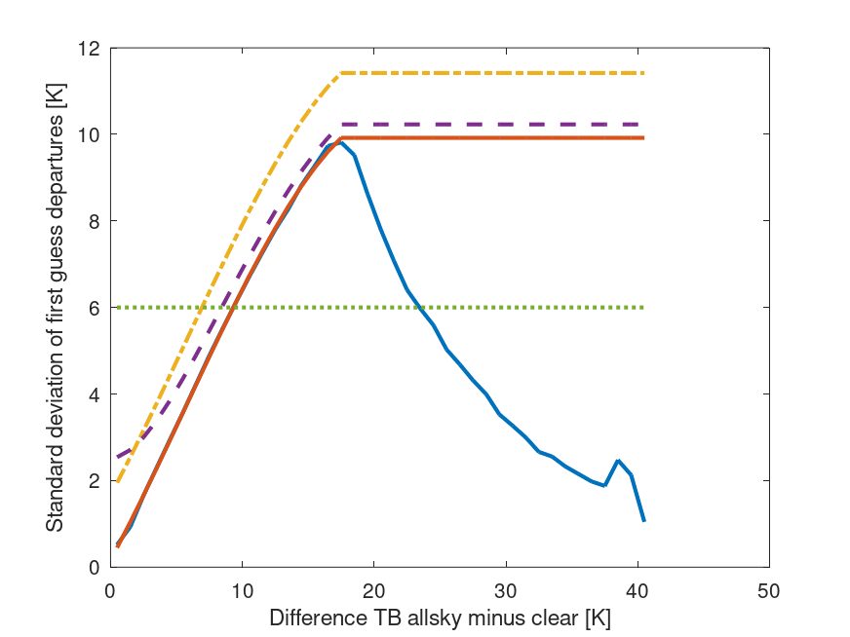
Task 2: Observations (surface to clouds)
SEVIRI IR WV (water vapour channels)
(Annika Schomburg a.o.)
sensitive to water vapour + cloud (top temperature) in middle + mainly upper troposphere
technical work done for setup suitable for operations
(obs operators etc. in ICON, cloud impact, obs error model,height assignment, thinning)
experiments (e.g. June 2021, Nov. 2020)
all-sky, no bias correction
thinning: every 4th pixel (both horiz. dir.)
1 scan per hour
observation error model: →
const 6 K → inflated σ(O-B)-based
inflated error model
const obs error
stdev Obs – FG
stdev Obs – FG
cloud impact −→

Slide 24
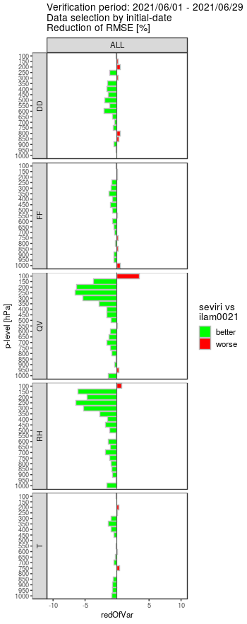
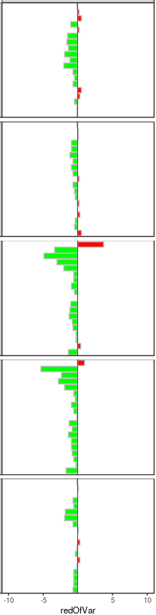
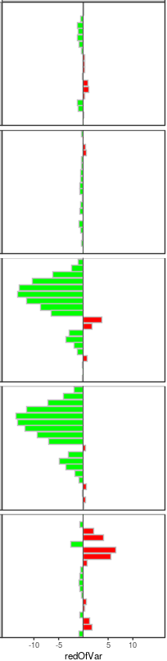
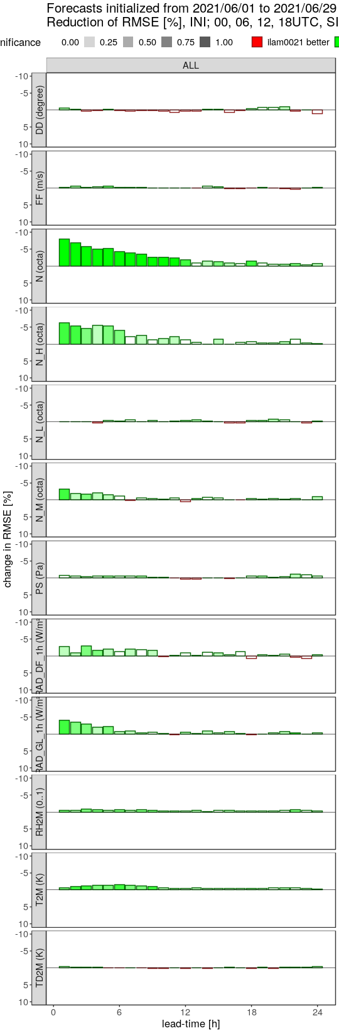
Task 2: Observations (surface to clouds)
SEVIRI IR WV
RMSE
STDDEV
Bias
RMSE
wind
direction
wind direction
surface pressure
wind
speed
wind speed
diffuse radiation
specific
humidity
total cloud cover
global radiation
high cloud cover
RH2M
relative
humidity
low cloud cover
T2M
temperature
mid-level cloud cover
dewpoint 2M
precip slightly reduced, but FSS neutral (slightly positive first 6 – 12 h)

Slide 25
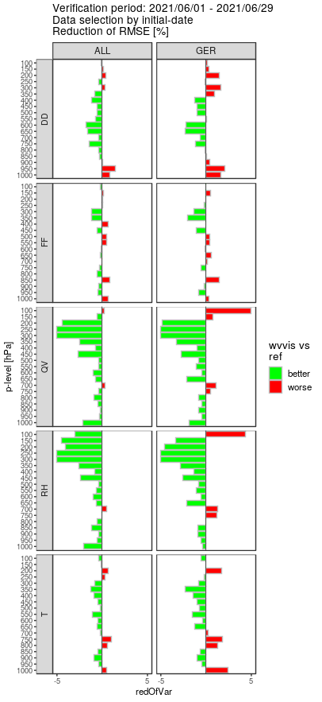
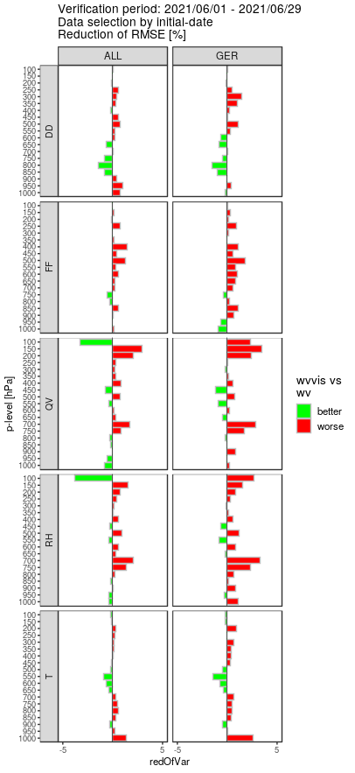
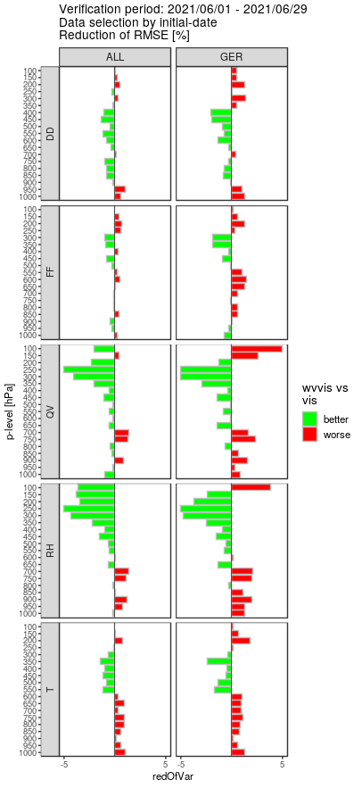
Task 2: Observations (surface to clouds)
SEVIRI IR WV (water vapour channels)
Nov. 2020: impact similar in quality but smaller in size
cloud ice also updated in analysis
positive impact on humidity < 300 hPa
combined assimilation of WV + VIS :
slightly worse than WV alone
→ too large overview influence of SEVIRI,
correlated obs errors?
→ inconsistencies due to thinning for WV,
superobbing for VIS ?
→ finding suitable thinning (superobbing)
setup useful for both VIS + WV
account for correlated R ?
operational in 2023 (?)
WV+VIS
REF better
WV+VIS better
WV better
WV+VIS
VIS better
wind
direction
wind
speed
specific
humidity
relative
humidity
temperature

Slide 26

Task 2: Observations (surface to clouds)
Task 2.4: MTG IRS (Meteosat Third Gen. hyperspectral IR Sounder)
(Mahdiyeh Mousavi, Christina Köpken-Watts, a.o. DWD)
temperature + humidity profiles (clear-sky / about clouds)
cloud detection (evaluation for ICON-global + ILAM),
channel selection (generic tool based on DFS),
surface emissivity (atlas implemented, monitoring)
synthetic clear-sky / cloudy IRS data
by RadSim (output as feedback file)
cycled EnVar exp. ‘end-to-end’ (all components)
with synthetic IRS data for ICON-global
0.1
1
10
[hPa]
100
1000
IRS channels with > 90%
of weighting fn. below 50 hPa
(participate in cloud detection)
LETKF code extended for use of non-diagonal obs error covariance matrix R
with inter-channel correlations ( → Steffi Hollborn + Hendrik Reich)
important aspects: slant radiative transfer, 4D-EnVar (for indirect wind info),
horizontal obs error correlations (for use of obs at high resolution)

Slide 27


Task 2: Observations (surface to clouds)
ground-based remote sensing
Assimilation of Microwave Radiometer (Jasmin Vural a.o.)
7 temperature +
7 humidity sensitive channels
DA of brightness temperatures
change [%] of rmse
of 6-h forecasts
results:
better to use few channels: 1 T + 1 q
(inter-channel obs error correlations)
specify vertical localisation
to avoid overlapping channels (?)
positive impact repeatedly,
but not statistically significant
future:
address inter-channel
observation error correlations
→ use more channels (?)
test use of non-zenith elevations

Slide 28


Task 2: Observations (surface to clouds)
3 wind lidars operational at MeteoSwiss, very small positive impact (+ 1h)
1 collocated wind lidar + radar (wind profiler) at Basel Binningen (Daniel Regenass a.o.)
  positive impact on 1-h forecasts in verif scores
  in some cases longer-lasting effect (~ 6 hrs)
→ may be important for customers, e.g. for dispersion modelling
REF
EXP (with Basel lidar + profiler)
faster transport in EXP
(after 4 h)

Slide 29





Task 2: Observations (surface to clouds)
Raman lidar mixing ratio + temperature vertical profiles (Bas Crezee a.o.)
Assimilation and Forecast Experiment (20.7. – 20.8.2019)
state-dependent
obs error,
provided by instrument
O-B statistics against PAY radiosonde (CRPS)
improved FSS of
heavy precip forecasts
WV Mixing Ratio Error
RH
T
REF
EXP
EXP
REF
spurious ↓ jump
O-B
temperature
(~4 days)
operational use planned for Q4 2022
(data artefacts to be solved by obs team running the lidar)
calibration

Slide 30
Task 3: Soil / surface
Task 3.1: Soil moisture analysis using satellite soil moisture data
(Valerio Cardinali, Francesca Marcucci, COMET; on hold)
DACE code being adapted to apply to ICON
experimental runs with soil moisture assimilation in COSMO-IT: no impact so far
Task 3.3: Sea Surface Temperature (SST) analysis
(Thomas Hüther, Gernot Geppert, Martin Lange, etc., DWD)
“omniVAR”: flexible (at present 2-D)-variational analysis in DACE:
  core of code developed (minimization, B-matrix, etc.), for plain 2D-Var
  adapted to T2M analysis (e.g. height correction)
  (T2M analysis used e.g. for soil moisture analysis)
  (to do: station selection, QC, etc.)
  April 2023: SST analysis technically ready and tested with full set of obs
  (needs to account for land/sea mask)

Slide 31


Slide 32


Task 2: Observations (surface to clouds)
Assimilation of Microwave Radiometer (Claire Merker a.o.)
verification of FG
against Raman Lidar
Mixing ratio
small improvement in thermodynamical structure above Payerne
neutral impact in forecast verification
potential for improvement
operational since 10.08.2022
(10 channels, incl. cloudy)
include Grenchen and Schaffhausen stations when new devices are available
REF
EXP
Temperature

Slide 33


Task 2: Observations (surface to clouds
ground-based remote-sensing
Doppler lidar (Lindenberg) (Jasmin Vural a.o.)
change [%] of rmse of 6-h forecasts
Lindenberg TEMP
assimilated
Lindenberg TEMP
not assimilated
experiments
June (+ July) 2021
small domain
(~ 600 x 600 km)
(Lindenberg
wind profiler
not assimilated)
results
better use 1 than 2 profiles per hour
shorter temporal averaging for single obs profiles preferred (10 vs. 30 min)
reduced rmse (in 1 exp.) not statistically significant
(depends on exp. setup, period)
to do: longer experiments for statistical significance,
case studies

