Slide 1
Update of ensemble activities at Arape
Chiara Marsigli
Arpae SIMC, Bologna, Italy

Slide 2
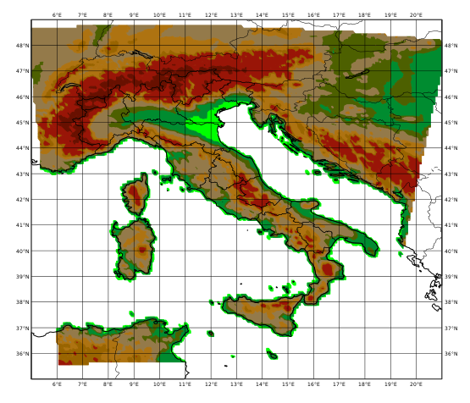
COSMO-2I-EPS: operational set-up
COSMO 2.2 km, 65 levels
20 members
BCs from the first 20 members of COSMO-ME-EPS
ICs from KENDA
No physics perturbations
1 run per day, 00 UTC, +48 h

Slide 3
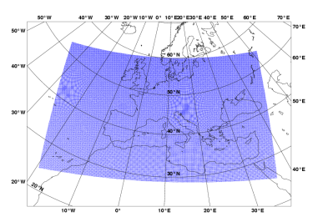
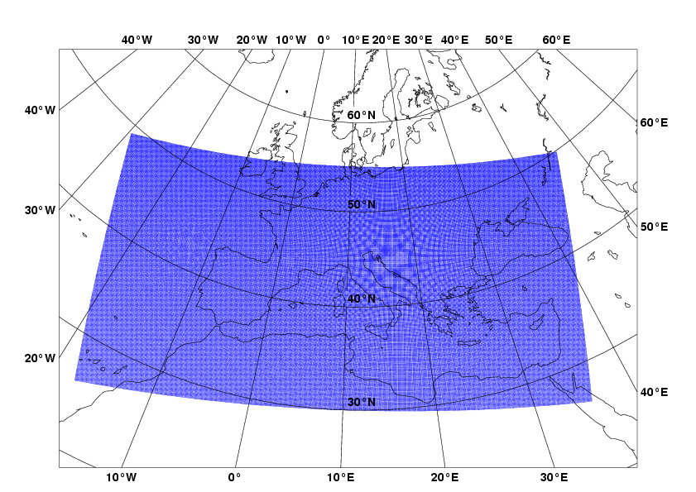
COSMO-2I-EPS: operational set-up
LETKF (COMET)
COSMO-ME-EPS (COMET)
7 km
2.2 km
explicit convection
COSMO-2I-EPS (Arpae)
7 km

Slide 4
Introducing simple model perturbations
Four configurations of an ensemble “COSMO-2I-EPS like” are run in order to test the model perturbation methodology:
control run (no perturbations)
PP, with parameter perturbation
SPPT, with SPPT
PP+SPPT, with a combination of parameter perturbation and SPPT
The ensembles have 10 members, IC and BC from the first 10 IFS members (no data assimilation), and the forecast range is 24 hours.
Runs are performed on two selected periods: 1-31 July 2021 and 1-15 November 2021.

Slide 5
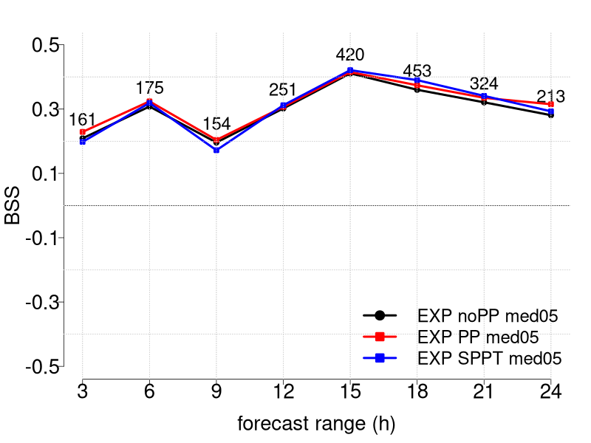
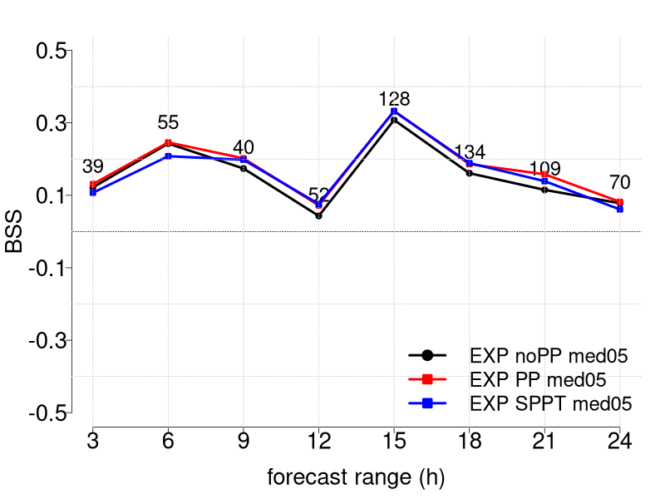
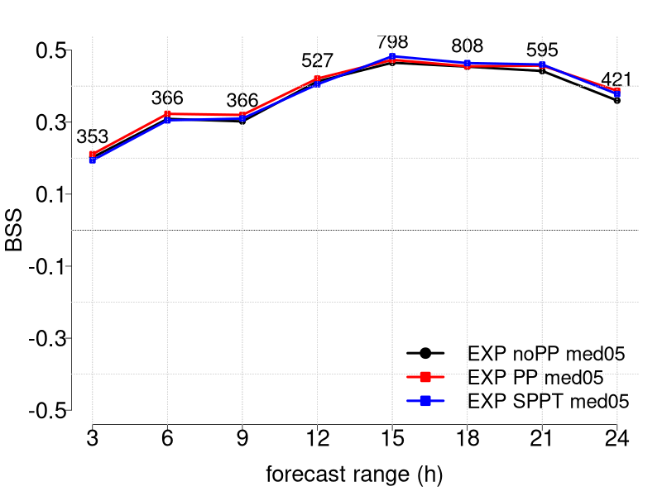
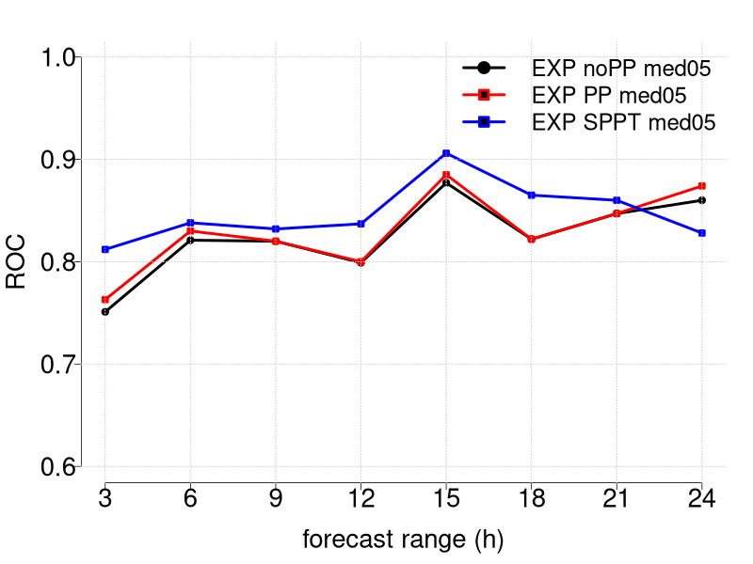
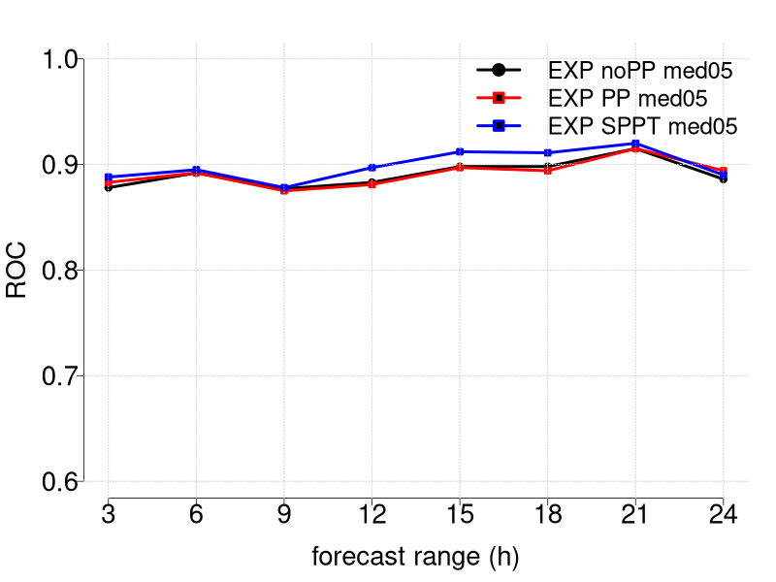
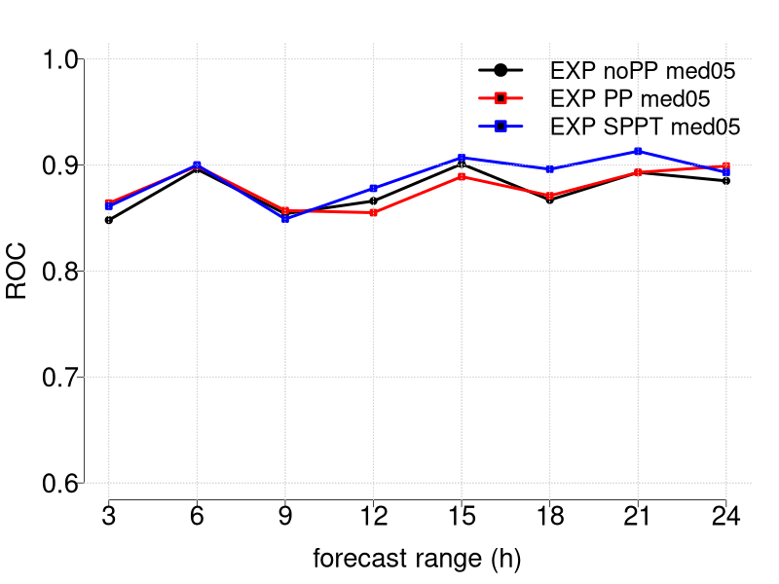
3-hourly precipitation scores verification against rangauge data average precipitation over boxes 05

Slide 6
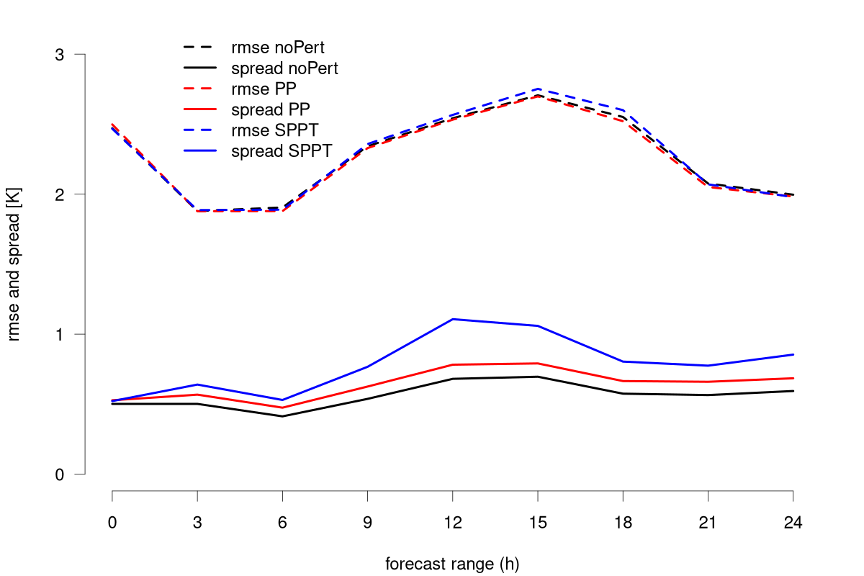
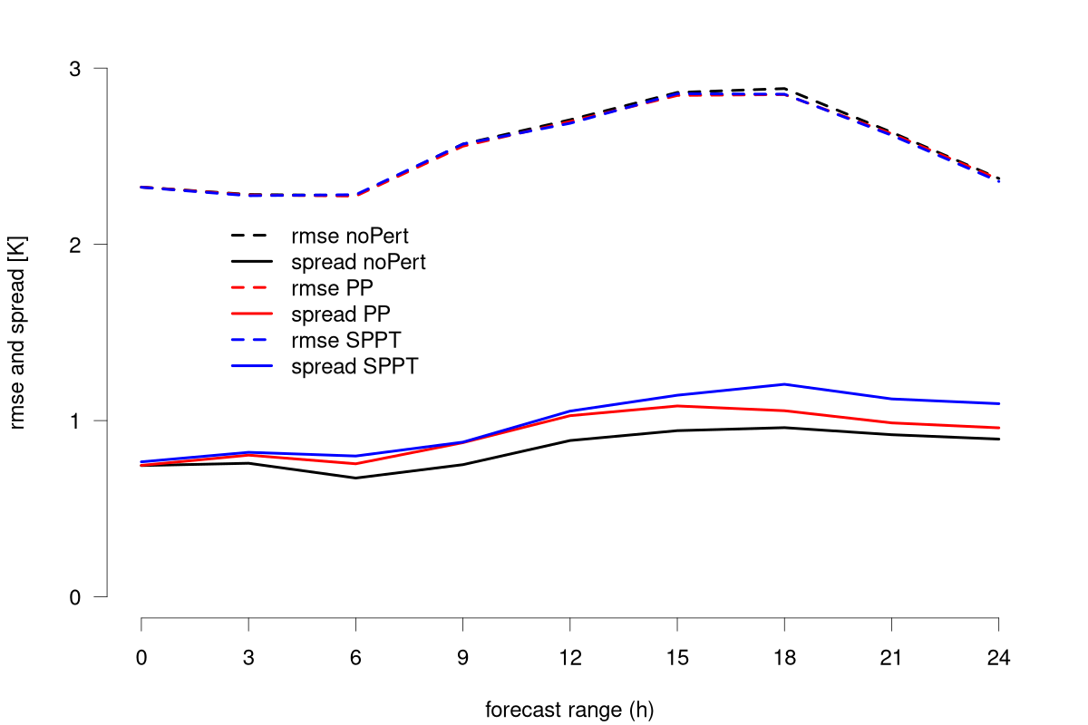
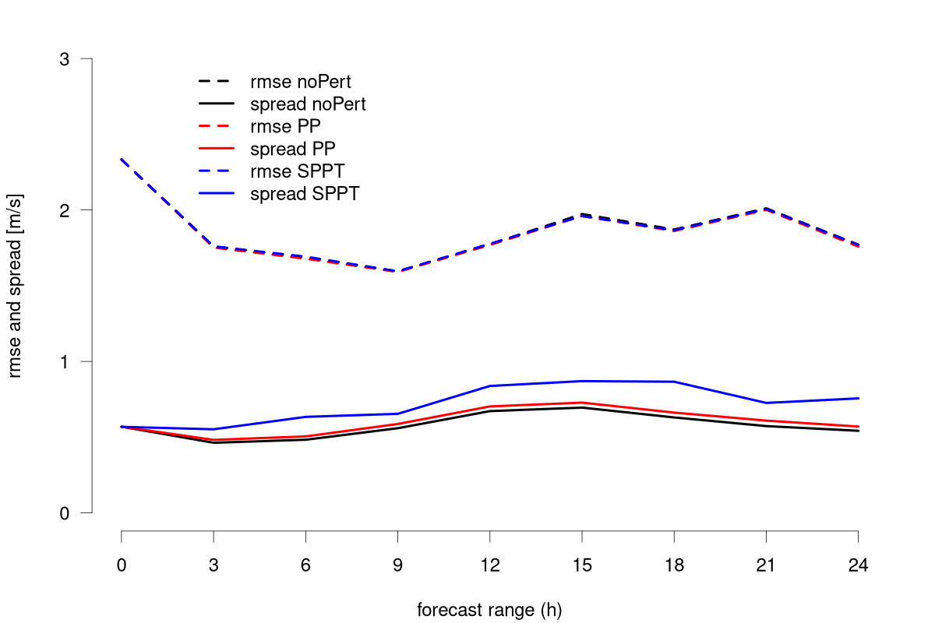
Spread/skill relation
verification against SYNOP data
T2m
Td2m
S10m

Slide 7
Next steps and future plans
Introduce the model perturbation in the operational ensemble suite:
Parameter Perturbation (PP) only
Set-up a testing ensemble suite for ICON at ECMWF
start testing model perturbations in ICON (start with PP)
no data assimilation
Migration of the COSMO-2I-EPS ensemble to ICON (ICON-2I-EPS) will follow the migration of the KENDA cycle

