Slide 1
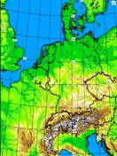
Model perturbations for ICON-D2-EPS
Chiara Marsigli and Christoph Gebhardt
Deutscher Wetterdienst (DWD)
with contributions by Christian Keil and Matjaž Puh (LMU)
ESSL

Slide 2
Outline
The ICON-D2-EPS operational ensemble
Aim: improve the ability of the ensemble to account for model uncertainties
  improve the spread/skill relation of the ensemble
Operational model perturbation: Parameter Perturbation (PP)
Current research:
  PP: increase the amplitude of the perturbations
  SSC: Stochastic Shallow Convection
  PSP2: Physically based stochastic perturbations for subgrid turbulence
Concluding remarks

Slide 3
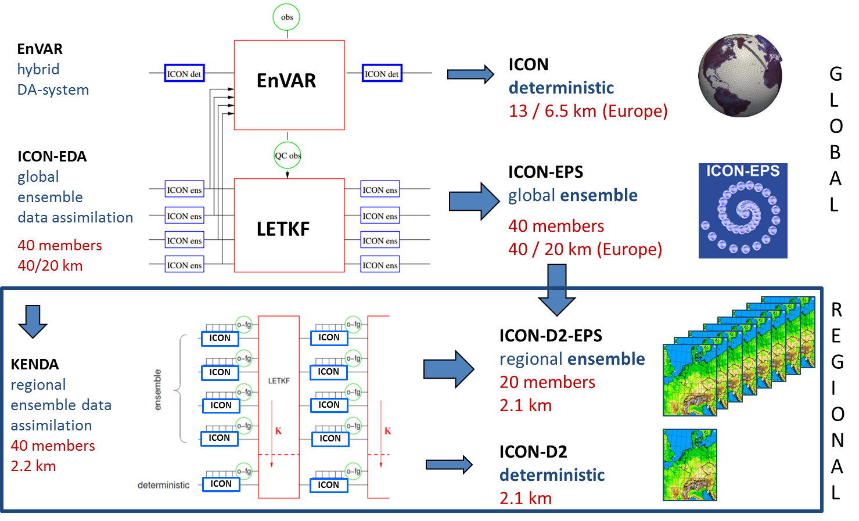
The operational NWP system at DWD
COSMO GM 2022

Slide 4
Parameter Perturbation
A set of parameters (18) of the model physics schemes are perturbed in ICON-D2-EPS
The parameters receive a value from a distribution (including the default value), different at each forecast start and for each member (the value is kept fix during the run):
pert_param=ref_param+2.∗(rand_num−0.5)∗range
rand_num∈[0,1]is drawn from a uniform distribution
the random number is always set either to 0 or1, i.e. only the boundary values of the specified range are used besides the default value
PP test: increase the amplitude of the perturbation for a small set of parameters:
  tkhmin, tkmmin -> scaling factor for minimum vertical diffusion coefficient for heat and moisture and momentum, respectively
  rlam_heat -> scaling factor of the laminar boundary layer for heat
  tur_len -> asymptotic maximal turbulent distance
  rain_n0_fac -> intercept parameter of raindrop size distribution

Slide 5
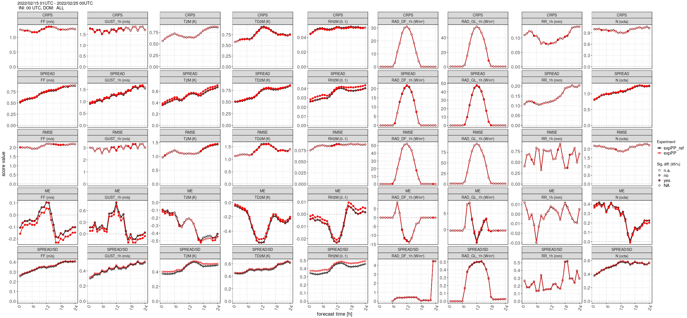
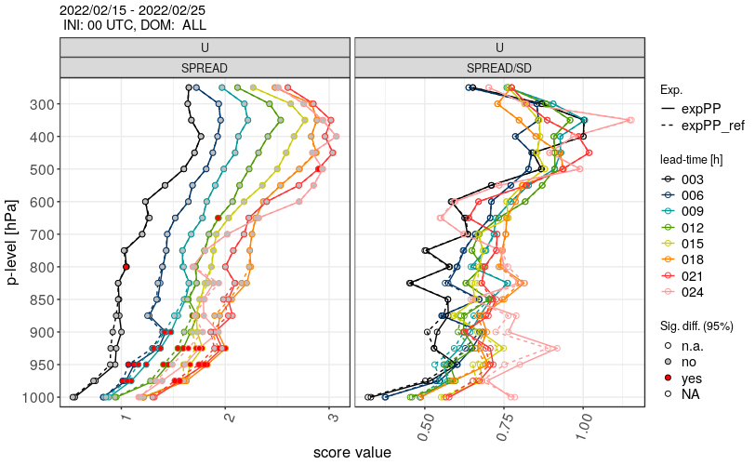
Results: increase perturbation amplitude
February 2022
Verification against SYNOP and TEMP
ref
expPP
ref
expPP

Slide 6
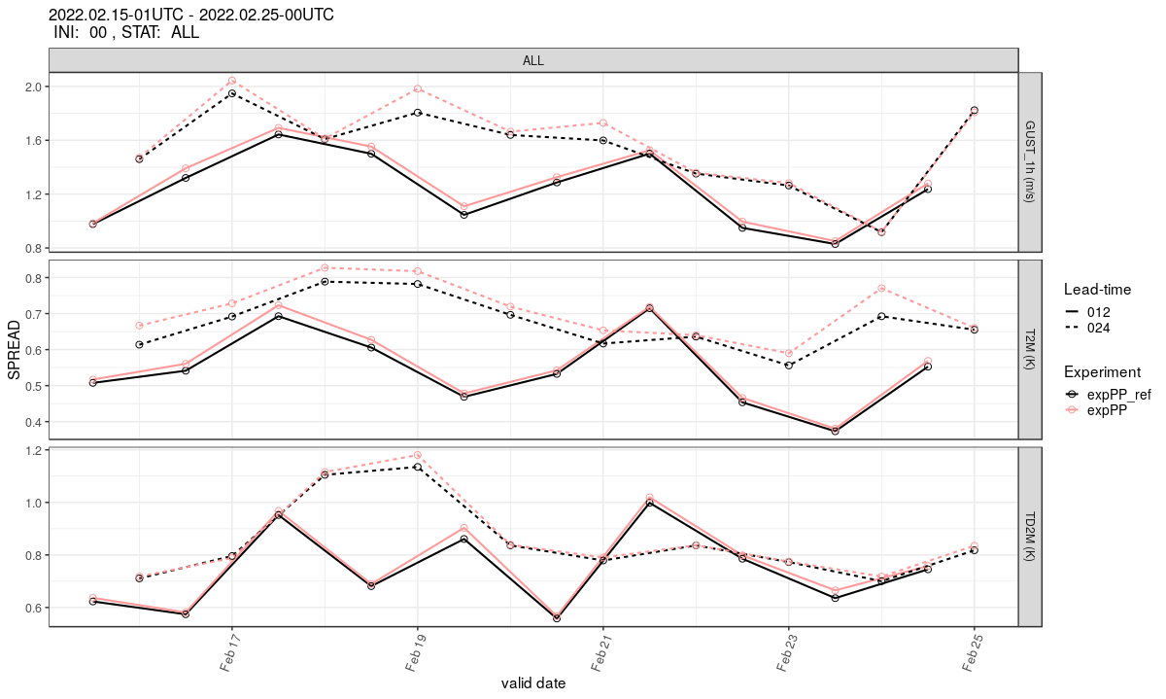
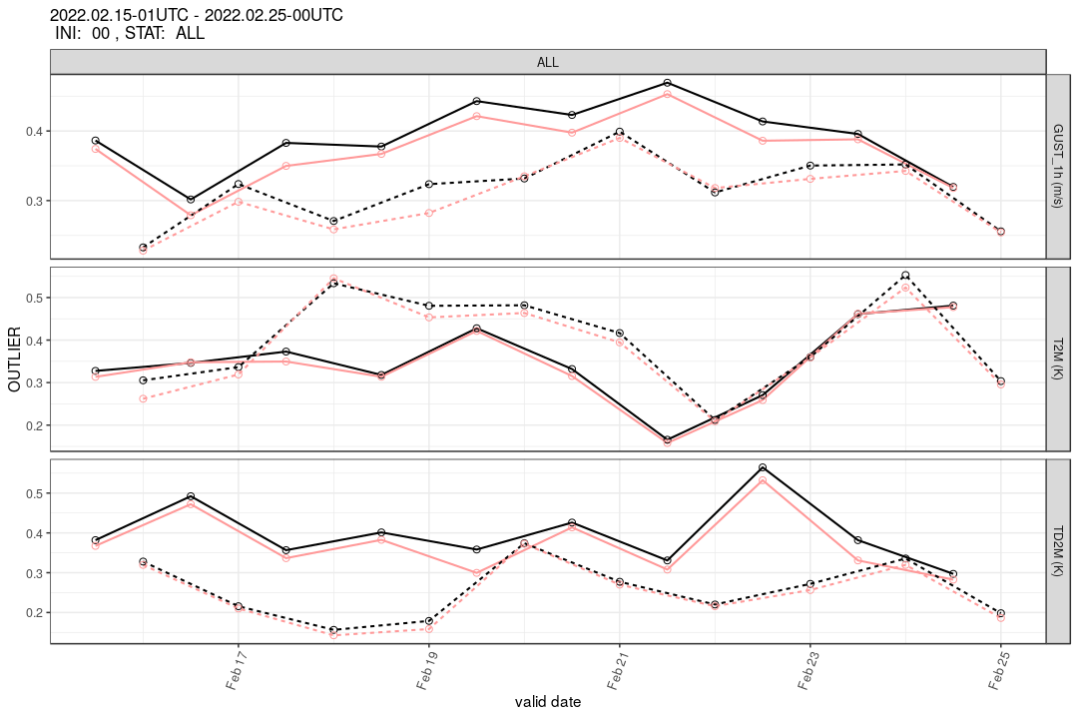
Results: increase perturbation amplitude
February 2022
Verification against SYNOP
spread
outliers
Vmax 10m
T 2m
Td 2m
ref
expPP

Slide 7
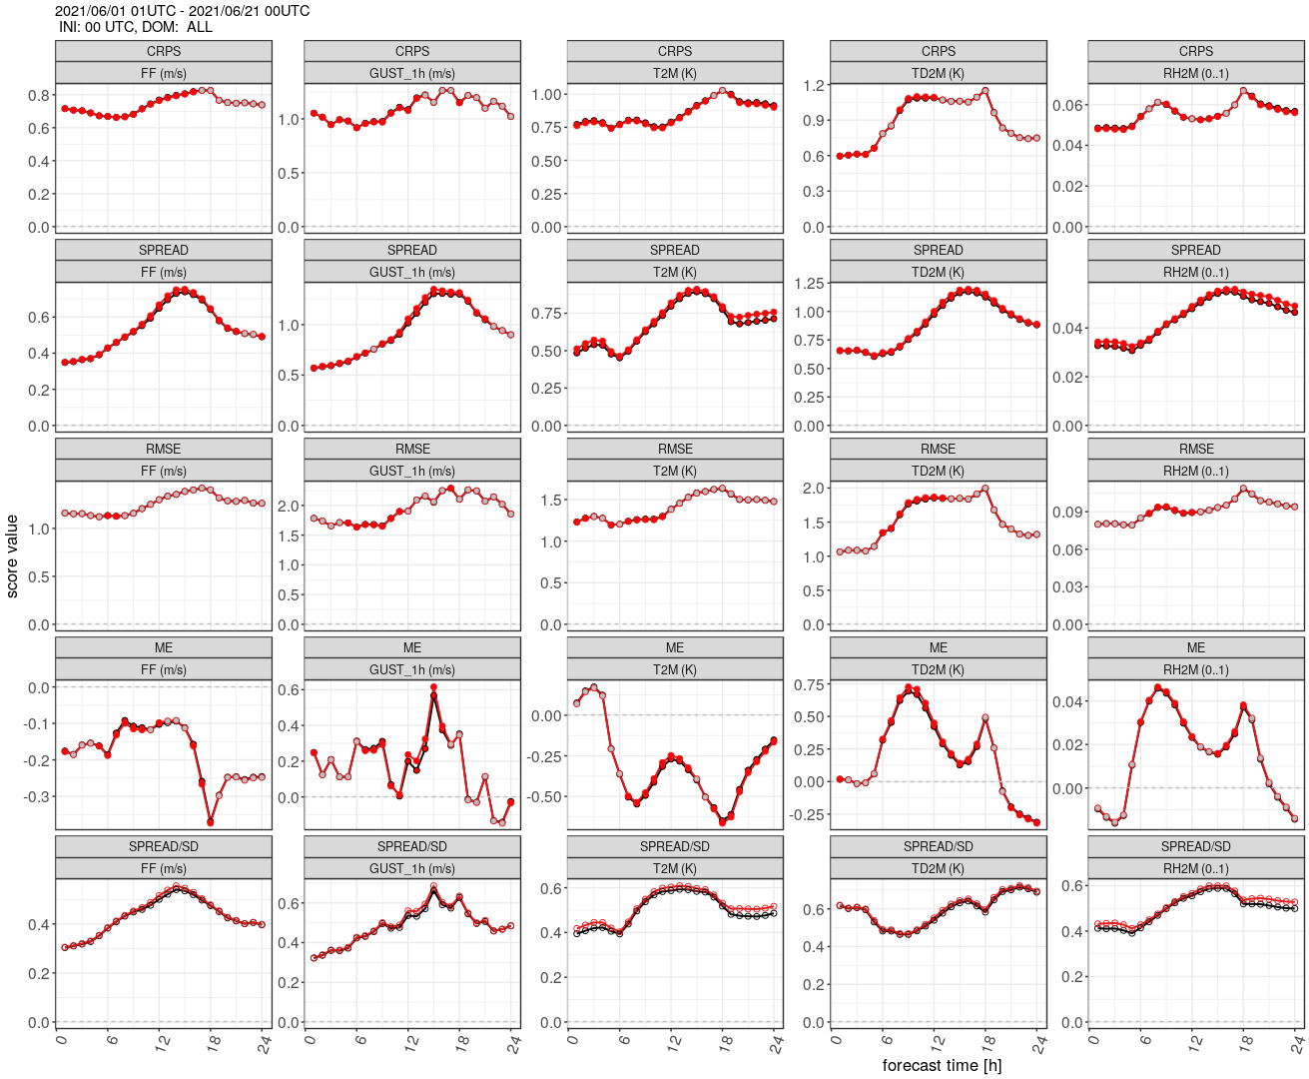
Results: increase perturbation amplitude
June 2022
Verification against SYNOP

Slide 8
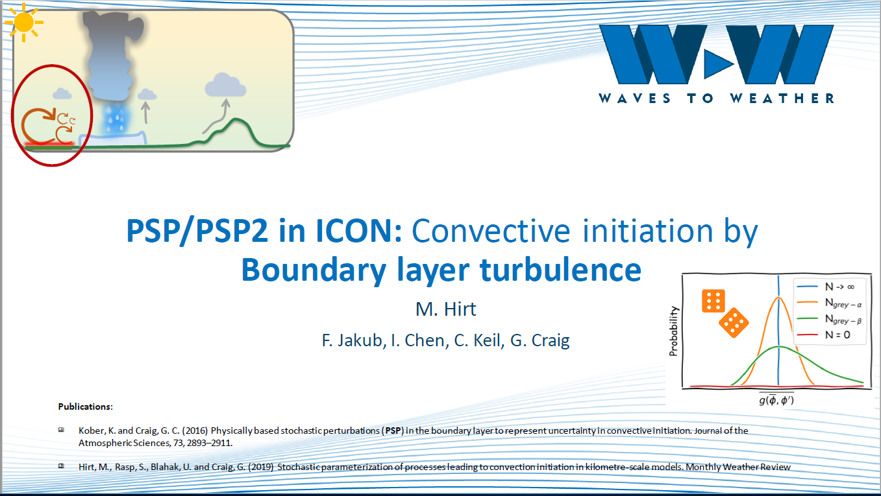
Physically based model perturbation: PSP2
Hirt et al., 2021
COSMO GM 2022

Slide 9
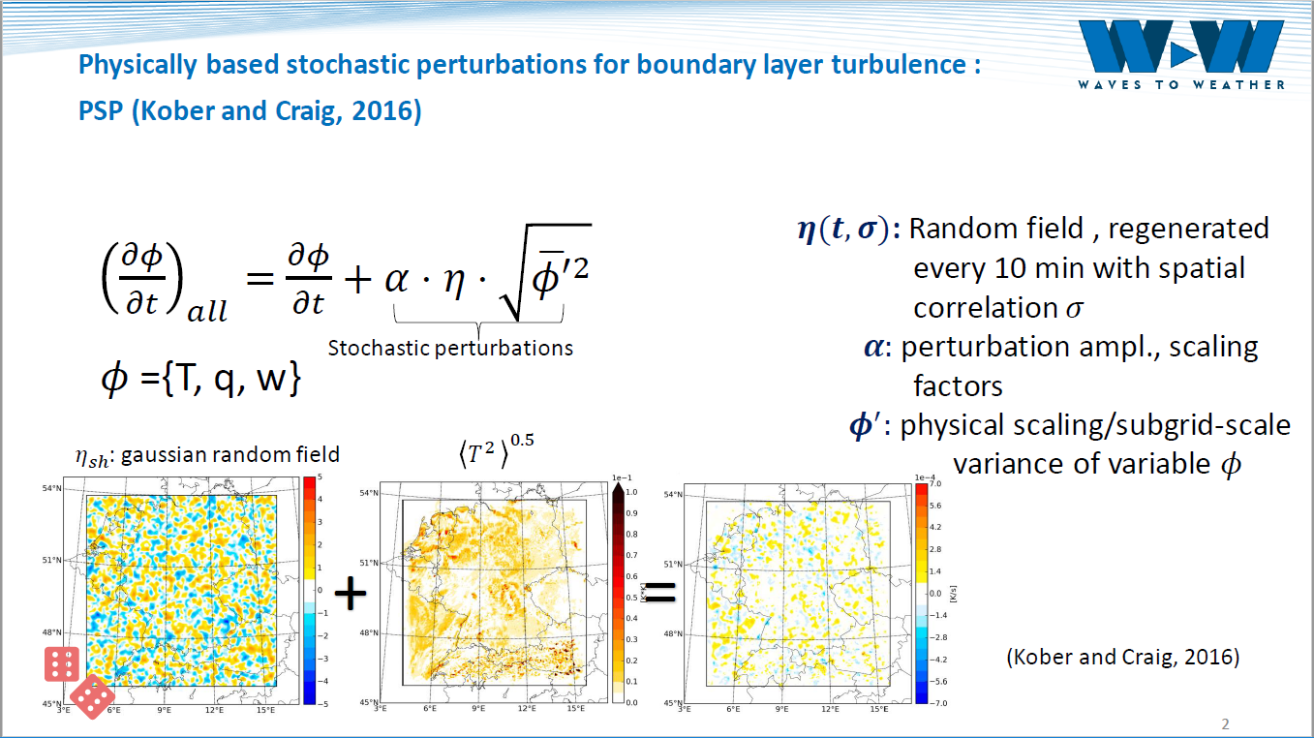
Physically based model perturbation: PSP2
COSMO GM 2022

Slide 10
Results: PSP2
June-July-Aug 2022
Verification against SYNOP

Slide 11
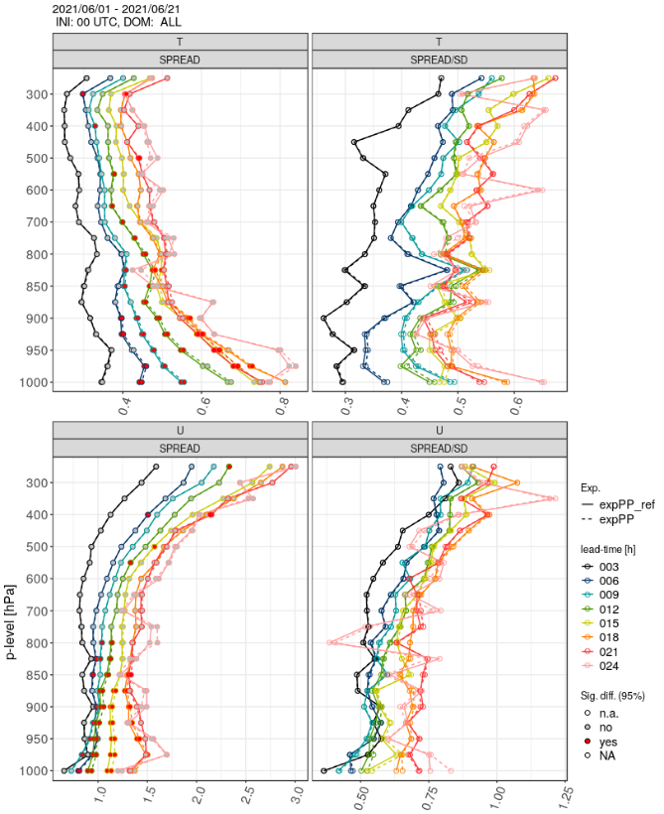
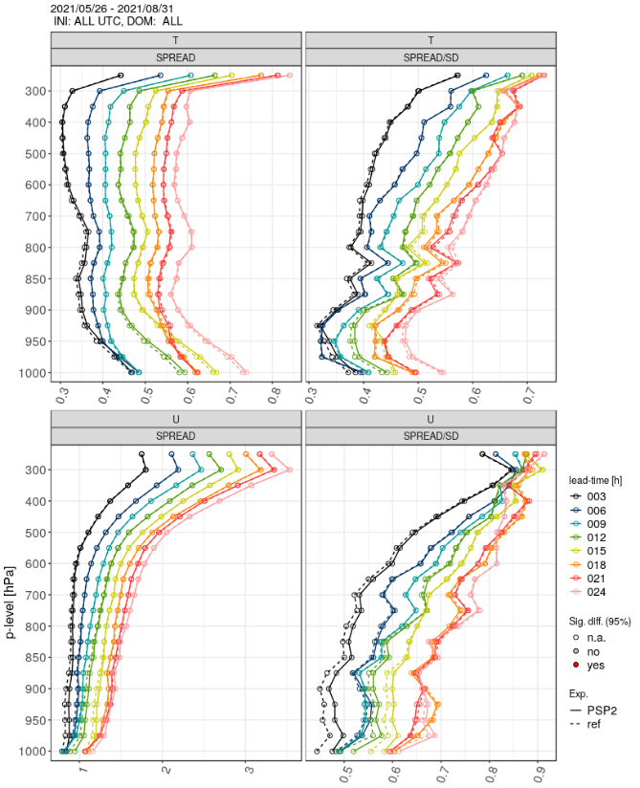
Vertical impact of perturbations
PP
PSP2

Slide 12
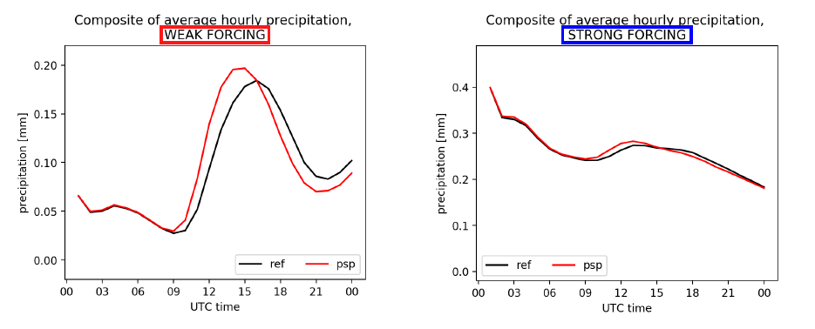
PSP2: impact on convection initiation
M. Puh, C. Keil (LMU)

Slide 13
PSP2: impact on weakly forced cases
Fractions Skill Score
ref ens members
psp2 ens members
mean of FSSs ref
mean of FSSs psp2

Slide 14
Concluding remarks
enlarging the amplitude of few parameter perturbations has a positive effect: the spread is increased while the RMS error is unchanged
more efficient in the winter period, smaller effect in the summer period (not shown)
in the convection-dominated season, the physically based stochastic perturbation for subgrid turbulence (PSP2 scheme) has a positive impact on the diurnal cycle of the precipitation (earlier onset of the convection) and determine an increase of the precipitation amount
the effect is mainly visible in weakly-forced cases
the spread/skill relation is improved for some near-surface variables, but an increase of the mean error of the 10 wind is observed, which was detected also in the verification of wind gusts (not shown), and which deserves further investigations
physically-based schemes, like PSP2, seems to be promising as additional perturbations, to complement the effect of the parameter perturbation method

Slide 15
Thank you for your attention!

Slide 16

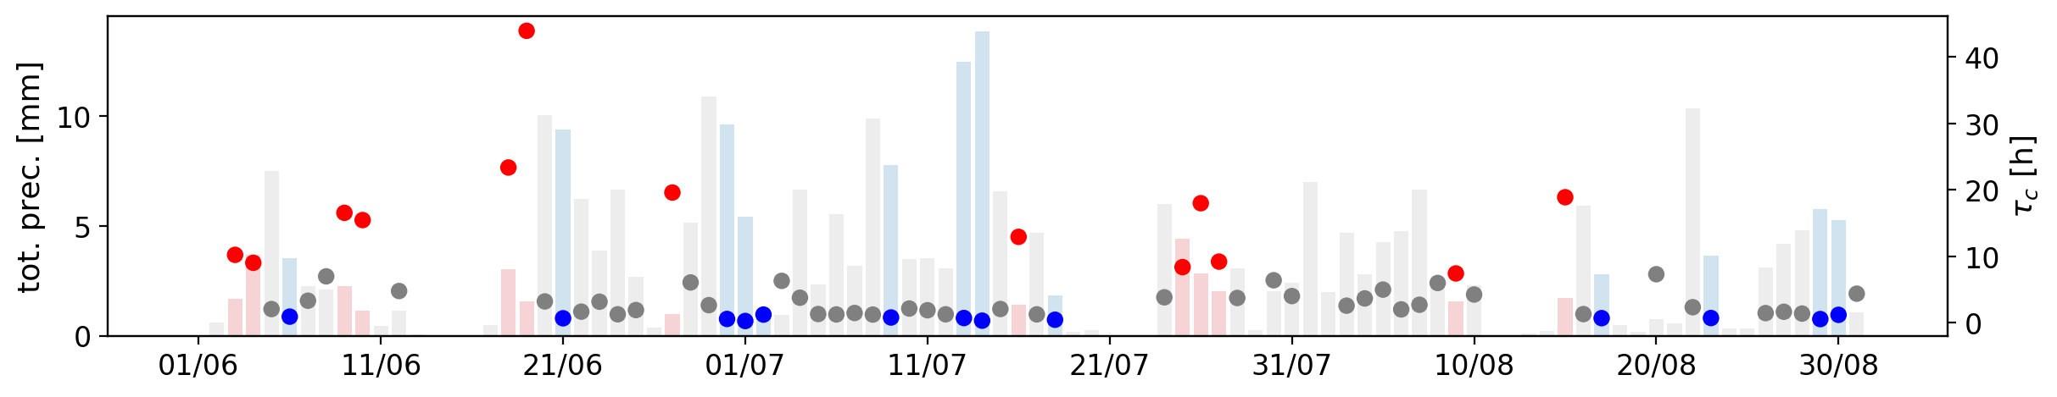
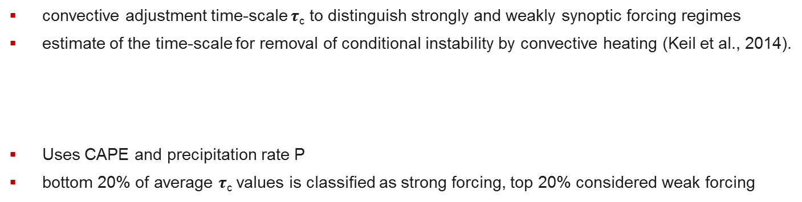
Convective Adjustment timescale
convective adjustment time-scale $τ$_{c} to distinguish strongly and weakly synoptic forcing regimes
estimate of the time-scale for removal of conditional instability by convective heating (Keil et al., 2014).
Uses CAPE and precipitation rate P
bottom 20% of average $τ$_{c} values is classified as strong forcing, top 20% considered weak forcing

