Slide 1
PROPHECY activities at IMGW - Update from TLE-MVE
Andrzej Mazur, Joanna Linkowska, Grzegorz Duniec, Witold Interewicz
Institute of Meteorology and Water Management
National Research Institute

Slide 2
Contents
(Sub)tasks
Basic results, things done
Specific case study on lagged EPS
Basic conclusions, to-dos
Publication!

Slide 3
(Sub)tasks
Subtask 1.1 – Development of the parameter perturbation.
Subtask 2.2 – Assessment of the influence of various methods of perturbation of initial field of soil temperature.
Subtask 3.5 – Modification of lagged-approach scheme (”weights with memory”)
Dataset used for ‘verification’ – ERA-5 reanalysis fields for 2011-2020 (https://cds.climate.copernicus.eu), 0.25x0.25 degree, hourly data.

Slide 4
Subtask 1.1
Continuation of work on additional parameters that may be perturbed, with verification against the ERA-5 dataset.
Best candidate – moisture!
No final decision…
Considerations for additional fields to be placed in the standard output set (gusts, top/cloud base, CAPE) have been extended to vertical turbulent diffusion coefficient for momentum and heat (TVKM/TVKH) – connection to dispersion model.
In progress…

Slide 5
Subtask 2.2
Influence of various methods of perturbation of soil temperature’s initial field.
Spotlight on how deep into the ground the temperature perturbation should be introduced for significant/positive impact.
Dataset used for verification – ERA-5 reanalysis fields for 2011-2020 (https://cds.climate.copernicus.eu), 0.25x0.25 degree, hourly data.

Slide 6
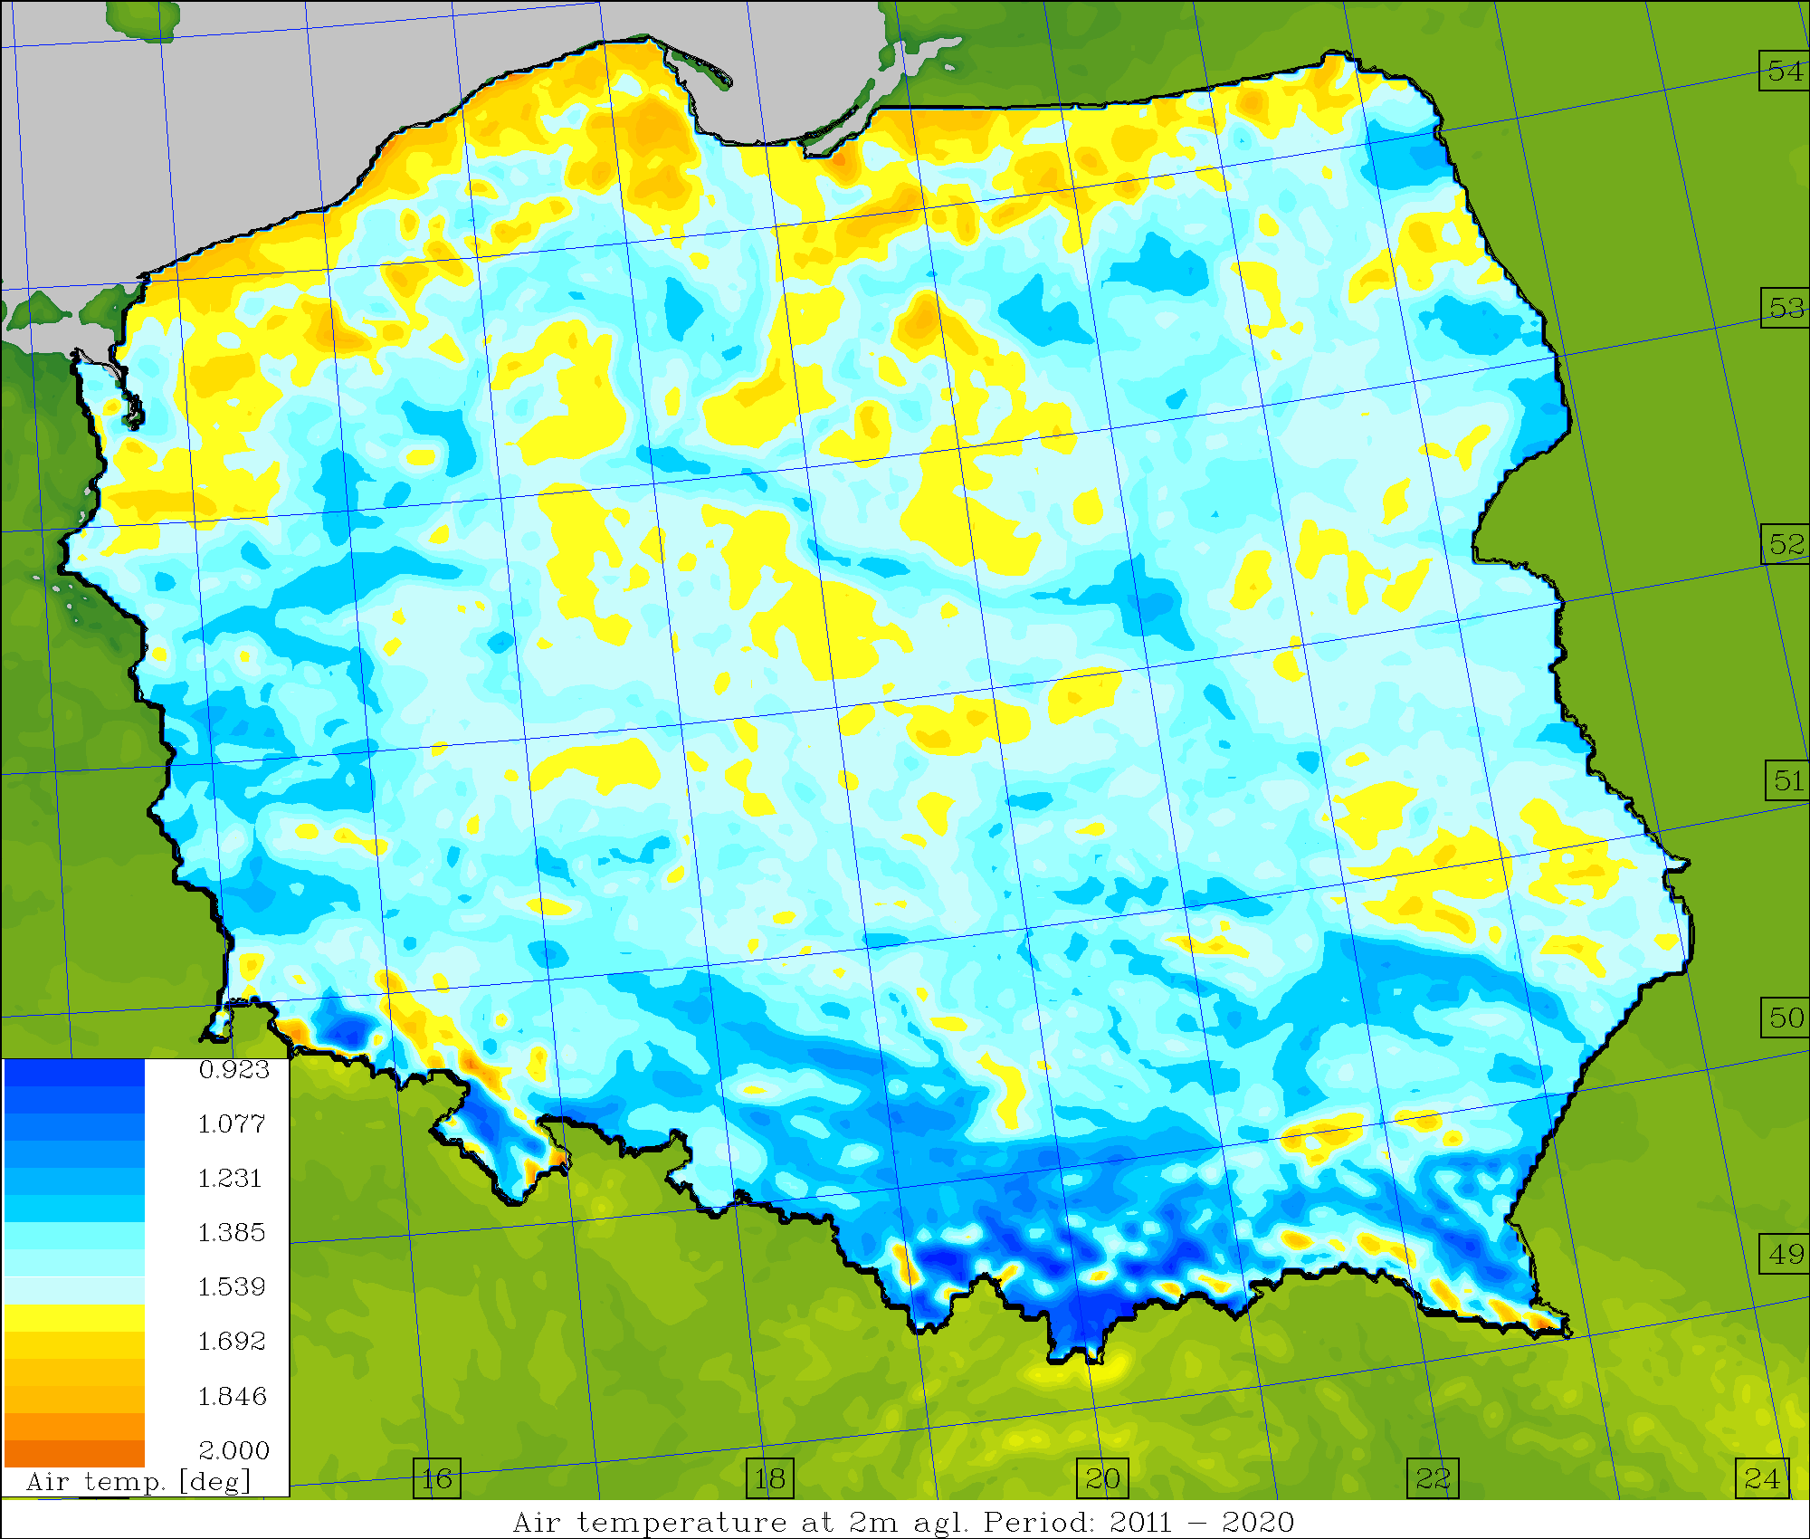
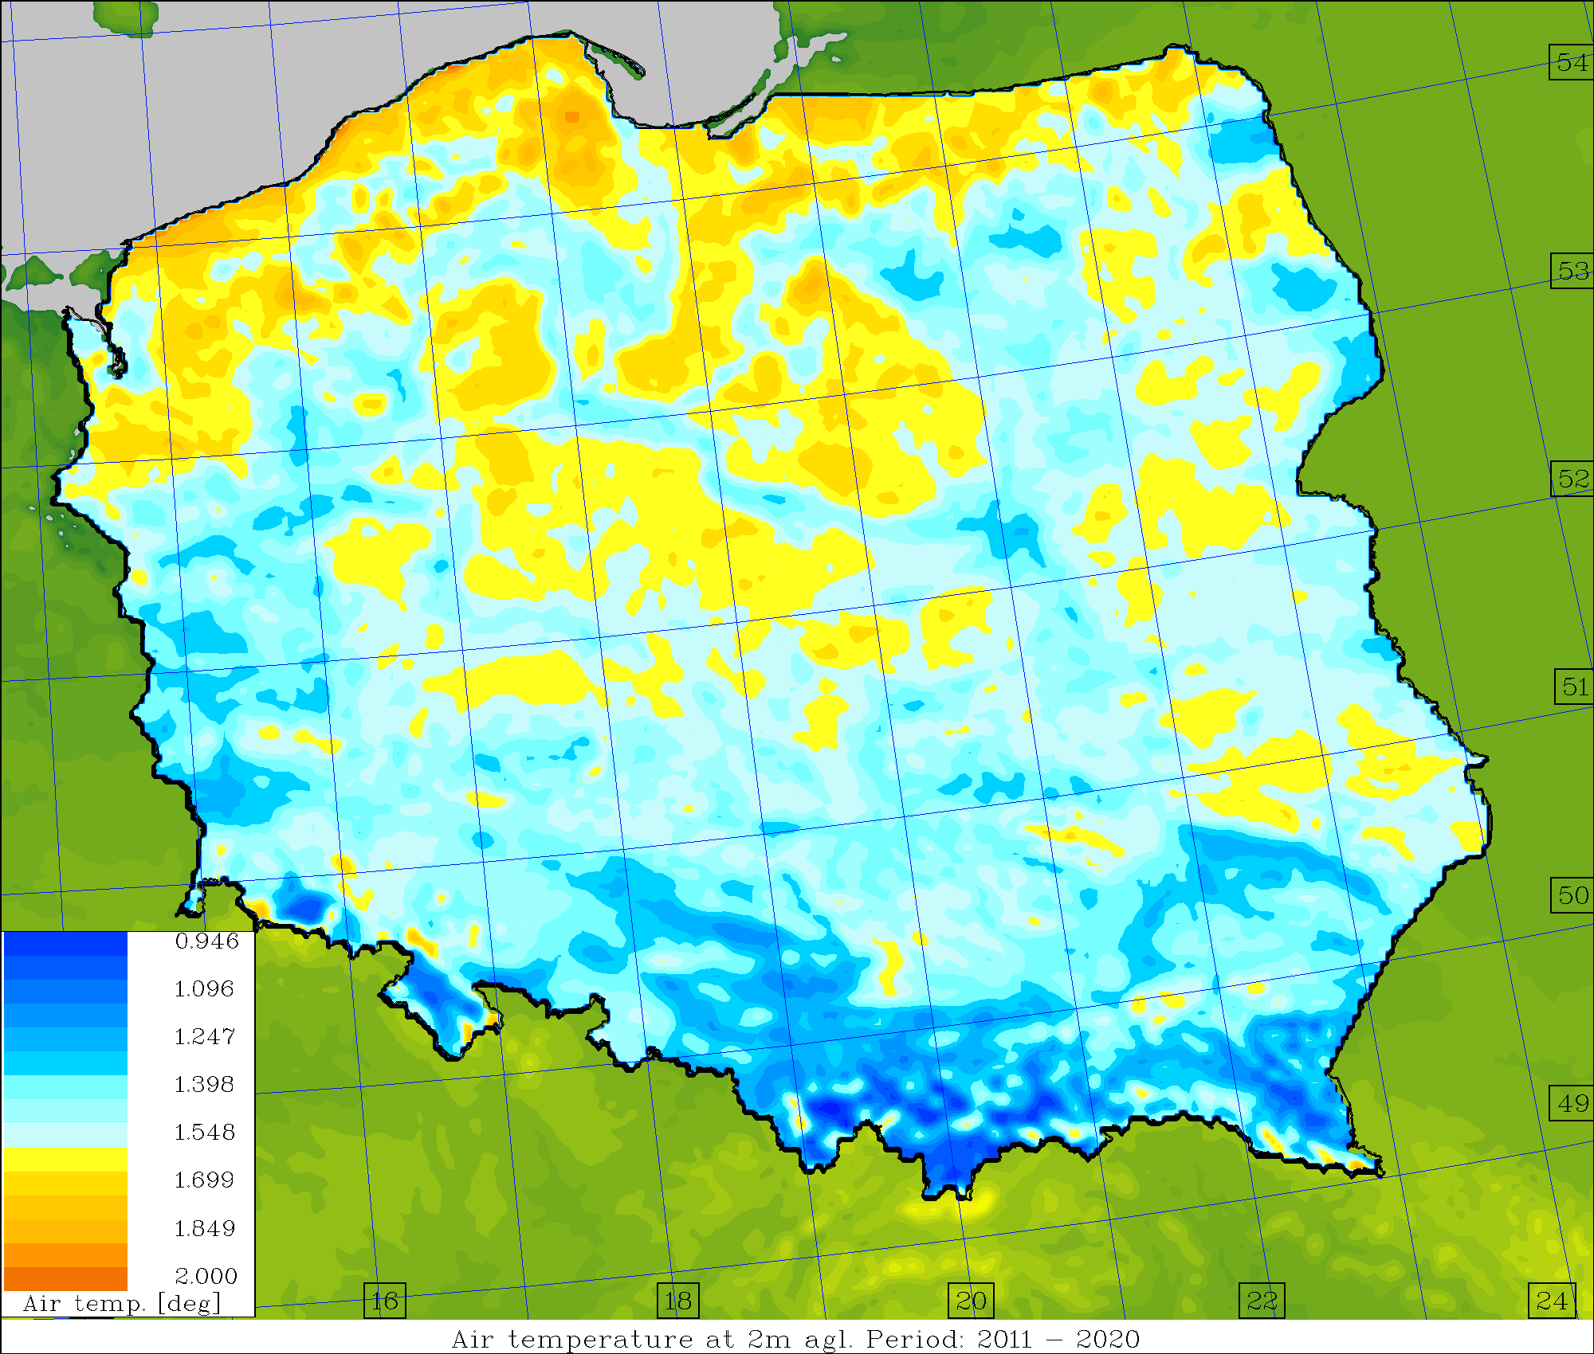
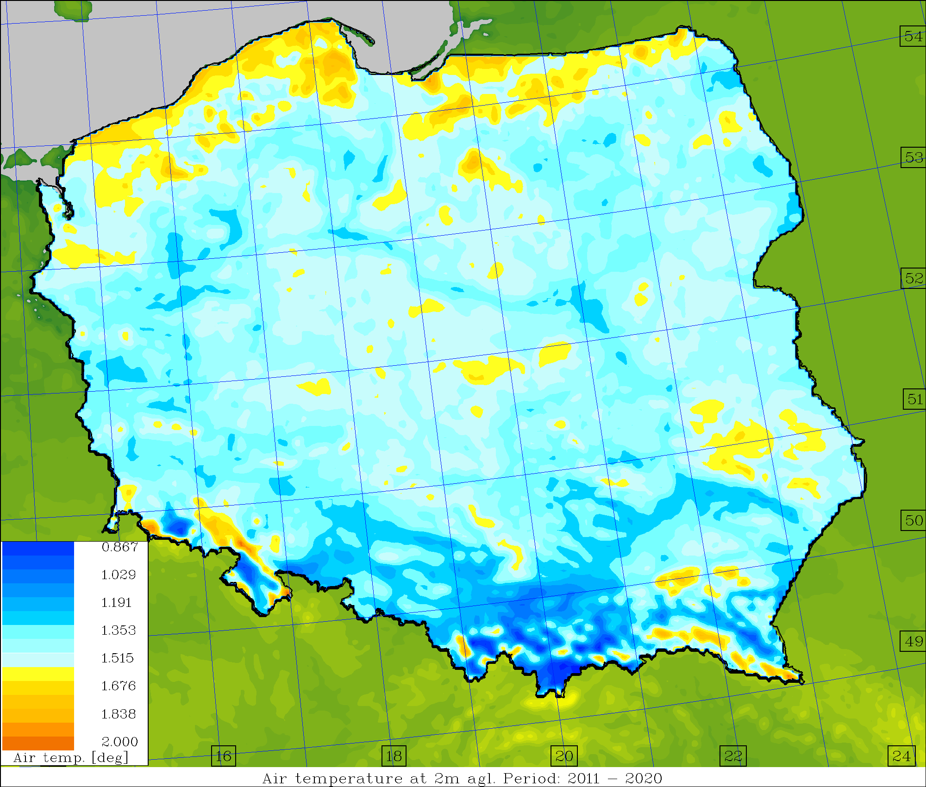
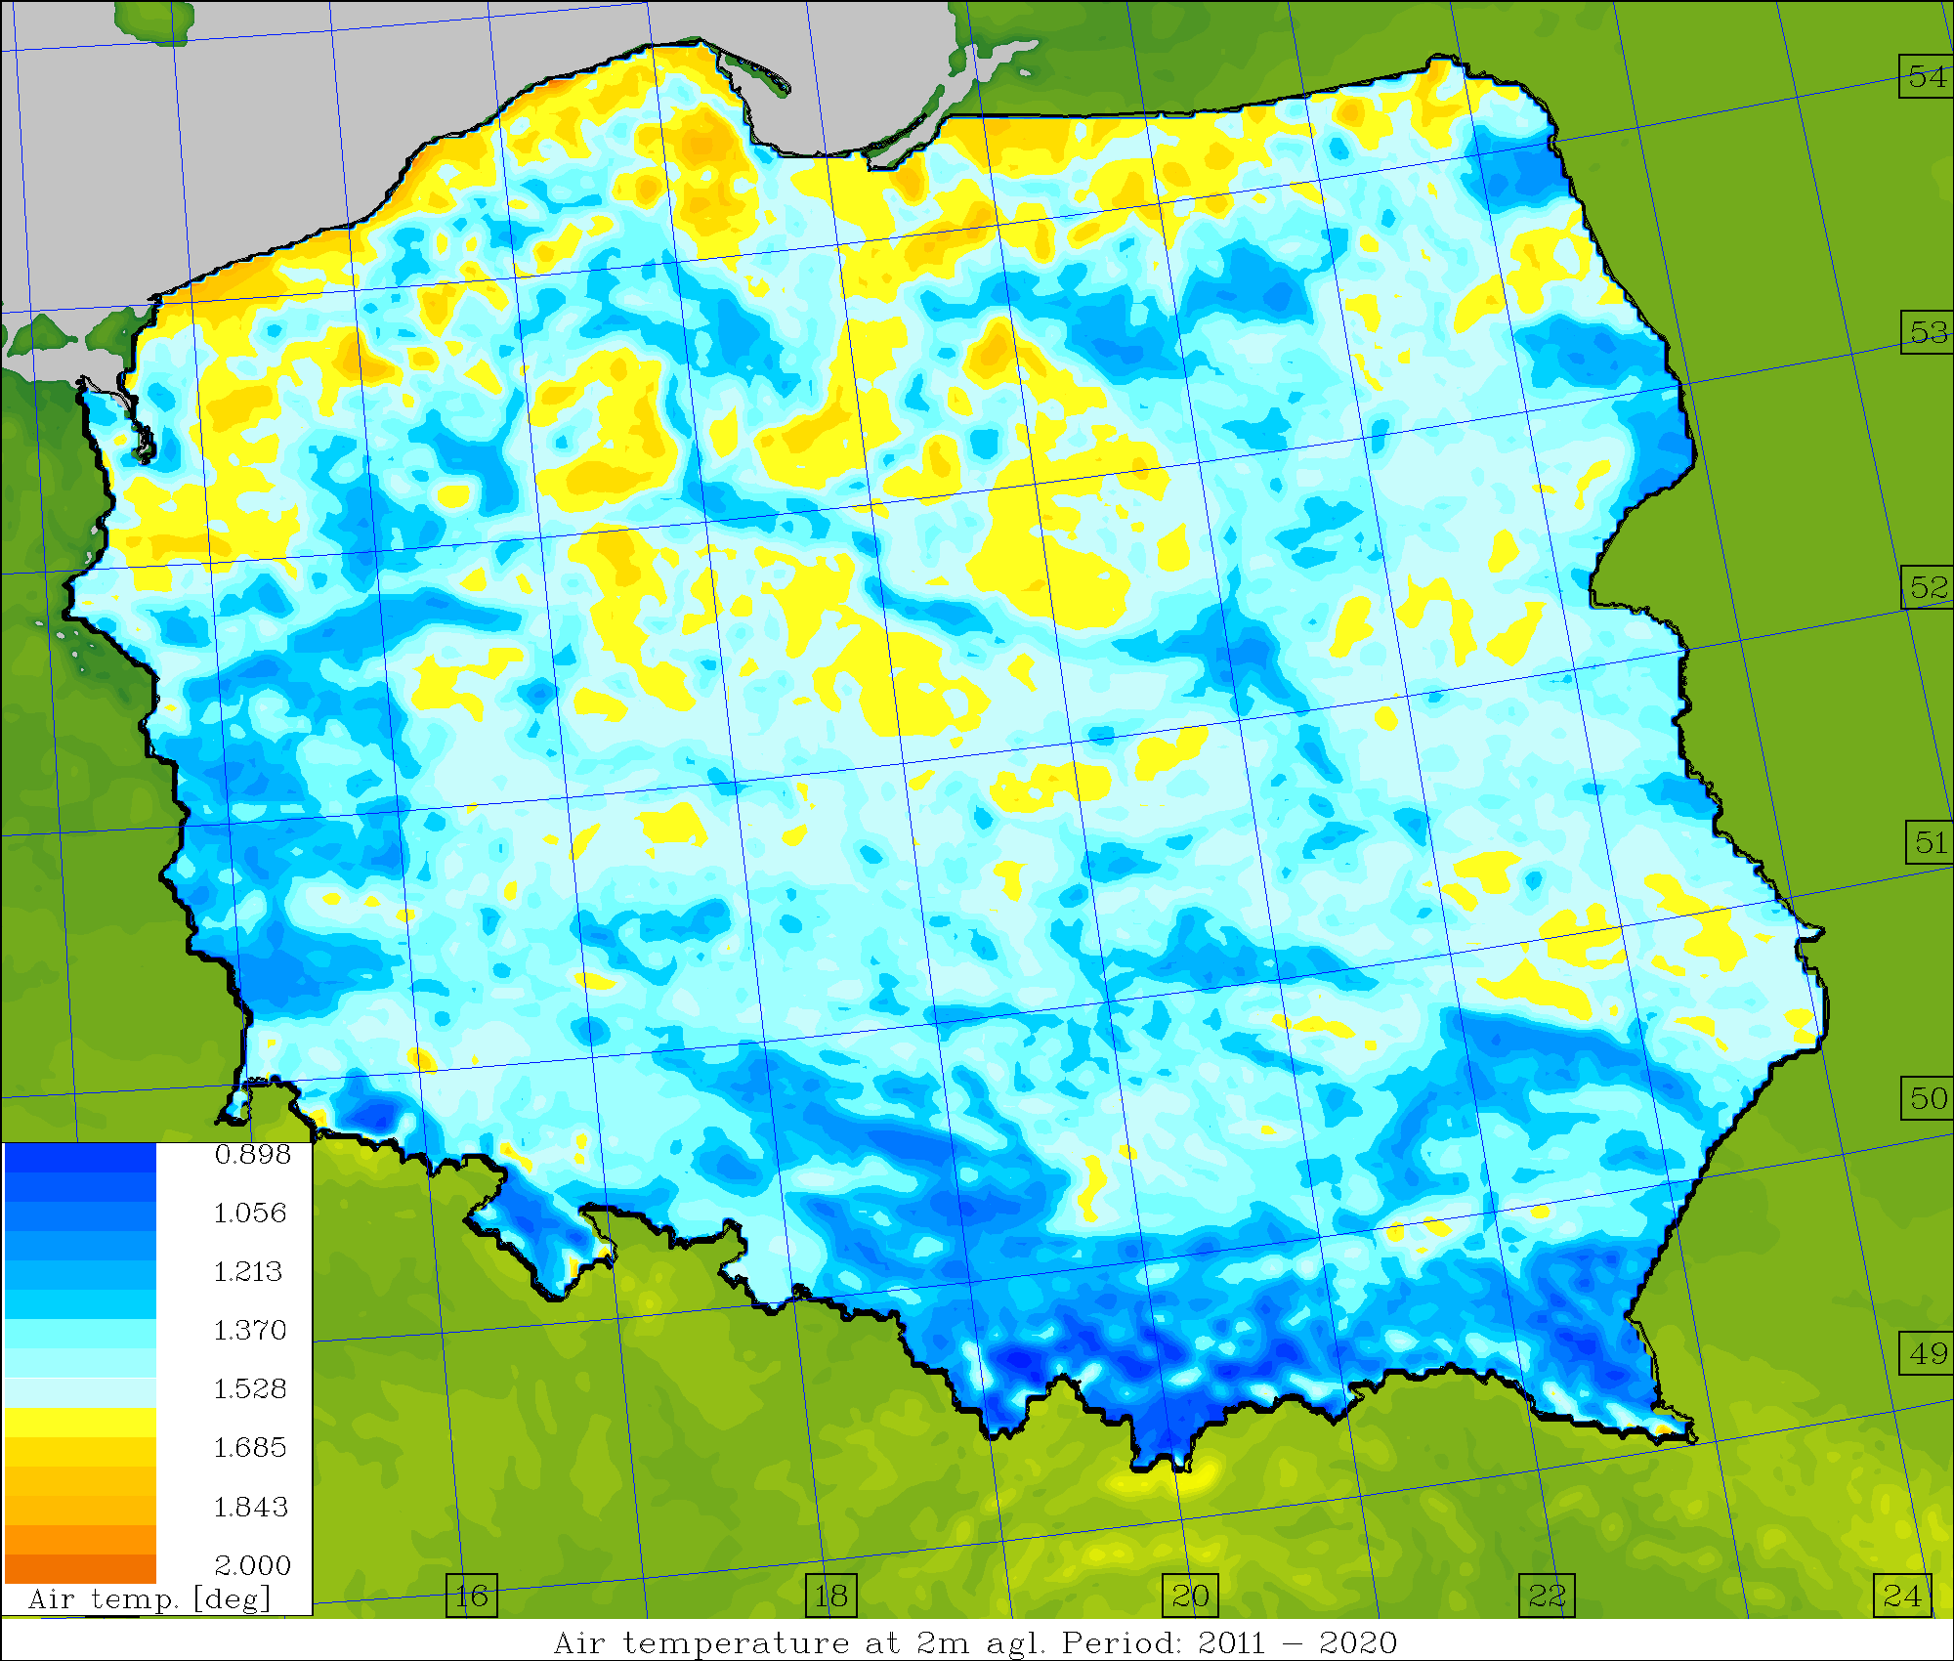
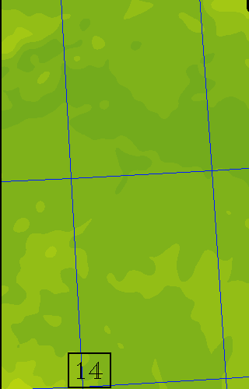
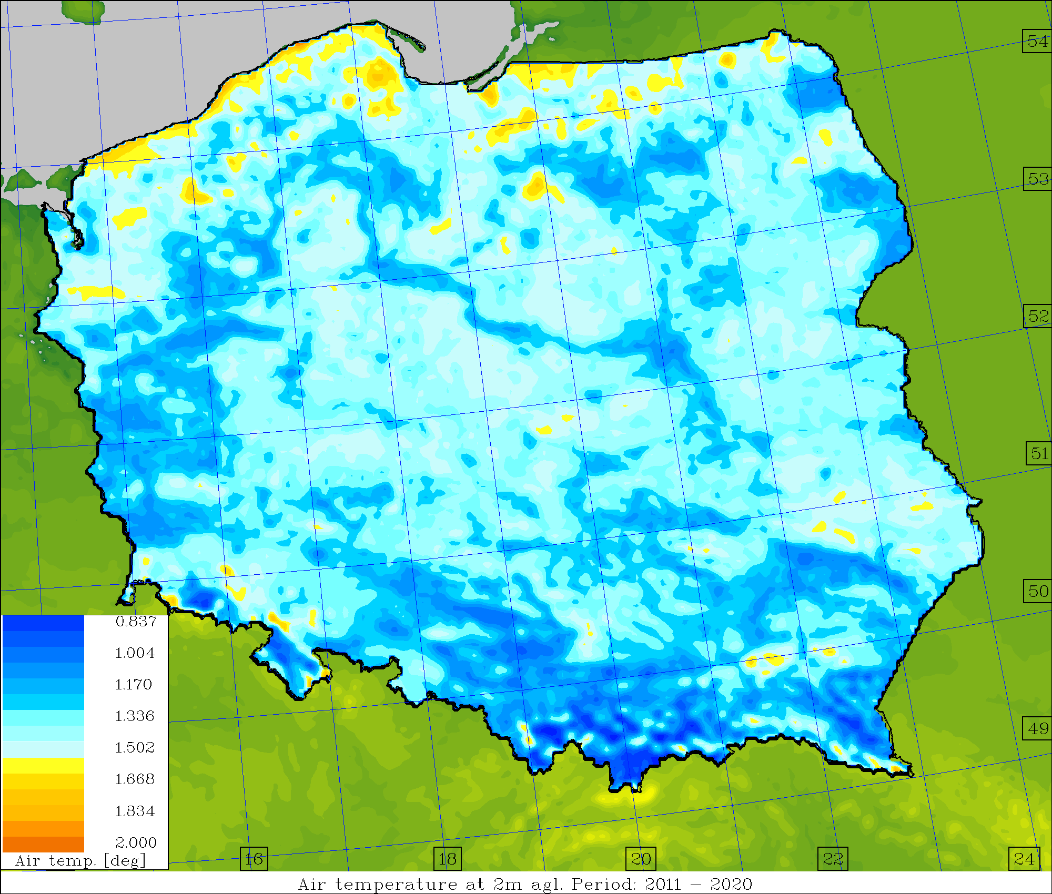
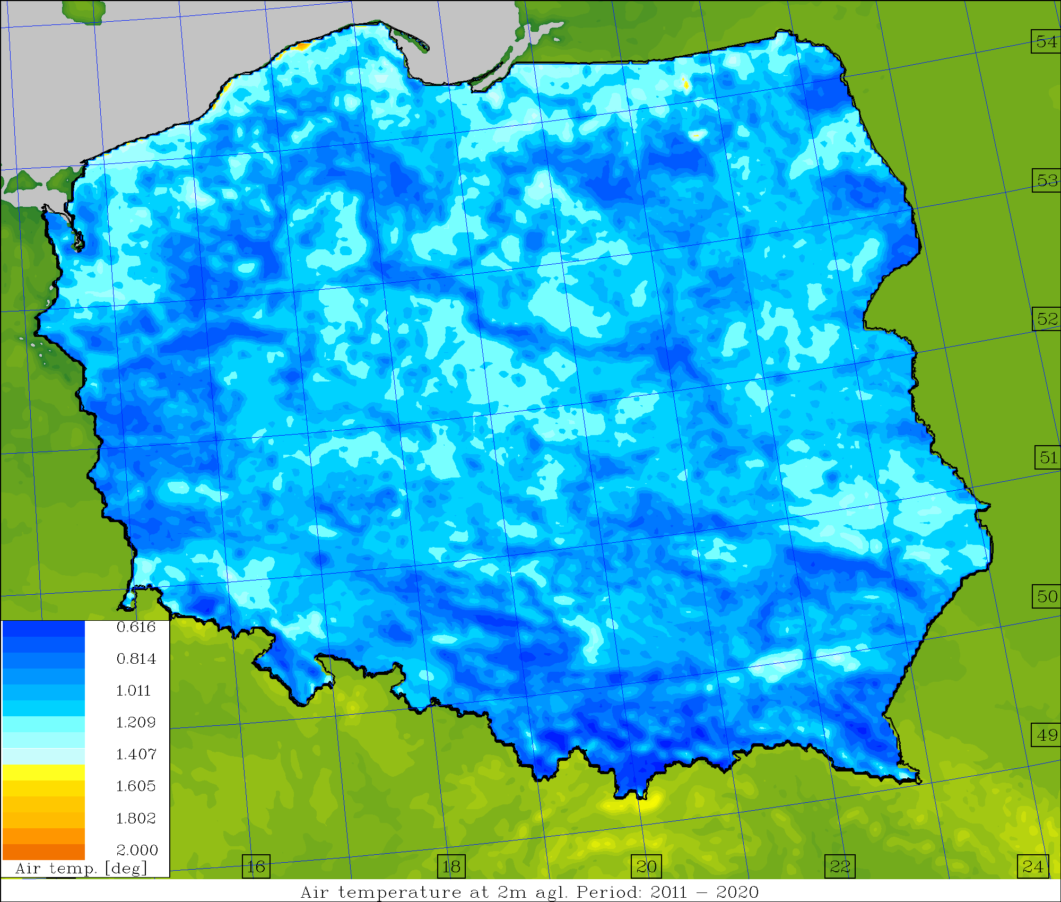
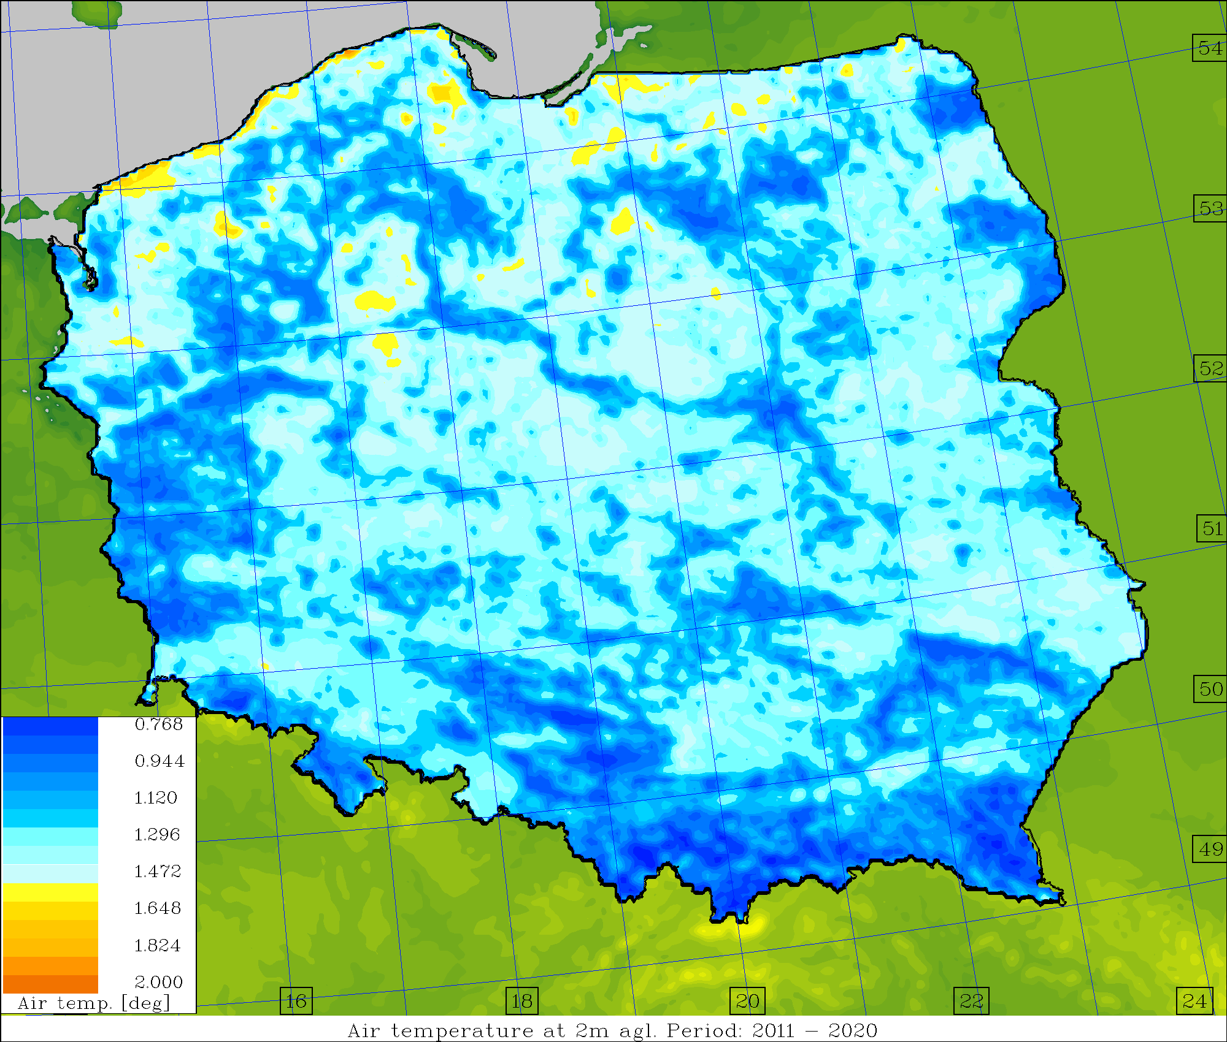
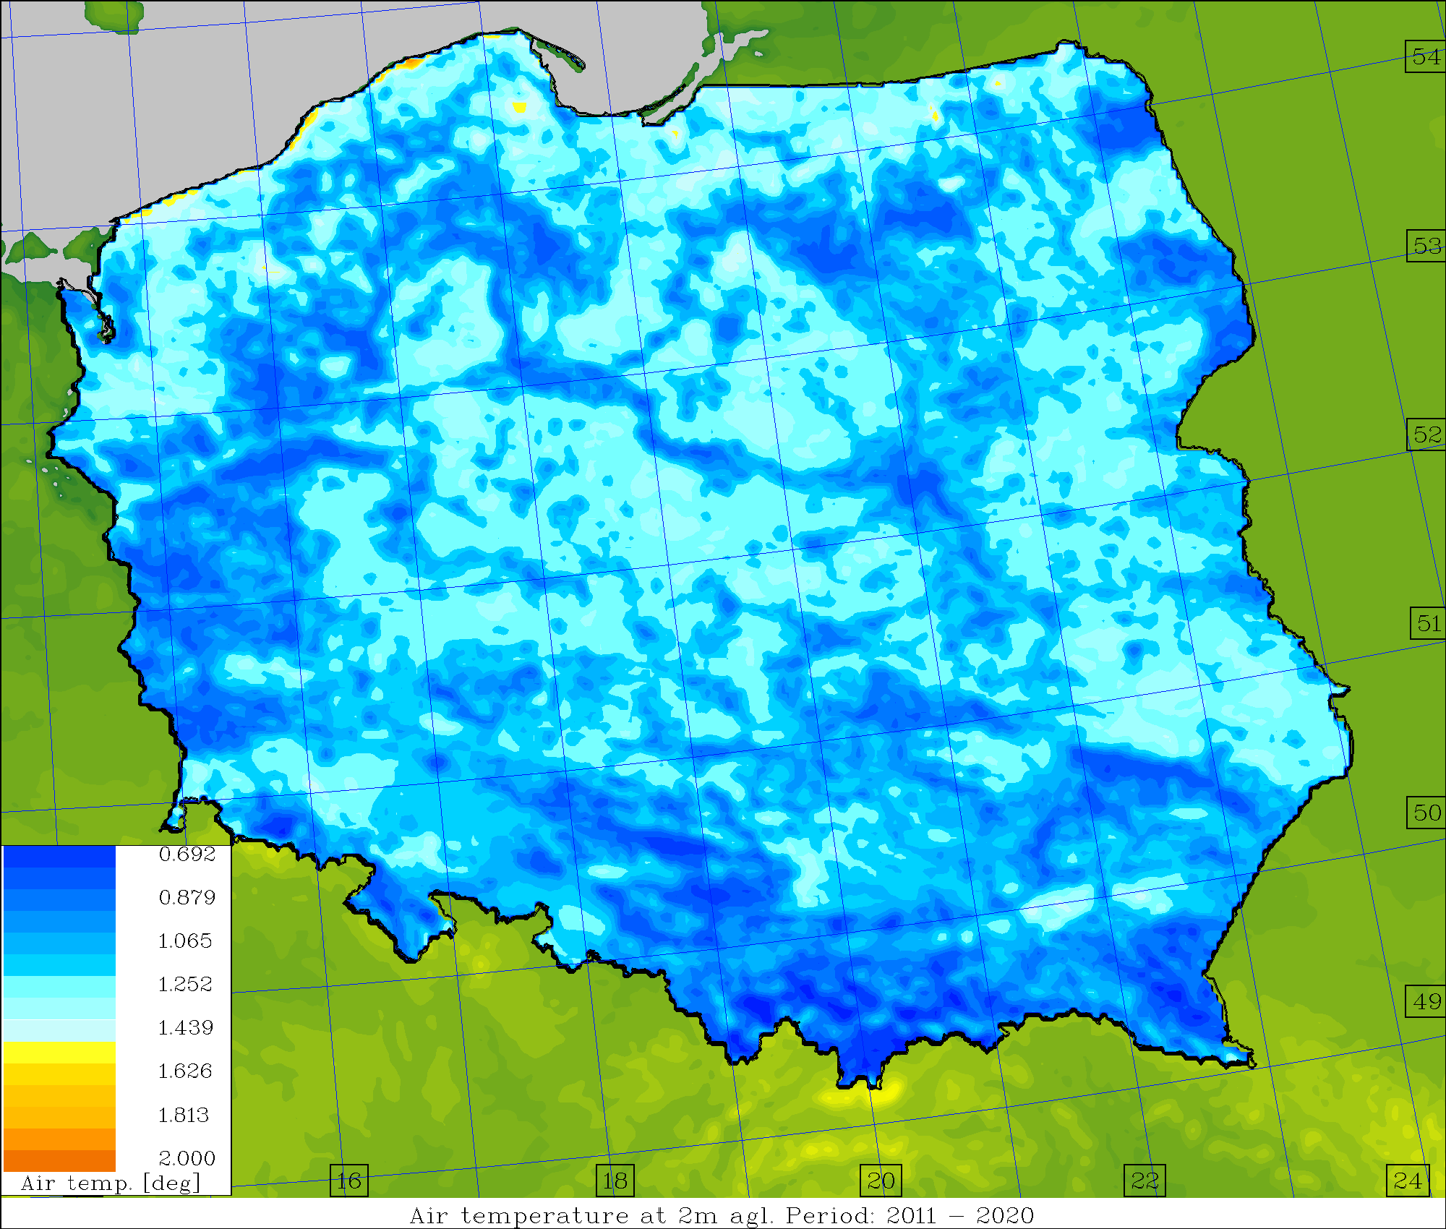
Average skill/spread values, T2M [deg.] (2011-2020)
Operational Surface pert. Down to ~1.0m Down to ~2.5m

Slide 7
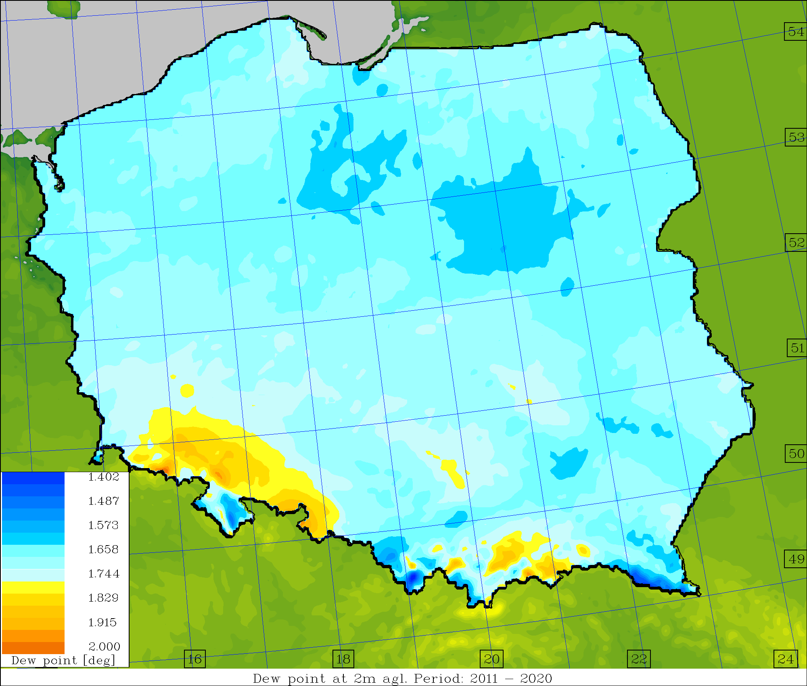
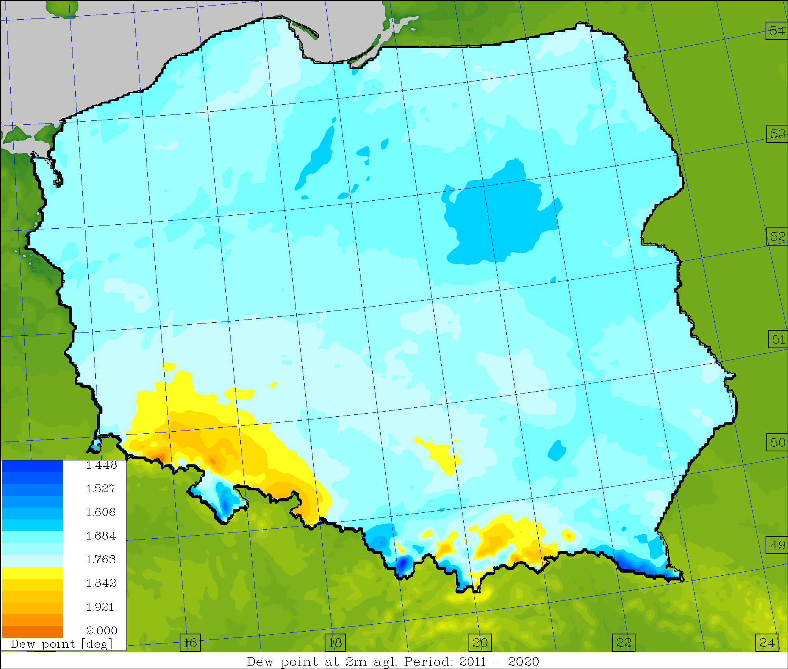
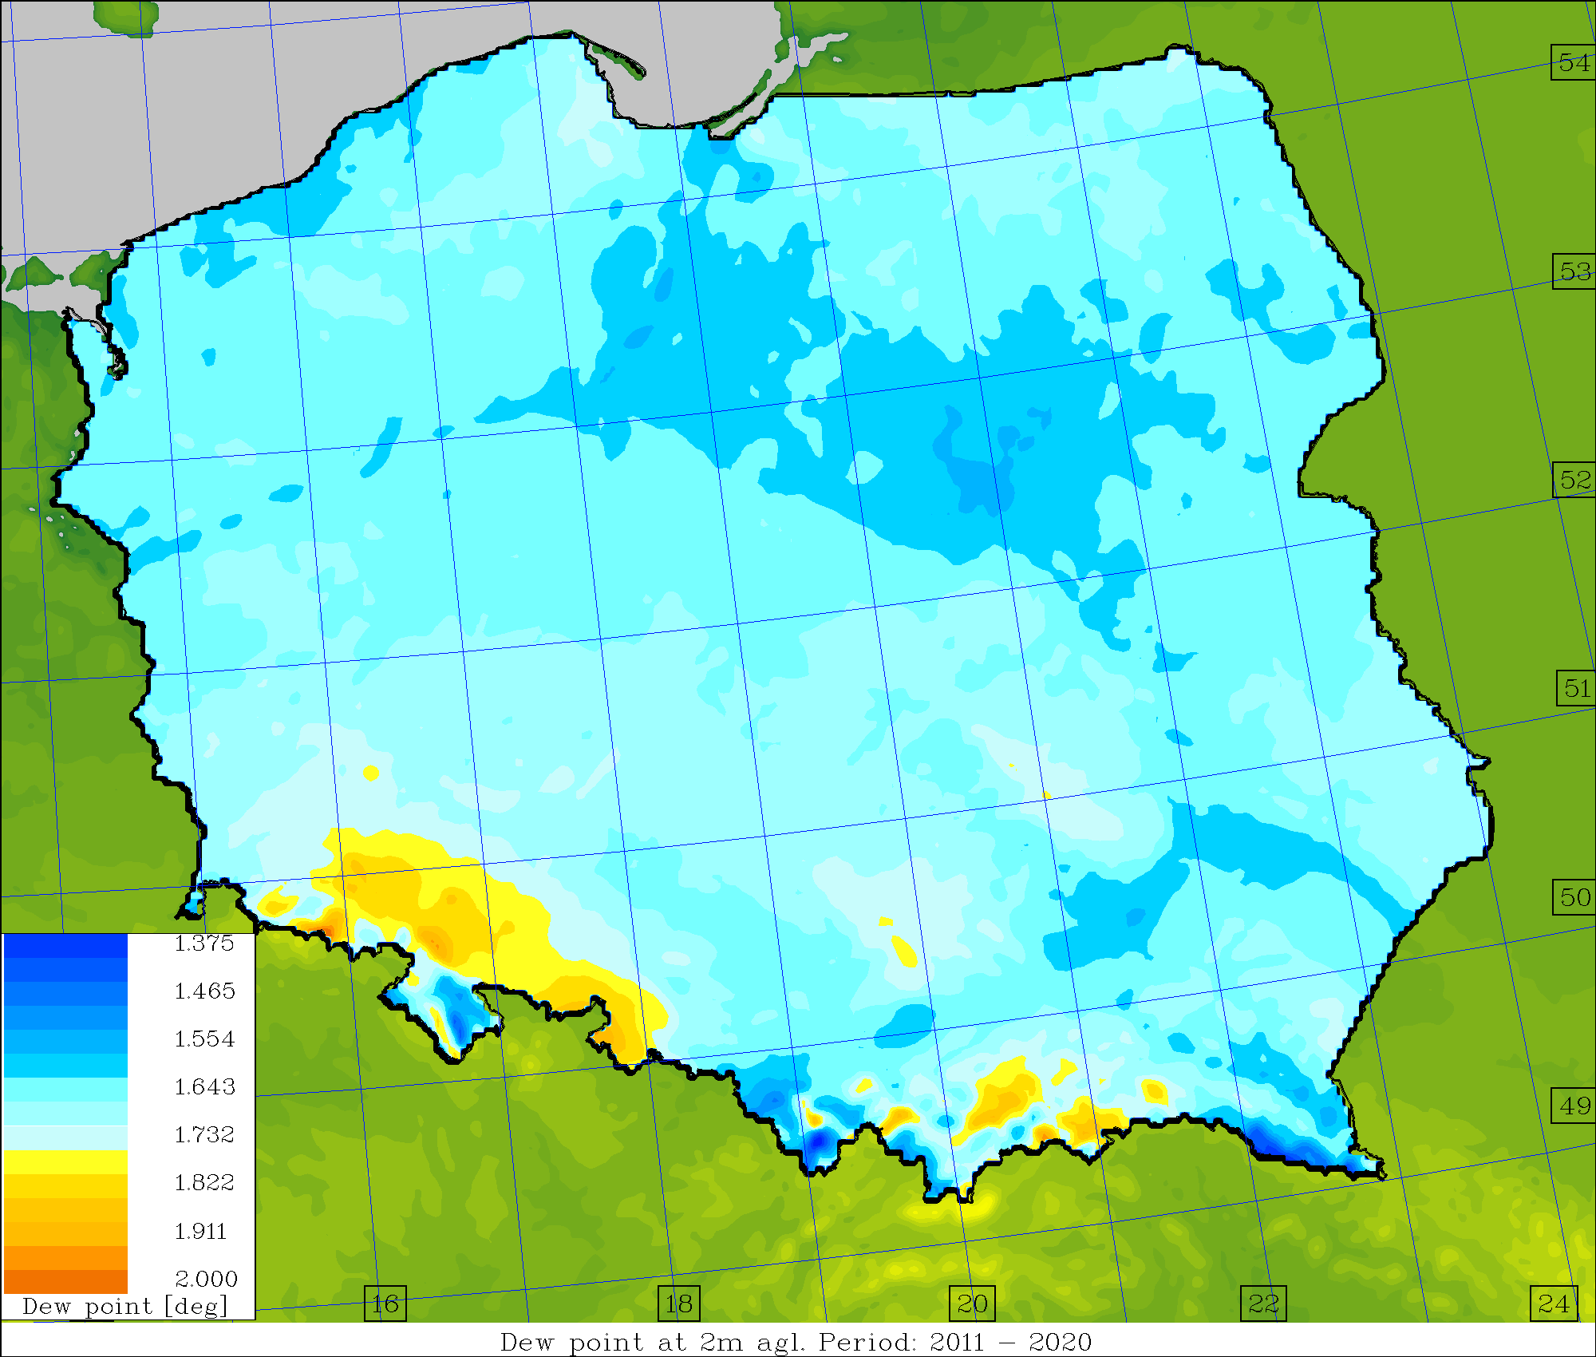
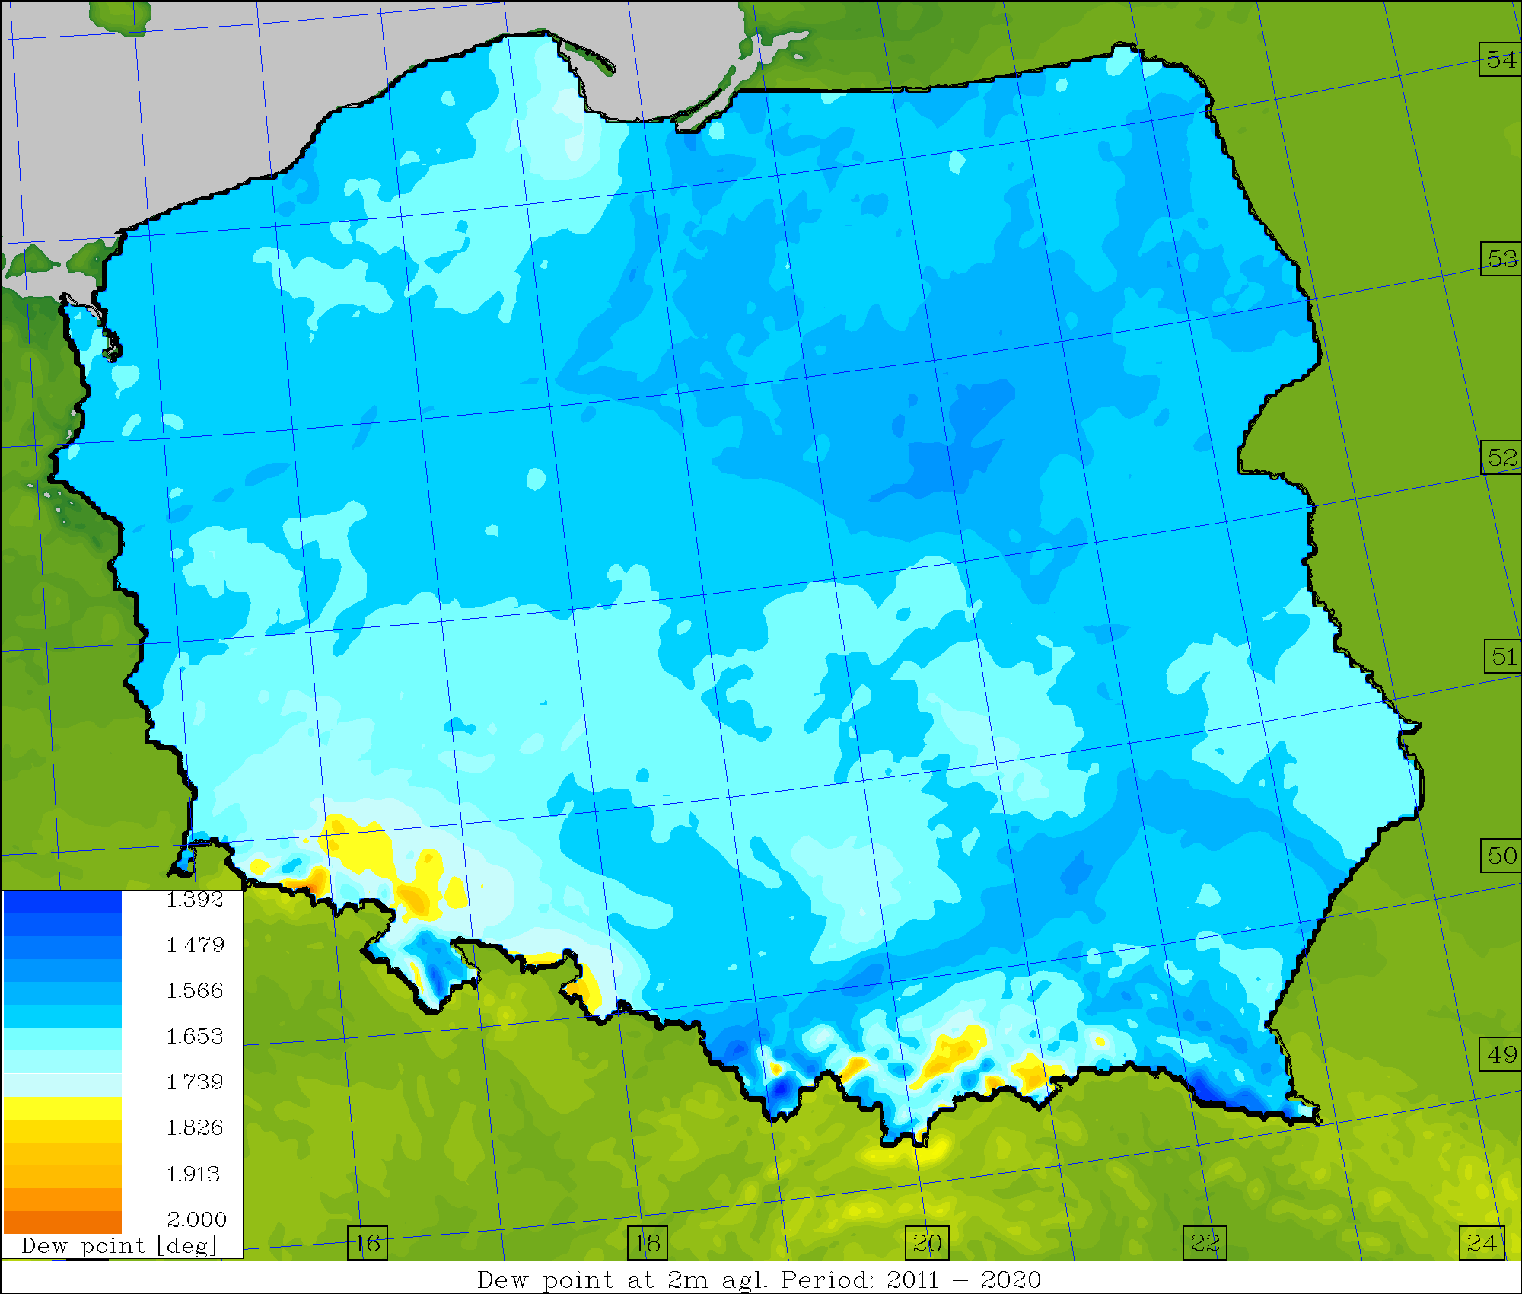
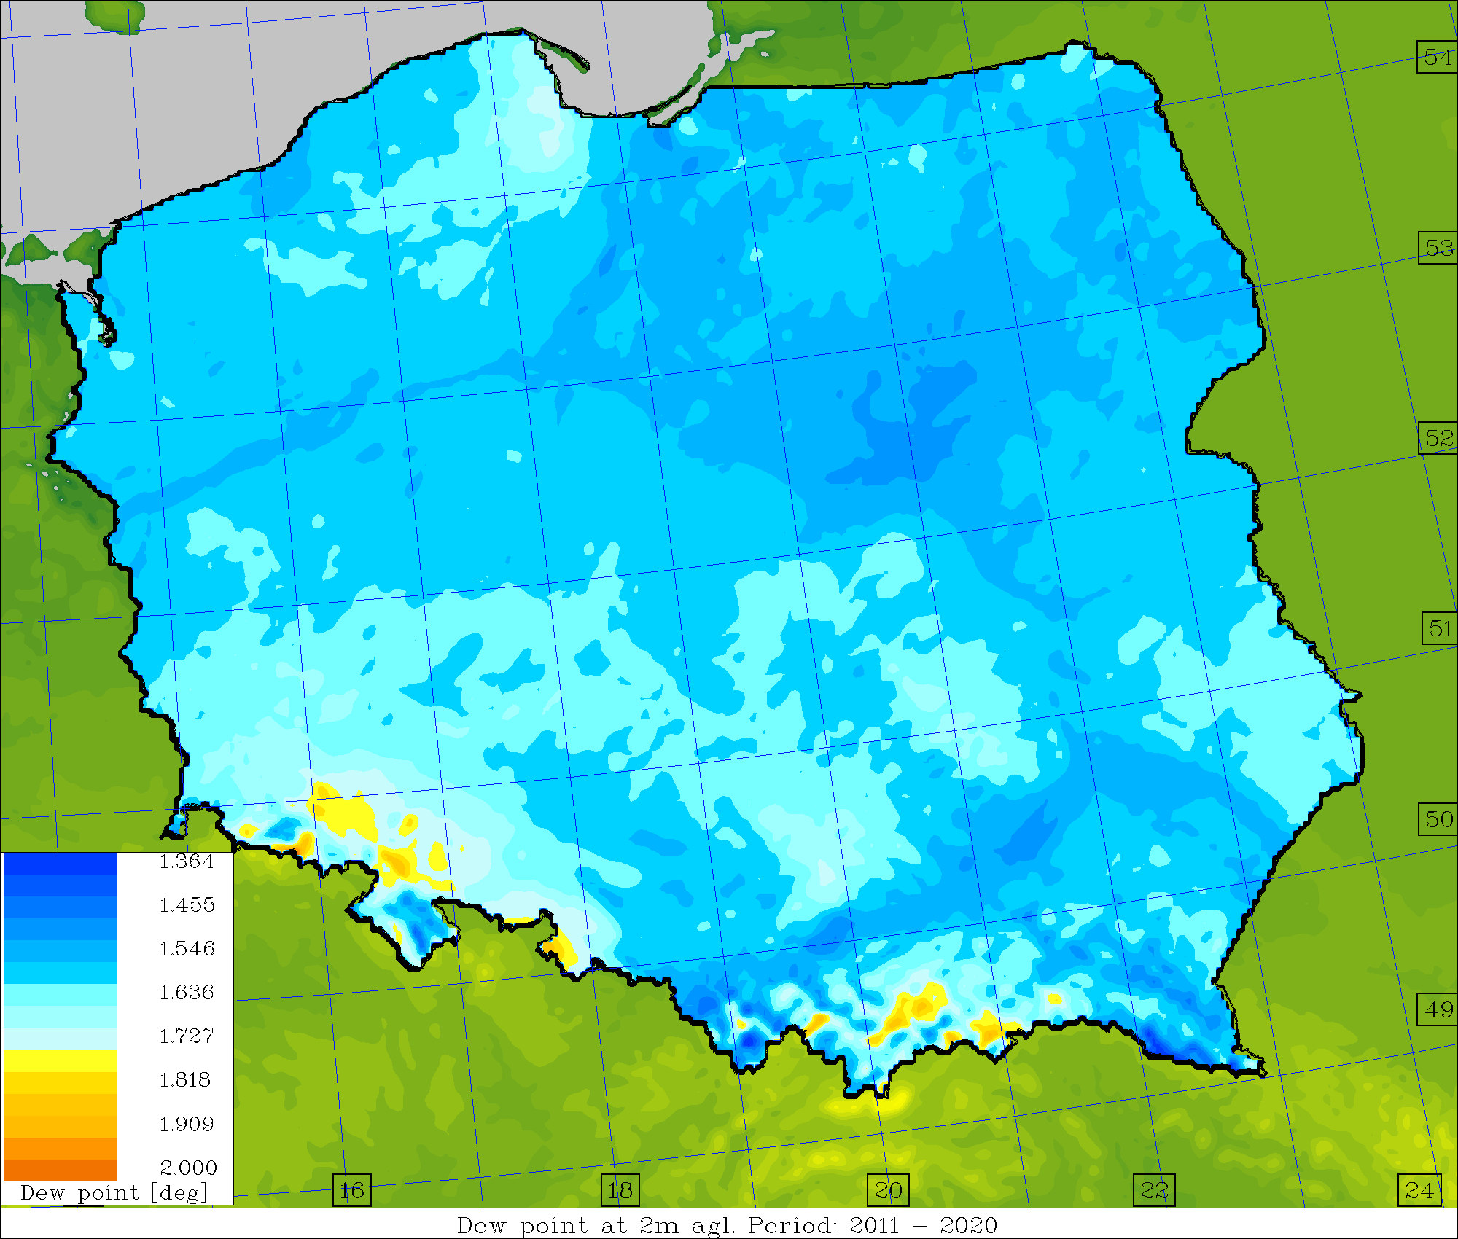
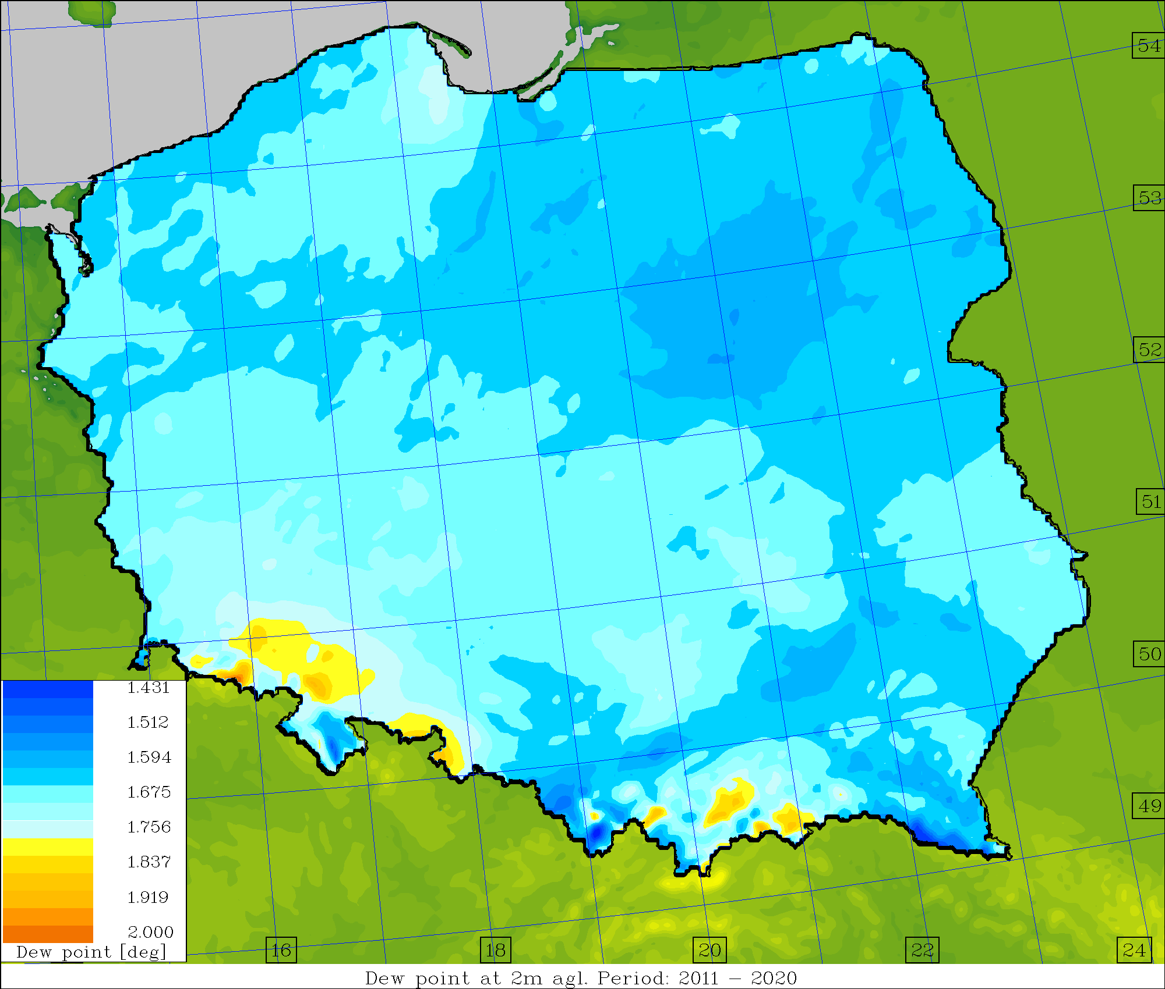
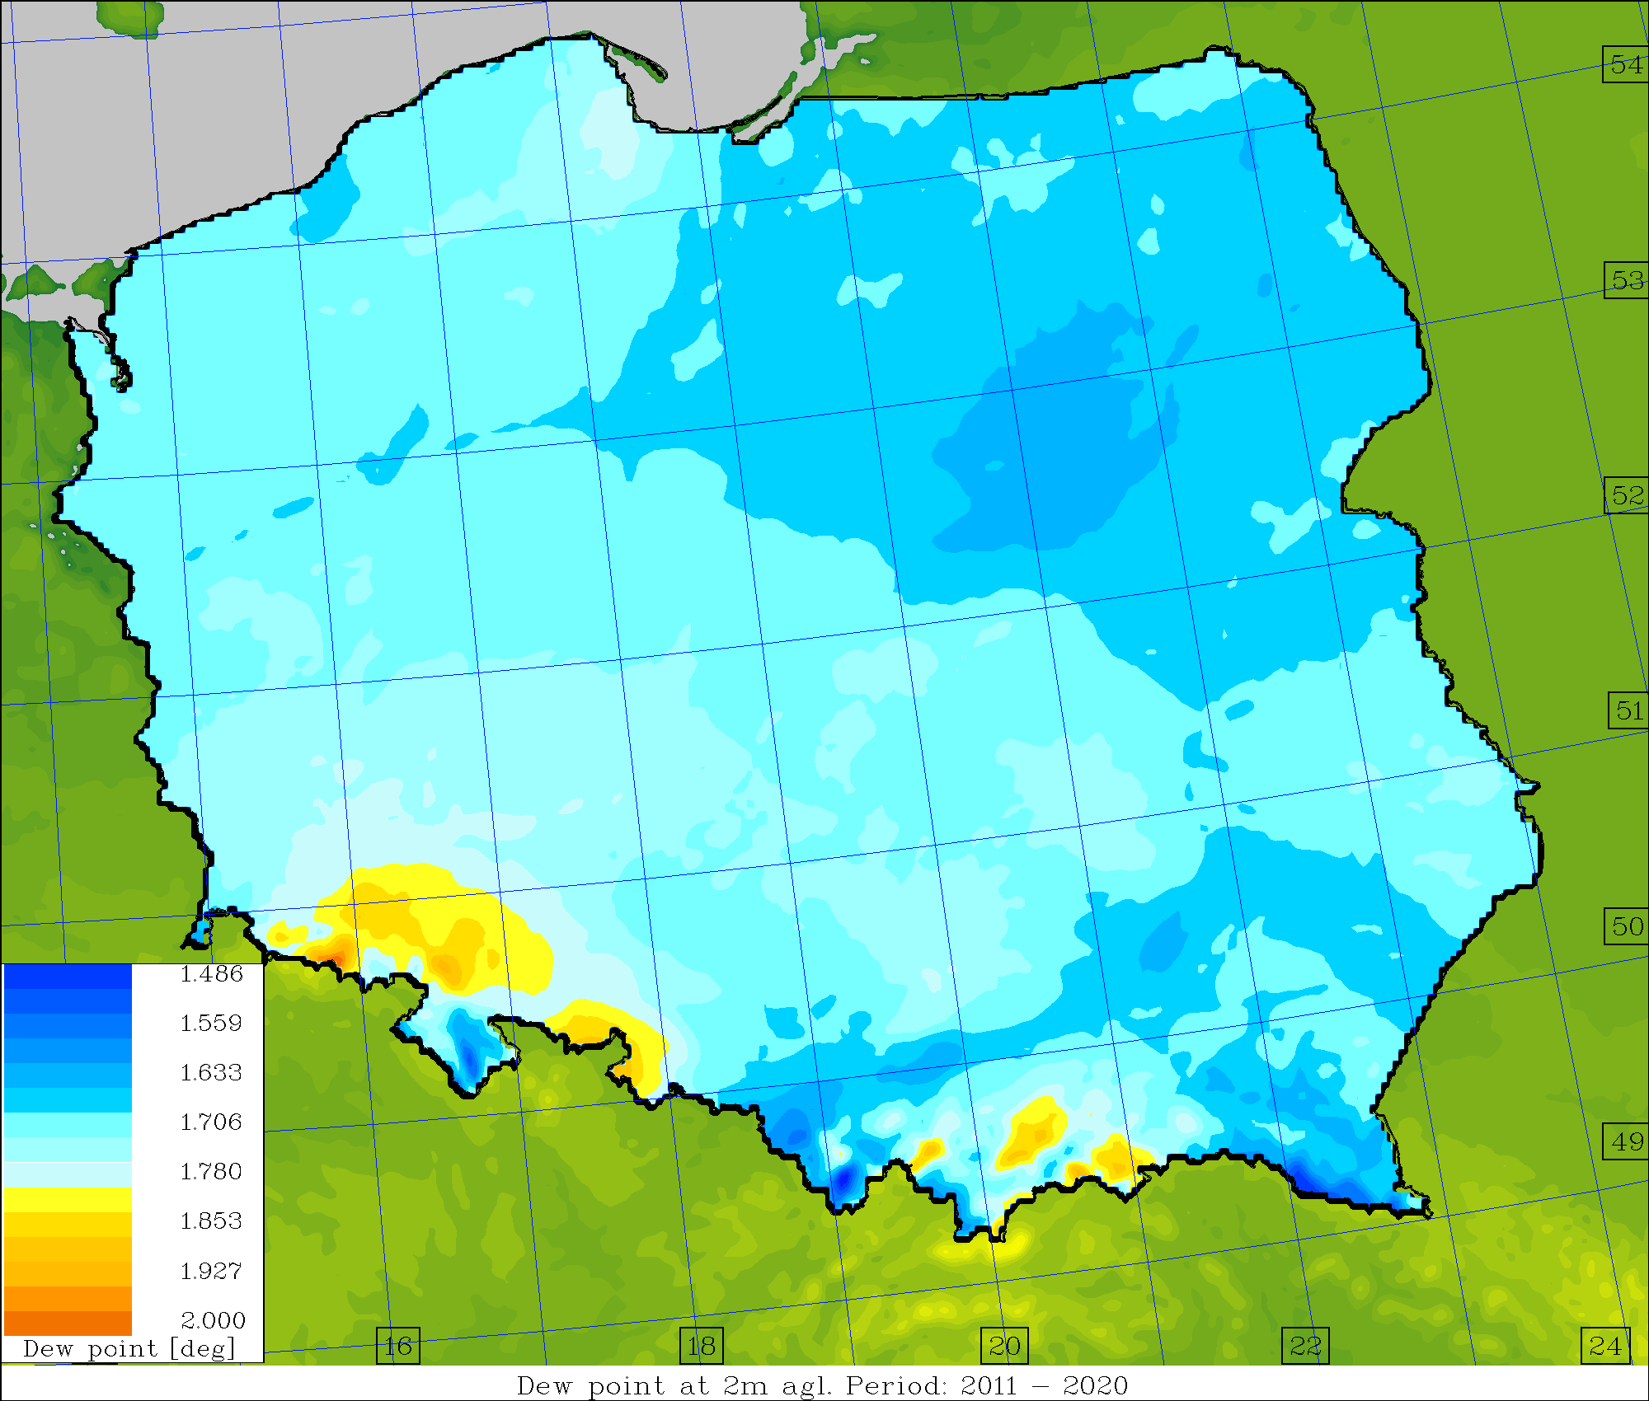
Average skill/spread values, TD2M [deg.] (2011-2020)
Operational Surface pert. Down to ~1.0m Down to ~2.5m

Slide 8
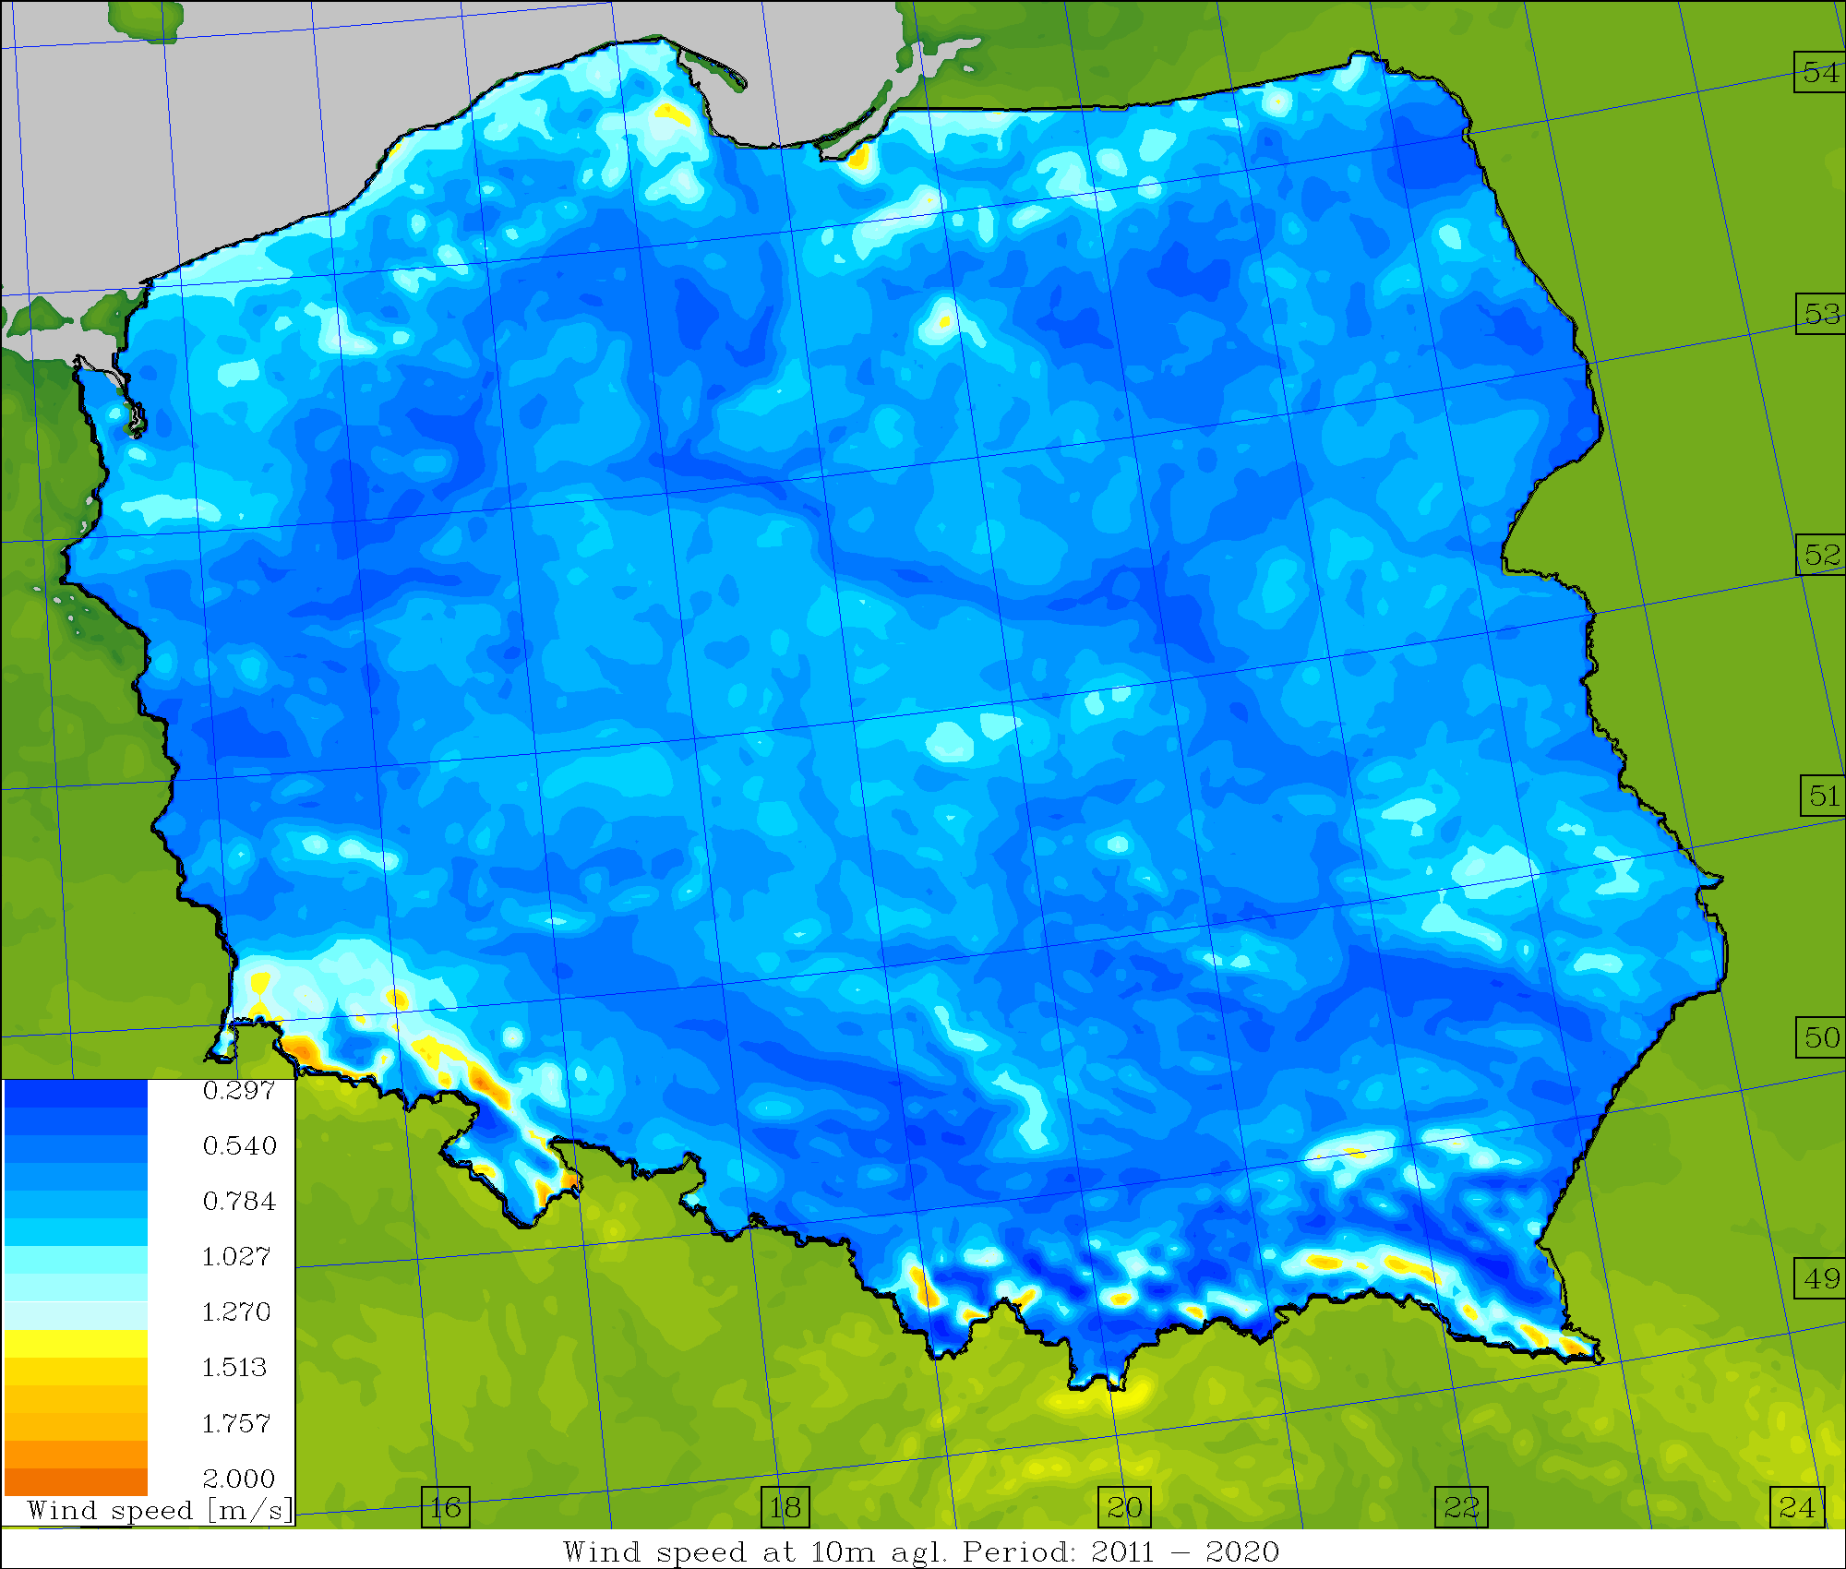
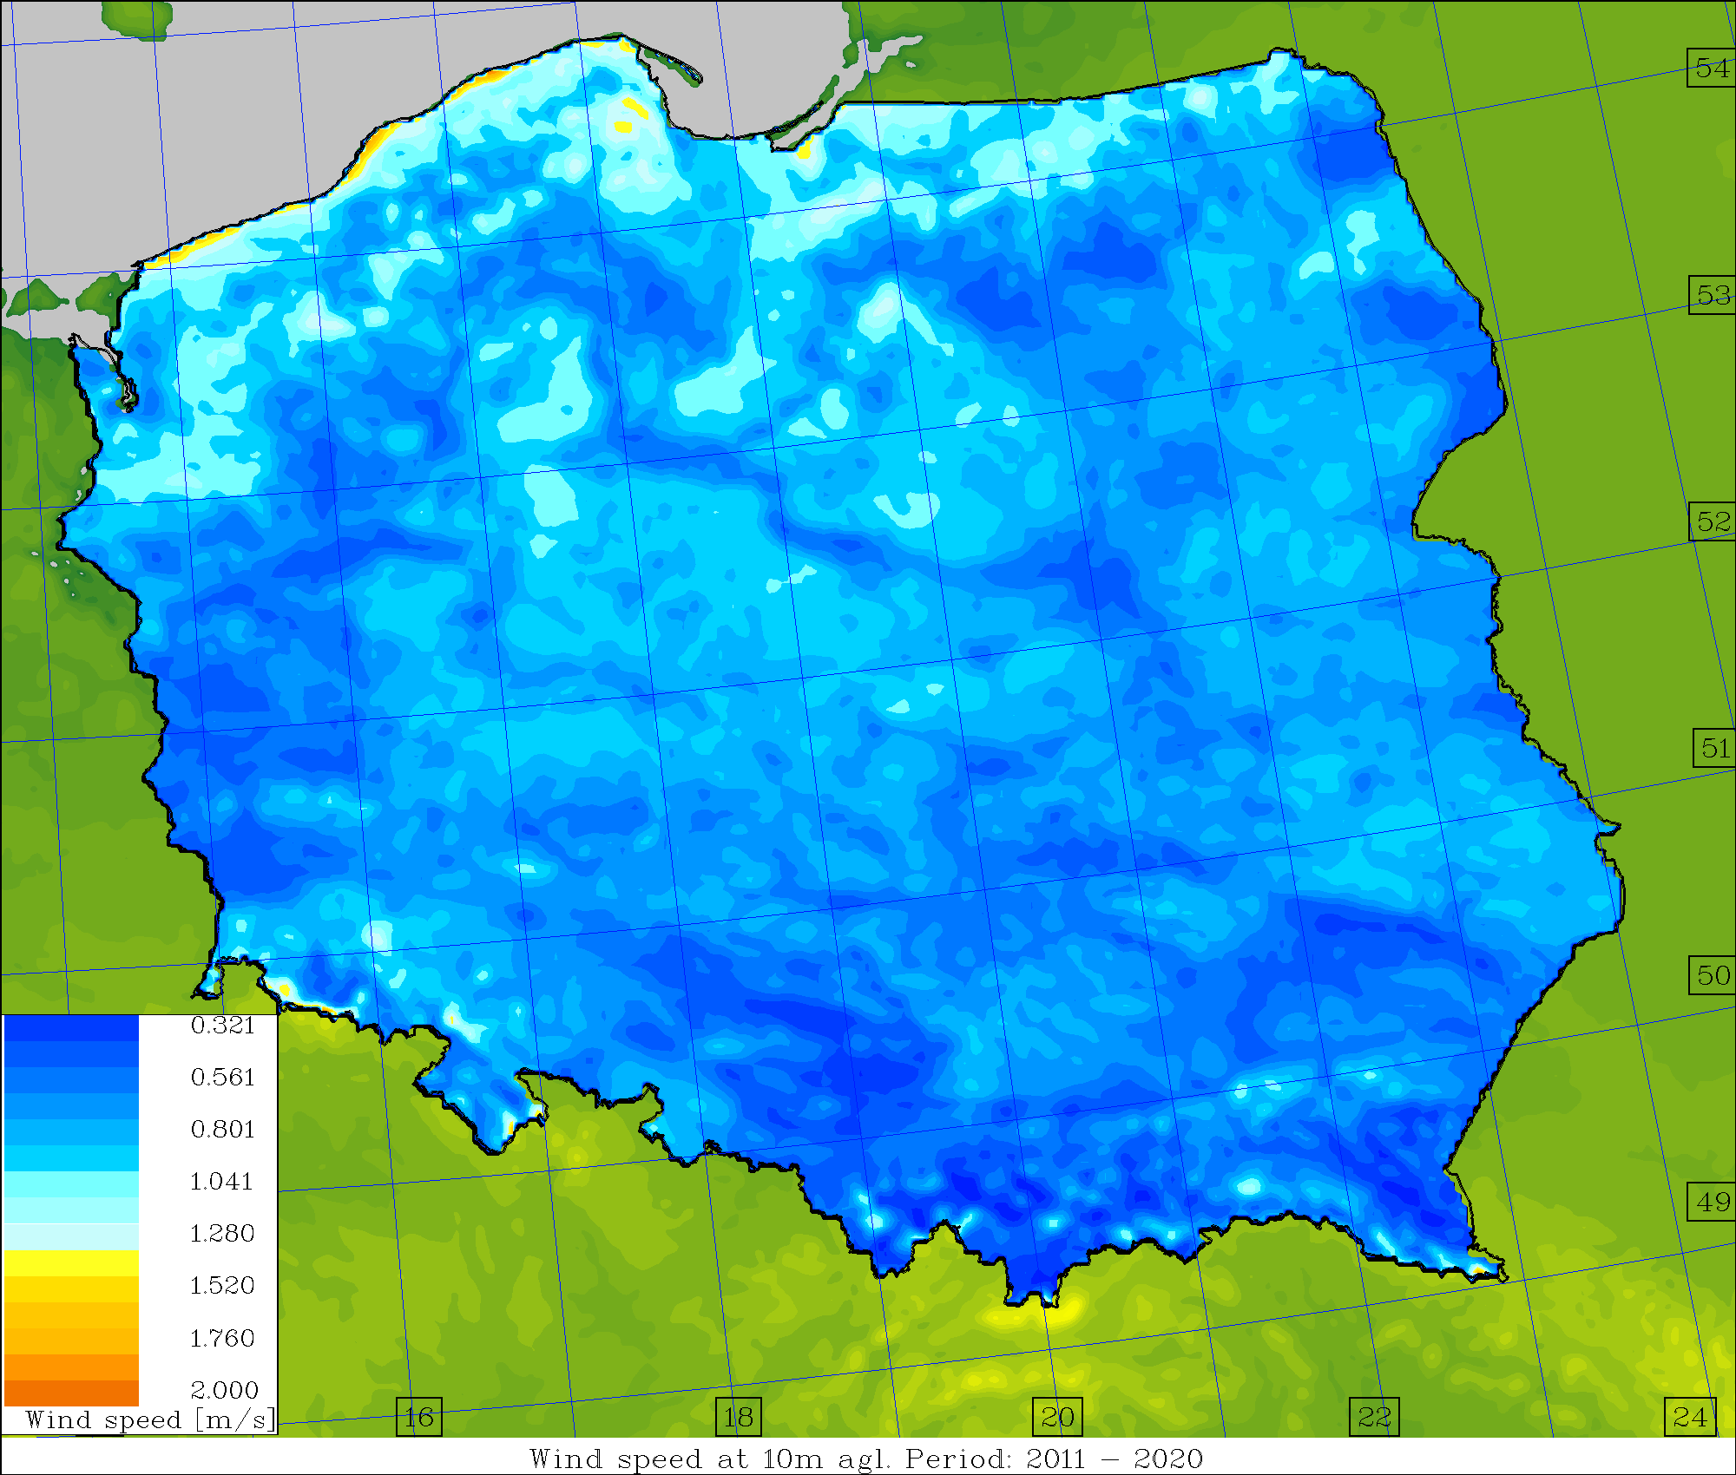
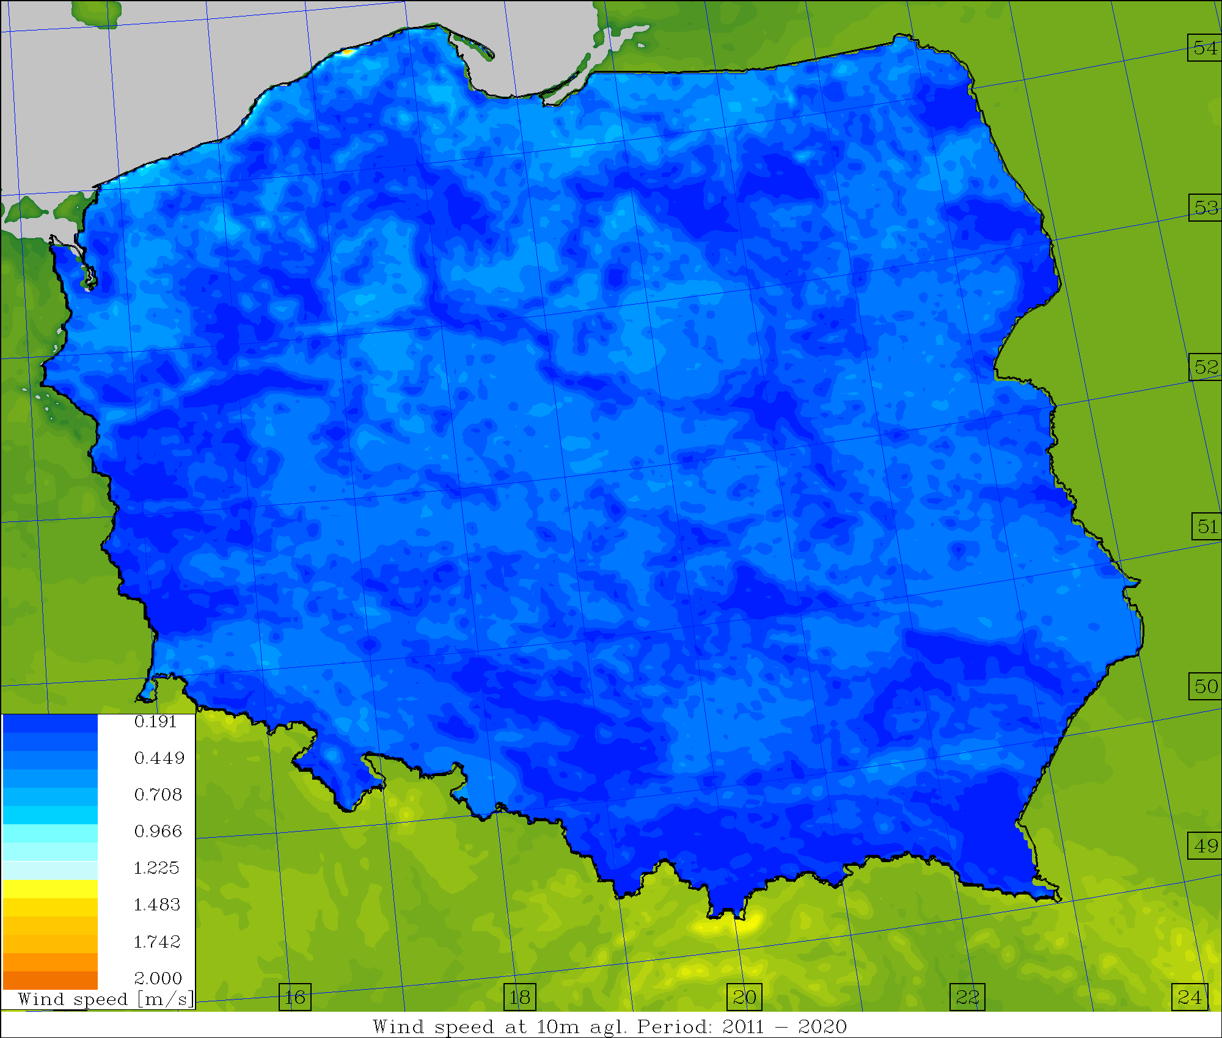
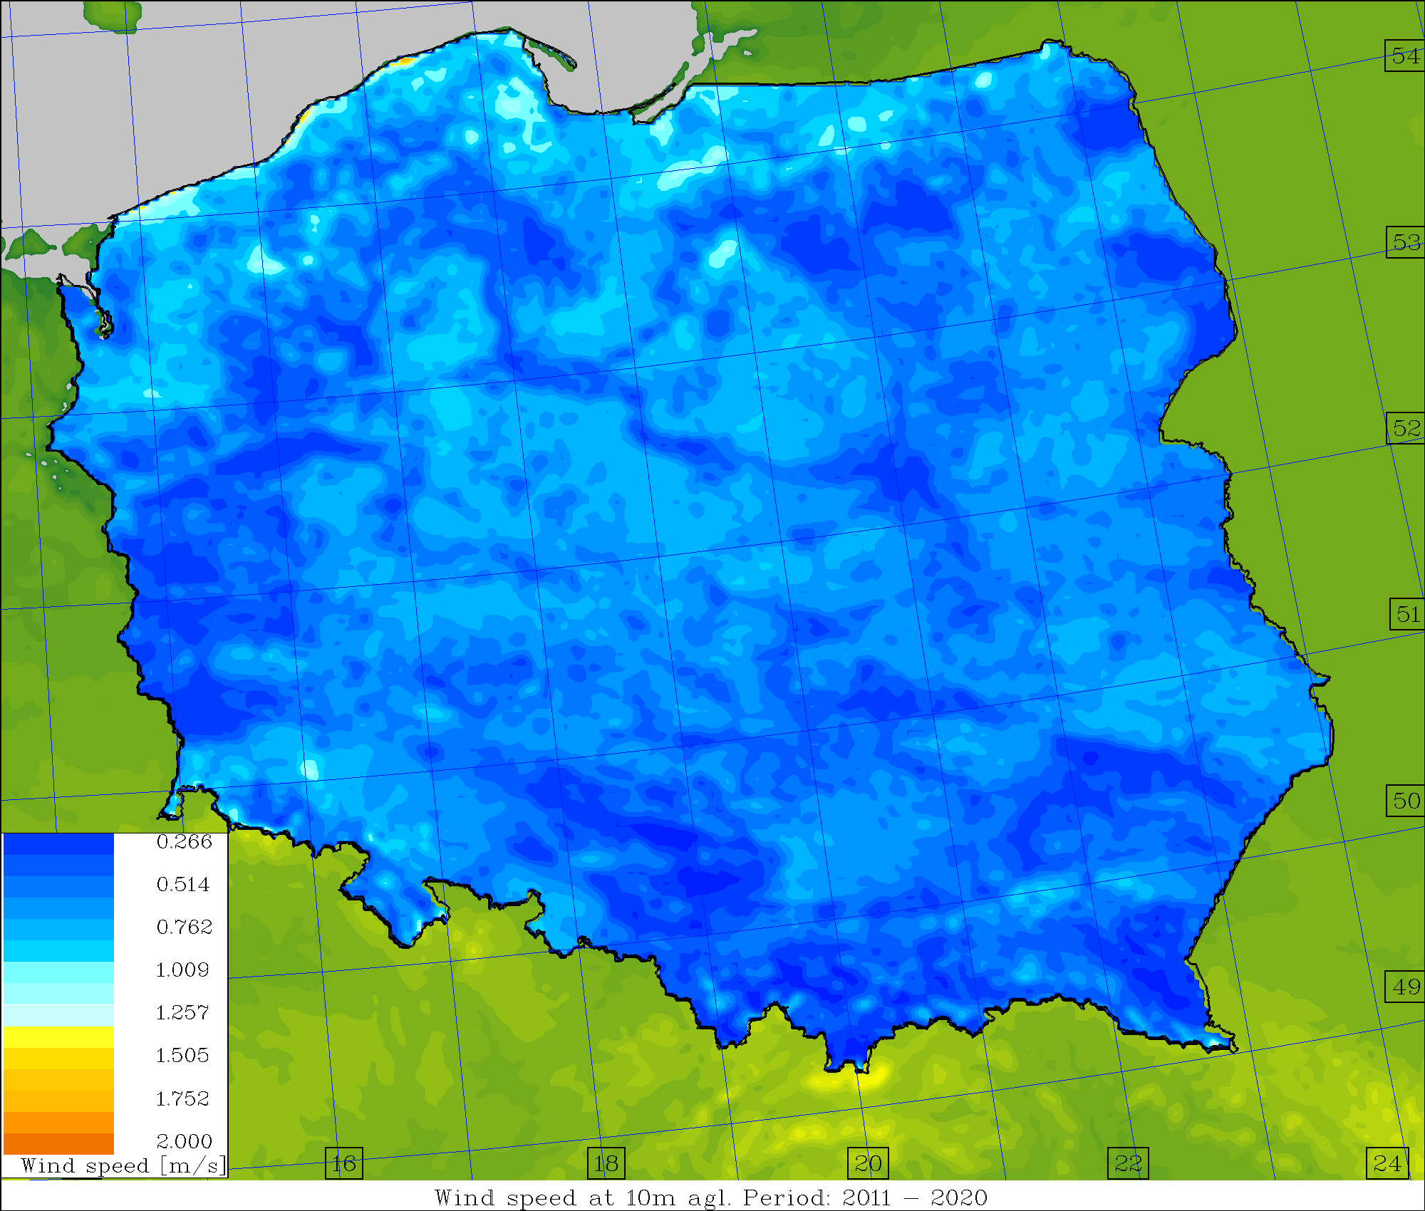
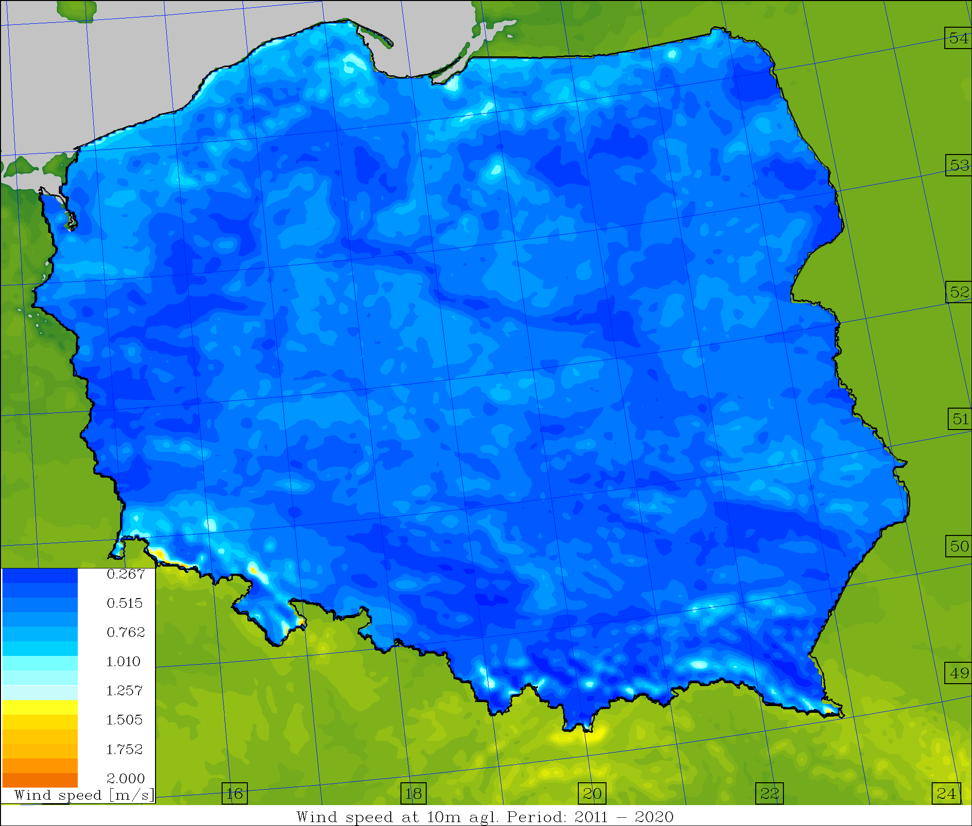
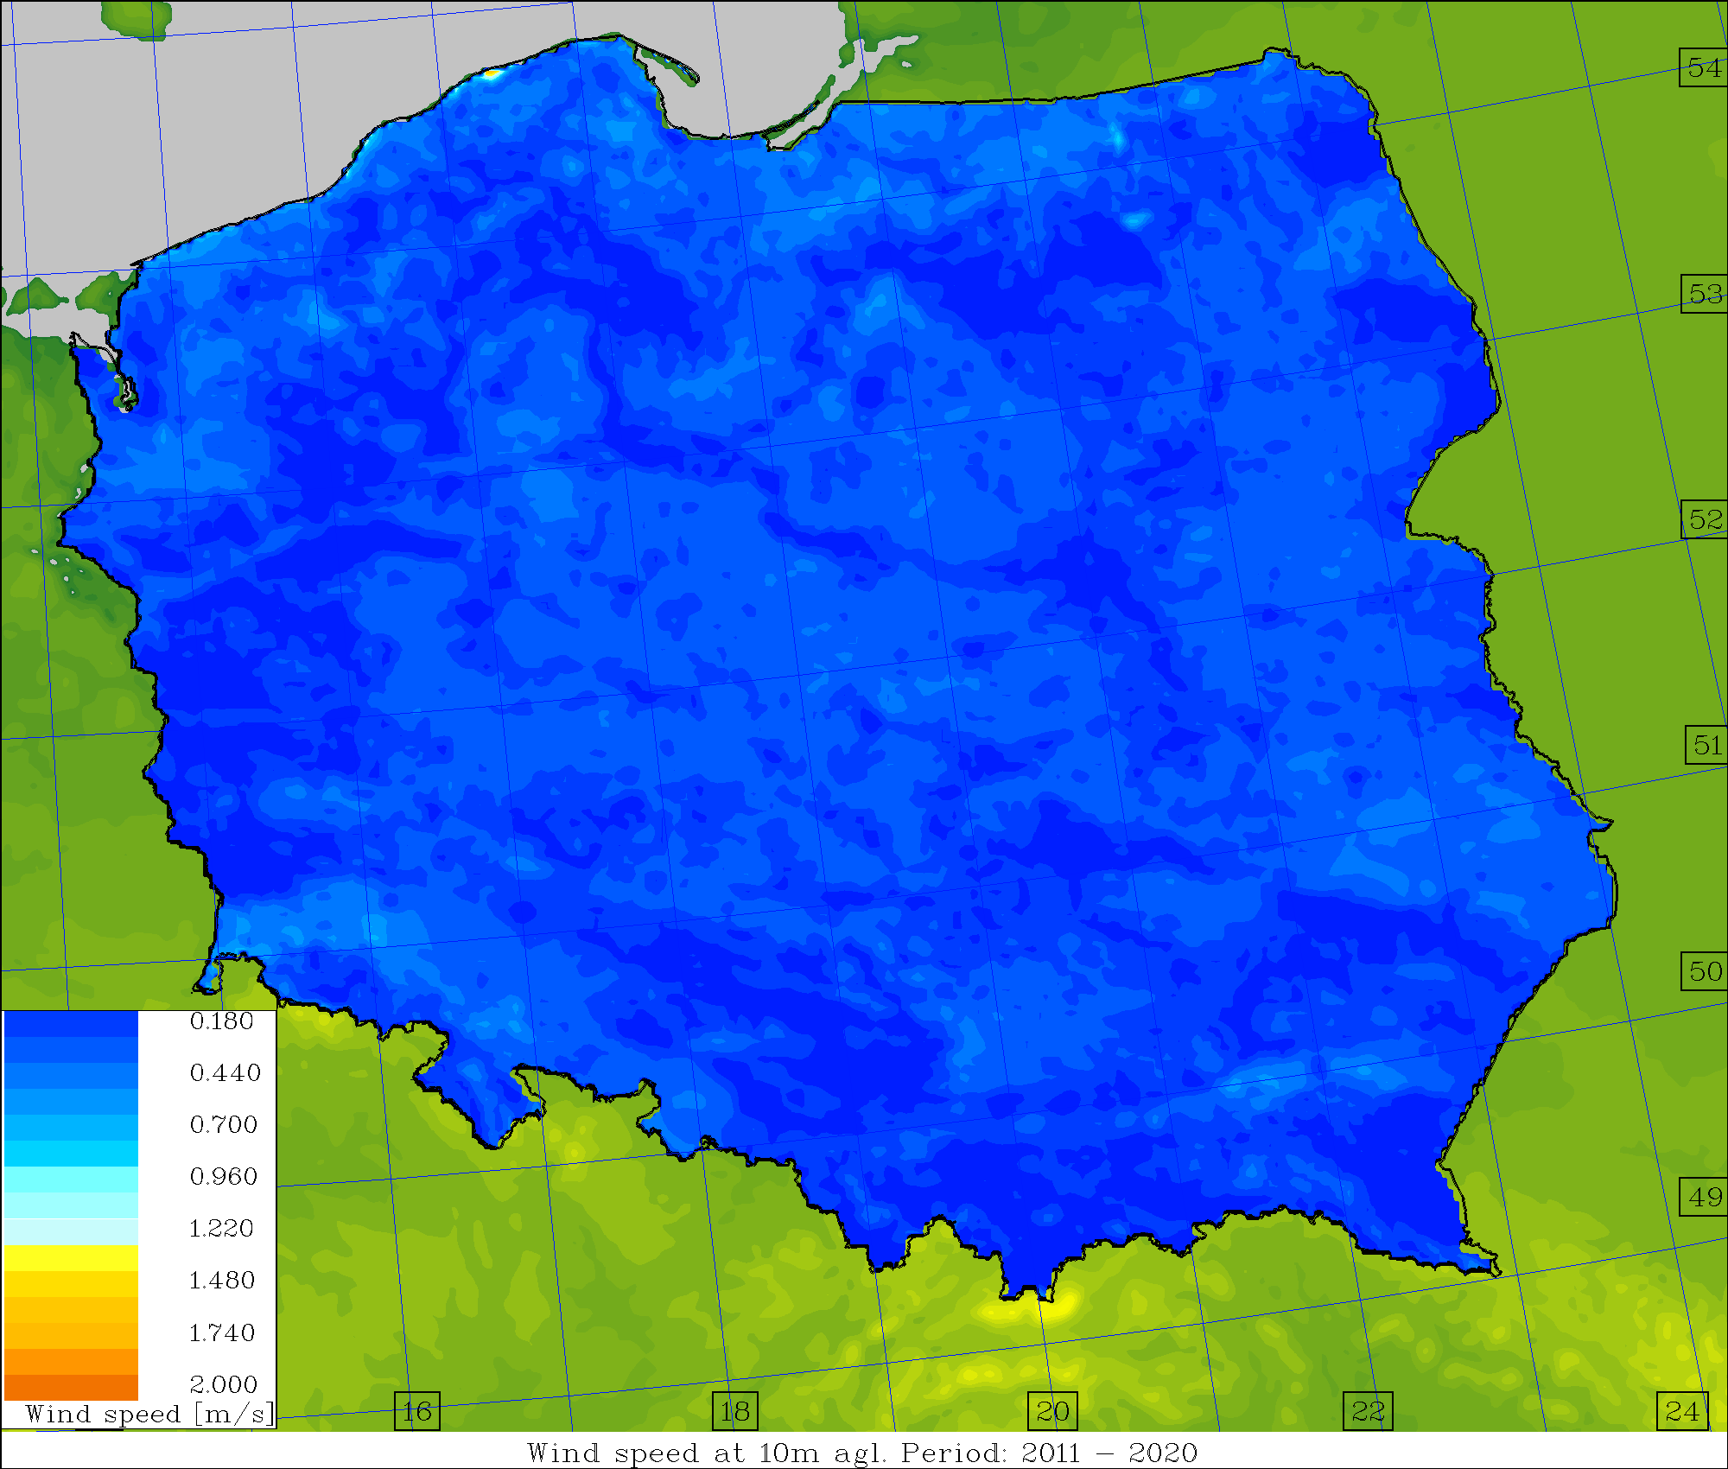
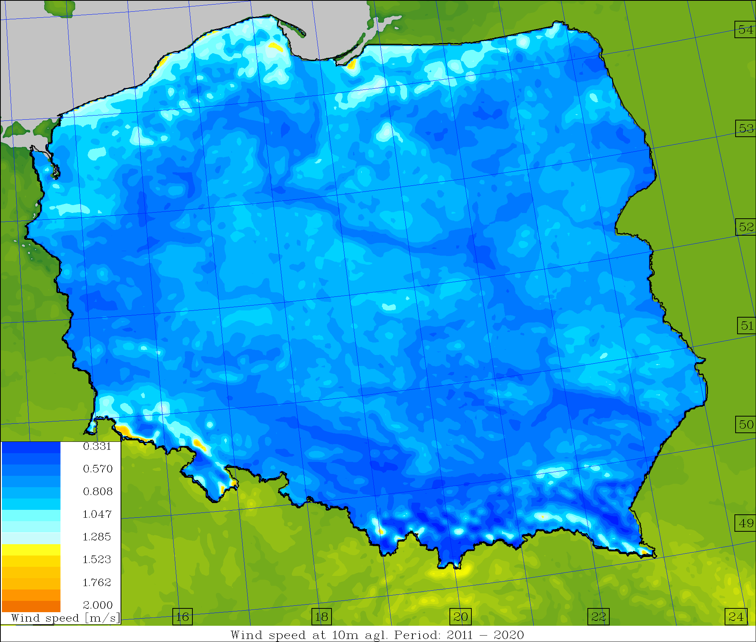
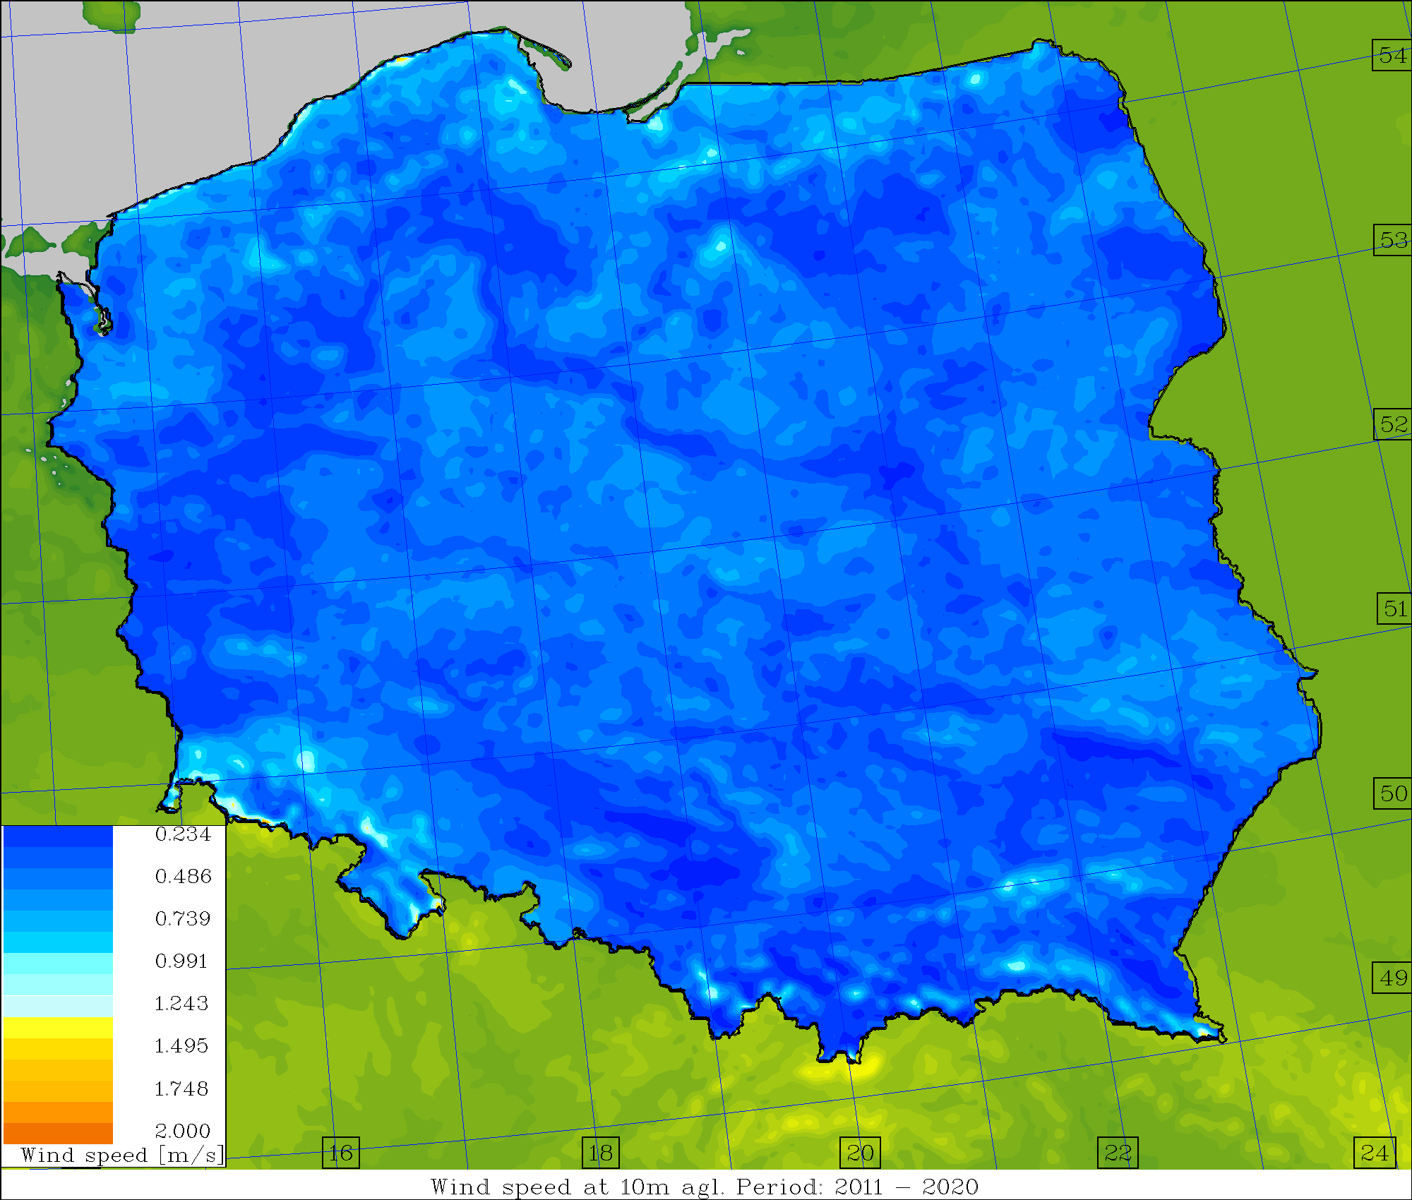
Average skill/spread values, U10M [m/s] (2011-2020)
Operational Surface pert. Down to ~1.0m Down to ~2.5m

Slide 9
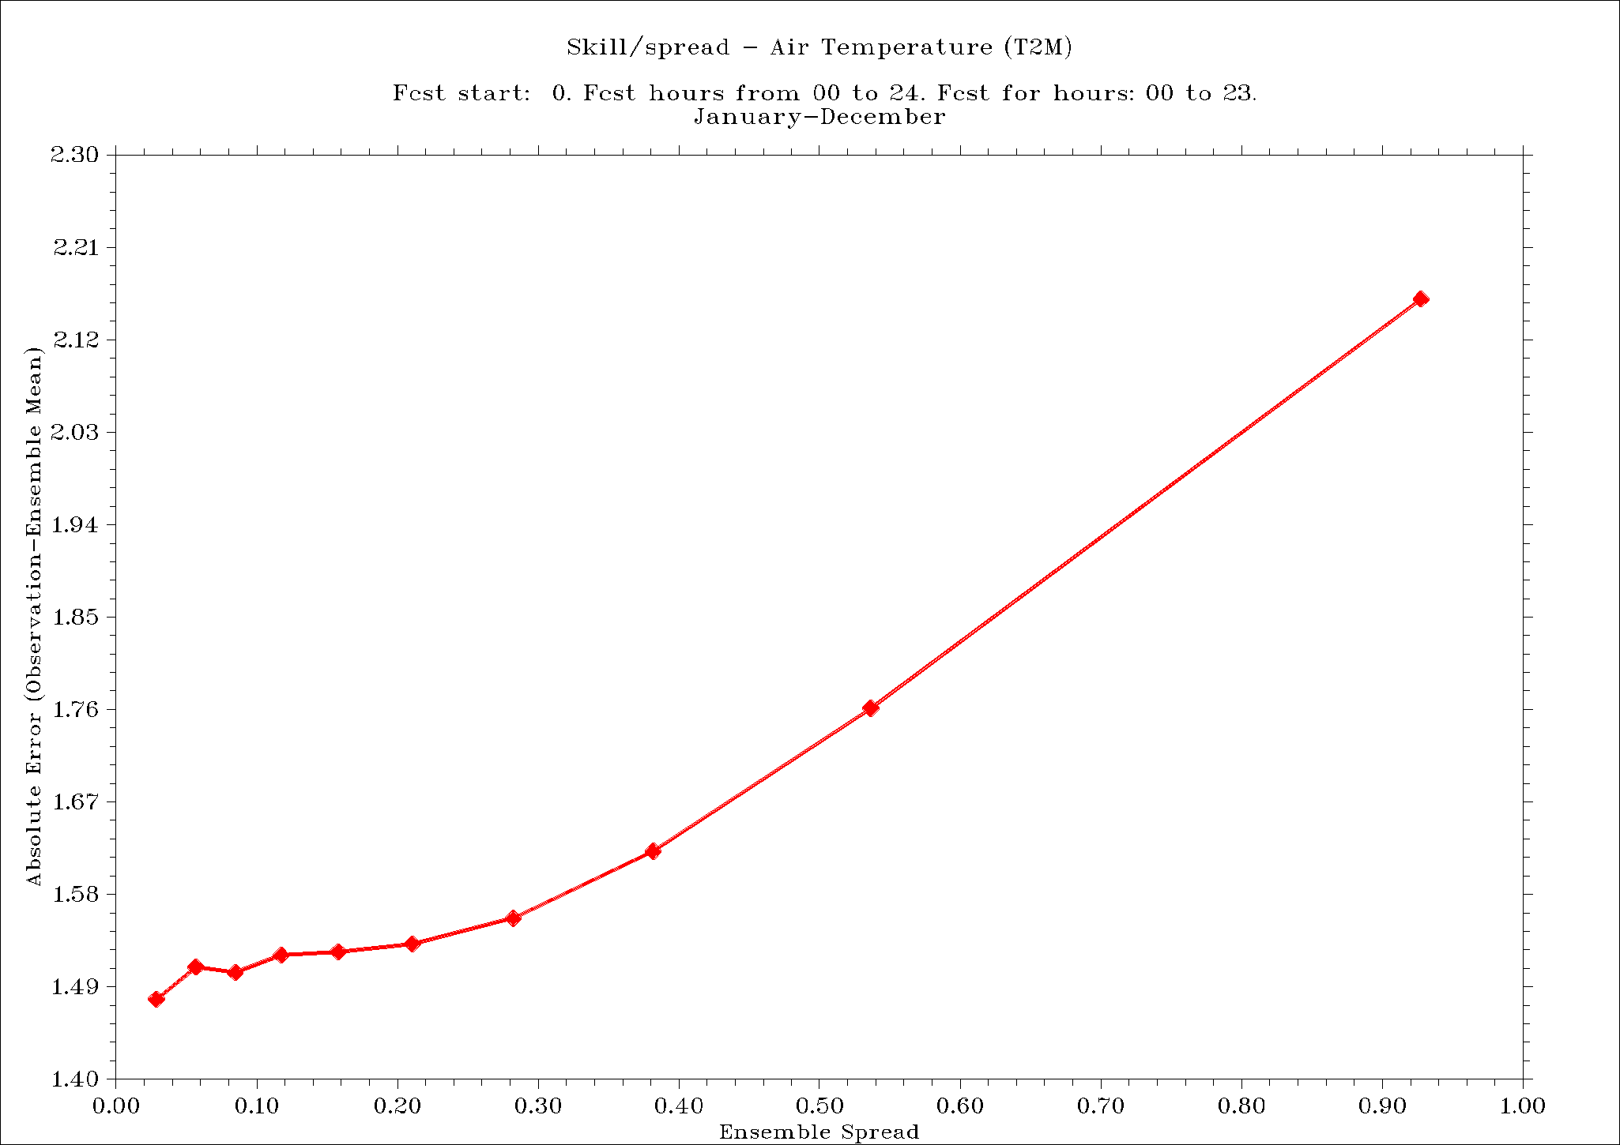
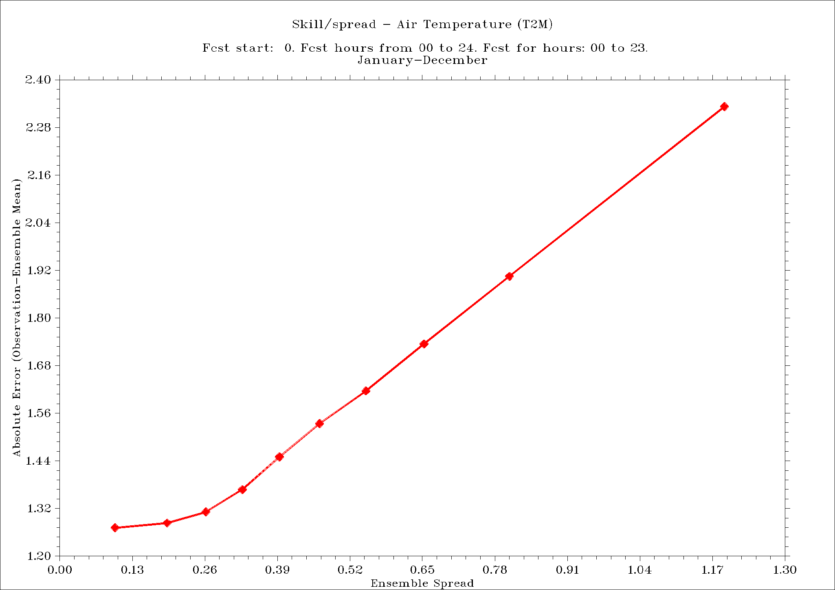
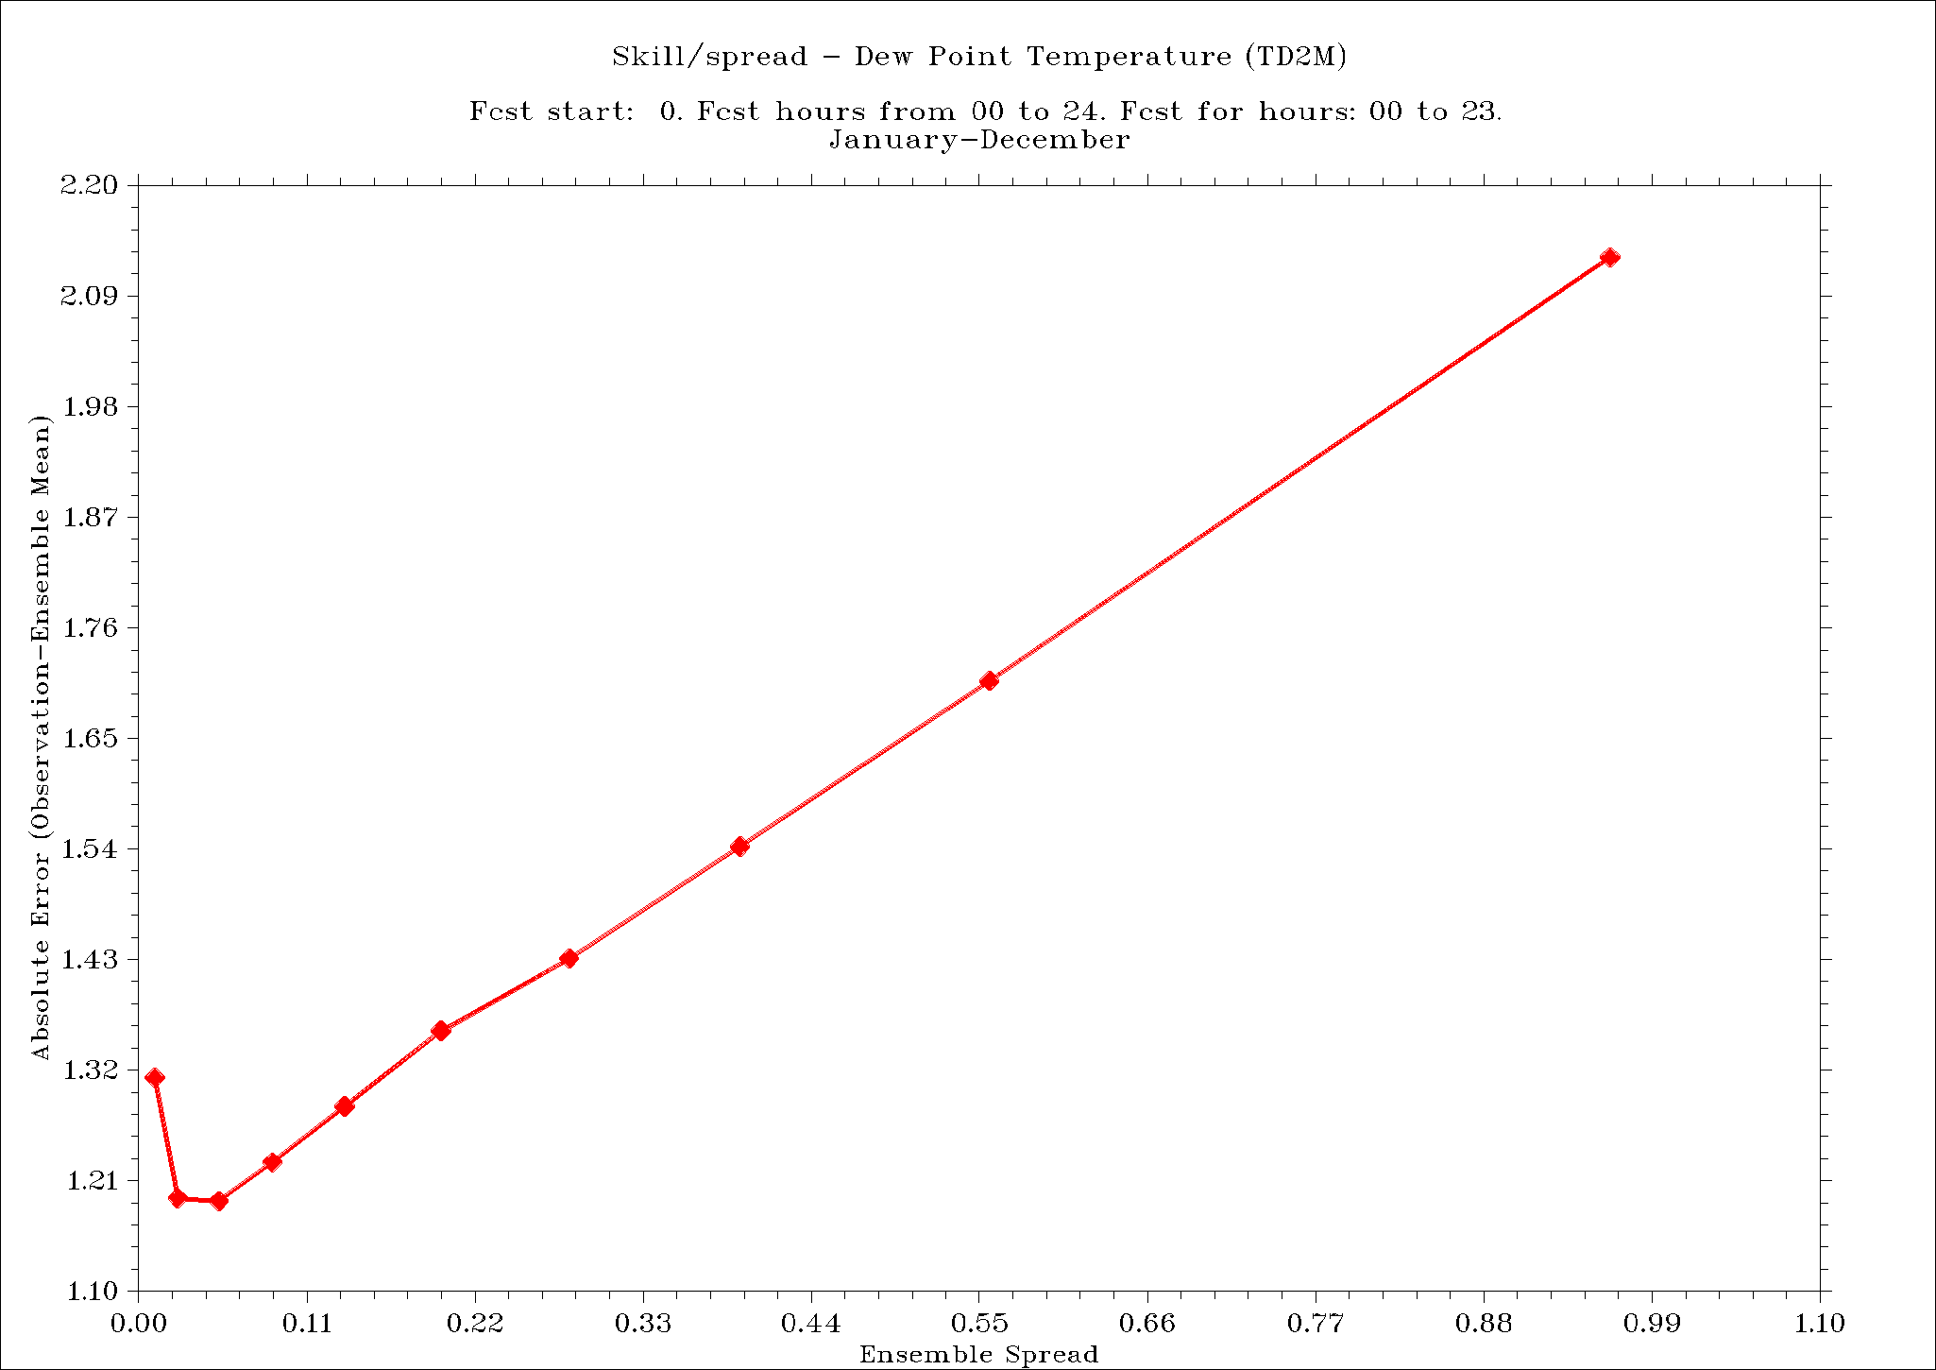
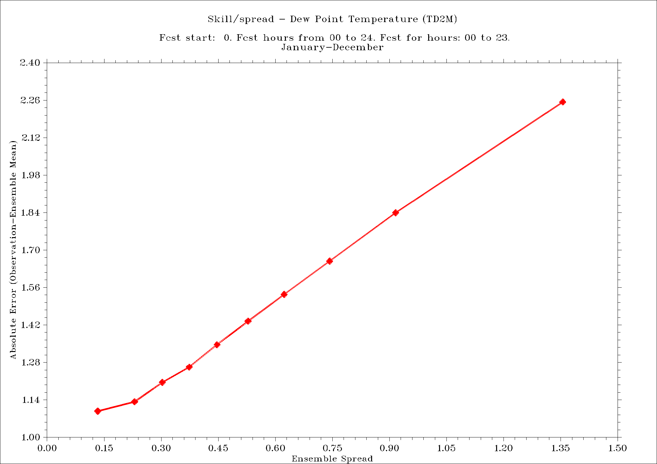
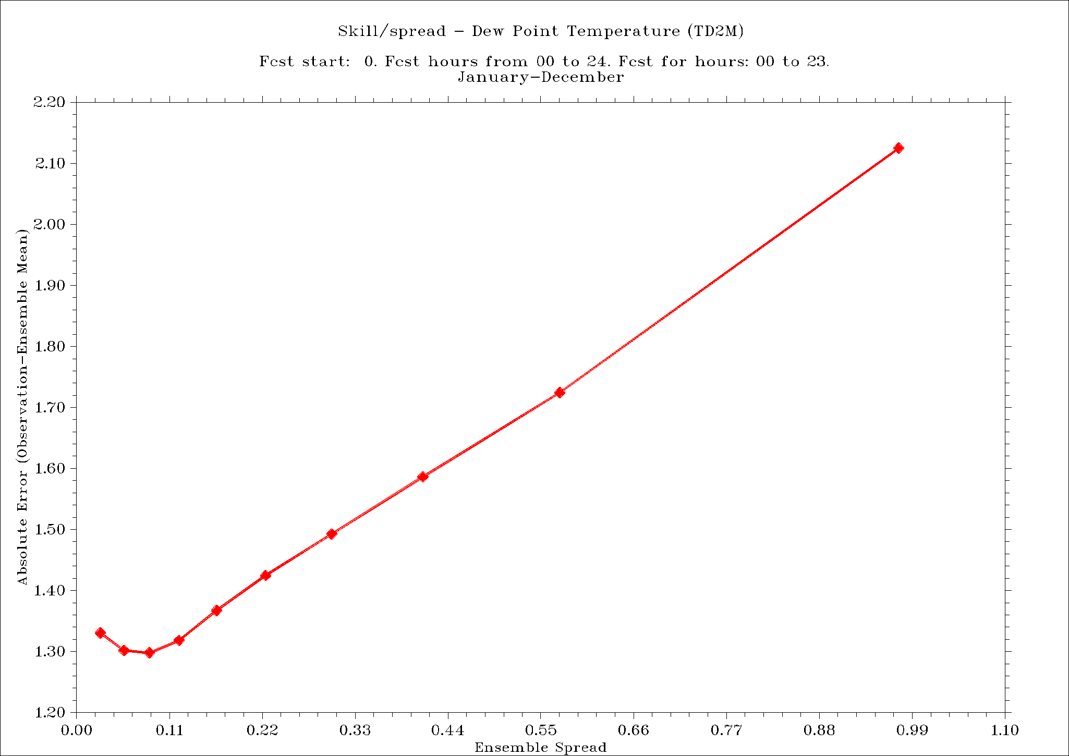
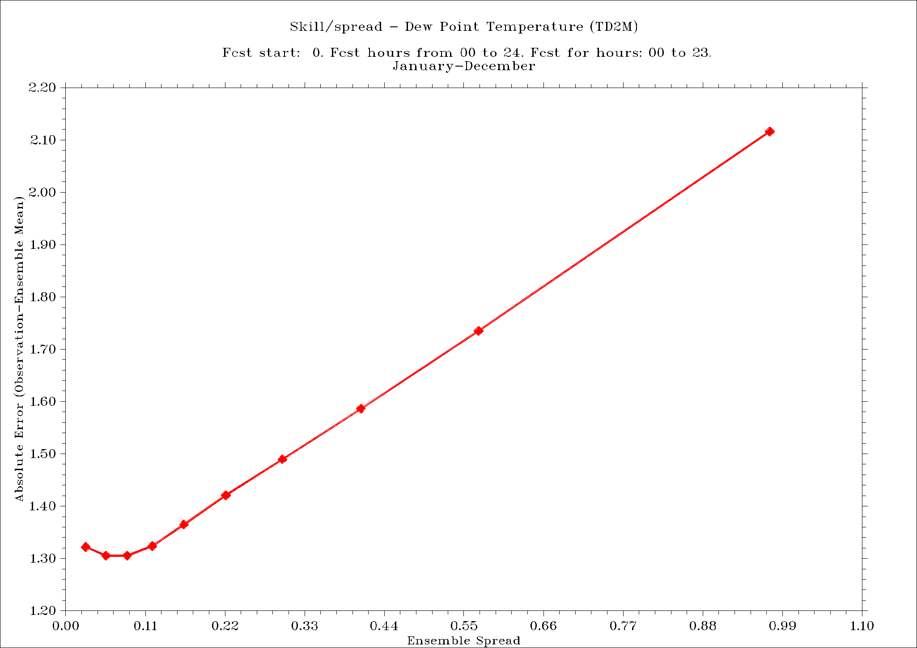
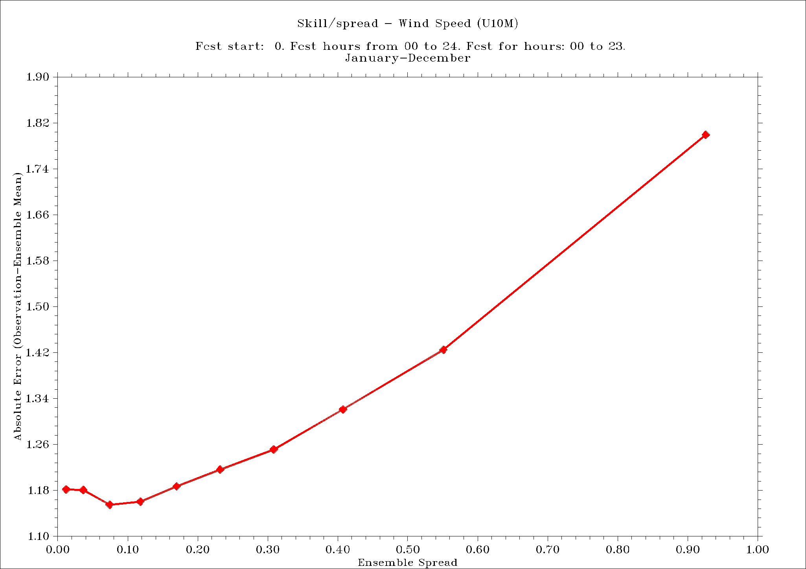
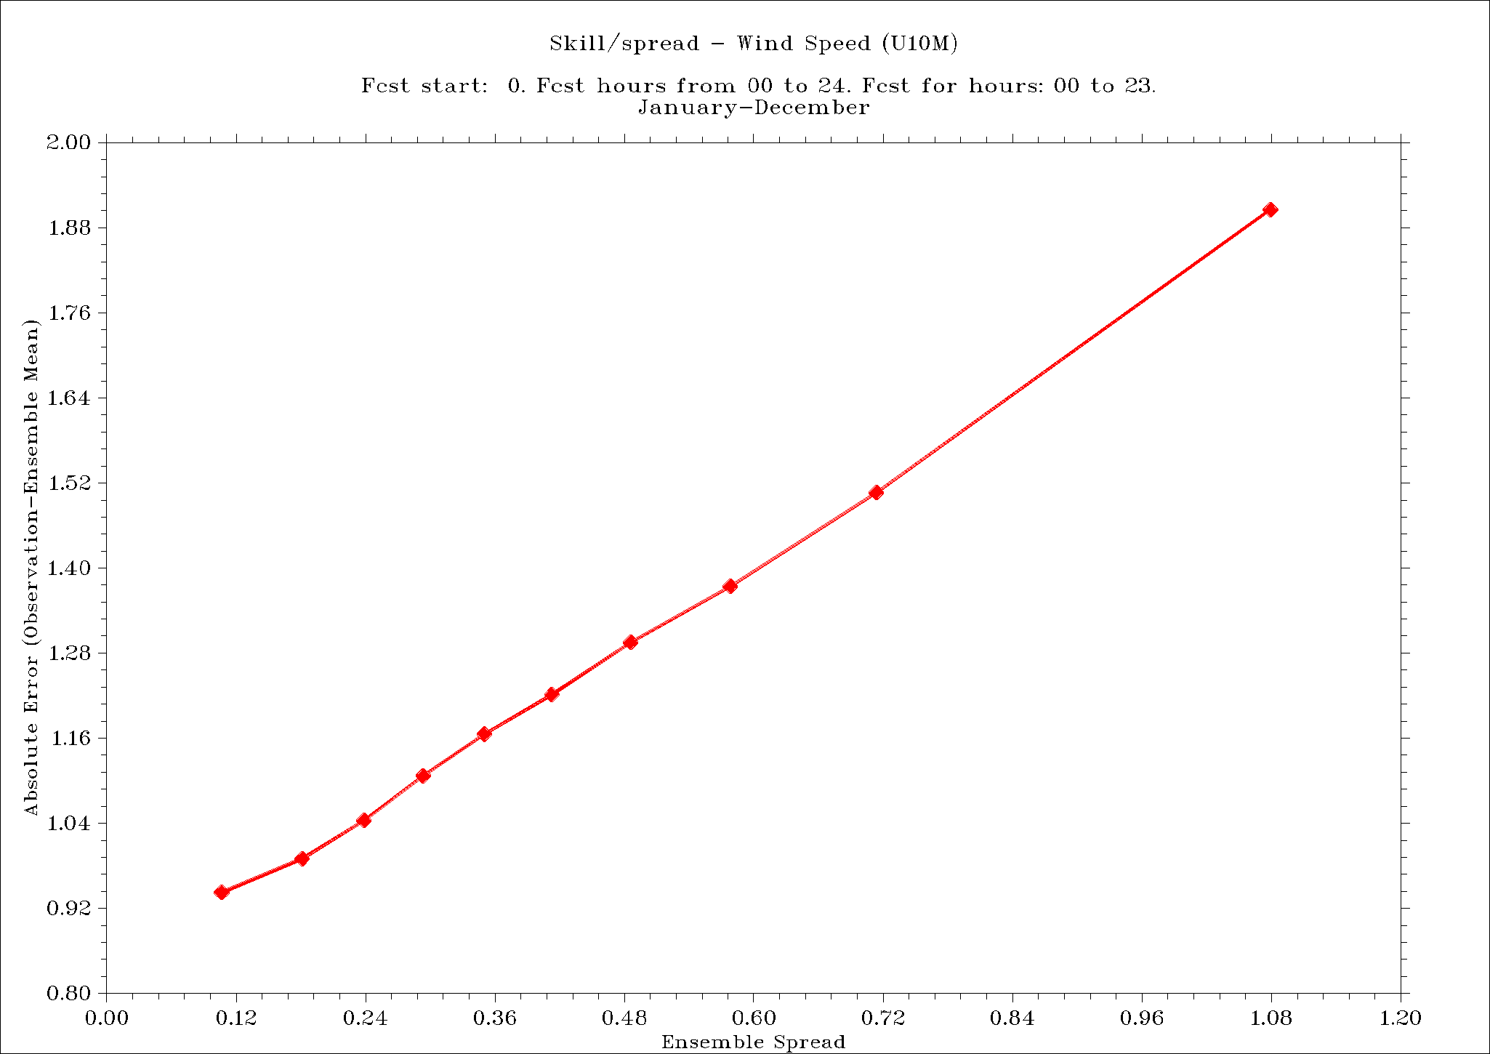
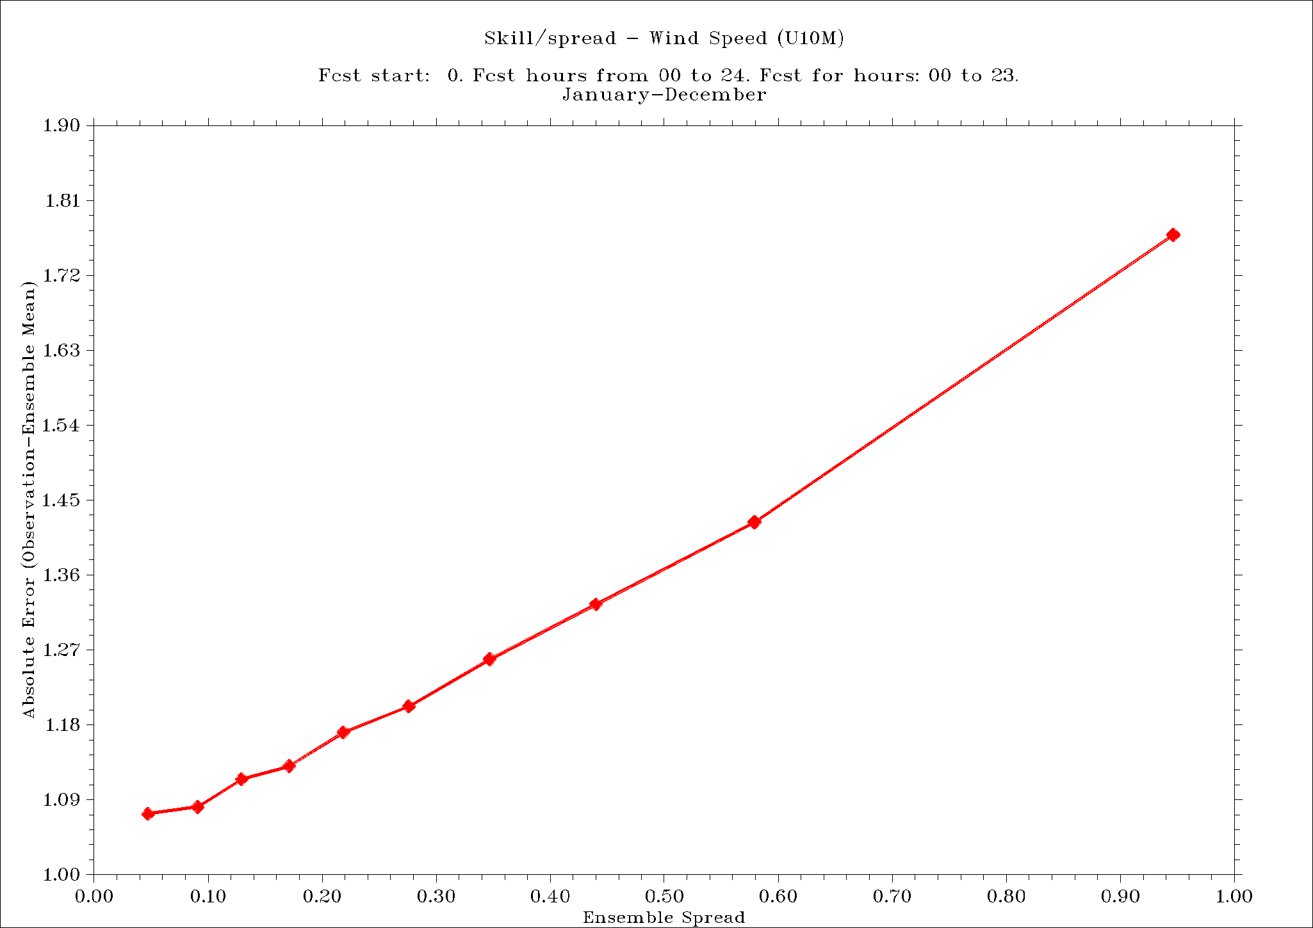
Skill-spread relations, T2M/TD2M/U10M (2011-2020)
Operational Surface pert. Down to ~1.0m Down to ~2.5m

Slide 10
Skill and spread mean values, T2M/TD2M/U10M (2011-2020)
Verification against ERA-5 reanalysis results (Poland covered, resolution 0.25x0.25 degree)
 |  | Oper. | Sfc. | 1.0m | 2.5m
T2M | Skill | 1.576 | 1.586 | 1.547 | 1.548
 | Spread | 0.501 | 0.284 | 0.497 | 0.493
TD2M | Skill | 1.480 | 1.499 | 1.461 | 1.459
 | Spread | 0.573 | 0.296 | 0.565 | 0.564
U10M | Skill | 1.135 | 1.170 | 1.131 | 1.132
 | Spread | 0.421 | 0.278 | 0.430 | 0.316

Slide 11
Subtask 3.5
Current operational setup – every member is used with equal importance (and equal probability with input weight), and every group has the same number of members. This data is subsequently passed to ANN-based post-processing.
Modification of postprocessing of the lagged-approach scheme is essentially an assessment whether a change in the input weight assigned to a specific member may positively affect the EPS results.
The 'weight with memory' approach – interesting alternative to equal weights.
Slight improvement with linear time-dependency of particular member(s)’ weights

Slide 12
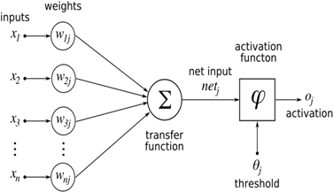
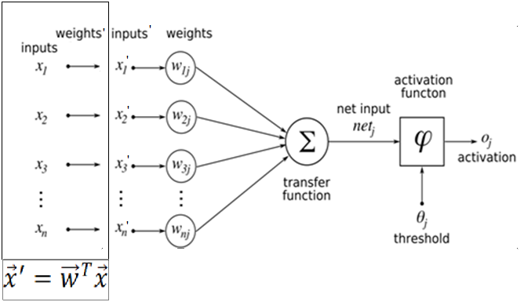
Modification of lagged-approach scheme – basic idea(s)
Operational setup
Setup with changeable initial weights
”Raw” values of skill
Corrected values of skill
Final output
Which approach gives better results?

Slide 13
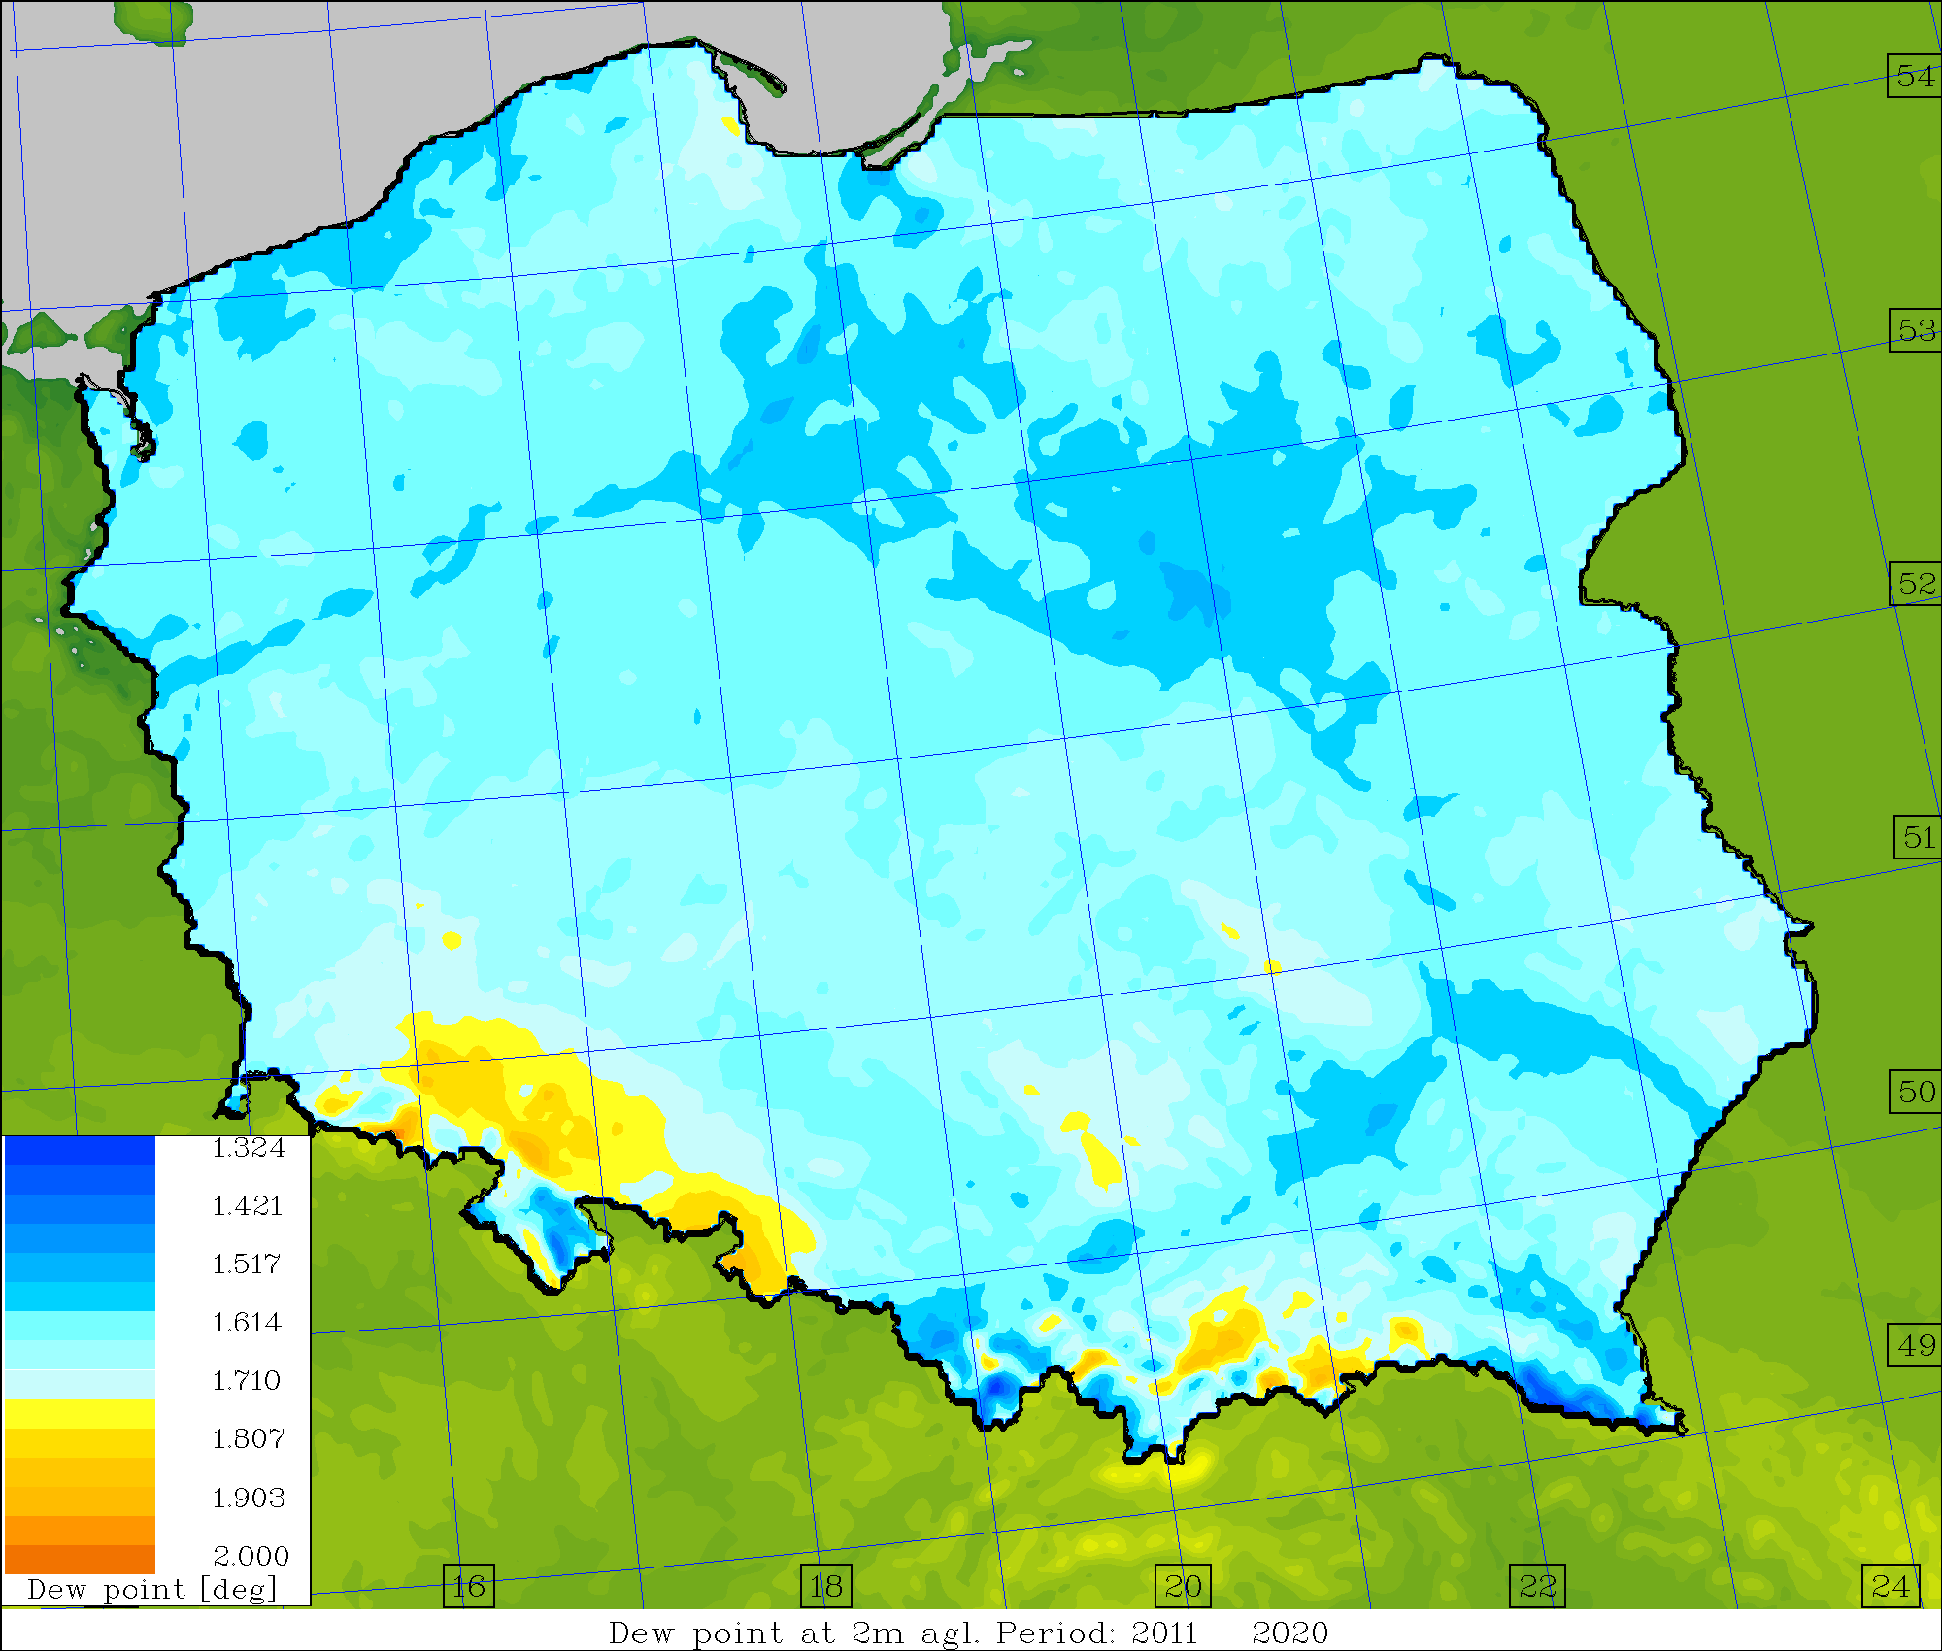
Standard vs. corrected weights (2011-2020)
standard weights
avg. skill
T2M | TD2M | U10M
1.576 | 1.480 | 1.135
corrected weights
avg. skill
T2M | TD2M | U10M
1.552 | 1.467 | 1.134
T2M TD2M U10M

Slide 14
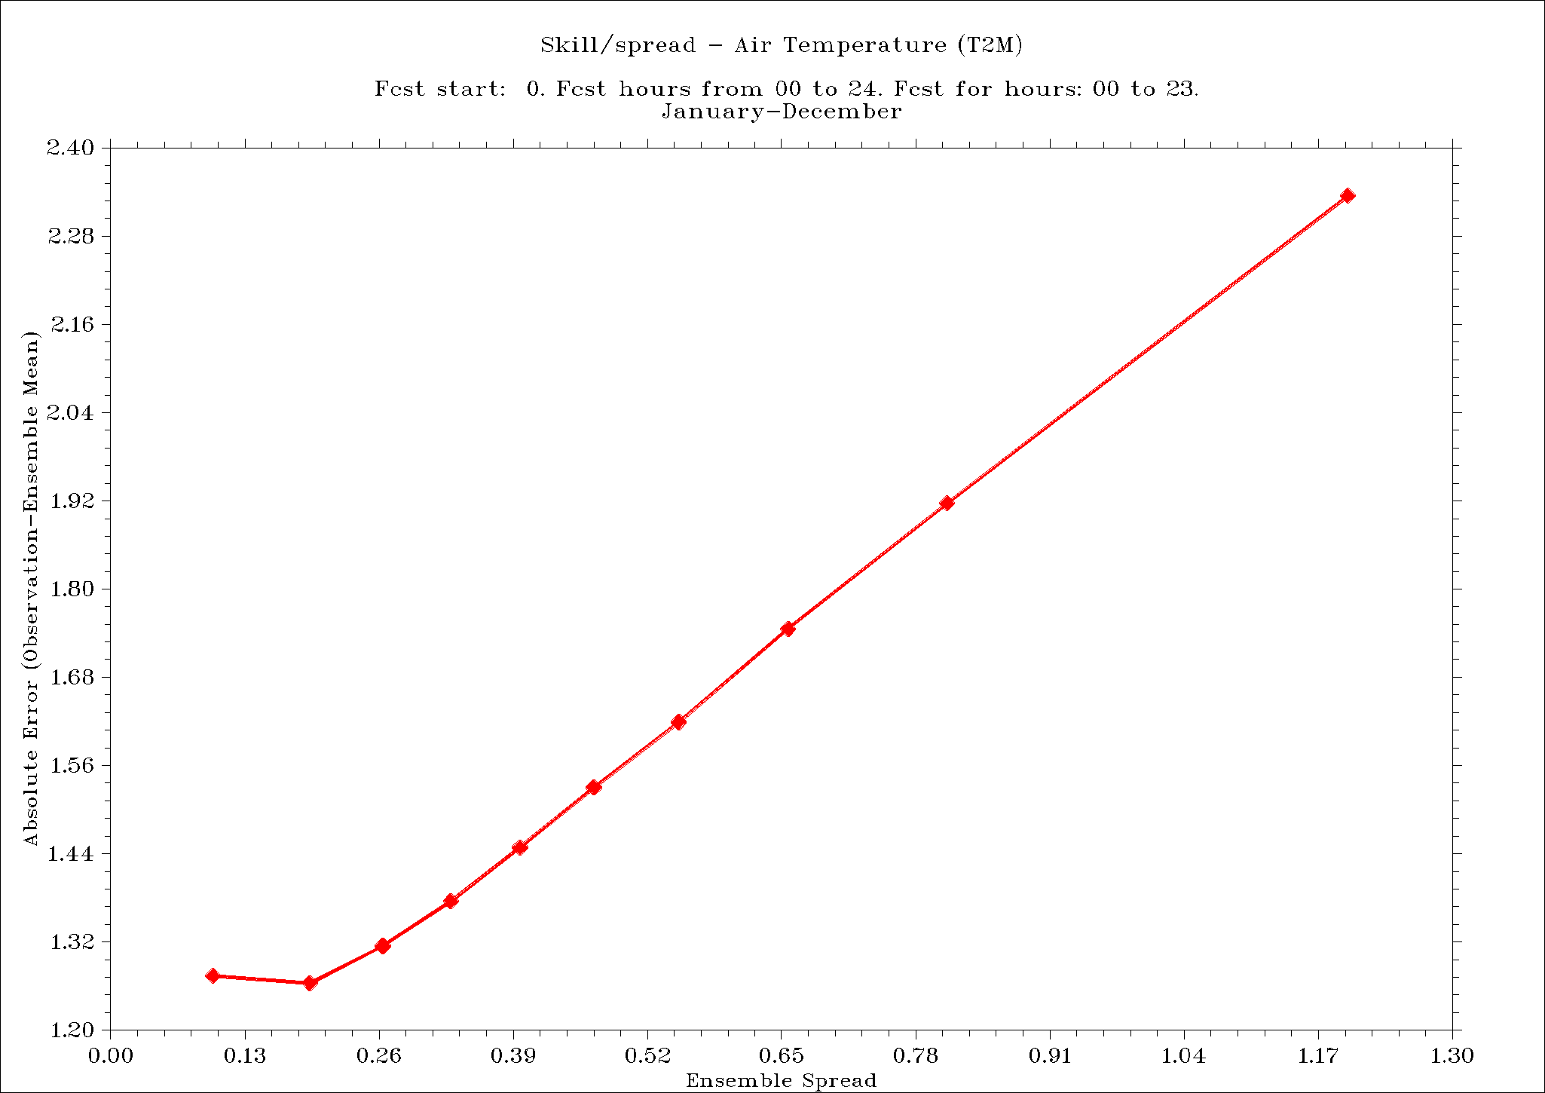
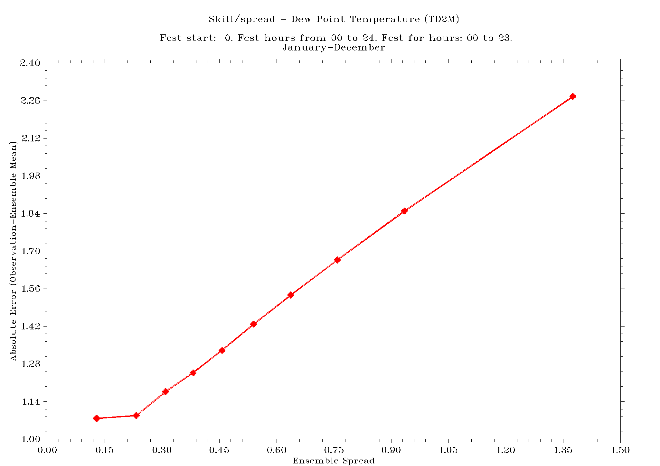
Standard vs. corrected weights (2011-2020)
T2M TD2M U10M

Slide 15
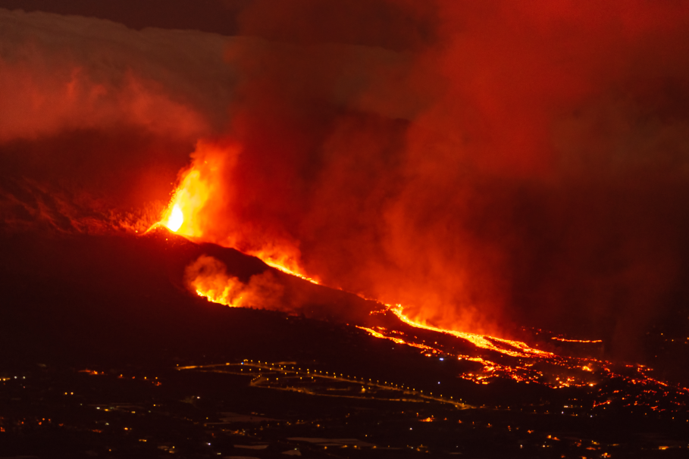
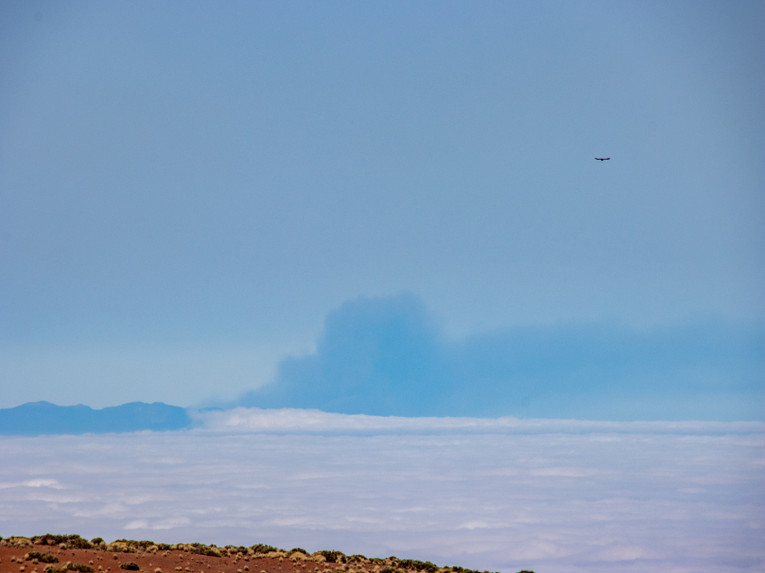
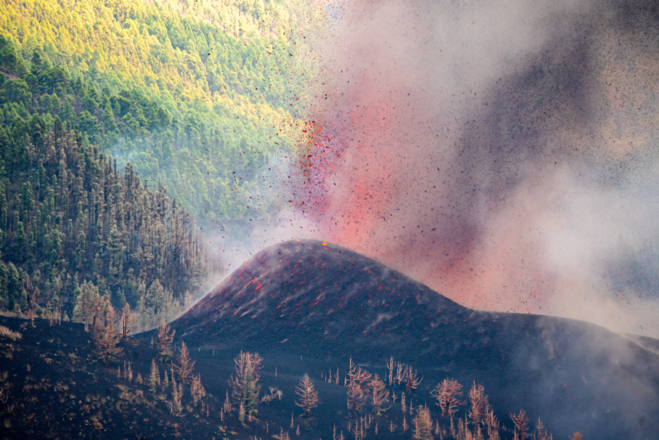
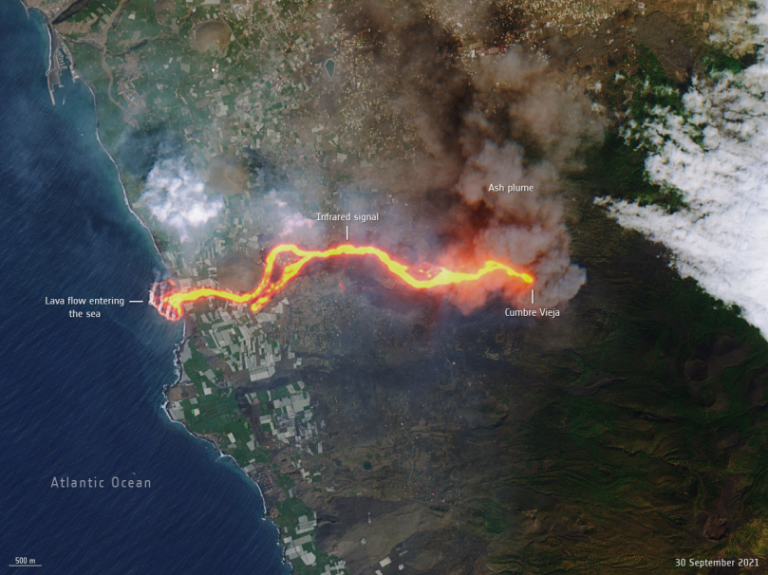
Cumbre Vieja (Old Peak) – September - December
© Eduardo Robaina,
CC BY-SA3.0, https://commons.wikimedia.org/w/index.php?curid=110322497
© Mike Peel (www.mikepeel.net).
CC BY-SA 4.0, https://commons.wikimedia.org/w/index.php?curid=110655270
Erupción volcánica de La Palma de 2021 Ash plume, view from Tenerife, 30.09
© Eduardo Robaina,
CC BY-SA 3.0, https://commons.wikimedia.org/w/index.php?curid=110322516
Copernicus Sentinel data 2021, Attribution, https://commons.wikimedia.org/w/index.php?curid=110628016
The eruption on 20.09 Molten lava flow, Copernicus image, 01.10

Slide 16
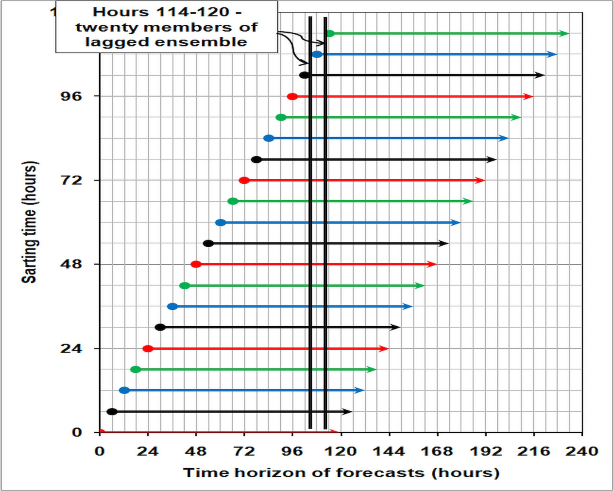
Cumbre Vieja (Old Peak) – September - December
Base – NCEP GFS Forecasts, 120 hourly data, 0.25 degree grid. Start (19.09.2021 – 5 days+)

Slide 17
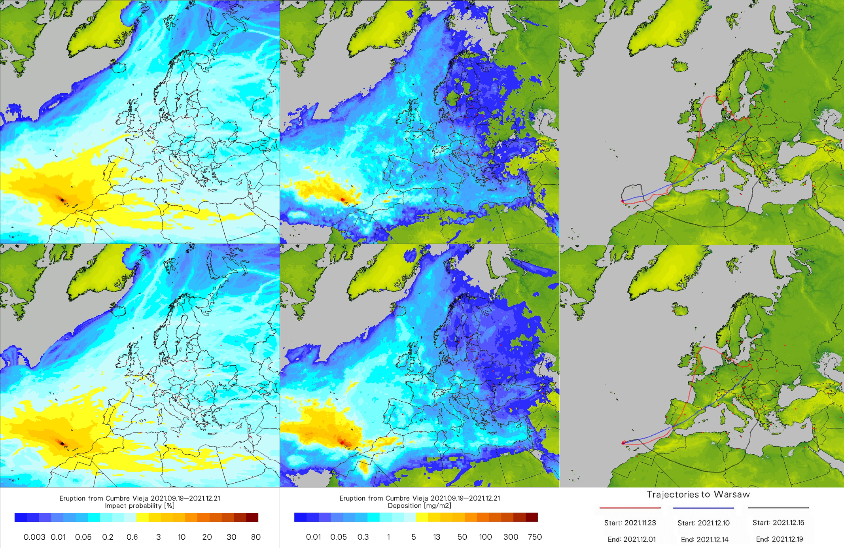
Cumbre Vieja (Old Peak) – September – December ‘21
Det.
EPS
Accepted for publication – Archives of Environmental Protection, vol. 48(3), 2022.

Slide 18
Conclusions
Dataset used for ‘verification’ – ERA-5 reanalysis fields for 2011-2020 (https://cds.climate.copernicus.eu), 0.25x0.25 degree, hourly data.
Subtask 1.1 – preliminary assessment of changes to operational setup has been carried out. No conclusive decision was made so far.
Subtask 2.2 – the impact of depth of soil temperature input field perturbation on different output fields vs. the results of ERA-5 reanalysis was tested. Final result – increasing the max. depth of perturbation to 2-2.5 meters not necessarily gave better results compared to perturbation to 1m down; but better than those of surface-only perturbation. Results to some extent differ from the verification against measurements at Polish synoptic stations (previously done).
Subtask 3.5 – modification of postprocessing of the lagged scheme positively affects the results (esp. verification vs. ERA-5 reanalysis). Slight improvement of the 'weight with memory‘ comparing to equal initial weights confirmed.

Slide 19
It’s been released on November 2009 – The PROPHECY!!!
”Scooter, remind me to stop setting up these video conferences... they're not very productive”

Slide 20
#StandWithUkraine

