Slide 1
SPPT in ICON at MeteoSwiss
André Walser, Sascha Bellaire, Matthias Röthlin
Acknowledgement: Daniel Reinert, Axel Seifert, Carlos Osuna
COSMO GM 2022, Athens, WG7

Slide 2
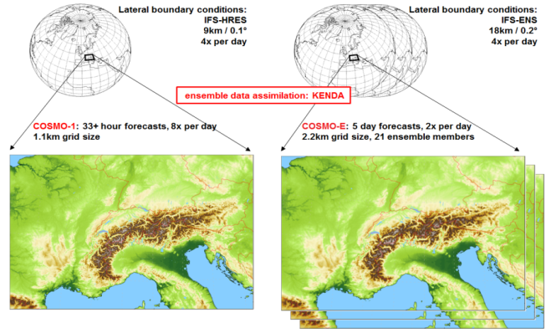
History of SPPT at MeteoSwiss
2016: COSMO-1 und COSMO-E
First limited-area EPS of MeteoSwiss has been introduced 2016: COSMO-E
available model perturbations:
PP (COSMO-LEPS, DWD)
SPPT (L. Torrisi)
SPPT showed better spread-error relationship in COSMO-E tests
SPPT introduced in COSMO-E, in KENDA 2017

Slide 3
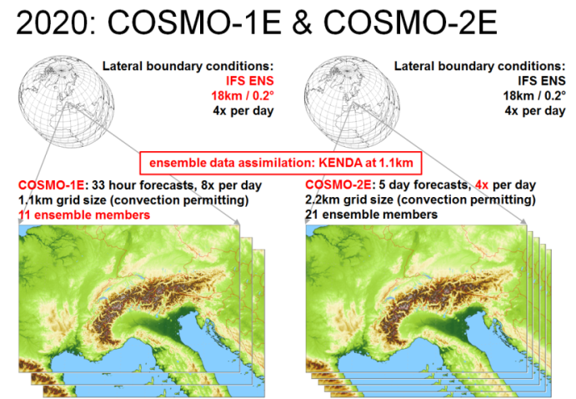
History of SPPT at MeteoSwiss
2016: COSMO-1 und COSMO-E
continuous improvements in SPPT implementation in next years
SPPT also used by COSMO-1E, COSMO-2E and KENDA-1

Slide 4
Learnings from SPPT with COSMO

Slide 5
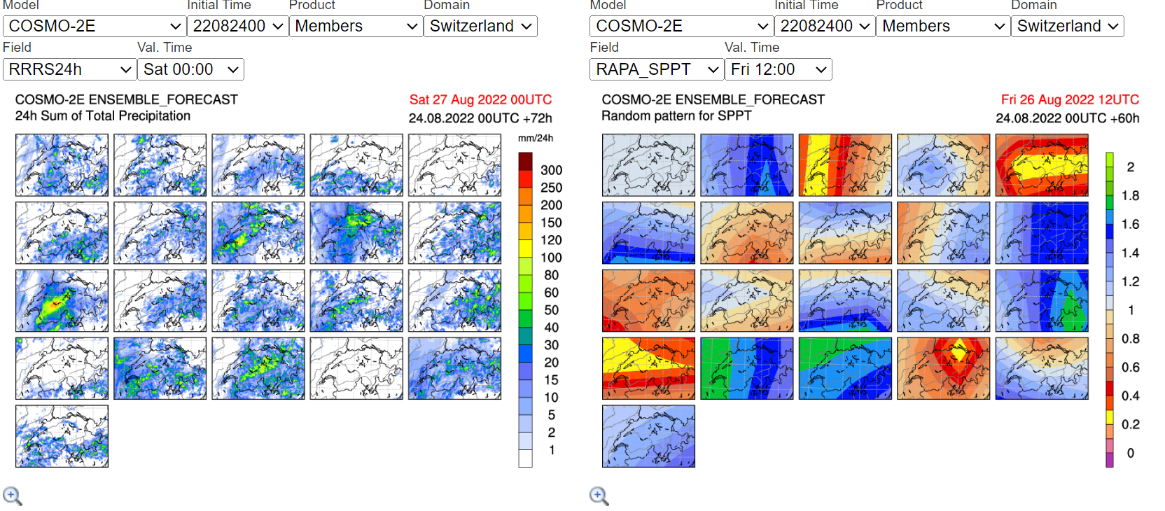
SPPT can lead to too much variability
Forecaster feedback COSMO-2E: convective case 26 August 2022
Most likely SPPT turned off convection entirely in 3 members by strongly reducing physical tendencies (yellow area = 20-25% at 12 UTC)

Slide 6
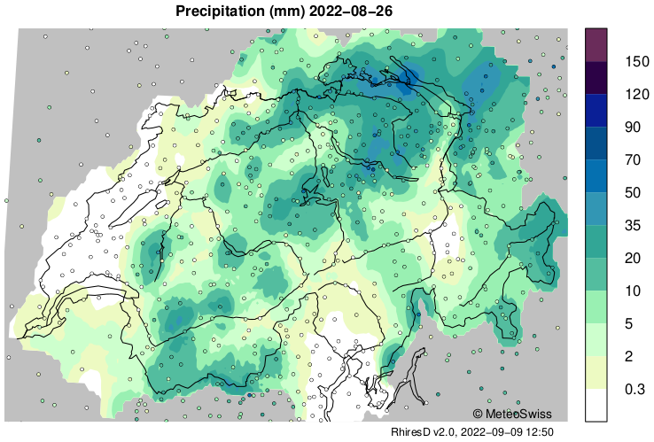
SPPT can lead to too much variability
Forecaster feedback COSMO-2E: convective case 26 August 2022
Observations
SPPT turned off convection entirely in 3 members by strongly reducing physical tendencies (yellow area = 20-25% at 12 UTC)

Slide 7
Verification T2m, spread-error-relation
Winter 2021/2022
Spring 2022
error (STDE ens mean)
spread
COSMO-1E
COSMO-2E
IFS-ENS
Ensembles clearly underdispersive (obs error not considered)
still typical for near-surface parameters

Slide 8
Limits for perturbations by SPPT
risk for unphysical values and stability issues (CFL) with larger ranges than +/- 0.9 for the random numbers
for safety: range_rn=
COSMO-2E: 0.8
COSMO-1E & KENDA-1: 0.6
→ not recommended
Linda Füzér, Master Thesis 2019

Slide 9
SPPT learnings: summary
SPPT model perturbations can have such a strong impact on physical processes that hardly a convective system can develop in an environment with all ingredients for thunderstorms
forecast overdispersive
SPPT does by far not consider all sources of model uncertainties
forecasts generally underdispersive for near-surface fields
Our current SPPT setup allows perturbations that are rather close at the limit for a stable production
→ difficult to increase spread with SPPT for near-surface fields

Slide 10
Advantages of SPPT
SPPT is far away from providing perfect model perturbations in a convection-permitting EPS, but:
still not easy to get better ensemble forecasts with other model perturbations
produces equally likely members on average (same weights for all members for probabilistic products)
implementation is comparably cheap (but nevertheless significant)
reasoning for implementation in ICON
open to switch to other model perturbations in the future

Slide 11
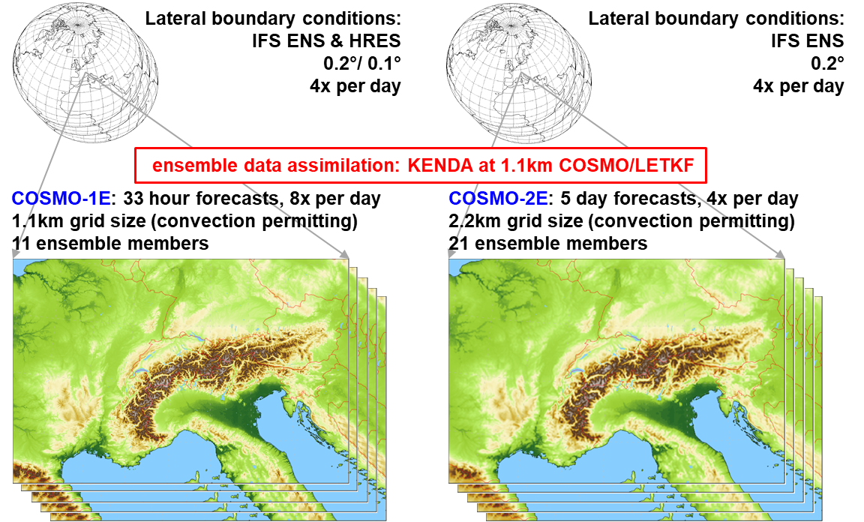
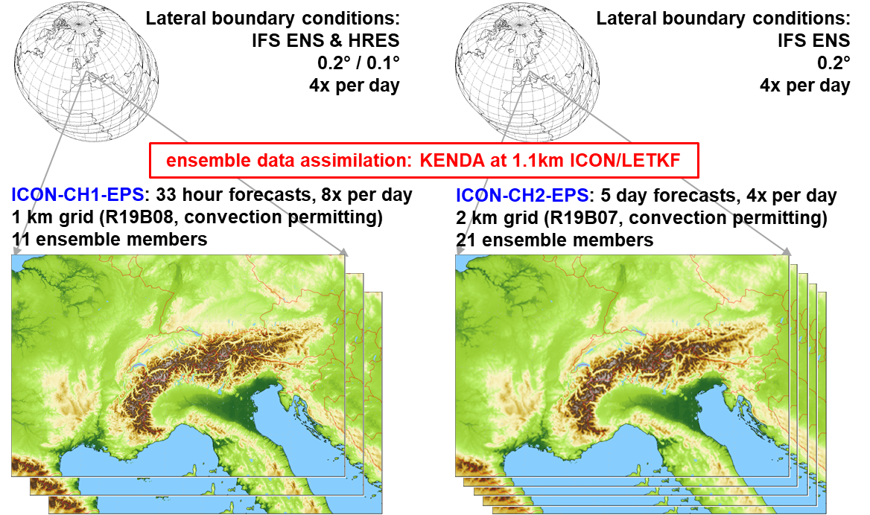
ICON-22 project: COSMO to ICON
updated timeline: ICON models planned to become operational in Q1/2024
«1:1-replacement with ICON»

Slide 12
Migration of SPPT to ICON

Slide 13
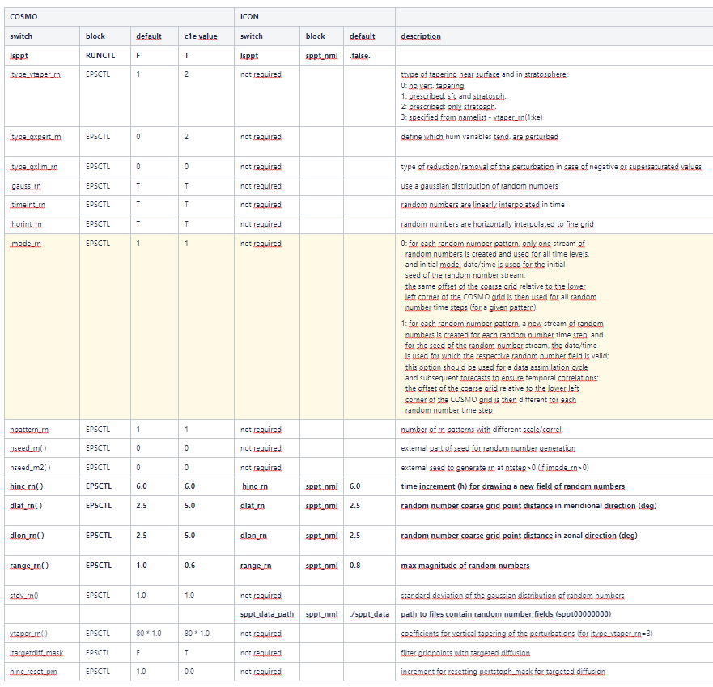
SPPT namelist switches in COSMO
many!
only a few are used (as far as we know)

Slide 14
SPPT namelist switches in ICON
Subset of supported switches (besides lsppt):

Slide 15
SPPT implementation in ICON
Available features:
random numbers: gaussian and interpolated in space and time
one pattern only, i.e. no overlay with different scales
tapering: prescribed for stratosphere (itype_vtaper_rn=2)
Still to be done:
seed: use of valid date/time besides member id → specific random pattern for a given valid time to ensure temporal correlations between subsequent KENDA cycles and between KENDA and subsequent forecast (imode_rn=1)

Slide 16
Implementation strategy
Stochastic Perturbation of Physics Tendencies Temperature (T), Wind (U,V) as well as all water tracers (QV, QC, QI, QS, QR, QG)
Separate procedures to get tendencies for fast & slow physics
Random Number Generator adapted from ‘ecrad’; external generation (fieldextra) and internal generation
Adding of perturbed tendencies to prognostic fields
Source: ICON-Tutorial

Slide 17
Tendencies from ‘Fast Physics’
In ICON prognostics fields are directly updated, thus T, U, V, Qx are saved before and increments are calculated after call of schemes
since T, U, V are diagnostics fields, it must be ensured that they are updated before ‘save old’ and ‘get new’
1 ) save old
after tracer_add_phytend()
2) get new (currently done after saturation adjustments)
before call of ’slow physics’
3) calculate ΔT, ΔU, ΔV, ΔQ_{n}

Slide 18
Tendencies from ‘Slow Physics’
tendencies already available in ICON
ΔQ_{n}
ΔT
ΔU, ΔV
Rayleigh Friction
no contribution for Q_{G}

Slide 19
SPPT perturbations
pert(x) = sum slow physics tendencies Δx * sppt%rn_3d
+ sum fast physics tendencies Δx * sppt%rn_3d
sppt%rn_3d(jc,jk,jb) = random numbers from [-range_rn, range_rn]
mo_sppt_core.f90
pert(T)
pert(Q_{v})

Slide 20
SPPT random pattern
Started with an external generation of random pattern fields produced with fieldextra (straightforward): use of available infrastructure for interpolation of coarse lat/lon grid to ICON grid
Meanwhile, internal generation is also implemented thanks to Matthias and Carlos
currently two options, controlled with hardcoded logical lread_rn
b) clearly preferable and if our implementation is accepted to be merged into the master a) becomes obsolete

Slide 21
Internal generation of SPPT
random patterns

Slide 22
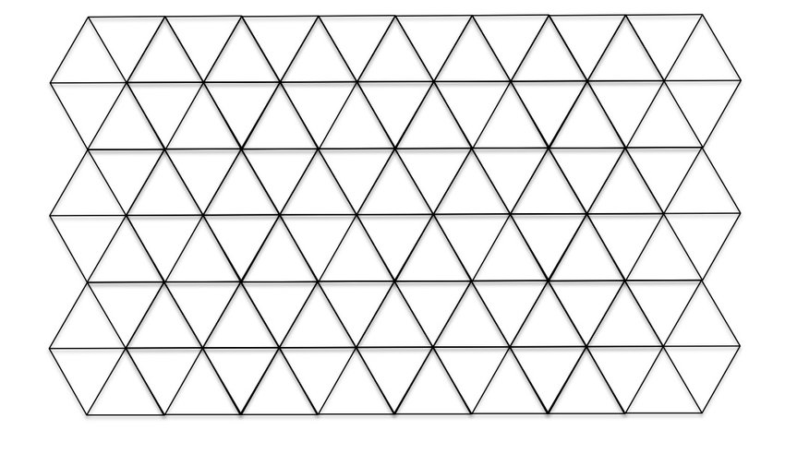
Algorithm
compute tight bounding box around entire simulation domain

Slide 23
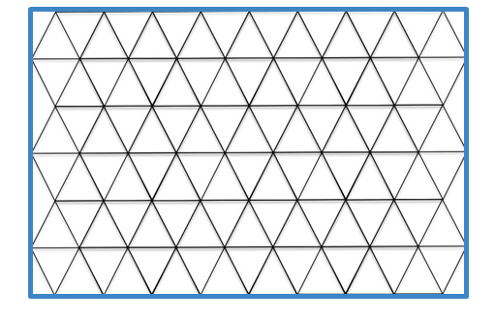
Algorithm
compute tight bounding box around entire simulation domain
ICON has no infrastructure for it
done in mesh read-in subroutine and stored in pre_patch object
on all MPI ranks

Slide 24
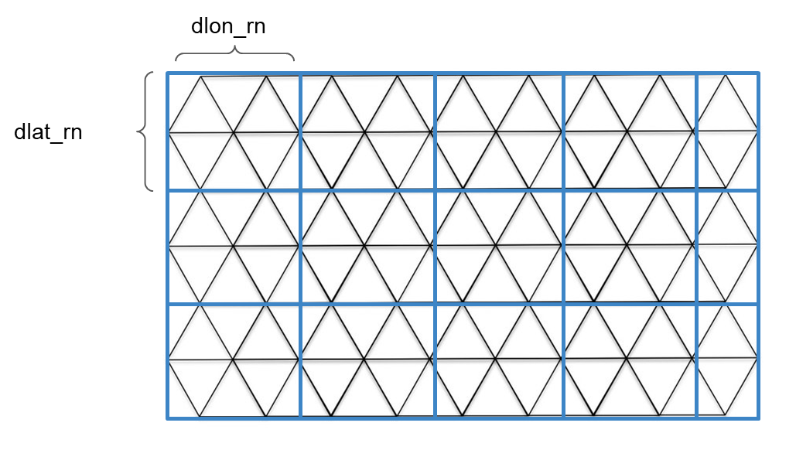
Algorithm
divide bounding box by dlon_rn / dlat_rn (namelist parameters) to get a coarse, cartesian grid
in default setup the ratio of dlon_rn / dlat_rn to edge length of triangle is much larger, i.e. thousands of triangles within four grid points

Slide 25
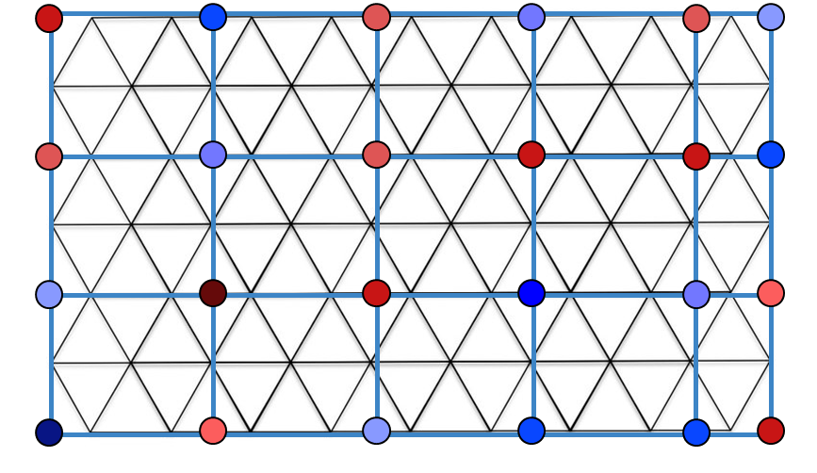
Algorithm
assign a random number to each grid point on the coarse grid
note again: done on all MPI ranks, i.e. all MPI ranks knows the entire coarse grid
using the same seed on all MPI ranks ensures that all MPI tasks uses the same random numbers

Slide 26
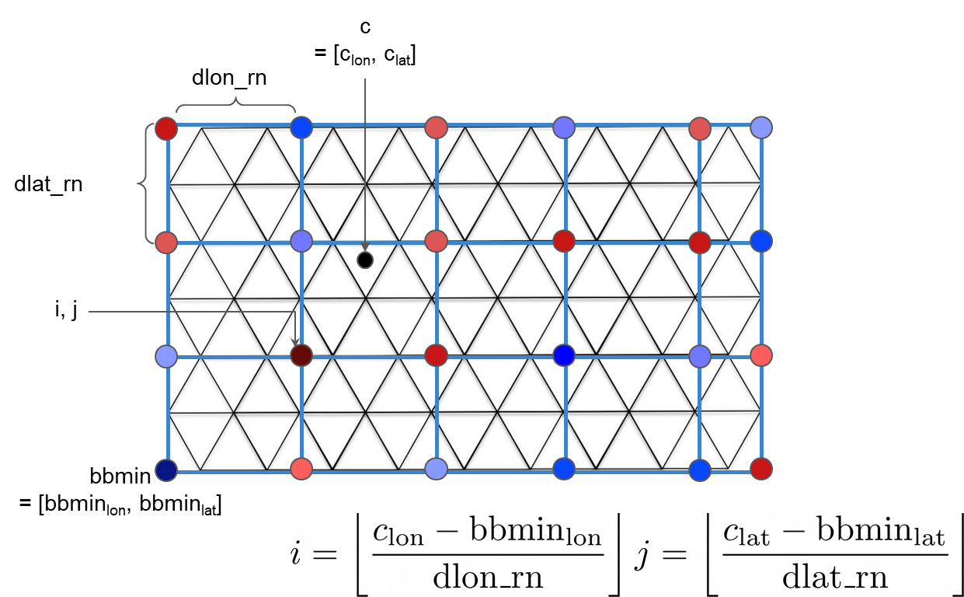
Algorithm
for each cell center c compute the coarse grid i and j
every MPI rank does it for the cells in his patch (domain decomposition)

Slide 27
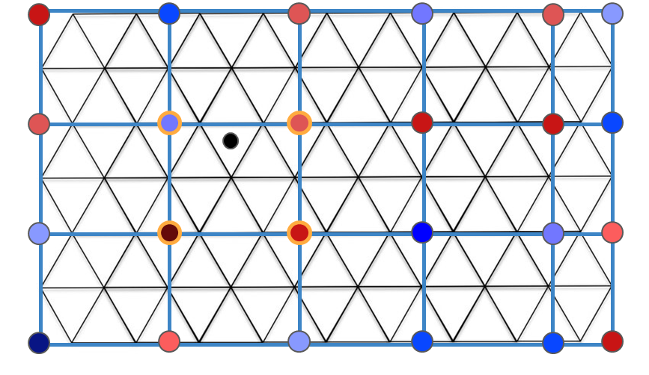
Algorithm
retrieve values of the coarse grid at [i,j], [i+1,j], [i, j+1], [i+1, j+1]
perform bilinear interpolation of the corner values onto the cell center
repeat that for every cell center

Slide 28
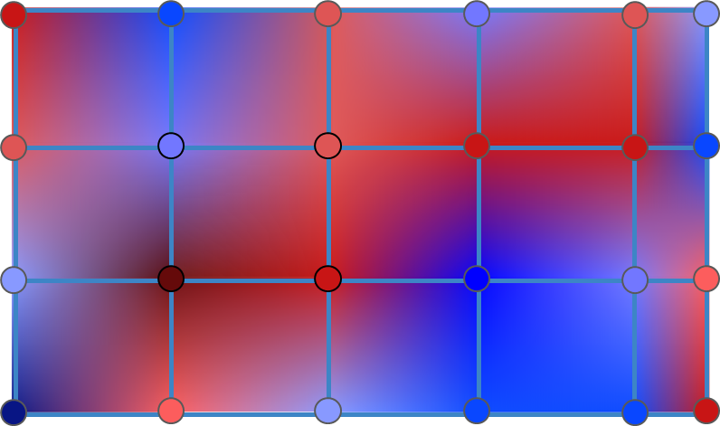
Algorithm
Results in random pattern field with horizontal correlation:

Slide 29
SPPT tests with ICON

Slide 30
Minimal tests only
just one case with control and 3 perturbed members
ICON-CH2-EPS grid
SPPT only, no other perturbations
internal and external random pattern generation
on CPU

Slide 31
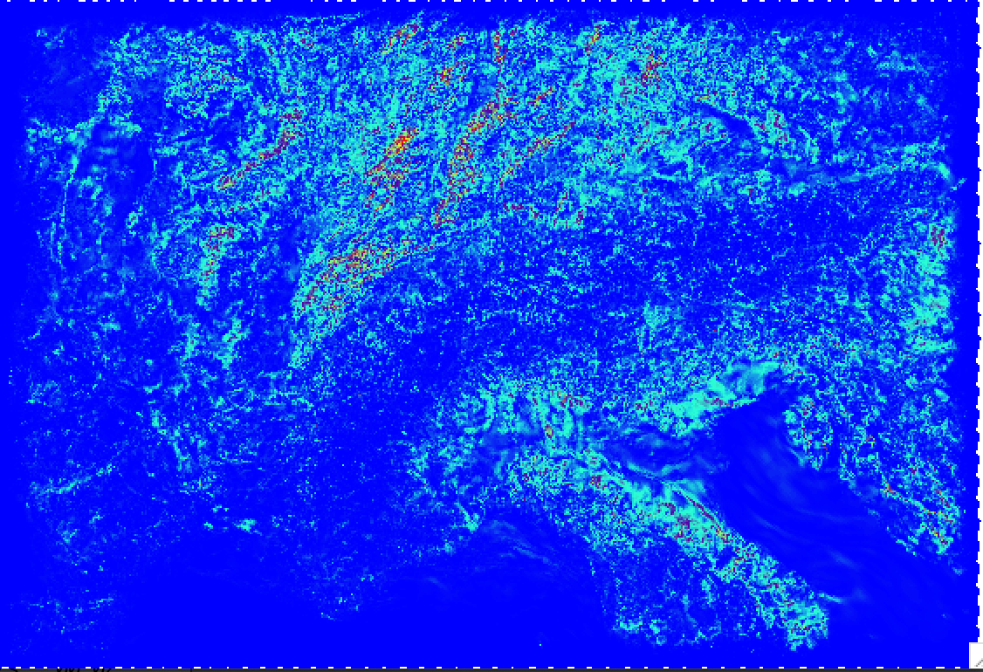
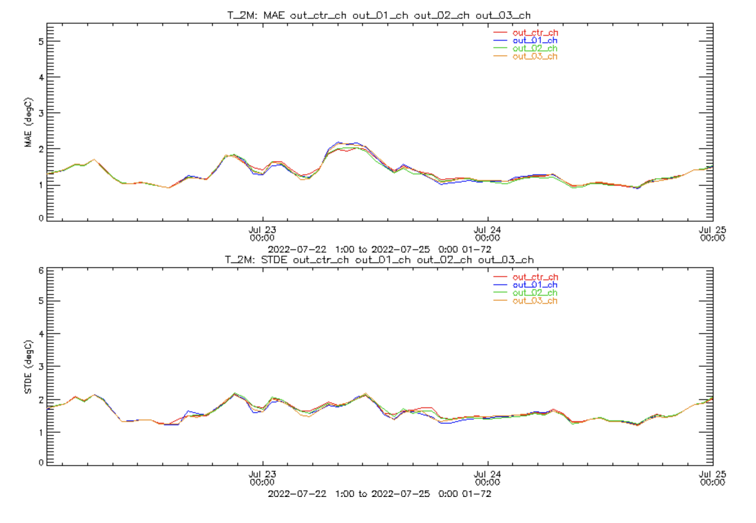
Spread and verification of test case
Ensemble spread +72h as expected
scores for all members similar
T2m
MAE (℃)
D. Reinert found bug in calculation of tendencies!
New test with fix pending
Latitude
STDE (℃)
T_2m
Longitude
K
Time
Fig. 1: Standard deviation of the 2-m air temperature for a three member ensemble after a 72 hour forecast. Bounding box represents the ICON-2 domain, marginally larger than the current COSMO-2E domain operationally used at MeteoSwiss.
Fig 2: Surface verification of three a ensemble members (blue, green, brown) plus control run (i.e. SPPT switched off, red) for 2-m air temperature. Shown are mean absolute error (MAE, top) and standard deviation (STDE, bottom) .

Slide 32
Next steps
test of fixed version
implementation of seed as a function of valid date & time for random numbers
review for merge into master ongoing
output variables for random field and tendencies
porting to GPU
extensive validation (contribution by IMS too)

