Slide 1
C2I status at IMS
P. Khain, H. Muskatel, A. Shtivelman, A. Baharad, L. Uzan and Y. Levi
GM, Athens, September 2022

Slide 2
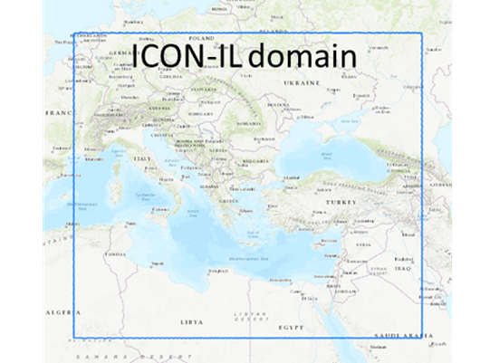
ICON-IL2.5
Platform: Time Critical Suite on the ECMWF HPC
Model setup: Domain: 4-45.5E/25.5-53N
Resolution: ~2.5km horizontal, 65 levels vertical
Range: 90h
IC/BC: det. IFS
SBU/run: ~50K
Oper. runs: 2 runs/day (00, 12 UTC)
SBU/year: 36.5M
Storage: ~150 T/year
Data assimilation: LHN (IMS radar + OPERA)

Slide 3
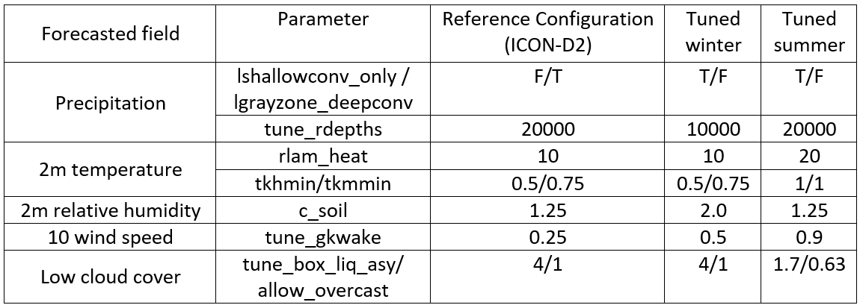
Configuration of ICON-IL2.5
from October to April (Tuned winter) and from May to September (Tuned summer)

Slide 4
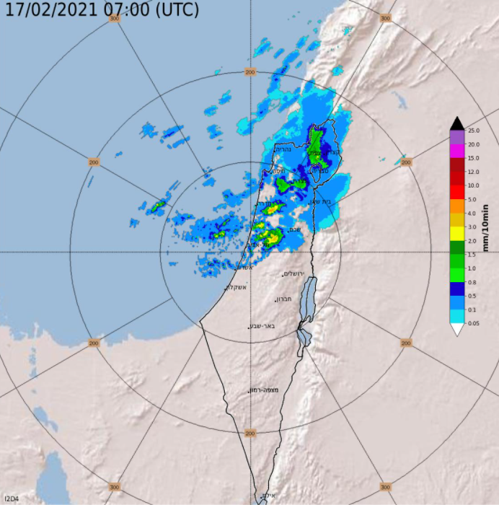
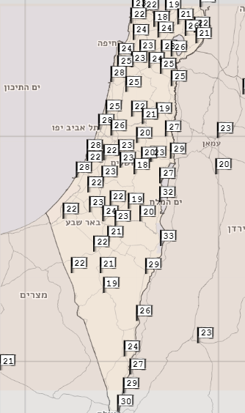
Verification over Israel
Radar composite
~ 80 meteorological stations

Slide 5
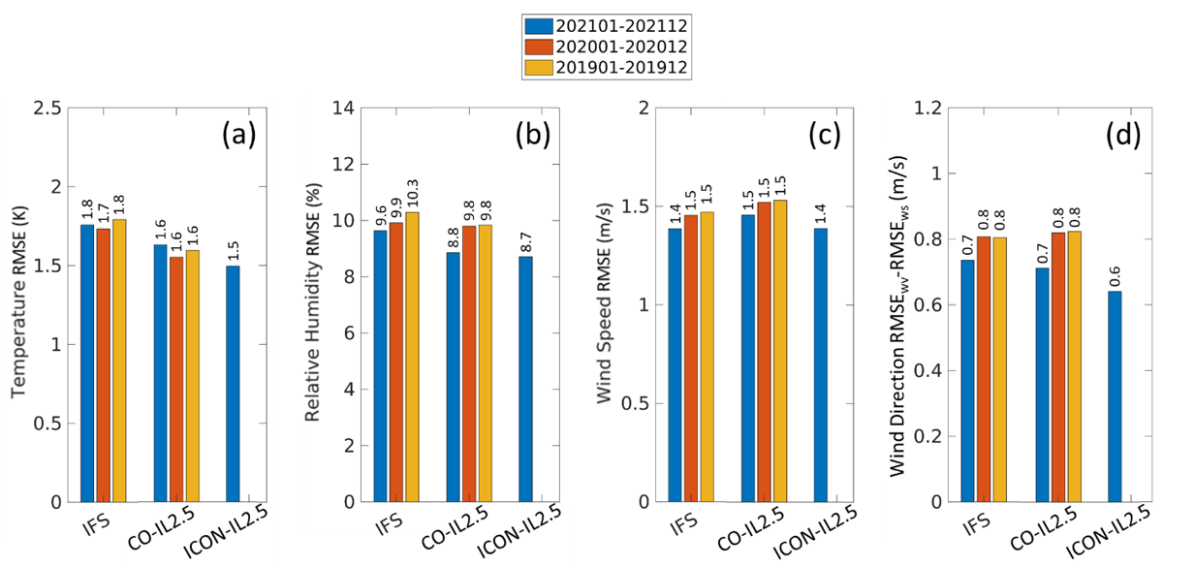
RMSE-type verification for near surface fields

Slide 6
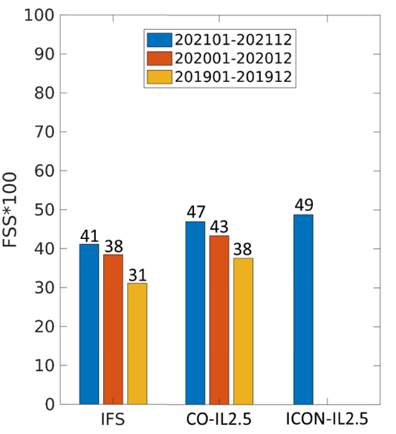
Precipitation verification
For every 6 hours accumulated precipitation (6hAP) forecasted and observed map, FSS was calculated for 20 km smoothing radius and thresholds of 0.01, 0.1, 0.5, 1, 2, 5, 10, 20 mm per 6h. The FSSs were averaged over these thresholds, with double weight for the more important thresholds of 0.5, 1, 2, 5 mm per 6h.

Slide 7
Planned upgrade in November 2022 (in Bologna)
SST - continuous updates from IFS forecast, not fixed at the initial state
CAMS dust forecast – replace the Tegen climatology for days with high dust load in the Eastern Mediterranean
Soil and surface - initialized from the global ICON model, the atmosphere fields from IFS

Slide 8
Planned upgrade in November 2022 (in Bologna)
SST - continuous updates from IFS forecast, not fixed at the initial state
CAMS dust forecast – replace the Tegen climatology for days with high dust load in the Eastern Mediterranean
Soil and surface – initialized from the global ICON model, the atmosphere fields from IFS

Slide 9
SST - continuous updates from IFS forecast
Example: Medicane Apollo, October 2021
Steady cyclone mixes and cools the water below, reducing sensible heat flux, leading to increase in SLP
T_S (K)
SLP (Pa)

Slide 10
Planned upgrade in November 2022 (in Bologna)
SST - continuous updates from IFS forecast, not fixed at the initial state
CAMS dust forecast – replace the Tegen climatology for days with high dust load in the Eastern Mediterranean
Soil and surface - initialized from the global ICON model, the atmosphere fields from IFS

Slide 11
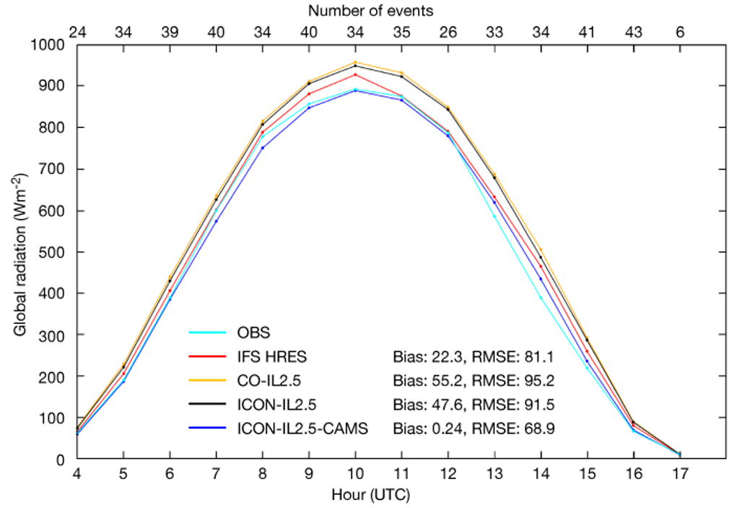
CAMS dust forecast on polluted days
Global radiation verification over Israel for 12 clear-sky polluted days during the year 2020

Slide 12
Other activities
ICON tests with high (600m) resolution
ICON RUC with radar LHN nudging
ICON + URBAN (CITTA – WG3b)
ICON + CAMS/ecRad (CAIIR - WG3a)
ICON + SBM (CAIIR - WG3a)
ICON-EPS + SPPT (PROPHECY - WG7)
ICON-CLM

Slide 13
Other activities
ICON tests with high (600m) resolution
ICON RUC with radar LHN nudging
ICON + URBAN (CITTA – WG3b)
ICON + CAMS/ecRad (CAIIR - WG3a)
ICON + SBM (CAIIR - WG3a)
ICON-EPS + SPPT (PROPHECY - WG7)
ICON-CLM

Slide 14
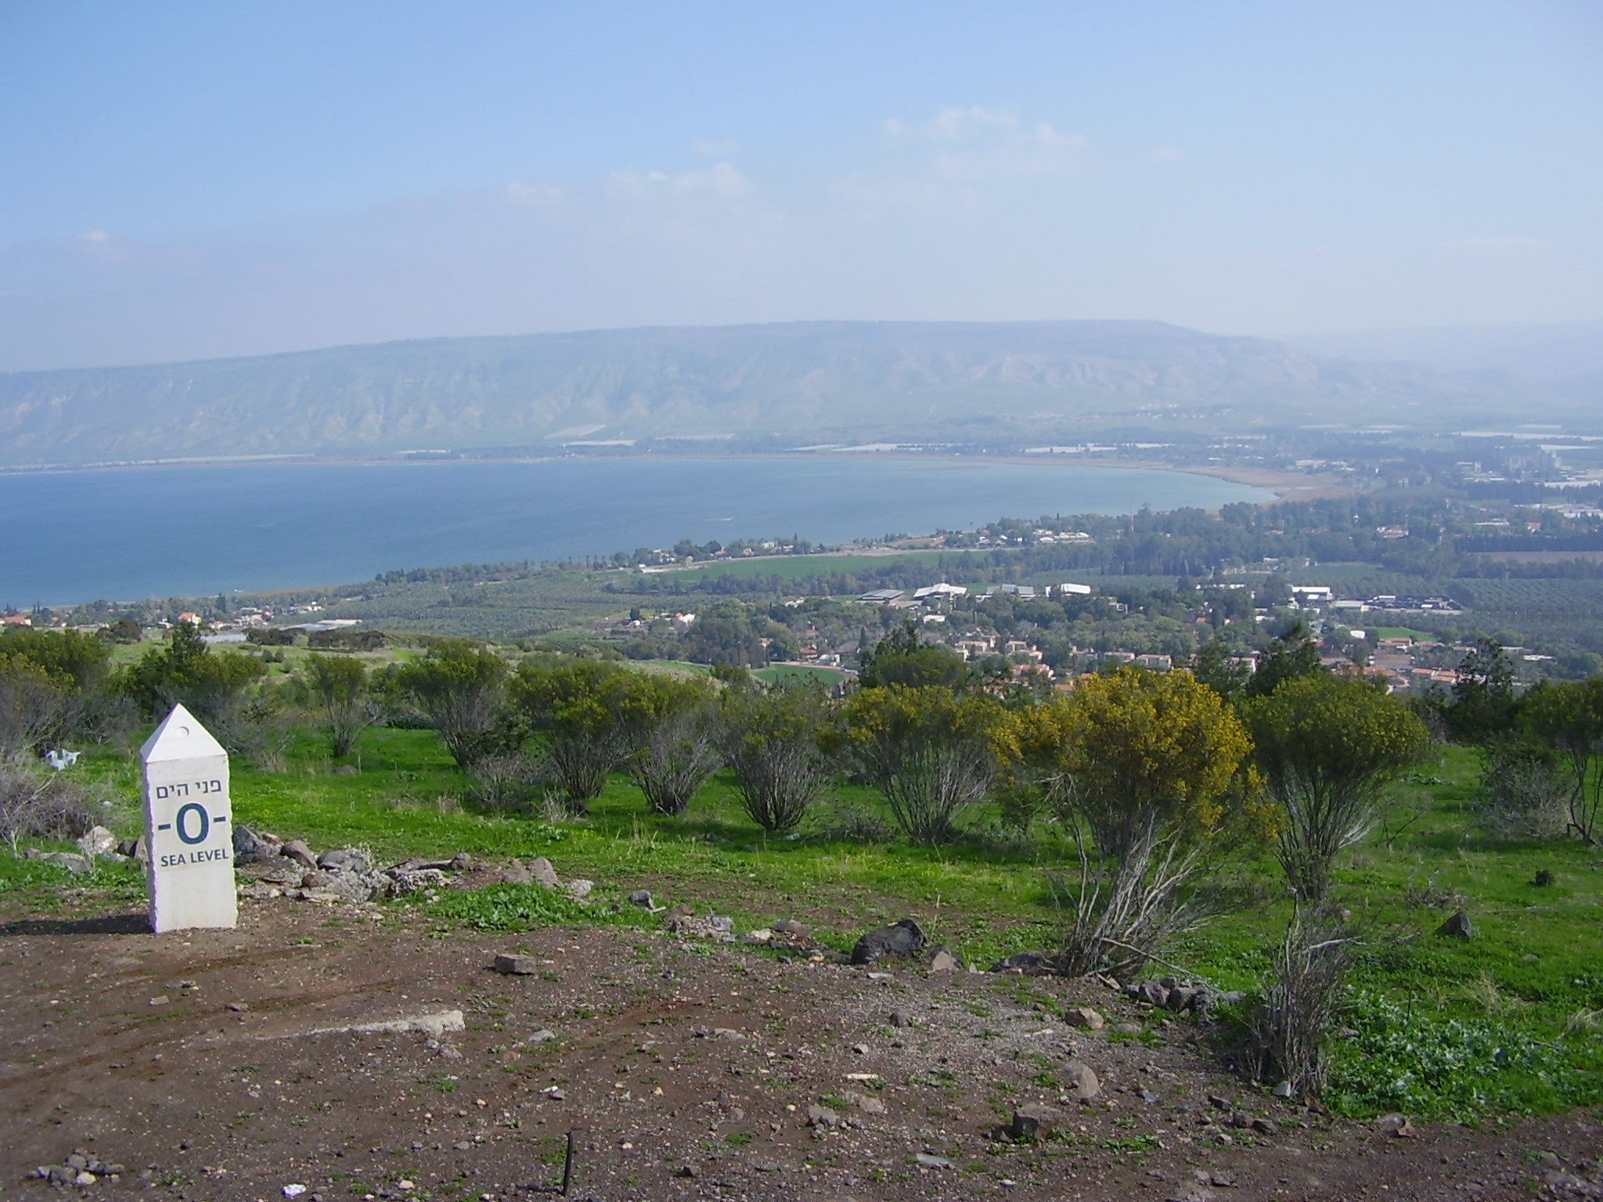
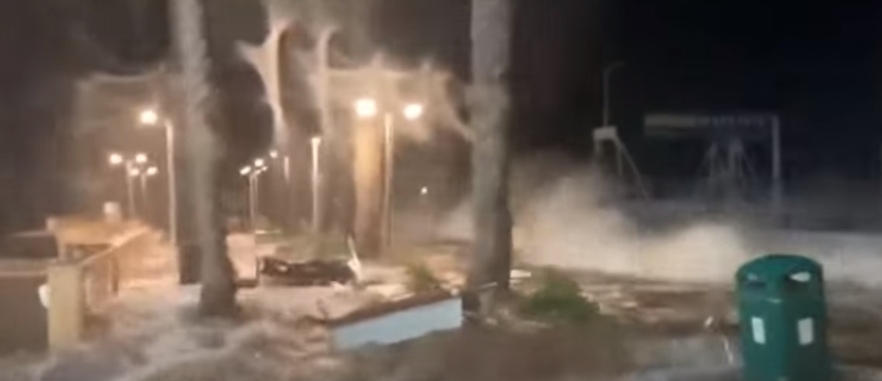
Sea of Galilee destructive waves floods Tiberias ICON-LAM simulation at 600 m
550 m
You tube
https://www.youtube.com/watch?v=p05Yt1MbRuM
COSMO GM 2022, Athens

Slide 15
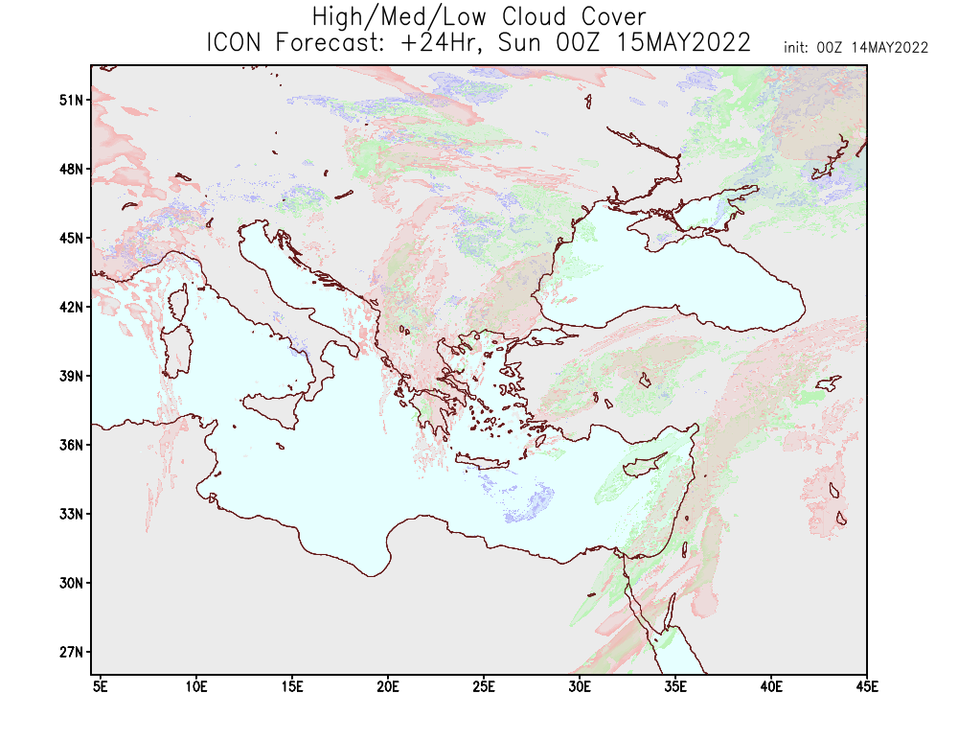
High resolution simulation
IFS BC
Init: 14.5.2022 00Z
Two way nesting ~2.5 - > ~1.2 -> 0.6 Km
ΔT (0.6 km) = 6 sec
Grid points = 2.2X4.2 deg
Levels = 65
Lead time = 29 hours
Run time (3 doms) = 1h53’
Nodes*cores = 20*36 = 720
0.6km
1.2km
2.5km
COSMO GM 2022, Athens

Slide 16
movie
hydraulic jump
Altitude [m]
Sea of Galilee 9.5 km
Zonal wind cross-section through the sea of Galilee at 32.8N
COSMO GM 2022, Athens

Slide 17
movie
Altitude [m]
Sea of Galilee 9.5 km
Vertical velocity
COSMO GM 2022, Athens

Slide 18
Other activities
ICON tests with high (600m) resolution
ICON RUC with radar LHN nudging
ICON + URBAN (CITTA – WG3b)
ICON + CAMS/ecRad (CAIIR - WG3a)
ICON + SBM (CAIIR - WG3a)
ICON-EPS + SPPT (PROPHECY - WG7)
ICON-CLM

Slide 19
Other activities
ICON tests with high (600m) resolution
ICON RUC with radar LHN nudging
ICON + URBAN (CITTA – WG3b)
ICON + CAMS/ecRad (CAIIR - WG3a)
ICON + SBM (CAIIR - WG3a)
ICON-EPS + SPPT (PROPHECY - WG7)
ICON-CLM

Slide 20
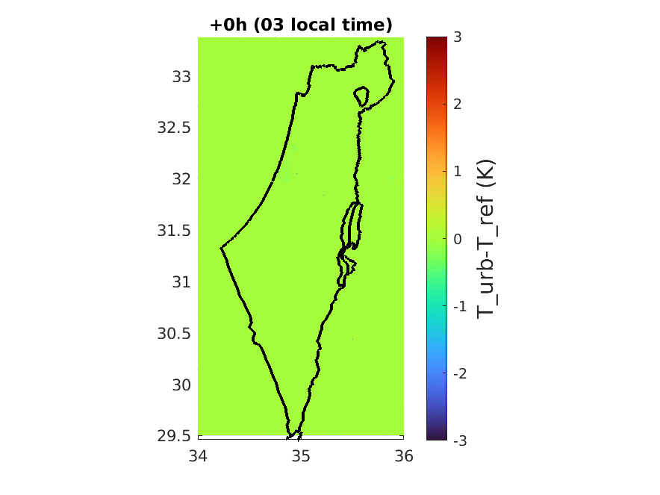
T_2m (URBAN) – T_2m (REF): averaged 0-78h run for July 2020
Warmer at night, colder at day
The urban area is underestimated

Slide 21
Other activities
ICON tests with high (600m) resolution
ICON RUC with radar LHN nudging
ICON + URBAN (CITTA – WG3b)
ICON + CAMS/ecRad (CAIIR - WG3a)
ICON + SBM (CAIIR - WG3a)
ICON-EPS + SPPT (PROPHECY - WG7)
ICON-CLM

Slide 22
Other activities
ICON tests with high (600m) resolution
ICON RUC with radar LHN nudging
ICON + URBAN (CITTA – WG3b)
ICON + CAMS/ecRad (CAIIR - WG3a)
ICON + SBM (CAIIR - WG3a)
ICON-EPS + SPPT (PROPHECY - WG7)
ICON-CLM

Slide 23
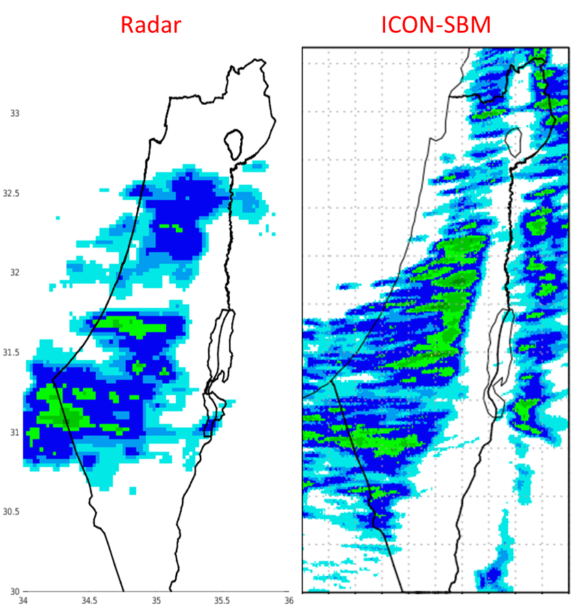
Warm-Phase Spectral-Bin Microphysics in ICON
Pavel Khain, Koby Shpund, Yoav Levi, Alexander Khain
Thanks to: Axel Seifert, Daniel Reinert, Daniel Rieger
16
12
Warm-Phase Spectral-Bin Microphysics (SBM) scheme was implemented in ICON (not master). 66 new bins (drop+CCN tracers) are advected. Runs 6.8 times slower than 1M.
SBM and 2M schemes were compared. SBM shows reasonable behavior, strong sensitivity to CCN.
8
QC+QR (g/kg)
4
0
Example: Cumulonimbus development (Weisman-Klemp 1982)
50km
sea
land
sea
Preliminary: real “warm” case shows strong sensitivity to topography
Published in: Khain, P., J. Shpund, Y. Levi and A.P. Khain (2022): Warm-phase spectral-bin microphysics in ICON: reasons of sensitivity to aerosols. Atmos. Res., 279, 106388.
Ongoing: Mixed phase SBM → ICON
24/9/2021:06Z

Slide 24
Other activities
ICON tests with high (600m) resolution
ICON RUC with radar LHN nudging
ICON + URBAN (CITTA – WG3b)
ICON + CAMS/ecRad (CAIIR - WG3a)
ICON + SBM (CAIIR - WG3a)
ICON-EPS + SPPT (PROPHECY - WG7)
ICON-CLM

Slide 25
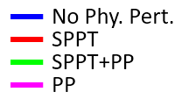
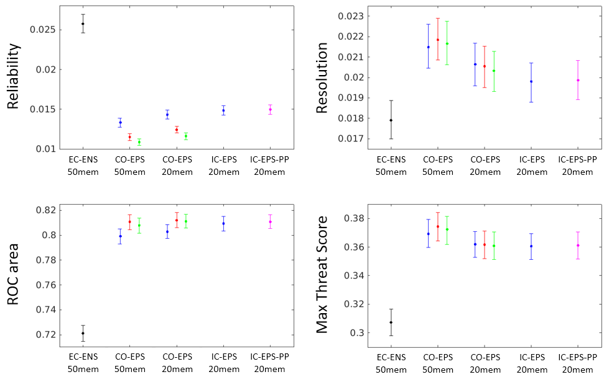
ICON ensemble verification
61 winter runs verified against the Quantitative Precipitation Estimation (QPE) composite.
Average score for 6 hourly precipitation forecast ranges 12- 78h not up-scaled thresholds of 0.5, 1, 2 and 5 mm/6h, and up-scaled thresholds of 10 and 20 mm/6h.
The error bars were obtained using boot strap method. Lower reliability, higher Resolution, higher ROC area and higher TSmax indicate better forecast.
lower is better
Higher is better
“Optimizing convection-permitting ensemble via selection of the coarse ensemble driving members”, Atmos. Res. 2022 (under revision)
Higher is better
Higher is better
SPPT tests in ICON are planned

Slide 26
Other activities
ICON tests with high (600m) resolution
ICON RUC with radar LHN nudging
ICON + URBAN (CITTA – WG3b)
ICON + CAMS/ecRad (CAIIR - WG3a)
ICON + SBM (CAIIR - WG3a)
ICON-EPS + SPPT (PROPHECY - WG7)
ICON-CLM

Slide 27
Conclusions
ICON-IL2.5 is better than COSMO-IL2.5 (similar quality in precipitation)
Operational Plans:
SST - continuous updates from IFS forecast, not fixed at the initial state
CAMS dust forecast – replace the Tegen climatology for days with high dust load in the Eastern Mediterranean
Soil and surface - initialized from the global ICON model, the atmosphere fields from IFS

Slide 28
Additional slides

Slide 29
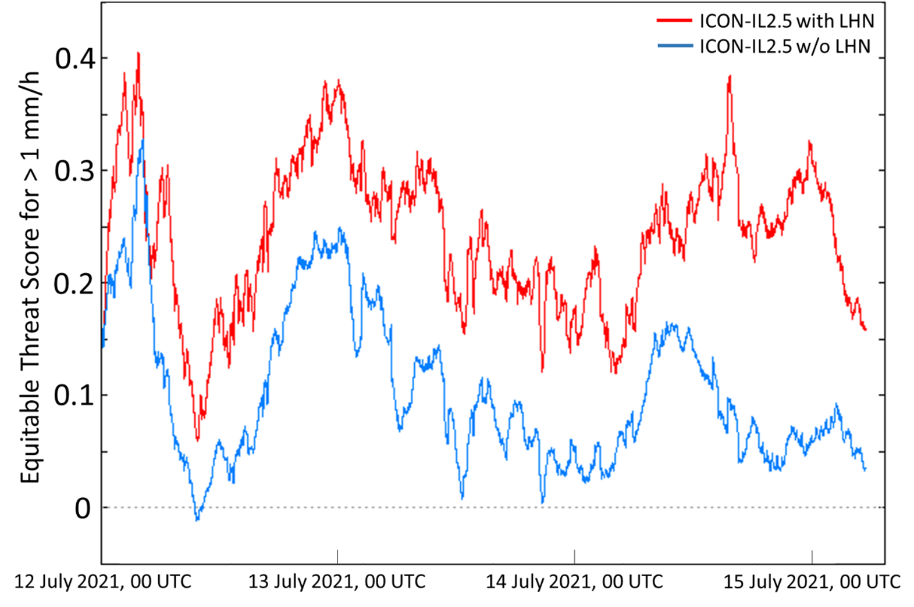
Assimilation of OPERA radar network
Operational in ICON-IL since November 2021. Recently a new tuning of the LHN scheme, related to the bright band detection, was suggested by DWD. It is planned to be tested in ICON-IL2.5.
Verification of ICON-IL2.5 with (red) and without (blue) OPERA assimilation during a severe flooding event over central Europe (12–15 July 2021). The verification was performed with OPERA data using the Equitable Threat Score for the threshold of 1 mm/h. Higher values indicate better results. Thanks to Stephan Klaus!

Slide 30
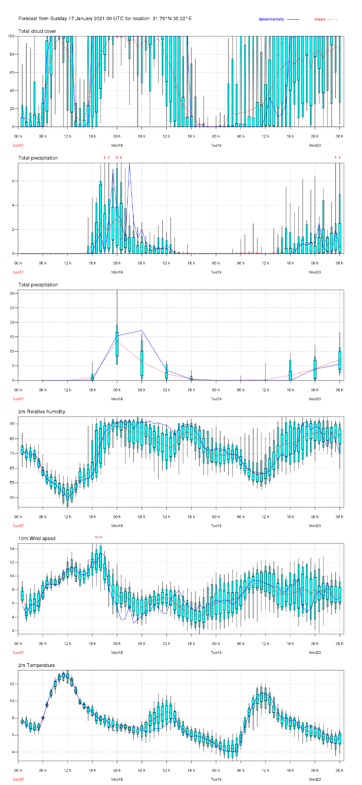
Migrating COSMO-EPS to ICON-EPS
Plan: 2023
Platform: “Time Critical Suite” on the ECMWF HPC
Model setup: Domain: 25-39E/26-36N
Resolution: ~2.5km horizontal, 65 levels vertical
Range: 90h
IC/BC: 20 ens. IFS + SPPT
SBU/run: ~100K
Oper. runs: 2 runs/day (00, 12 UTC) in the summer to save SBUs only 00 UTC
SBU/year: ~65M (not including runs for model tuning)
Storage: ~250 T/year
Data assimilation: LHN, (in ICON LETKF will be tested)

Slide 31
Fix the “problem” of lakes in case of cold start
Water point (not lake) → SST is taken from the global model
Flake=on → sst is taken from the skin temperature
Water point (lake)
Flake=off → sst is taken from the sst temperature

Slide 32
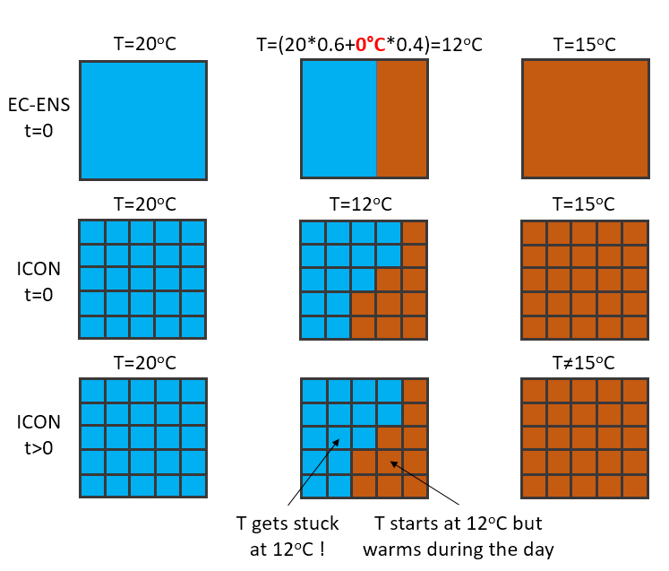
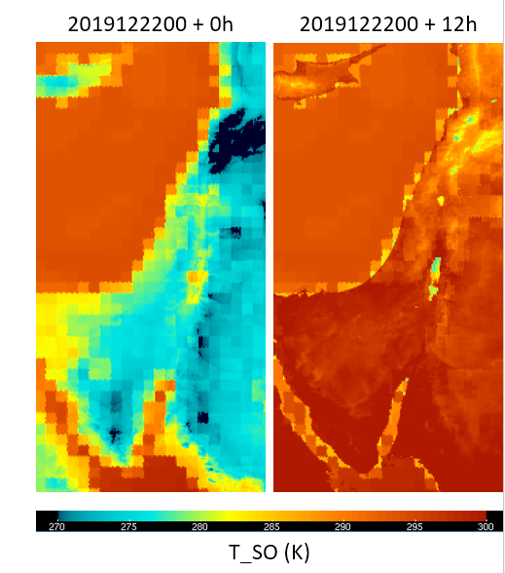
IFS skin temperature Erroneous coastal grid cell with 0°C

Slide 33
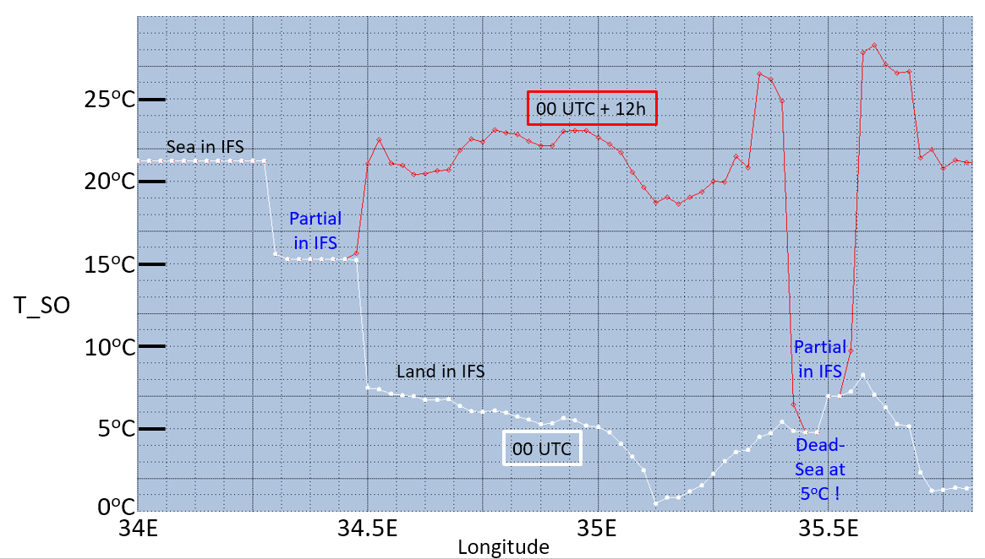
IFS skin temperature problem

Slide 34
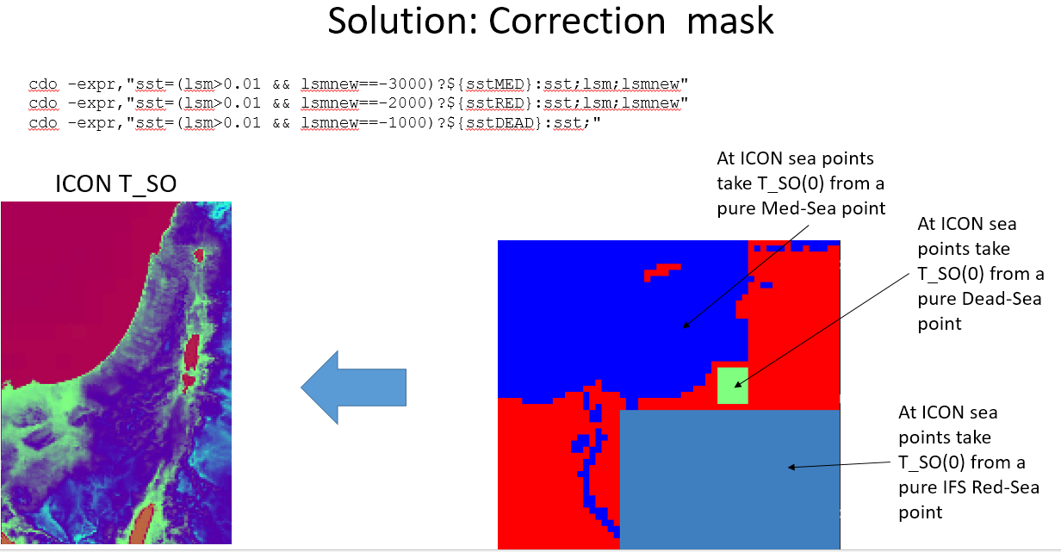
IFS skin temperature problem

