Slide 1
SCA Report for ICON-NWP and still: COSMO-Model and INT2LM
Ulrich Schättler, Daniel Rieger
Source Code Administrators

Slide 2
Contents
COSMO 6.0 and INT2LM 3.0
Latest ICON Releases
Working with ICON
License and Support Issues
ICON Projects

Slide 3
COSMO 6.0 and INT2LM 3.0

Slide 4
The Final Steps
On December 14th, 2021, the final versions of COSMO and INT2LM have been published.
5.13 (09.11.21): Adaptations to latest COSMO-ART version
5.14 (07.12.21): Update of SNOWPOLINO; data assimilation fixes
All parts of the documentation have been updated and are available with DOIs.
Since then we are in maintenance mode.

Slide 5
Problems Already Reported
For COSMO
For INT2LM
10.12.21 | MCH | No proper domain check in LHN.
04.01.22 | CLM | Averaged fields in first output after a restart are not correct. Only occurs for settings as hcomb=24,48,1. Ok for hcomb=0,48,1 or also for hcomb=23,48,1.
04.03.22 | GPU | Removed vector index lists in Tiedtke-Bechtold convection (conv_cuascn.f90) due to a compiler problem with new PGI compiler.
30.05.22 | URB | Variable tcm in turb_transfer.f90 has to be INTENT(INOUT) instead of INTENT(OUT). Important for itype_kbmo_uf > 0 or lurbfab.
31.08.22 | LEPS | Reading GRIB 2 meta data for special local section 28: global communication problem in src_input.f90.
08.03.22 | CLM | Value, which is read for vcflat_in from a NetCDF file is not set to global value vcoord_in%vcflat (only problematic, if vcflat for driving model is not the default).

Slide 6
Actions Taken
Problems are rather „isolated“, so no official updates have been provided.
Fix for Tiedtke-Bechtold convection has been implemented in github-master (for ETH Zürich).
Fixes for LEPS, Tiedtke-Bechtold convection and Turbulence (GPU) have been implemented in ECMWF version cosmo_211214_6.00 (cca and new hpc) for interested users (on August 31st)
CLM community offers fixes for the restart problem and INT2LM.
MCH is working on consolidation of SNOWPOLINO. Together with this update we can officially implement above fixes.
How / Whether to integrate work from PT VAINT (CLM work for vegetation)?

Slide 7
Latest ICON Releases from the Protocol of Release Commits

Slide 8
ICON 2.6.4 (28.09.21)
Large refactoring of infrastructure modules by DKRZ
Cleanup: Removal of Hydrostatic Core, PSRAD and RG radiation, #ifdef COSMO
Implementation of Seifert-Beheng two-moment microphysics scheme (HAM physics)
Synchronize effective radius calculation between radiation and microphysics
Improved description of gravity waves emission in SSO scheme
Revised upper boundary condition for vertically nested grids: reduces spurious reflection
Optional diagnostics of lightning potential index (LPI, see Reports on ICON - Issue 010)
New option for adaptive pressure bias correction at lateral boundaries (LAM only)
Reintroduce an optimized reading of Kinne aerosols (read only the required months)
Fix for the soil water budget with snow tiles
OpenACC port for LHN code

Slide 9
ICON 2.6.5 (29.07.22)
Usage of netcdf instead of CDI for restart I/O (old restart files with new version works, but not vice versa)
Cleanup: Removal of Ritter-Geleyn radiation scheme, synchronous lateral boundary condition read
Optional diagnostics: sunshine duration, accumulated snow melt
Extension for upscaling additional (optional) input fields to the reduced radiation grid
Introduction of the ICON Single Column Model
Kinne aerosol climatology for ecRad
New Namelist variable czbot_w_so: user defined thickness of the hydrological active soil layer for TERRA
Bugfix for accumulated runoff
Buildbot update & integration in Gitlab (https://gitlab.dkrz.de/icon/wiki/-/wikis/How-to-use-the-new-buildbot)
Optional Transient solar radiation for ICON-NWP

Slide 10
ICON 2.6.5 (29.07.22); cont.
CSCS: introduction of more and optimized OpenACC code parts and introducing work to allow for more modularization later to improve and consolidate the ICON code => ICON-C
MCH: providing more model components of NWP physics for use on GPUs.
First Steps for ICON-SEAMLESS
allow coupled ocean/atmosphere simulations using ICON-NWP atmosphere, ICON-O ocean, TERRA land and sea-ice dynamics; thermodynamics components from FESOM2 and Dmitrii Mironov. Coupling is done with YAC2
JSBACH/VDIFF: provide downwelling shortwave fluxes as well as their diffuse fractions as additional fields in NWP diagnostics needed as input for JSBACH.
Full list: https://gitlab.dkrz.de/icon/wiki/-/wikis/Protocol-of-Release-Commits

Slide 11
Working with ICON

Slide 12
For Developers
How to start with ICON? You can find useful information and links on:
http://cosmo-model.org/content/support/icon/default.htm
accessible from the main page
For example: Link to a document „ICON for Developers“, which explains how to get access to the ICON gitlab.
Once you have access, you can take a loo to the gitlab page:
https://gitlab.dkrz.de/icon/icon-nwp
Or you can download (clone) the code:
git clone --recursive git@gitlab.dkrz.de:icon/icon-nwp.git
Also take a look to the “ICON developer wiki”
https://gitlab.dkrz.de/icon/wiki

Slide 13
Some Facts
Right now (31st of August) icon-nwp has
Branches: hard to count, I guess > 100
Issues: 53
Merge Requests: 58
Feature branches: 23
COSMO activities: 3
dursun, dursun_m in output of mch_opr_r04b07_lhn_12
cairr cams
read cams data
CLM activities: 1
GPU developments: 14
Others (infrastructure): 17

Slide 14
Documentation for ICON
ICON Tutorial:
Comprehensive manual for getting started with ICON.
ICON for Developers
Short description on how to get access to the ICON gitlab and install the model.
Reports on ICON
Series of non-peer-reviewed articles dedicated to the numerical weather prediction and climate model ICON.
https://www.dwd.de/EN/ourservices/reports_on_icon/reports_on_icon.html
Further Reading
https://code.mpimet.mpg.de/projects/iconpublic

Slide 15
For Plain Users / Non-Developers
My personal opinion:
There is no need to get access to the ICON gitlab, although you do not have access to some information then, e.g. the Release Notes or other ICON activities.
We try to make the most relevant informations available somehow.

Slide 16
Important Changes in ICON Operational Suite
Enhancement in the vertical resolution:
Number of vertical levels will be enhanced from 90 to 120 levels.
More levels added in the stratosphere, which reduces wind and temperature forecast errors in the stratosphere by about 5 %.
Requires modifications in INT2LM namelist group /GRID_IN/:
ke_in_tot = 120 was 90 before
nlevskip = 31 was 20 before
Introduction of a new orography data set for the global ICON:

Slide 17
Important Changes in ICON Operational Suite
Introduction of a new orography data set for the global ICON:
New orography is a composit of the MERIT (90°N-60°S; 3‘‘ resolution) and the REMA (62°S-90°S; 200 m) data set. Former data set was GLOBE.
New data set allows for a more accurate calculation of SSO parameters.
Necessary change for COSMO applications:
Do not use old icon_hhl-files any more. HHL is now distributed with every data set igfff00000000 and icon_hhl files must not be used any more!

Slide 18
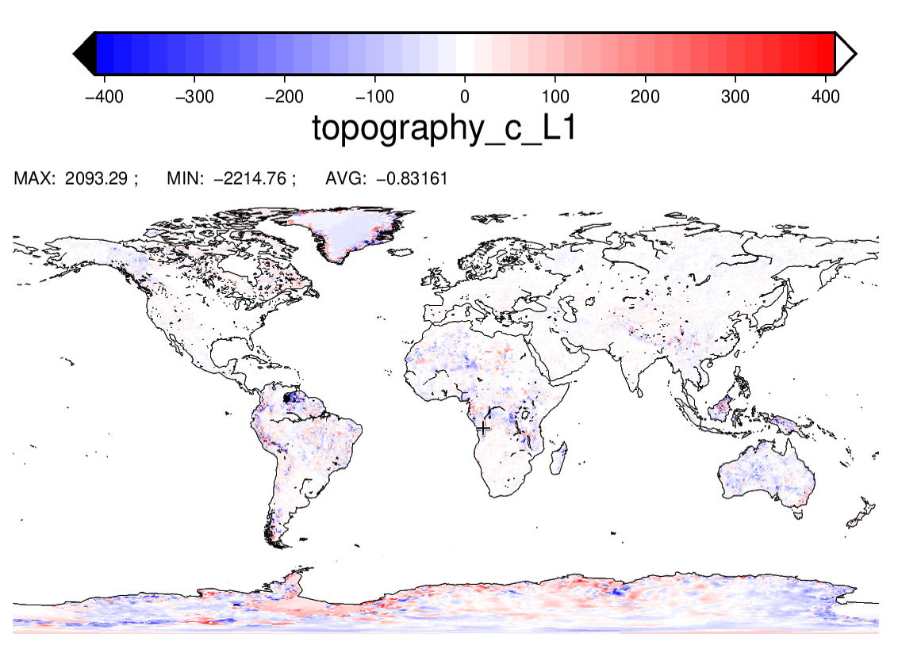
Important Changes in ICON Operational Suite
Large systematic differences are restricted to parts of northern South America, where GLOBE is known to be erroneous.

Slide 19
ICON on ECMWF Computers
cca:
Running newer ICON versions than 2.6.3 on cca is not possible due to Cray compiler problems (cce 8.7.7 is the last compiler version installed. No newer compiler version will be installed any more).
New hpc:
Two config-scripts are provided on the new machine in Bologna:
atos2020.gcc-11.2.0: for GNU compiler suite with OpenMPI:
significantly slower than Intel version
atos2020.intel-2021.4: for Intel compiler with a special Mellanox OpenMPI version (hpcx-openmpi)
OpenMP without ecrad now working: export OMP_PLACES=threads
still problems with OpenMP and ecrad

Slide 20
ICON on ECMWF Computers (cont.)
Other things to discuss:
COSMO-LEPS with 6.0, GRIB 2 ?
ICON-LEPS
NWP Testsuite
Buildbot tests on the new system: may be possible, but would need BUs

Slide 21
License and Support Issues

Slide 22
Still under Construction
Usage of ICON is for free. Even an Open Source License is under discussion.
COSMO / DWD will provide a commercial license for „Delivery of Software and Meteorological and Climatological Support Services for Official Duty and Scientific Purposes“: to be discussed by STC this week.
This license comprises
Use of COSMO Software:
MEC, DACE, Rfdbk
Services:
Provision of initial and lateral boundary data
Support for use of ICON and COSMO-Software provided by COSMO
Proposal for a new COSMO-PP: C2I4LC
Main task: set up a support infrastructure

Slide 23
ICON Projects

Slide 24
ICON Seamless
NWP plus climate forecasting with ICON-A-O-L and Data Assimilation.
Initiated by the directors of DWD, MPI-M, KIT and DKRZ in October 2020.
Expert Groups (Atmosphere, Ocean, Land, Data Assimilation) started work in 12/2020.
First prototype available in icon-nwp master:
Allows coupled ocean/atmosphere simulations using ICON-NWP atmosphere, ICON-O ocean, TERRA land and sea-ice dynamics; thermodynamics components from FESOM2 and Dmitrii Mironov. Coupling is done with YAC2
JSBACH/VDIFF: provide downwelling shortwave fluxes as well as their diffuse fractions as additional fields in NWP diagnostics needed as input for JSBACH.
New colleagues hired at DWD.

Slide 25
ICON-C (full name: ICON-Consolidated)
ICON-C is an infrastructure project with the following objectives:
Make ICON more modular: encapsulate components with clear interfaces.
Allow for more scalable development workflow: especially for an improved testing of individual components.
Define a new development process: how to implement major / minor changes and bug fixes.
The new code should allow for all needed climate and NWP operational applications.
Most work will happen in the Fortran code, but a rewrite of components in other languages is not part of ICON-C. But ICON-C should allow easier interfacing with other languages.

Slide 26
ICON-C Explained (or better: as I see it)
Encapsulate components:
Try to build a „TERRA standalone“ or a „Microphysics standalone“:
That was hard in COSMO
It is a nightmare in ICON, because ICON is a huge software package with really many inter-dependencies.
ICON-C tries to find a way to encapsulate such components by finding „alternative ways“ to provide the necessary data to a special component.
How to allocate memory for fields?
How to access fields (inter-language operable)?
How to provide fields or scalar data to a component?
This will need a more modern programming style (not with USE or standard interfaces).

Slide 27
ICON-C Explained (or better: as I see it) (cont.)
The hope is, that a component can then easily be put to a different framework, e.g. a „standalone“ framework.
This will facilitate component (or unit) testing. We will see how it enables (or improves) a scalable development workflow.

Slide 28
Prototype Works / Concepts
The Memory Interface
The Community Interface
Modularization interfaces design for ICON-C
Refactoring of initial conditions component

Slide 29
Roadmap from 22.05.2022 (some highlights)
ICON-C repo from ICON release begining of July 2022 (icon-2.6.5)
Define ICON-C initial code base for ICON-C (15.07.2022)
Agree on the initial component modularization, interface and data management design (15.07.2022)
Prototype implementation modularization and data management (01.08.2022)
Build and Test environment/infrastructure (new buildbot) (01.08.2022)
Prepare initial code base (15.08.2022)
Functional Data Management library – with prototype allocation library (October 2022)

Slide 30
Roadmap from 22.05.2022 (some highlights)
Modularization/encapsulation of the initial ICON-C code base (Q4 2022)
Demonstrator use cases to show advantages of ICON-C (ie testing/developing components separately) (Q4 2022)
Demonstrator use cases to show advantages of ICON-C (ie testing/developing components separately) (Q4 )
Prepare functional ICON-C version by adding missing components(scientists with support from project team, Q4 2023)

Slide 31
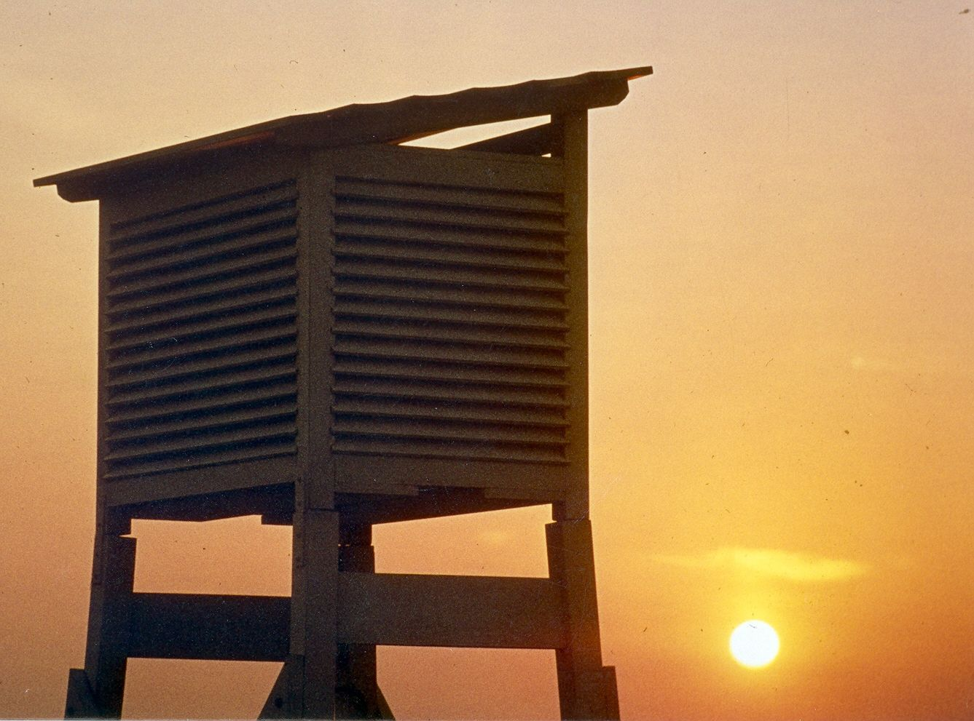
Thank you very much for your attention!

