Slide 1
PP CITTA: summer verification over Israel
Pavel Khain, Leenes Uzan, Alon Shtivelman, Yoav Levi
COSMO GM, Athens, 2022

Slide 2
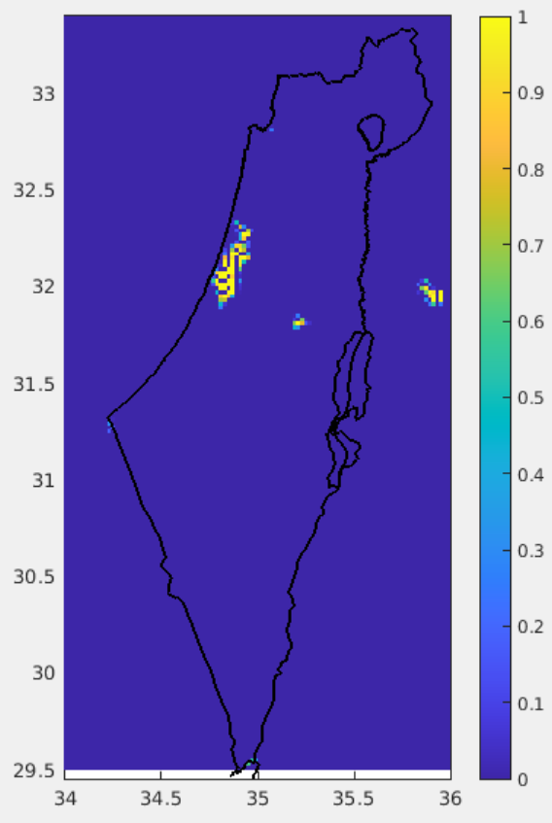
URBAN (ISA) field
ICON-IL domain (2.5km) driven by IFS
sea
land
Tel Aviv
Jerusalem
31 days experiment: 1/7/2020-31/7/2020 00 UTC 0-78h on ATOS@ECMWF
Summer characterized by strong afternoon see breeze and weak nighttime land breeze
ISA field over Israel is outdated!

Slide 3
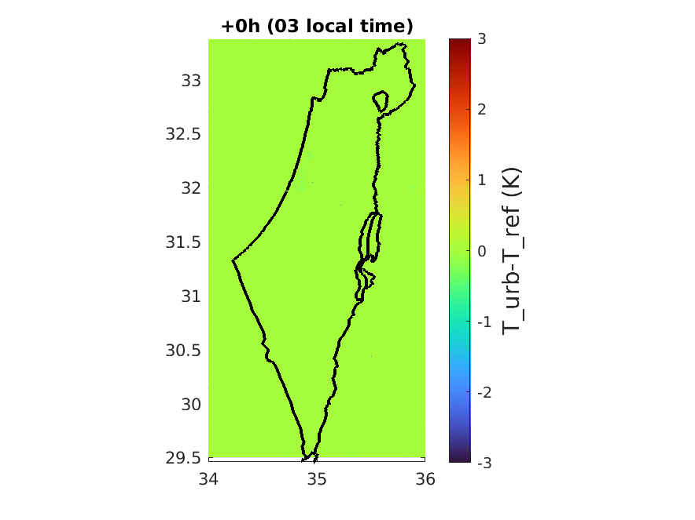
T_2m (URBAN) – T_2m (REF): averaged 0-78h run for July 2020
Warmer at night, colder at day
The urban area is underestimated

Slide 4
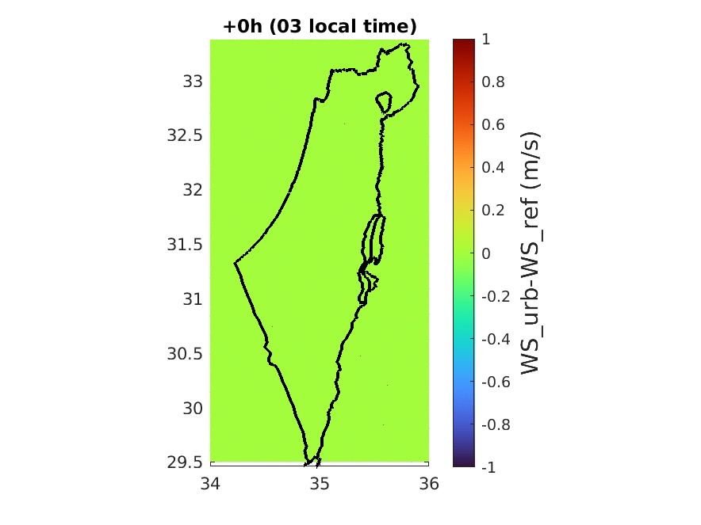
WS_10m (URBAN) – WS_10m (REF): averaged 0-78h run for July 2020
Stronger at late evening, weaker at noon
The urban area is underestimated

Slide 5
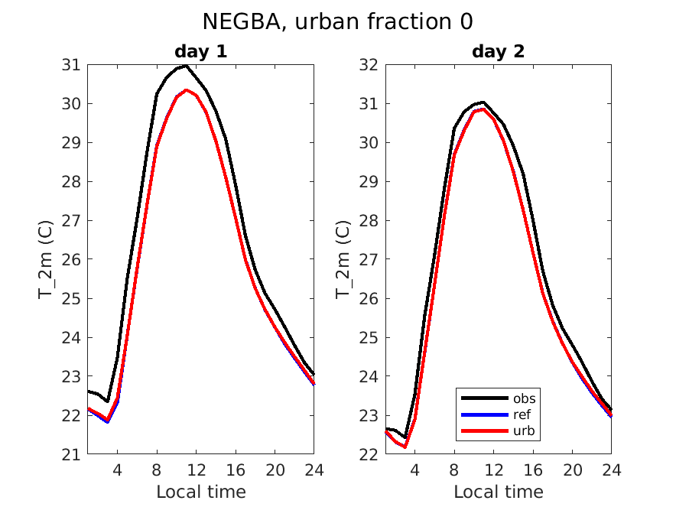
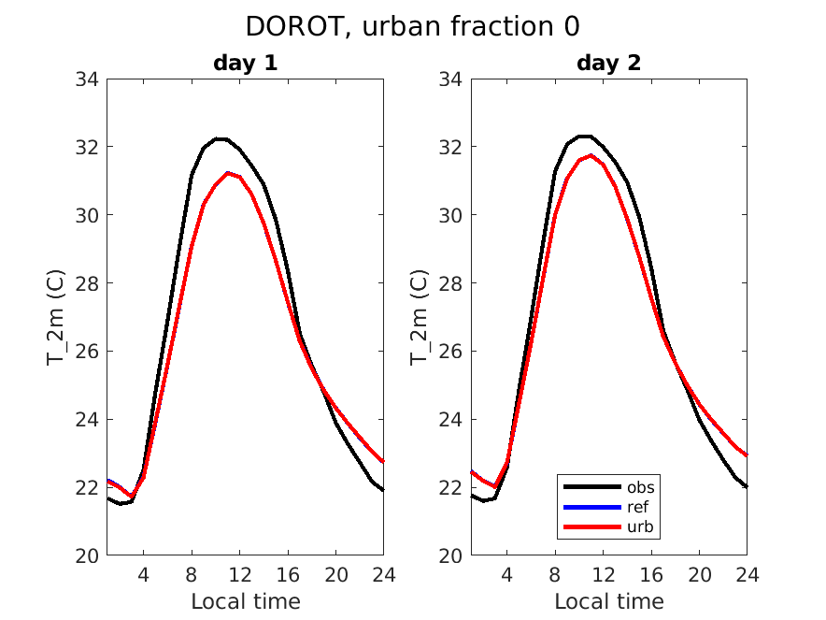
T_2m verification: averaged 0-78h run for July 2020
Rural area:
No effect of the urban scheme. Good.
Technical: urban field can’t be added to output_nml?!

Slide 6
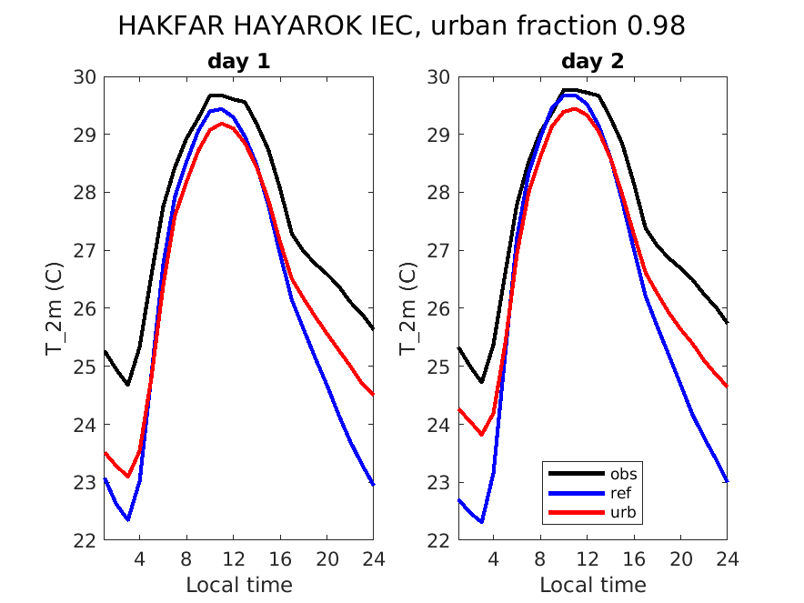
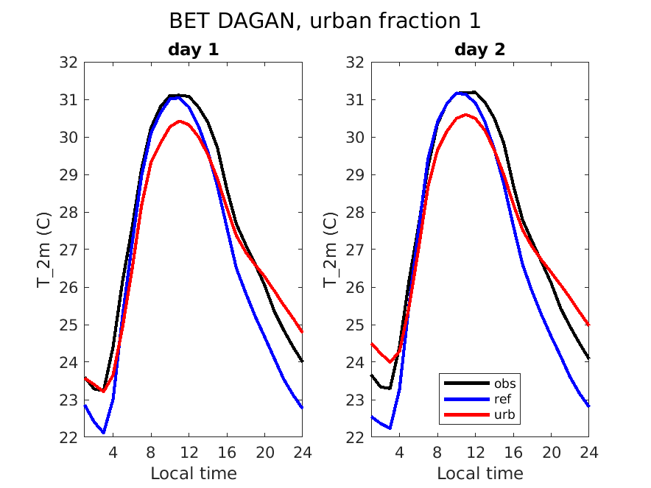
T_2m verification: averaged 0-78h run for July 2020
Urban area:
The nights were indeed too cold. Urban run is better!
Both stations are in reality “half-urban” – an update of the URBAN (ISA) map is needed

Slide 7
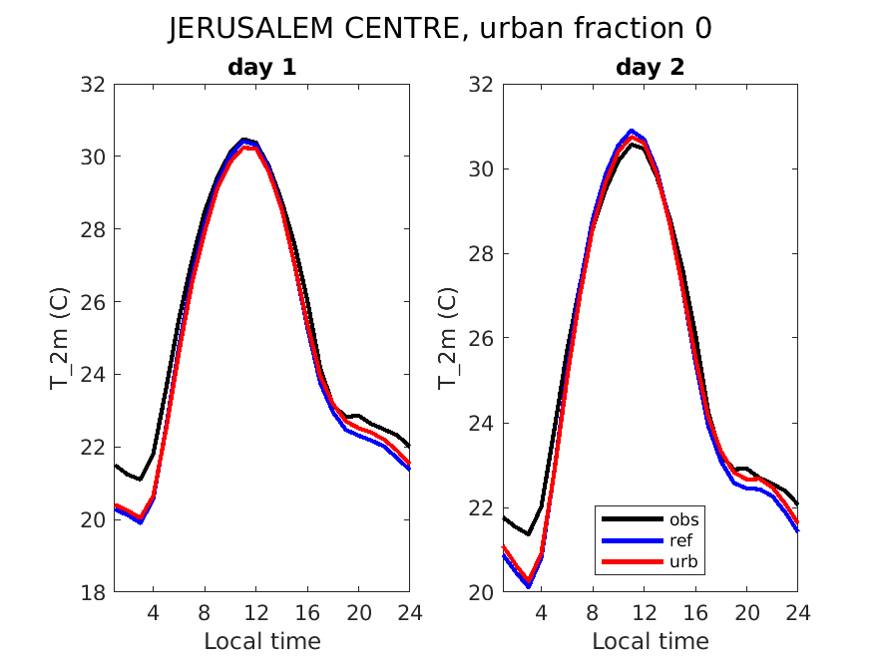
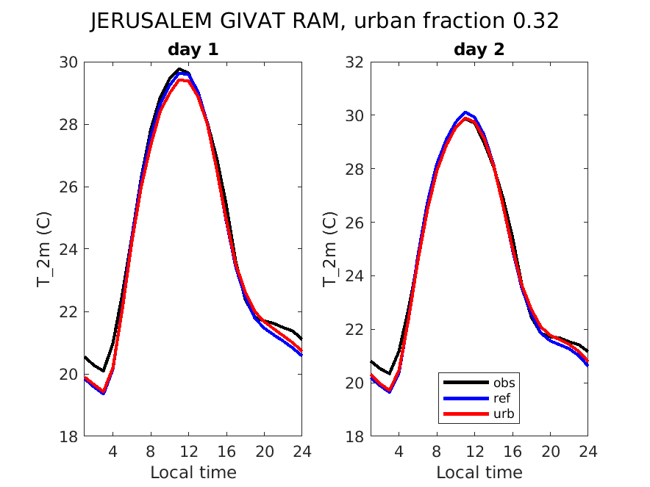
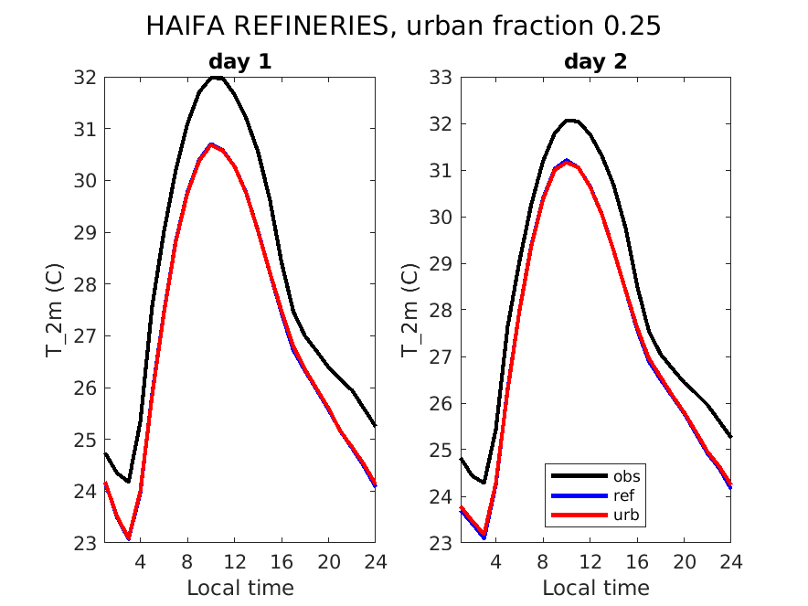
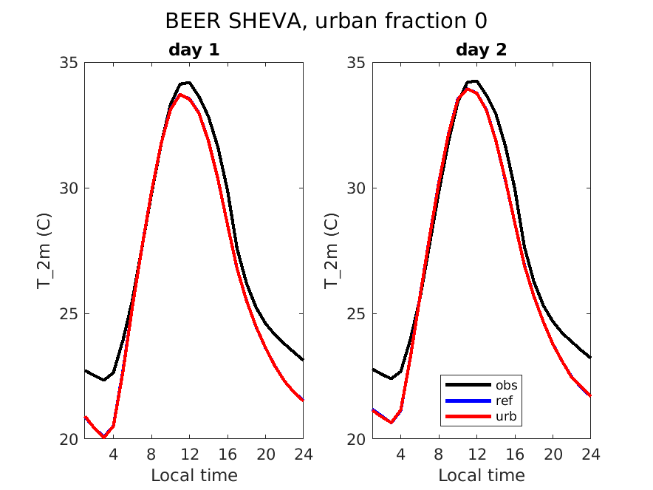
T_2m verification: Cont.
Urban area:
These stations are in reality urban – an update of the URBAN (ISA) map is needed

Slide 8
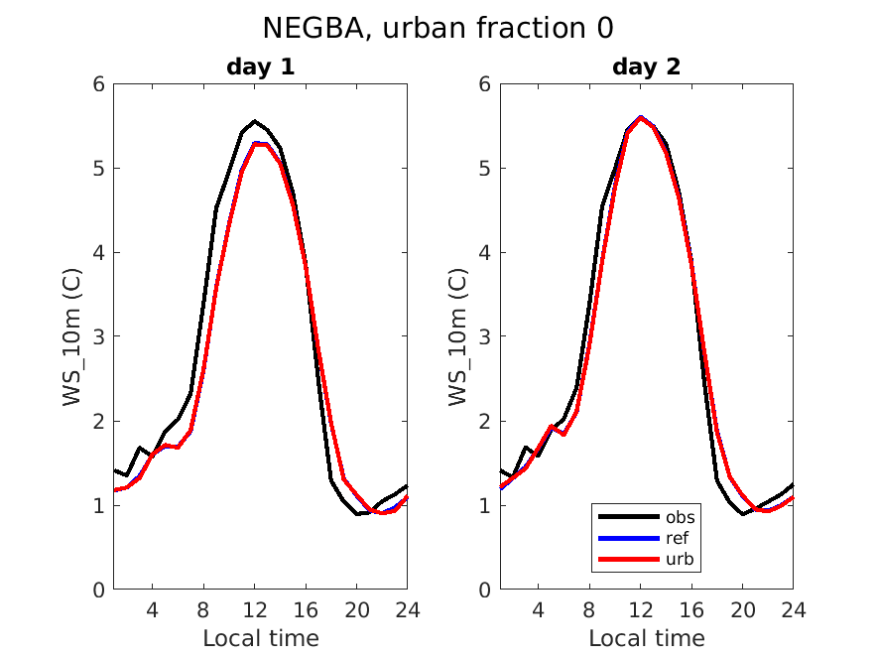
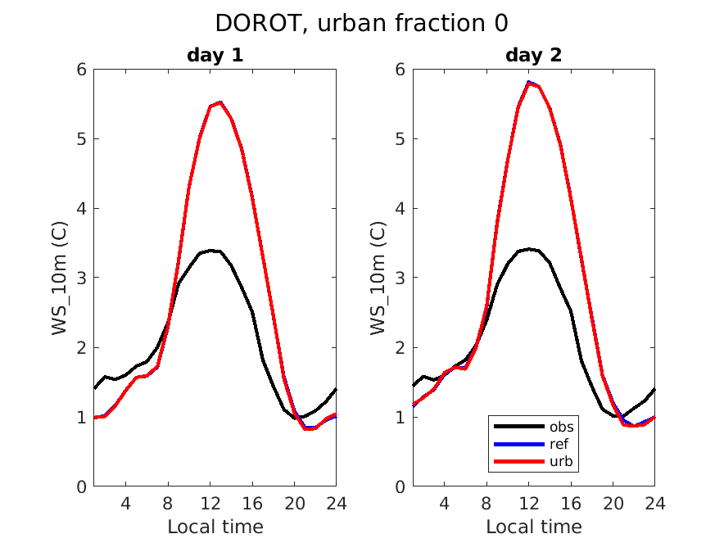
W_10m verification: averaged 0-78h run for July 2020
WS_10m (m/s)
WS_10m (m/s)
WS_10m (m/s)
WS_10m (m/s)
Rural area:
No effect of the urban scheme. Good.
There are problems not related to the urban scheme

Slide 9
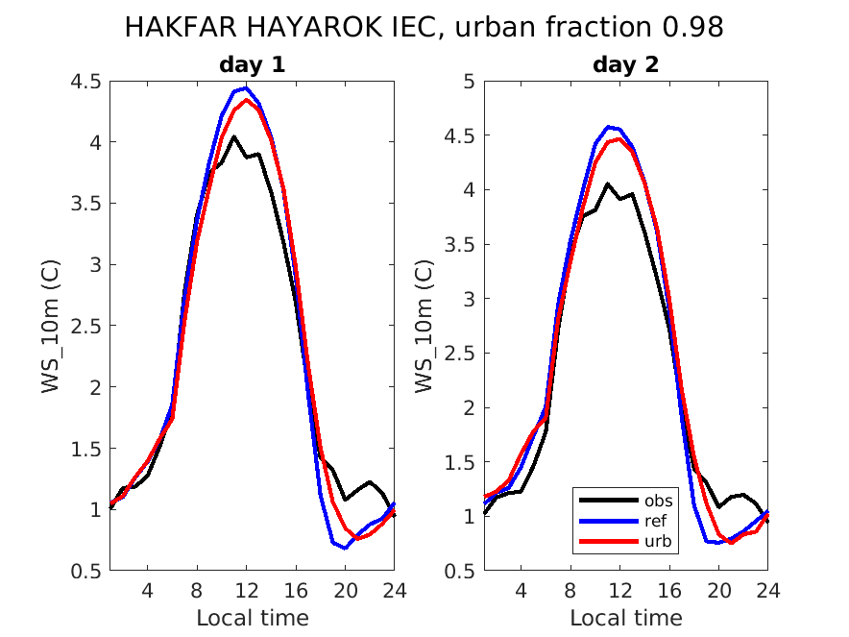
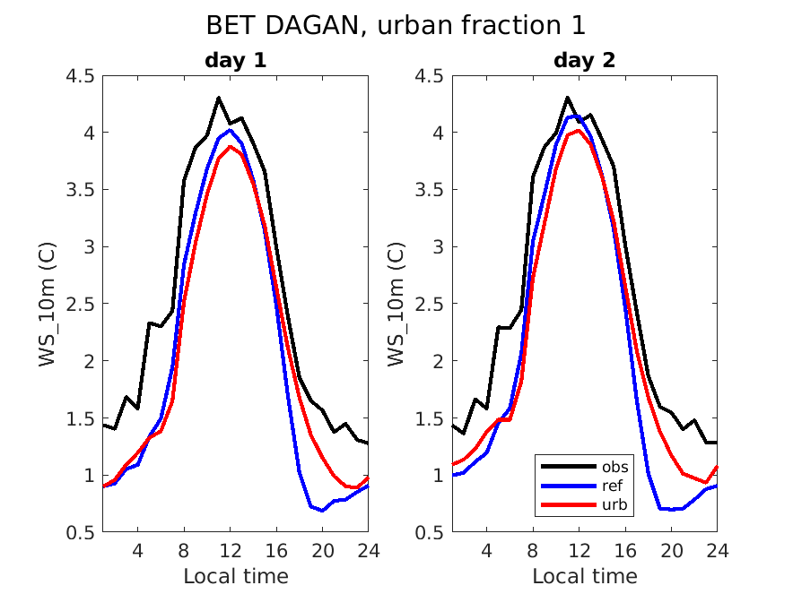
WS_10m verification: averaged 0-78h run for July 2020
WS_10m (m/s)
WS_10m (m/s)
WS_10m (m/s)
WS_10m (m/s)
Urban area:
The night wind was indeed too weak. Urban run is better!
Both stations are in reality “half-urban” – an update of the URBAN (ISA) map is needed

Slide 10
Conclusions
31 days experiment was performed over the Eastern Mediterranean with the urban scheme on and off. The summer is characterized by strong afternoon see breeze and weak nighttime land breeze
Urban scheme behaves correctly. Forecast in urban areas in improved.
Need: Improve the ISA (URBAN) field over Israel. How?
Technical: urban field can’t be added to output_nml?!

Slide 11
Additional slides

Slide 12
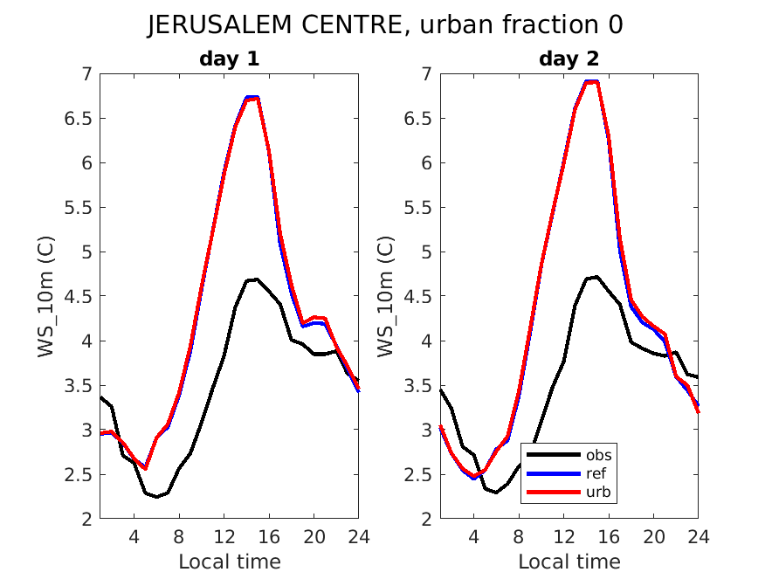

Slide 13
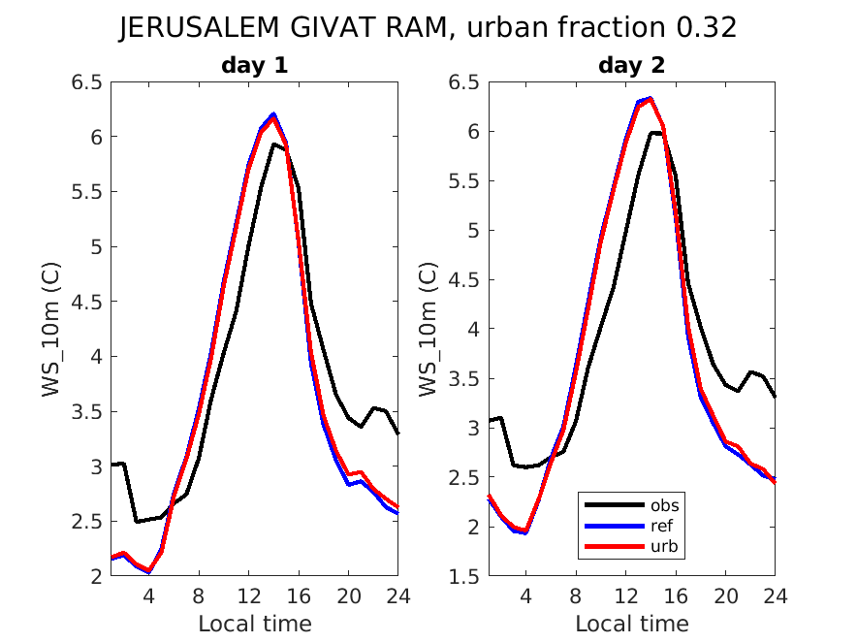

Slide 14
