Slide 1
preliminary tests with terra urb at very high resolution over souther italy
Davide Cinquegrana, Edoardo Bucchignani, Myriam Montesarchio
CIRA – Italian Aerospace Research Center, Capua CE Italy
{d.cinquegrana, e.bucchignani, m.montesarchio}@cira.it
COSMO Global Meeting 2022– 13 September 2022, Athen, Greece

Slide 2
Numerical settings
Parameterization schemes
Shallow convection parameterization is active
Deep and mid-level convection are switched off
Single moment cloud microphysics
Diagnostic Kohler cloud cover
1 day run in forecast mode:
Start date: 2018-11-19
IC: IFS Analysis @ 00:00
BCs reads @ IFS forecast every 3h
Timestep size= 6 s
lterra_urb = .true. Vs .false.
Domains compared
«DOM2» size: ~ 1 Km (R02B11)
ncells = 110216
nedges = 165812
nverts = 55597
Fine : ~ 0,6 Km (R02B12)
Results:
ΔT2m(True - False) field on »DOM2» @{1,3,16}hh
Local T2m(t) as function of fr_paved

Slide 3
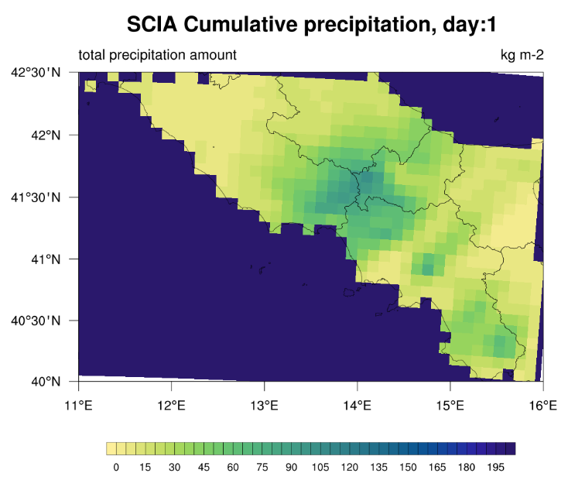
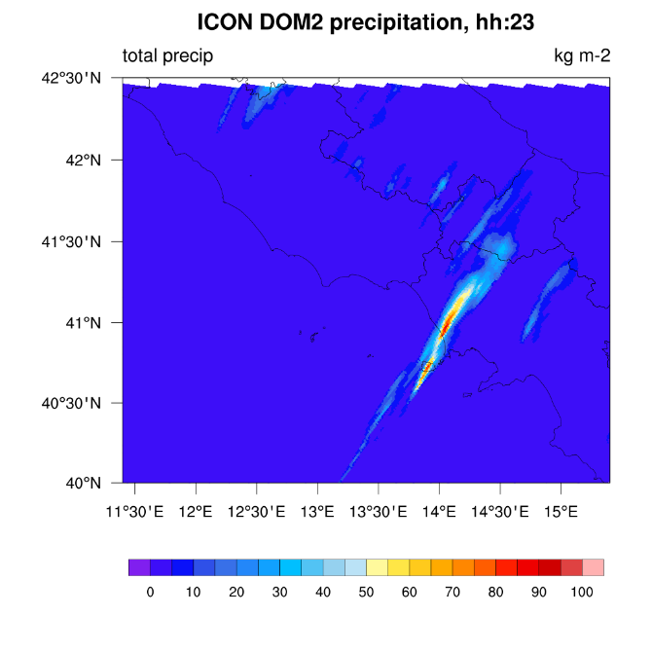
Analyzed week features
Most of the region is exposed to the humid westerly winds and, consequently, high precipitation values are recorded even along the coasts, generally up to 1000 mm/year.
19–20 November 2018: a low pressure system coming from Western Mediterranean ran over Sardinia first and then hit the south-central regions of Italy, determining intense storms and gusts.
Cumulated 24h precipitation measured from SCIA
ICON precipitation at 23.00

Slide 4
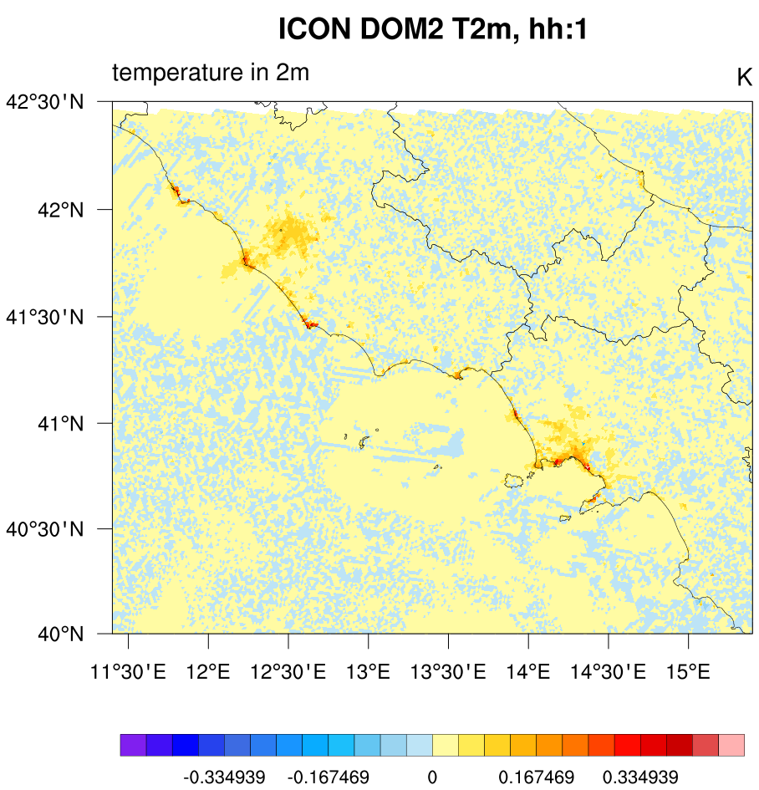
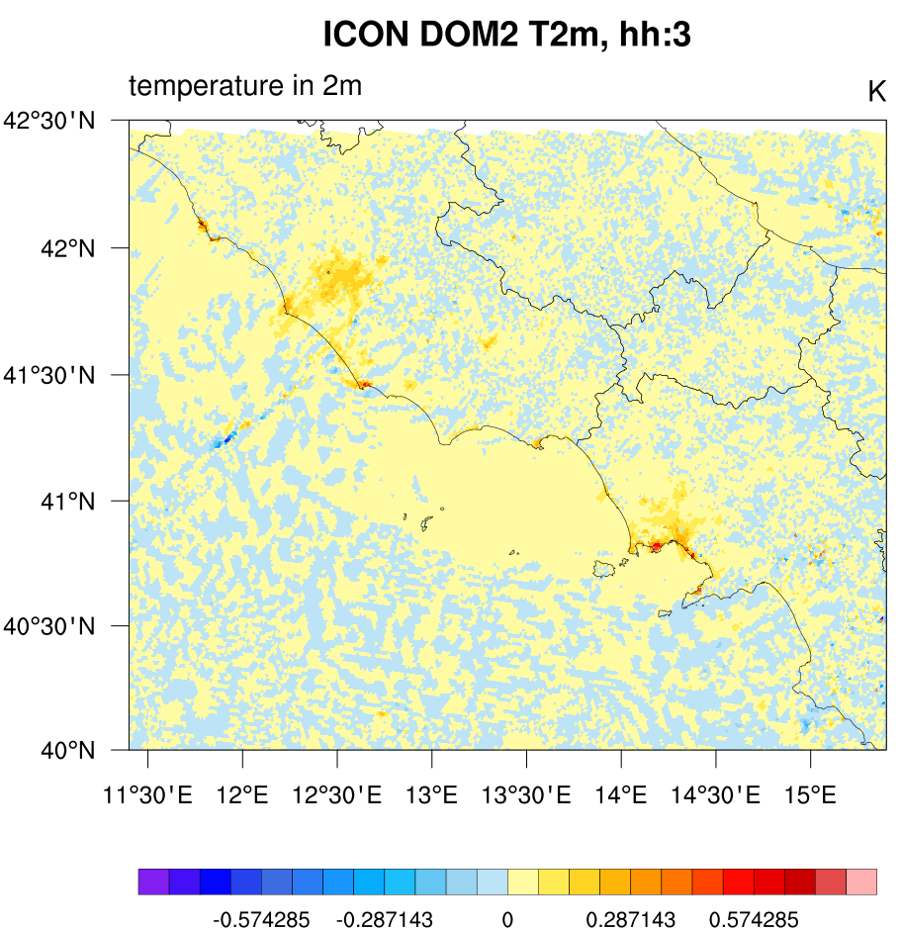
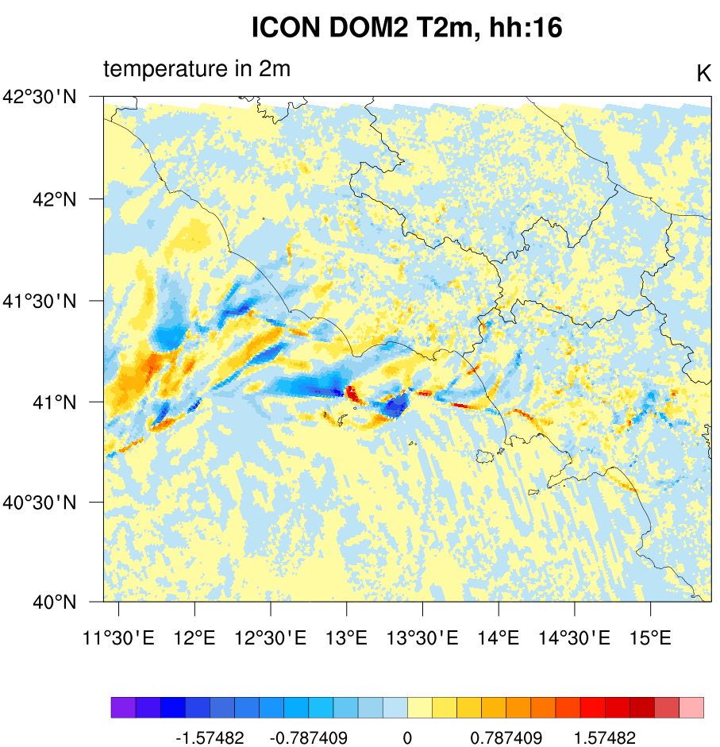
Results - 1km res.
ΔT2m(True - False): map field

Slide 5
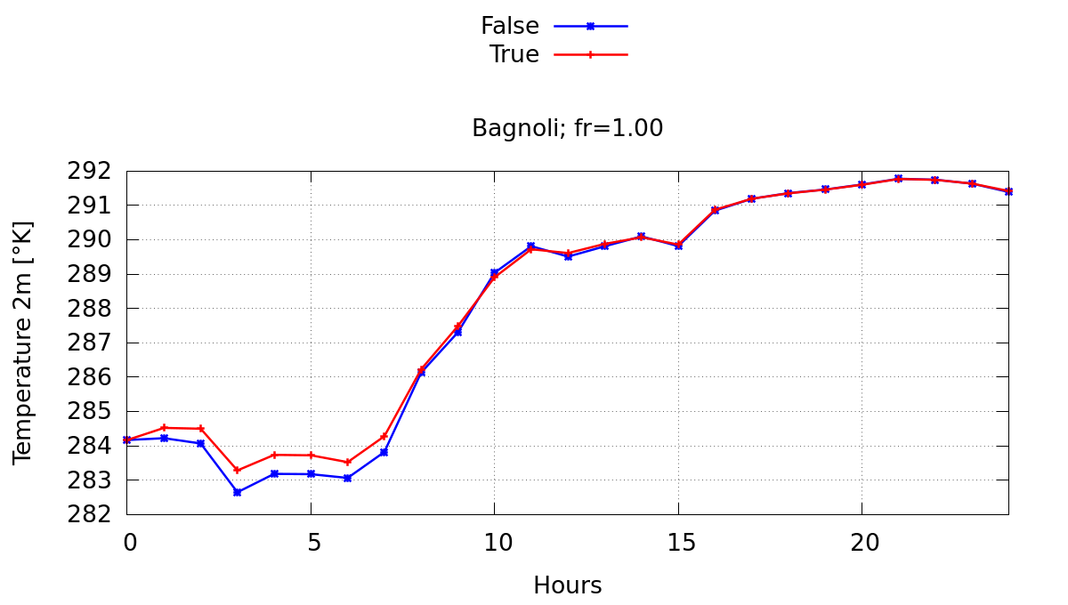
Results - 1km res.
ΔT2m(True - False): local results
Higher T2m during the nightime
Up to +0.6K, influenced by fr_paved
Numerical instability grows up during morning time starting from sea
noise detected during afternoon time (i.e. «Capua», purple line on bottom graph)

Slide 6
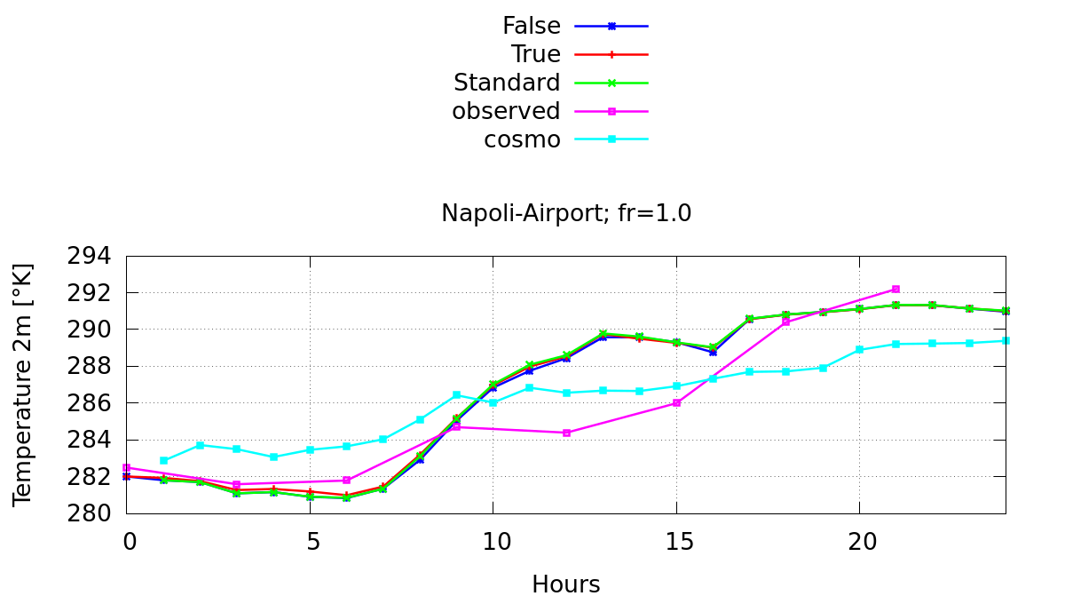
Results - 1km res.- Comparison
ICON TERRA_URB (T/F) compared with:
ICON-LAM (green line)
COSMO (light blue line)
Observed data (violet)

Slide 7
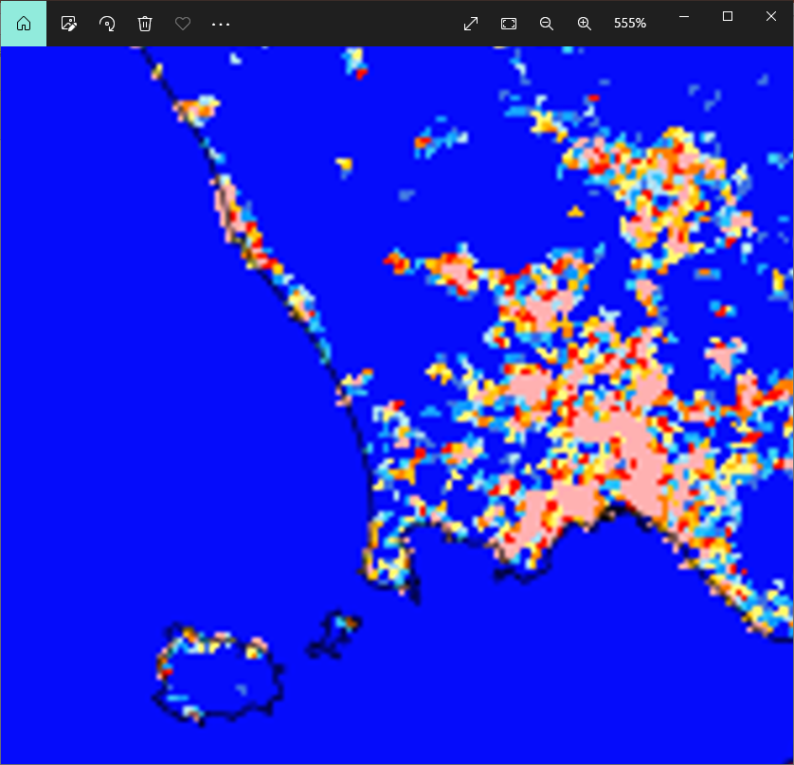
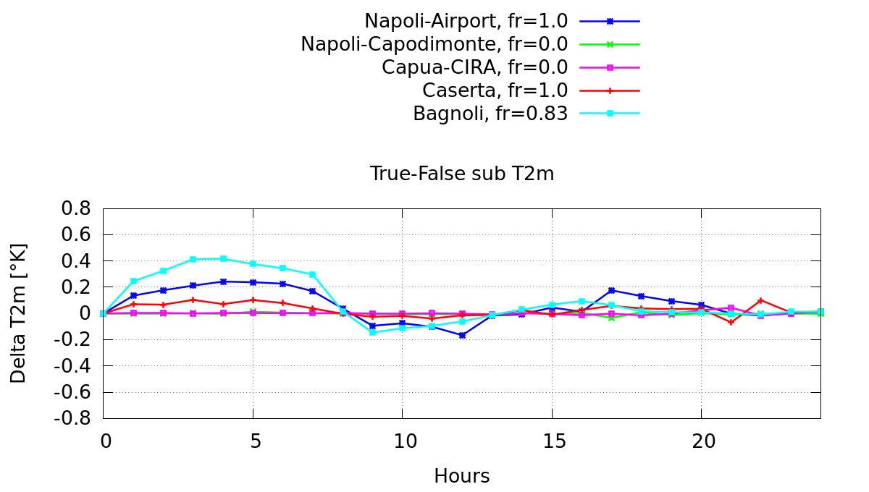
Fine Grid (0,6 km)
zoomed fr_paved maps at different grid resolutions
Horizontal resolution = ~ 0,6 Km (R02B12)
ncells = 109860; nedges = 165277; nverts = 55418
dt = 6 s
Horizontal resolution = ~ 1,0 Km (R02B11)
Res 600 m
fr_paved differ locally

Slide 8
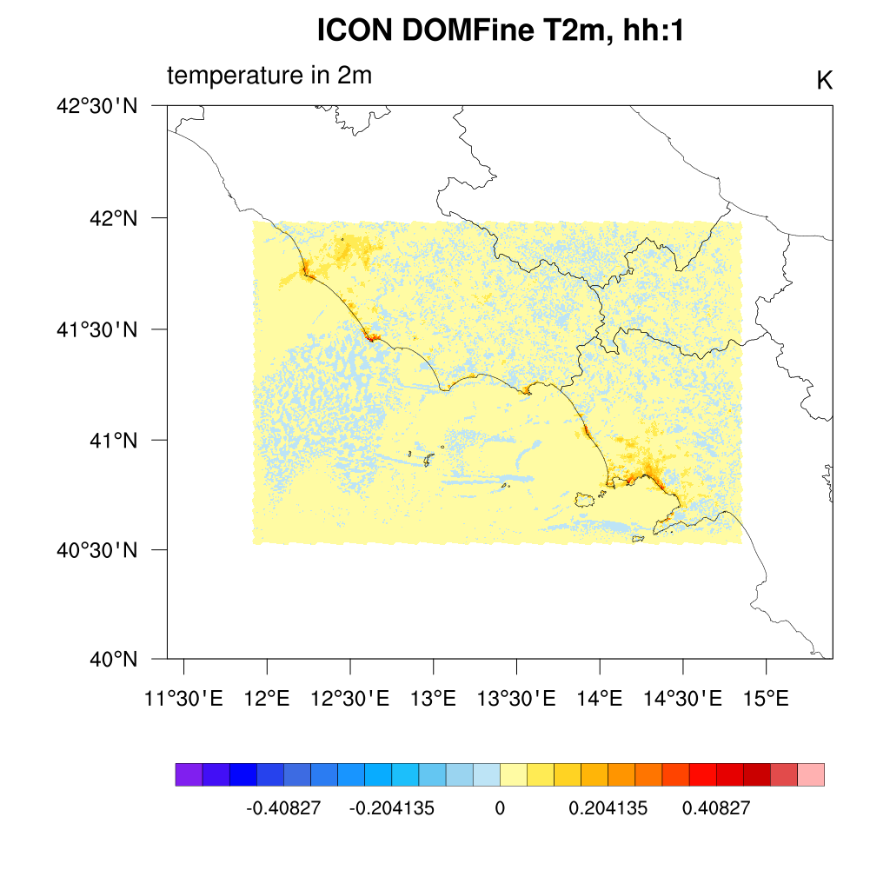
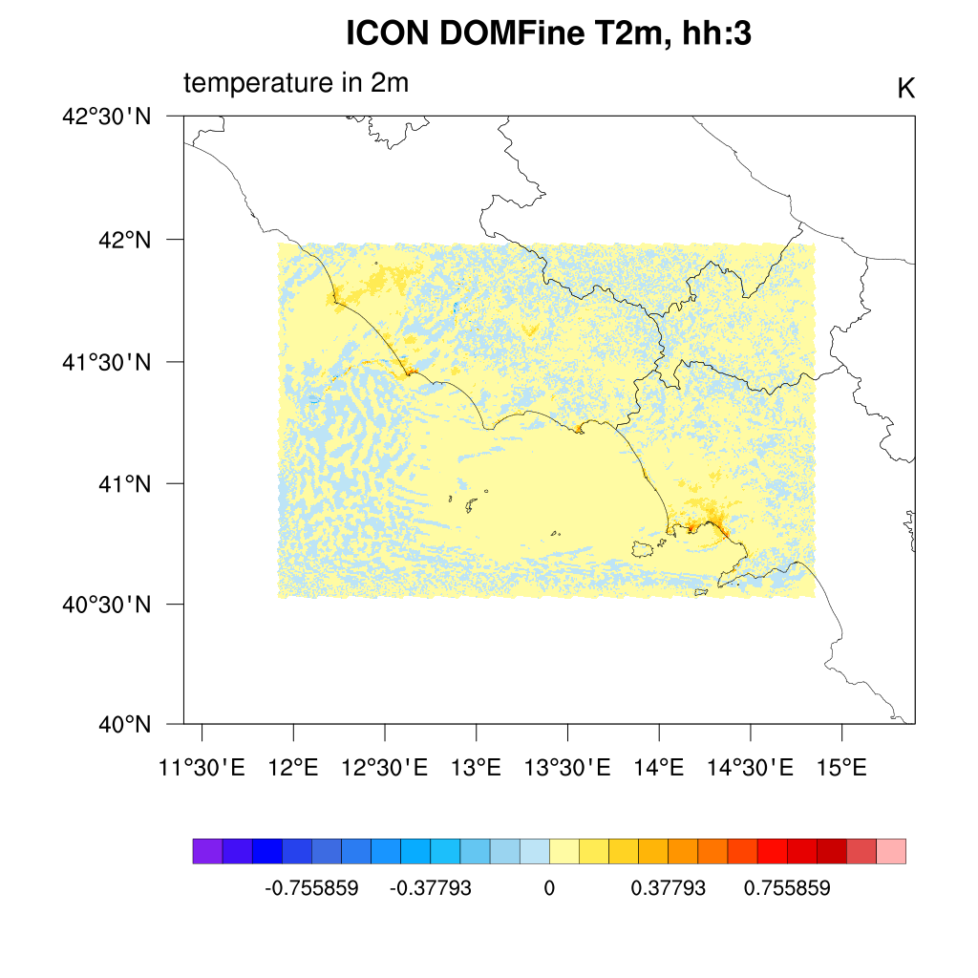
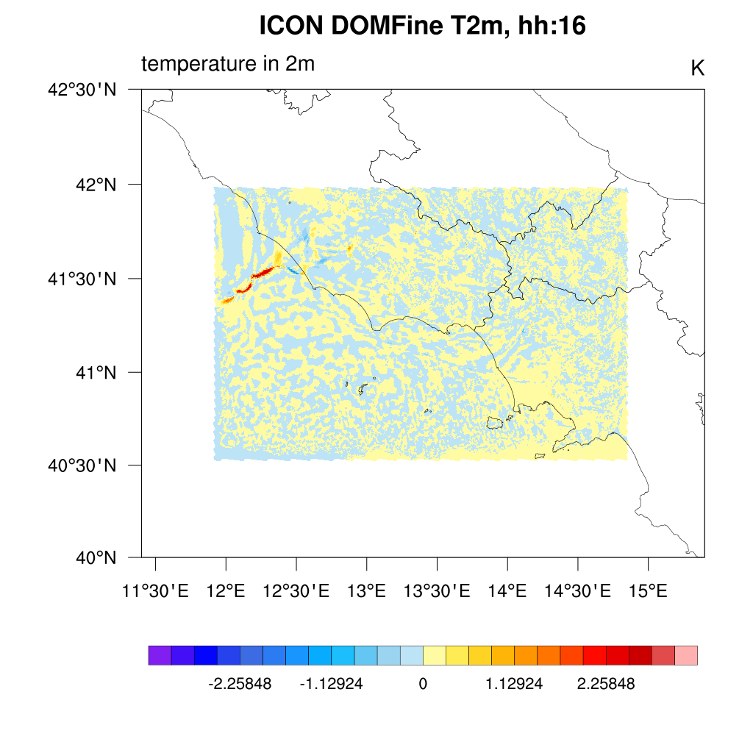
Results – 0,6 km res.
ΔT2m(True - False): map field

Slide 9
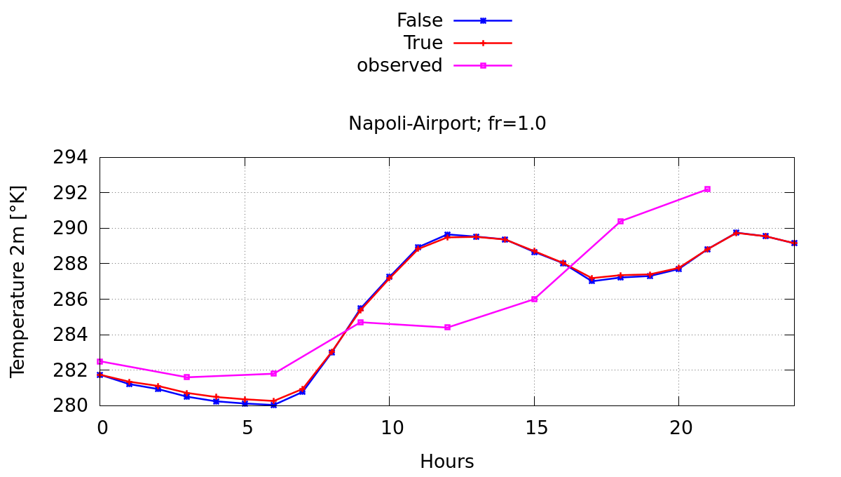
Results – 0,6 km res.
ΔT2m(True - False): local results
ICON TERRA_URB compared with:
ICON-LAM (green line)
COSMO (light blue line)
Observed data (magenta)
grid-res ~ 1000m
grid-res ~ 600m

Slide 10
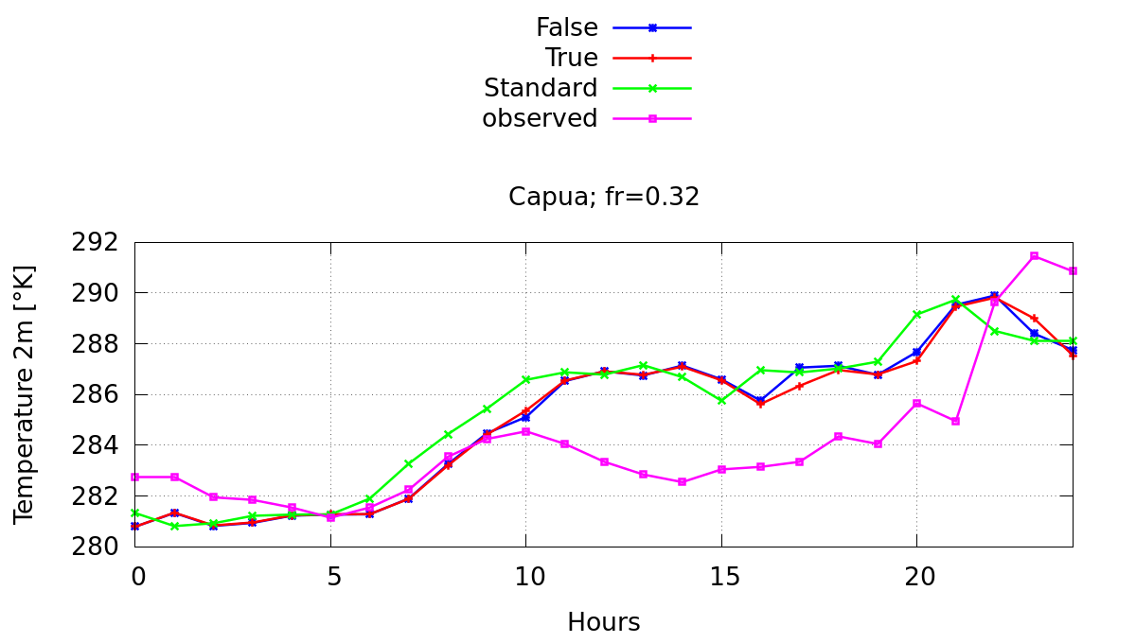
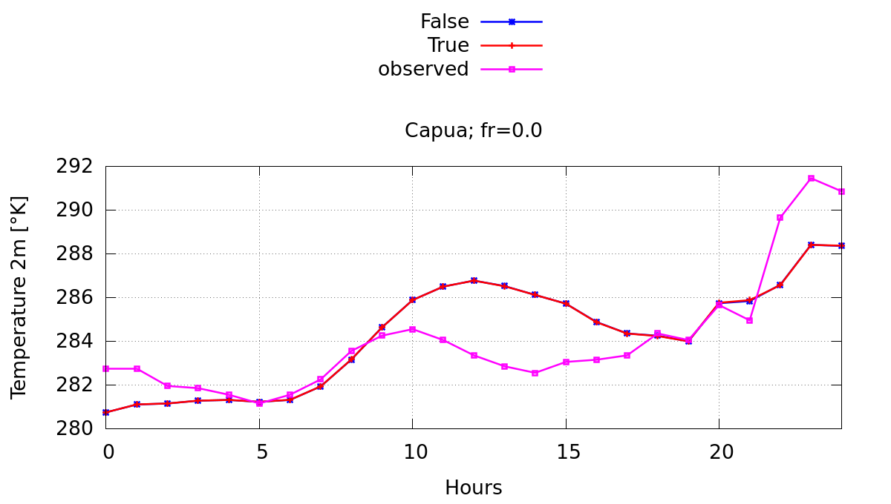
Results – 0,6 km res.
ΔT2m(True - False): local results
ICON TERRA_URB compared with:
ICON NWP (green line)
Observed data (CIRA visibilimeter, magenta)
grid-res ~ 1000m
grid-res ~ 600m

Slide 11
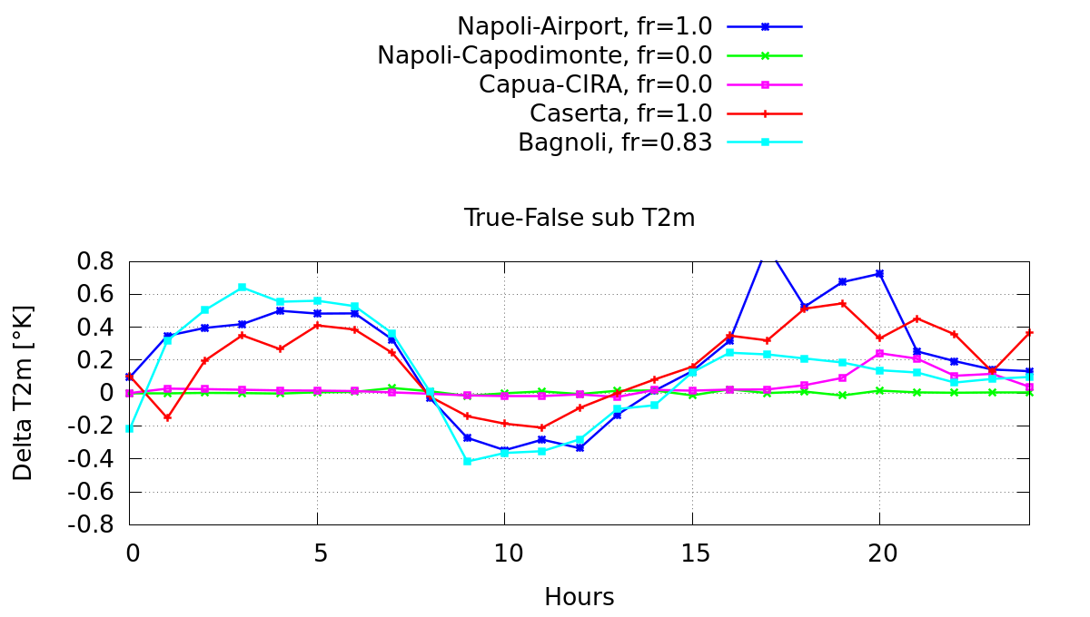
New ICON release check
Check with itype_kbmo = 2 , compared with previous release
0.6Km resolution
ΔT2m(True - False): local results
Fig. 1 Prev. release
Fig. 2 Kbmo=2

Slide 12
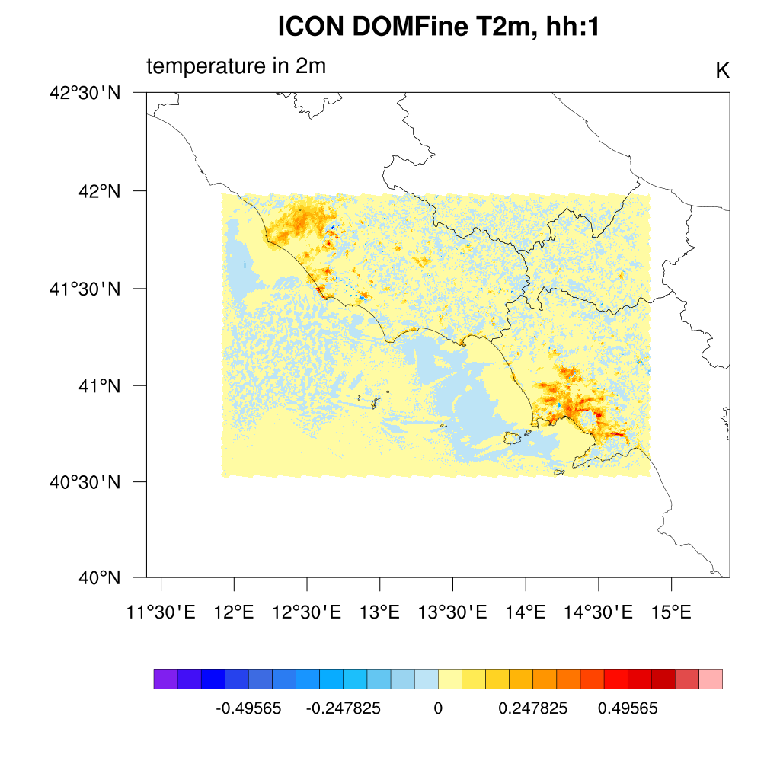
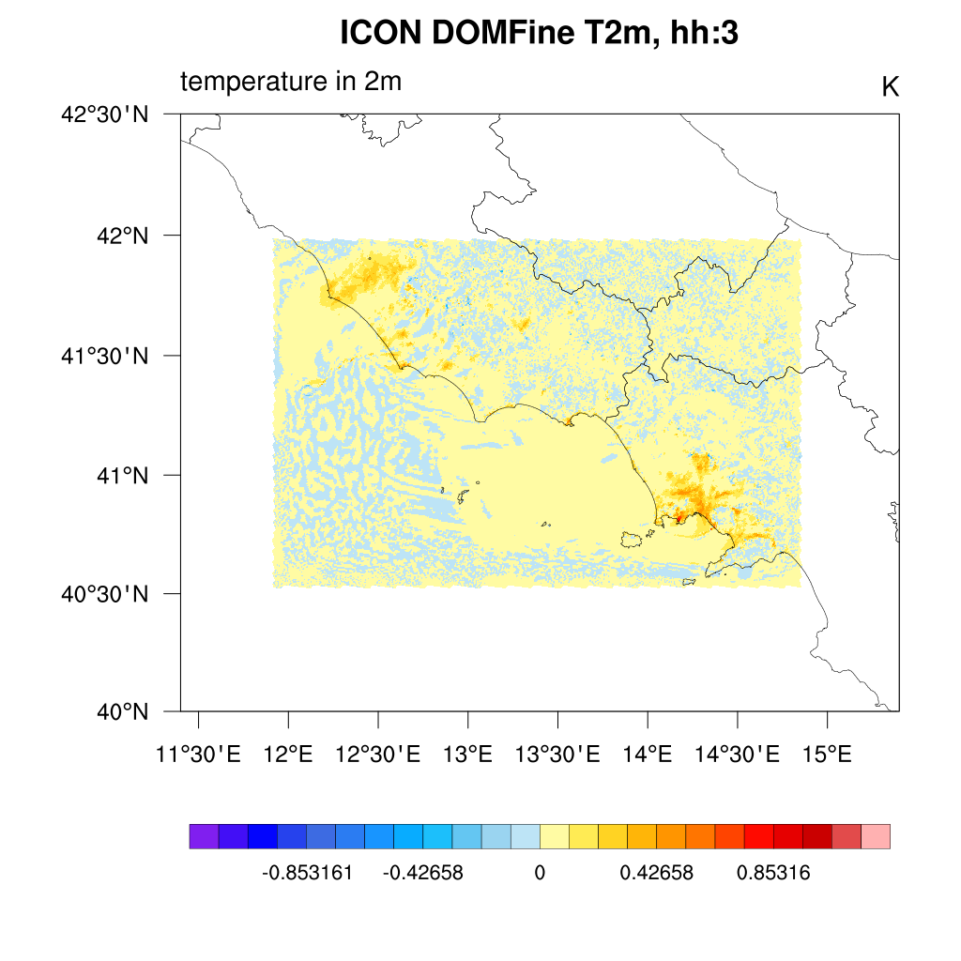
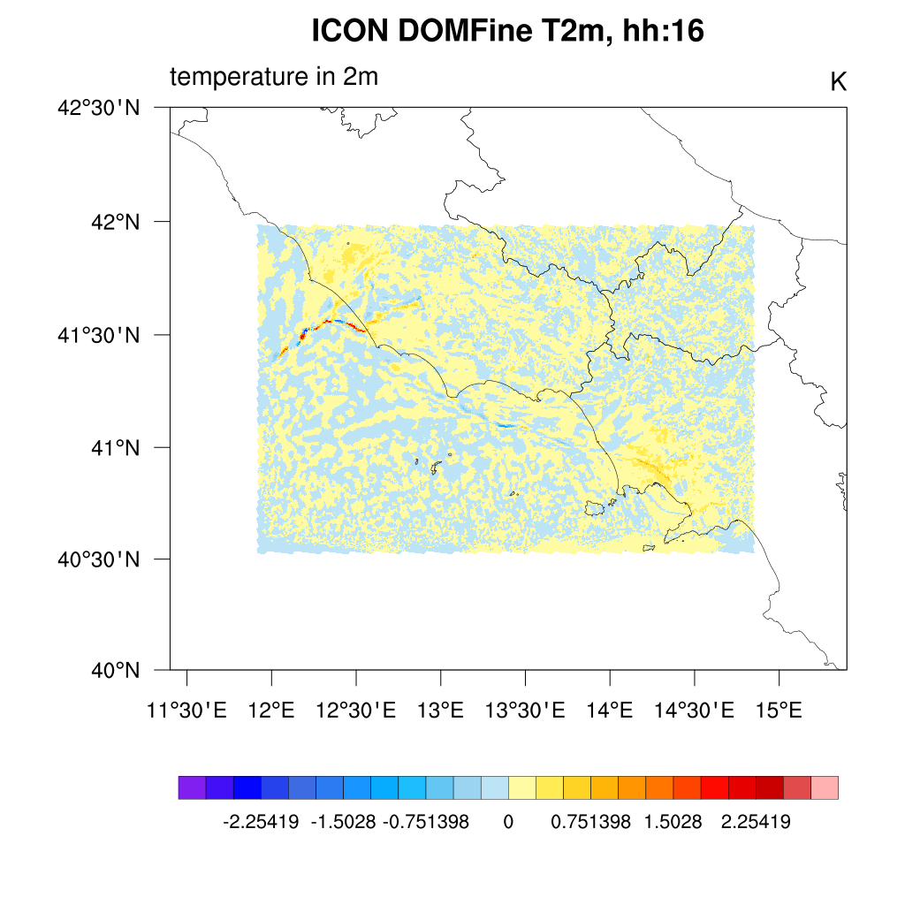
Results – 0,6 km res.
ΔT2m(True - False): local results
itype_kbmo = 2

Slide 13
Comments and way forward
Preliminary analisys with ICON –Terra_urb performed
Only 1-day considered
Numerical noise is evident on short run
A first test with grid resolution of 600mt
the new uploaded terra_urb release was checked
Next steps:
Longer simulations
Further statistics based on wider area rural/urban

