Slide 1
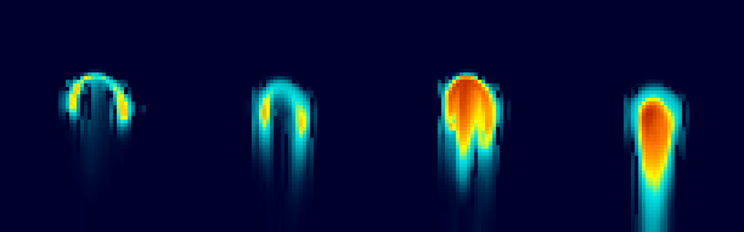
Warm-Phase Spectral-Bin Microphysics in ICON
Pavel Khain¹, Koby Shpund², Yoav Levi¹, Alexander Khain³
Thanks to: Axel Seifert⁴, Daniel Reinert⁴, Daniel Rieger⁴, Ulrich Blahak⁴
      Israeli Meteorological Service
      Pacific Northwest National Laboratory
      The Hebrew University of Jerusalem
      Deutscher Wetterdienst
GM, Athens, September 2022

Slide 2
Outlook
  Overview
  Warm-Phase SBM Implementation in ICON
  First tests of Cumulonimbus development (Weisman-Klemp 1982)
  Real case example

Slide 3

Two methods of representing cloud microphysics
Bulk-microphysics Parameterization Spectral (Bin) Microphysics (SBM)
Description of size distributions | Gamma distributions with several given parameters | Examples of real size distributions (droplets)
Basic equations | For moments: K=0 number concentration; k=1 mixing ratios; k=2-radar reflectivity. 2M → 2 parameters are free and 2 are preset | For size distribution functions f(m)
PSDs along flight track
core
edge
Diameter, µm

Slide 4
Two methods of representing cloud microphysics
Bulk-microphysics Parameterization Spectral (Bin) Microphysics (SBM)
Description of size distributions | Gamma distributions with several given parameters | Examples of real size distributions (droplets)
Basic equations | For moments: K=0 number concentration; k=1 mixing ratios; k=2-radar reflectivity. 2M → 2 parameters are free and 2 are preset | For size distribution functions f(m)
PSDs along flight track
core
edge
Diameter, µm

Slide 5
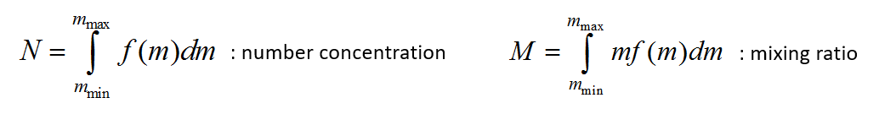
Mass grid in SBM
In ICON:
33 drops bins
33 ccn bins
33 activated ccn (for regeneration*)
(= 2 in ICON)
*Currently switched off
Equation for size distribution is solved for each bin:
mixed phase
Advection
(outside microphysics)
sedimentation
nucleation
cond/evap
Collisions+break up

Slide 6
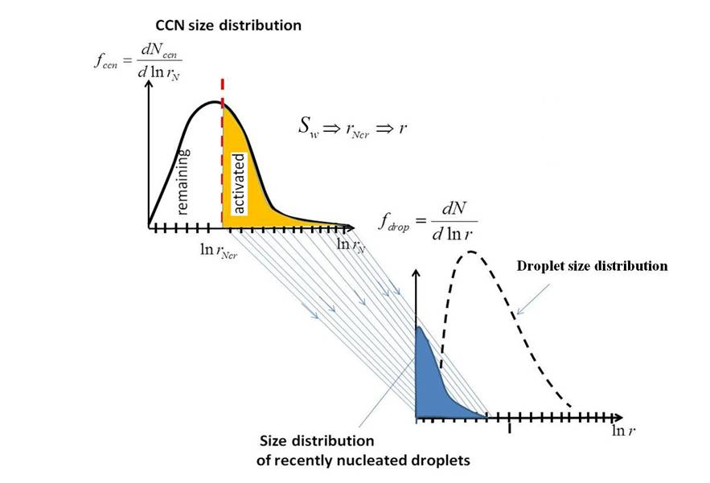
Description of physical processes: Nucleation (Kohler theory)
From S, critical ccn radius is calculated
Aerosols larger then Rcrit → droplets
Only increase in S (updraft) may lead to activation of smaller ccn (in-cloud nucleation) → multi modal PSD

Slide 7
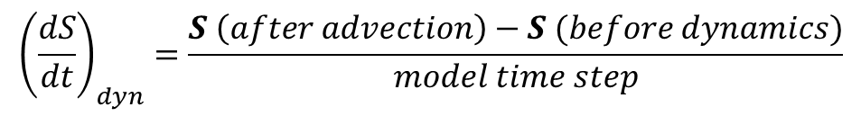
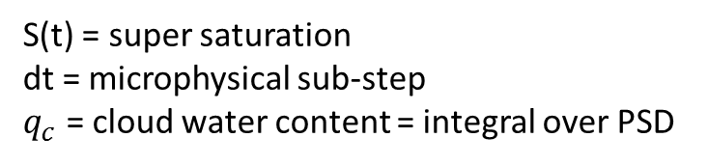
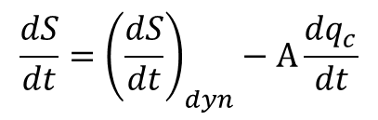
Description of physical processes: Cond/Evap
Solution of 2 equations:
Eqn for Supersaturation
S increases in updraft (source) and condensates (sink)
Eqn of diffusional growth for each bin r_{i}
(how the molecules condensate on droplet surface)
$$\frac{dS}{dt}={\left(\frac{dS}{dt}\right)}_{dyn}−A\frac{dq_{c}}{dt}$$
S(t) = super saturation
dt = microphysical sub-step
$q_{c}$ = cloud water content = integral over PSD
r(t) = super saturation → PSD(t)
$${\left(\frac{dS}{dt}\right)}_{dyn}=\frac{S \left(after advection\right)−S (before dynamics)}{model time step}$$
On input, the microphysics needs:
T and qv before dynamics
T and qv after advection

Slide 8
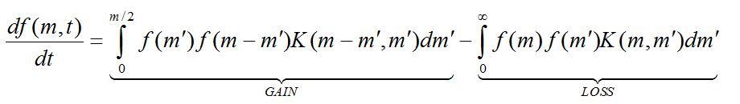
Description of physical processes: Collisions
Stochastic equation for collisions:
Change of:
Number of droplets of mass m
Collision Kernel =
probability of collision of 2 droplets.
Depends on rel. velocity, droplets sizes
Increase of f(m) due to collisions of masses: (m’) and (m-m’)
Such that:
(m’)+(m-m’)=m
Decrease of f(m) due to collision of (m) with some (m’)
* Works for entire range of drop sizes

Slide 9
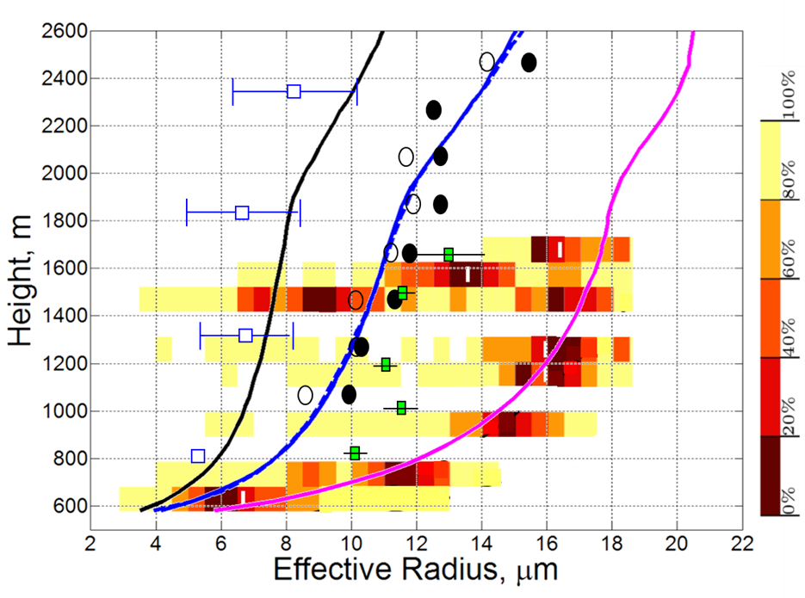
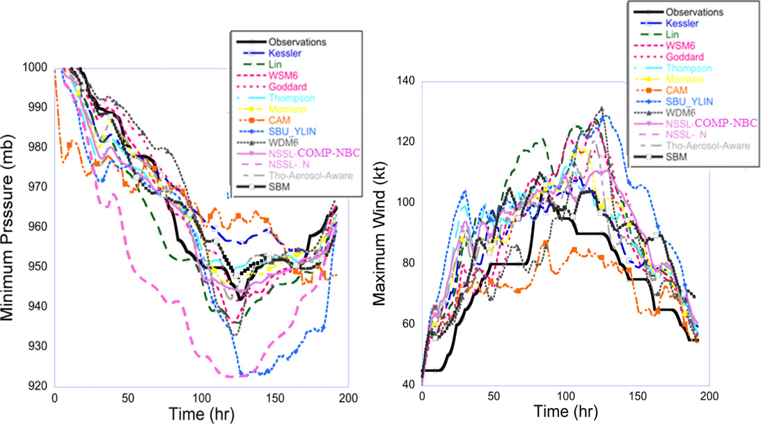
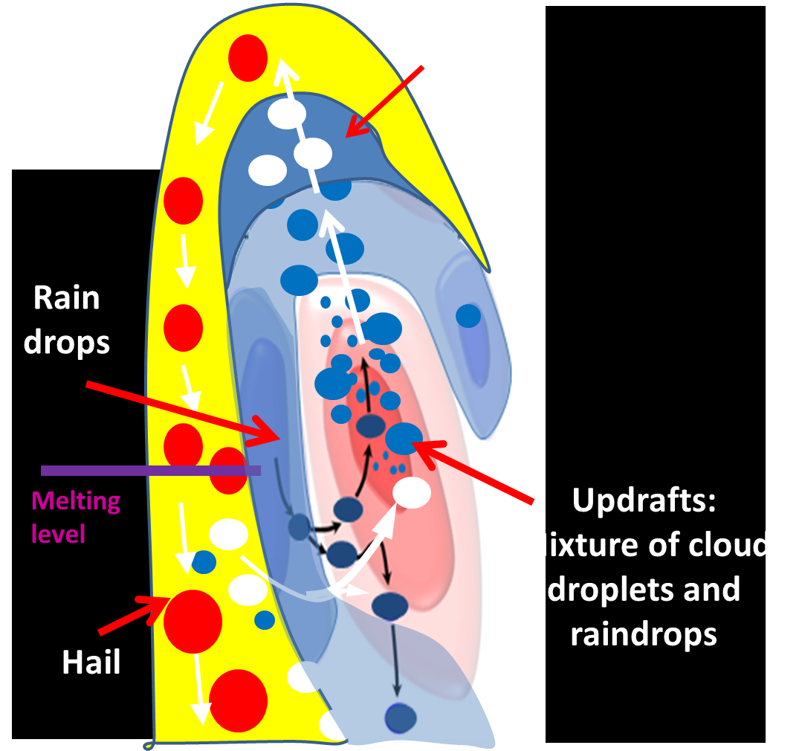

SBM is used for various cloud-related phenomena
Shallow clouds
(SAM-LES)
Hail storms:
Mesoscale convective systems with squall lines:
Khain P. et al. 2019
Comparison of mean effective radius profiles simulated using SAM with observations
Hurricanes:
Ilotoviz et al. 2019
Mechanism of large hail formation in deep convective clouds (HUCM)
Khain et al. 2016.
Simulation of hurricane Irene (2011) using WRF-SBM and different bulk schemes
SBM is also implemented in:
The Goddard Cumulus Ensemble (GCE) model
https://cloud.gsfc.nasa.gov/index.php?section=11
JMA-NHM (Japanese model) Iguchi, et al., 2012
HWRF (Hurricane-WRF):
https://www.emc.ncep.noaa.gov/gc_wmb/vxt/HWRF/index.php
Implementation in progress
Shpund et al. 2019
MC3E field campaign.
Simulation using WRF-SBM

Slide 10
Outlook
  Overview
  Warm-Phase SBM Implementation in ICON
  First tests of Cumulonimbus development (Weisman-Klemp 1982)
  Real case example

Slide 11
2. Warm-Phase SBM Implementation in ICON
subr. integrate_nh
(mo_nh_stepping.f90)
call perform_dyn_substepping
call diffusion (numerical)
call step_advection
call nwp_nh_interface
subr. nwp_nh_interface (mo_nh_interface_nwp.f90)
call calc_old_temp (calculate T before dynamics: T_{new}-dt*dT/dt)
save T,qv (after advection and before saturation adjustment)
call satad_v_3D (saturation adjustment, LH release, qc)
call nwp_surface (land/sea)
call nwp_turbdiff (turbulent diffusion – atmo. column)
call nwp_microphysics
call nwp_turbtrans (atmo-surf interface)
call nwp_convection (slow)
call cover_koe (cloud cover - slow)
call set_reff (calc reff for radiation - slow)
call nwp_radiation (slow)
call nwp_gwdrag (gravity waves drag - slow)
call nwp_upatmo_interface (upper-atmo physics - slow)
T,qv=?
High SupSat (S) after advection
new

Slide 12
2. Warm-Phase SBM Implementation in ICON
subr. nwp_microphysics
(mo_nwp_gscp_interface.f90)
subr. graupel
(gscp_graupel.f90)
subr. two_moment_mcrph
(mo_2mom_mcrph_driver.f90)
subr. sbm
(mo_sbm_driver.f90)
PSD_{drops}, PSD_{ccn}
T,qv(b.ad), T,qv(a.ad)
subr. clouds_twomoment
(mo_2mom_mcrph_main.f90)
call ccn_activation_hdcp2
call ccn_activation_sk_4d
call autoconversionKB
call accretionKB
call rain_selfcollectionSB
call autoconversionKK
call accretionKK
call rain_selfcollectionSB
call autoconversionSB
call accretionSB
call rain_selfcollectionSB
call rain_evaporation
subr. sedimentation_explicit
(mo_2mom_mcrph_main.f90)
subr. warm_sbm
(mo_sbm_main_NEW.f90)
call jernucl01_ks (nucleation) → water_nucleation
call onecond1 (diffusional growth)
call coal_bott_new_warm (collisions, break up)
call falfluxhucm_z (sedimentation)
subr. onecond1
call jerrate_ks (calc coefs for the diffusional growth eqn)
call jertimesc_ks (calc coefs for the supersaturation eqn)
call jersupsat_ks (calc integral S(t)*dt)
call jerdfun_ks → jernewf_ks (recalc drops size)
call jerdfun_new_ks → jernewf_ks (get new PSD - remapping)
subr. coal_bott_new_warm
call kernals_ks (collision efficiency X swept volume)
call coll_xxx_bott (stochastic collision eqn)
call coll_breakup_ks (collisional breakup)
1 moment
…
mixed phase switched off
…
subr. satad_v_3D
(mo_satad.f90)
subr. satad_v_3D
(mo_satad.f90)
subr. satad_v_3D
(mo_satad.f90)
PSD_{drops}, PSD_{ccn}
T,qv,qc,qr,qnc,qnr

Slide 13
Outlook
  Overview
  Warm-Phase SBM Implementation in ICON
  First tests of Cumulonimbus development (Weisman-Klemp 1982)
  Real case example

Slide 14
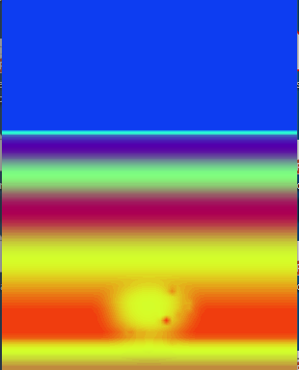
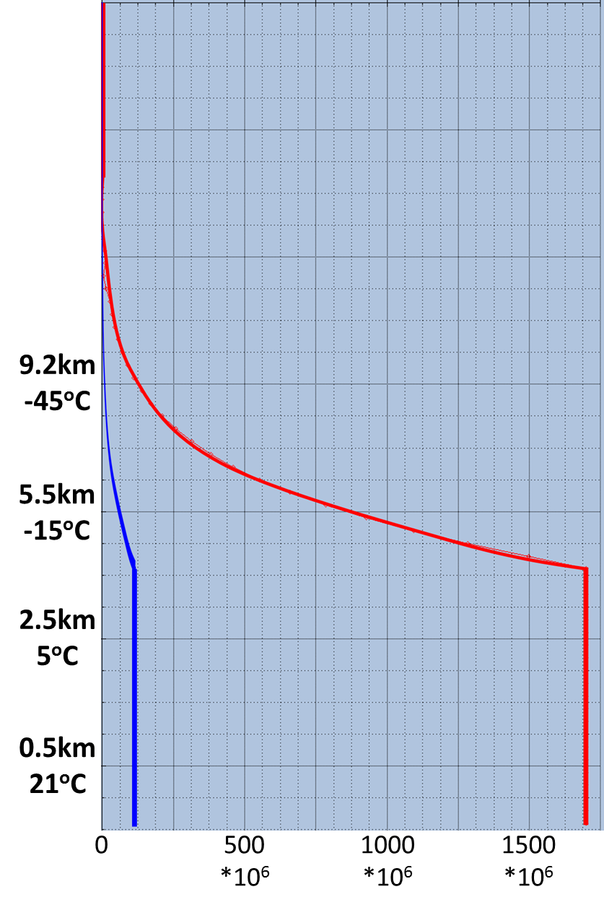
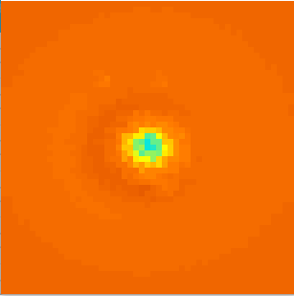
ICON run setup:
dt=1sec
dx=1.2km
3. First tests of Cumulonimbus development (Weisman-Klemp 1982)
Important: effect of aerosols on clouds and precipitation
(weather and climate)
View from above
Cross section
CAPE (J/kg) after several minutes
CCN (z)
Height
Height
50km
continental
dT=2K
Resolution: 1.2 km
Z=2100m
maritime
50km
Z=700m
qv=14g/kg
50km
CAPE (J/kg)
NC_{a} (1/kg)
Initial Relative Humidity (%)

Slide 15
This work: Warm phase only
Warm phase allows supercooling. Rain may exist at T=-20C, small droplets at T=-37C.
Warm phase plays the dominating role in cloud dynamics and microphysics
Latent heat of condensation is 3 time higher than latent heat of freezing. Freezing is not essential for updraft estimation
The fall velocity of graupel is similar to that of rain → time of rain initiation at surface does not change much
The formation of ice particles is defined mostly by drops distribution. First, we have to make sure it works correctly.
cp/cv bug corrected also in the microphysics scheme. Thanks to Axel!

Slide 16
cp/cv bug corrected also in SBM implementation
September 2021: Significant inconsistency between the cloud development in 2M (W up to 45 m/s) and SBM (W up to 13 m/s).
There was a "cp/cv bug" within the SBM implementation in ICON. We have to use L/cv and not L/cp in the latent heat release during condensation. ICON uses internal energy, not enthalpy, for the temperature equation. Therefore all heating rates that transfer energy to the resolved dynamics have to be calculated with cv and the volume expansion is done by the dynamical core.
After this correction, the latent heat release is going only to the temperature increase and is not "lost" to the volume expansion. In other words the effective latent heat release is larger.
So now the cumulonimbus evolution in SBM is similar to that in the 2M scheme, and W reaches 35-40 m/s.

Slide 17
Maximum W comparison
Strong sensitivity of SBM to CCN. Cloud invigoration in polluted case because of longer time available for LH release (before collisions start). No sensitivity of 2M

Slide 18
Maximum W comparison
Why W(2M-H) > W(SBM-H) ? Why W(2M-L) >> W(SBM-L) ?

Slide 19
Why W(2M-H) > W(SBM-H) ?
Probably:
Lack of the CCN budget in 2M → droplet concentration in 2M remains high at the upper levels for much longer time than in SBM → latent heat release in 2M at the upper levels is larger than in SBM
Fig. 3. The vertical velocity fields in all simulations in x-z cross-sections through the cloud cores at t = 23 min. (a-d), 27 min. (e-h), 46 min. (i-l) and 57 min. (m-p).

Slide 20
Vertical profiles of maximum droplet concentration

Slide 21
Why W(2M-L) >> W(SBM-L) ?
Probably:
Lack of the CCN budget in 2M → droplet concentration in SBM-L remains lower than in 2M-L → higher S in SBM-L → faster drop growth → earlier collisions → rain loading at low levels reduces W
Justification: removing collisions in SBM-L yields: 27.1 → 37.5 m/s !
Fig. 3. The vertical velocity fields in all simulations in x-z cross-sections through the cloud cores at t = 23 min. (a-d), 27 min. (e-h), 46 min. (i-l) and 57 min. (m-p).

Slide 22
Why W(2M-L) >> W(SBM-L) ?
May be also:
Saturation adjustment in 2M → higher latent heat release than in SBM → higher W in 2M
Seems that: less important
Fig. 3. The vertical velocity fields in all simulations in x-z cross-sections through the cloud cores at t = 23 min. (a-d), 27 min. (e-h), 46 min. (i-l) and 57 min. (m-p).

Slide 23
Supersaturation at the cloud core during one time-step
Fig. 13. An example of the change in the supersaturation at the cloud core during one time-step in simulation SBM-H (a), SBM-L(b) and in an auxiliary simulation SBM-L_a (c), after 19 min of cloud evolution. The red curve is the supersaturation before the microphysical time step, and the blue curve is the supersaturation after the microphysics step of the condensational growth.

Slide 24
Why W(2M-L) >> W(SBM-L) ?
May be also:
Saturation adjustment in 2M → higher latent heat release than in SBM → higher W in 2M
Seems that: less important
Justification: Adding saturation adjustment in SBM-L yields: 27.1 → 30.3 m/s (too little)
Fig. 3. The vertical velocity fields in all simulations in x-z cross-sections through the cloud cores at t = 23 min. (a-d), 27 min. (e-h), 46 min. (i-l) and 57 min. (m-p).

Slide 25
Why W(2M-H) > W(SBM-H)
but
W(2M-L) >> W(SBM-L) ?
We showed:
Lack of the CCN budget in 2M → droplet concentration in SBM-L remains lower than in 2M-L → higher S in SBM-L → faster drop growth → earlier collisions → rain loading at low levels reduces W.
This effect is amplified because in SBM-L rain falls through the cloud core!
Fig. 3. The vertical velocity fields in all simulations in x-z cross-sections through the cloud cores at t = 23 min. (a-d), 27 min. (e-h), 46 min. (i-l) and 57 min. (m-p).

Slide 26
in SBM-L rain falls through the cloud core!
Fig. 14. Fields of vertical velocity (upper row) and mass loading (bottom) in the cross-sections through the cloud core are shown at t = 30 min in different simulations.

Slide 27
Result: maximum W comparison
If we would add CCN budget to 2M, would it be similar to SBM? Almost.
Saturation adjustment still makes a difference in pristine case. Axel: adjust S to equilibrium
Probably: There is an underestimation of the collision rate in 2M

Slide 28
Droplet number concentration
Polluted > pristine
2M > SBM
no CCN budget in 2M
Probably low collision rate in 2M

Slide 29
Droplet LWC
polluted > pristine
(cloud invigoration because of longer LH release)
2M > SBM
no CCN budget in 2M → higher NC at high levels
Saturation adjustment in 2M
Probably low collision rate in 2M
Fig. 6. Cloud-water mixing ratio in vertical cross-sections through the cloud core in different experiments at 23 min. (a-d), 27 min. (e-h), 46 min. (i-l), and 57 min. (m-p).

Slide 30
Drop RWC
polluted < pristine
2M < SBM
no CCN budget in 2M → higher NC at high levels
Saturation adjustment in 2M delays rain
Probably low collision rate in 2M

Slide 31
Rain initiation
Fig. 8. Vertical profiles of cloud (red) and rain (blue) mixing ratios in the cloud core at the developing stage of cloud evolution (23 min). The profiles of mass loadings (qc + qr) in 2M-L and SBM-L are plotted in panels a) and b), respectively (dashed green lines).

Slide 32
Rain initiation, works good in 2M as well
Fig. 10. Vertical profiles of qr (black curves) and Rv (red curves) in the cloud cores of developing clouds in all experiments. The time of rain beginning is chosen when qr exceeded 10􀀀 6 kg/kg.

Slide 33
Fig. 12. Spatial distribution of accumulated rain in different experiments 2M-H, SBM-H, 2M-L and 2M-H at 60 min (upper row) and 120 min (bottom row).

Slide 34
Outlook
  Overview
  Warm-Phase SBM Implementation in ICON
  First tests of Cumulonimbus development (Weisman-Klemp 1982)
  Real case example

Slide 35
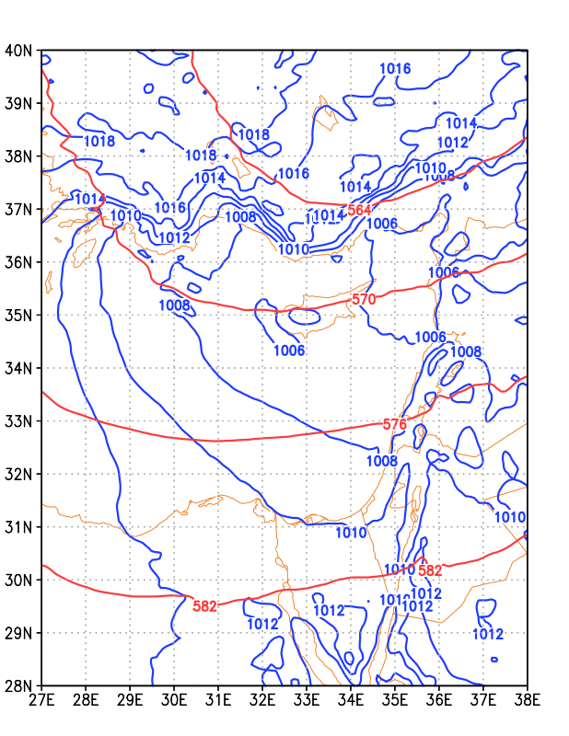
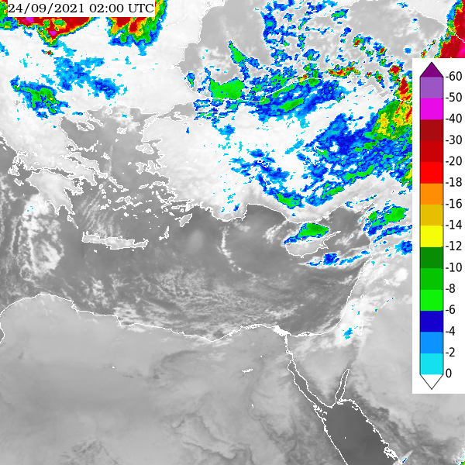
Real “warm” case: 23-24/9/2021
Fri 24 Sep 00Z

Slide 36
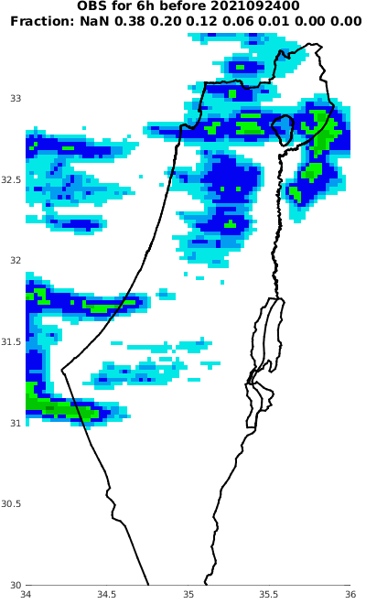
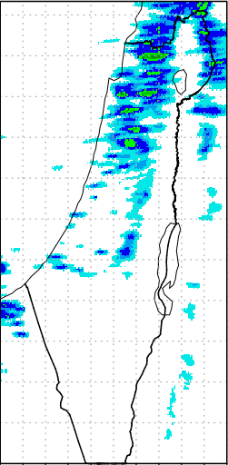
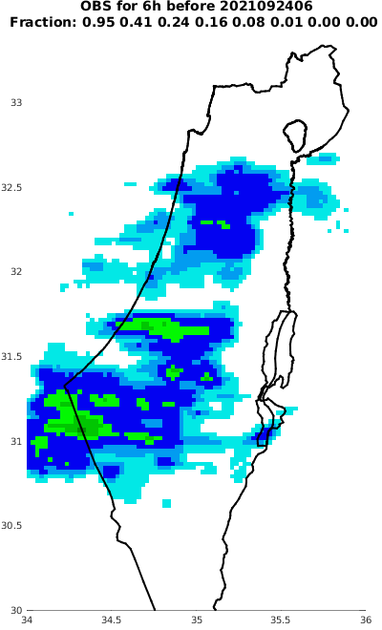
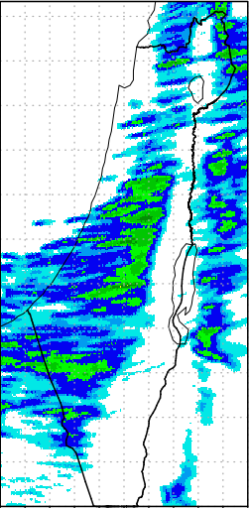
Real “warm” case: 23-24/9/2021
23/9:18Z - 24/9:00Z
24/9:00Z - 24/9:06Z
Radar
ICON-SBM
Radar
ICON-SBM

Slide 37
Conclusions
Warm-Phase Spectral-Bin Microphysics is implemented in ICON. Runs 6.8 times slower than 1M
WK82 test case was performed using different CCN concentrations. 2M and SBM schemes were compared.
CCN significantly affect cloud microphysics and dynamics. SBM is more sensitive than 2M.
In Maritime clouds the rain forms earlier but the integral accumulated values are lower.
Convective invigoration is seen already at warm phase.
Plan as part of the CAIIR project: Mixed phase SBM → ICON
Recommended for 2M: use CCN budget + adjust the saturation adjustment to equilibrium
Thanks!

