Slide 1
Plans at DWD for satellite data assimilation
Christina Köpken-Watts, FE12, DWD
Robin Faulwetter, Olaf Stiller, Silke Mai, Mahdiyeh Mousavi,
Michael Bender, Anne Rojahn, Nora Schenk, Alexander Cress,
Annika Schomburg, Lilo Bach, Thomas Deppisch,
Leonhard Scheck (HErZ), Florian Bauer (HErZ),
Christoph Schraff, Roland Potthast, Christina Köpken-Watts

Slide 2
Outline
Satellite data usage in Global ICON / EnVar
Main ongoing and planned developments for ICON
MW sounders
IR hyperspectral sounders
Aspects related to EnVar & KENDA developments
Developments for Satellite Data in KENDA
SEVIRI all-sky radiances
Winds (high-resolution AMVs)
Preparation for future instruments: MTG and EPS-SG
COSMO GM (General Meeting), 12-15 Sep. 2022, Athens
Christina.Koepken-Watts@dwd.de , Christoph.Schraff@dwd.de

Slide 3
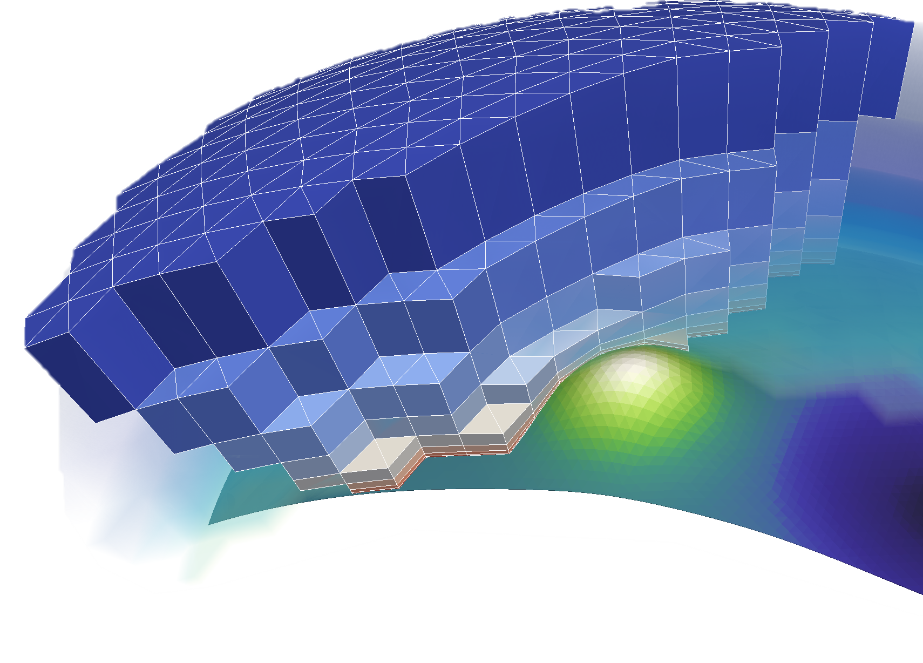
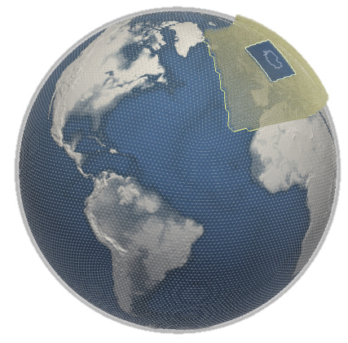
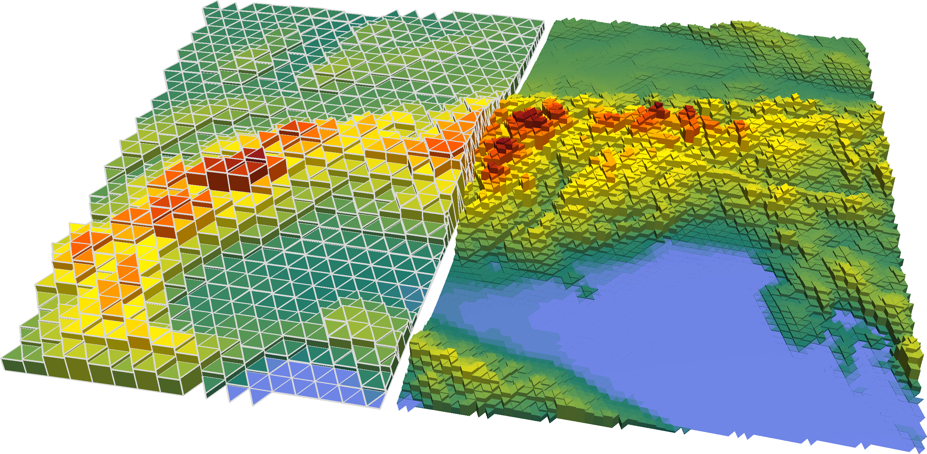
Satellite data for NWP
Satellite instruments
provide a wealth of data
Earth surface:
Surface temperature (ocean, land)
Ice cover
Snow cover
Vegetation
Soil moisture
Waves
…
Atmosphere:
3-dim. temperature, humidity, wind information
Clouds
Aerosoles, trace gases
...

Slide 4
Satellite data for NWP
Satellite instruments
provide a wealth of data
Earth surface:
Surface temperature (ocean, land)
Ice cover
Snow cover
Vegetation
Soil moisture
Waves
…
Atmosphere:
3-dim. temperature, humidity, wind information
Clouds
Aerosoles, trace gases
...
Surface information used through:
External products within SST, ice, snow analyses
Fixed parameter fields
Operationally used
Advanced developments
Assimilation developments started

Slide 5
Satellite data usage in global ICON
Instrument type | Key Parameters | Typical resolution (@SSP)
MW - sounders | T, q - profile | ~45 km; ~16km (frequency dependent)
IR hyperspectral sounders | T, q – profile, Ts | ~12 km
IR radiances geostationary (ASR product) | q – profile | ~50 km
MW - imagers | IWV, wind speed (ocean), Cloud water, precipitation | ~25-40km (frequency dependent)
AMVs (geostationary, polar orbiters) | Wind vectors at various heights | variable density
Aeolus Lidar | Line-of-sight wind profile | ~90 km
Altimeters | Wind speed (ocean) | nadir only, ~10-30 km (along track)
Scatterometers | Wind vector (ocean surface) (surface moisture) | 50 km, 25 km, 12.5 km
Radio occultations | T, q – profile (Strato-, upper troposphere) | ~ 8000/day globally

Slide 6
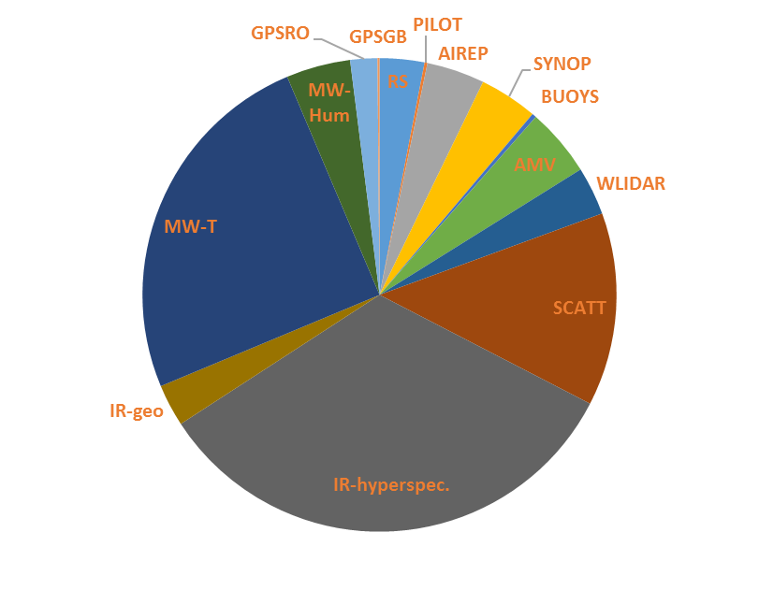
Satellite data usage in global ICON
Operational usage in ICON:
Operational monitoring: ~ 165 Mio. data items per day of which ~ 98 % satellite data
Used data: over 5 Mio. Daten per day, of which ~ 85 % satellite data
Satelite data from various providers
EUMETSAT, USA, China, and others
many new additional instruments over coming years
Conventional data:
„direct“ measurements
Satellite winds
Satellite data for:
temperature, humidity
Satelliten data usage and their importance
for NWP is continually increasing

Slide 7
Impact on forecast quality
Investigated using differant configurations of the operational assimilation
Here: Impact experiments of 2018
RMS difference relative to operational system Geopotential, 500 hPa
(forecast lead time: 12h bis 144h)
Südhemisphäre
Nordhemisphäre
Routine - configuration
No conventional data
No MW – satellite data
No RO – satellite data
No AMV – satellite data
No Wind – satellite data
Lack of satellite data lead to marked degradation of forecasts
Satellite data provide essential observations, esp. in data sparse areas (e.g. SH)
Conventional data (RS, aircraft, surface OBS, buoys) remain key backbone of the analysis, esp. on NH

Slide 8
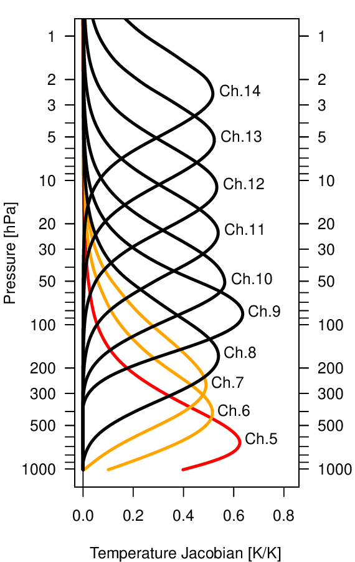
Developments – MW sounders & imagers
MW-sounders
Current work: Improve data usage over land
Use of emissivity retrieval over land surfaces (+ atlas values)
Addition of AMSU-A ch. 7+8, ATMS ch. 8+9 over land & ice
Ongoing experiments: adding ch 5+6, Needs better description of surface emission and background errors (e.g. emissivity used in RTTOV over snow+ice, Ts errors)
AMSU-A channels
MW – imagers
Technically implemented (first step: ocean only)
ICON evaluation & experiments pending (planned 2022/2023)
MW data may become more relevant for regional NWP:
advent of constellations of small satellites with more frequent overpasses, but still at limited horizontal resolution

Slide 9
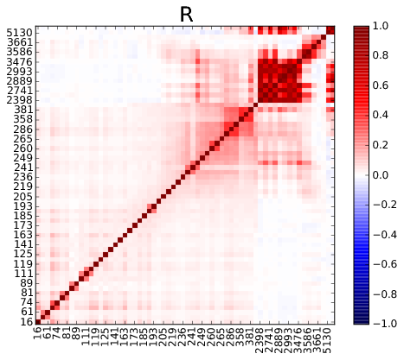
Developments – IR hyperspectral sounders
Status & recent work:
Usage: ocean, clear-sky, 62 channels (T and humidity)
Assimilation with non-diagonal OBS error covariances
Improved cloud screening (latest CADS version)
Use of O₃ from ECMWF forecasts in RTTOV forward calculations
Current work:
Improved radiative transfer:
Implementation of IR emissivity atlas over land surfaces
Preparation for using full vertical model resolution in radiative transfer (RTTOV); take advantage of ICON levels increasing from 90 to120
Experiments ongoing
Increase number of used channels, esp. in lower atmosphere
Overlap with preparation for MTG/IRS
for global ICON/EnVar
for high-res. ICON-D2/KENDA

Slide 10
Satellite usage improvements with links to EnVar, KENDA & model developments
Using full vertical resolution of ICON (and future 120 levels)
DACE generalization for use in RTTOV
Setup testing & optimization needed
All – sky assimilation
Generalization of DACE: allow clear-sky and all-sky data routes depending on instrument/channel for VIS, MW and IR
Extension of EnVar for assimilation of cloud information (work started, trial of ML components)
Implementation of RTTOV-SCATT for MW all-sky
Slant radiative transfer
Improvements for edge of scan data
Implementation ongoing
FGAT und 4D-EnVar
Improve OBS-FG, enable indirect wind information from radiances
MTG, EPS-SG and small-satellite constellations
KENDA: Vertical error correlations
for satellite sounders, radiometers
Technically implemented, tests coming
Horizontal error correlations
Needed esp. for high-resolution assimilation to increase data density
Model biases
Ongoing improvements in used online bias correction approaches

Slide 11
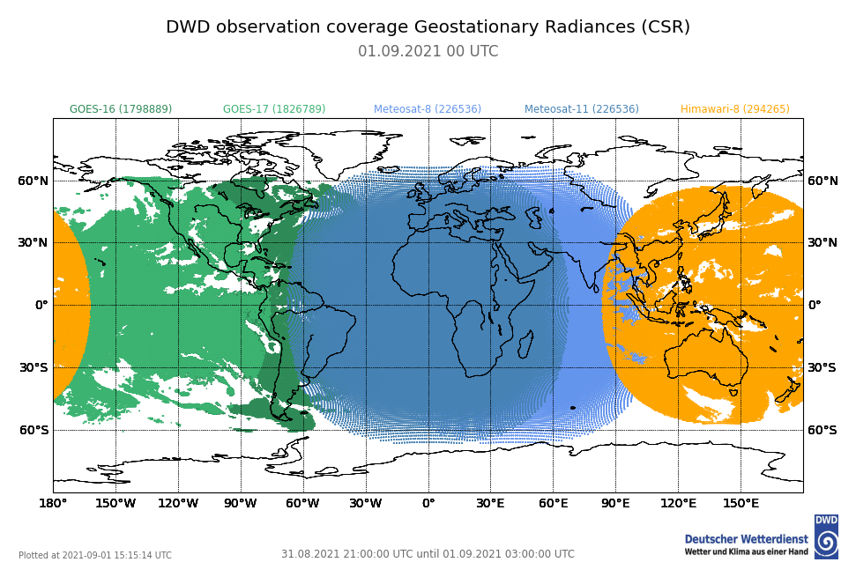
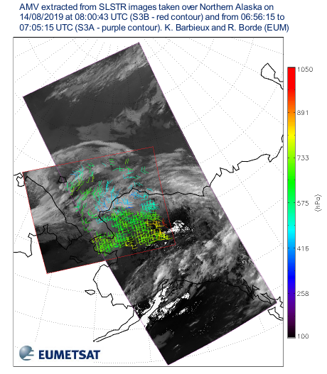
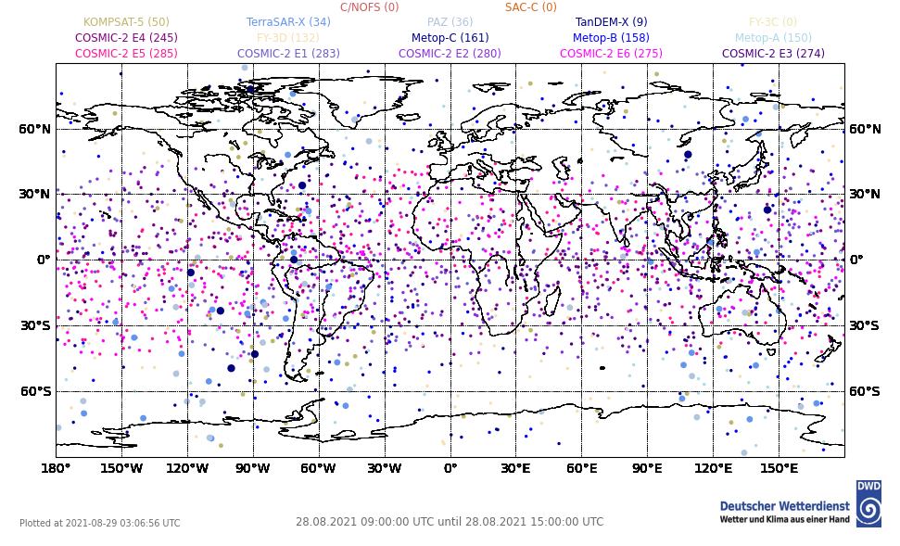
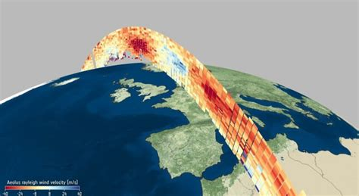
GEO radiances / RO / AMVs / Aeolus / SCAT
GEO water vapour clear-sky radiances (from ASR and CSR products)
GEO and LEO AMVs
AMVs from Sentinel-3A/B (demonstration product, EUMETSAT)
used AMVs 3h
Aeolus
wind lidar
RO coverage (9 – 15 UTC, 28 Aug 2021)

Slide 12
Satellite data for KENDA: radiances
SEVIRI VIS & WV all-sky assimilation
VIS and WV channel assimilation achieves positive impact (see plenary overview talk)
VIS operational implementation for SINFONY, ICON-D2 (Q4/2022 or Q1/2023)
Ongoing and planned work:
Experiments with VIS+WV, focus on thinning and error settings
Add 1.6 um channel (better discriminate ice and water clouds)
Bias correction and improved error tuning for clear-sky WV signal
Study on influence of inhomogeneities within satellite footprints
Aim: description of FOV dependent errors and biases (using ML)
EUMETSAT fellowship (starting end 2022)

Slide 13
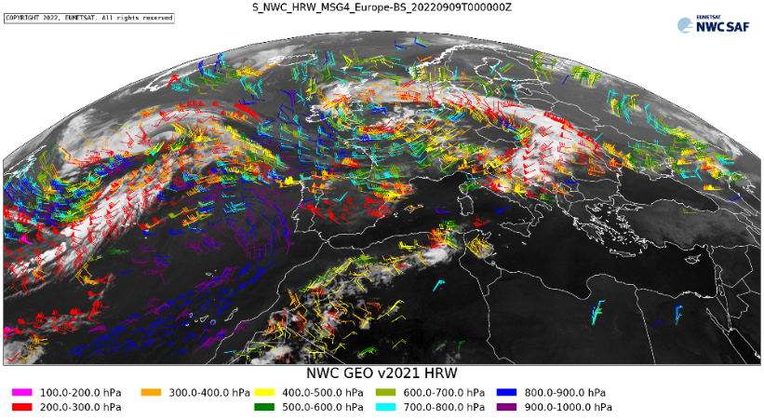
Satellite data for KENDA: winds
AMV: high-resolution winds
Study potential benefit of AMVs in ICON-D2 while assimilating also MODE-S winds
Preparation for future winds products:
FCI
IRS winds (optical flow method) ?
High-resolution AMVs derived using NWC SAF package (stored in DWD data base)
Experiments planned for late 2022/early 2023

Slide 14
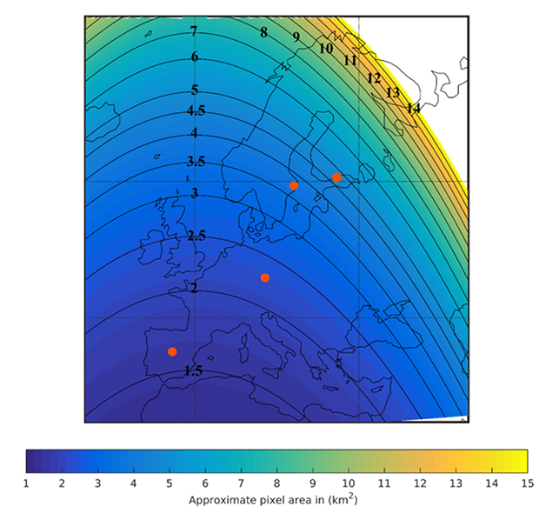
Future instruments: MTG/FCI
FCI
Launch: Nov 2022, CalVal during 2023
Benefit from ongoing MFASIS developments (fast NN-based VIS forward operator in RTTOV, implemented by LMU/DWD)
Preparation of pre-processing for FCI (new format)
Prepare switch of VIS/WV assimilation to FCI
Trial assimilation of additional channels (e.g. 0.9 µm)
Approximate pixel area in km²
^{for} the 1km resolution channels (VIS/NIR)

Slide 15
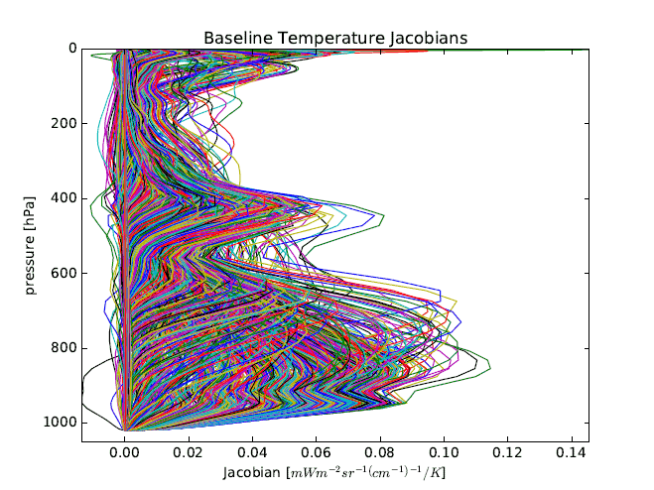
Future instruments: MTG/IRS
Initial focus: clear-sky data
Profile and stability information
Complement cloud information from FCI VIS & WV all-sky assimilation
Preparation steps (completed or well advanced, started)
IR emissivity atlas use
Cloud detection, channel selection
Use of ICON profile above ICON-D2 model top (for radiative transfer)
Implementation of non-diagonal OBS error matrix usage for KENDA
Monitoring tools (inherit & adapt from global DA)
Improved Ts estimates for radiative transfer (low peaking channels)
Thinning, super-obbing – strategy
Bias correction

Slide 16
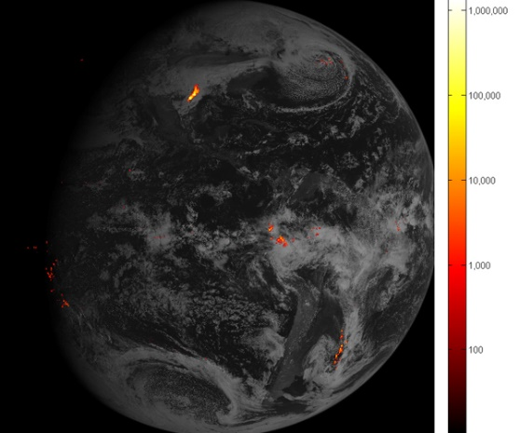
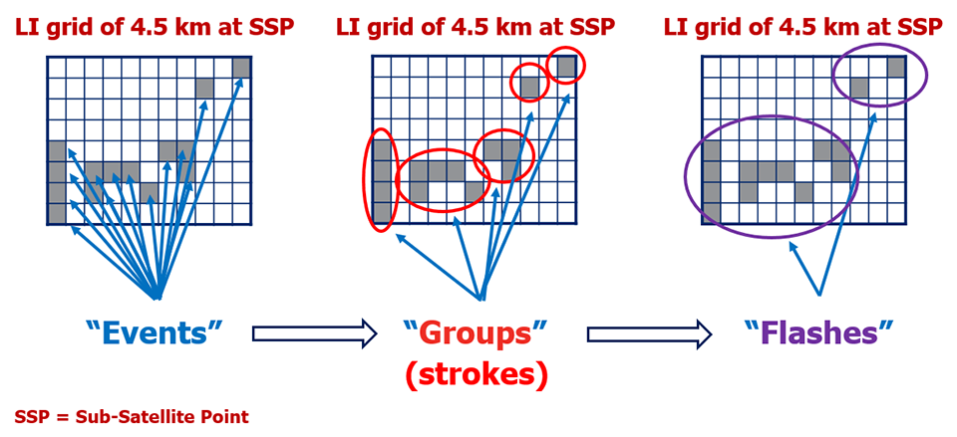
Future instruments: MTG/LI
MTG lightning imager (LI) data
Monitoring planned within global ICON (NWP-SAF)
Use of model derived LPI (lightning potential index, adapted to convection parameterization) and LFD (lightning flash density)
KENDA: Explore potential to complement ground-based LINET data?
GOES lightning imager
LI product categorization, EUMETSAT

Slide 17
Future instruments: EPS-SG & AWS/STERNA
EPS-SG instruments – mostly aimed at global NWP:
Imager MetImage
MW & IR sounders: MWS, IASI-NG
potentially to be complemented with small-satellite constellation AWS/STERNA for frequent q-profile information from MW sounding (cloudy situations)
Microwave and ice cloud imager: MWI, ICI
cloud water and cloud ice information
Scatterometer: SCA
Radio-occultation: RO
Use in ICON will build on current usage and ongoing developments

Slide 18
Summary
ICON: Satellites play key role for forecasts, developments ongoing in many areas
KENDA: Development of satellite data usage is picking up speed
Good results for all-sky assimilation of SEVIRI
VIS (0.6 µm) and WV (6.25 & 7.35 µm)
Operational implementation is close (SINFONY, ICON-D2)
Further scientific enhancements of approach planned
Preparation for FCI to start
Trials with NWC SAF AMVs to start soon
Preparation for MTG / IRS is advancing well
Experience and technical implementation of IASI in global ICON/EnVar is supporting implementation in KENDA
COSMO GM (General Meeting), 12-15 Sep. 2022, Athens
Christina.Koepken-Watts@dwd.de , Christoph.Schraff@dwd.de

