Slide 1
Developments on Radar DA at DWD
Kobra Khosravian, Lisa Neef, Klaus Vobig, Jana Mendrok, Uli Blahak, Klaus Stephan
&
Christoph Schraff, Lilo Bach, Alberto De Lozar

Slide 2
Current investigations at DWD
Investigation of observation error for reflectivity
First test with European data (BE, NL, CH, F, DK, PL, CZ, D)
News for LHN
LHN meetas 2Mom
Sensitivity tests
Ensemble pertubations
Assimilation of objects (back to the roots and try first reflectivity objects) by Lisa Neef
Further investigations and improvements of TCI by Klaus Vobig

Slide 3
Observation error of Radar Reflectivity
Kobra Khosravian

Slide 4
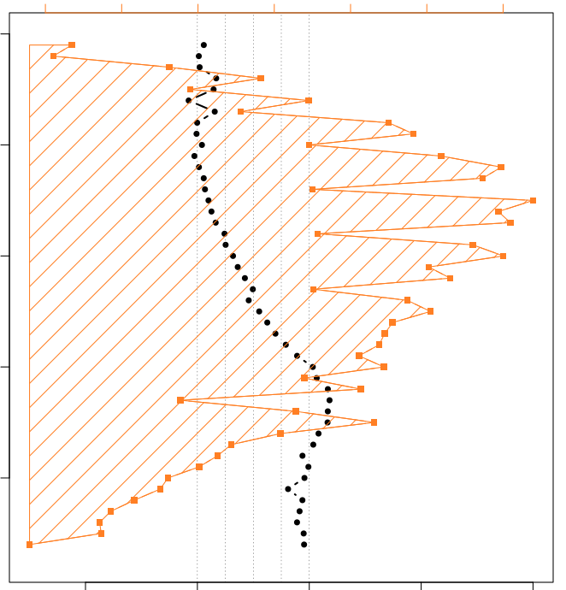
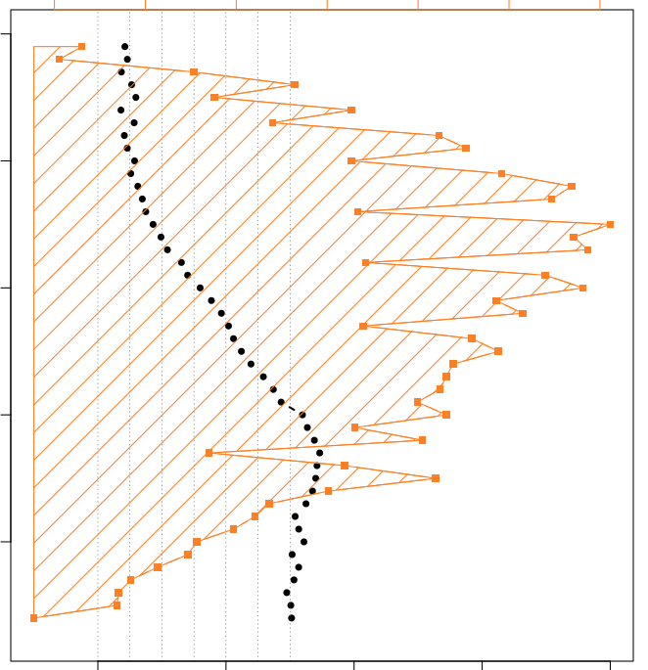
Modify the reflectivity error in LETKF
1st run
2nd run
Calculate the Desroziers statistic
error to define the refectivity error profile:
Number of observation
Number of observation
10000
20000
30000
10000
20000
30000
10000
Elv:3.5
Elv:3.5
8000
6000
Height with respect to radar station (m)
4000
2000
2
4
6
8
10
2
4
6
8
10
Run 3 experiments to verify different defined reflectivity errors in LETKF:
Elv:3.5
10 dbz
3 dbz
7-4 dbz
ICCARUS
08 March 2021
Kobra Khosravian
9

Slide 5
12h forecast verification of reflectivity and precipitation
over Germany - From 01 July until 14 July 2021
Sum scores over all initial times (3h interval)
Obs error= 10 dbz
Obs error= 3 dbz
Obs error= 7-4 dbz
reflectivity
precipitation
0.8
0.75
fss
0.6
0.50
0.4
box length: 15 pix ~ 31 km
box length: 15 pix ~ 31 km
0.25
0.2
thr: 0.1mm/h
thr: 15 dbz
0.6
0.6
fss
0.4
fss
0.4
0.2
box length: 15 pix ~ 31 km
0.2
box length: 15 pix ~ 31 km
thr: 37 dbz
thr:5mm/h
0
3
6
9
12
0
3
6
9
12
22nd EMS
5-9 Sep 2022
Kobra Khosravian
forecast lead time (h)
forecast lead time (h)
10

Slide 6
Verification against AIREP observation
Mean error
RMSE
Scale: -10 to 10%
Scale: -10 to 10%
Obs error 7-4dbz
temperature
Obs error 10dbz
wind direction
wind speed
22nd EMS
5-9 Sep 2022
Kobra Khosravian
11

Slide 7
Use of European Volume Data
Klaus Stephan, Uli Blahak

Slide 8
By adoption of EMVORADO it can process data of any European radar station in direct neighbourhood to Germany.
Together with German data is about 61 stations
Limitation of LETKF: only 64 different fof files can be processed so far
Technical tests were done in April/May 2022, running a set with 59 station passive and another set with 59 stations active, using DWD operational settings (limitation of elevations angles, height restrictions and same parameter for localisation, superobbing and so on…)

Slide 9
Country | Stations | Reflectivity | Radialwind
Germany | 17 | 1.5, 3.5, 5.5, 8, 12° | 0.5,1.5,3.5°
Switzerland | 5 | -0.2, 1.0, 1.6° | None (to low NI)
France | 20 | 0.7-2.2, 2.8-4.0, 5.0-8.9° | 0.4-2.2, 2.8-3.2°
Belgium | 2 | None | None | Technical issues
Netherlands | 2 | 0.3, 0.8, 1.2, 2.0, 2.8° | 0.3, 0.8, 1.2, 2.0, 2.8°
Denmark | 5 | 0.7, 1.0, 1.5, 4.8, 8.5, 10° | 0.5, 0.7, 1.0, 1.5° | 120 km range for wind optimized data
Poland | 8 | 1.4, 2.1, 3.4, 5.5, 7.7, 10.6° | None (no corresponging DBZH)
Czech Republic | 2 | 0.1, 0.9, 1.3, 1.7, 2.2, 3.2, 6.3° | None (to low NI)
8 | 61 | ~40 elevations | ~16 elevations

Slide 10
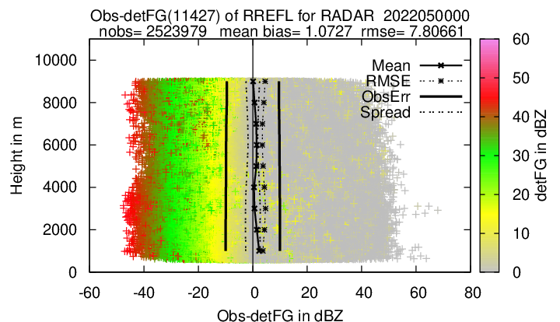
Monitoring results over 5 days in May 2022

Slide 11
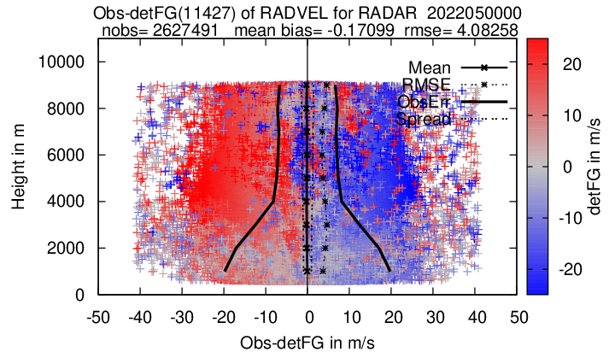
Monitoring results over 5 days in May 2022

Slide 12
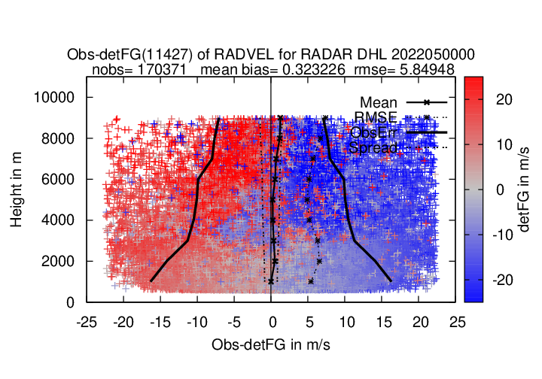
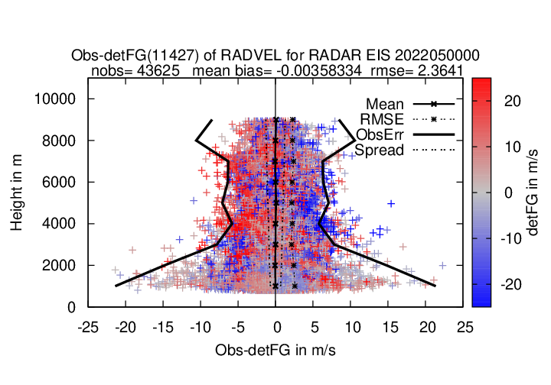
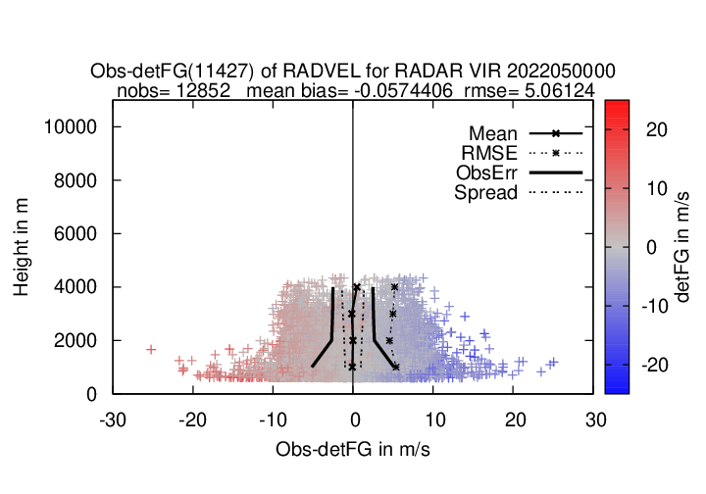
4 examples for radial wind, when used actively

Slide 13
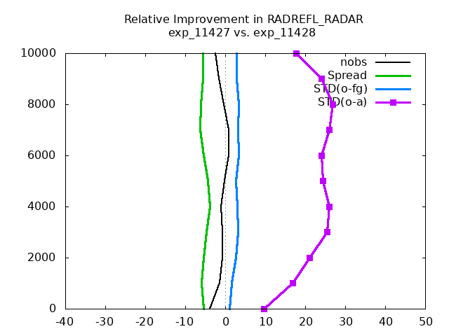
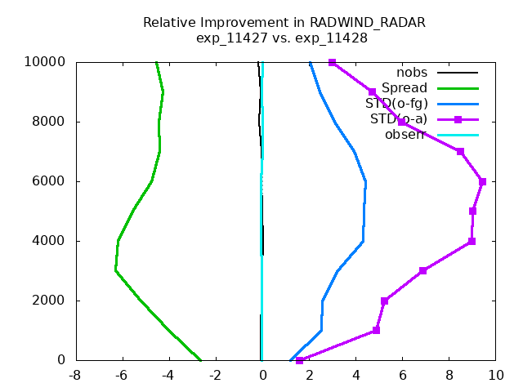
Result of OmB statistics over 8 days
Reflectivity
Radialwind
Good improvement in analysed Refl, minor in Radwind
But small effects still visible in first guess
And as usual, reduction in spread when introduction of more observations.

Slide 14
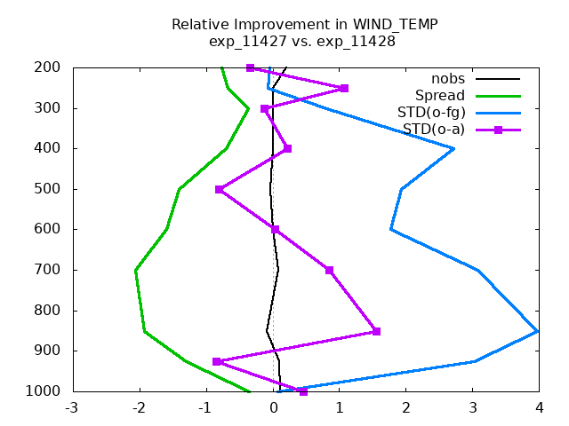
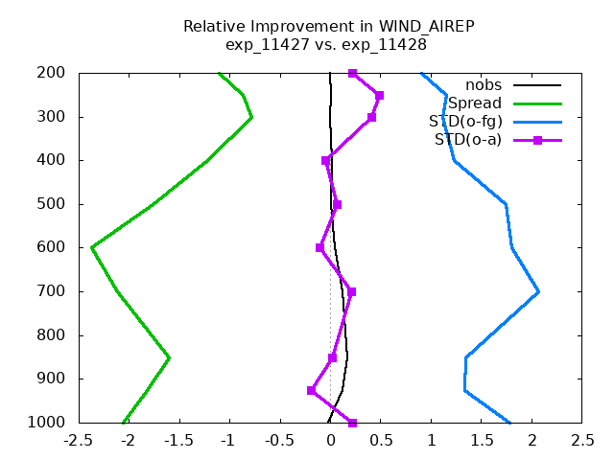
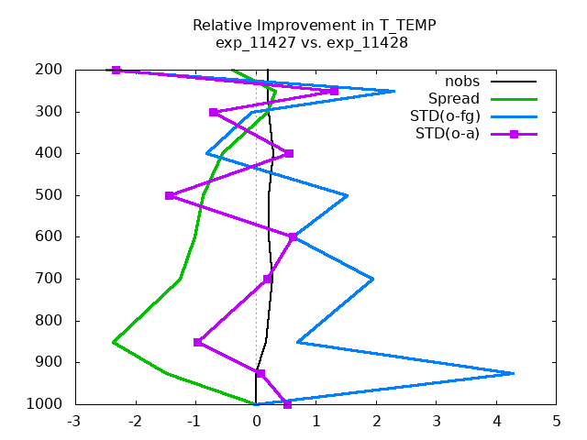
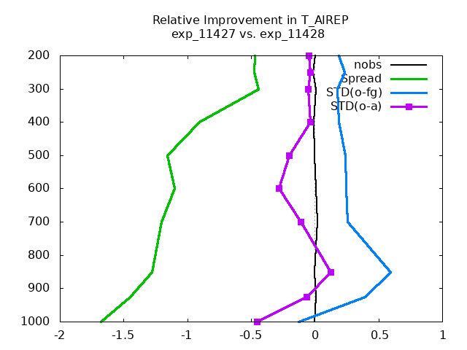
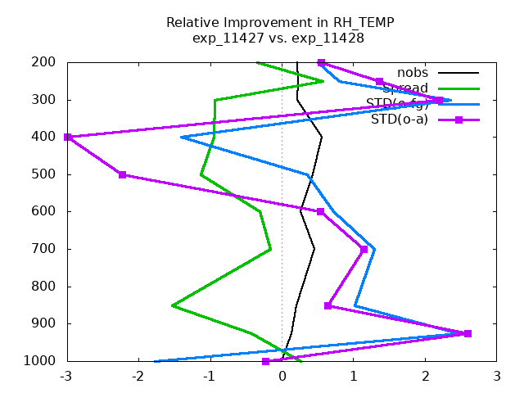
Result of OmB statistics over 8 days
Radiosondes
Aireps
Windprofiler
Wind
Temp
Good improvement in WIND
Less in TEMPERATURE
Unclear in HUMIDITY
Humidity

Slide 15
Summary
Technical test yields some minor issues:
Number of fof files to be processed by LETKF
Does we need an additional de-aliasing in LETKF, when already performed in EMVORADO?
Some crashes occur, due to this check, but not exactly clear why
Comp. time for LETKF is much increased
avoid writing to much information in fof files, which then is never used (ie. no information above 15 km height is needed)
How to define the observations rules. So far sat_zenith = elevation_angle is used. But this is very inhomogeneous in Europe. Restriction by height intervals?
First results look promising for the cycle. Only minor benefits in the forecast, esp. on precipitation.

Slide 16
2 Moment scheme meets LHN
Kobra Khosravian, Alberto De Lozar, Klaus Stephan, Uli Blahak

Slide 17
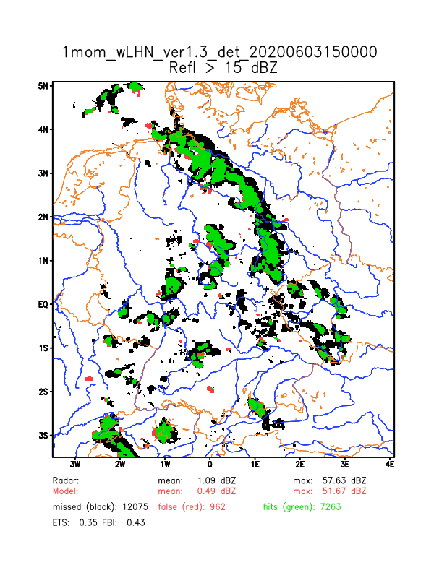
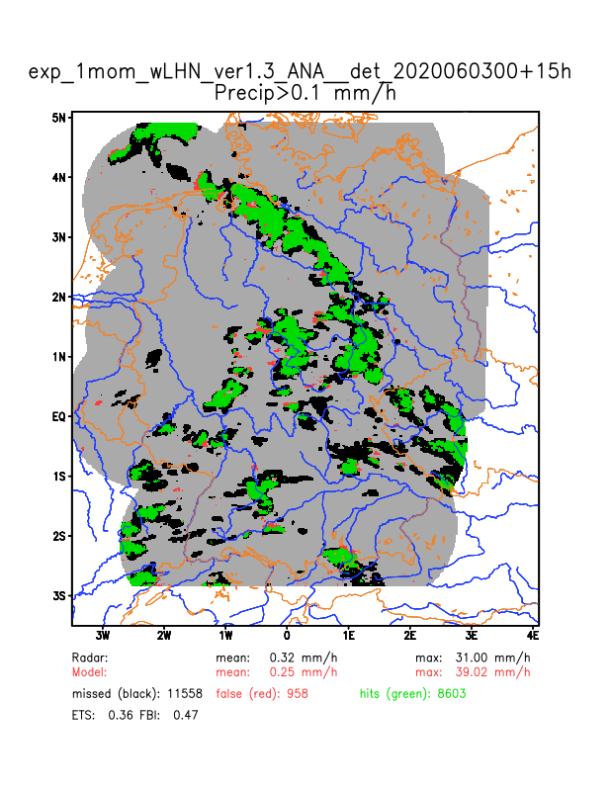
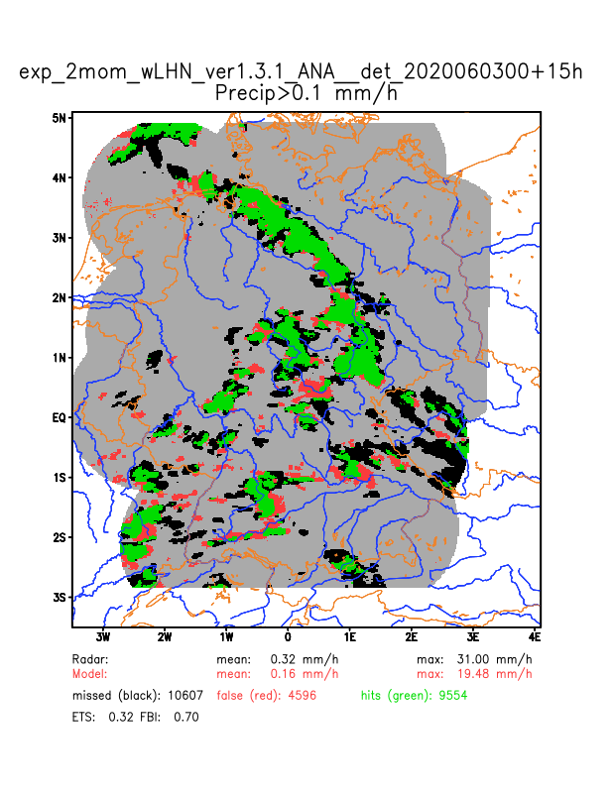
1 MOM FG
2 MOM FG
>15 dBZ
>0.1 mm/h

Slide 18
12h forecast verification of reflectivity and precipitation
over Germany - From 01 July until 14 July 2021
2mom
2mom+LHN
2mom+LHN+radar ass
Sum scores over all initial times (3h interval)
reflectivity
precipitation
0.8
0.75
0.6
fss
0.50
0.4
box length: 15 pix ~ 33 km
0.2
box length: 15 pix ~ 33 km
0.25
thr: 15 dbz
thr: 1mm/h
0.6
0.6
fss
0.4
0.4
0.2
box length: 15 pix ~ 33 km
0.2
box length: 15 pix ~ 33 km
thr: 37 dbz
thr:5mm/h
0
3
6
9
12
0
3
6
9
12
22nd EMS
5-9 Sep 2022
Kobra Khosravian
forecast lead time (h)
forecast lead time (h)
4

Slide 19
Verification against AIREP observation
Mean error
RMSE
Scale: -10 to 10%
Scale: -10 to 10%
2mom+LHN+radar ass
temperature
2mom+LHN
wind direction
wind speed
22nd EMS
5-9 Sep 2022
Kobra Khosravian
5

Slide 20
Sensitivity of LHN settings concerning new methodology
Klaus Stephan

Slide 21
Since January operational running
Only qv increments taken into account (rttend=0.0) with settings:
fac_lhn_down=0.7, fac_lhn_up=1.1, and …
 | lhn_coef | rttend | abs_lhn_lim | Impact
Routine | 2.0 | 0.0 | 0.0035
Test1 | 1.0 | 0.5 | 0.0017 | UA, RR, SY, EPS
Test2 | 1.0 | 0.75 | 0.0035 | UA, RR, SY, EPS
Test3 | 1.5 | 0.5 | 0.0035 | UA, RR, SY, EPS
Test4 | 3.0 | 0.1 | 0.0035 | UA, RR, SY, EPS
Test5 (noLHN) | 0.0 | - | - | UA, RR, SY, EPS
Test6 (noLHN+ no 3d Refl) | 0.0 | - | - | In progress

Slide 22
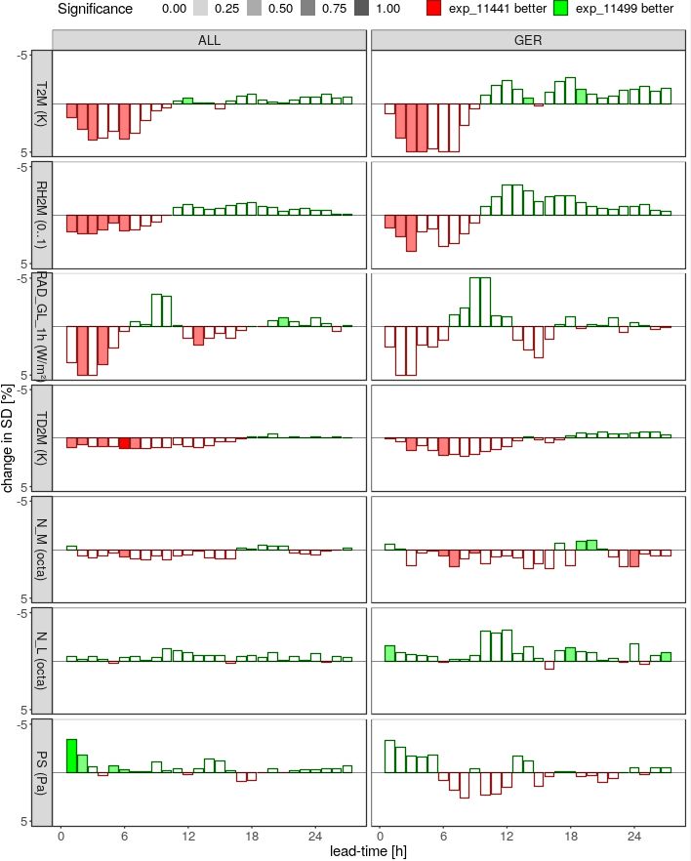
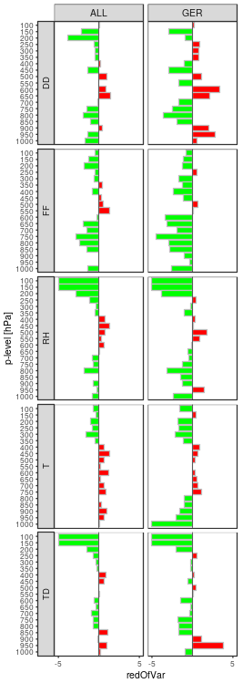
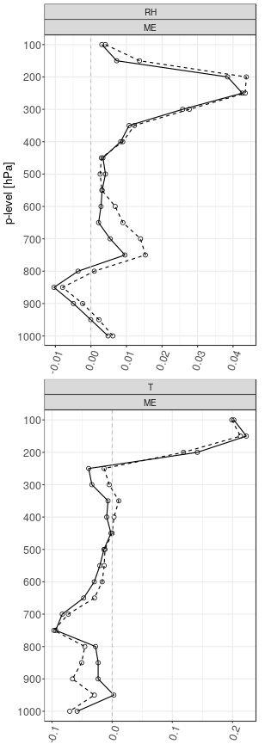
Routine against noLHN (10-30.05.2022)
SD Synop
SD TEMP
BIAS TEMP
T
DD
RH
FF
RAD
RH
TD
RH
NM
T
T
NL
PS
TD

Slide 23
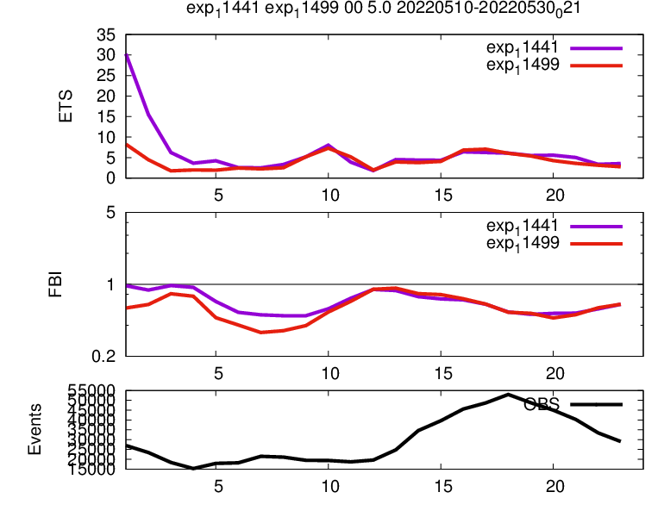
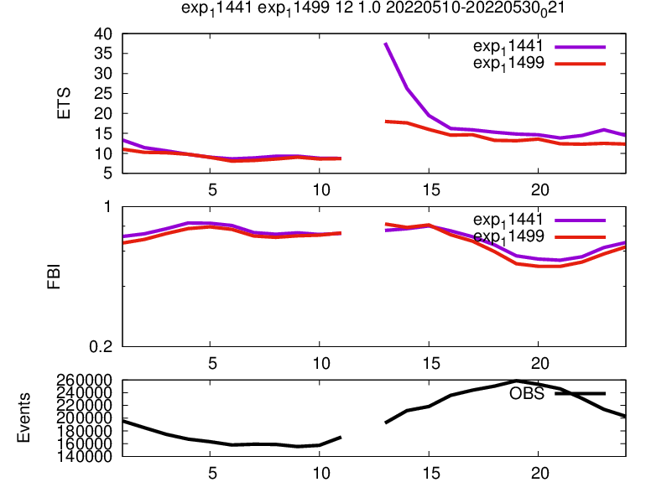
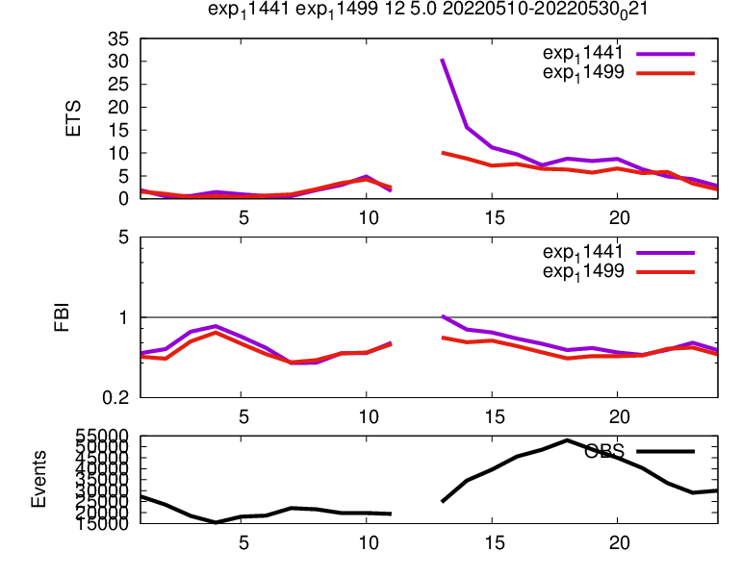
1.0 mm/h
5.0 mm/h
00 UTC
12 UTC

Slide 24
Applying LHN pertubation in FG cycle
Klaus Stephan

Slide 25
LHN decreases the spread in the system!
Can this mitigate by perturbing LHN parameters? Does it improve forecasts?
LHN perturbations are in addition to perturbations of physics parameter
Parameter | Range | Interval
lhn_coef | 0.2 | 1.8 - 2.2
fac_lhn_artif_tune | 0.5 | 0.5 - 1.5
fac_lhn_up | 0.4 | 1.0 - 1.5
fac_lhn_down | 0.2 | 0.5 - 0.9

Slide 26
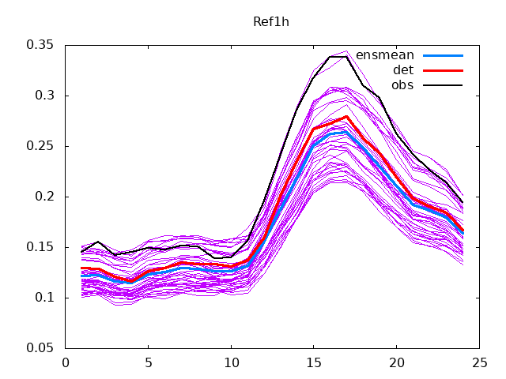
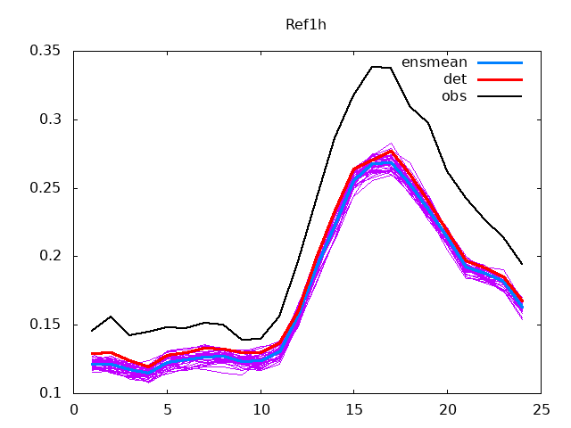
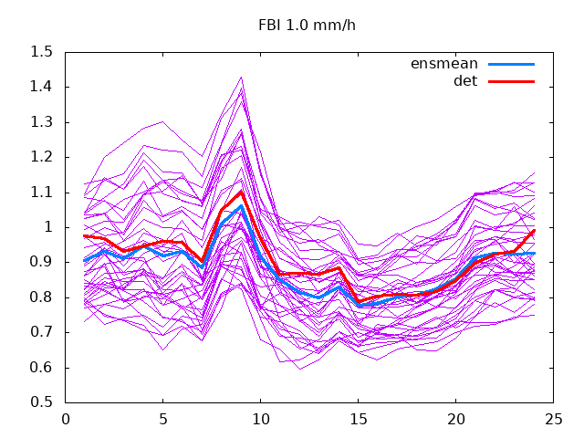
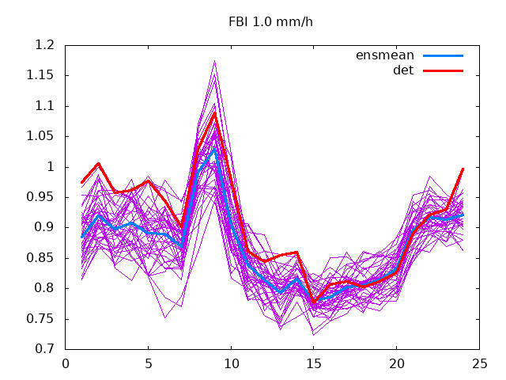
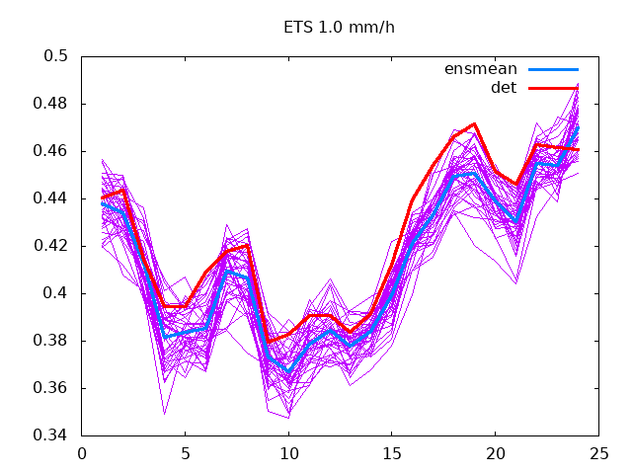
LHN Monitoring
during FG cycle
With perturbations
Without perturbations
RR1h
FBI 1 mm/h
ETS 1 mm/h
Spread is increased, neutral impact on DET

Slide 27
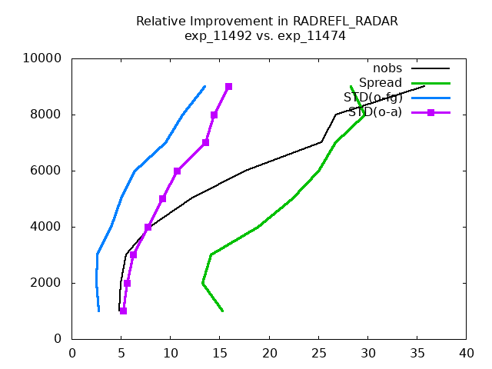
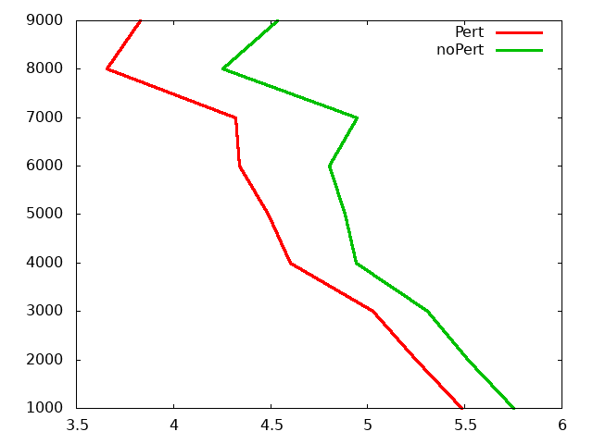
Impact on FG cycle
ObsErrStat RadRefl
Height
Percent of improvement
Estimated Observation Error in RadRefl

Slide 28
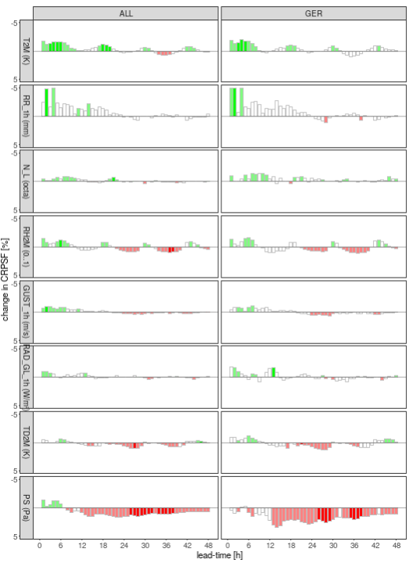
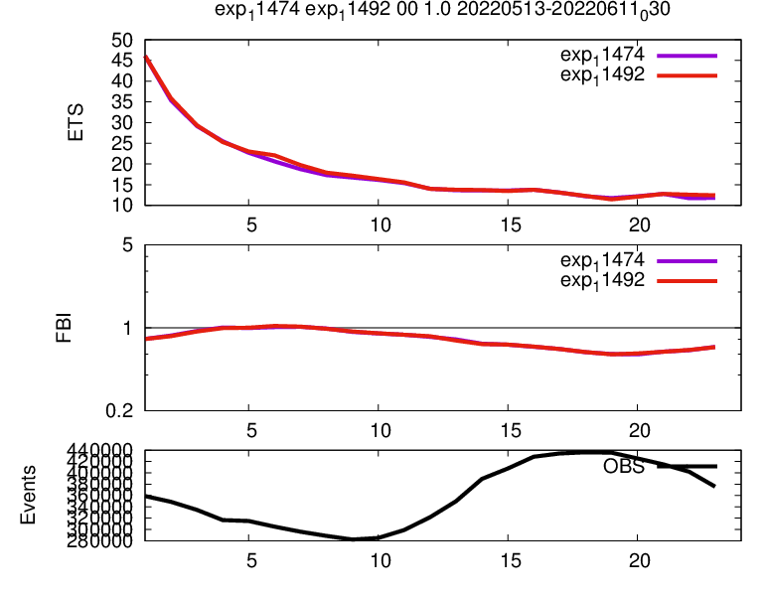
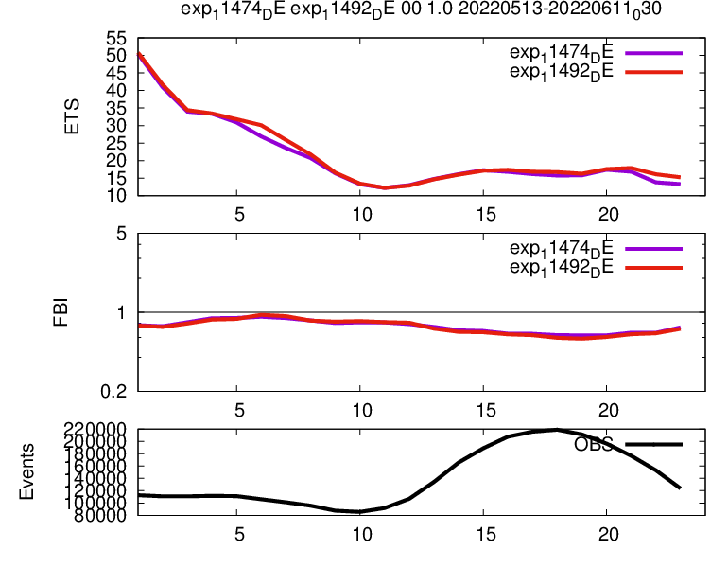
Impact on EPS forecasts
CRPS TEMP (first 12 hours)
CRPS Synop (-5..5%)
1.00 mm/h 00 UTC DET
ALL
T
RH
RR
NL
T
RH
U
GER
Gust
RAD
V
TD
PS
Only little impact on precipitation.
Small positive impact on EPS at least in the first hours of forecasts

