Slide 1
Assimilation of Raman Lidar observations in KENDA-1 using state-dependent observation errors.
Bas Crezee¹, Daniel Leuenberger¹, Giovanni Martucci², Alexander Haefele², Marco Arpagaus¹
(1) MeteoSwiss, Zurich-Airport, Switzerland
(2) MeteoSwiss, Payerne, Switzerland

Slide 2
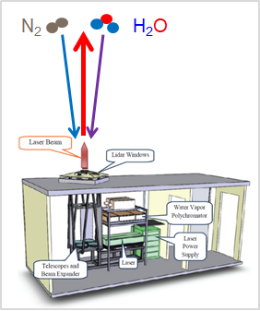
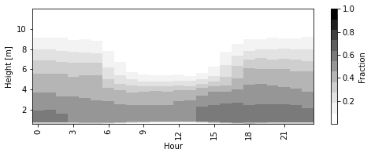
Raman Lidar (RALMO)
Vertical profiles of Temperature and WV Mixing Ratio at 30 min temporal resolution
Coverage of about 60% below 2000m (see below)
Diurnal data coverage as a fraction for RALMO (T)
Raman lidar for meteorological observations
(RALMO), one instrument in PAY

Slide 3
Recap KENDA meeting last march
Raman lidar assimilation leads to a reduction of dry bias in model and improved forecasts for (heavy) precipitation over a summertime convective period.
Using a state-dependent observation error is better compared to a constant observation error.
Discussed about representivity error (additive or multiplicative) → recommendation additive
Notes:
Speaker note: slightly different observation error in ‘constant obs error’ as compared to the mean of ‘state-dependent obs error’

Slide 4
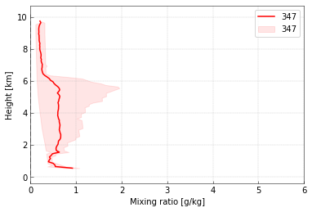
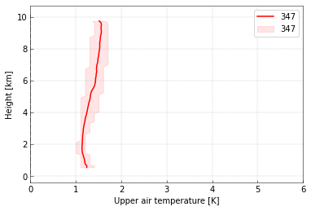
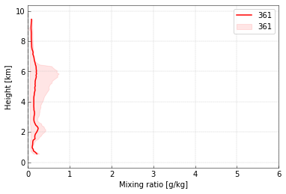
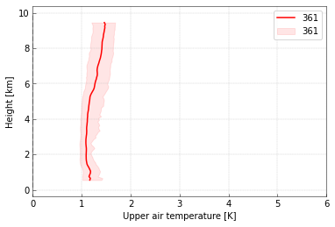
A setup for operational assimilation - error specification
Take state-dependent observation error provided by RALMO and add additional representativity error (tuning)
Temperature: add 0.5 K
WV mixing ratio: add 3% of climatological values
WV mixing ratio
Temperature
summer
winter
Notes:
Line is mean, shading shows 10-90 percentile of data, it reflects the daily cycle in observation error (small errors during night; larger errors during day due to lower signal-to-noise ratio when sunlight is present)

Slide 5
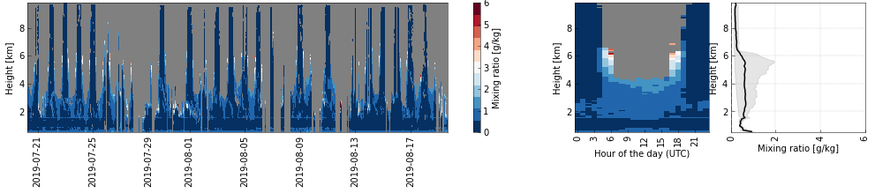
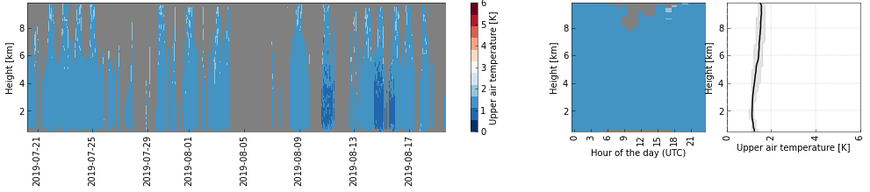
Time-varying observation error from RALMO
WV Mixing Ratio Error
Temperature error

Slide 6
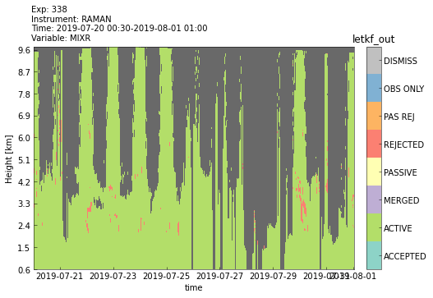
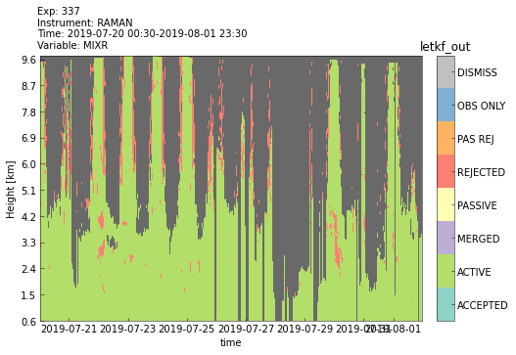
A setup for operational assimilation - QC
KENDA has a FG check, however when observation errors are large, it is not strict in rejecting observations → Additional QC is needed
Flag if: |O-B| > thres * MAD
Additional QC off
Additional QC on
Notes:
MAD = median absolute deviation (a statistically robust measure for variability) ; median from absolute deviations from median [statistics over ~one year of RALMO O-B]

Slide 7
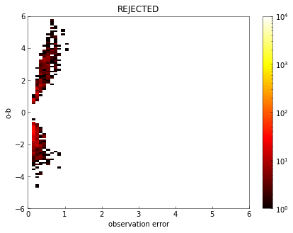
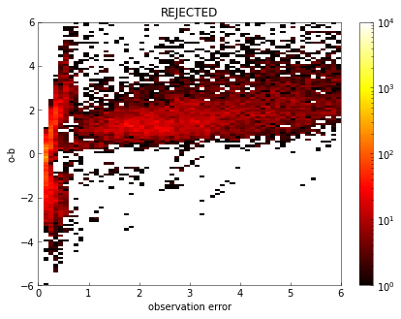
Intermezzo: why not throw out based on observation error?
There is no obvious observation error cutoff value
REJECTED - Additional QC off
REJECTED - Additional QC on
Notes:
[ internal discussion: But how about relative error? We did an experiment with stricter masking based on relative observation error; there we found that we were too strict and threw away too much data. Maybe a less strict threshold on relative observation error would work. The bimodal distribution in observation error (visible both in REJECTED statistics and in ACTIVE statistics) originates mainly from day/night contrast. ]

Slide 8
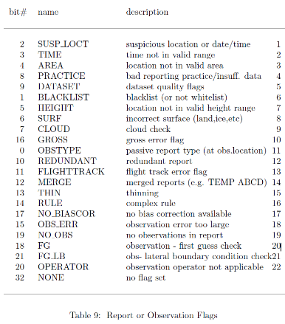
Discussion: new flag?
Currently my own QC sets the flag FG (since it is a FG check taking place before the FG check by KENDA). Ideally, we would have a new flag here to distinguish the two.

Slide 9
Experiment overview
COSMO-2E
REF as OPR but without T2m/RH2m assimilation
Two periods:
20 July 2019 - 20 August 2019 (summer)
1 Jan 2022 - 1 Feb 2022 (winter)
Notes:
We used COSMO-2E because experiments are finished about 4x faster compared to COSMO-1E

Slide 10
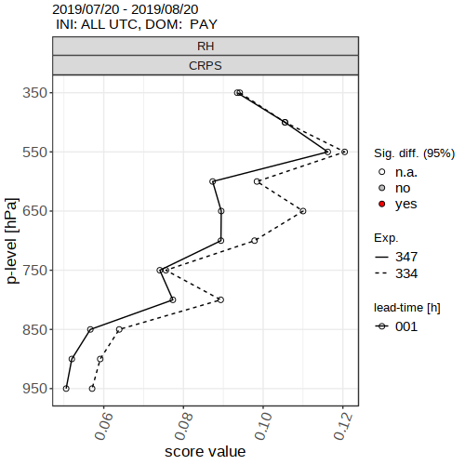
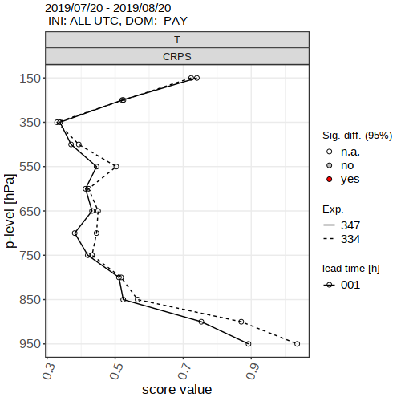
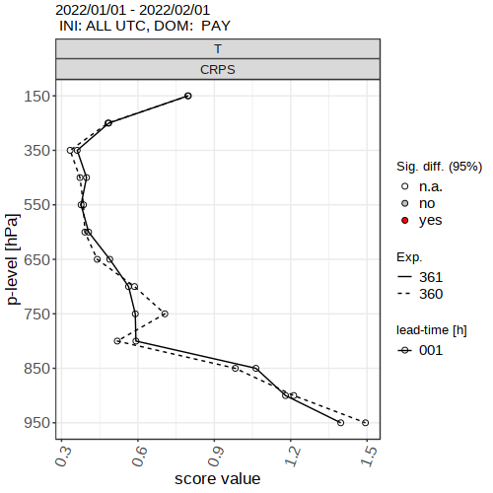
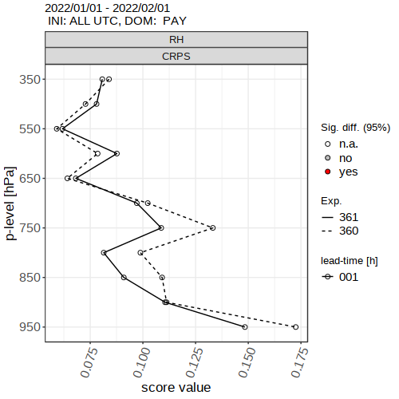
Verification sounding - FG ensemble
Relative Humidity
Temperature
Clear improvements for Relative Humidity in both summer and winter
Small improvement for Temperature in summer, neutral in winter
summer
RALMO
REF
winter

Slide 11
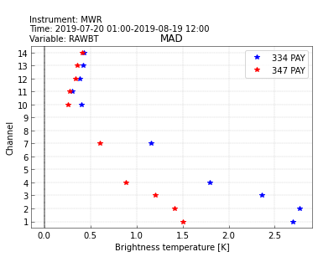
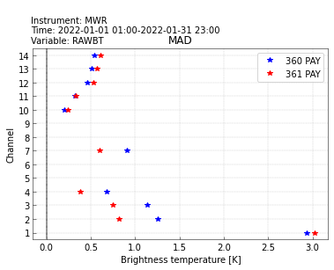
Verification with Microwave Radiometer (independent data)
~temperature
Verification of analysis deterministic run in observation space using RTTOV-gb to calculate model equivalents.
Shown is median absolute deviation, a robust measure for variability
Moisture variability is larger in summer compared to winter
Assimilation of RALMO reduces variability in humidity-sensitive channels almost by factor 2
For Temperature the effect is much smaller
summer
~humidity
REF
RALMO
winter

Slide 12
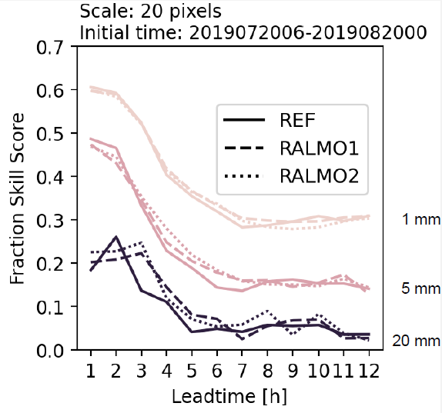
Summertime impact on (heavy) precipitation
Verified against radar derived precipitation sums (COMBIPRECIP)
Improvement in fraction skill score for leadtimes 3-8 hours for 1h precipitation sums
Notes:
Speaker note: Tell that RALMO1 is with constant observation error and RALMO2 is with state-dependent observation error (not the focus here)

Slide 13
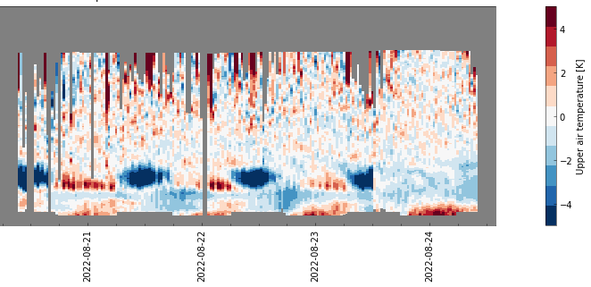
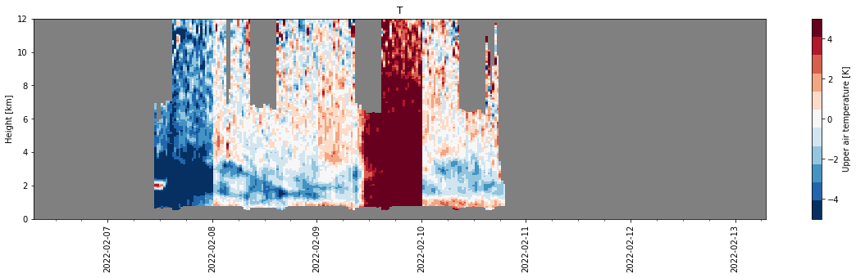
Quality issues for Temperature
Monitoring of O-B revealed several issues for the Temperature
(Our experiments and also verification of MWR assimilation by Claire are not impacted)
O-B Temperature
Spurious jump
Calibration
Calibration
O-B Temperature
More complex feature related to misalignment of the instrument.
Colleagues in Payerne are committed to finding a way to flag bad data.
Notes:
Calibration is a “good jump” it brings RALMO back to a calibrated state in which measurements are trustworthy. PAY sees options to use additional data (e.g. backscatter) for improved flagging of bad data

Slide 14
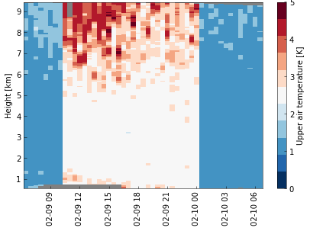
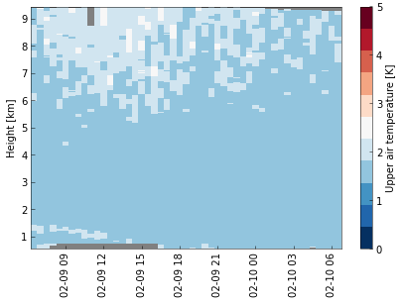
How robust is KENDA in case of jumps?
Temperature O-B
Two experiments:
Inflated T obs. error ←→ Non-inflated T obs. error
Spurious jump
Notes:
Differences in coverage between left plot and two right plots are because of different version of RALMO data (left is from O-B monitoring, data pulled from DWH; right is based on bulletin files Gianni)

Slide 15
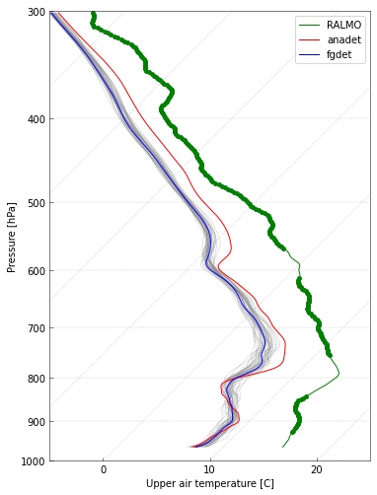
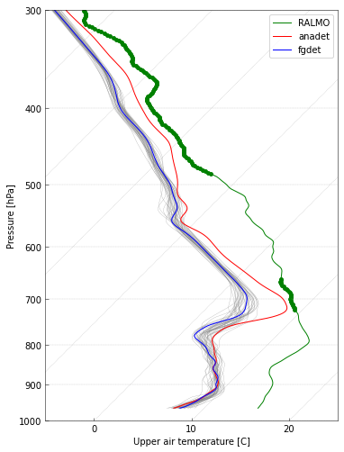
How robust is KENDA in case of jumps? - Profile at 18 UTC
Inflated T obs. error
Non-inflated T obs. error
Notes:
TODO: see formula in OneNote → LETKF [ask Christoph about e_fgchk]

Slide 16
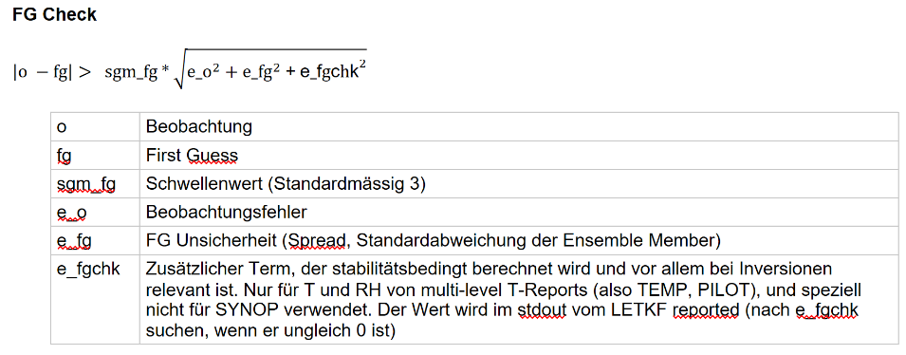
Discussion
In this case it is obvious that we have to flag these data (colleagues in Payerne are working on it). → but how to deal with this trade-off in general? Experiences ?
Inflating observation error | No inflation
More bad data can pass FG check | A ‘stricter’ FG check
Bad data gets lower weights | Bad data has too large weights
What is the value of e_fgchk for PILOT?
Temperature
WV mixing ratio ?

Slide 17
Summary & Outlook
Assimilation of RALMO data…
Leads to better profiles of humidity and (to a lesser extent) temperature above PAY in summer and winter
Leads to better forecasts of (heavy) precipitation in summer
Neutral impact on other variables
→ we have a setup for operational e-suites, but temperature data quality issues need to be fixed
Outlook
Winter experiment with COSMO-1E (in progress) (~Aug 22) → impact on fog and low stratus ?
Colleagues in PAY will do their best to flag bad temperature data and then reprocess one year of data (~Oct 22)
Calculate O-B statistics based on this data (~Oct 22) and use this for representivity error and QC thresholds
Calculate a 30d summer period with COSMO-1E (~Nov 22)
Notes:
TODO: add discussion points here again BONUS: nebel veri winter period.

Slide 18
Discussion
New flag for pre-KENDA QC ?
FG check
trade-off of inflating observation errors
Value and relevance of e_fgchk for raman lidar
Notes:
TODO: add discussion points here again BONUS: nebel veri winter period.

