Slide 1
Operational assimilation of microwave radiometer observations in KENDA-1

Slide 2
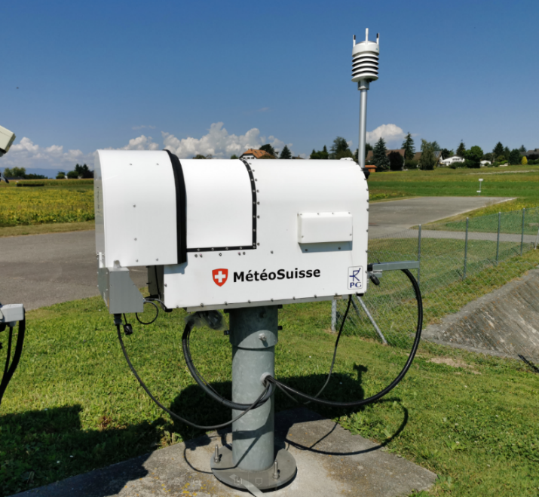
Assimilation of ground-based microwave radiometer data (MWR)
Passive remote-sensing device
Brightness temperature for 14 frequency bands
7 K-band channels (22.24-31.40 GHz): mainly humidity information
7 V-band channels (51.26-58.00 GHz): mainly temperature information

Slide 3
Configuration for MWR DA
zenith scan
channels: 1-4, 7, 10-14
observation error and educated guess for the bias from preliminary O-B analysis
adaptive bias correction (device- and channel-dependent)
cloudy conditions: channels 2, 3, 7, 10-14 (obs. error * 2)
vertical localization: plev from Jacobians, vloc=10 (~no vertical localisation)
→ In operations since 10.08.2022

Slide 4
Experimental suite setup
KENDA-1 vs. KENDA-1 + MWR
conventional observations incl. 2m T&RH
COSMO-1E COSMO-1E
initialized at 00UTC and 12 UTC, +24h lead time
Two periods of one month: Summer (July 2021) and Winter (January 2022)
July 2021:
Payerne: HATPRO G5
Grenchen: HATRPO G2
Schaffhausen: TEMPRO G2
January 2022:
Payerne: HATPRO G5
Grenchen: HATPRO G2

Slide 5
Departures statistics for brightness temperature
July 2021
Ensemble mean
(January 2022 similar)

Slide 6
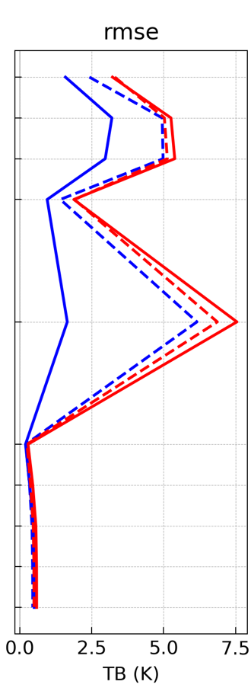
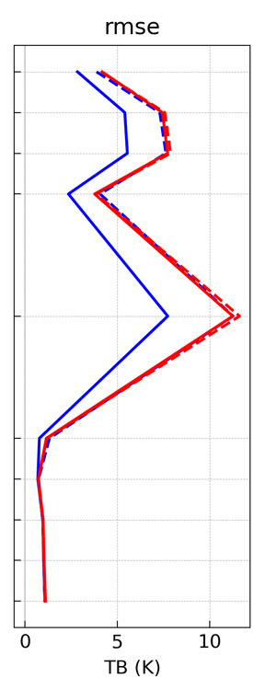
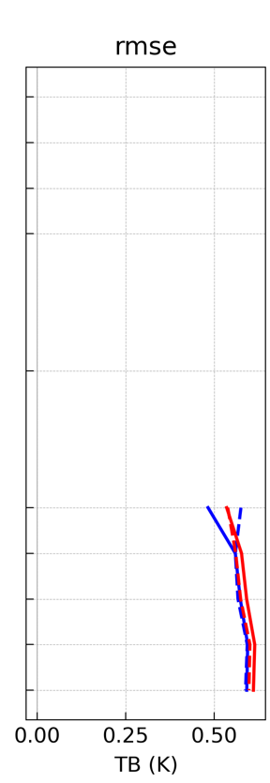
Departures statistics, RMSE July 2021, ensemble mean
ref FG
ref ANA
exp FG
exp ANA
Payerne
Grenchen
Schaffhausen
Effect on analysis clearly visible
Slight effect on first guess in Payerne (new device)
Almost no effect on V-band channels

Slide 7
Standard verification of forecasts with surface SYNOP stations and soundings
July 2021
(January 2022 similar)

Slide 8
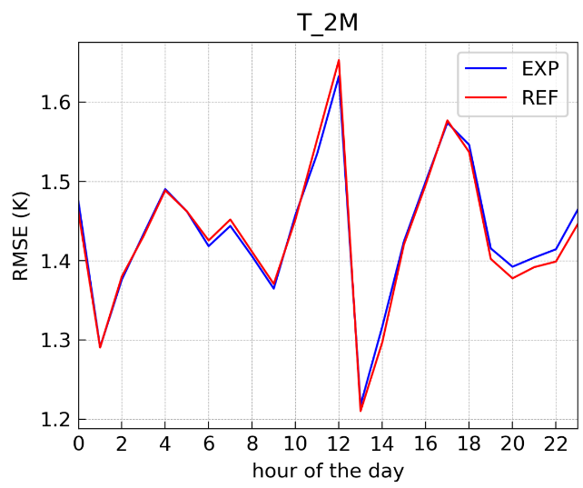
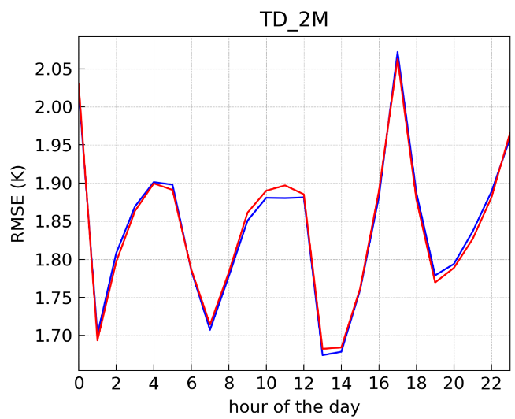
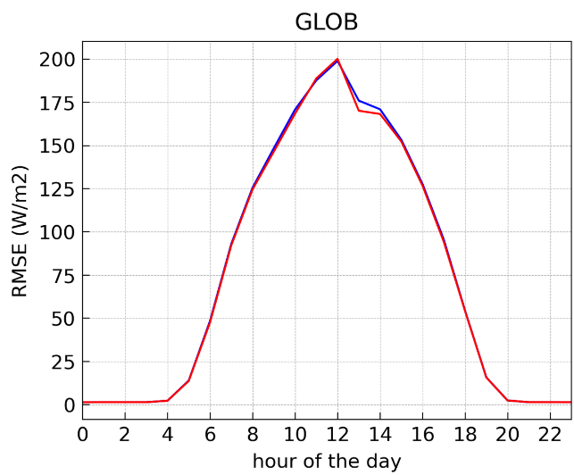
Surface verification, RMSE July 2021, ensemble median, lead times +01h to +12h
ref
exp
2m temperature
2m dew point temperature
global downward shortwave radiation
Neutral

Slide 9
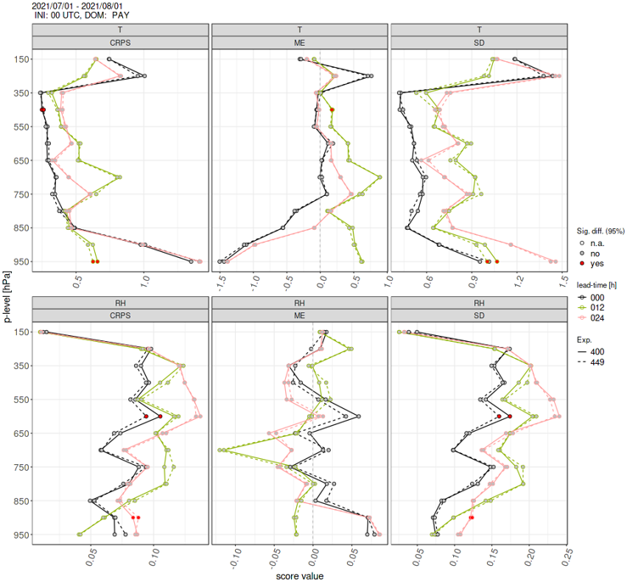
Sounding verification in Payerne July 2021
ref
exp
2m temperature
Neutral
Very slight positive tendency for RH, maybe an indication that the impact goes in the right direction but is weak
relative humidity

Slide 10
Comparison to temperature and mixing ratio of Raman Lidar in Payerne
January 2022 (RALMO not available in July 2021)
weighted average of first guess and analysis of KENDA-1

Slide 11
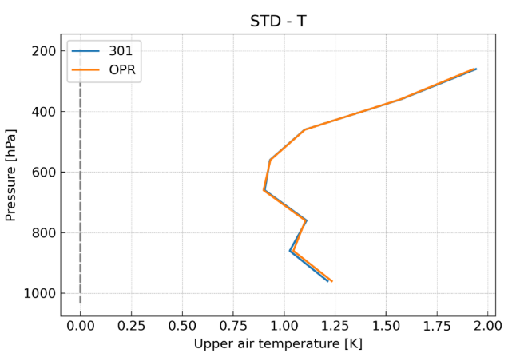
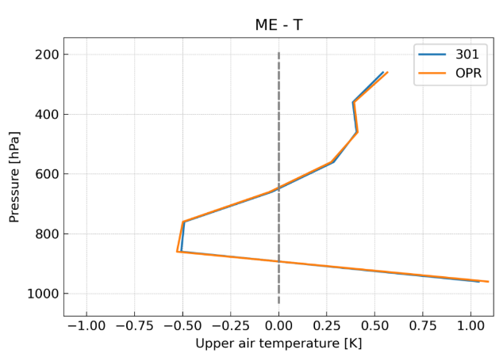
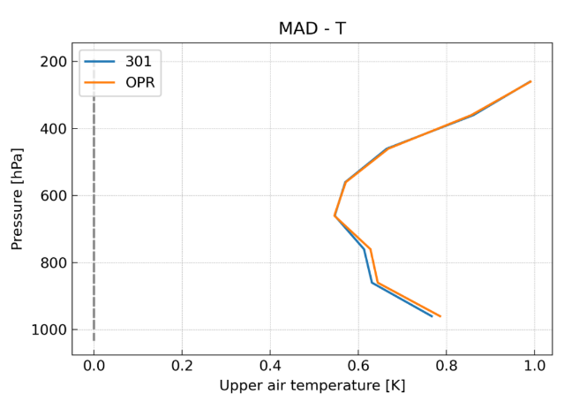
RALMO temperature
Many thanks to Bas for this analysis!
standard deviation
mean error
median absolute deviation
Impact not significant but goes in the right direction
Slight improvements are < 0.01/0.02 K
ref
exp

Slide 12
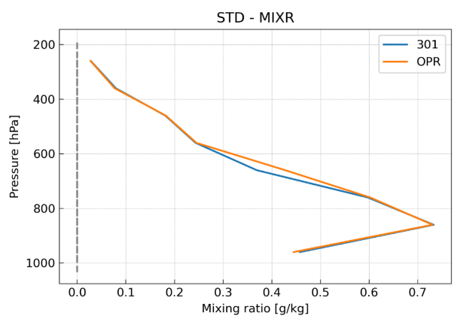
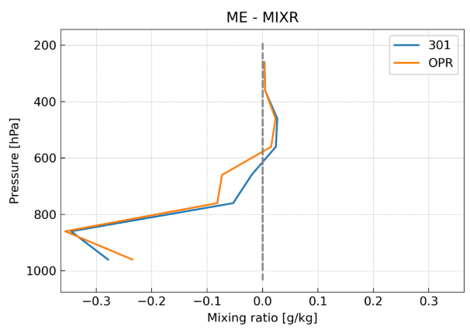
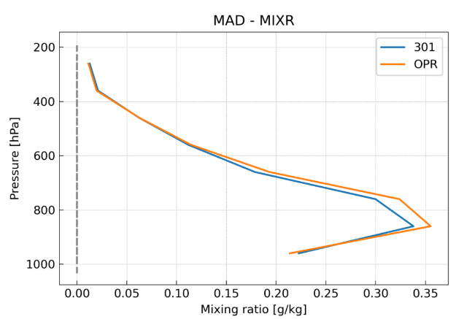
RALMO mixing ratio
Many thanks to Bas for this analysis!
standard deviation
mean error
median absolute deviation
Impact not significant but goes in the right direction
Slight improvements are < 0.02/0.03 g/kg
ref
exp

Slide 13
Fog and low stratus verification using satellite data
January 2022

Slide 14
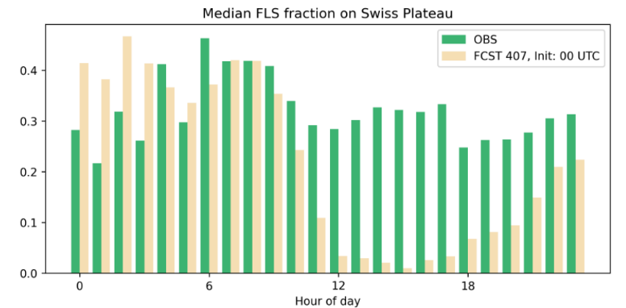
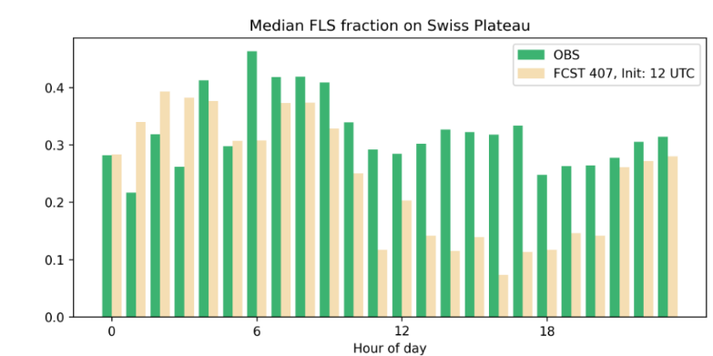
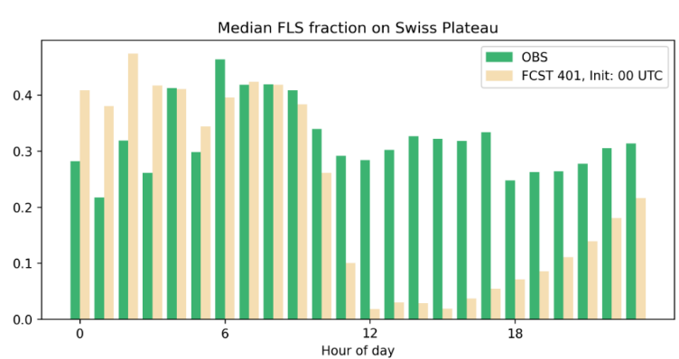
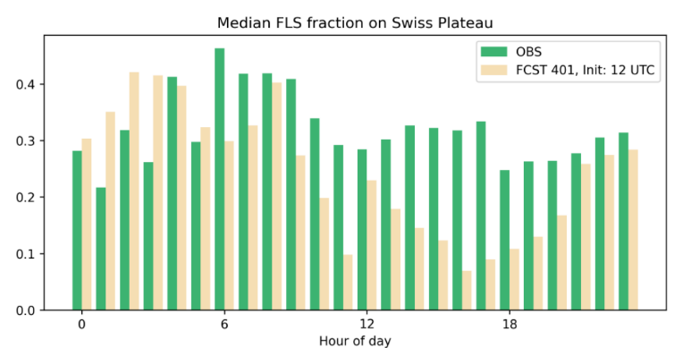
Fog and low stratus verification
Many thanks to Steffi for this analysis!
no significant impact
Reference
init 00UTC
init 12UTC
Experiment

Slide 15
Monitoring of the operational system
for the last two weeks

Slide 16
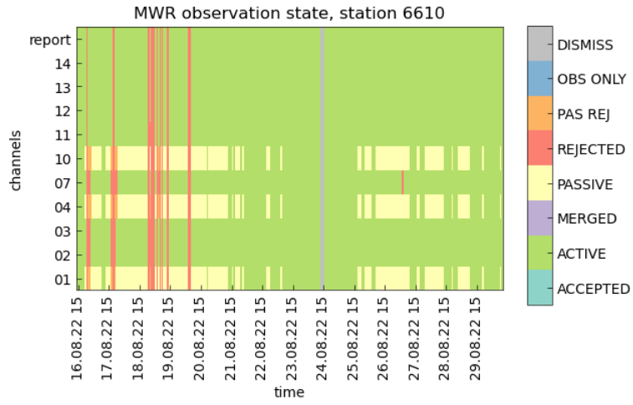
MWR observations state in the LETKF
Data flow works well, very few missing data
Some rejections because of rain
Passive observations because of clouds

Slide 17
MWR departures
Impact on analysis is visible, especially in the standard deviation

Slide 18
MWR departures

Slide 19
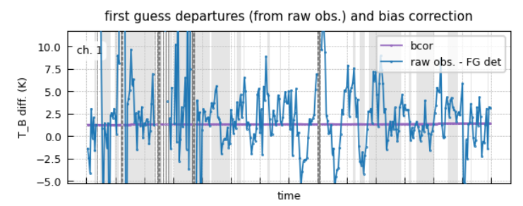
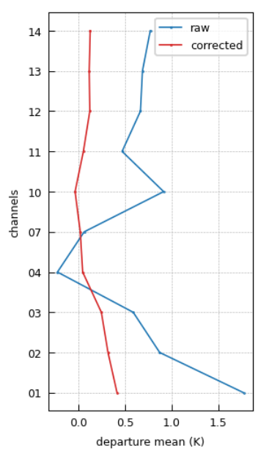
MWR adaptive bias correction
The adaptive bias correction is working: the bias between model and observations is reduced

Slide 20
Potential for improvement
Two more stations will be equipped with the new generation of MWRs
System tuning and further possible investigantions
tuning of observation errors
correlated observation errors
study of vertical localisation impact
better impact with less channels?
off-zenith angles (potential for larger impact on temperature)
Technical
move from MEC-light to MEC
more flexible namelist

