Slide 1
Status of KENDA-1 at MeteoSwiss
Marco Arpagaus for the data assimilation team at MeteoSwiss
WG 1 / KENDAscope parallel session, COSMO GM, Athens, 2022

Slide 2
Operational Evolution during last year
Introduction of T2m and RH2m on 27.09.2021
Introduction of Wind Lidar at 3 stations on 08.03.2022
Introduction of MODE-S v2.2 on 30.05.2022 (see extra slide)
Introduction of Microwave Radiometer in Payerne on 10.08.2022 (see extra slide)

Slide 3
Assimilation of MODE-S v2.2 Stream
TEMP verification
WPROF verification
Operational since 30.05.2022
Number of obs (28.03 – 05.04.2022)
% change in CRPS averaged over all LT
% change in RMSE averaged over all LT

Slide 4
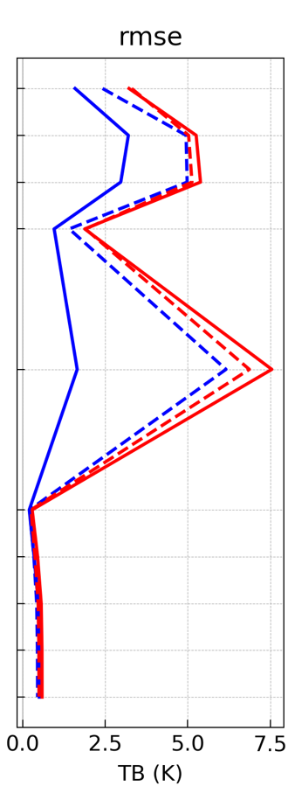
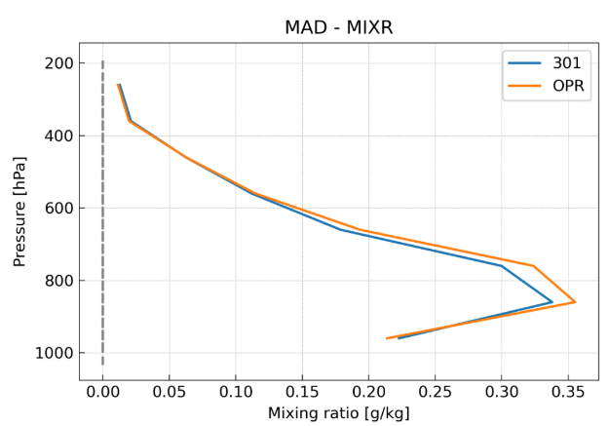
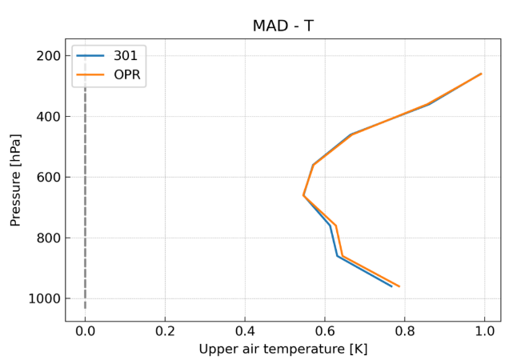
Assimilation of Microwave Radiometer
O-B of MWR BT
(STDE, July 2021)
Verification of B against Raman Lidar (MAD)
Payerne
Payerne
Small improvement in thermodynamical structure above Payerne
Neutral impact in forecast verification
Potential for improvement
Operational since 10.08.2022
Include Grenchen and Schaffhausen stations when newest generation devices are available
Mixing ratio
REF
EXP
Temperature
REF FG
REF ANA
EXP FG
EXP ANA

Slide 5
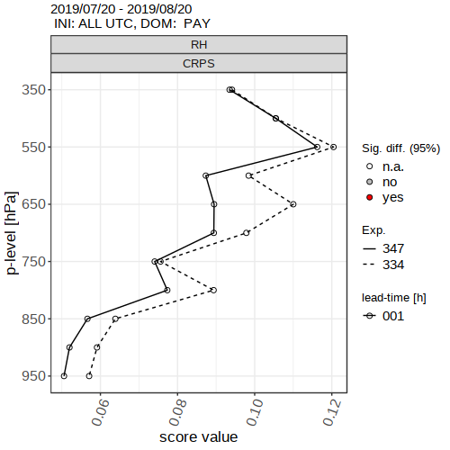
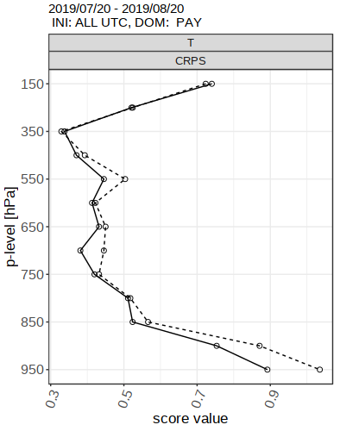
Assimilation of Raman Lidar MIXR and T
Assimilation and Forecast Experiment (20.7.-20.8.2019, 2 km mesh-size)
Operations planned for Q4 2022
State-dependent obs error, provided by instrument
O-B statistics against Radiosonde in Payerne (CRPS)
Improvement in FSS for heavy precip forecasts
RH
T
REF
EXP
WV Mixing Ratio Error
EXP
REF

Slide 6
Planned developments with COSMO
Operational assimilation of Raman Lidar observations in Q4 2022
Assimilation of high-res ascent and descent TEMP observations
“The end!”

Slide 7
Planned developments with ICON
Migration of KENDA-1 to ICON
Assess / retune KENDA settings (see next slide)
Assimilation of 3D Radar Reflectivity
Extension of LHN with OPERA composite
Assimilation of Meteodrone observations
Measurement campaign during last winter in Payerne
Ongoing measurement campaign with up to O(10) stations (~2y)
Additional surface stations in Switzerland
long-term: Additional observations
GPS zenital total delays (dense network in CH and D)
Satellite observations: MSG (VIS, WV channels), MTG
More T2m/RH2m/p_{s} observations (partner stations, Netatmo)

Slide 8
Assess / retune KENDA settings
Assess / tune KENDA-1 with ICON at 1.1km mesh-size
O-B statistics, obs errors, FG and ANA spread for all assimilated observations using Desroziers statistics
Number of effective observations, do we need more ensemble members?
Can we decrease horizontal localisation? For all obs, or for certain obs?
Observation impact (EFSOI, Method of Olaf Stiller, data denial experiments)
Hourly assimilation of profiler observations (currently 30min)

Slide 9
Discussion Points and Questions
Quality control (outside of KENDA) of T2m/RH2m observations at DWD?
Revisit the grid point assignment for surface observations? Select gridpoint with a smaller vertical distance (allowing for larger horizontal distance) to station? Status of new observation operator at DWD?
Transition from MEC-light to MEC / ICON
Who does the work for MWR, RALMO, Meteodrones?
Status of work on correlated observation errors for
different levels of profile observations
multiple microwave channels (MWR)

