Slide 1


Verification Overview
(based on CP activity: JJA2019-MAM2020)
Alexander Kirsanov, Dimitra Boucouvala & WG5

Slide 2
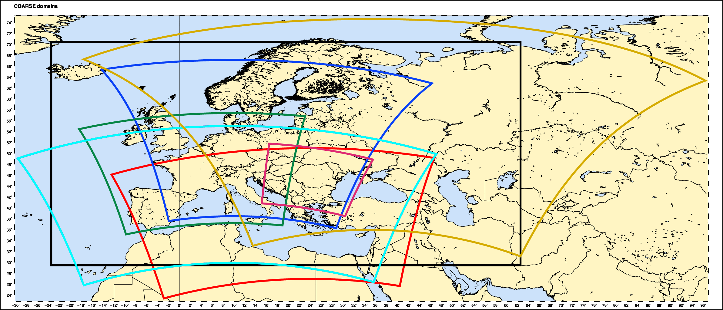
Common Plots 2019-2020 – COARSE –COSMO
ICON-EU
COSMO-PL7
COSMO-RU7
COSMO-7
COSMO-ME4
COSMO-5M
COSMO-RO7
COSMO-GR4
COARSE |  | FINE
COSMO | ICON | COSMO | ICON
COSMO-5M |  | COSMO-2I/2IRUC
COSMO-GR4 |  | COSMO-GR1 | ICON-GR2 or 1
 |  | COSMO-IL | ICON-IL
COSMO-RU7 | ICON-RU | COSMO-RU++
 | ICON-EU | COSMO-DE | ICON-D2
COSMO-PL7 |  | COSMO-PL2.8 | ICON-PL2.5
COSMO-7 |  | COSMO-1
COSMO-ME | ICON-ME | COSMO-IT | ICON-IT
COSMO-RO7 |  | COSMO-RO1

Slide 3
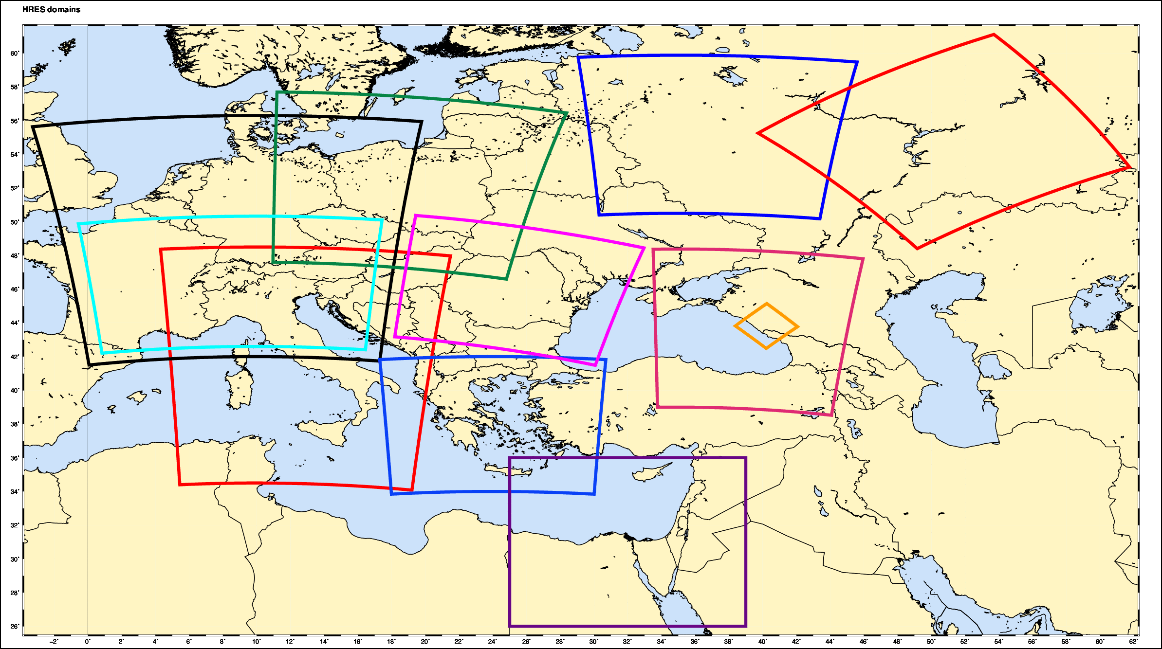
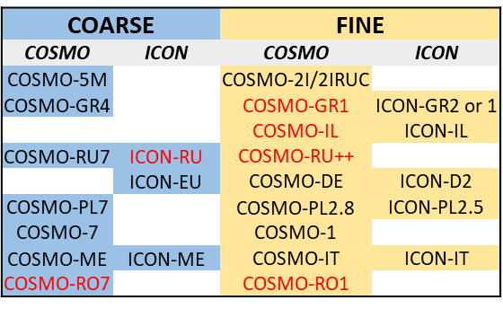
Common Plots 2019-2020 - COSMO FINE
COSMO-RU2
COSMO-D2
COSMO-PL2
COSMO-RU2
COSMO-1
COSMO-RO
COSMO-RU2
COSMO-I2/2I
COSMO-GR1
COSMO-IL

Slide 4
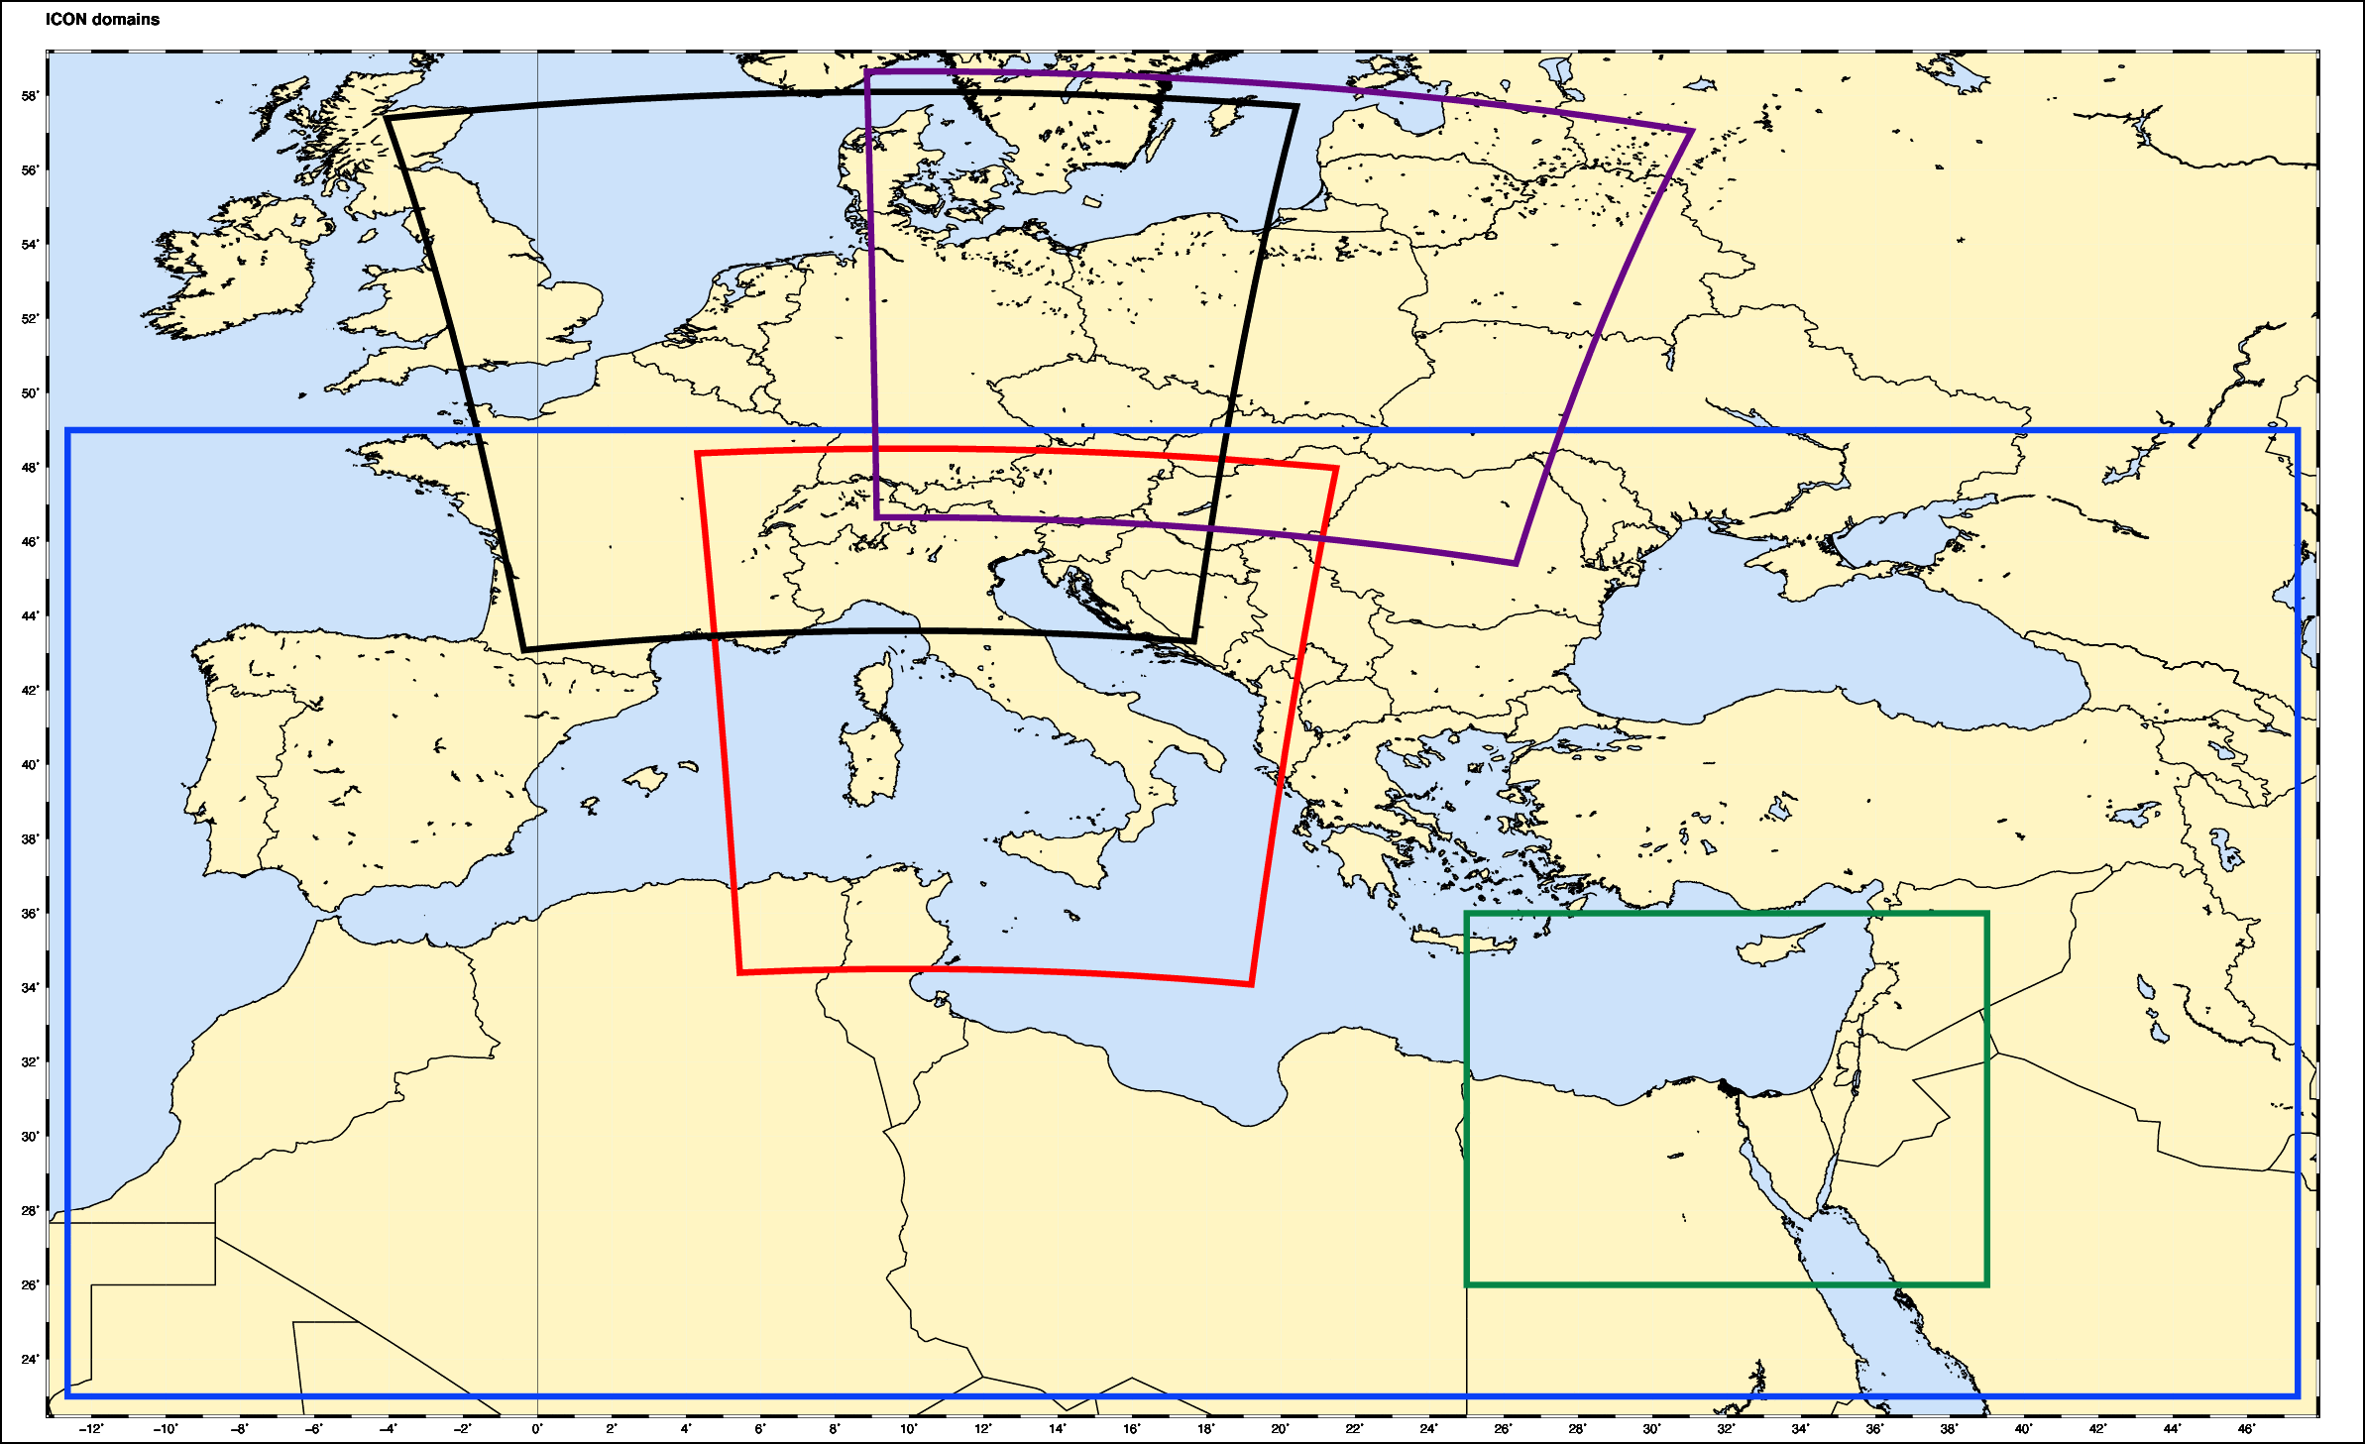
Operational (?) ICON-LAM
ICON-D2
ICON-PL
ICON-I2
ICON-IL
ICON-GR
ICON-LAM
ICON-EU | 0.0625 | √
ICON-D2 | 0.02 | 2020
ICON-GR | 0.025 | √
ICON-PL | 0.025 | 2019
ICON-IL | 0.025 | ?
ICON-IT | 0.02 | √
ICON-ME | 0.045 | √

Slide 5


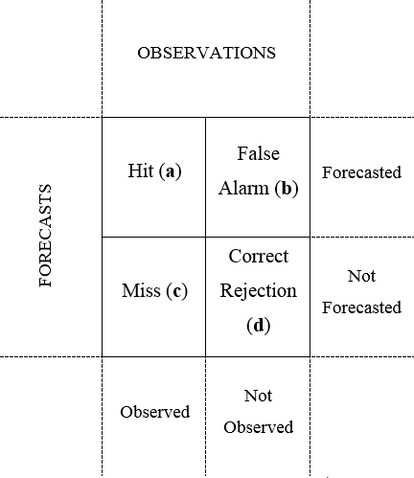



General Information on Scores
Continuous parameters
Temperature at 2 m
Dew point temperature at 2 m
Pressure reduced to Mean Sea Level
Wind speed at 10 m
Total cloud cover
Dichotomic parameters
Total Precipitation (Various thresholds)
Total cloud cover (0-25,25-75,75-100)
Wind gust at 10 m (>12.5,>15, >20)
Calculated with VERSUS software

Slide 6
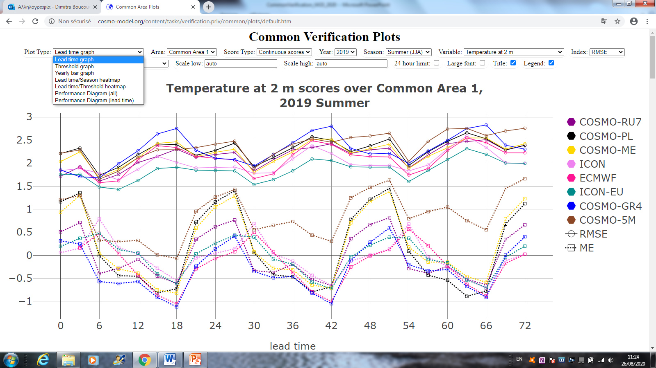
Common Plots Interactive view on COSMO Website
A. Kirsanov
http://www.cosmo-model.org/ -> COSMO Tasks -> Verification
Since Aug 2019, common plots can be viewed interactively (Kirsanov). Older-style plots before then, can be seen in the links below
All the scores you can view at the website:
http://cosmo-model.org/content/tasks/verification.priv/common/plots/default.htm
Annual reports and Seasonal analytics are located at the website:
http://cosmo-model.org/content/tasks/verification.priv/

Slide 7

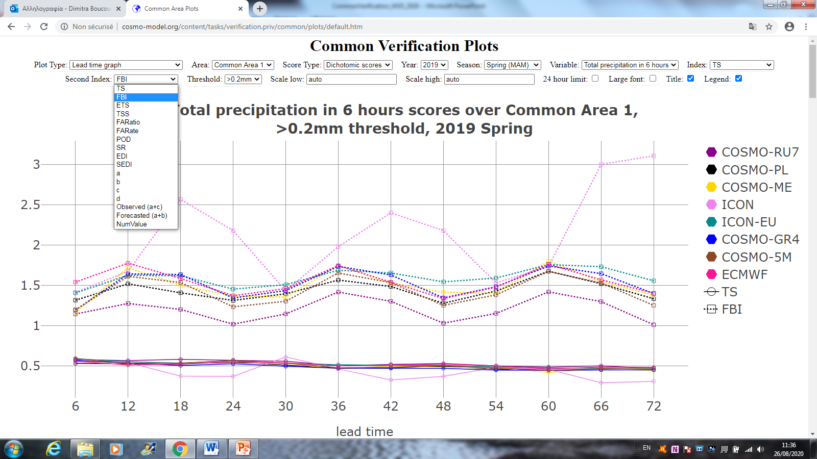
Common Plots Interactive view on COSMO Website
A. Kirsanov
Selection of year, season, type of graph, parameter, type of score, threshold, font, scale, number of values, etc. Trends of parameters of previous years since 2015 can be viewed.
Possibility of downloading the plot
All the graphs of this presentation are downloaded from the website.
Thanks Alexander for the great job !!

Slide 8
Common Plots data (Non) Availability
Model | No Data | No data VMAX | No data TCC
COSMO-GR4 |  | ALL
COSMO-PL7 | MAM | ALL
COSMO-ME |  | JJA,SON
COSMO-5M
ICON |  | ALL
ICON-GR | JJA, SON, DJF | ALL
COSMO-RU7 |  | DJF, MAM (?) JJA, SON | DJF, MAM (?) JJA, SON
ICON-EU | SON, DJF, MAM
ECMWF-IFS |  | ALL
COSMO-D2 | SON,MAM
COSMO-2I |  | JJA,SON
COSMO-PL1 |  | ALL
Please send any missing data for the report !!

Slide 9
Common Plots: Are there any changes on the scores ?
The diurnal cycle and the general scores evolution with lead time have not changed from last year, there are only slight score value differences.
The slight differences can be due to:
Different weather regime, different number of data (observations and model).
Some emphasis in this presentation is given to JJA and MAM as there are results from ICON-LAM models

Slide 10
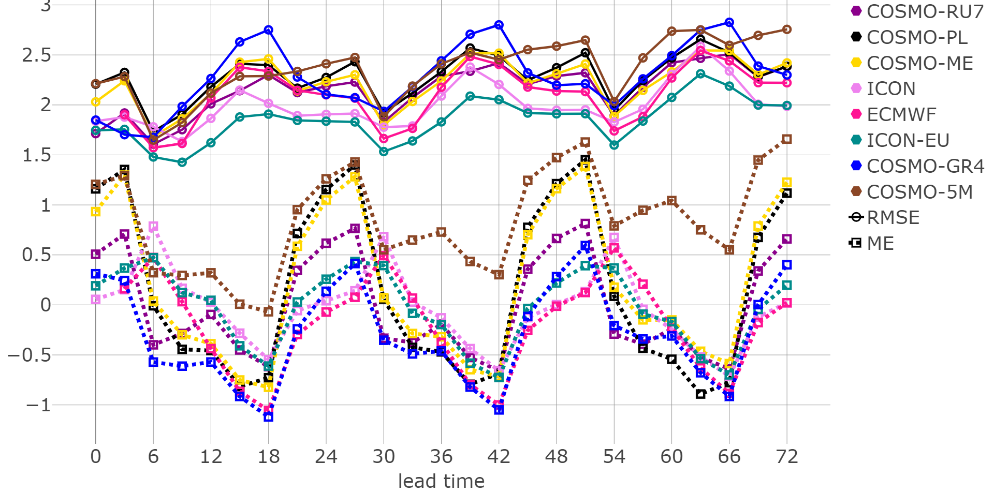
Temperature at 2 m scores
Common Area 1, Summer 2019
RMSE
ME
ICON-EU good results with lowest RMSE followed by ICON
Diurnal cycle underestimation
Persists

Slide 11
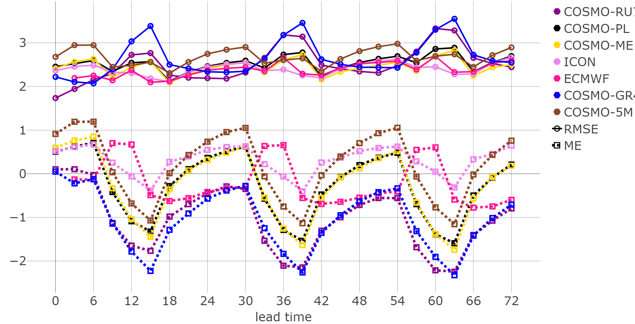
Temperature at 2 m scores
Common Area 1, Winter 2019-2020
RMSE
RMSE
ME
ME
Diurnal variability underestimation
Persists
ICON and IFS lowest RMSE

Slide 12
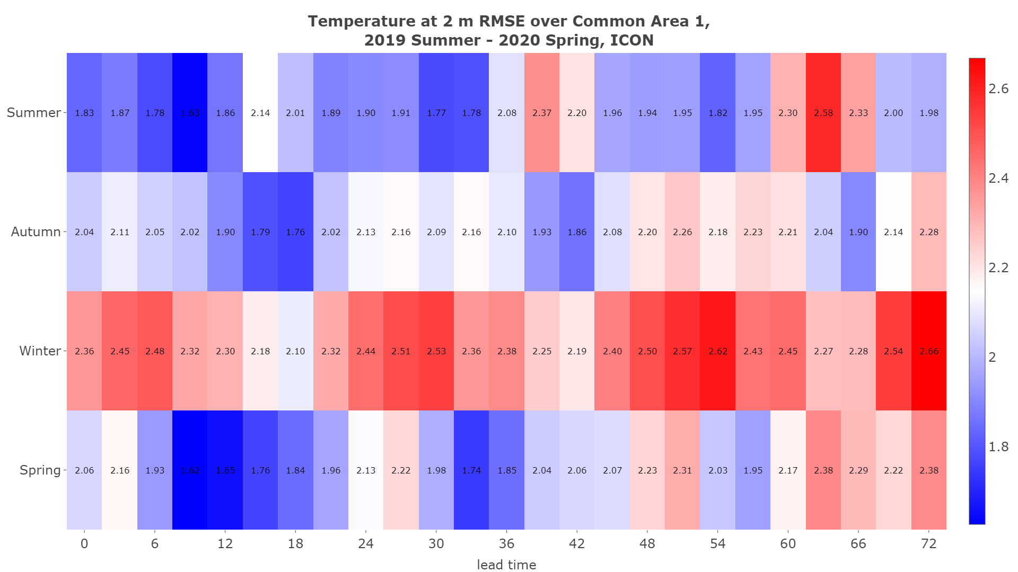
ICON RMSE Temperature for all seasons and time steps
ICON RMSE higher in Winter, increasing with lead time, max values in the morning

Slide 13
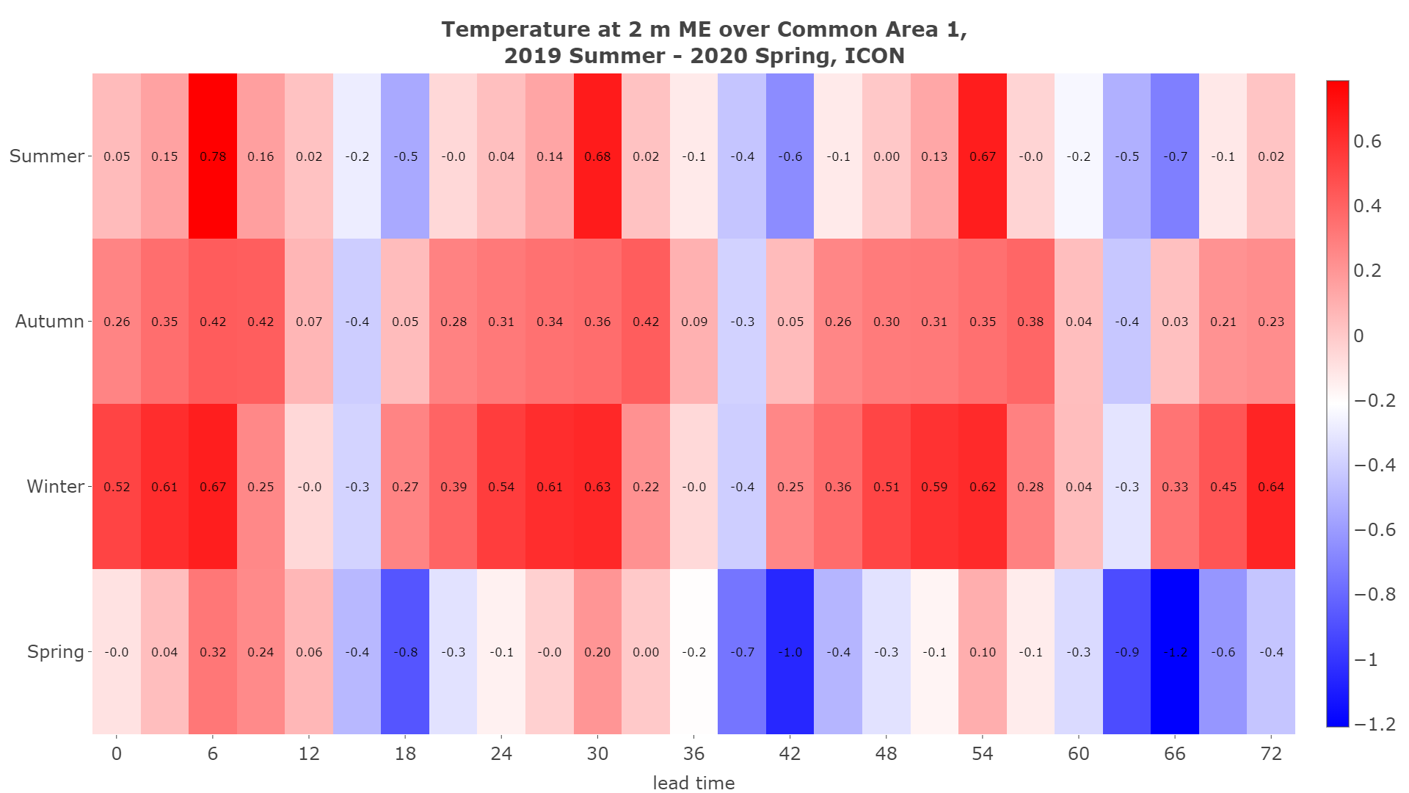
ICON ME Temperature for all seasons and time steps
ICON Overestimates T2m in winter especially morning hours
ICON ME positive SON, DJF

Slide 14
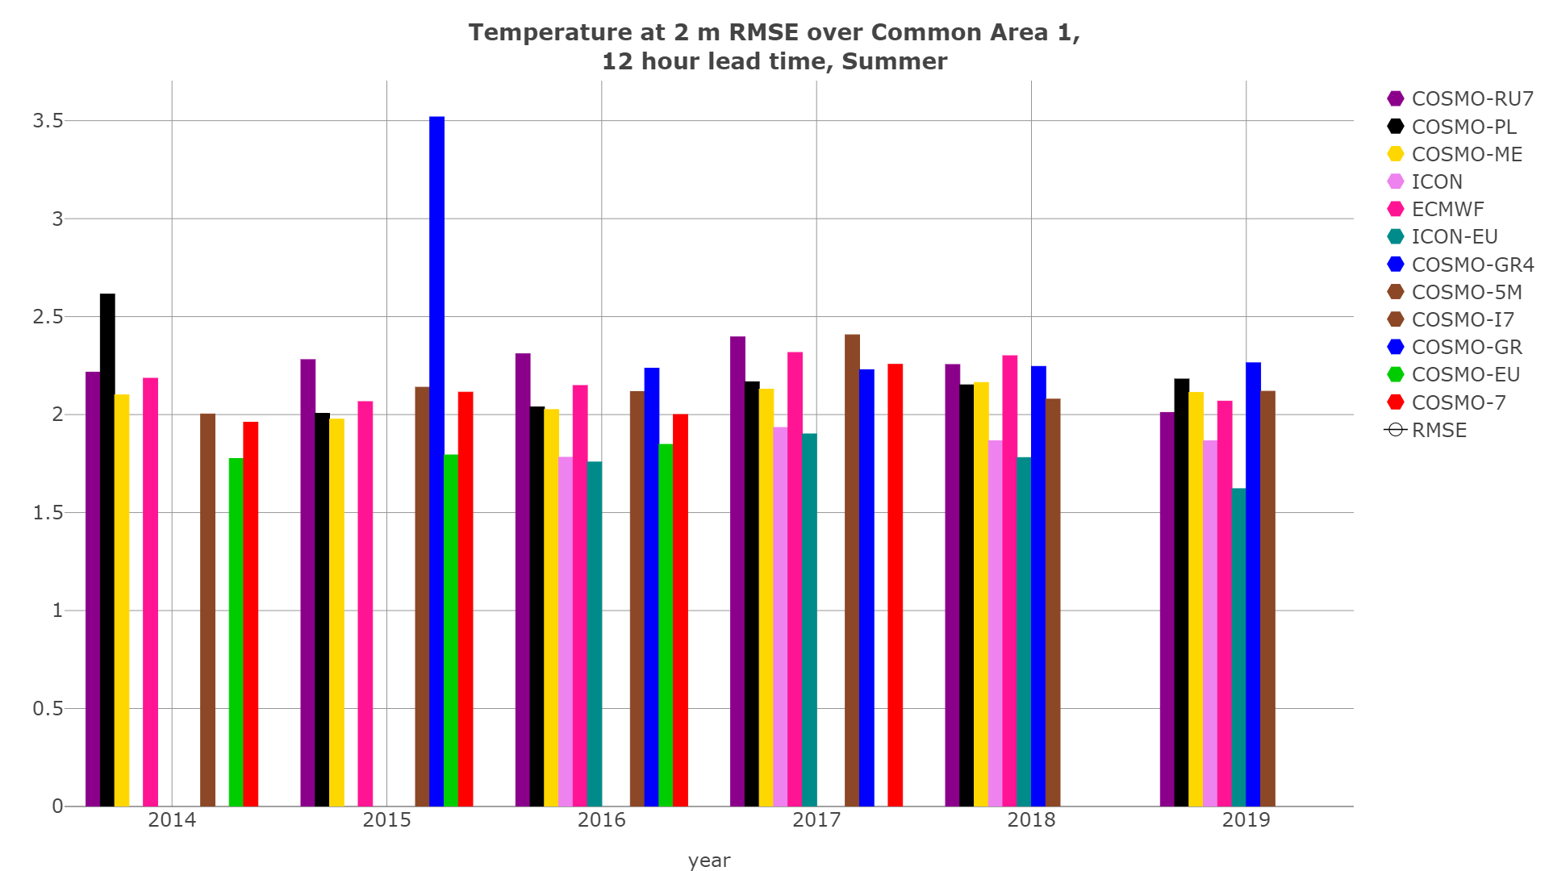
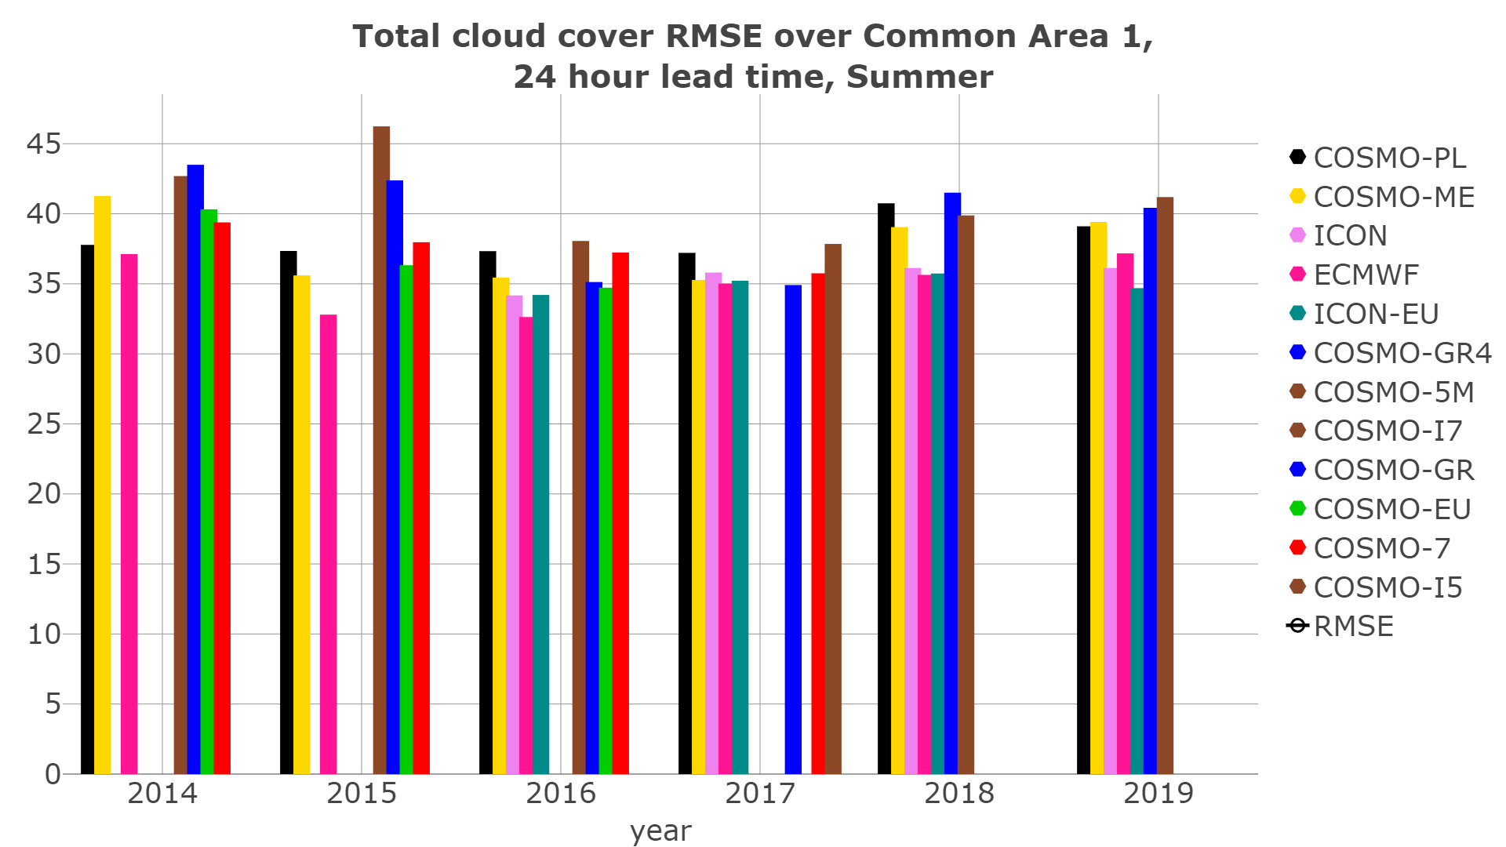
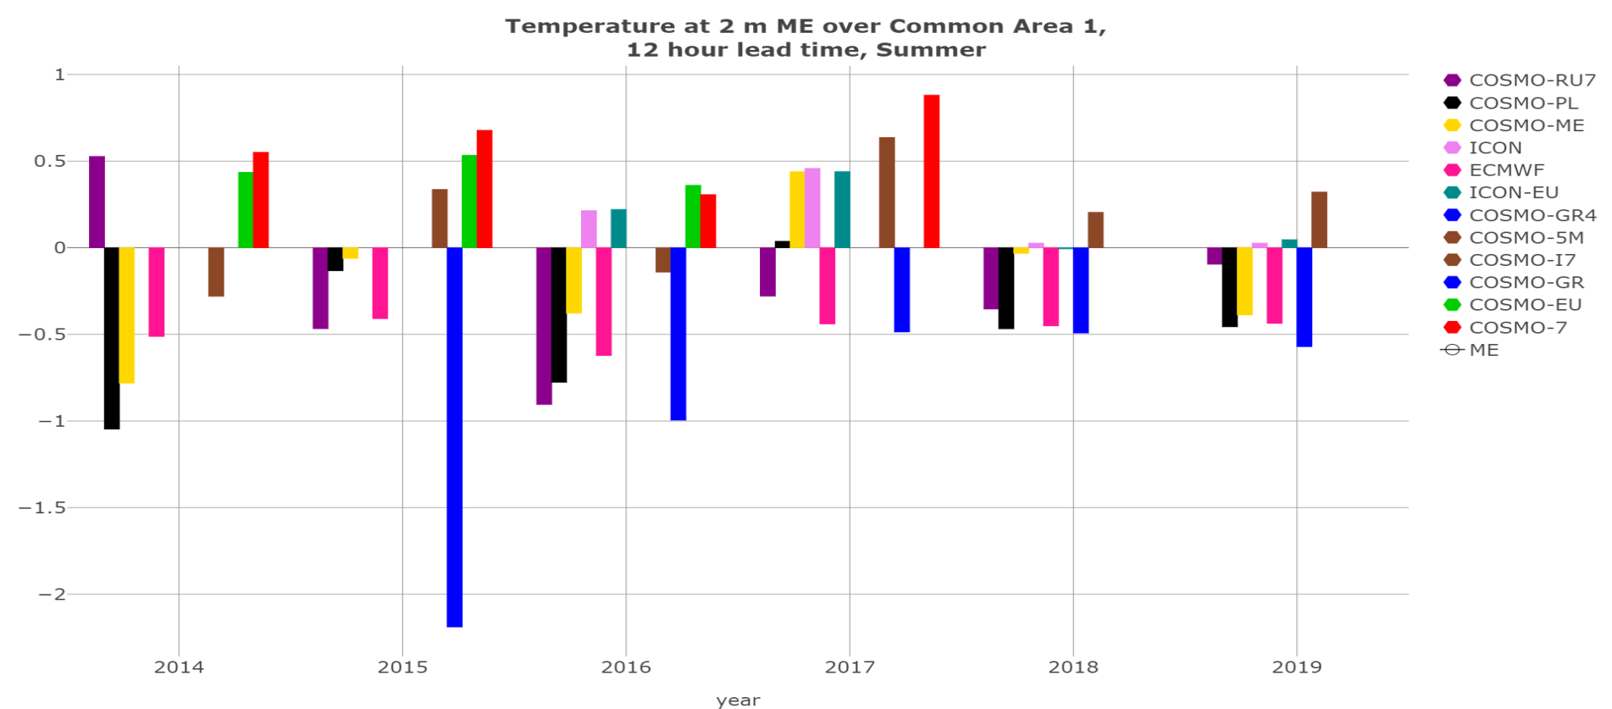
Temperature at 2 m daytime TRENDS
Common Area 1 JJA (ME-RMSE)
2017 2018 2019
RMSE
ME
No significant changes from last year
ICON-EU better scores

Slide 15
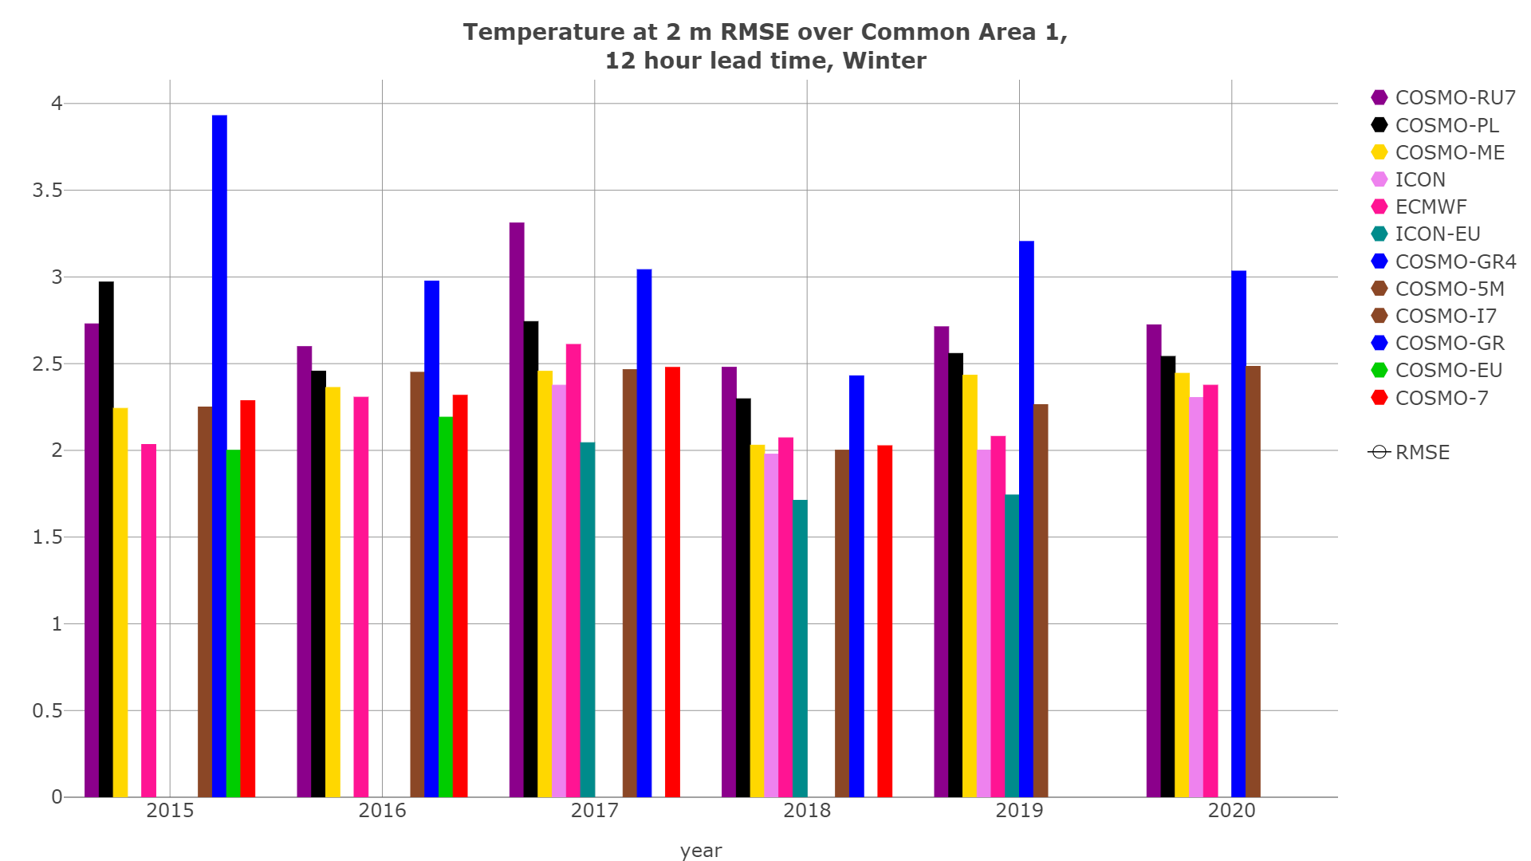
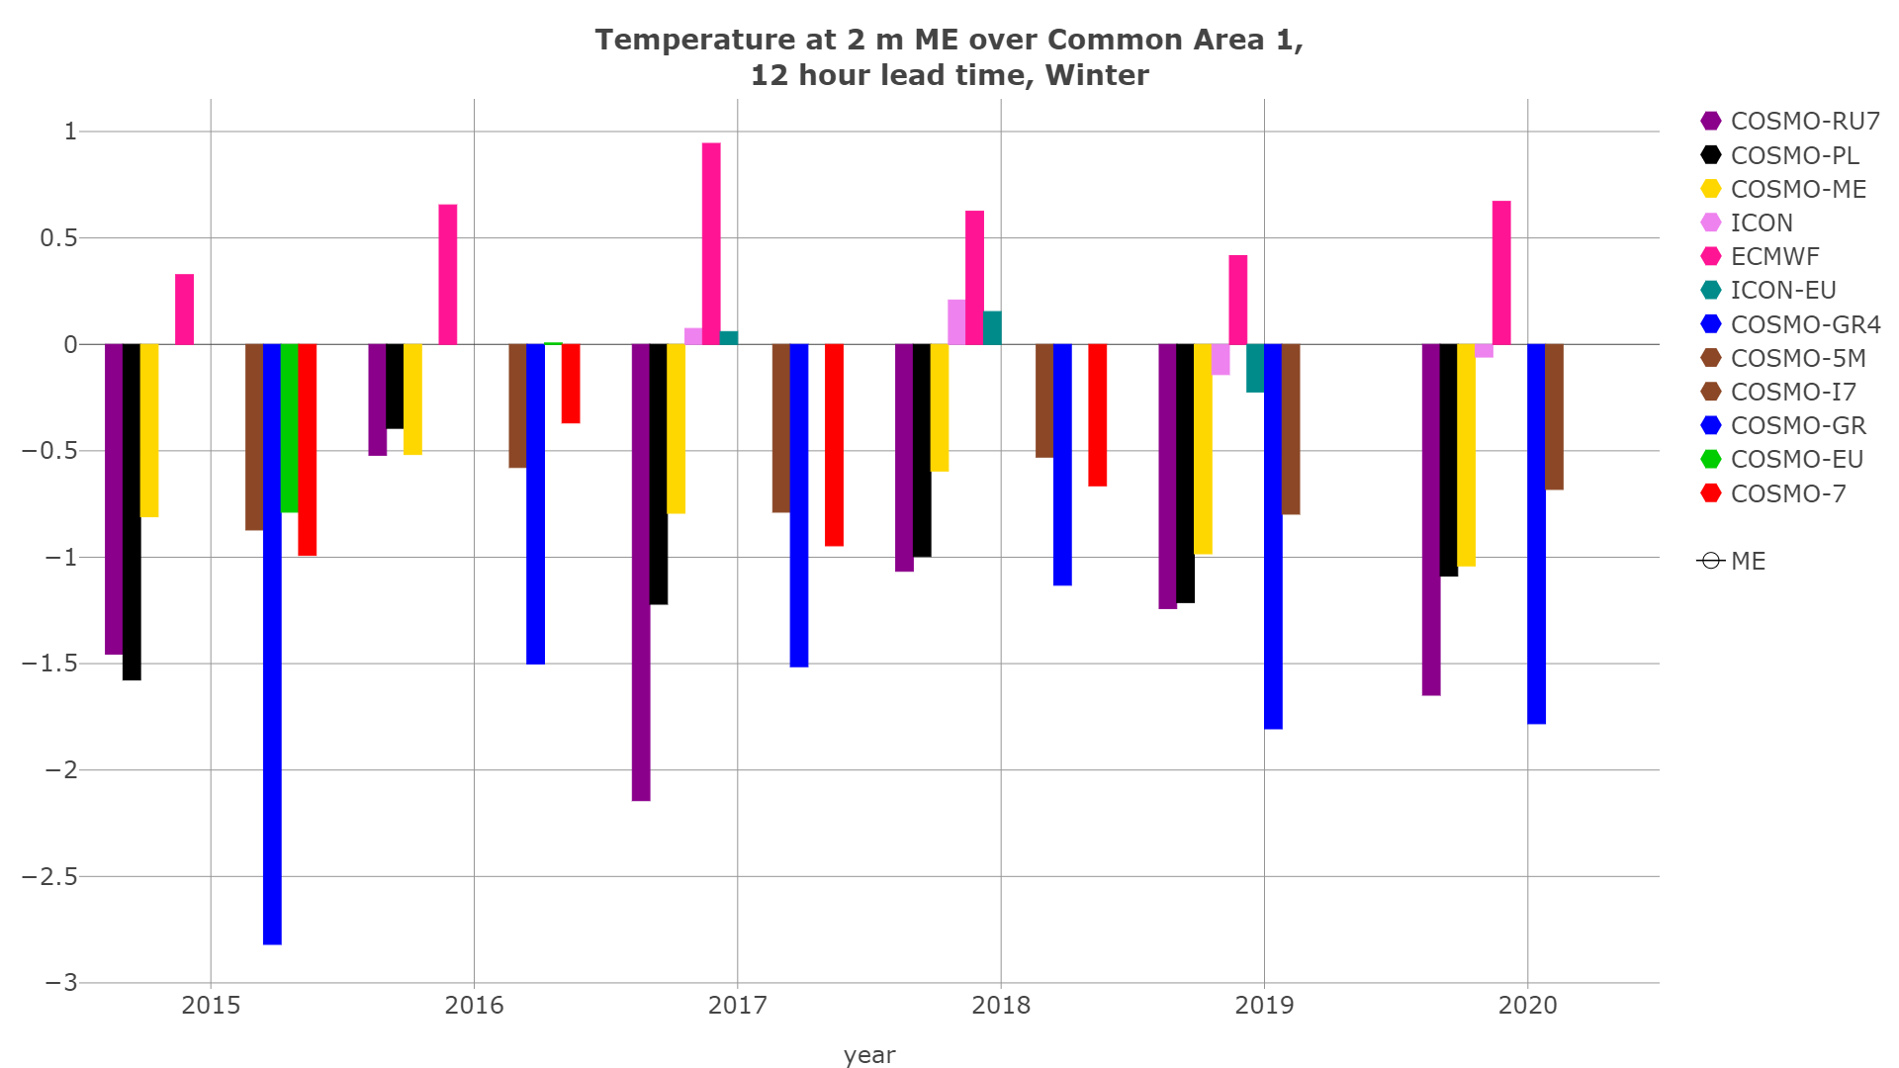
Temperature at 2 m TREND
Common Area 1, 12 hour lead time, Winter (ME-RMSE)
2018 2019 2020
RMSE
ME
For some models including ICON there was a slight ME-RMSE increase

Slide 16
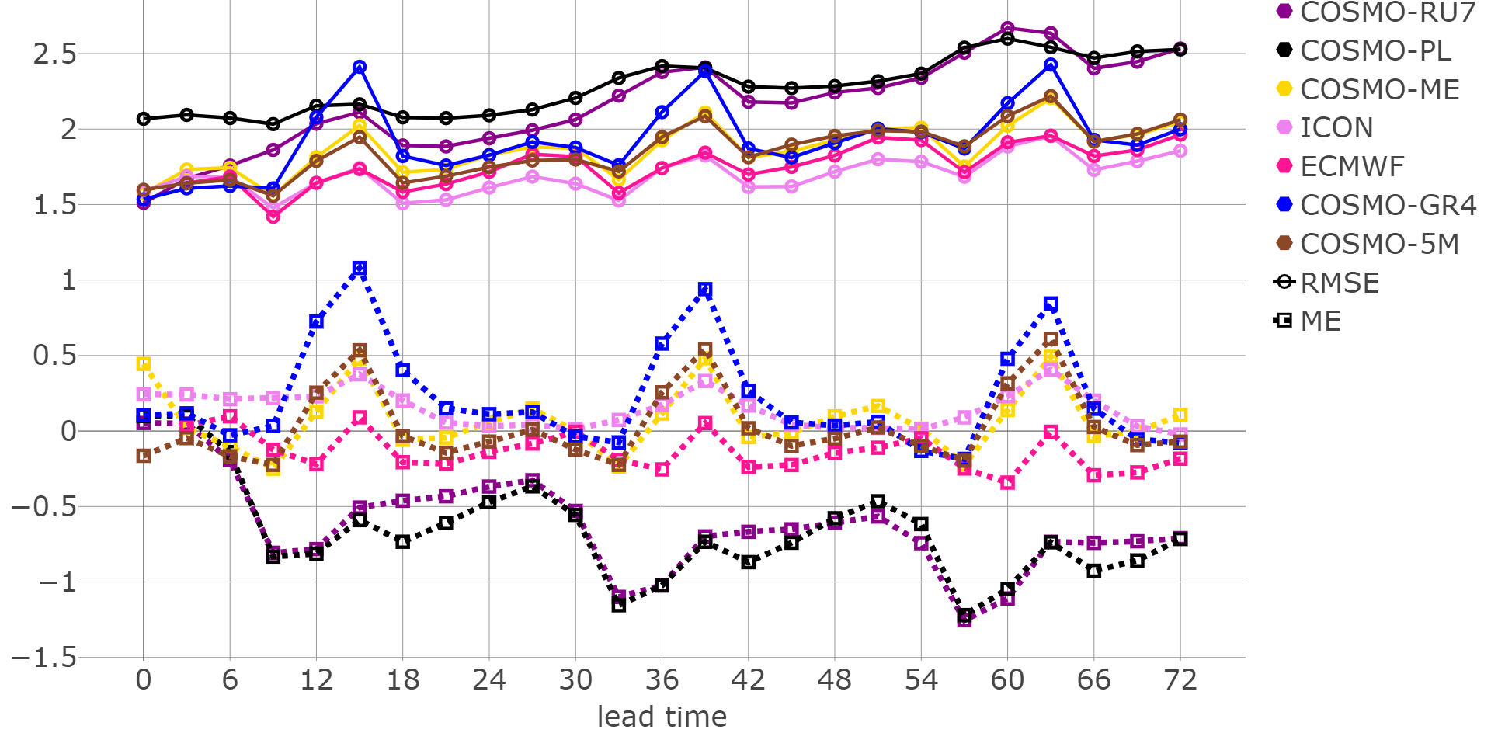
Dew point Temperature at 2 m scores
Common Area 1, Autumn 2019
RMSE
ME
ICON ME(+) but close to zero and lower RMSE
Discrepancies among models in SON
Notes:
ICON tend to overestimate Dew point temperature at 2 m, COSMO generally overestimates it too, but COSMO-PL and COSMO-RU7 underestimate it during autumn.

Slide 17
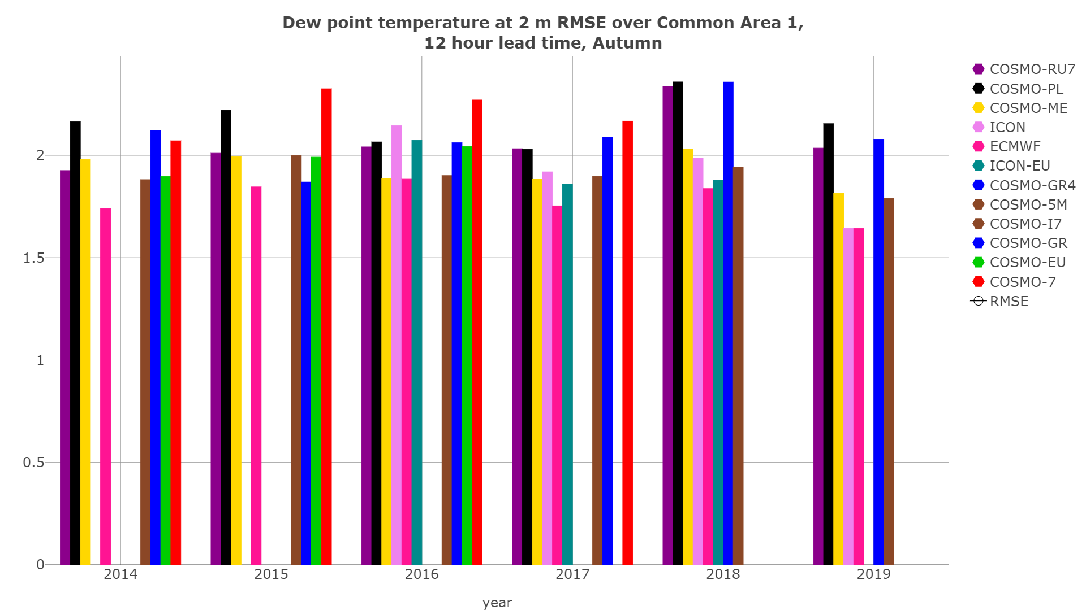
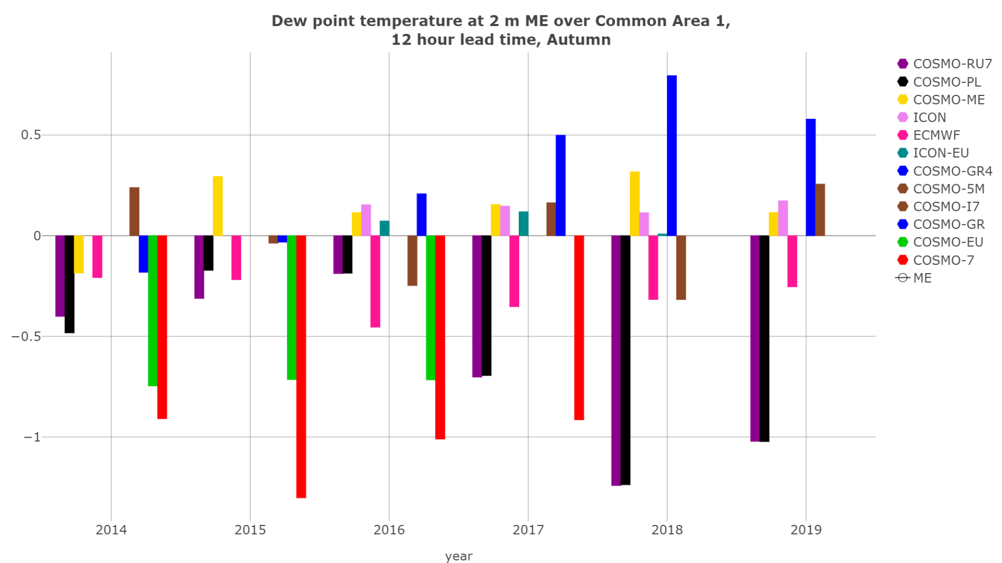
Dew point Temperature at 2 m (ME-RMSE)
Common Area 1, 12 hour lead time, Autumn
2017 2018 2019
RMSE
ME
Autumn RMSE and ME decreased compared to last year

Slide 18
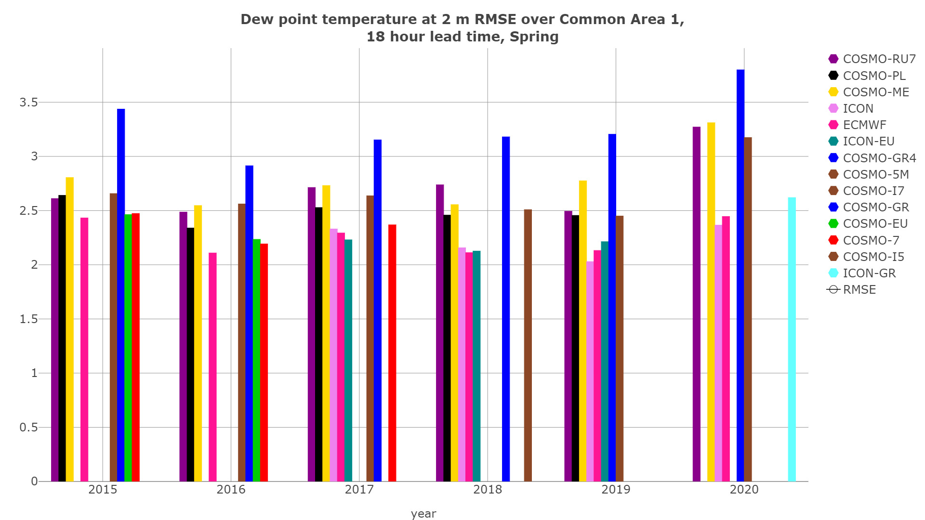
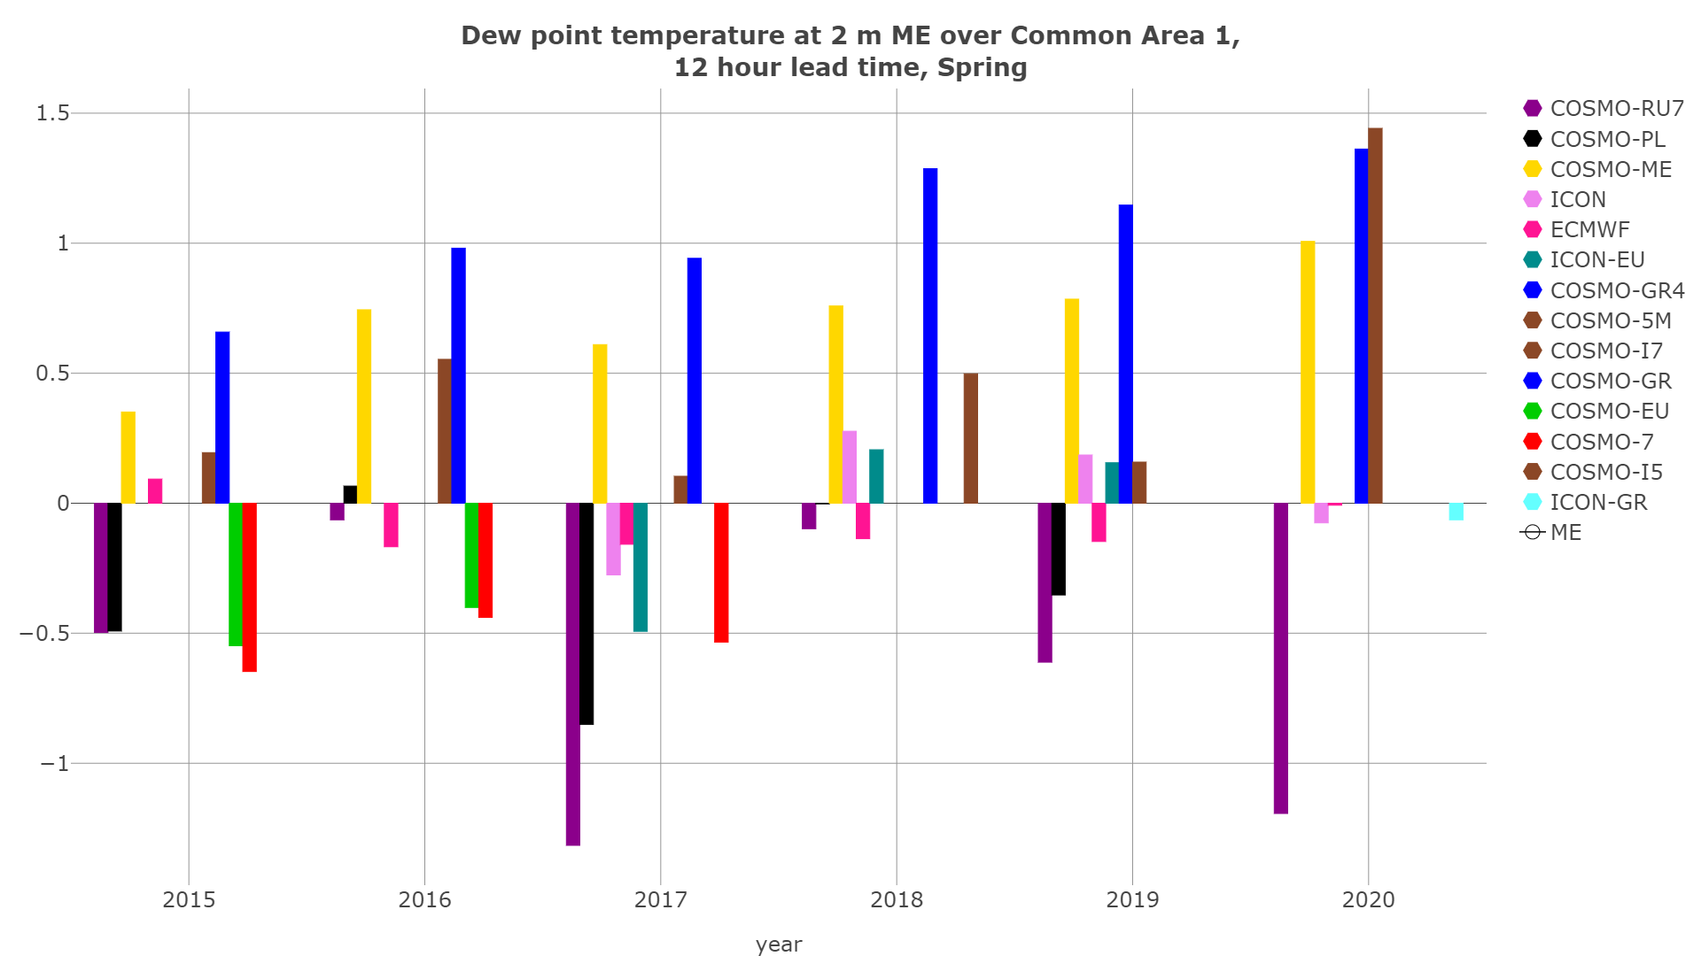
Dew point Temperature at 2 m (ME-RMSE)
Common Area 1, 12 hour lead time, Spring
2017 2018 2019
RMSE
ME
Spring RMSE (ME for some models) increased compared to last year

Slide 19
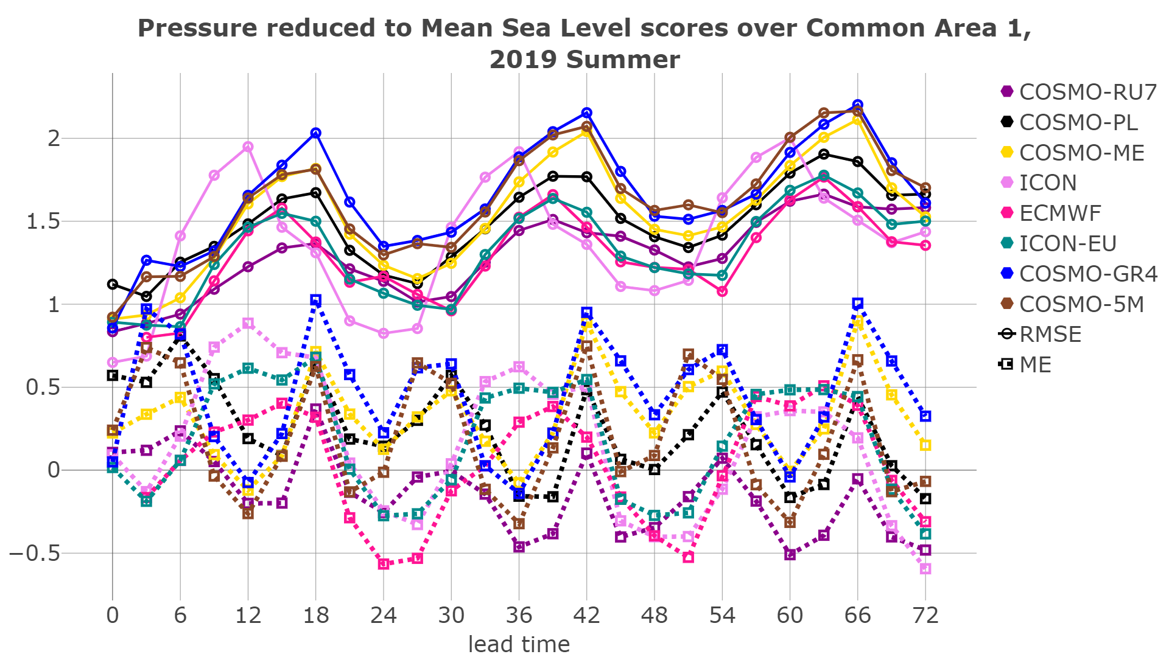
Pressure reduced to Mean Sea Level scores
Common Area 1, Summer 2019
RMSE
ME
Daily cycle RMSE
maximum during
Afternoon- ICON earlier (noon)
Shift -ICON and ICON-EU overestimate noon

Slide 20
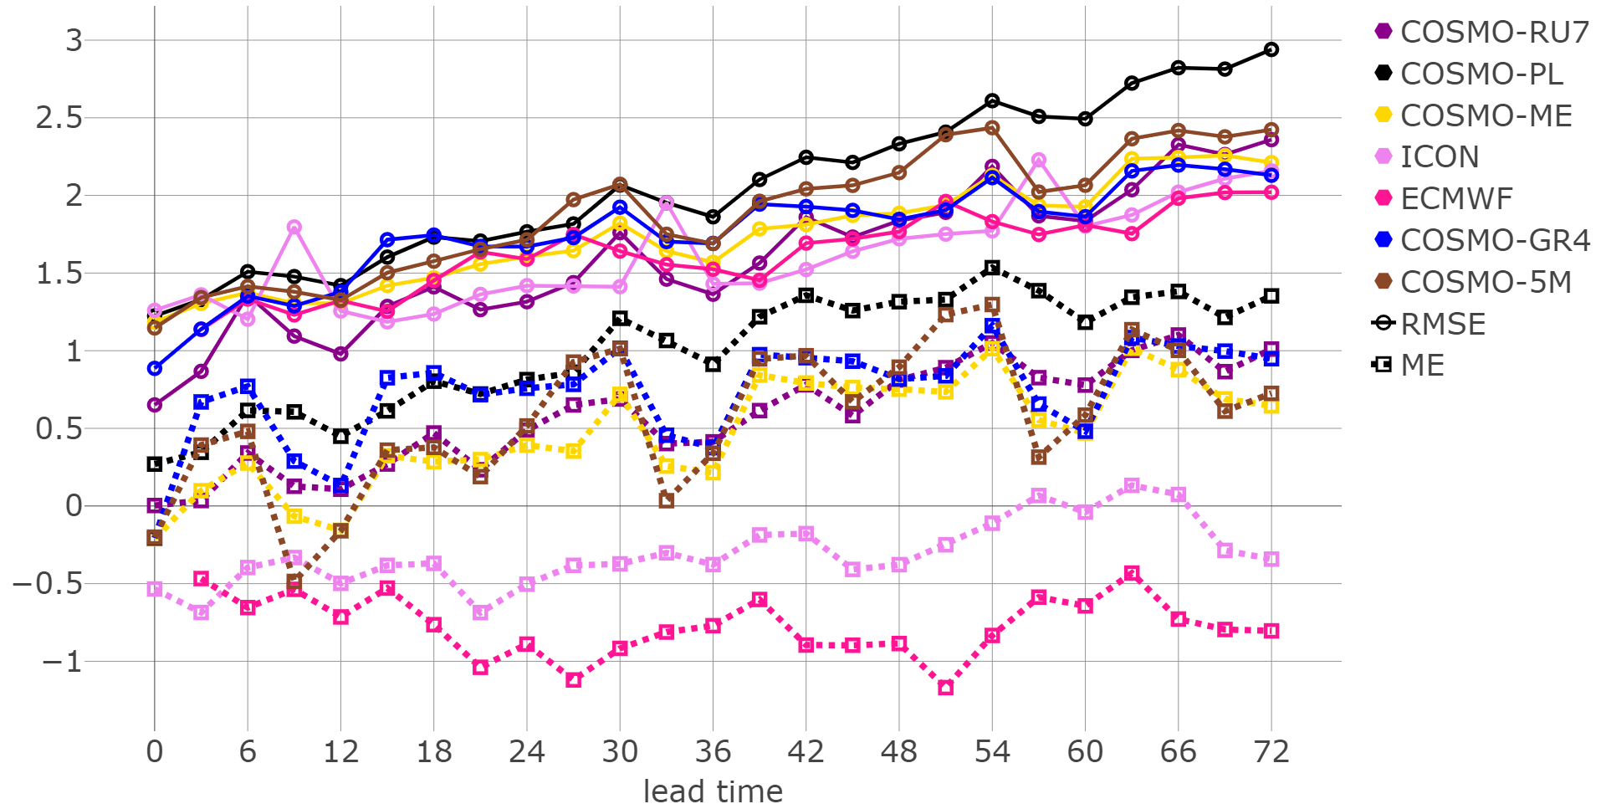
Pressure reduced to Mean Sea Level scores
Common Area 1, Winter 2019-2020
RMSE
ME
RMSE
Increasing with lead time (SON, DJF)
Lower for ICON
ICON and IFS Underestimate (SON, DJF) COSMO overestimate

Slide 21
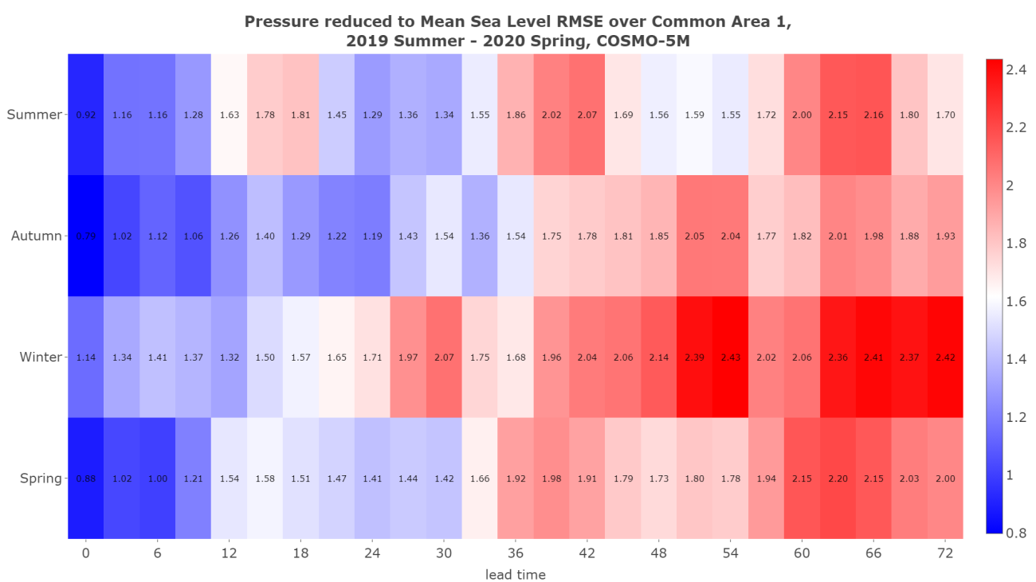
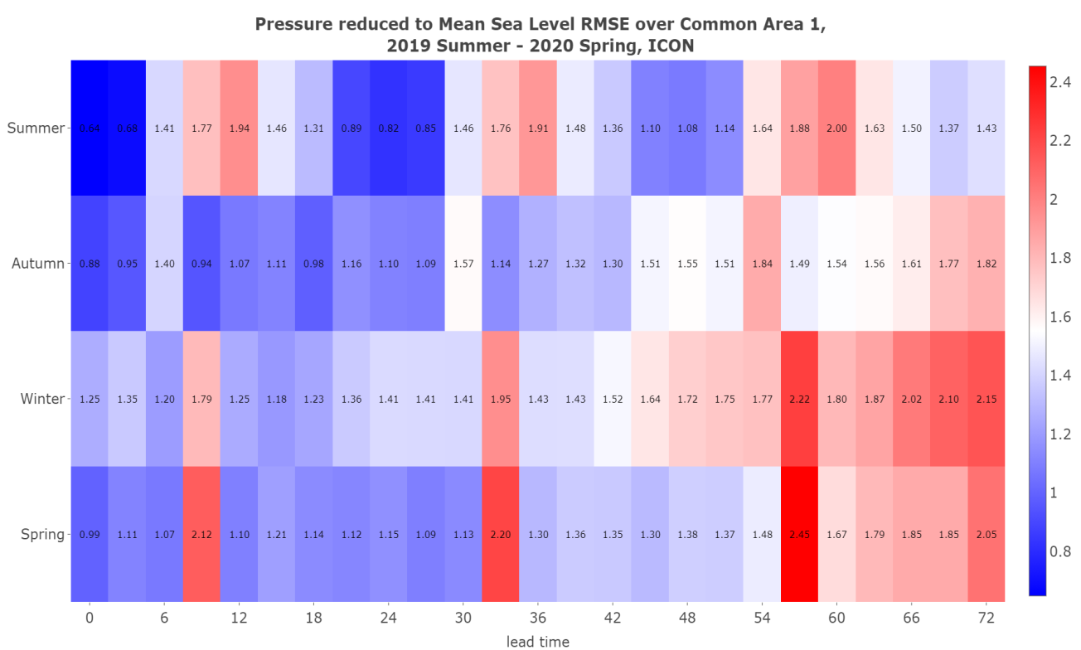
RMSE MSLP
JJA
SON
DJF
MAM
COSMO-5M
ICON
JJA
SON
DJF
MAM
RMSE
Increase with lead time, lower for ICON, and values are higher in winter

Slide 22
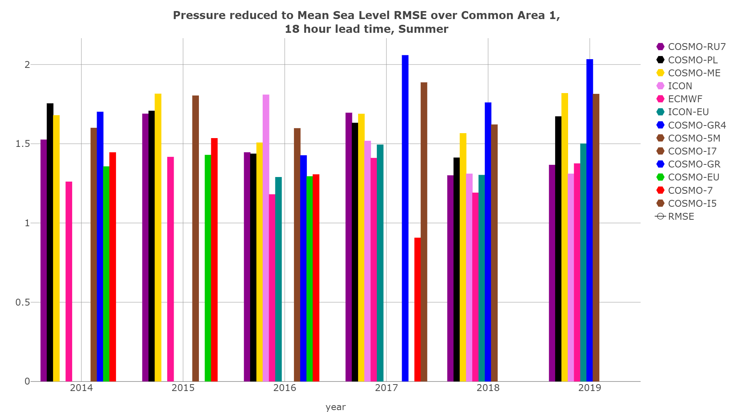
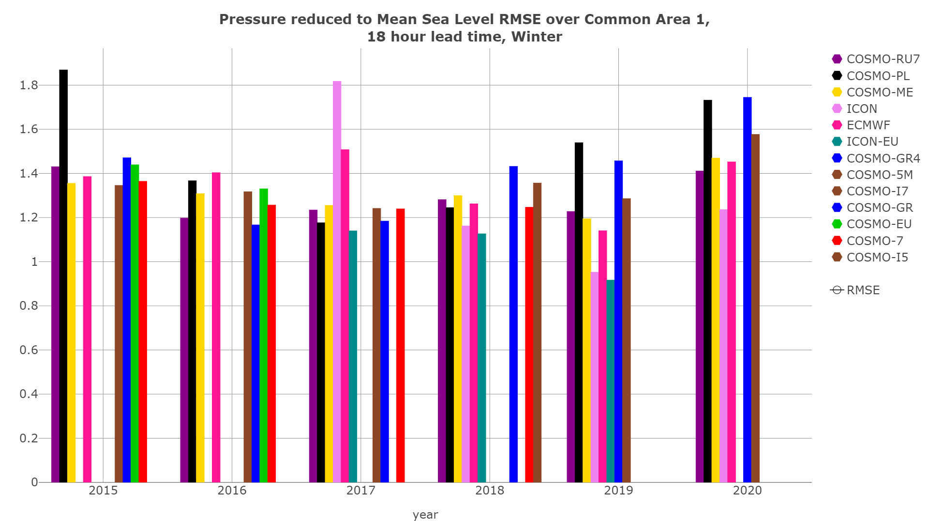
MSLP (RMSE)
Common Area 1, 12 hour lead time, Summer, Winter
2017 2018 2019
Summer
2018 2019 2020
Winter
Spring and Winter RMSE increased compared to last year for most models

Slide 23
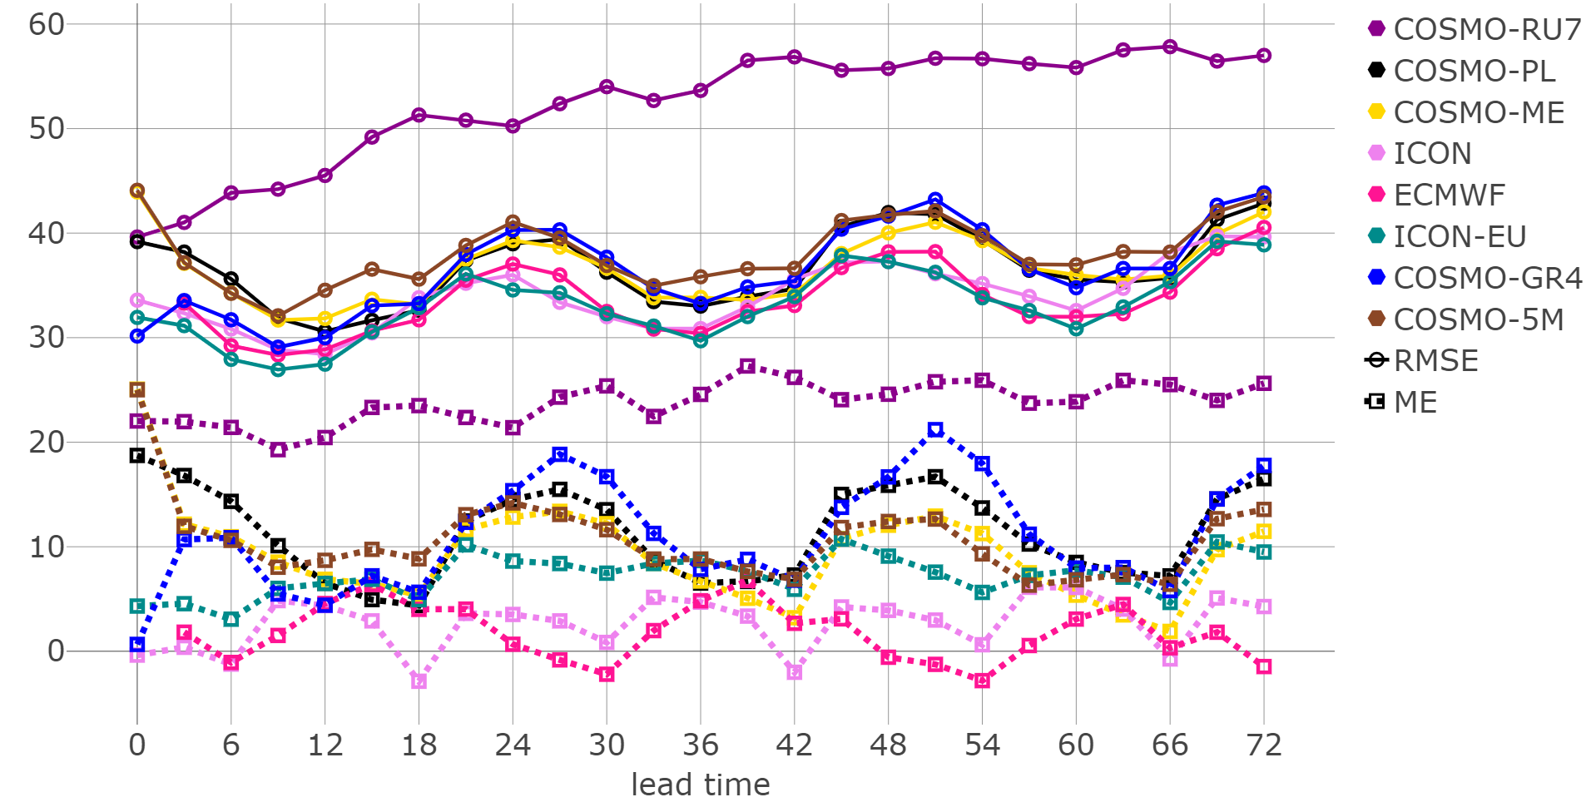
Total cloud cover scores
Common Area 1, Summer 2019
RMSE
ME
ME (+) and RMSE higher at night (like previous years) . Better
ICON and IFS which do not follow COSMO cycle
Notes:
Problem with observationsat night ?

Slide 24
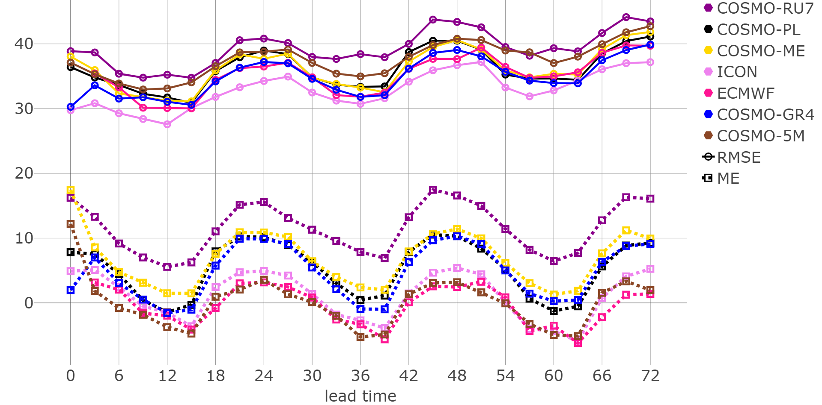
Total cloud cover scores
Common Area 1, Winter 2019-2020
RMSE
ME
ICON follows COSMO cycle (SON, DJF)
Better Scores ICON, IFS
Notes:
Compared to the previous year RMSE decreased during spring, COSMO ME and RMSE increased during summer, while ICON RMSE did not change significantly.

Slide 25
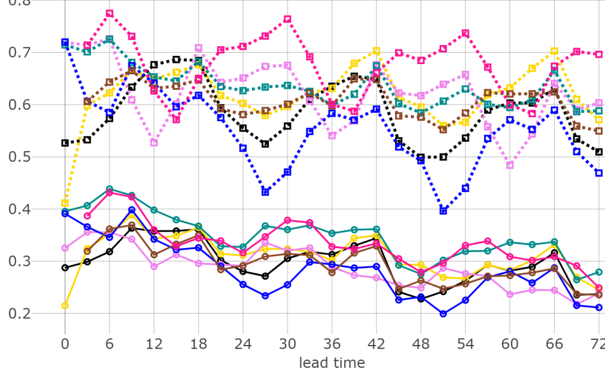
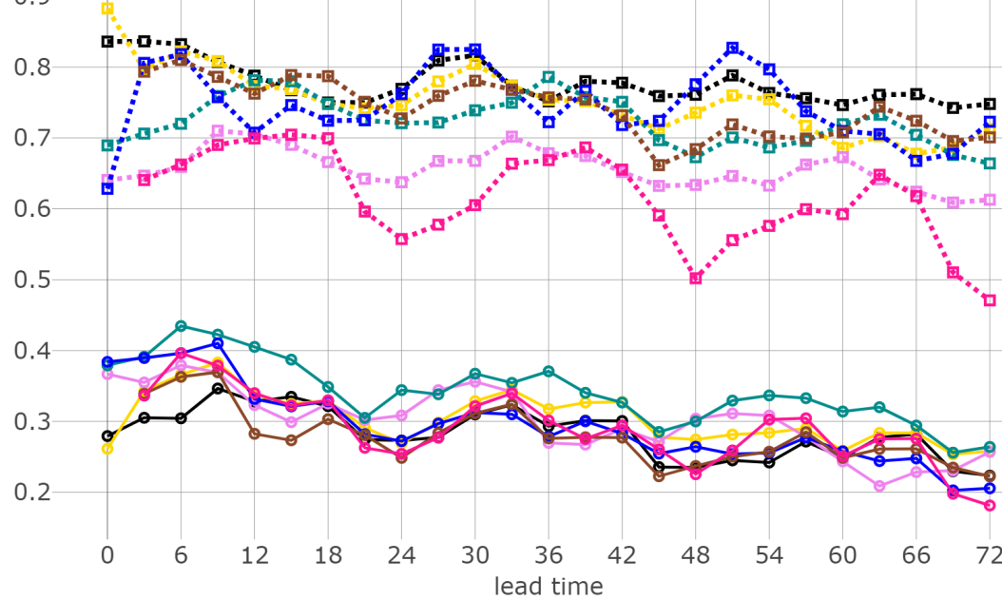
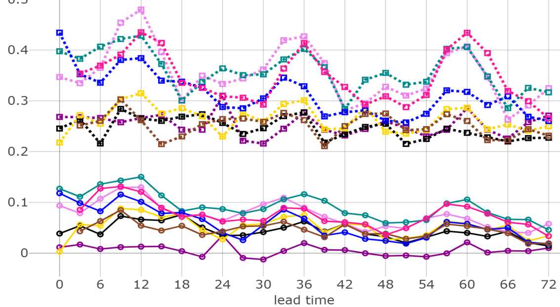
Total cloud POD ETS Dichotomic score
Common Area 1, Summer 2019
0-25%
75-100%
ETS values generally worse for
25-75%.
ICON POD worse than COSMO for 75-100%
25-75%

Slide 26
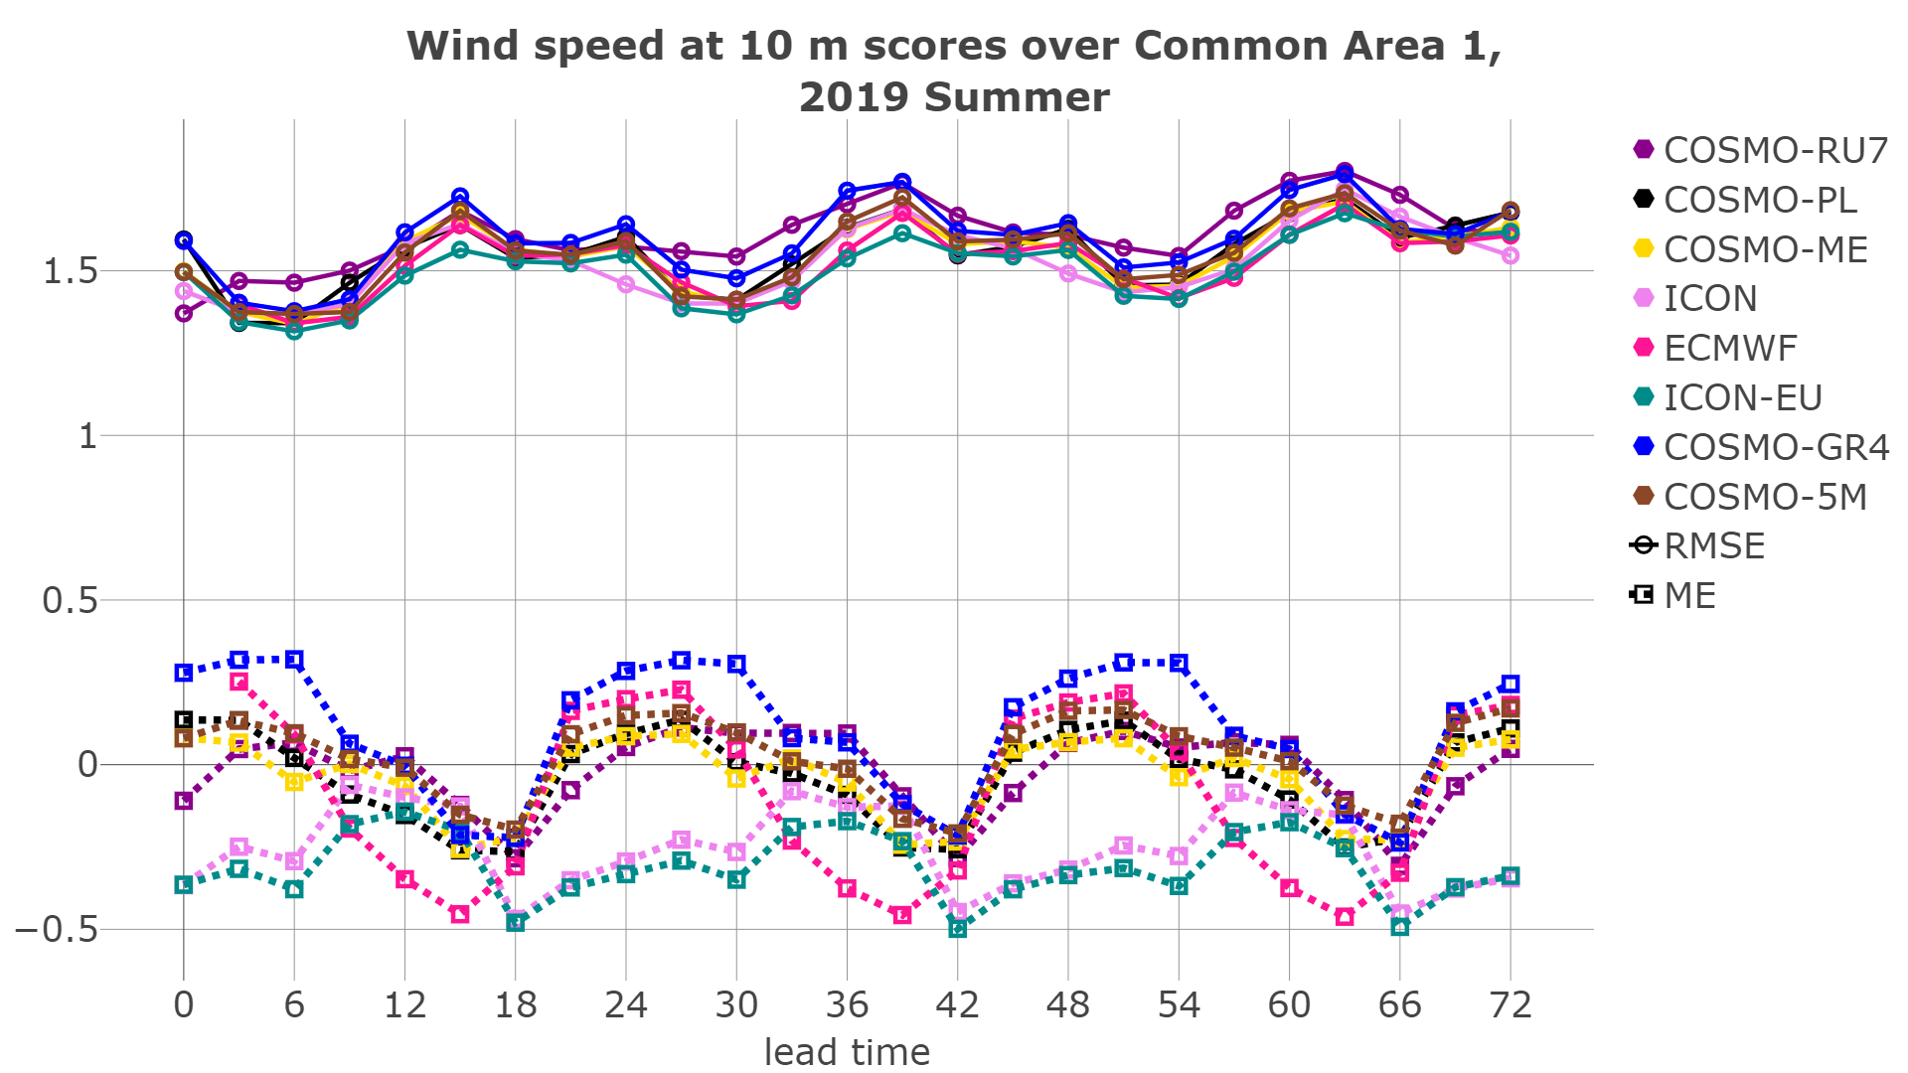
Wind speed at 10 m scores
Common Area 1, Summer 2019
RMSE
ICON and ICON-EU
underestimate
Wind speed at 10 m
ME
RMSE increases in DJF compared to last year.
Notes:
All models have similar RMSE values and variation. There is a notable RMSE difference between ICON and ICON-EU during winter.

Slide 27
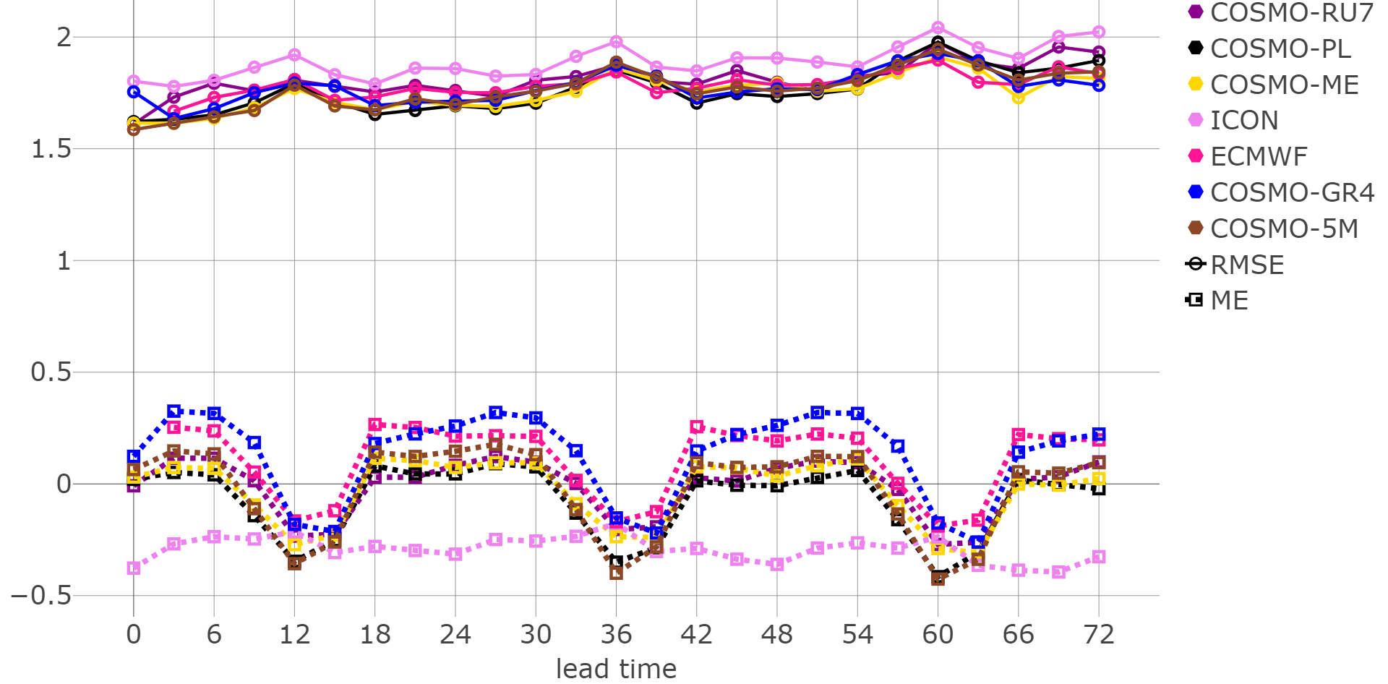
Wind speed at 10 m scores
Common Area 1, Winter 2019-2020
RMSE
ME
ICON underestimates
Wind speed at 10 m
RMSE ICON higher

Slide 28
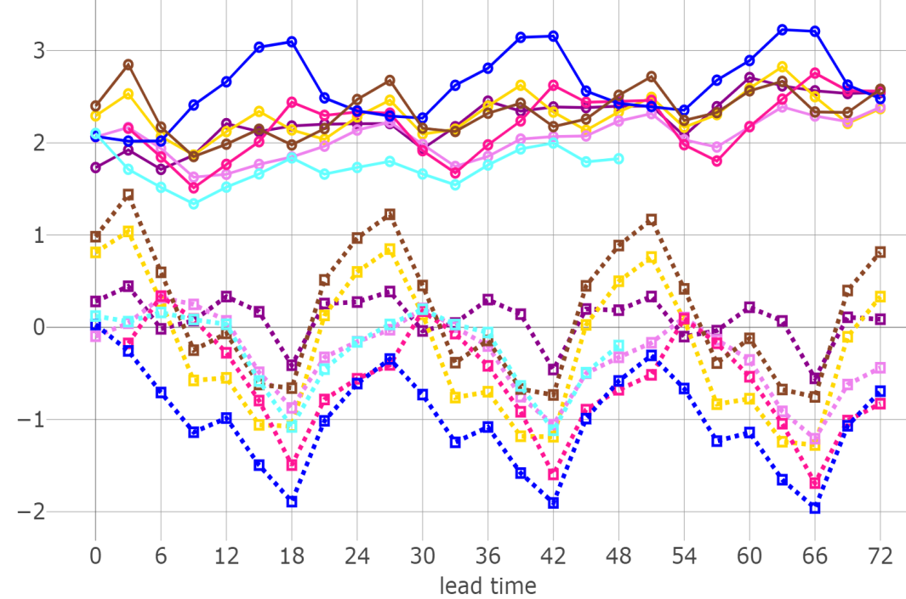
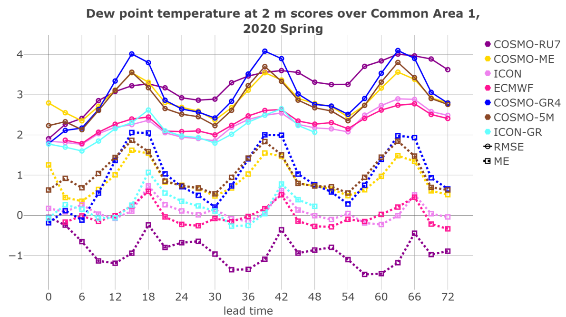
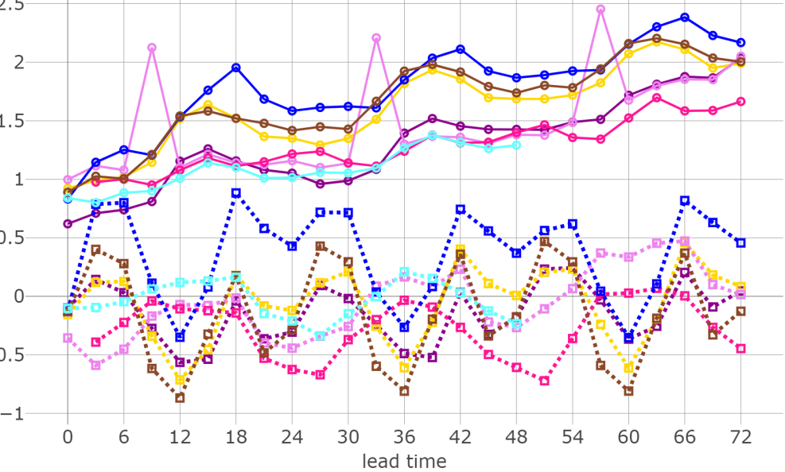
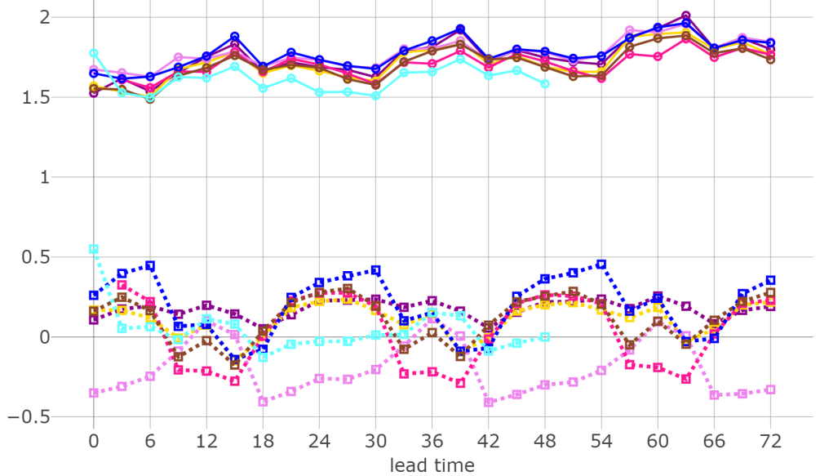
Common Area 1, Spring 2020
T2m
Td2m
WS10m
MSLP
ICON-GR Good Scores !!

Slide 29
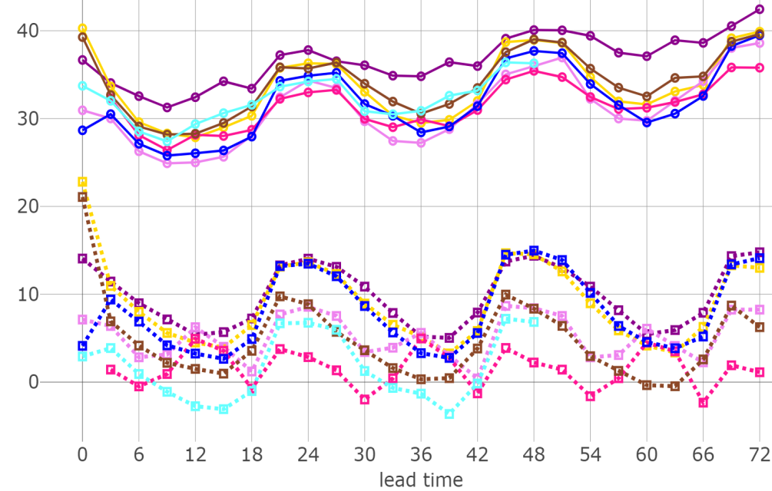
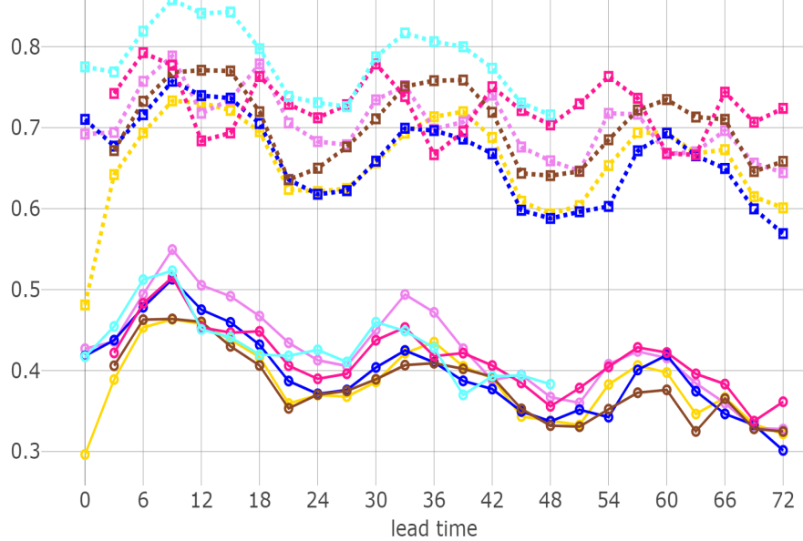
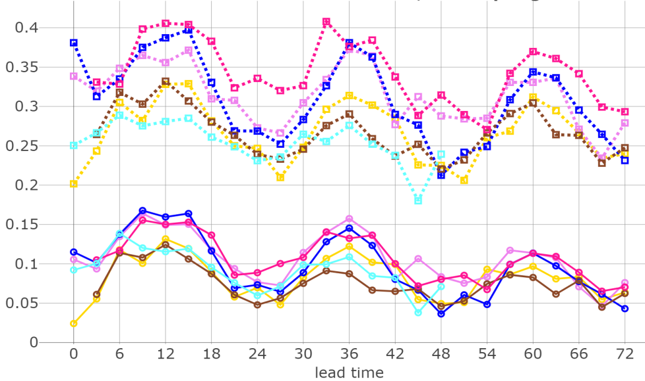
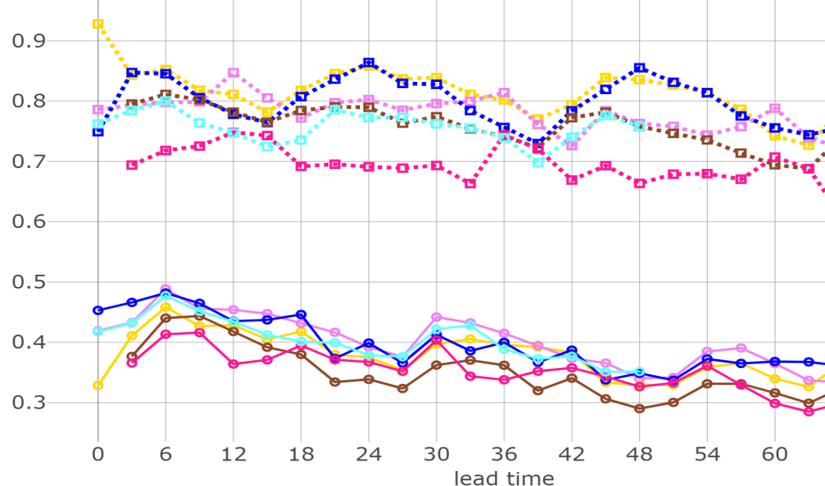
Common Area 1, TCC Spring 2020
0-25%
POD
RMSE
ETS
ME
25-75%
75-100%
POD
POD
ETS
ETS
ICON-GR better than other models (POD) 0-25%, worse 25-75%

Slide 30
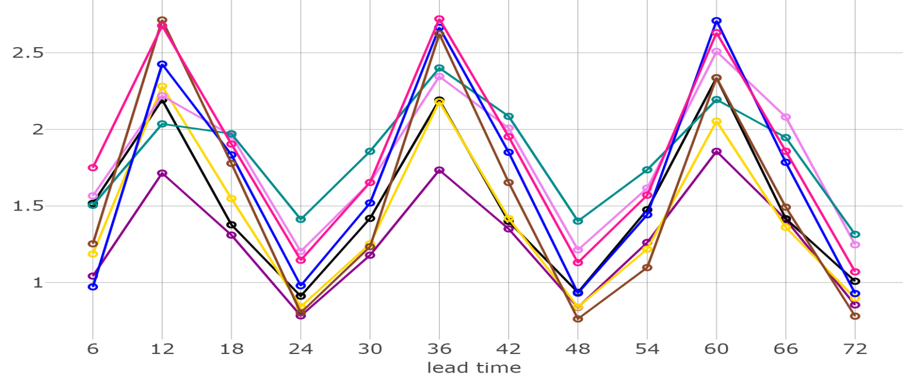
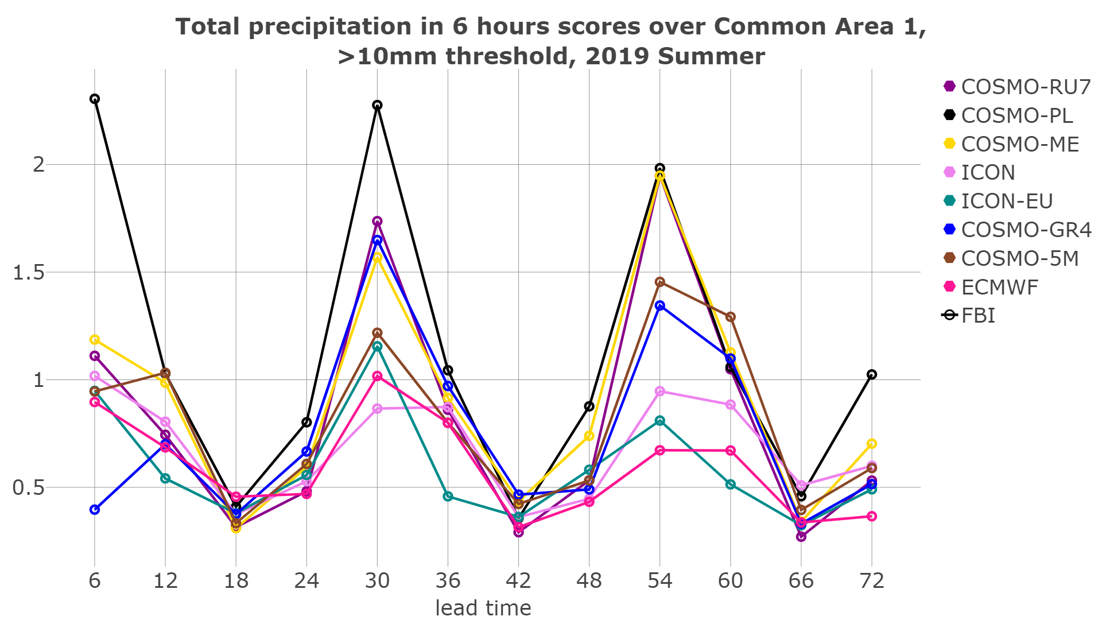
Total precipitation in 6 hours FBI
Common Area 1, Summer 2019
>0.2mm
ICON-EU, ICON tend to underestimate events for higher thresholds
>10mm
>0.2 mm Tot.prec. overestimated
“drizzle” persists

Slide 31
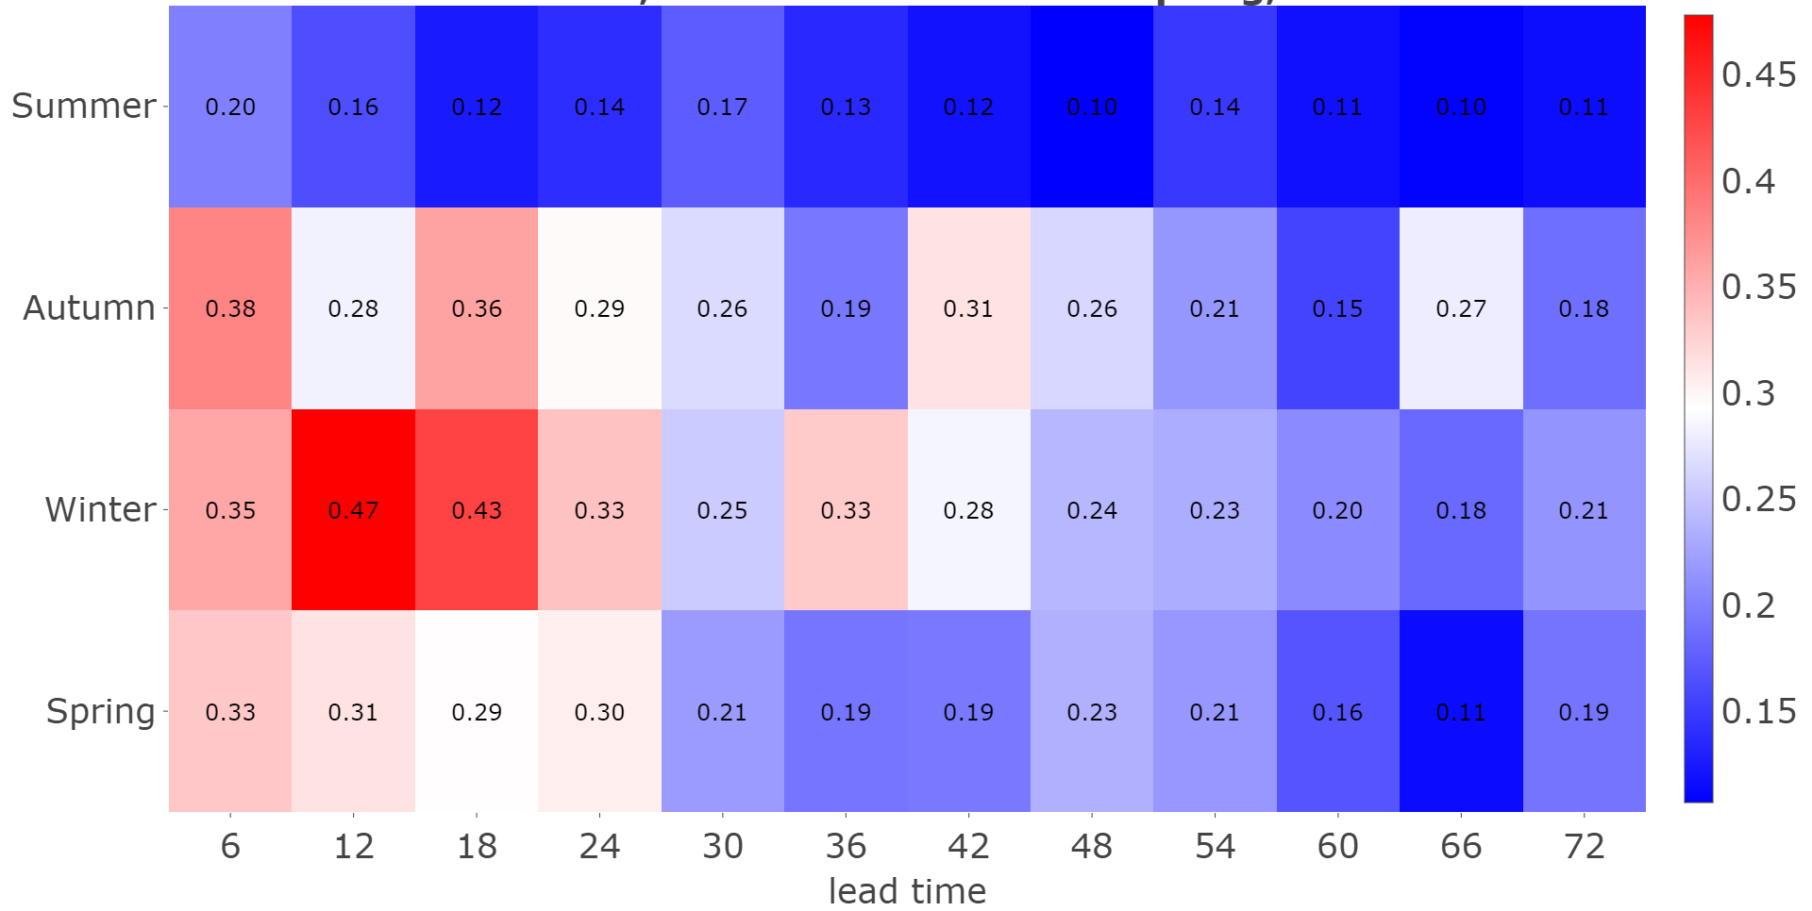
>5 mm Total precipitation in 6 hours ETS
Common Area 1, COSMO-5M
Better ETS COSMO values in Winter, ETS decreases with lead time
Notes:
Both ETS and FBI decrease for higher precipitation thresholds.

Slide 32
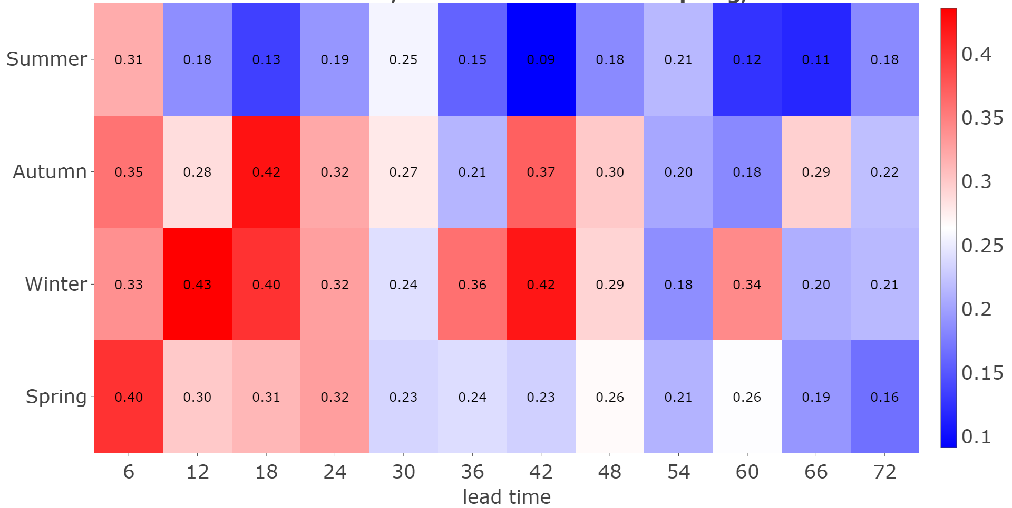
>5 mm Total precipitation in 6 hours ETS
Common Area 1, ICON
Better ETS ICON values in Winter, ETS decreases with lead time , scores better than COSMO`
Notes:
Both ETS and FBI decrease for higher precipitation thresholds.

Slide 33
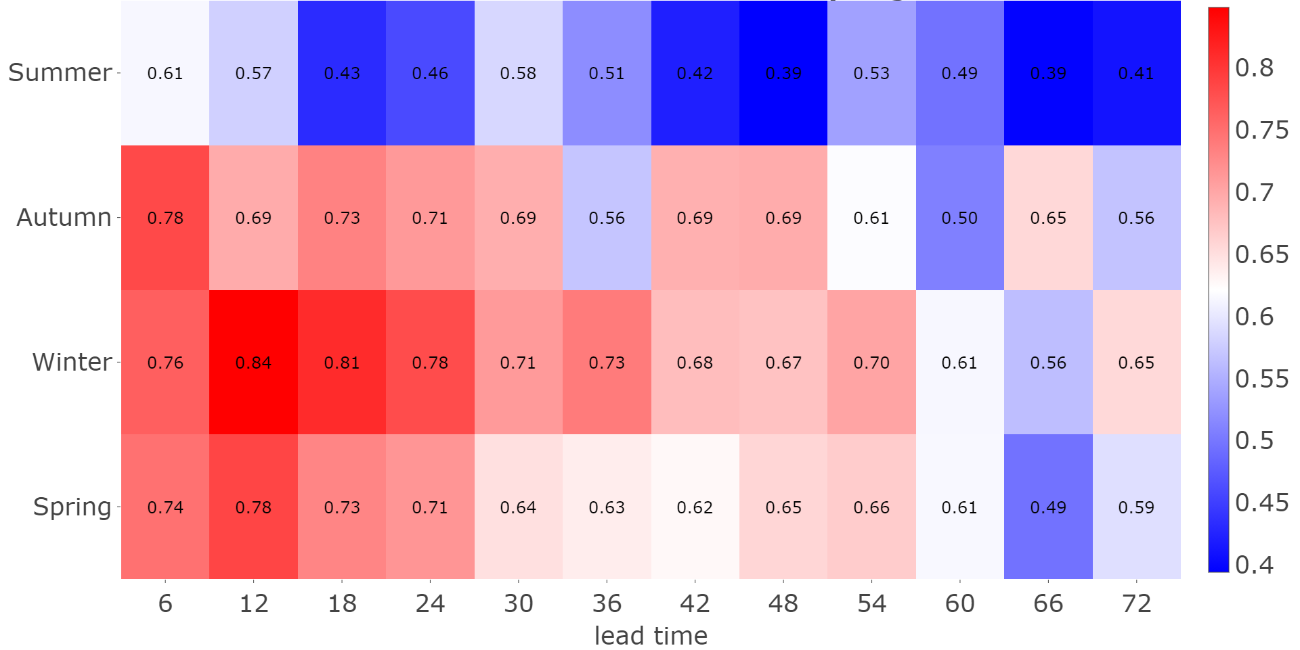
>5 mm Total precipitation in 6 hours SEDI
Common Area 1, COSMO-5M
Better ETS COSMO values in Winter, SEDI decreases with lead time
Notes:
Both ETS and FBI decrease for higher precipitation thresholds.

Slide 34
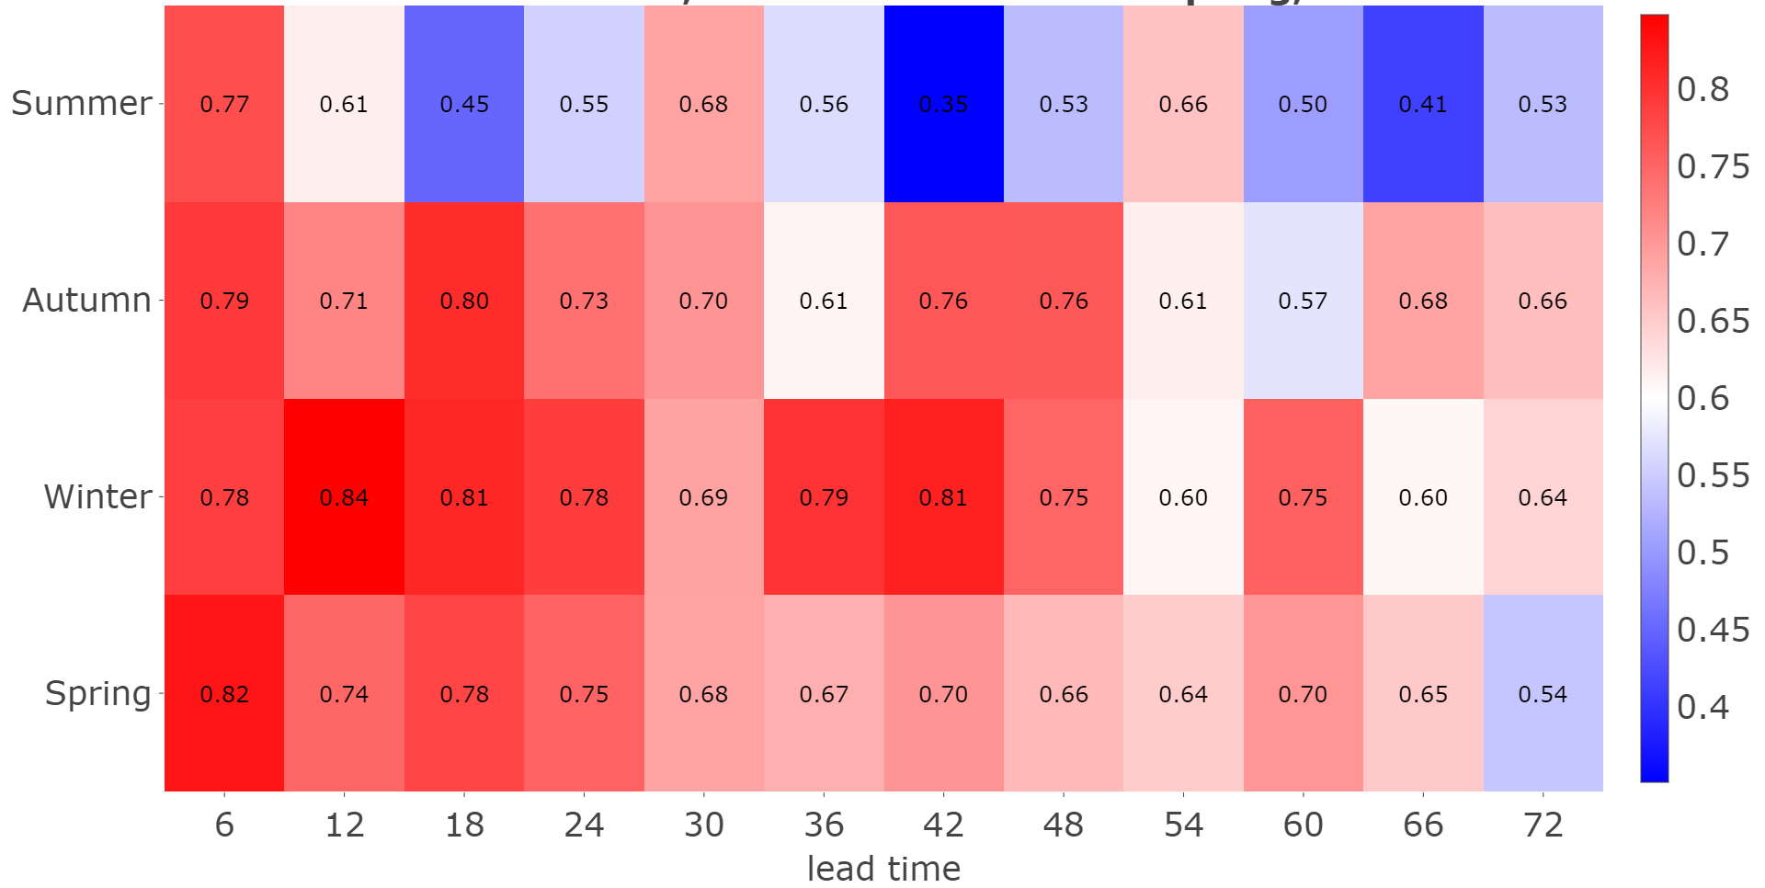
>5 mm Total precipitation in 6 hours SEDI
Common Area 1, ICON
Better ETS COSMO values in Winter, SEDI decreases with lead time, values better than COSMO

Slide 35
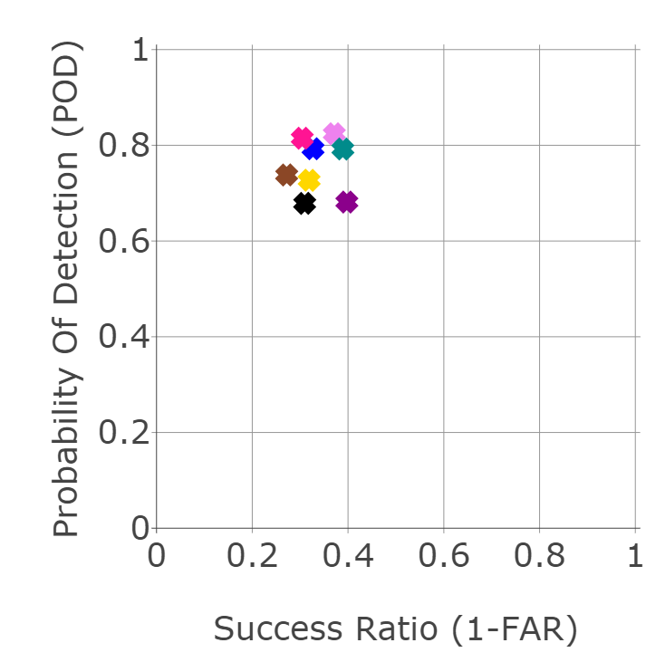
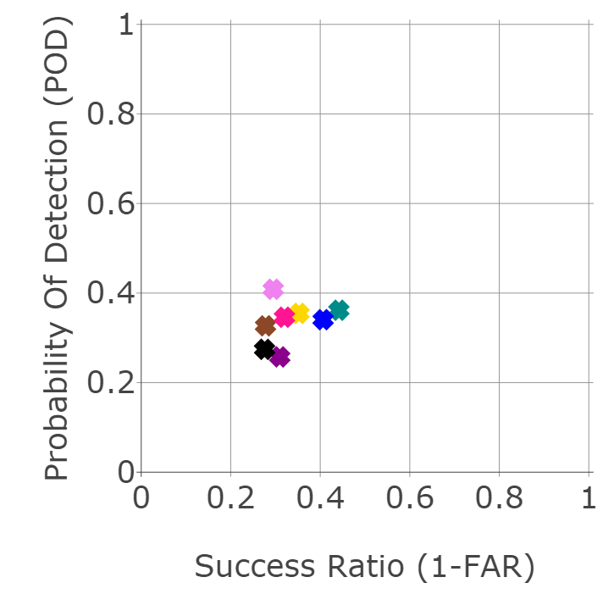

Common Area 1, Summer 2019 6h Precipitation, 12h step
0.2mm
5mm
10mm
ICON-EU values better than COSMO

Slide 36



Common Area 1, Spring 2020 6h Precipitation, 12h step
5mm
0.2mm
10mm
ICON-GR low POD and (1-FAR) values for low thresholds, ICON better for high values

Slide 37
Conclusions
The general features of the parameters have not changed from last year.
ICON-EU, ICON and ICON-GR results are satisfactory.
The temperature diurnal cycle is underestimated, especially in the summer, with higher values of the scores in the afternoon.
The MSLP exhibits a bias and RMSE diurnal cycle in the summer, and the RMSE is increasing with lead time especially in the winter.
The TCC bias and RMSE is higher at night with worse values in the summer.
25-75% TCC events have lower ETS. ICON and ICON-GR models have better
POD for <25%
The Dew Point Temperature exhibits the worse scores around noon and the bias among models differs in fall. However, there is an improvement on fall values from last year
The trends from last year showed some worsening of the scores for this winter

Slide 38
Conclusions
The FBI Diurnal cycle with Overestimation of drizzle in the daytime persists. Higher thresholds are underestimated.
The scores worsen with threshold as expected, somehow less for ICON models.
ICON-GR POD is worse for low thresholds FAR is better, and FBI is also lower with less overestimation. For higher thresholds results are closer and at some lead times better than COSMO.

Slide 39
Report will be available on the website soon with more results and conclusions
ICON-LAM models are expected for next year in order to have new models for comparison !
Thank you for your attention !!

