Slide 1
KENDA developments at DWD
highlights
19 Nov. 2019: ICON-D2 (based on KENDA) in parallel suite
5 March 2020: Radar radial velocity operational (in COSMO-D2)
17 June 2020: Radar reflectivity + radiosonde descent profiles operational
… and a huge amount of work into adaptation of KENDA to ICON-LAM, incl. testing !
… and into port to NEC (→ a lot of compiler bugs, etc.)
→ Hendrik Reich, Christian Welzbacher, Thorsten Steinert, Harald Anlauf,
Klaus Stephan, Thomas Rösch, Martin Lange, Sven Ulbrich, Gernot Geppert,
Lilo Bach, Uli Blahak, Christoph Schraff, Roland Potthast, et al. (!), … ,
Günther Zängl
this talk: aspects on
KENDA for ICON-LAM
further development of KENDA-LETKF: inflation; radiosonde descents; Mode-S

Slide 2
Task 4.1: KENDA for ICON-LAM:
implementation
LHN: reading of blacklist info and processing of radar beam height map for
bright band detection implemented in ICON-LAM; further tuning
→ solves previous problems in winter
soil moisture nudging towards interpolated ICON-EU soil moisture (with SMA)
plus processing of 2-m temperature bias for
online adjustment of plant stomata resistance, fraction of sealed surfaces, and leaf area index
(analogous to global ICON DA cycle, operational since 30 July 2019)
beneficial mainly for first sunny days in early spring when soil moisture adjustments by SMA are too slow)

Slide 3
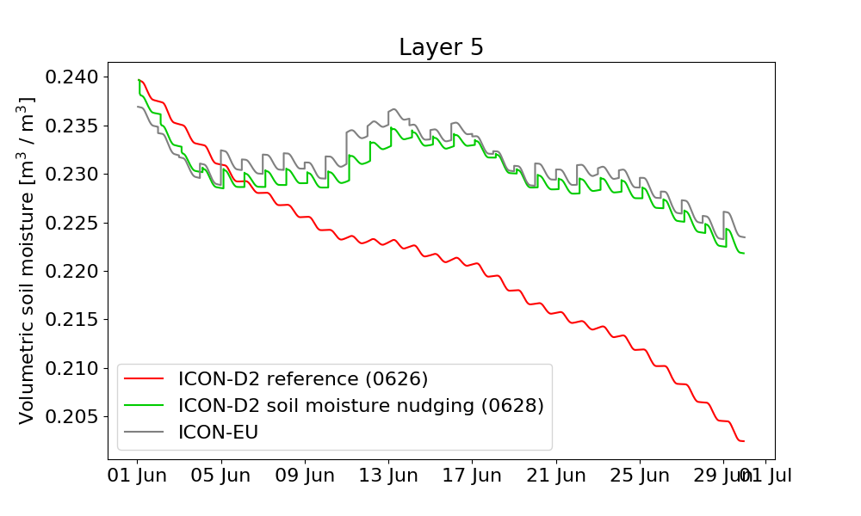
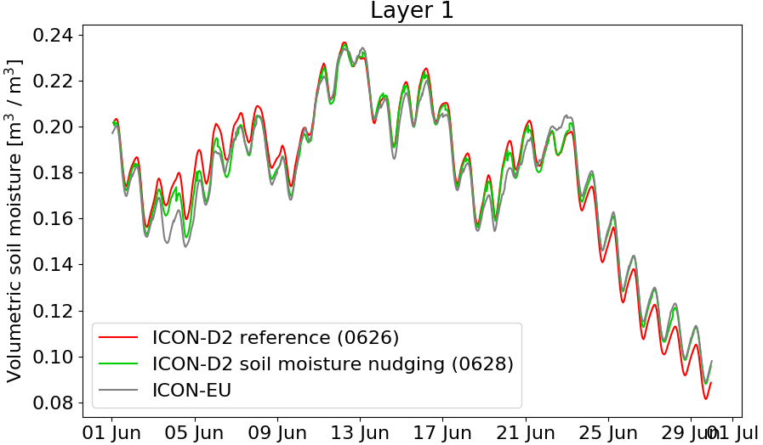
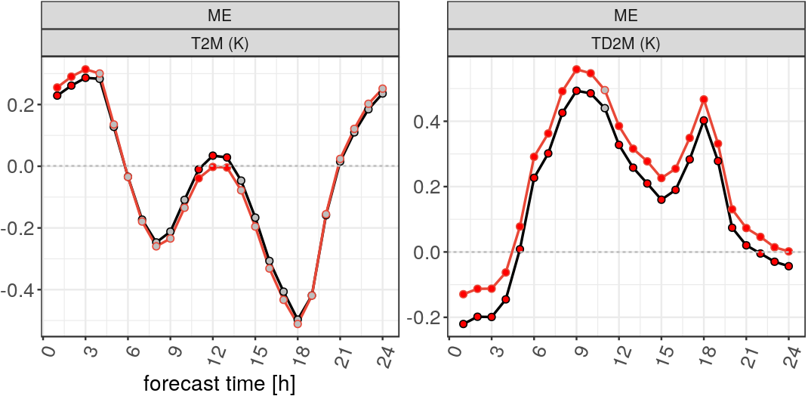
Task 4.1: KENDA for ICON-LAM
nudging of soil moisture index (SMI)
domain averaged soil moisture (SM)
layer 5: 27 – 81 cm
layer 1: 0 – 1 cm
(with soil moisture analysis)
1 – 18 June 2019, 0-UTC runs
ICON-D2 reference
ICON-D2 w. SM nudging
SM nudging
moistening of soil > 9 cm
until 18 June!
  T2m bias slightly decreased
  mse scores neutral

Slide 4
Task 4.1: KENDA for ICON-LAM:
comparison ICON-D2 with KENDA (complete LETKF + LHN, except for soil moisture nudging)
(and w/o use of 3-D radar obs)
  for 3 periods: winter: 26 Nov. 19 – 6 Jan. 2020
        autumn: 13 Sept. – 13 Oct. 2019
        summer: 1 June – 23 June 2019
  vs. COSMO-D2
  vs. downscaler: ICON-D2 with interpolated ICON-EU as IC (“ID2-EU-IC”)
  autumn: different external param (orography) → surf. pressure, 10-m wind not comparable
  summer: & difference in cloud scheme → cloud cover, surface radiation not comparable

Slide 5
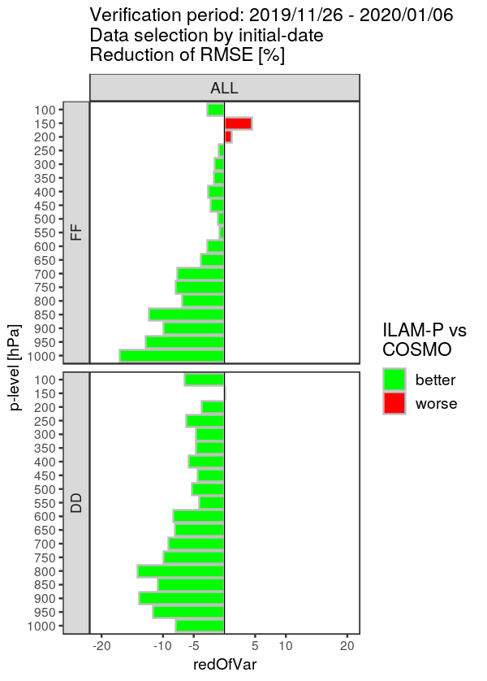
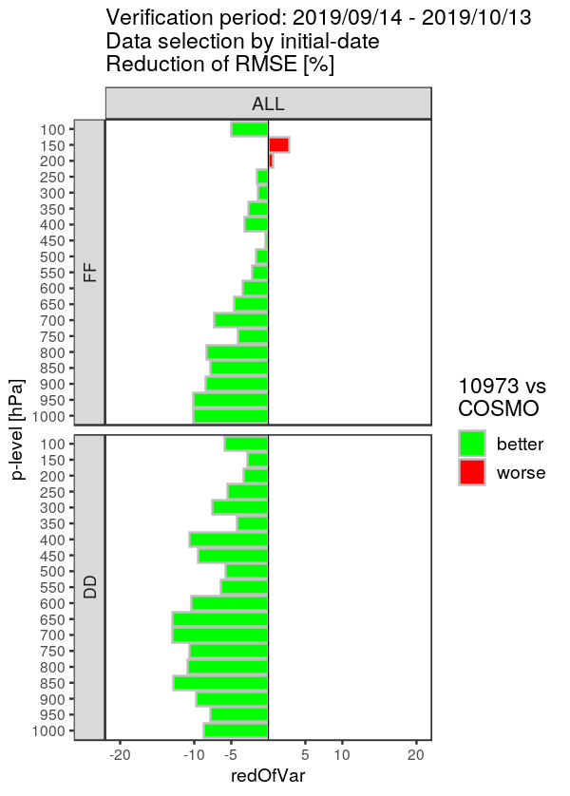
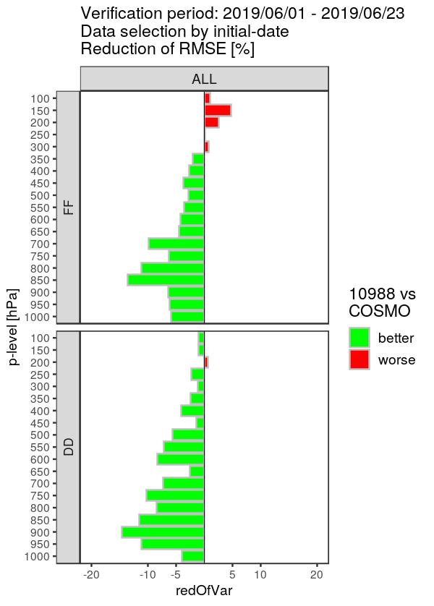
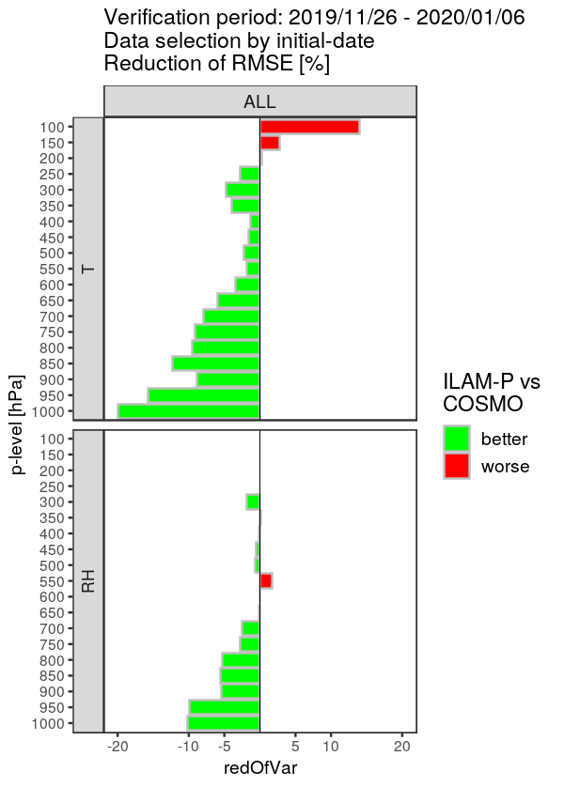
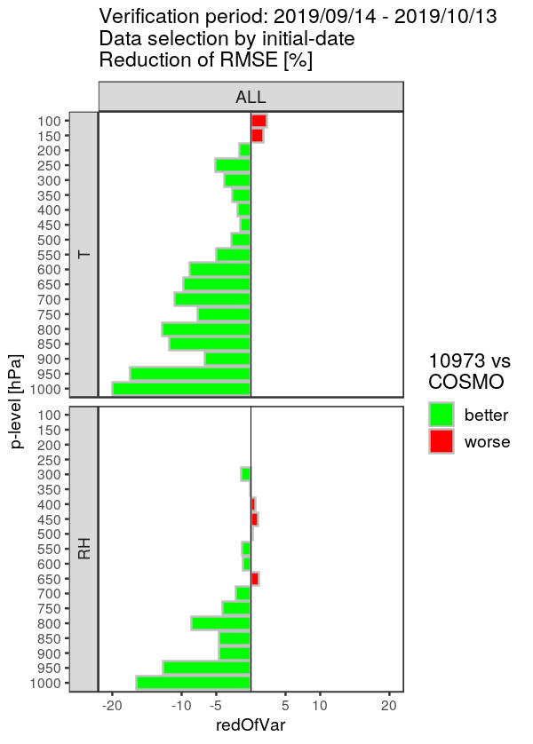
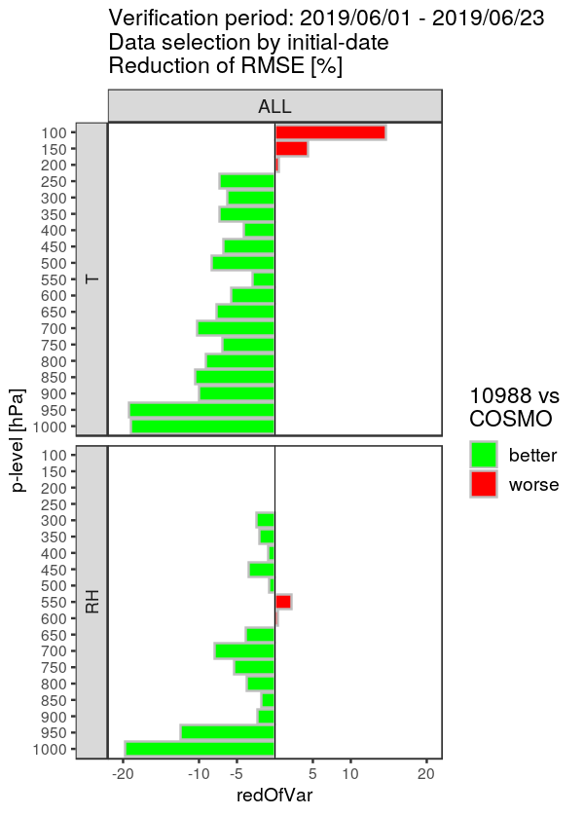
Task 4.1: KENDA for ICON-LAM
comparison to COSMO
change [%] of RMSE, averaged over 12-h & 24-h forecasts, against radiosondes
winter 26/11/19 – 06/01/20
autumn 13/09 – 13/10/19
summer 01/06 – 23/06/19
ICON-D2 better
COSMO-D2 better
wind
speed
T
RH
change [%] in RMSE
ICON-D2 much better than COSMO in troposphere, all seasons, all variables

Slide 6
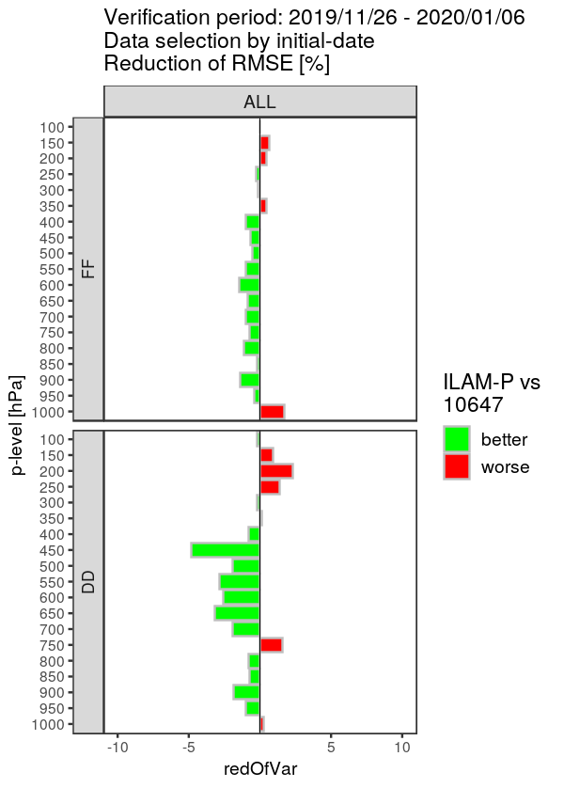
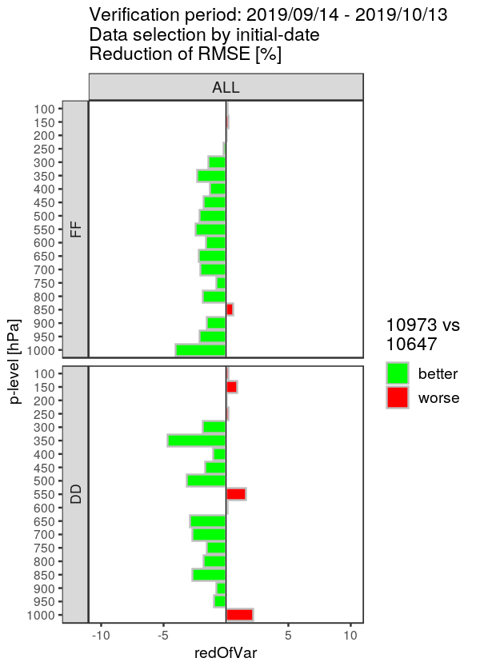
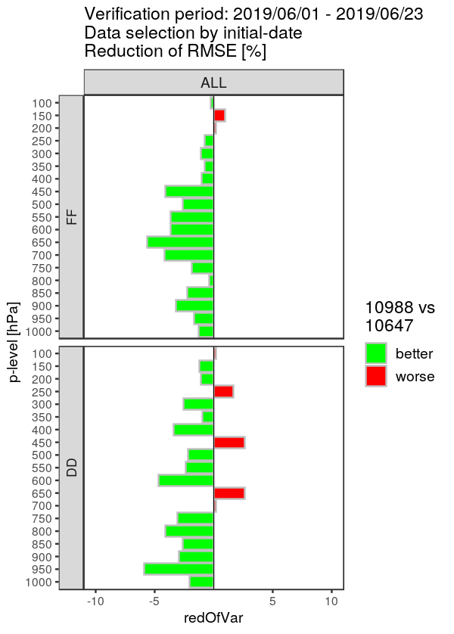
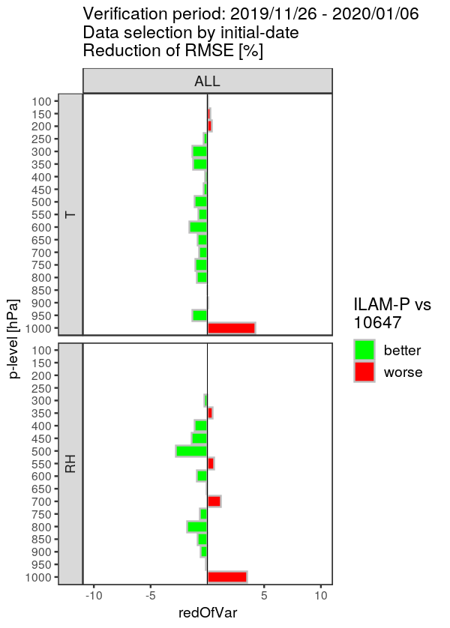
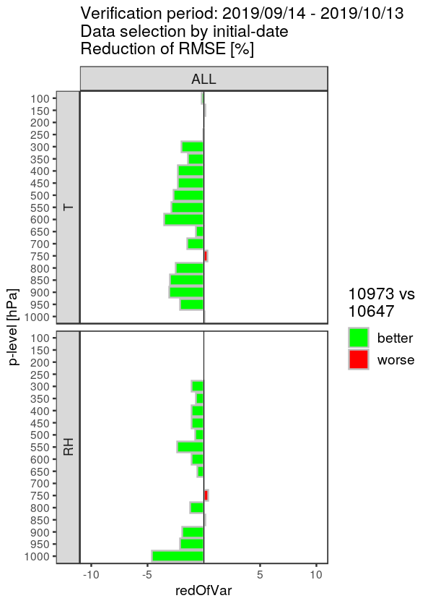
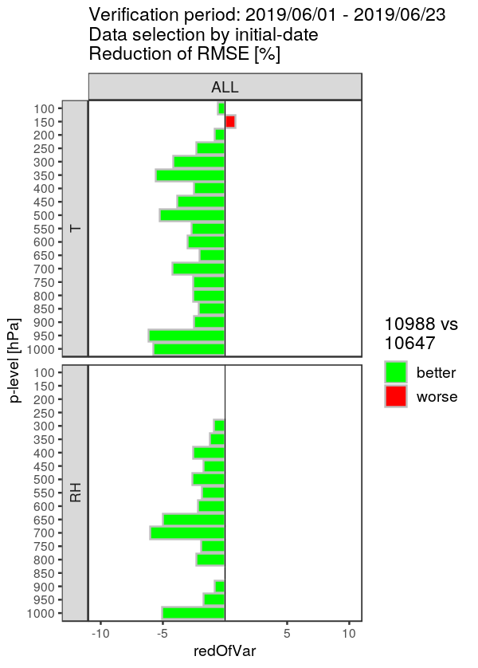
Task 4.1: KENDA for ICON-LAM
comparison to downscaler
change [%] of RMSE, averaged over 12-h & 24-h forecasts, against radiosondes
winter 26/11/19 – 06/01/20
autumn 13/09 – 13/10/19
summer 01/06 – 23/06/19
ICON-KENDA better
ICON downscaler better
wind
speed
T
RH
change [%] in RMSE
KENDA better than downscaler (mainly summer, autumn), except lowest level in winter

Slide 7
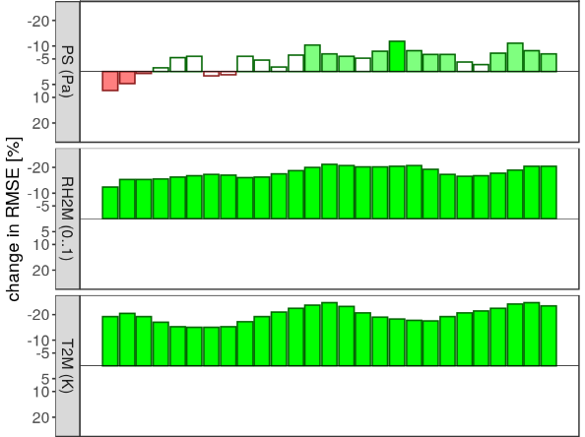
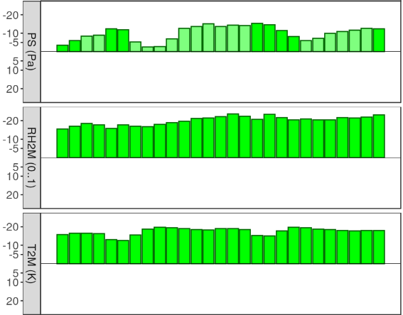
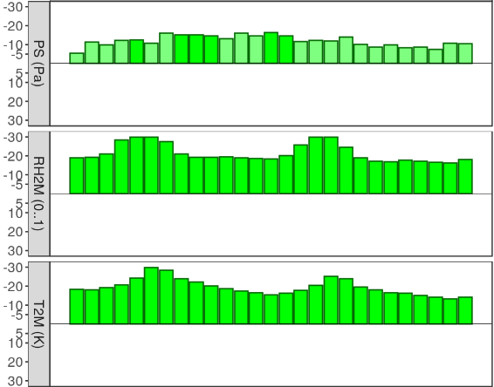
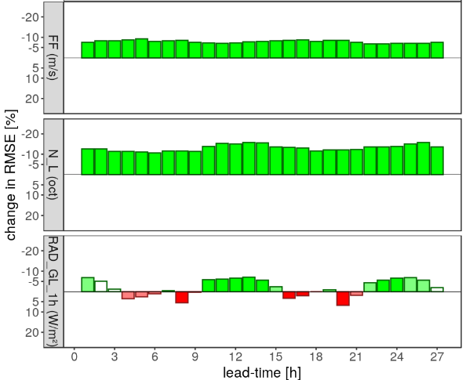
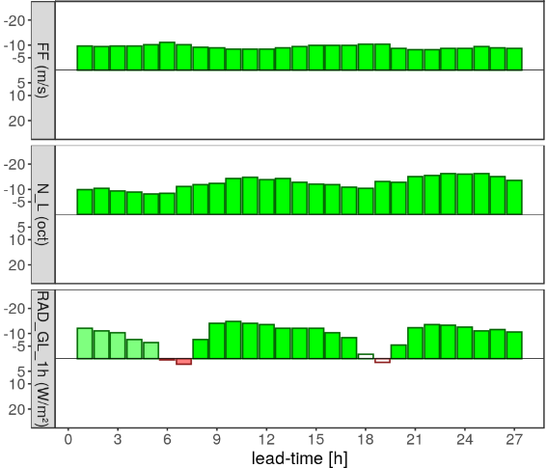
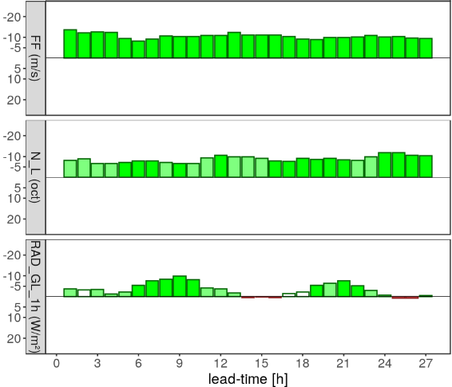
Task 4.1: KENDA for ICON-LAM
comparison to COSMO
change [%] of RMSE against synop
winter 25/11/19 – 06/01/20
autumn 13/09 – 13/10/19
summer 31/05 – 23/06/19
PS
RH2M
T2M
ICON-D2 better
COSMO-D2 better
10-m wind
speed
low
cloud
global
radiation
ICON-D2 much better than COSMO

Slide 8
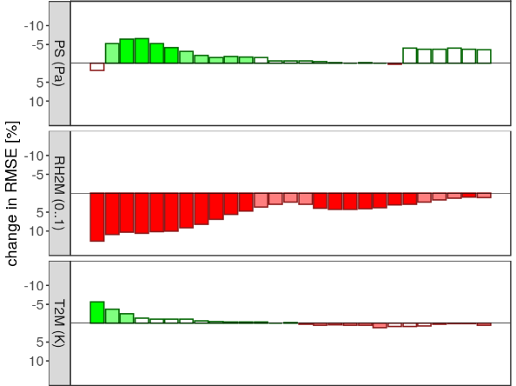
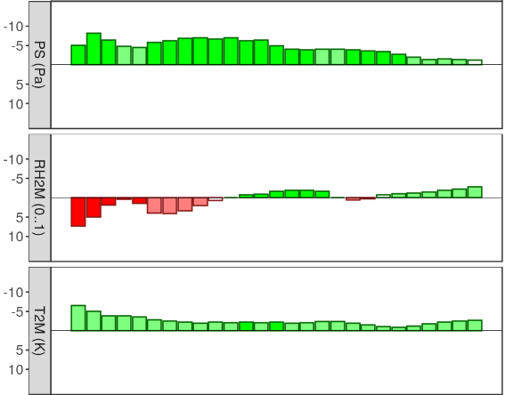
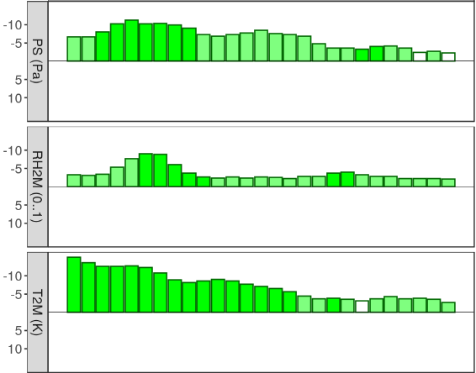
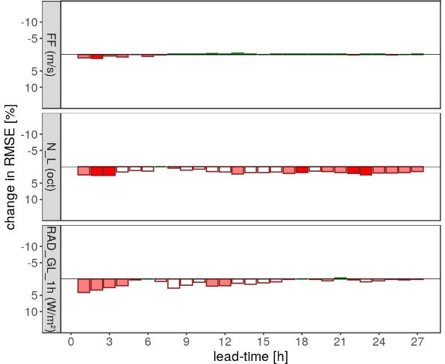
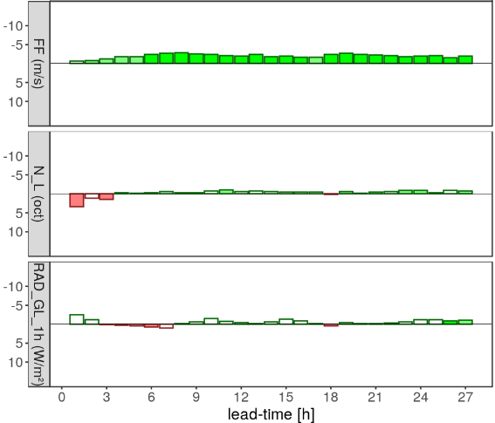
Task 4.1: KENDA for ICON-LAM
comparison to downscaler
change [%] of RMSE against synop
winter 25/11/19 – 06/01/20
autumn 13/09 – 13/10/19
summer 31/05 – 23/06/19
PS
RH2M
T2M
10-m wind
speed
low
cloud
ICON-KENDA better
ICON downscaler better
global
radiation
KENDA better than downscaler (particularly in summer)
except for low cloud and RH2M (LETKF w/o RH2M vs. EnVar with use of RH2M)

Slide 9
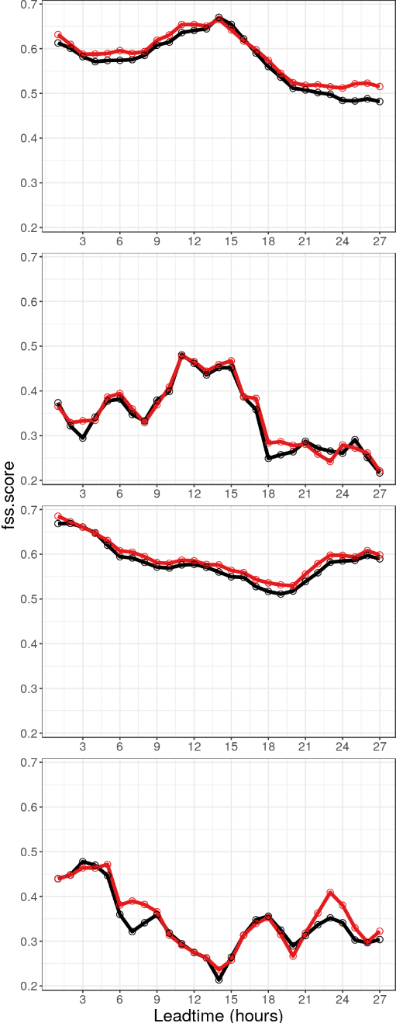
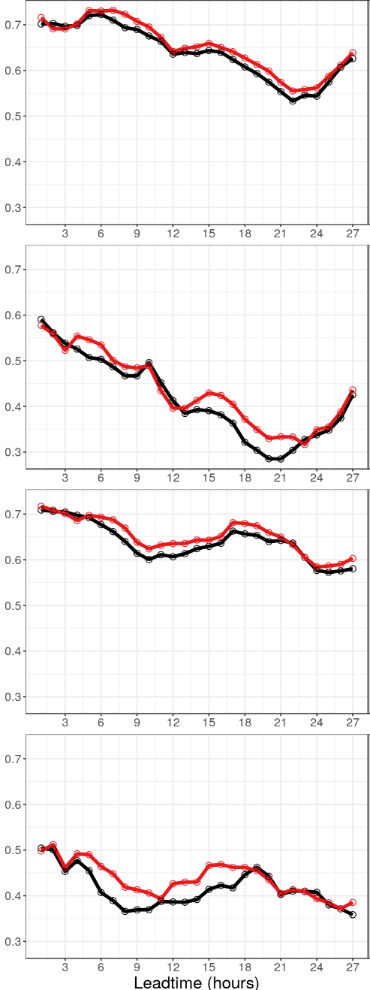
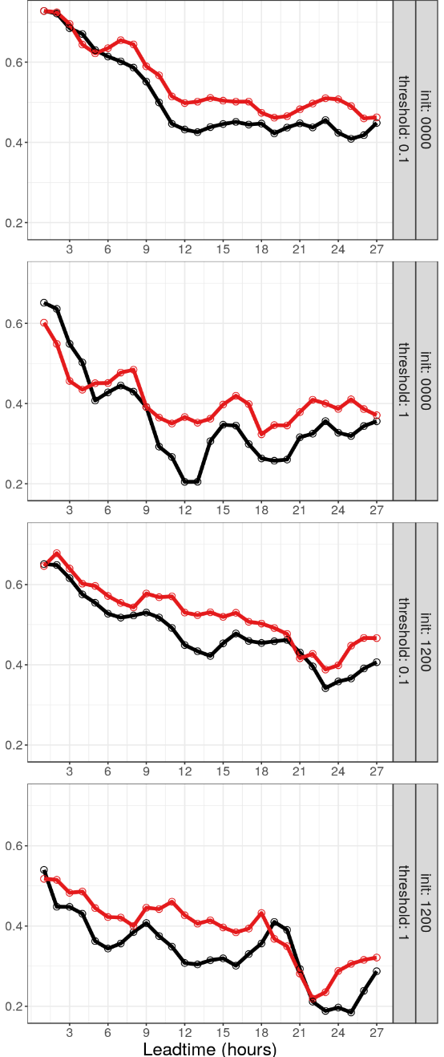
Task 4.1: KENDA for ICON-LAM
comparison to COSMO
1-h precip vs. radar
FSS
(15 g.pt. ≅ 30 km)
0.1 mm/h
0-UTC runs
winter 01/12/19 – 04/01/20
autumn 15/09 – 14/10/19
summer 01/06 – 24/06/19
1 mm/h
ICON-D2
COSMO-D2
0.1 mm/h
12-UTC runs
1 mm/h
after first 3 hrs, ICON better than COSMO (particularly summer)

Slide 10
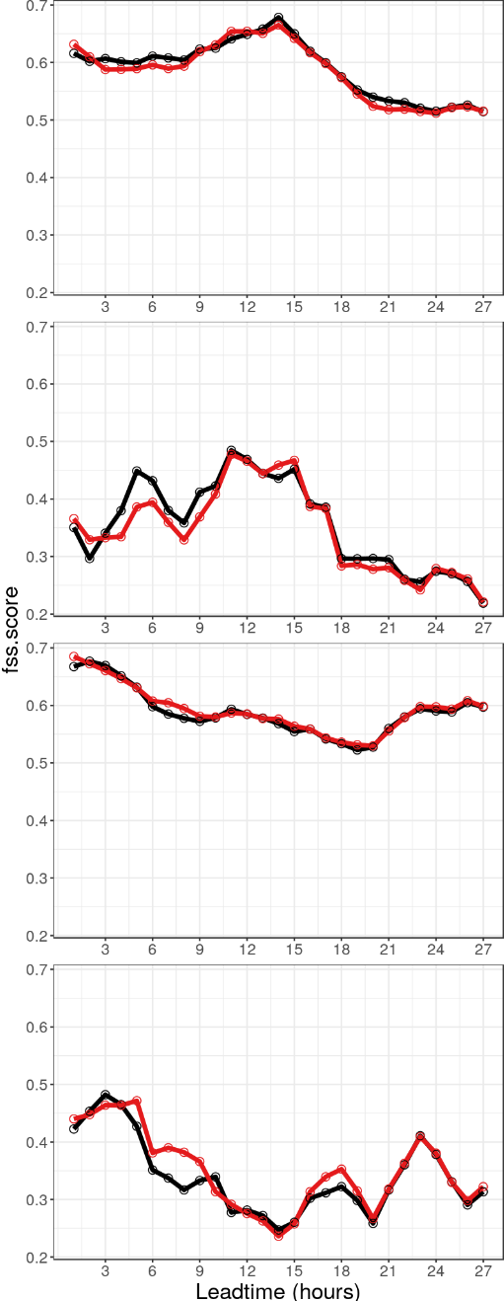
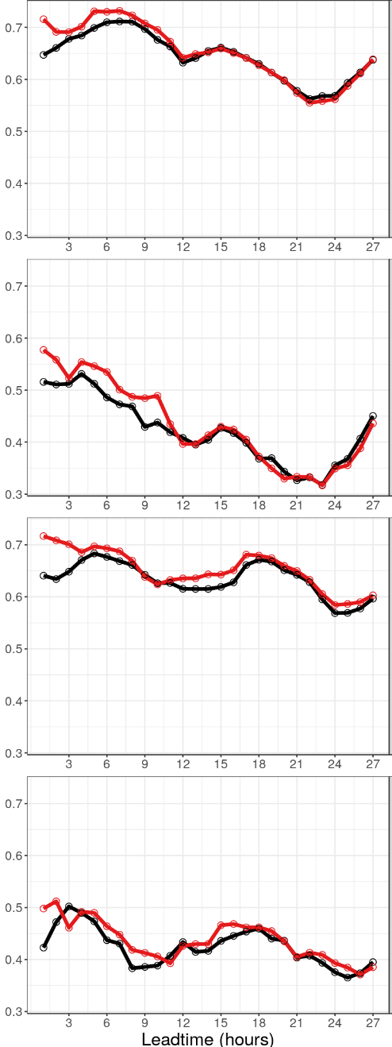
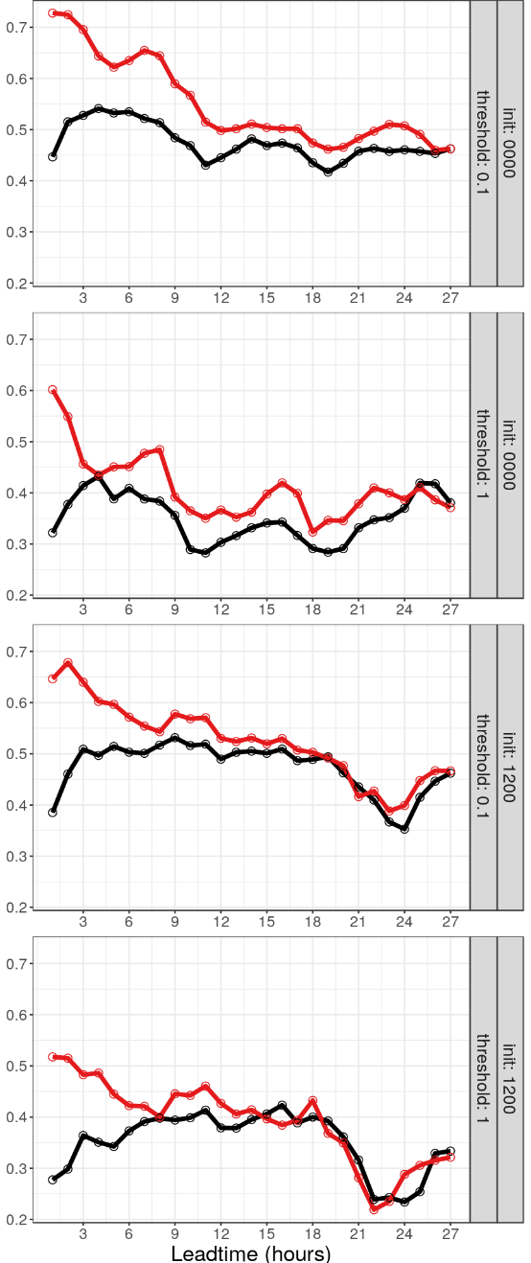
Task 4.1: KENDA for ICON-LAM
comparison to downscaler
1-h precip vs. radar
FSS
(15 g.pt. ≅ 30 km)
0.1 mm/h
0-UTC runs
winter 01/12/19 – 04/01/20
autumn 15/09 – 14/10/19
summer 01/06 – 24/06/19
1 mm/h
ICON-KENDA
ICON downscaler
0.1 mm/h
12-UTC runs
1 mm/h
KENDA improves precip for ~ 12 – 24 h in autumn & summer

Slide 11
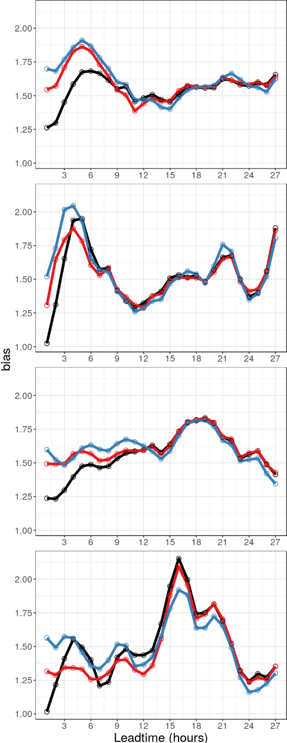
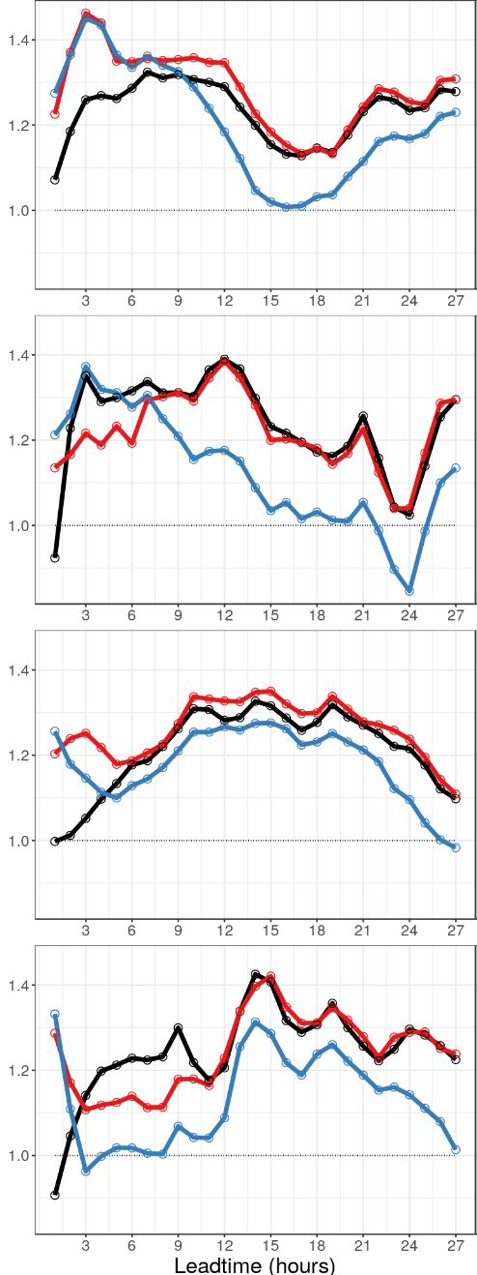
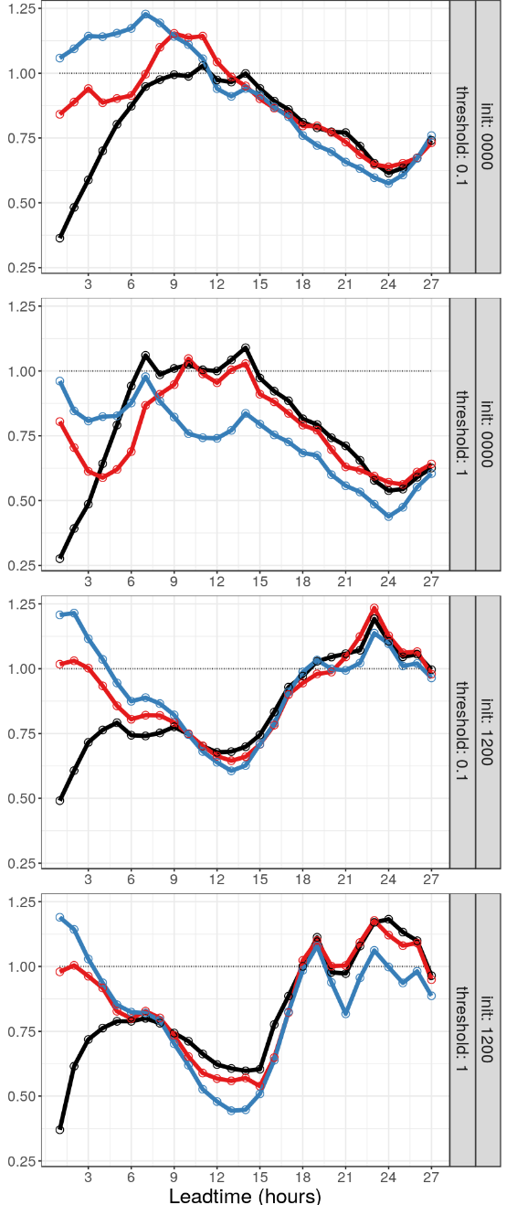
Task 4.1: KENDA for ICON-LAM
comparison to COSMO
1-h precip vs. radar
bias
0.1 mm/h
0-UTC runs
winter 01/12/19 – 04/01/20
autumn 15/09 – 14/10/19
summer 01/06 – 24/06/19
1 mm/h
ICON-KENDA
ICON downscaler
COSMO-D2
0.1 mm/h
12-UTC runs
1 mm/h
spin-up in downscaler
less spin-down from LHN in I-D2 than C-D2

Slide 12
Task 1: Refinement of KENDA
Study on spread / cov. inflation
motivation
errors are smaller in ICON-D2 than COSMO-D2,
but ensemble spread is also smaller
→ can we increase spread without increasing errors for better EPS ?
examine 12-day period (in June 2019) by Klaus Stephan

Slide 13
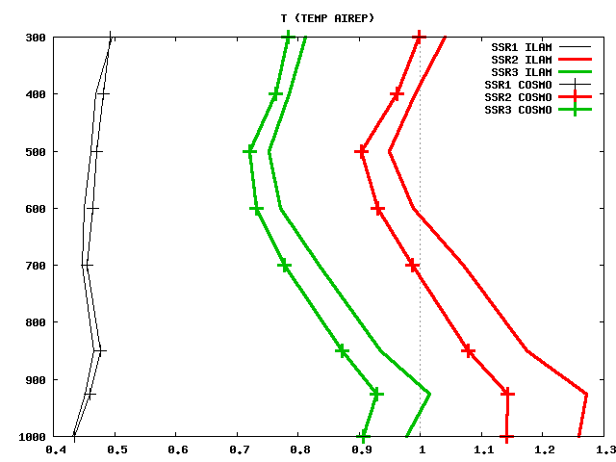
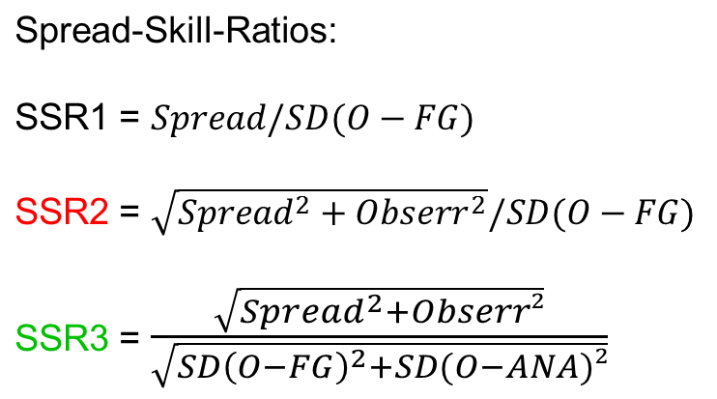
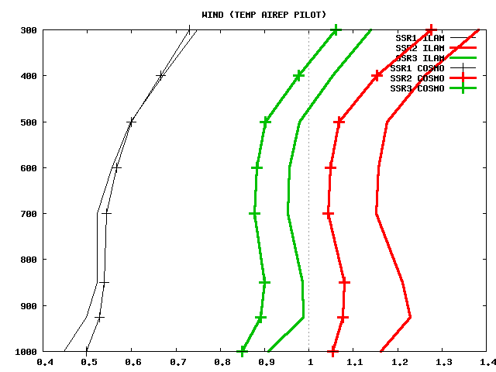
Task 1: Refinement of KENDA
Study on spread / cov. inflation
current state: spread/skill (of first guess)
T
ILAM: solid line
COSMO: symbols
wind
spread/skill ILAM > COSMO (too large !) if obs errors taken into account (SSR2)
vice versa in SSR1

Slide 14
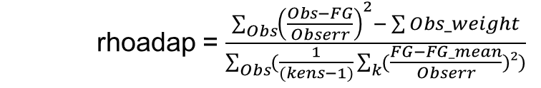
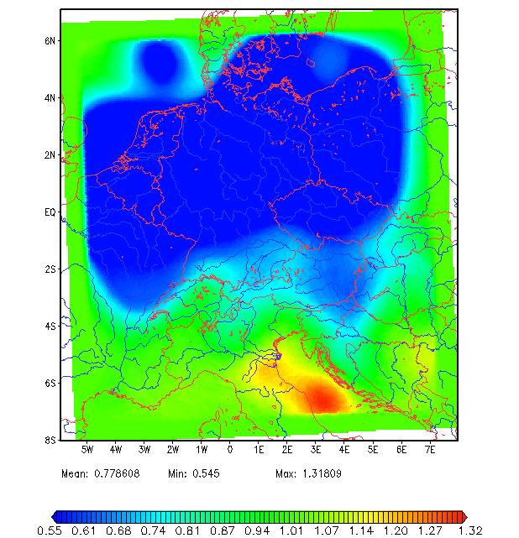
Task 1: Refinement of KENDA
Study on spread / cov. inflation
multiplicative covariance inflation ρ :
spread/skill often too large
(if obs errors taken into account)
→ often covariance deflation !
→
ρ_{adapt}
upper + lower limit to ρ :
ρ = min( max( ρ_{min} , ρ_{adapt} ) , ρ_{max} )
ρ_{min} = 0.5 , ρ_{max} = 3.0
(and temporal averaging for final ρ )
If in above equation for ρ_{adapt} :
decrease obs error → ρ_{adapt} increased (if ρ_{min} also increased: e.g. ρ_{min} = 0.95 and RTPP strongly reduced)
increase obs error → ρ_{adapt} decreased
0.55
1.0
1.32

Slide 15
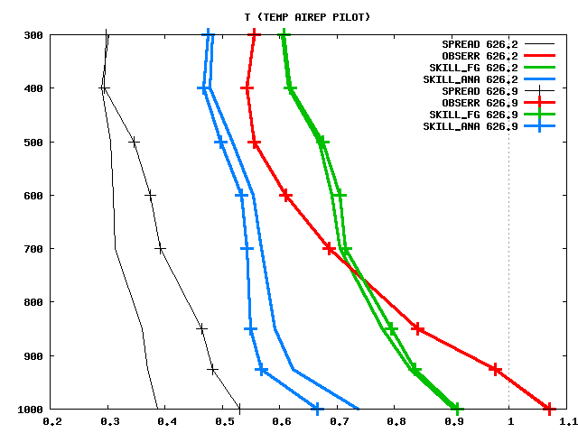
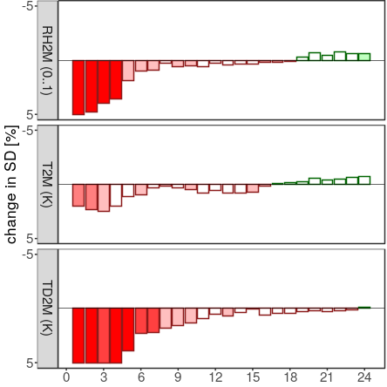
Task 1: Refinement of KENDA
Study on spread / cov. inflation
Trial 1: decrease obs error in eq. ρ_{adapt} , ρ_{min} = 0.95 ; RTPP off
→ increase cov. inflation ρ (reduce covariance deflation)
analysis
errors
decreased
because
more weight
given to
the obs
first guess
errors
increased
spread
increased
as expected
forecast worse !

Slide 16
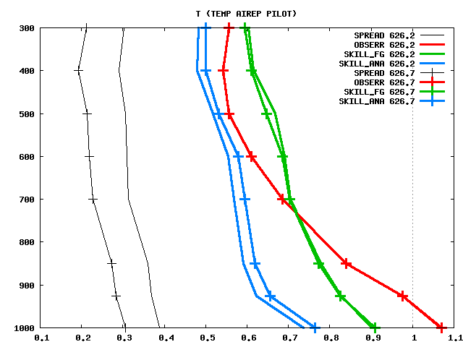
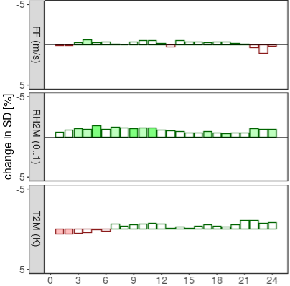
Task 1: Refinement of KENDA
Study on spread / cov. inflation
Trial 2: increase obs error in eq. ρ_{adapt} , ρ_{min} = 0.95 ; RTPP off
→ decrease cov. inflation ρ (but also reduce covariance deflation)
analysis
errors
increased
because
less weight
given to
the obs
first guess
errors
slightly
decreased
spread
decreased
(as expected)
forecast slightly better !
(also upper-air verif.)

Slide 17
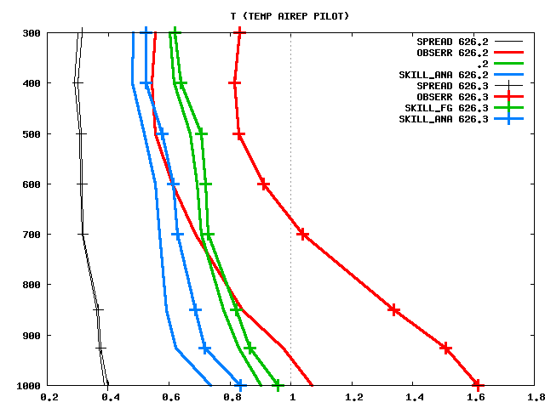
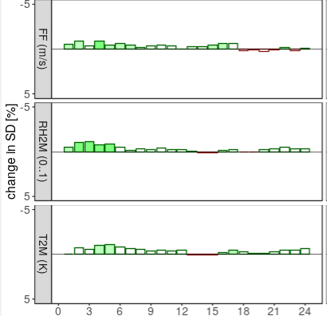
Task 1: Refinement of KENDA
Study on spread / cov. inflation
preliminary summary
further setups have been tested (e.g. overall increase of obs errors in LETKF)
in settings where spread is increased, forecast errors are also increased
interesting exception: overall increase of obs errors in LETKF by 50 %
analysis
errors
increased
because
less
weight
given to
the obs
first guess
errors
increased
spread
hardly
increased
but:
forecast slightly better !
(also upper-air verif.)
Why ?
→ further investigations needed !

Slide 18
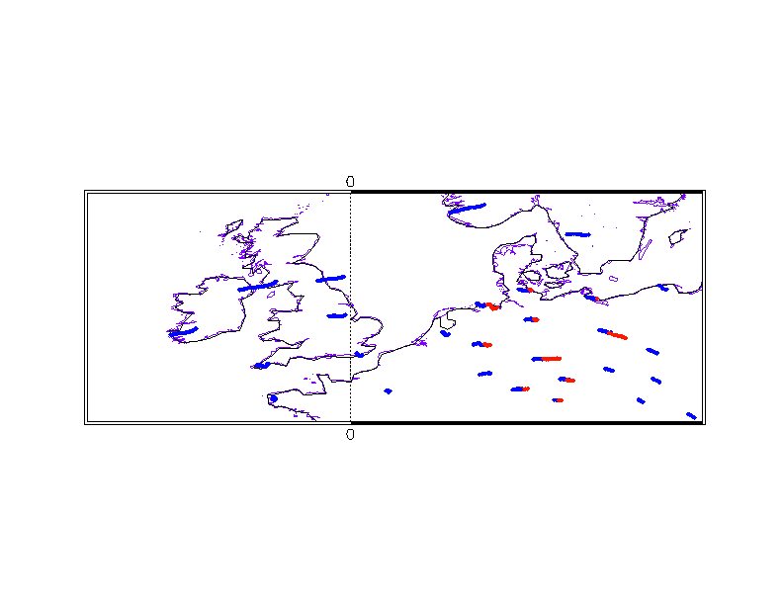
Task 1: Refinement of KENDA
Radiosonde descent profiles
ascents
descents
Alexander Cress, DWD
ascents: ~ 2 hrs : (still old ‘TEMP’ used in KENDA at DWD)
descents: 0.5 – 2 hrs : high-resolution profiles with drift info
potentially available from Vaisala sondes, type 41, with parachutes:
11 – 12 German, 1 Swiss, (additional ones since recently)

Slide 19
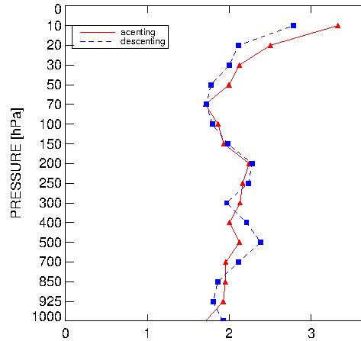
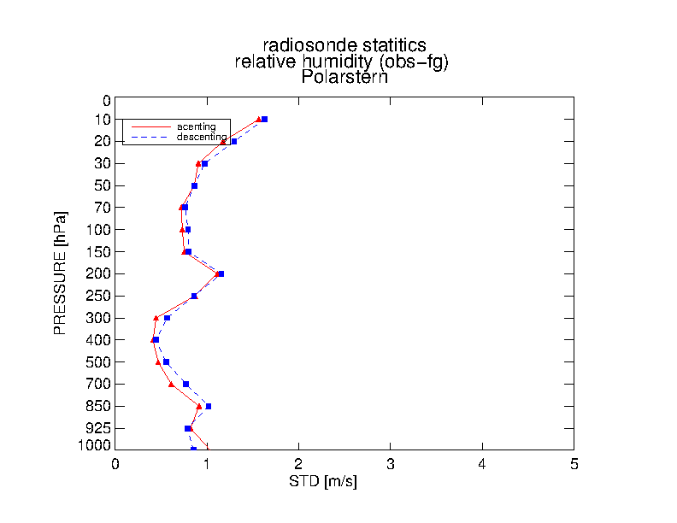
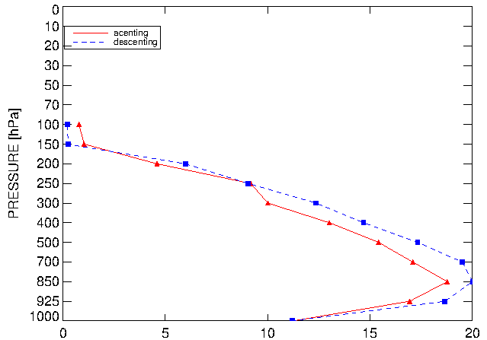
Task 1: Refinement of KENDA
Radiosonde descent profiles
Monitoring of data quality:
standard deviation (vs. ICON-global FG, 1 – 15 March 2020)
wind speed
temperature
relative humidity
ascents
descents
Alexander Cress, DWD
bias (very small, not shown) + random errors
similar to radiosonde ascents (below 70 hPa)

Slide 20
Task 1: Refinement of KENDA
Radiosonde descent profiles
implementation
high-resolution profiles, superobbing (10 hPa > 750 hPa, 20 hPa < 700 hPa)
assimilated as instantaneous vertical profile at location / time of lowest obs level
  → location + time are well accounted for in low troposphere (PBL)
  → 00- / 12-UTC sondes assimilated in 1 – 3 UTC / 13 – 15 UTC analyses
  → largest impact expected in 03-, 15-UTC forecast runs (… over Germany)
(requires COSMO V5_7a, better V5_7d after bug fixes)
quick and short experiment for COSMO
22 – 29 March 2020: deterministic every 3 h, EPS at 03-, 15-UTC
meteorological situation: quiet, little precip

Slide 21



Impact of radiosonde descent data on COSMO-D2
22 – 29 March 2020
deterministic, change of RMSE, 8 runs / day
EPS, change of CRPS, 03 + 15 UTC runs
verif. against German Synops
2-m rel. humidity
total cloud
low cloud
global surface radiation
21

Slide 22

Task 1: Refinement of KENDA
Radiosonde descent profiles
COSMO-D2
positive impact on 2-m temperature + humidity, cloud, global radiation …
in deterministic (RMSE) and EPS fc. (CRPS, RMSE, spread-skill increased except T2M)
small positive impact in radiosonde verification; no precip verif (too few events)
introduced operationally on 17 June 2020
(despite only short experiment,
to compensate for loss of aircraft data
due to the pandemic;
in parallel suite tested
together with 3-D radar reflectivity)
(AMDAR + Mode-S)
17 June

Slide 23
Task 1: Refinement of KENDA
Radiosonde descent profiles
ICON-D2 experiments
May 2020: without 3-D radar data (results comparable to 2nd exp.)
4 June – 3 July 2020: with 3-D radar data (in Exp. + Ref.) (fairly wet, convective)
determ. runs 00, 12 + 03, 15 UTC ; EPS runs 03, 15 UTC
(AMDAR + Mode-S)
Exp

Slide 24



Impact of radiosonde descent data on ICON-D2
4 June – 3 July 2020
Synop
verification
00-, 12-UTC det. runs
03-, 15-UTC det. runs
03-, 15-UTC EPS runs
T2M
better
worse
RH2M
total cloud cover
global radiation

Slide 25



Impact of radiosonde descent data on ICON-D2
4 June – 3 July 2020
verification
against
radiosonde
ascent data
00-, 12-UTC det. runs
03-, 15-UTC det. runs
03-, 15-UTC EPS runs
T
T
RH
RH
better
worse
wind
speed
u
wind
dir.
v
% change of rmse
(mainly +12, +24h)
% change of rmse
(mainly +9, +21h)
% change of CRPS
(mainly +9, +21h)

Slide 26



Impact of radiosonde descent data on ICON-D2
4 June – 3 July 2020
verification
against
aircraft
data
00-, 12-UTC det. runs
03-, 15-UTC det. runs
03-, 15-UTC EPS runs
T
T
better
worse
wind
speed
u
positive
impact
lasts
whole
forecast
range
wind
dir.
v
% change of rmse
(+1 to +24h)
% change of rmse
(+1 to +24h)
% change of CRPS
(+1 to +24h)

Slide 27
Task 1: Refinement of KENDA
Radiosonde descent profiles
ICON-D2
small, but rather consistent positive impact (mainly) in 03-, 15-UTC runs …
in deterministic (RMSE) and EPS fc. (also precip)
(neutral impact in 00-, 12-UTC runs (slightly positive in aircraft verif.))
compared to COSMO experiment: smaller impact, why?
→ different meteorological situation !
→ different model, 3-D radar data added (in exp. + ref.): not much influence,
because radiosonde descent + 3-D radar obs together
had much smaller impact in COSMO parallel suite than in March Exp.
introduced in ICON-D2 parallel suite on 22 June 2020

Slide 28


Task 1: Refinement of KENDA
New Mode-S aircraft obs
EMADDC: “European Meteorological Aircraft Derived Data Centre services“
processed + quality controlled by KNMI (available from KNMI ftp server)
new all-stream test EMADDC data (available during pandemic on best effort basis)
traditional Mode-S
EMADDC Mode-S
4 May 2020,
15:30 – 16:29
Alexander Cress, DWD
obs: more dense, extended area, similar quality:
  > 100 times more Mode-S data !
  after thinning: ~ 8 times more data used
(as in May 2020, decreased air traffic due to pandemic)

Slide 29
Task 1: Refinement of KENDA
New Mode-S aircraft obs
all-stream test EMADDC
→ most data in upper troposphere
ICON-D2 experiments
May 2020: without 3-D radar data (results comparable to 2nd period)
4 June – 3 July 2020: with 3-D radar data (in Exp. + Ref.) (fairly wet, convective)
determ. runs 00, 12 + 03, 15 UTC ; EPS runs 00, 12 UTC

Slide 30


Impact of new EMADDC Mode-S aircraft data on ICON-D2
4 June – 3 July 2020
Synop
verification
deterministic
EPS
T2M
better
worse
RH2M
mid-level cloud cover
(total cloud: neutral impact)
global radiation

Slide 31





Impact of obs up to 200 hPa on ICON-D2
4 June – 3 July 2020
radiosonde verification
aircraft verification
better
worse
deterministic
EPS
deterministic
EPS
T
stdv..
larger
in first
3 hrs
T
RH
speed
u
speed
u
wind
wind
dir.
v
dir.
v
% change of rmse
/ % change of CRPS
% change of rmse / % change of CRPS

Slide 32

Task 1: Refinement of KENDA
New Mode-S aircraft obs
New EMADDC Mode-S aircraft obs
positive impact on upper-air, mid-level cloud, T2M, RH2M …
in deterministic (RMSE) and EPS (CRPS) forecasts
EPS: reduction of spread
+ spread/skill
for T2M, wind gusts
by 1 – 2 %
(in upper troposphere
up to 10 % in first hrs.)

Slide 33
summary
KENDA-ICON-D2 clearly better than ICON-D2 downscaler, especially in summer
more investigations needed on spread inflation
radiosonde descent profiles improve 03-, 15- UTC forecast runs
positive forecast impact from new, extended EMADDC Mode-S data
Thank you for your attention

