Slide 1
Assimilation of microwave radiometer brightness temperatures with KENDA-1
Claire Merker, Daniel Leuenberger, MeteoSwiss, Zürich
Maxime Hervo, Alexander Haefele, MeteoSwiss, Payerne

Slide 2
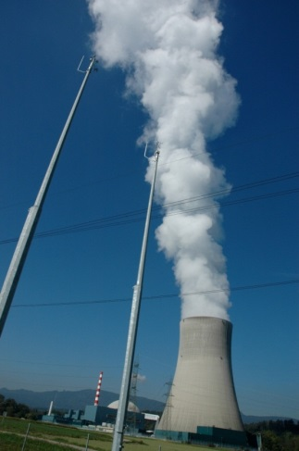
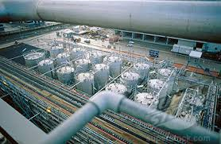
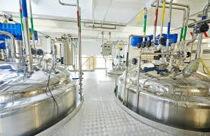
Project EMER-Met
Improvements for warnings with respect to nuclear, chemical and biological incidents
Assimilation of microwave radiometer (MWR) radiances with KENDA/LETKF (not retrieval profiles): three MWRs installed in Switzerland
Installation of Doppler wind lidars
Assimilation of Doppler wind lidar data (Samuel Monhart)
Development of a dispersion ensemble
EMER-Met: Emergency Response Meteorology

Slide 3
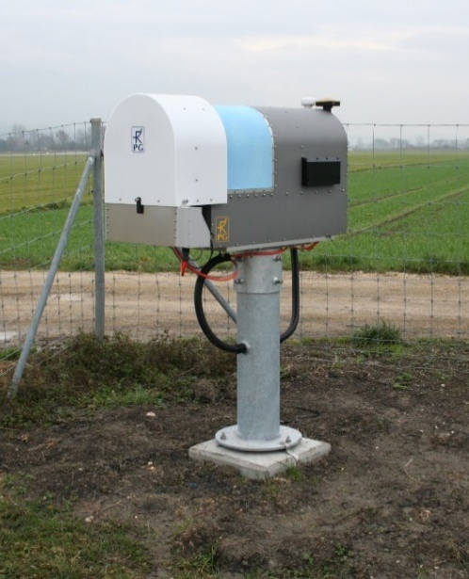
Ground-based microwave radiometers
Measures atmospheric radiation (passive): brightness temperature
14 frequency bands (sensitive to humidity and/or temperature)
6 scanning elevation angles
Provides temperature and humidity information in the boundary layer with high temporal resolution: potential for improving the representation of the boundary layer in the initial conditions
HATPRO (RPG)

Slide 4
Observation minus background (O-B) statistics

Slide 5
O-B data
Period: June to end of August 2020
Parameter: Brightness temperature for 14 frequency channels, 90° elevation scan

Slide 6
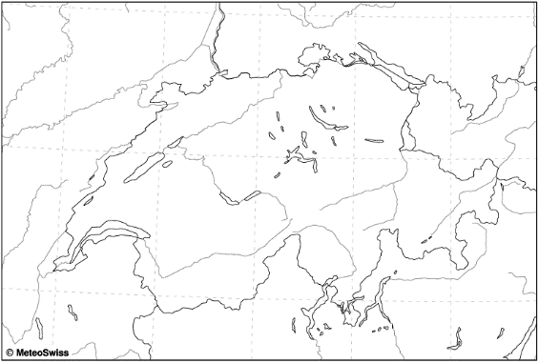
O-B data
Period: June to end of August 2020
Parameter: Brightness temperature for 14 frequency channels, 90° elevation scan
Observation: MWR at Payerne

Slide 7
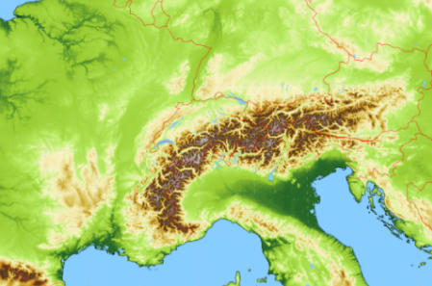
O-B data
Period: June to end of August 2020
Parameter: Brightness temperature for 14 frequency channels, 90° elevation scan
Observation: MWR at Payerne
Background: KENDA-1 hourly mean first guess, forward operator: RTTOV-gb (radiative transfer model)
KENDA-1 1.1 km grid size 40 ensemble members
+ RTTOV-gb De Angelis et al., 2016

Slide 8
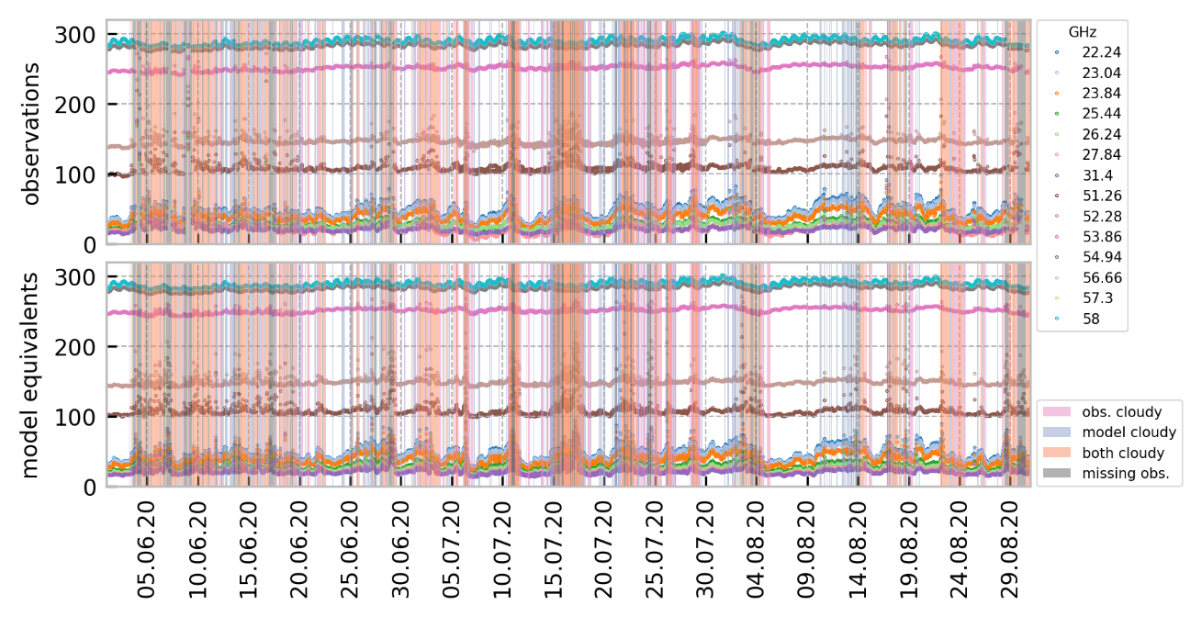
Radiance time series (JJA 2020)
Brightness temperature (K)

Slide 9
O-B time series (JJA 2020)
Brightness temperature (K)
Observation - Background
(2*σ filter is applied to O-B data)

Slide 10
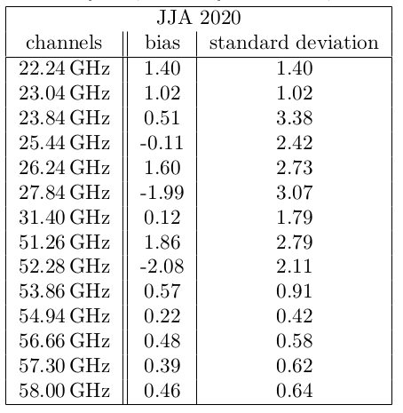
O-B statistics summary – clear-sky only
K-band
Humidity sensitive
V-band
Temperature sensitive

Slide 11
O-B results
There is a channel dependent bias that will need to be corrected for the assimilation
The bias is also dependent on station and elevation angle (not shown)
The handling of cloudy conditions must be further analysed

Slide 12
Using subgrid-scale clouds (QC_RAD) in RTTOV-gb instead of gridscale clouds (QC)

Slide 13
QC vs. QC_RAD (simplified)
QC_RAD: computed and used in the radiation scheme in COSMO, can be written to output
In general:
QC_RAD smaller than QC if QC present
QC_RAD larger than QC if no QC present
➔ QC_RAD produces more but thinner clouds

Slide 14
QC vs. QC_RAD study
Study to see if there is an impact in using QC_RAD instead of QC as input for RTTOV-gb
Period: 10.07.2020 – 30.07.2020
KENDA-1 first guess, deterministic run
Shown here as an example: channel 22.24 GHz, 90° elevation angle

Slide 15
QC vs. QC_RAD: O-B time series
QC
Brightness temperature (K)
Observation - Background
QC_RAD
More cases with clouds in the model / clouds in model and observations
Improved standard deviation of O-B values, bias sometimes larger, distributions more Gaussian

Slide 16
QC vs. QC_RAD: O-B overview
QC
QC_RAD

Slide 17
QC vs. QC_RAD results
Match between clouds in observations and cloud in model higher
O-B standard deviation decreases
O-B bias sometimes increases (but has to be corrected anyhow)
Distribution of O-B values follows Gaussian distribution better
Some channels (mainly temperature sensitive) are barely affected

Slide 18
First active assimilation of MWR data in KENDA-1 using the LETKF
Many thanks to people at DWD for the required changes in the DACE code

Slide 19
MWR DA: very first technical test
Single observation experiment with KENDA-1:
One station: Payerne
One elevation angle: 90°
One channel: 23.84 GHz
10.08.2020 12 UTC LETKF update
Following: quick looks and very first impressions

Slide 20
MWR DA: analysis increment profiles
Pressure (hPa)
Pressure (hPa)

Slide 21
MWR DA: analysis increments in space
Model level 70
≈ 940 hPa
Grid points
Grid points

Slide 22
MWR DA: comparison to radiosounding
Pressure (hPa)
Observation First guess Analysis

Slide 23
Summary and Outlook
O-B statistics implemented, needs final assessment as more KENDA-1 data becomes available, already shows the need for a channel and station dependent bias correction
QC_RAD seems to allow a better performance of the RTTOV-gb forward operator (we need further exchange with QC_RAD experts to expand our knowledge)
Active assimilation of MWR data with the LETKF works technically and first studies on the assimilation can start (DWD will cover ICON, we will work with COSMO)

Slide 24
Summary and Outlook
O-B statistics implemented, needs final assessment as more KENDA-1 data becomes available, already shows the need for a channel and station dependent bias correction
QC_RAD seems to allow a better performance of the RTTOV-gb forward operator (we need further exchange with QC_RAD experts to expand our knowledge)
Active assimilation of MWR data with the LETKF works technically and first studies on the assimilation can start (DWD will cover ICON, we will work with COSMO)
Thank you for listening!

Slide 26
Input for RTTOV-gb forward operator
Profiles
Pressure
Temperature
Specific humidity
Cloud liquid water
Values at device
Pressure
Temperature
Specific humidity
Wind
Device information
Position
Scanning angle(s)
Channel frequency(ies)
For the moment, the model equivalents are computed using RTTOV-gb as a standalone forward operator (call to RTTOV-gb implemented in DACE datools, integration of RTTOV-gb in DACE in dev branch).

