Slide 1
Bias correction and assimilation of 2-m temperature and humidity
Christine Sgoff, Elisabeth Bauernschubert, Roland Potthast, Christoph Schraff

Slide 2
SYNOP Stations – sources of error
Representativity error:
  SYNOP station is a point measurement while the model represents grid boxes
  Model height and observation height may not match
Radiation protection of the station, inertia of the measuring instrument
This can lead to individual errors depending on station and measuring instrument
On average over all stations, the difference between model and observation shows a dependence of diurnal cycle and cloud cover

Slide 3
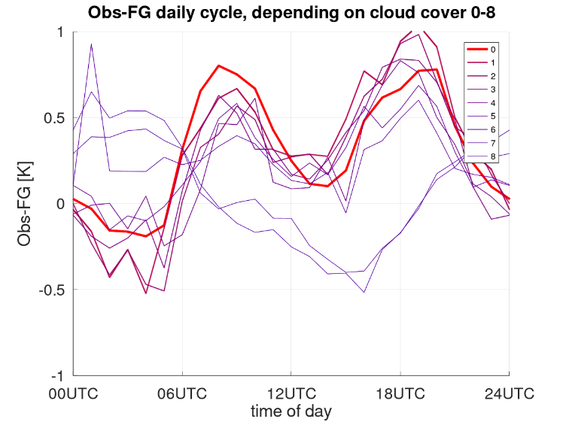
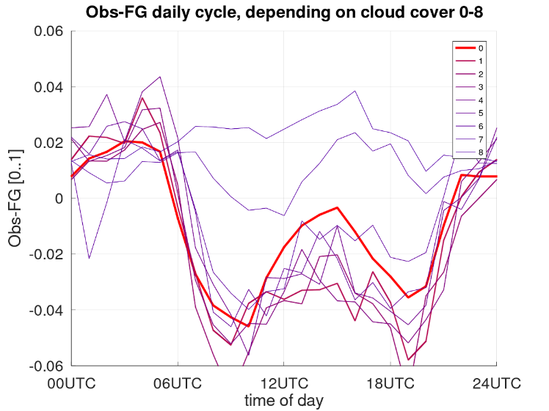
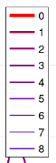
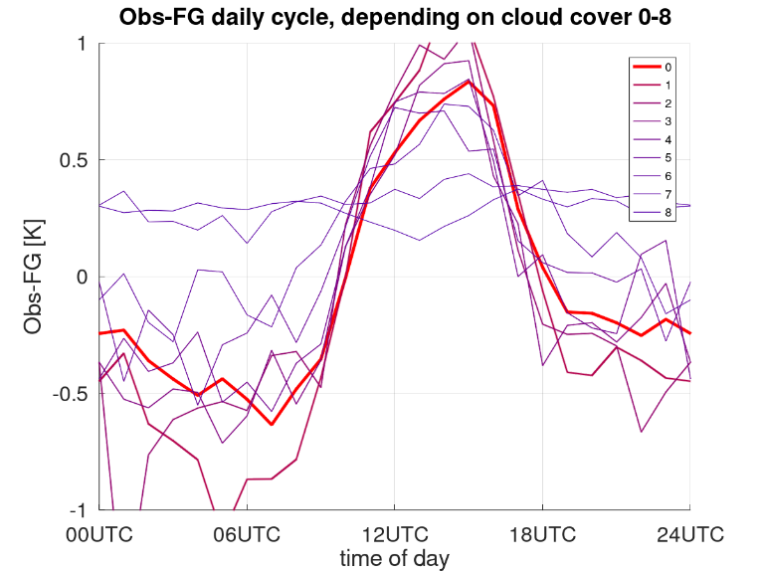
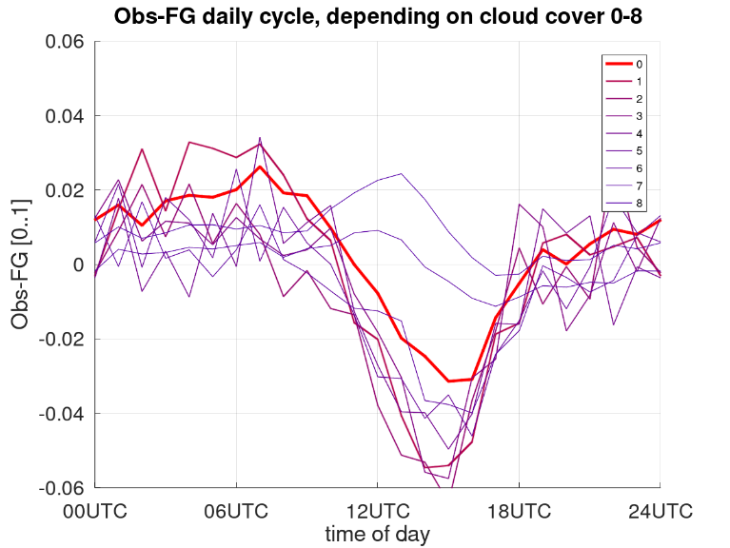
Average daily cycle: Obs. - FG
 | 2-m temperature | 2-m relative humidity
June 2016
Dec 2019
Obs-FG [K]
Obs-FG [0..1]
Cloud Cover [okta]
Obs-FG [K]
Obs-FG [0..1]
time of day
time of day

Slide 4
What does the bias look like?
Bias is dependent on the diurnal cycle
This dependence is increased or reduced by different cloud covers
With heavy cloud cover (7 - 8 octa) the diurnal cycle is much less pronounced
Summer and winter periods show differences in the daily cycle
Bias of RH2M and T2M are related → therefore the observed 2-m dew point temperature should be corrected

Slide 5
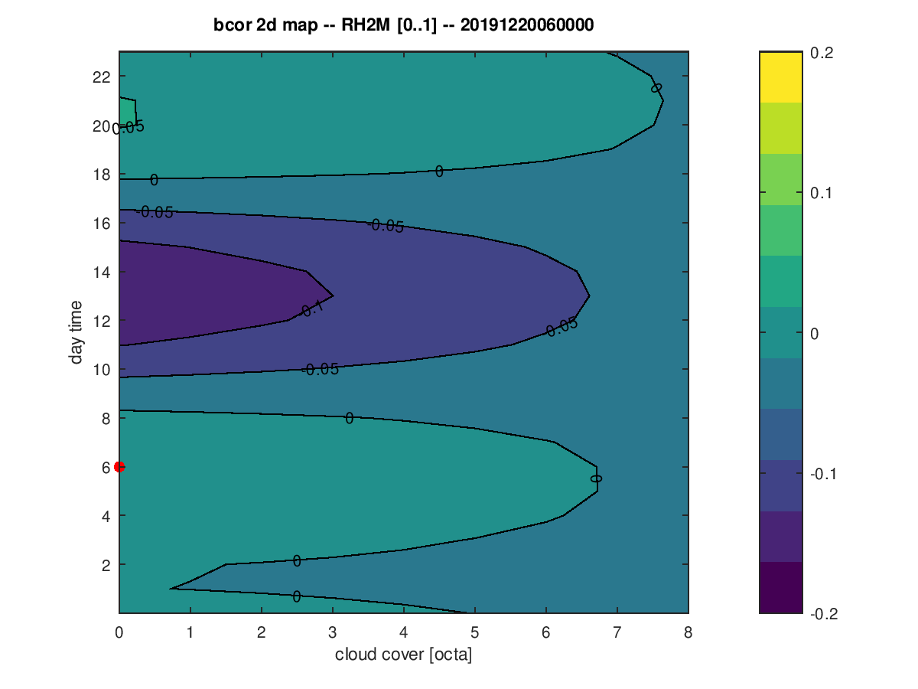
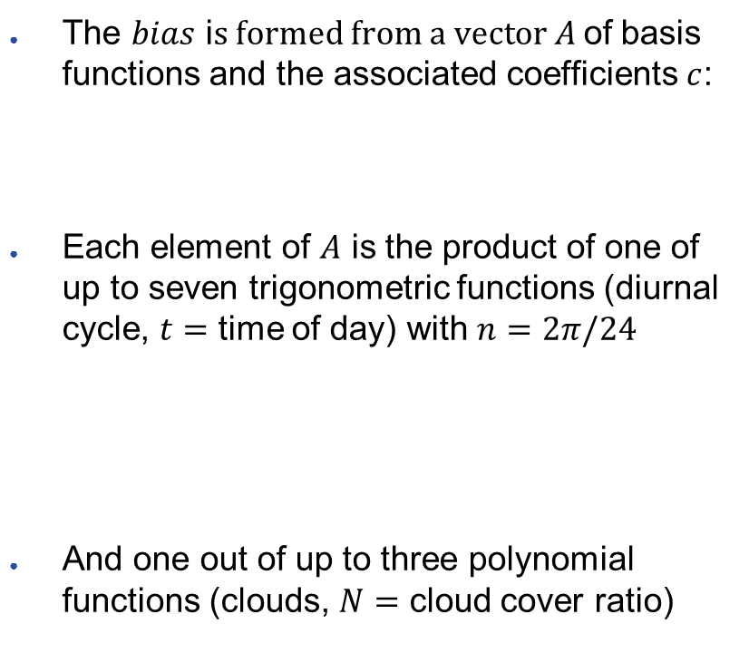


Bias correction concept
The $bias$ i$s formed from a vector A$of basis functions and the associated coefficients$c$:
Each element of $A$ is the product of one of up to seven trigonometric functions (diurnal cycle, $t=$ time of day) with $n=2π/24$
And one out of up to three polynomial functions (clouds, $N=$ cloud cover ratio)
$$bias=A∙c$$
time of day
$$1 sin{nt} \cos{nt} \sin{2nt} \cos{2nt} \sin{3nt} \cos{3nt}$$
cloud cover [okta]
$$1 9−N (9−N)²$$

Slide 6
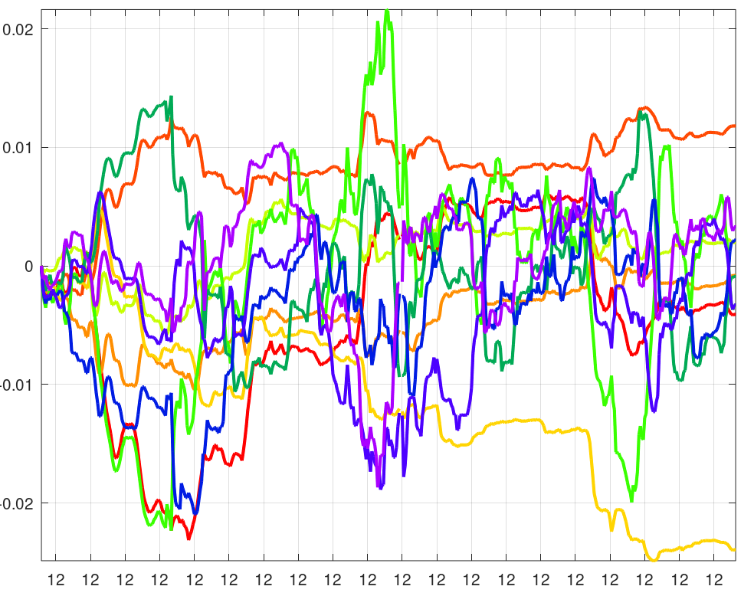

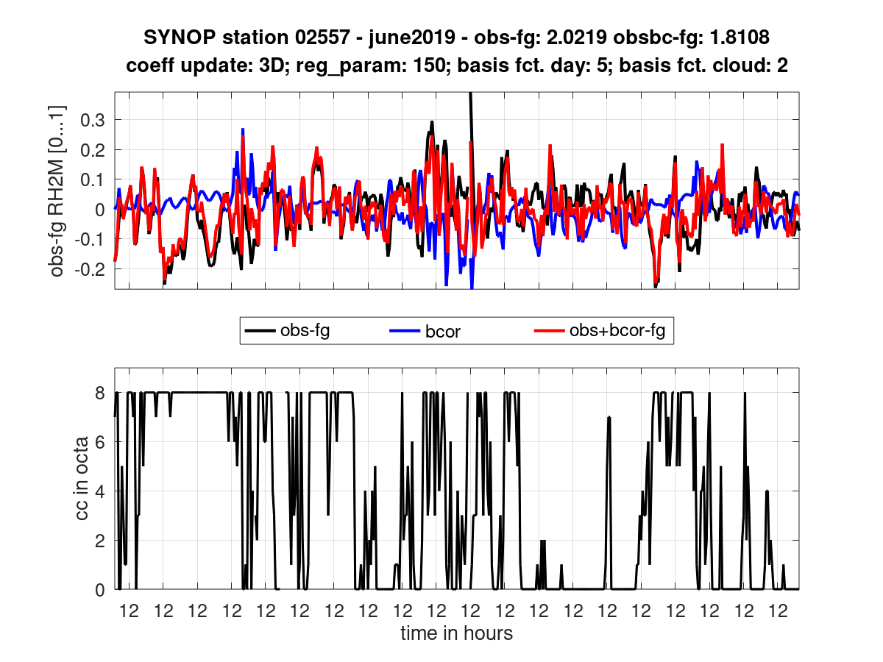
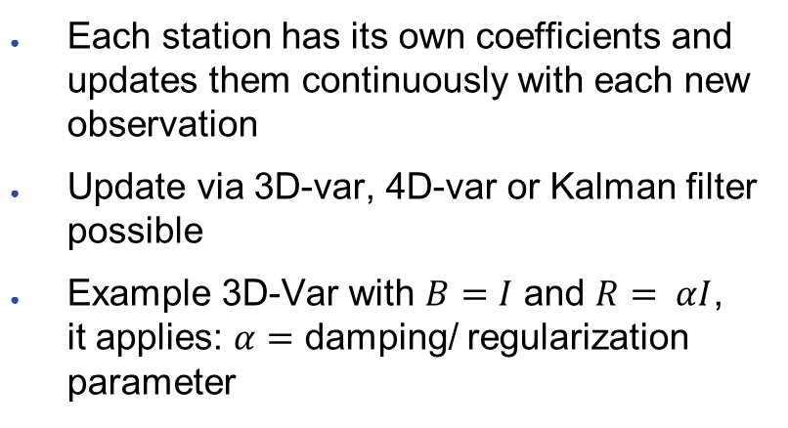



Coefficients update
Koeffizienten
0.02
Each station has its own coefficients and updates them continuously with each new observation
Update via 3D-var, 4D-var or Kalman filter possible
Example 3D-Var with $B=I$ and $R= αI$, it applies: $α=$ damping/ regularization parameter
0.01
0.00
-0.01
-0.02
$${bias}^{estimated}=A∙ c^{old}$$
$$obs_{bc}=obs −{bias}^{estimated}=obs+bcor$$
$$K=BA^{t}(R+ABA^{t})^{−1}$$
$$c^{new}= c^{old}+K\left( obs_{bc}−fg\right)$$
Cloud Cover [okta]

Slide 7
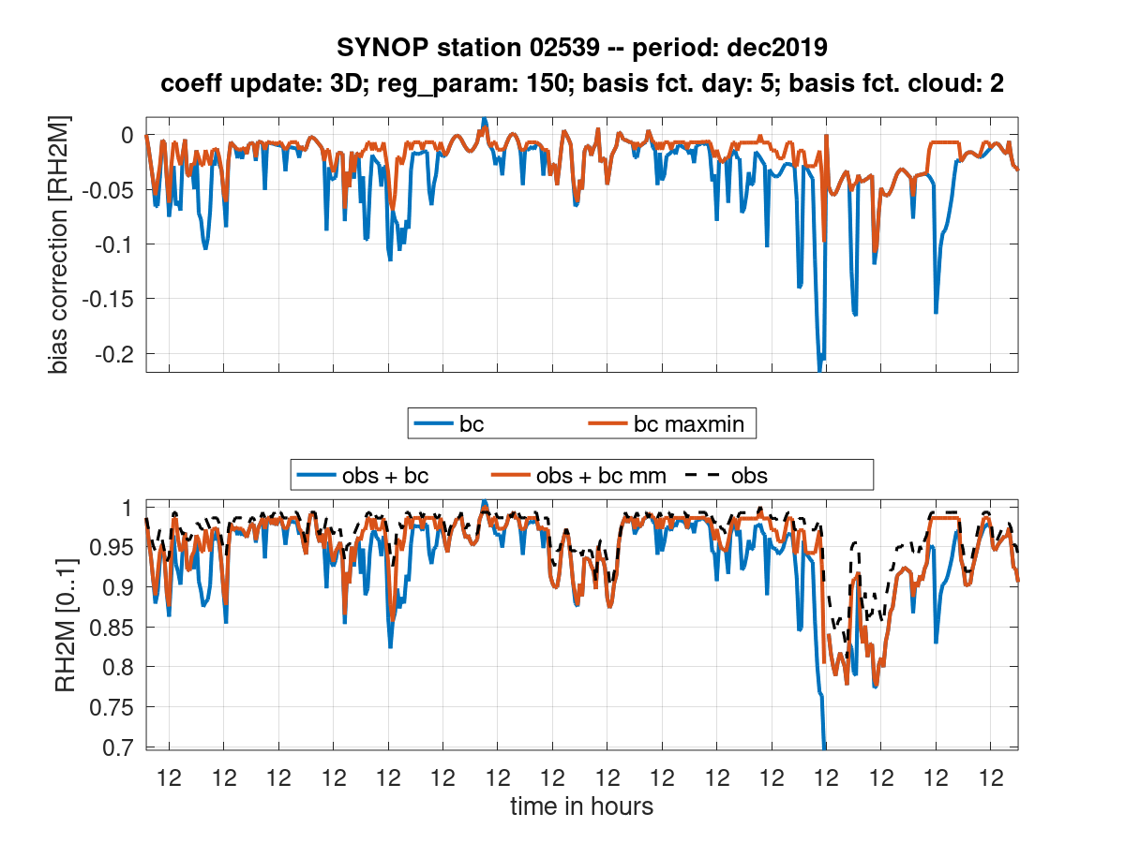
Coefficients update
Damping of the correction in the saturation range of RH2M with
$$b{cor}_{maxmin}=\max\left(\min\left(bcor, 1−obs.\right), obs. − 1\right)$$

Slide 8
Average daily cycle: Obs. - FG
 | 2-m temperature | 2-m relative humidity
June 2016
Dec 2019
Obs-FG [K]
Obs-FG [0..1]
Cloud Cover [okta]
Obs-FG [K]
Obs-FG [0..1]
time of day
time of day

Slide 9
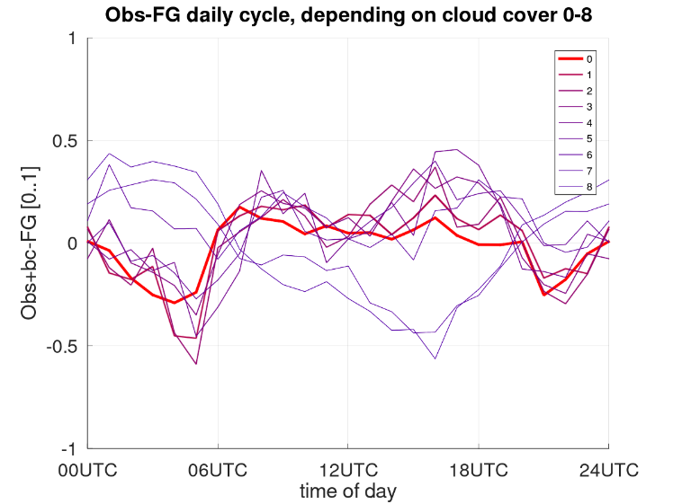
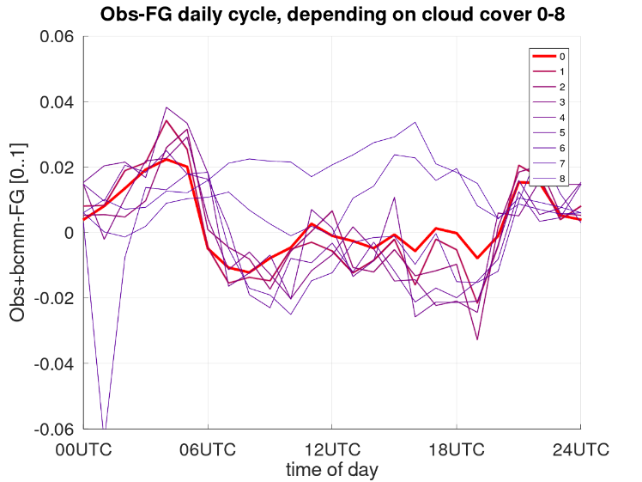
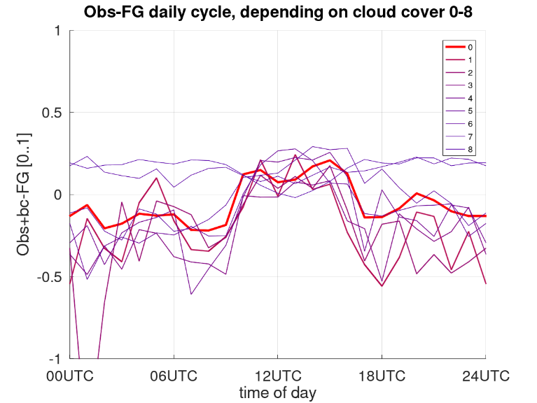
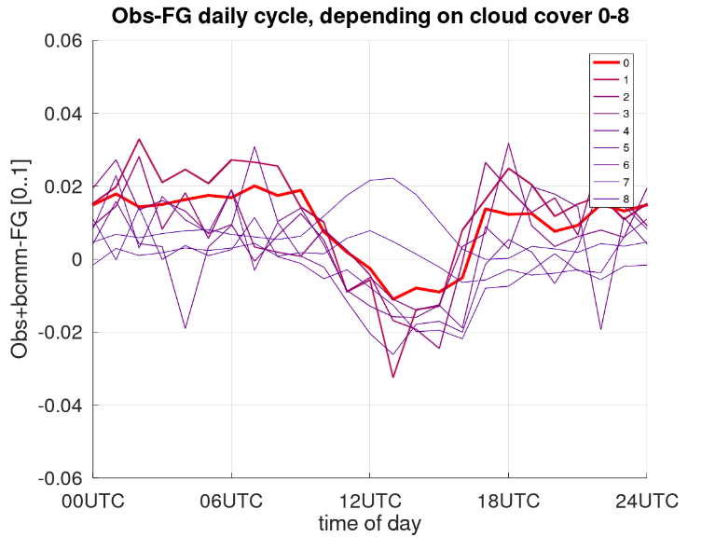
Average daily cycle: Obs.+bcor - FG
 | 2-m temperature | 2-m relative humidity
June 2016
Dec 2019
Obs-FG [K]
Obs-FG [0..1]
Cloud Cover [okta]
Obs-FG [K]
Obs-FG [0..1]
time of day
time of day

Slide 10
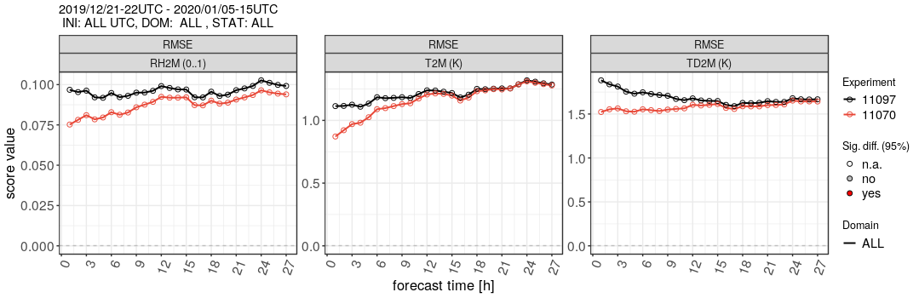
SYNOP: 21.12.2019 – 05.01.2020
RMSE: RH2M (0..1)
RMSE: T2M (K)
RMSE: TD2M (K)
Black: Reference Experiment without Assimilation of RH2M and T2M
Red: Experiment with bias correction and assimilation of RH2M and T2M
Improvements of RH2M, T2M and TD2M, especially in the first 9 hours of the forecast

Slide 11
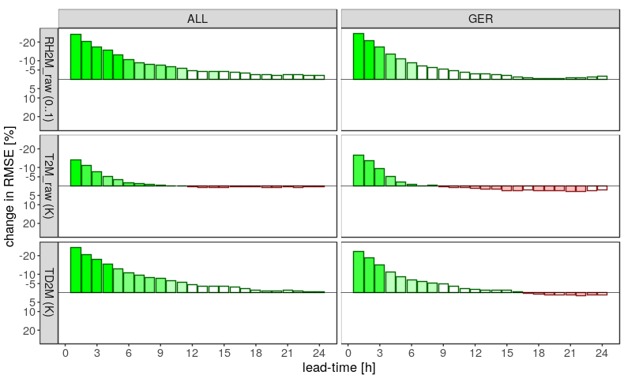
SYNOP: 21.12.2019 – 05.01.2020
Caution:
To verify against the same observations the “raw” observations are used
RH2M
T2M
TD2M
Experiment better
Reference better

Slide 12
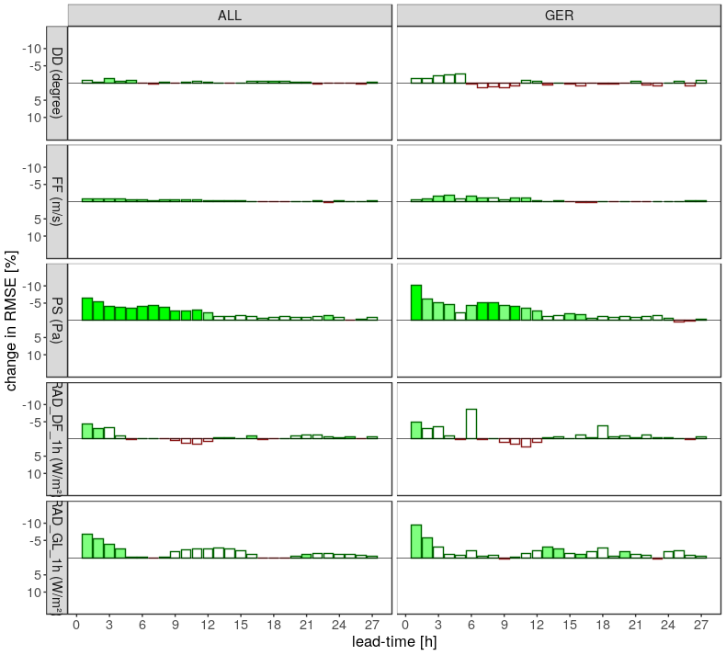
SYNOP: 21.12.2019 – 05.01.2020
DD
Experiment better
FF
Reference better
PS
RAD_DF
RAD_GL

Slide 13
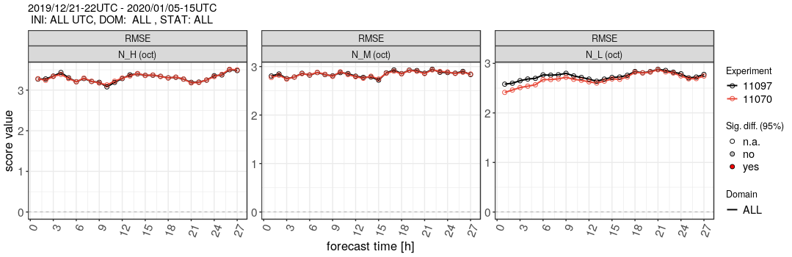
SYNOP: 21.12.2019 – 05.01.2020
RMSE: N_H (octa)
RMSE: N_M (octa)
RMSE: N_L (octa)
Black: Reference Experiment without Assimilation of RH2M and T2M
Red: Experiment with bias correction and assimilation of RH2M and T2M
Improved forecast of low cloud cover (N_L)
Medium high clouds (N_M) and high clouds (N_H) are nearly unaffected

Slide 14
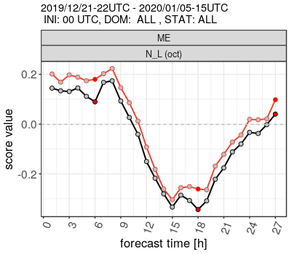
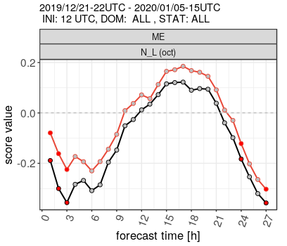
SYNOP: 21.12.2019 – 05.01.2020
ME: N_L (octa)
ME: N_L (octa)
Black: Reference Experiment without Assimilation of RH2M and T2M
Red: Experiment with bias correction and assimilation of RH2M and T2M
More low clouds are generated if assimilation of RH2M and T2M is active, positive effect if clouds are missing, negative effect if there are already too many clouds

Slide 15
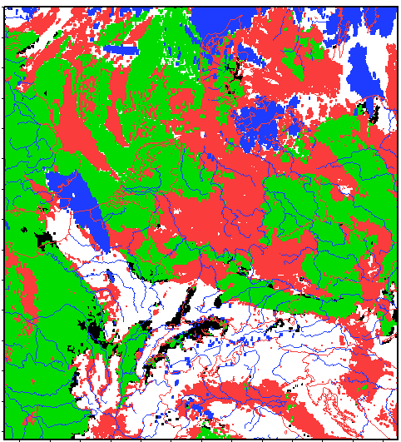
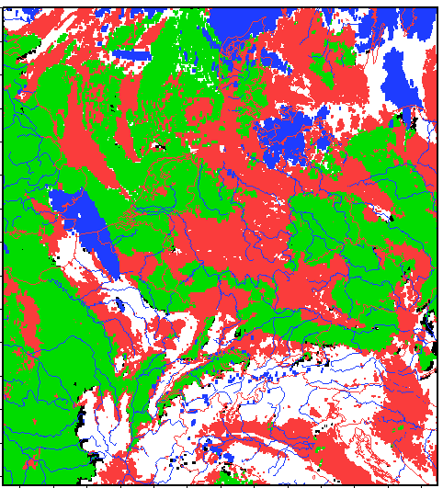
Thank you Klaus
Verification against NWCSAF
Reference 2020010100+01h
Experiment 2020010100+01h
ETS: 0.228 FBI: 1.749
ETS: 0.218 FBI: 1.868
hits | false alarms
misses | Correct negatives
Low stratus appears
Blue: unclear

Slide 16
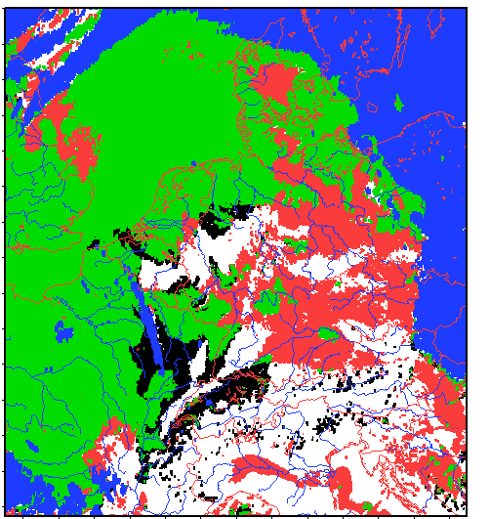
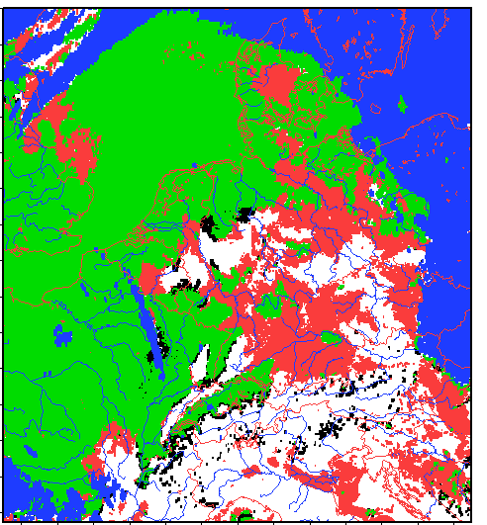
Verification against NWCSAF
Reference 2020010100+13h
Experiment 2020010100+13h
ETS: 0.352 FBI: 1.224
ETS: 0.408 FBI: 1.302
hits | false alarms
misses | Correct negatives
Blue: unclear

Slide 17
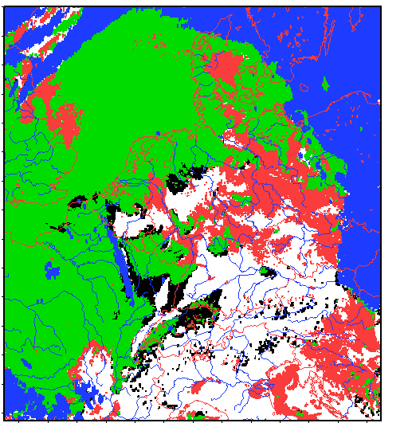
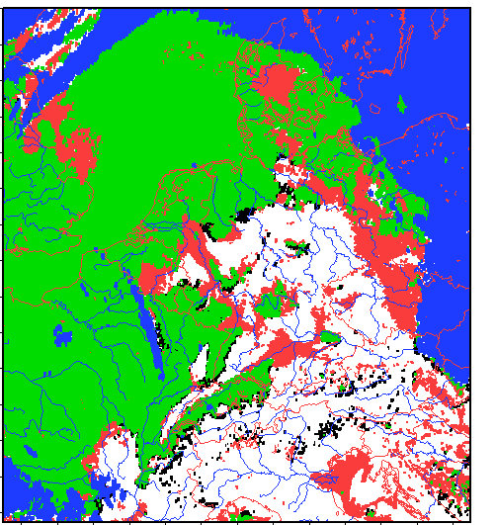
Verification against NWCSAF
Reference 2020010112+01h
Experiment 2020010112+01h
ETS: 0.407 FBI: 1.209
ETS: 0.537 FBI: 1.194
hits | false alarms
misses | Correct negatives
Blue: unclear

Slide 18
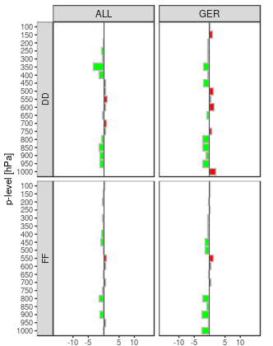
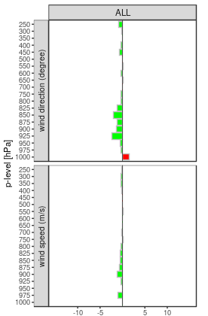
Upper Air: 21.12.2019 – 05.01.2020
TEMP - Verification
AIREP - Verification
DD
DD
Experiment better
Reference better
FF
FF
Reduction of RMSE [%]
Reduction of RMSE [%]

Slide 19
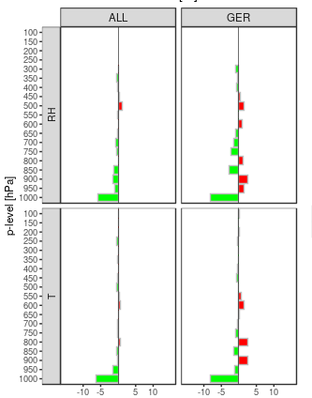
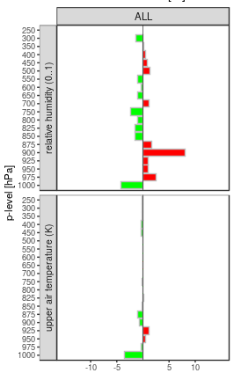
Upper Air: 21.12.2019 – 05.01.2020
TEMP - Verification
AIREP - Verification
RH
RH
Experiment better
Reference better
T
T
Reduction of RMSE [%]
Reduction of RMSE [%]

Slide 20
Summary and Outlook
Assimilation of RH2M and T2M with bias correction…
improves clearly the forecast of RH2M, T2M and TD2M, especially in the first 9 hours
introduces more low clouds with positive and negative consequences
has a neutral impact on wind, upper air temperature and relative humidity
Next steps:
Further investigation of the low clouds
Longer experiment period
Derive observation errors of the individual stations

