Slide 1
Ensemble products for ICON-D2-EPS with Fieldextra
Chiara Marsigli
Deutscher Wetterdienst

Slide 2
Motivation
Provide an example of post-processing of the ICON-LAM model fields by using the COSMO SW Fieldextra
Fieldextra can manage the unstructured ICON grid, by using the icontools package (developed for ICON at DWD and MPI)
The ICON-LAM fields are transformed to a regular grid before further post-processing
regular latlon
rotated latlon
Interpolation is made with the radial basis function method. The nearest neighbour interpolation method does not work for ICON-LAM
It is planned to provide in Fieldextra full support of the ICON grid

Slide 3
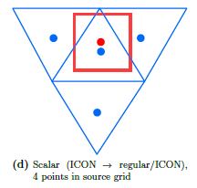
Icontool: remapping
The RBF-based interpolation algorithm approximates the input field with a linear combination of radial basis functions (RBF) located at the data sites
Interpolation stencil:
This approximate function is then evaluated at the points of the destination grid

Slide 4
Products generated
Parameters:
Temperature
Gusts
Cloud Cover
Precipitation, Snow
CAPE
Future: Reflectivity, Lightning Potential Index
Quantities:
Ensemble mean, minimum, maximum
spread / interquartile range
Exceedance probabilities (thresholds according to forecasters´ needs)
Percentiles
Future: upscaled probabilities (10x10 grid points)

Slide 5
Fieldextra namelist – common part
&GlobalResource
dictionary = "%extradir%/dictionary_icon.txt"
grib_definition_path = "%extradir%/grib_api_definitions.edzw","%extradir%/grib_api_definitions"
grib2_sample = "%extradir%/grib_api_samples/GRIB2.tmpl"
icon_grid_description = "%icongrid%„
/
&GlobalSettings
default_dictionary = "icon"
default_model_name = "icon"
default_out_type_stdlongitude = .true.
/
&ModelSpecification
model_name = "icon"
earth_axis_large = 6371229.
earth_axis_small = 6371229.
regrid_method = "from_unstructured_grid,rbf"
precip_snow = "SNOW_GSP", "SNOW_CON„
/

Slide 6
Fieldextra namelist – Tmin 6h
&Process
in_file="%infile_TMM%"
in_regrid_target = "rotlatlon,%minlon%,%minlat%,%maxlon%,%maxlat%,%reslon%,%reslat%,%pollon%,%pollat%", in_regrid_method = "default",
in_regrid_all = .true.,
out_mode_mismemb_limit = %mismem_limit%
out_mode_mismemb_abort = .true.
out_size_vdate=3
out_size_field=80
out_type="GRIB2"
out_file= "%outfile%_TMM„
/
&Process in_field="TMIN_2M",toper="min,-5,0,hour"
/
&Process out_field="TMIN_2M", product_category='eps_mean' /
&Process out_field="TMIN_2M", product_category='eps_standard_deviation'/
&Process out_field="TMIN_2M", product_category='eps_quantile', quantile= 0/
&Process out_field="TMIN_2M", product_category='eps_quantile', quantile=10 /
&Process out_field="TMIN_2M", product_category='eps_quantile', quantile=25 /
&Process out_field="TMIN_2M", product_category='eps_quantile', quantile=50 /
&Process out_field="TMIN_2M", product_category='eps_quantile', quantile=75 /
&Process out_field="TMIN_2M", product_category='eps_quantile', quantile=90 /
&Process out_field="TMIN_2M", product_category='eps_quantile', quantile=100 /
&Process out_field="TMIN_2M", product_category='eps_probability',prob_thigh=273.15,tag="T_MIN273.15"/
Here: COSMO-D2-EPS domain
minimum over last 6 hours
ensemble mean
ensemble spread
percentile

Slide 7
Fieldextra namelist – TP 6h
&Process
in_file="%infile_RR%"
in_regrid_target = "rotlatlon,%minlon%,%minlat%,%maxlon%,%maxlat%,%reslon%,%reslat%,%pollon%,%pollat%", in_regrid_method = "default",
in_regrid_all = .true.,
out_mode_mismemb_limit = %mismem_limit%
out_mode_mismemb_abort = .true.
out_size_vdate=7
out_size_field=80
out_type="GRIB2„
out_mode_weighted_member=.FALSE.
out_file= "%outfile%_RR,
/
&Process in_field="TOT_PREC", poper="replace_cond,TOT_PREC<0.01,0.0", toper="delta,6,hour"
/
&Process out_field="TOT_PREC", product_category='eps_mean' /
&Process out_field="TOT_PREC", product_category='eps_quantile', quantile=90 /
&Process out_field="TOT_PREC", product_category='eps_quantile', quantile=100 /
&Process out_field="TOT_PREC", product_category='eps_probability',prob_tlow=0.1,tag="TOT_PREC_0.1"/
&Process out_field="TOT_PREC", product_category='eps_probability',prob_tlow=1,tag="TOT_PREC_1"/
&Process out_field="TOT_PREC", product_category='eps_probability',prob_tlow=10,tag="TOT_PREC_10"/
&Process out_field="TOT_PREC", product_category='eps_probability',prob_tlow=20,tag="TOT_PREC_20"/
&Process out_field="TOT_PREC", product_category='eps_probability',prob_tlow=35,tag="TOT_PREC_35"/
&Process out_field="TOT_PREC", product_category='eps_probability',prob_tlow=60,tag="TOT_PREC_60"/
6 hour accumulation
excedance probability

Slide 8
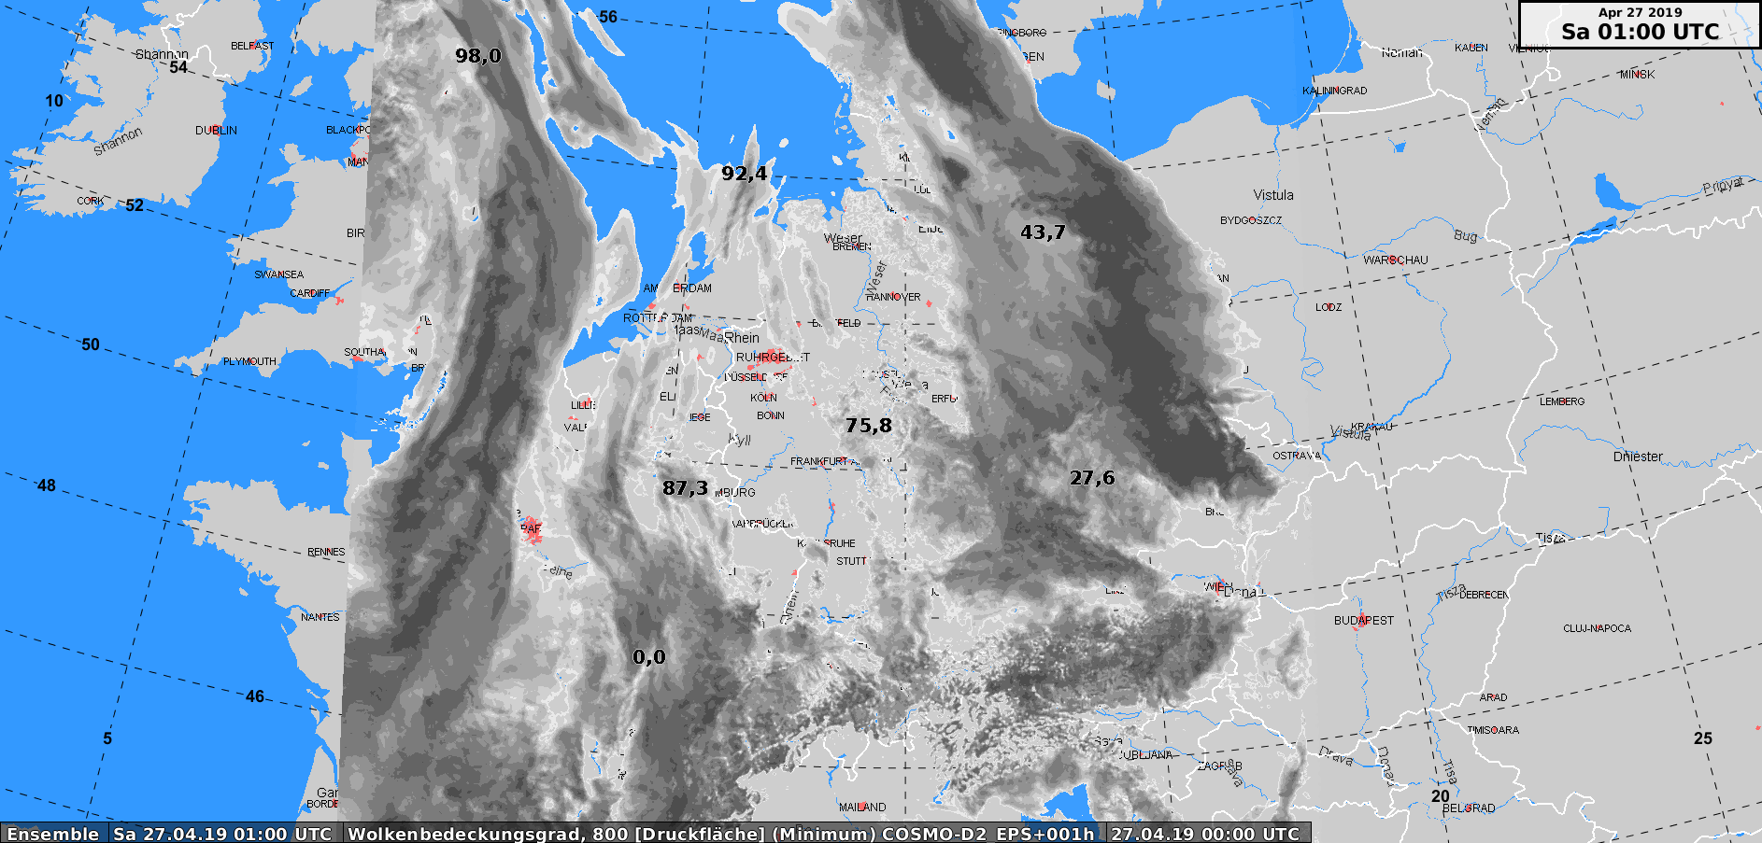
Total cloud cover - minimum

Slide 9
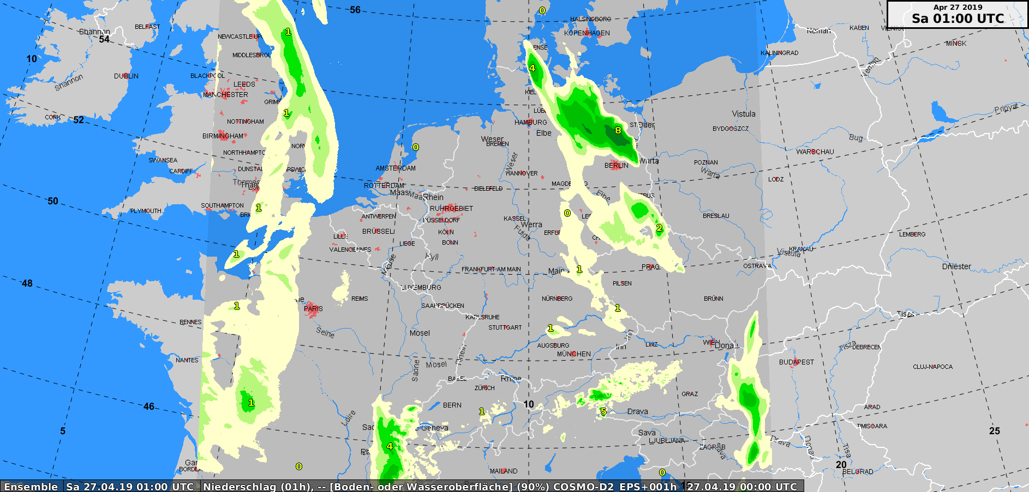
Total precipitation – 90th percentile

Slide 10
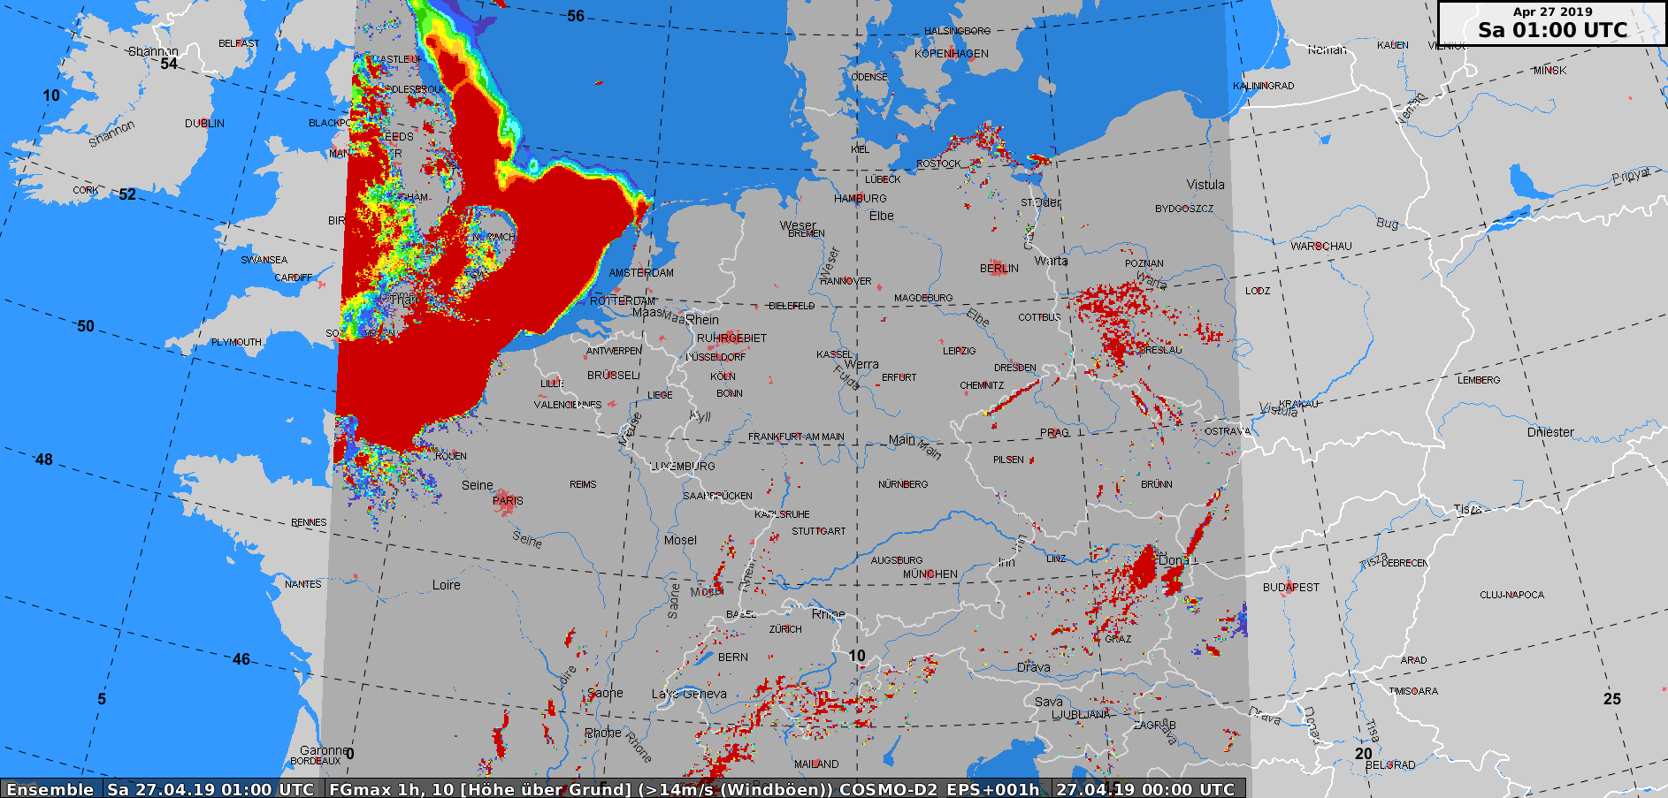
Wind gusts – probability of excedance 14m/s

