Slide 1
Recent developments on postprocessing
By MeteoSwiss

Slide 2
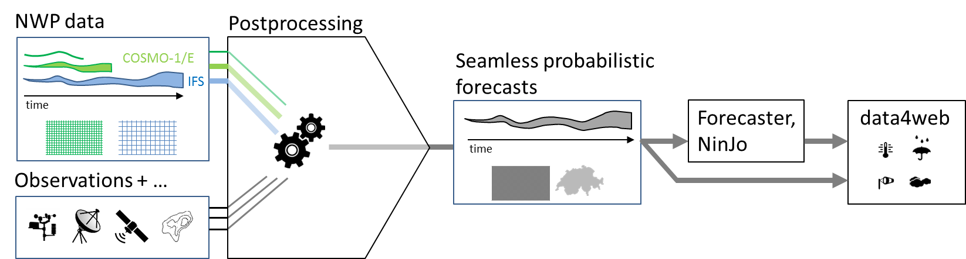
Project PostprocVeri @ Meteoswiss

Slide 3
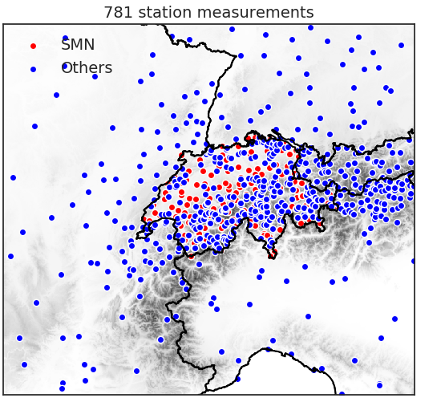
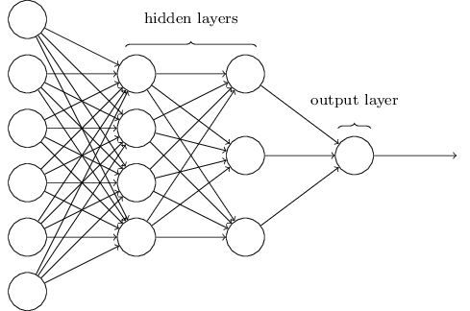
Wind forecast
ML on COSMO-1
COSMO-1 variables:
  Hourly mean wind, gust, u, v
  Pressure
  Boundary layer height
  Relative humidity
  …
Seasonality parameters:
  Hour and Day of the year
Topographical parameters
(resolutions 15 km – 100 m):
Notes:
Analysis:
COSMO-1 error interpolated in space using inverse distance weighting (horizontal and vertical).
leave one out cross-validation: equivalent or sometimes even worse performance as COSMO-1.
Forecast:
Linear blending between analysis and COSMO-1 (0-6h): unrealistic transitions.
Goal: evaluate machine learning techniques
Improve analysis and nowcasting of the model on the whole grid
Add wind gust

Slide 4
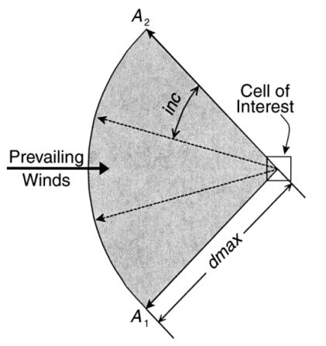
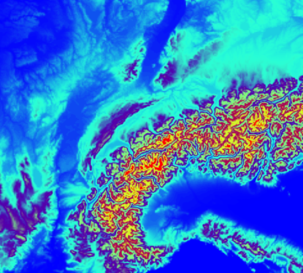
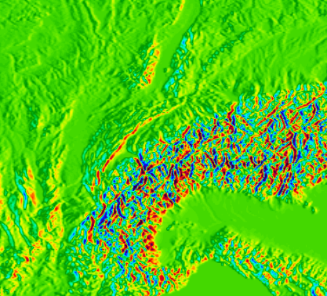
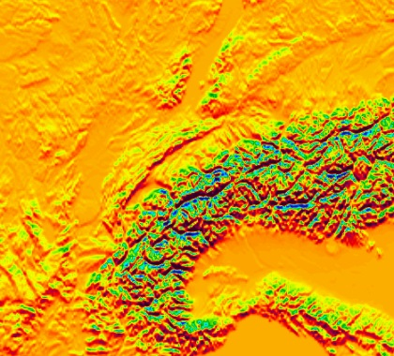
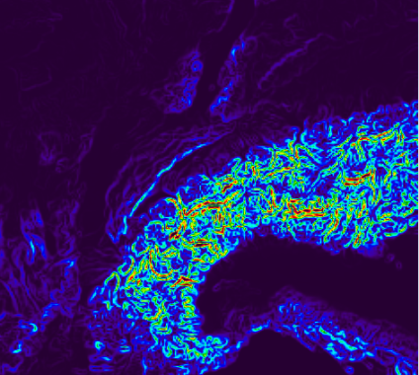
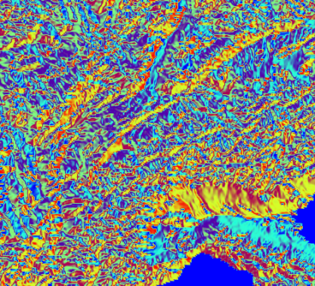
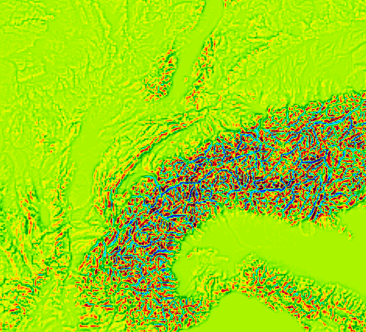
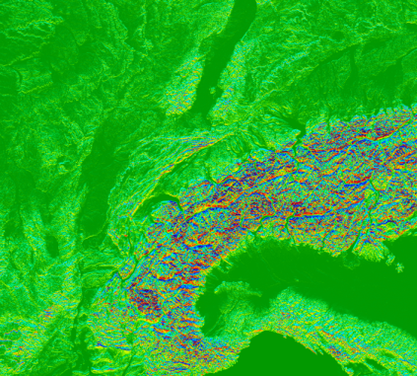
Wind forecast
ML on COSMO-1
DEM
E-W derivative
N-S derivative
Sx
Winstral et al. (2016)
Slope
Aspect
TPI
Notes:
Topographical parameters (resolutions 15 km – 100 m):
Altitude
Slope
Aspect
Directional derivatives
Topographic Position Index
Maximum slope dependent on wind direction

Slide 5
Project flowchart

Slide 6
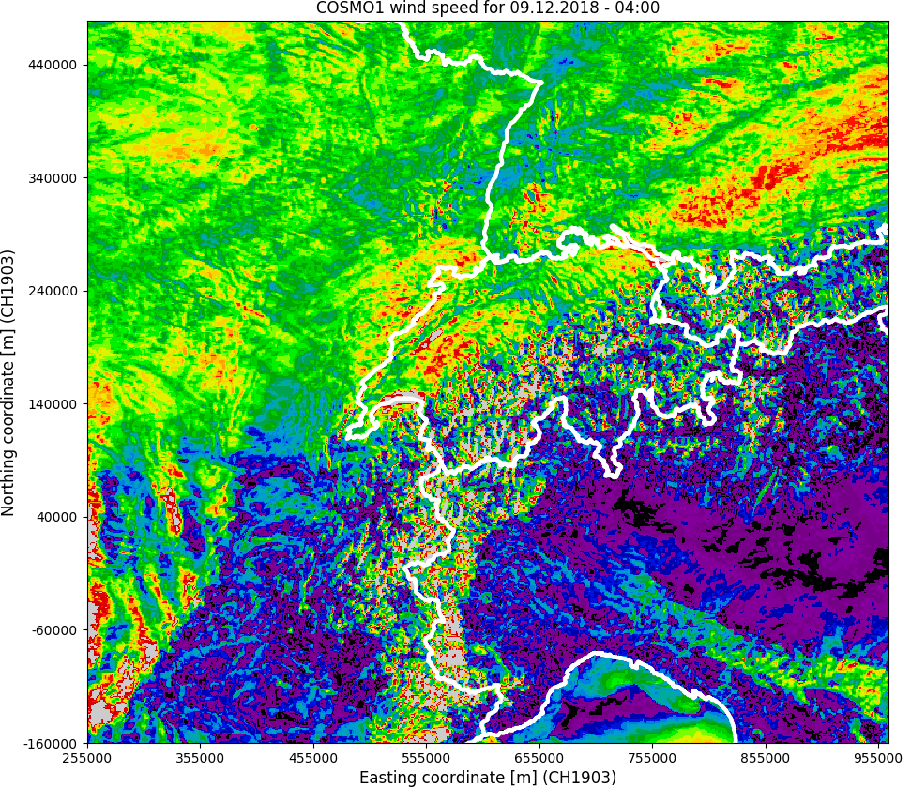
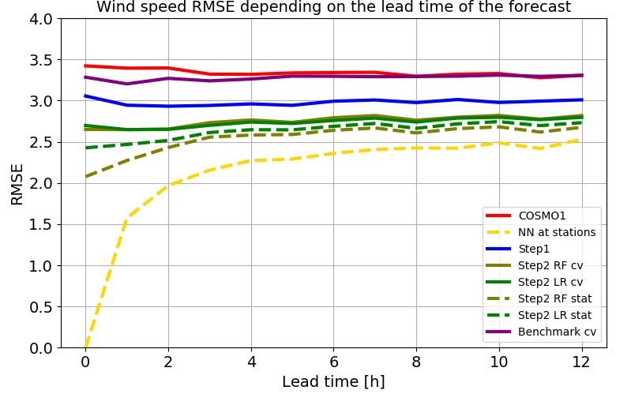
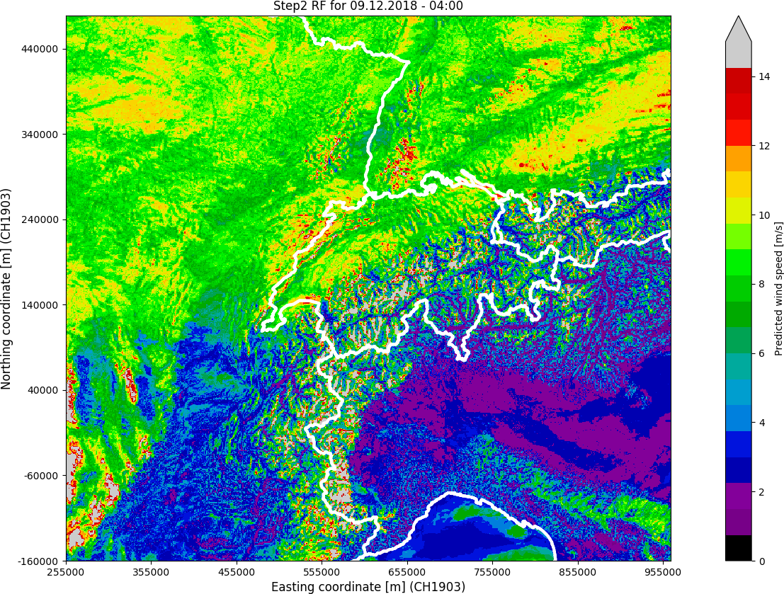
Wind forecast
ML on COSMO-1
Notes:
Model at stations
1 unique ML model leads to a strong improvement for all lead-times (0-24h).
Persistence of wind is very important for nowcasting.
Model on the grid
Machine learning for wind on locations without measurements remains a very difficult task in the Alpine region.
Multi-step approach aims to correct systematic and forecasting errors on the whole grid.
The efficacy of step 2 is evident for wind gusts, less significant for mean wind.
Possible improvements
Step 1: data size vs performance (learning curve)
Step 1: further optimisation of the Neural Network
Step 1: convolutional Neural Networks (better representativeness of topographical parameters) or/and more realistic ground model (accounting for buildings and vegetation)
Step 2: increase the number of high quality stations, try to give more importance to coordinates
Future work
Implementation of the model in real time and evaluate performance

Slide 7
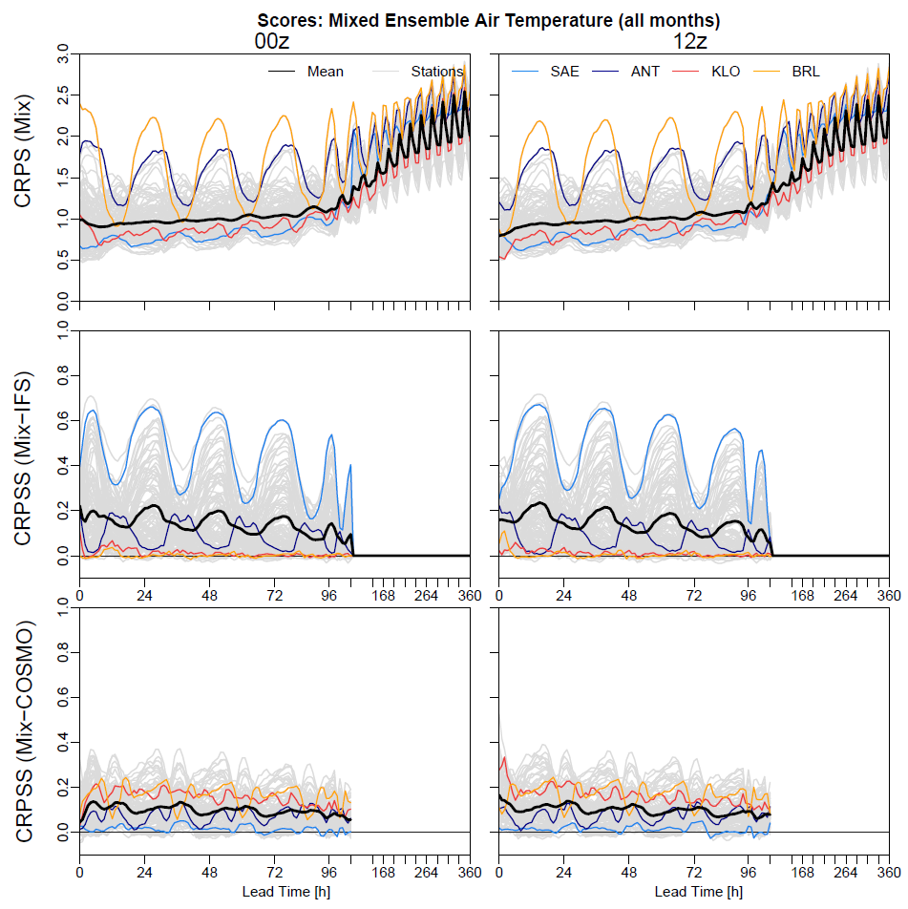


Air Temperature
“Mixed Ensemble”
121 Stations, 2017-2018
Combination of COSMO-E and IFS-ENS and post-processing with EMOS:
Mean:
mean COSMO mean IFS
Std:
Better than either calibrated single model

Slide 8
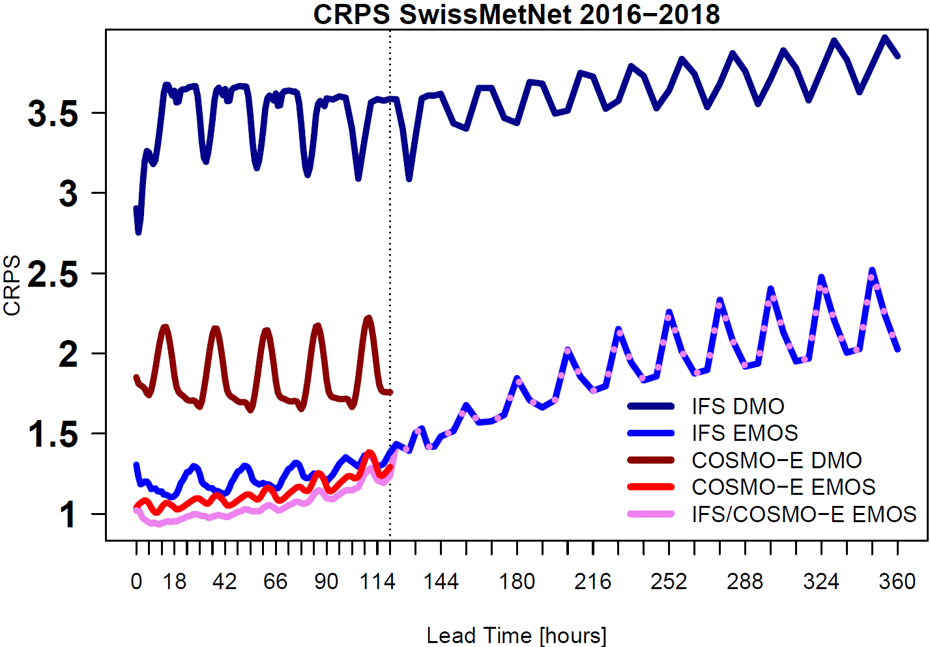
Temperature: Skill (CRPS) of DMO and EMOS
Swiss station-mean CRPS of temperature forecasts from IFS and COSMO DMO and EMOS, and a multi-model approach
COSMO improves IFS substantially.
Post-processing via EMOS leads to a further improvement
.
Combination of both (IFS and ECMWF) able to outperform COSMO-PP output.

Slide 9
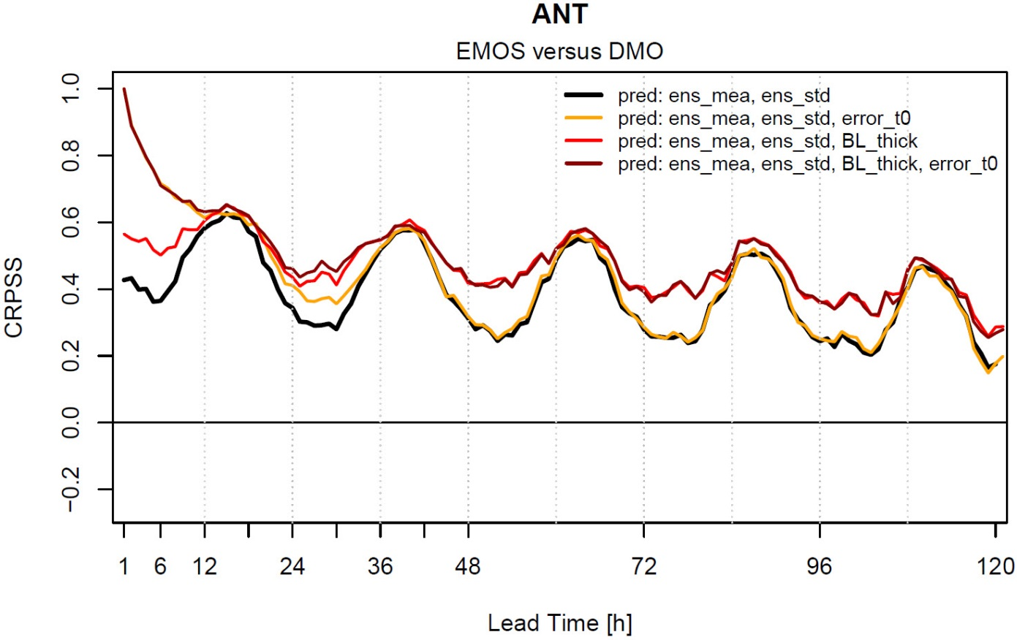
Temperature: Improving EMOS (add. Predictors)
CRPSS of temperature forecasts at the station Andermatt (ANT)
Suitable predictors are able to improve forecast substantially.
Error at init. time:
  Massive improvement in the beginning.
Boundary Layer thickness:
  Improvement at night/ in the morning.

Slide 10
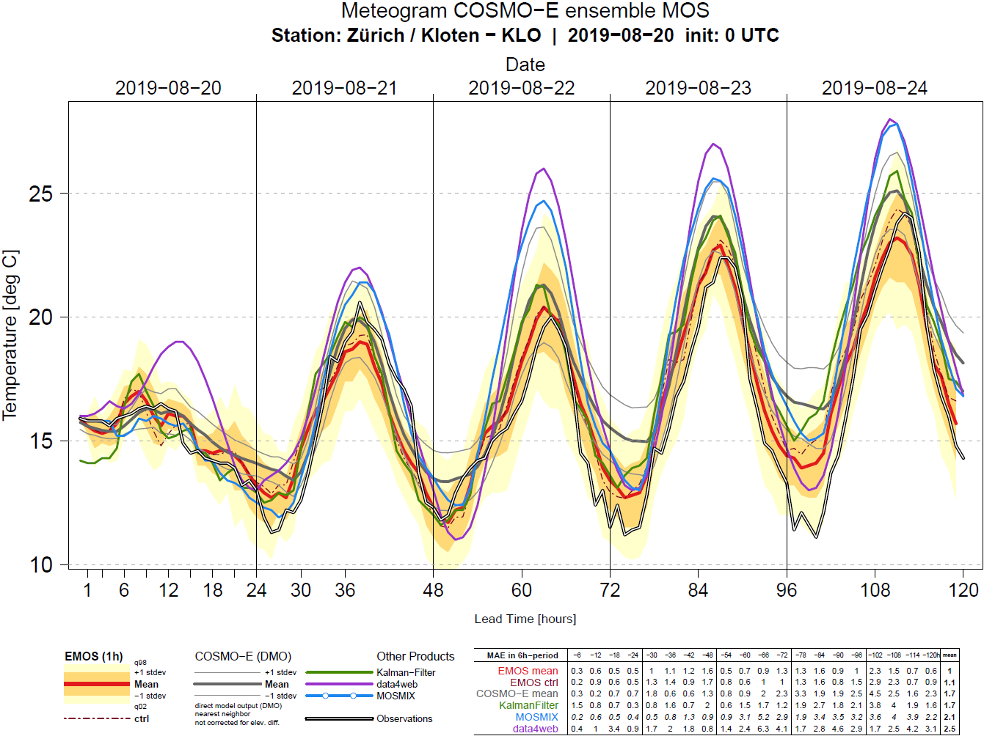
Temperature: Quasi-Operational station PP

Slide 11
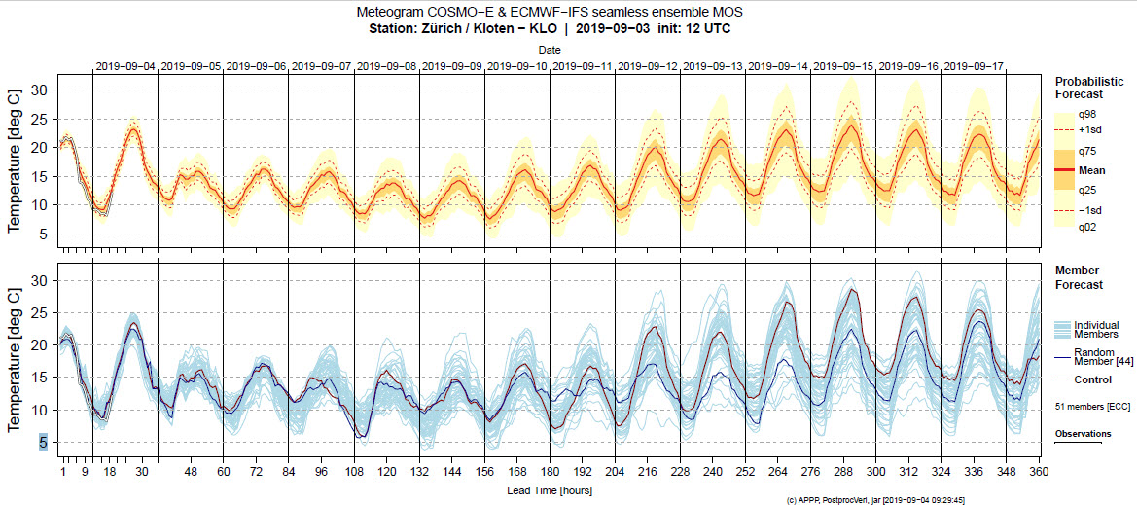
Temperature: Quasi-Operational station PP blended product including COSMO and IFS

Slide 12
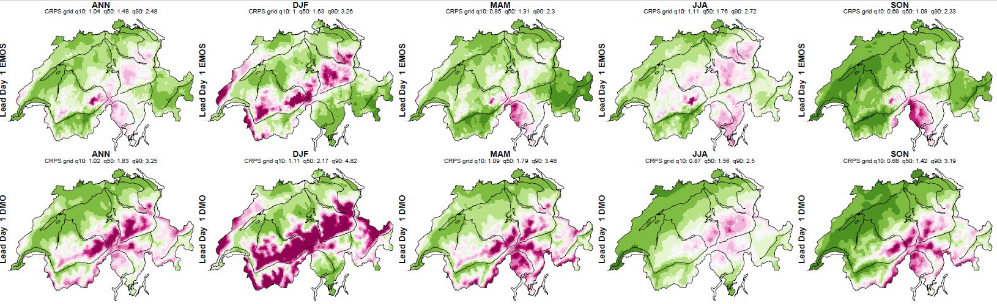
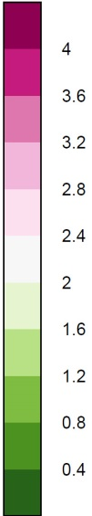
Precipitation: CRPS of DMO(bottom) and EMOS(top)
Notes:
The forecast is for leadtime 06 to 30, 24-hour accumulated
Displayed is the CRPS, so greenish colors are a small bias and violet a large bias. In mountain regions the DMO is much worse than EMOS, in the flat areas both are equally good so there is not much to improve via PP.
In terms of improvement there is a 20-40% improvement of forecasts in mountain regions, in flat-lands approx.. 0%, except in Summer where you see a very weak performance of PP.
The learnings is applied for each seasons separately.

Slide 13
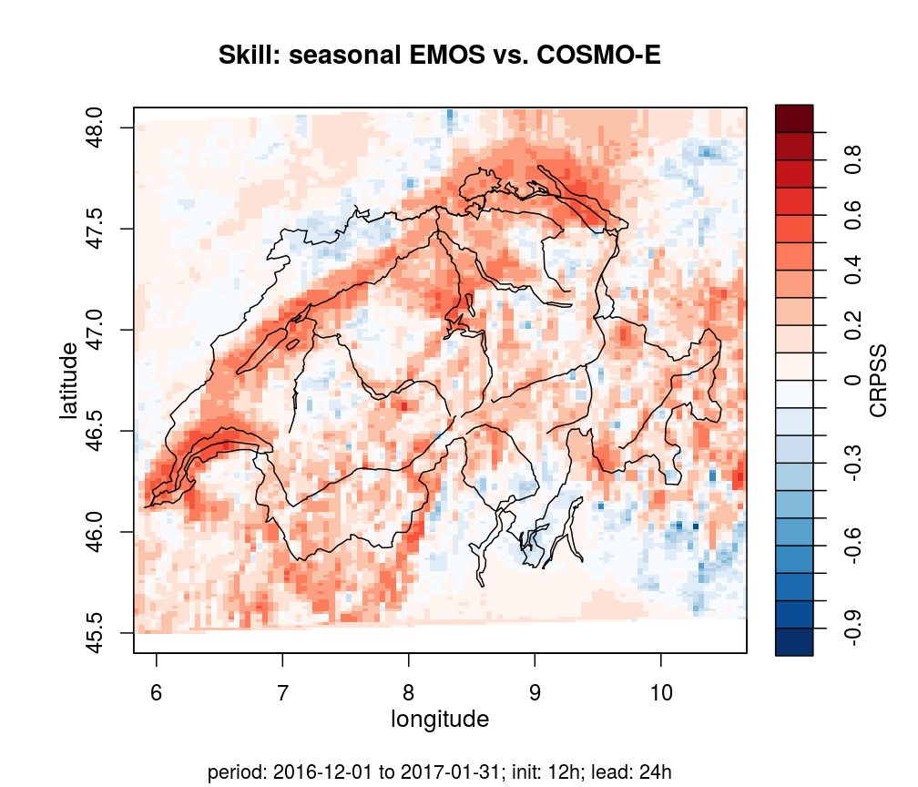
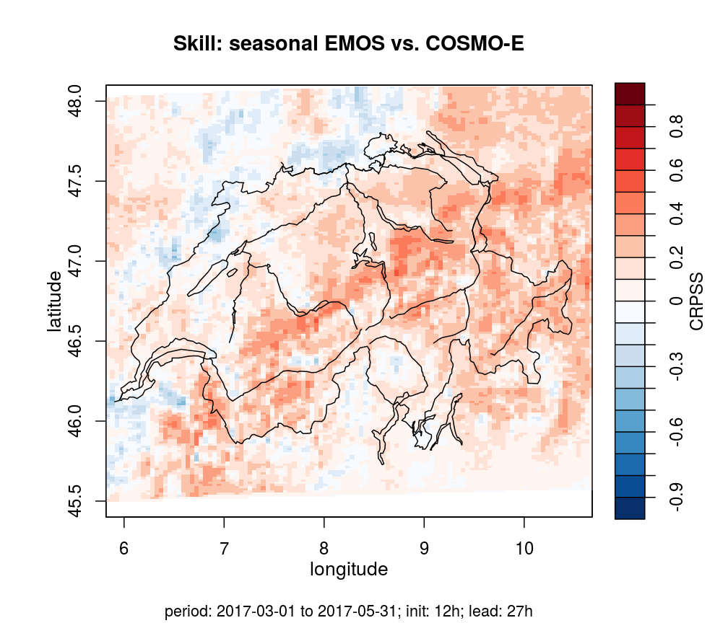
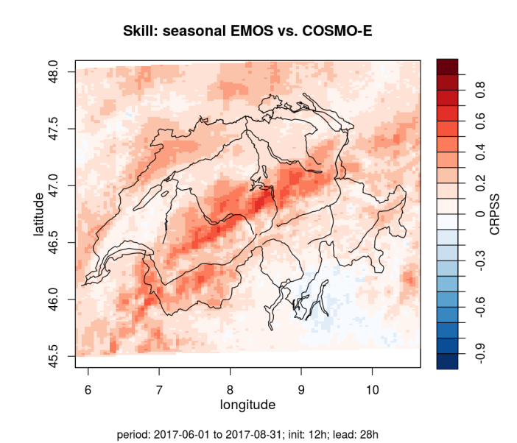
Skill (CRPSS) of EMOS for cloud cover
DJ 2016/2017,
Lead time 24 h
Valid time 12 UTC
MAM 2017,
Lead time 27 h
Valid time 15 UTC
JJA 2017,
Lead time 28 h
Valid time 16 UTC
Notes:
DJ: Valid time 12 UTC, because of strong effects of topography (low stratus) on CRPSS around noon;
→ Note: February is missing due to data availability
MAM: Valid time 15 UTC, may be affected by spreading heap/cumulus clouds
JJA: Valid time 16 UTC, affected by cumulus clouds

