Slide 1
A comparison of Rfdbk and VERSUS verification results Ulrich Pflüger Deutscher Wetterdienst

Slide 2
Motivation
Can Rfdbk results be compared with VERSUS results ?
if yes benefits (for DWD):
Operation of VERSUS at DWD would no longer be necessary
Elimination of time and effort for operation and maintenance of VERSUS
DWD's contribution to common verification activity could be integrated into the routine verification system of the DWD

Slide 3
Overview
Models
COSMO-D2 (June 2018, 00 UTC runs)
ICON-EU (June 2018, 00 UTC runs)
Areas (station lists)
Common Area 2 = CA2
Common Area 1 (ICON-EU) = CA1
Common Area 2_N = CA2_N
Common Area 1_N ( ICON-EU) = CA1_N
German Airports (24 stations) = GerAir
Frankfurt Airport = 10637
reduced station list, because not all stations
of CA2/CA1 were found in feedbackfiles

Slide 4
Overview (2)
Verified parameters T_2M, TD_2M, WS, Ps (Rfdbk), Pmsl (VERSUS)
Scores ME, RMSE, (LEN = number of observations)
Leadtimes
VERSUS COSMO-D2 (0,3,6, …, 27 h) ICON-EU (0,3,6, …, 72 h)
Rfdbk COSMO-D2 (0,1,2, …, 27 h) ICON-EU (0,3,6, …, 48,54,60,66,72 h)

Slide 5
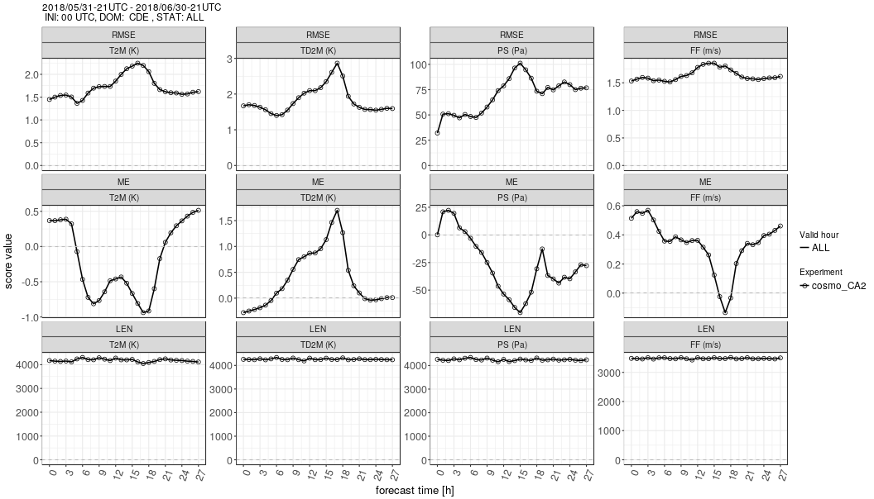
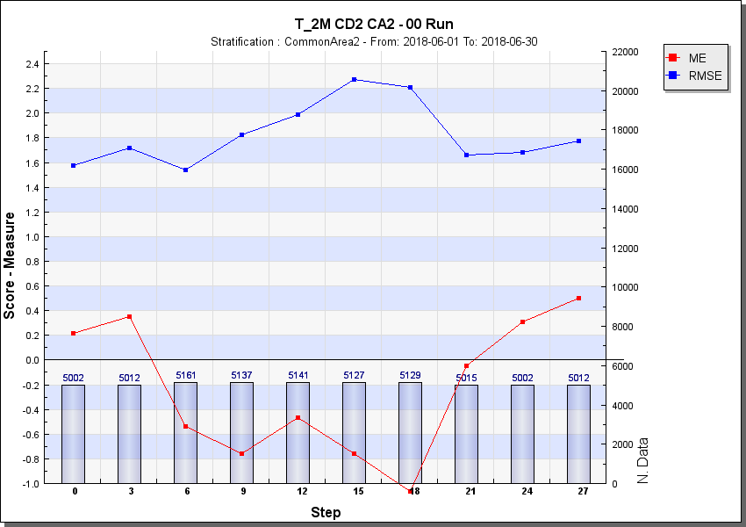
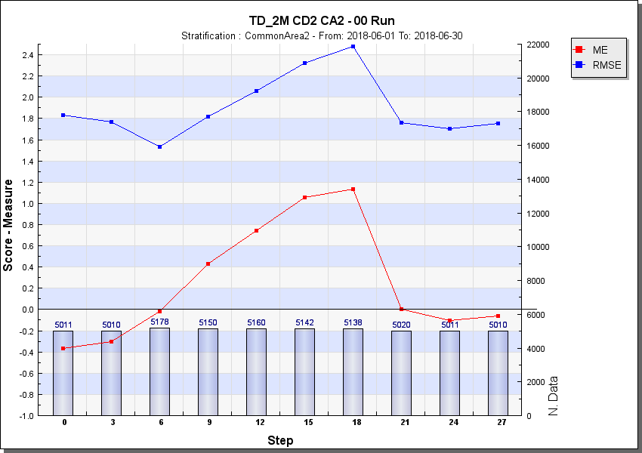
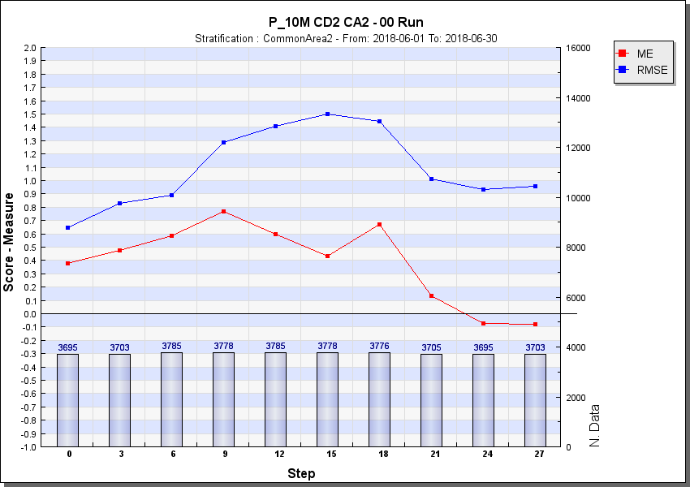
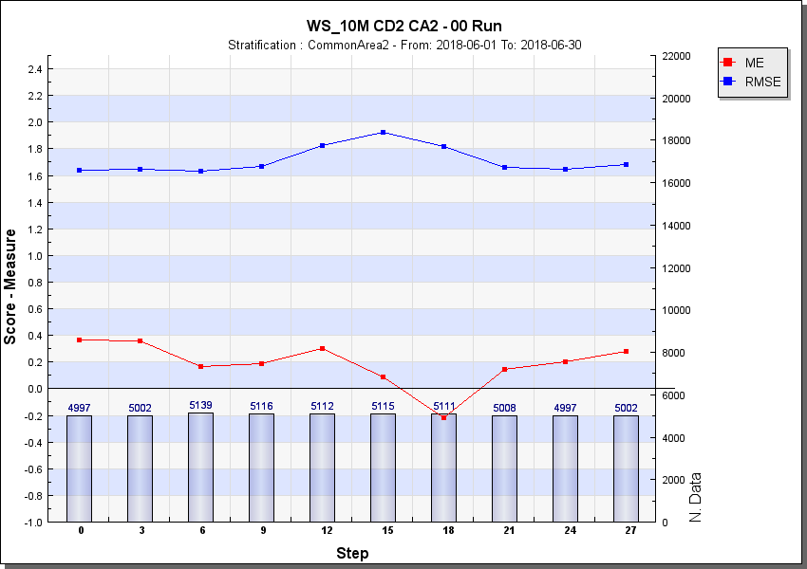
COSMO-D2 Rfdbk and VERSUS (CA2, 201806)
Example of original graphic output
of Rfdbk and VERSUS (COSMO-D2, 201806)

Slide 6
How can the verification results be compared better ?
export of the scores via ascii files from Rfdbk/VERSUS
IDL program to compare the scores of Rfdbk /VERSUS in one plot
mean over leadtimes (ME_{VERSUS} - ME_{Rfdbk}), (RMSE_{VERSUS} - RMSE_{Rfdbk})
correlation over leadtimes (ME_{VERSUS}, ME_{Rfdbk}), (RMSE_{VERSUS}, RMSE_{Rfdbk})

Slide 7
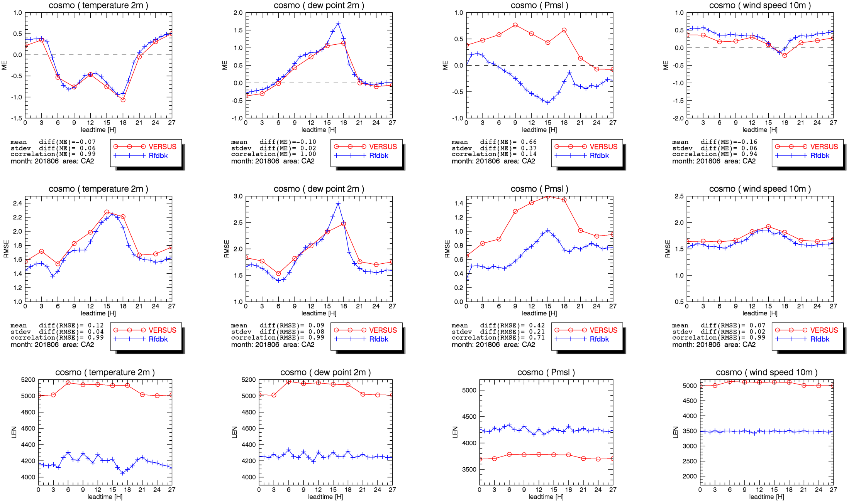
COSMO-D2 Rfdbk and VERSUS (CA2, 201806)

Slide 8
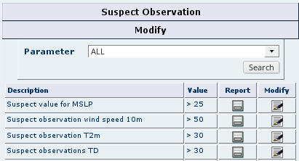
Reasons for different number of stations in VERSUS and Rfdbk
Different quality control of observations
In Rfdbk verification all observations (used and unused) which are not rejected by the quality control of DWDs data assimilation system are used
In VERSUS all observations which are not filtered through the suspect observation check are used
Rfdbk obs from DWD database
VERSUS obs from ECMWF database
Therefore modified station list CA2_N vs. CA2:
Alignment of stations (reduction of the stationlist CA2 by the number of stations not found in Rfdbk)
For Rfdbk: stations filtered as with VERSUS

Slide 9
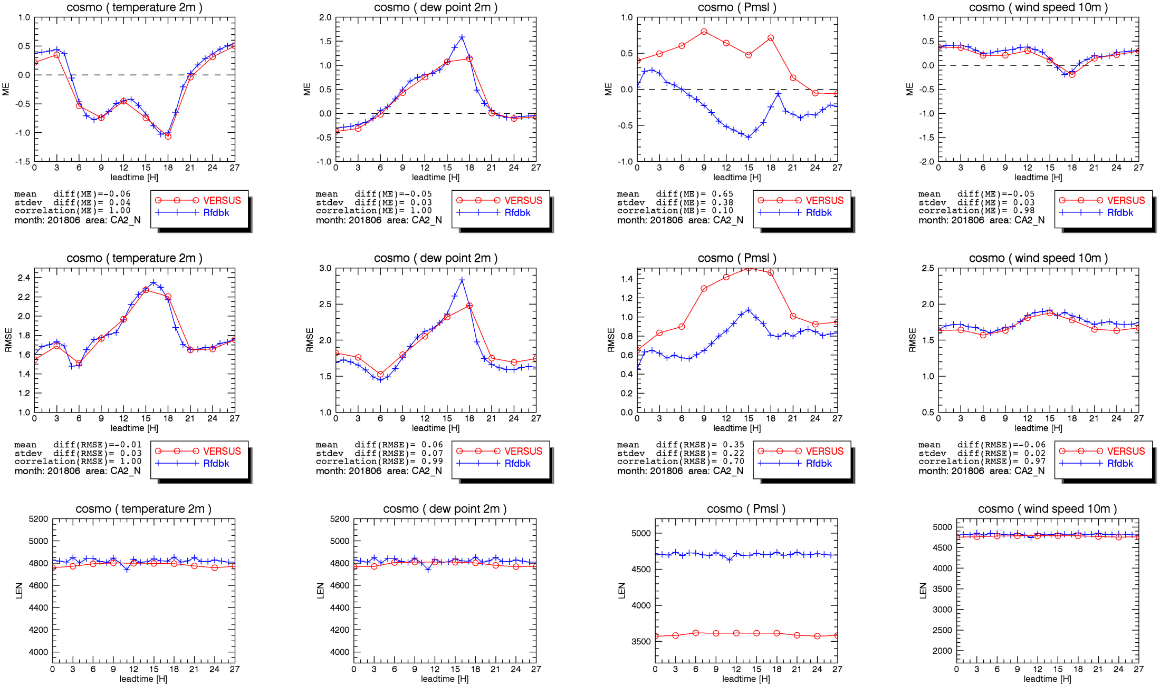
COSMO-D2 Rfdbk and VERSUS (CA2_N, 201806)

Slide 10
COSMO-D2 Rfdbk and VERSUS (CA2, 201806)

Slide 11
CA2 → CA2_N
Adjustment of the number of observations between Rfdbk and VERSUS except for ground pressure
the differences between Rfdbk and VERSUS verification become mostly smaller, when a station alignment and the same quality control is done
T_2M | CA2 | CA2_N
mean diff (ME) | -0.07 | -0.06
stdev diff (ME) | 0.06 | 0.04
correlation (MEs) | 0.99 | 1.00
mean diff (RMSE) | 0.12 | -0.01
stdev diff (RMSE) | 0.04 | 0.04
correlation (RMSEs) | 0.99 | 1.00
TD_2M | CA2 | CA2_N
 | -0.10 | -0.05
 | 0.02 | 0.03
 | 1.00 | 1.00
 | 0.09 | 0.06
 | 0.08 | 0.07
 | 0.99 | 0.99
Ps,Psml | CA2 | CA2_N
mean diff (ME) | 0,66 | 0.65
stdev diff (ME) | 0.37 | 0.38
correlation (MEs) | 0.14 | 0.10
mean diff (RMSE) | 0.42 | 0,35
stdev diff (RMSE) | 0.21 | 0.22
Correlation (RMSEs) | 0.71 | 0.70
WS | CA2 | CA2_N
 | -0.16 | -0.05
 | 0.06 | 0.03
 | 0.94 | 0.98
 | 0.07 | -0.06
 | 0.02 | 0.02
 | 0.99 | 0.97

Slide 12
The same verification but for ICON-EU

Slide 13
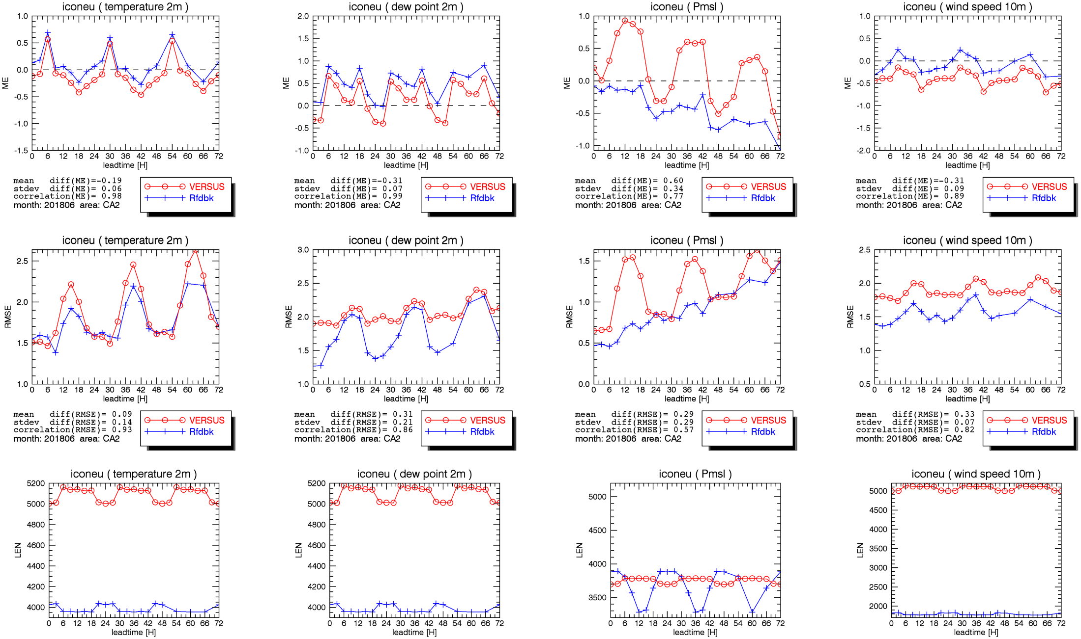
ICON-EU Rfdbk and VERSUS (CA2, 201806)

Slide 14
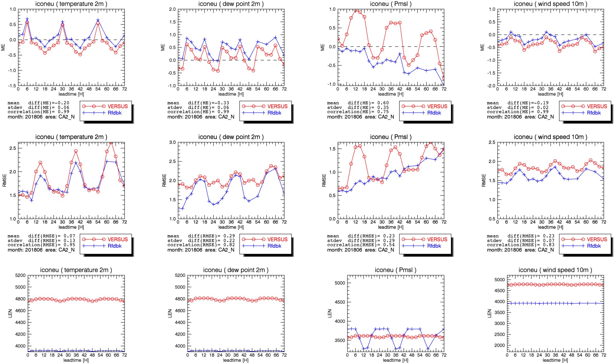
ICON-EU Rfdbk and VERSUS (CA2_N, 201806)

Slide 15
Verification of ICON-EU for CA2 and CA2_N
in contrast to the COSMO-D2 verification with Rfdbk/VERSUS
further on large differences in the number of observations despite station alignment, reason is unclear
perhaps because there is a difference in the feedback files of COSMO-D2 and ICON-EU regarding the assignment of the observations to the date of the feedback file
obs in COSMO-D2 fdbk files: 60 minutes before date of fdbk file
obs in ICON-EU fdbk files: 30 minutes before/after date of fdbk file
2018060200
2018060201
2018060202
COSMO 23:01-00:00
COSMO 00:01-01:00
COSMO 01:01-02:00
ICONEU 23:31-00:30
ICONEU 00:31-01:30
ICONEU 01:31-02:30

Slide 16
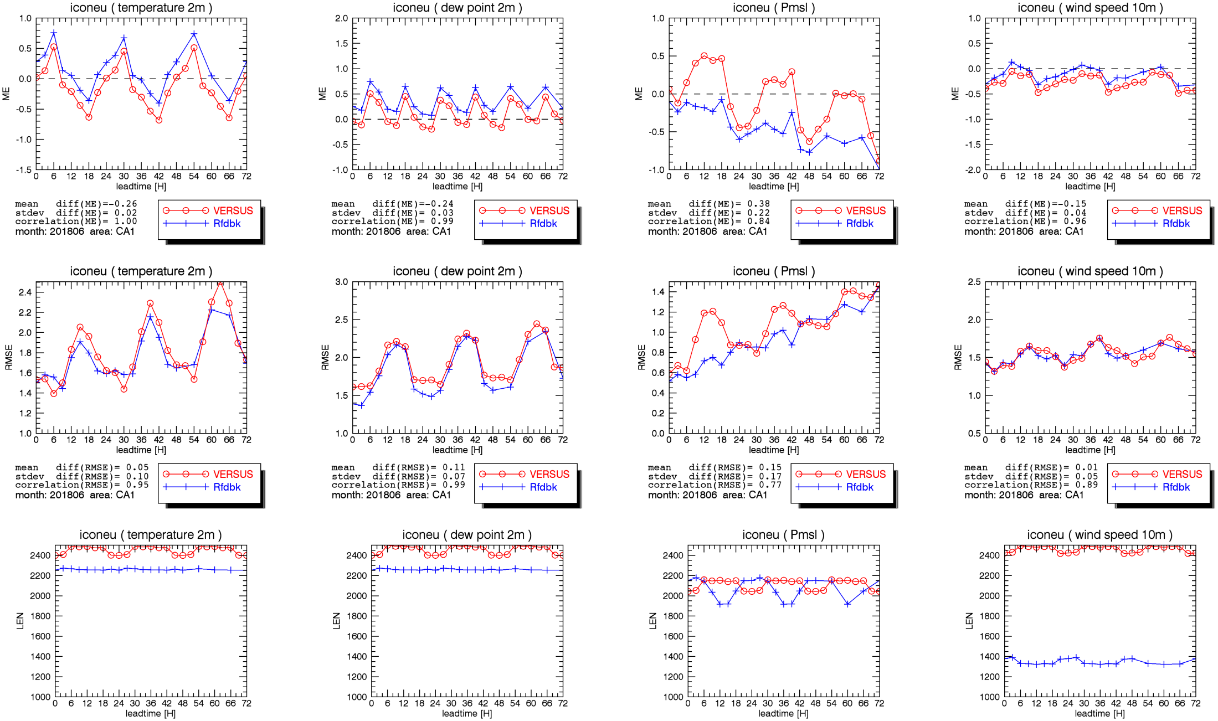
ICON-EU Rfdbk and VERSUS (CA1, 201806)

Slide 17
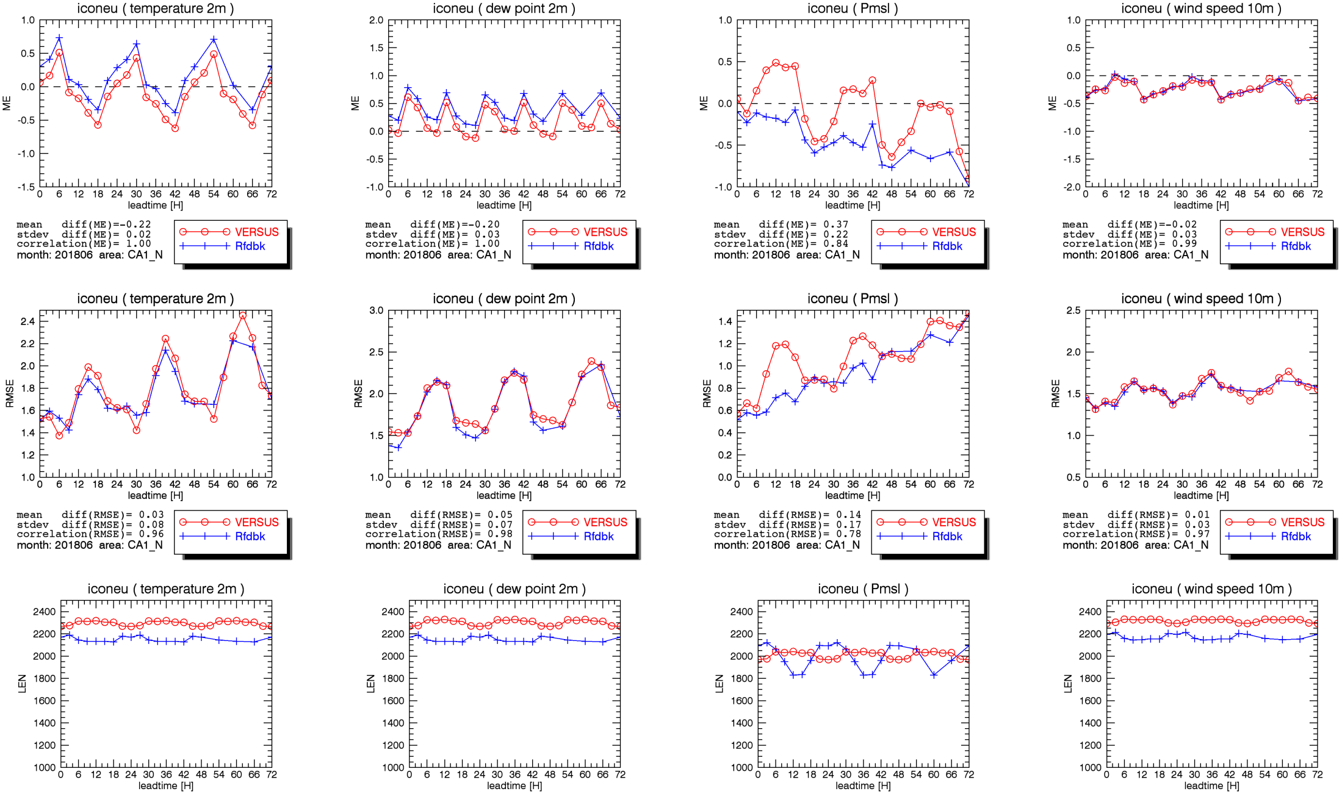
ICON-EU Rfdbk and VERSUS (CA1_N, 201806)

Slide 18
CA1 → CA1_N
No adjustment of the number of observations between Rfdbk and VERSUS except for wind spee
Anyhow the differences between Rfdbk and VERSUS verification become mostly smaller, when a station alignment and the same quality control is done
T_2M | CA1 | CA1_N
mean diff (ME) | -0.26 | -0.22
stdev diff (ME) | 0.02 | 0.02
correlation (MEs) | 1.00 | 1.00
mean diff (RMSE) | 0.05 | 0.03
stdev diff (RMSE) | 0.10 | 0.08
correlation (RMSEs) | 0.95 | 0.98
TD_2M | CA1 | CA1_N
 | -0.24 | -0.20
 | 0.03 | 0.03
 | 0.99 | 1.00
 | 0.11 | 0.05
 | 0.07 | 0.07
 | 0.99 | 0.98
Ps,Psml | CA1 | CA1_N
mean diff (ME) | 0,38 | 0.37
stdev diff (ME) | 0.22 | 0.22
correlation (MEs) | 0.84 | 0.84
mean diff (RMSE) | 0.15 | 0,14
stdev diff (RMSE) | 0.17 | 0.,17
Correlation (RMSEs) | 0.77 | 0.78
WS | CA1 | CA1_N
 | -0.15 | -0.02
 | 0.04 | 0.03
 | 0.96 | 0.99
 | 0.01 | 0.01
 | 0.05 | 0.03
 | 0.89 | 0.97

Slide 19
to minimize the influence of the number of observations
try and error search for a station list that provides the same number of observations for both models in both verification systems
found 24 German Airports/Airfields referenced as “GerAir”
(very close to the same number of observations)
verification for only 1 station (10637 Frankfurt Airport)
(exactly the same number of observations)

Slide 20
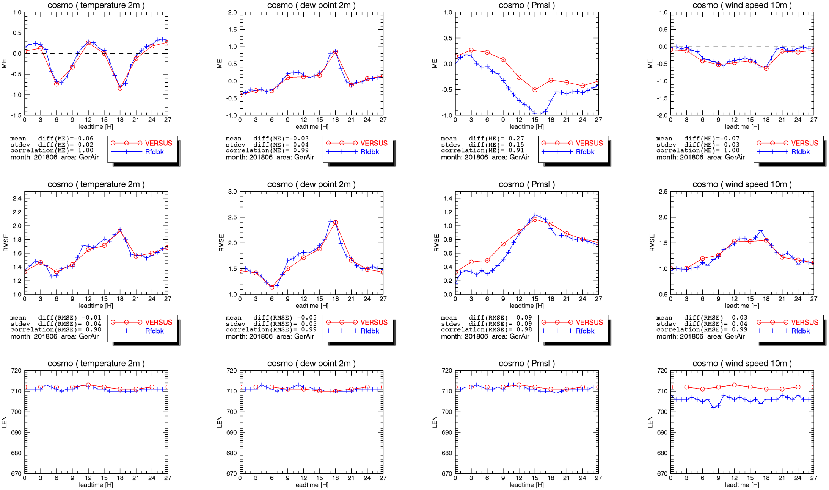
COSMO-D2 Rfdbk and VERSUS (GerAir, 201806)

Slide 21
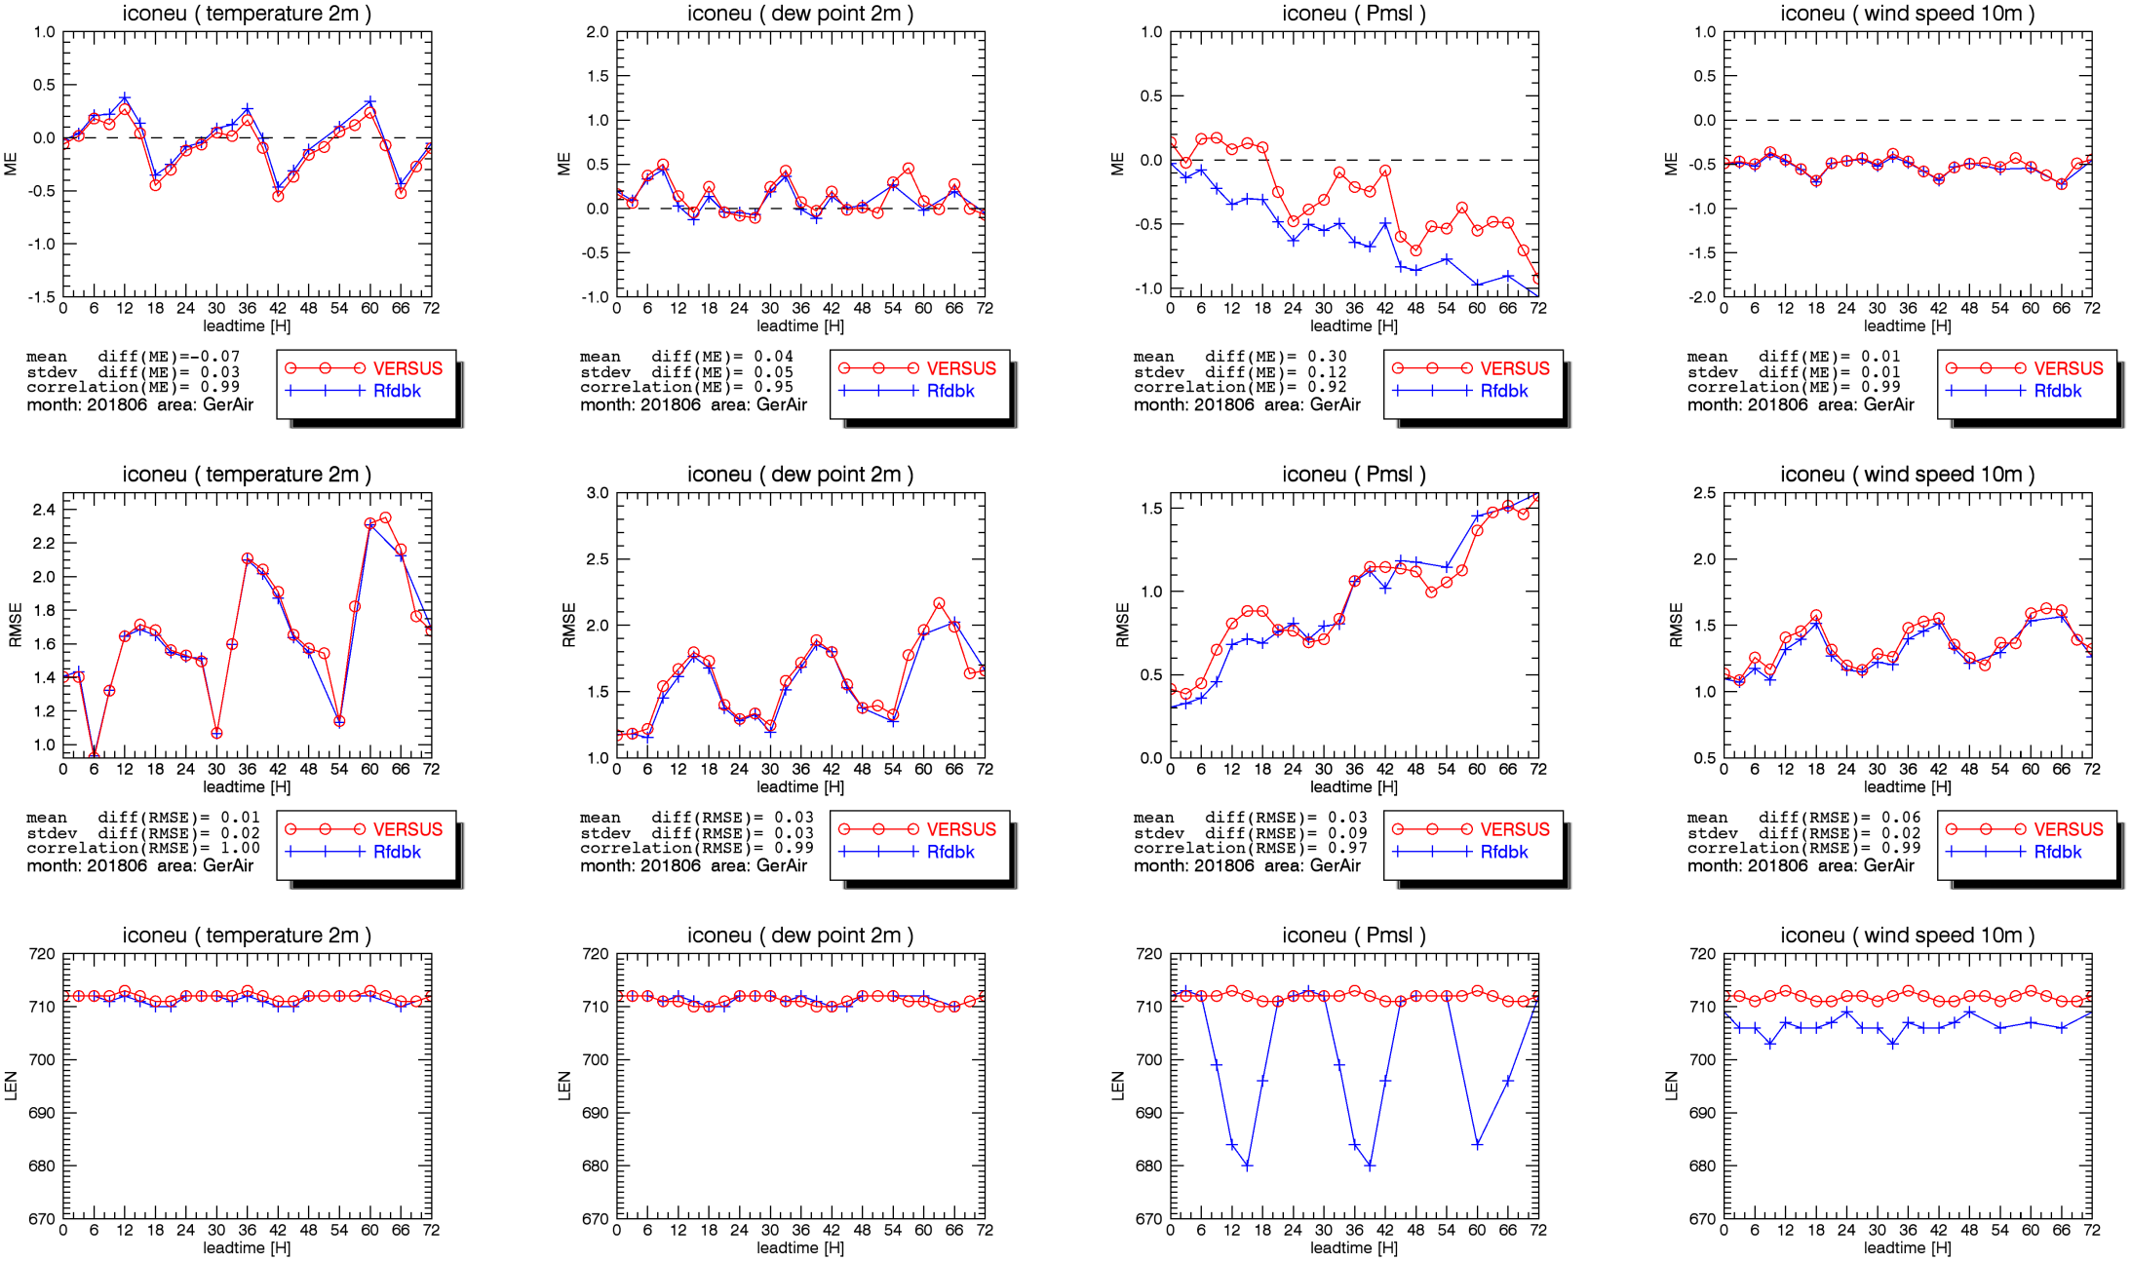
ICON-EU Rfdbk and VERSUS (GerAir, 201806)

Slide 22
The same 2 verifications but for 10637 (Frankfurt) only

Slide 23
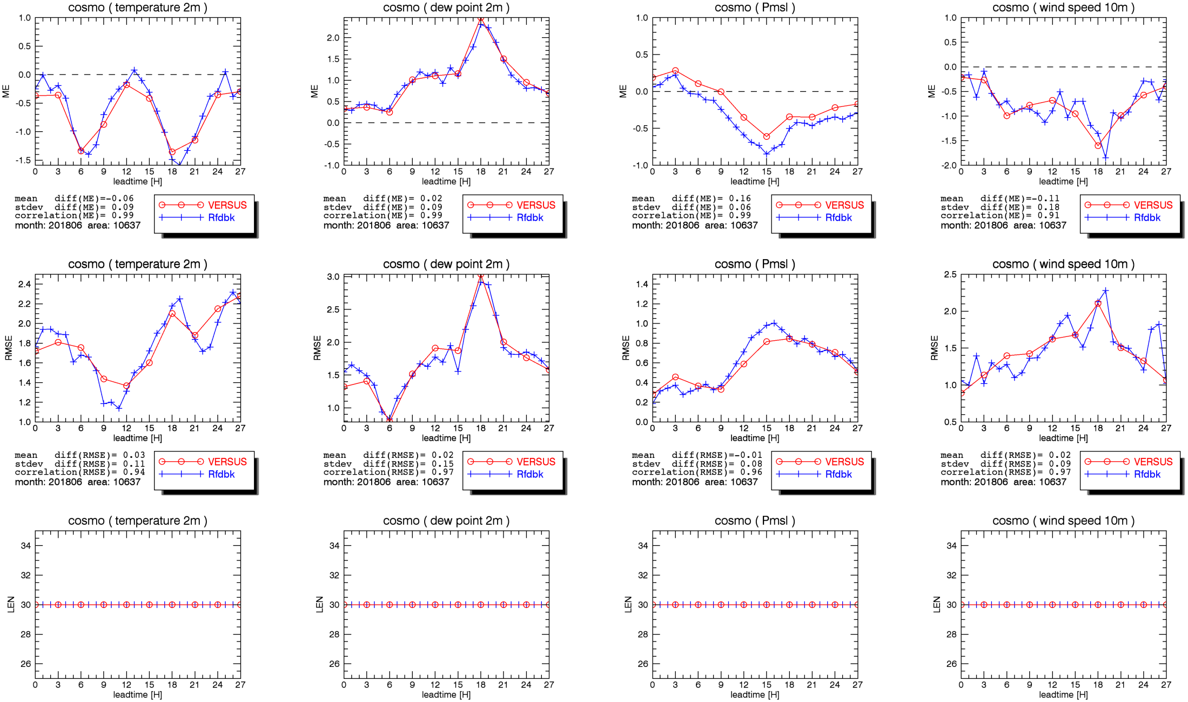
COSMO-D2 Rfdbk and VERSUS (10637, 201806)

Slide 24
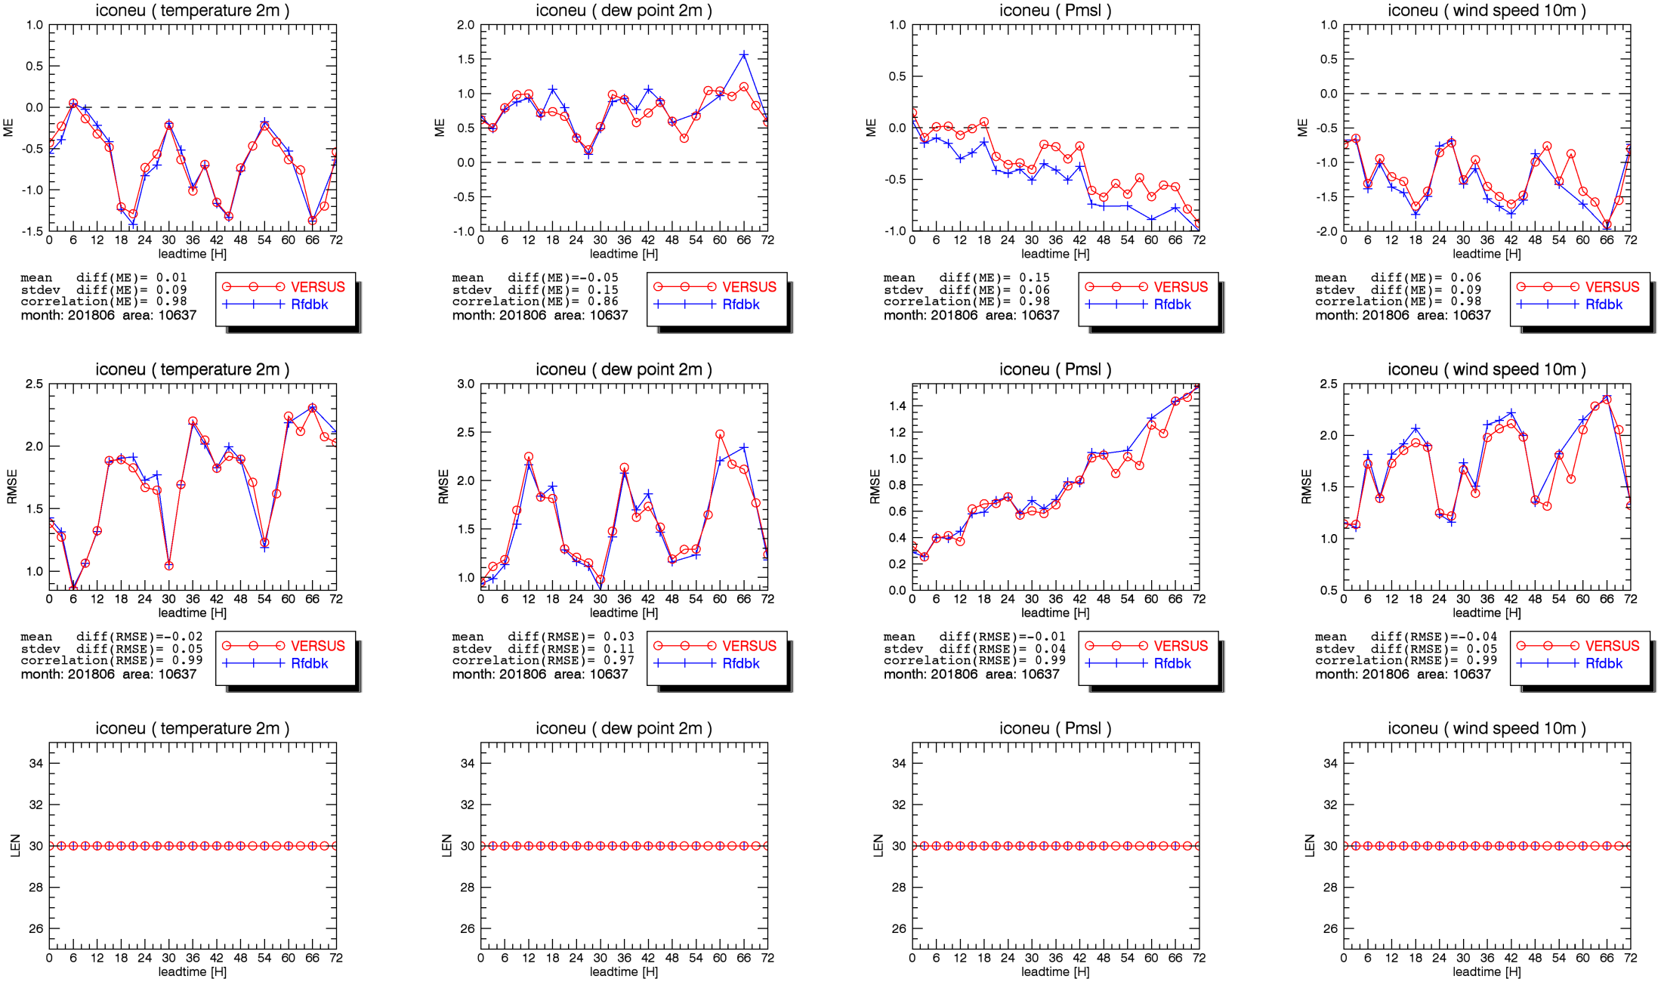
ICON-EU Rfdbk and VERSUS (10637, 201806)

Slide 25
how large is the difference of the same model forecast in the 2 different verification systems at a single station
Comparison of time series of 00 UTC runs from Rfdbk (obs and fcst) and VERSUS (obs and fcst) at a single station (day 1 to 15)
Time series created from 00 UTC runs and leadtimes from 0 to 21 h (3h interval)
Comparison fcst Rfdbk vs. obs Rfdbk
Comparison fcst VERSUS vs. obs VERSUS
Comparison and fcst VERSUS vs. fcst Rfdbk
Comparison and obs VERSUS vs. obs Rfdbk

Slide 26
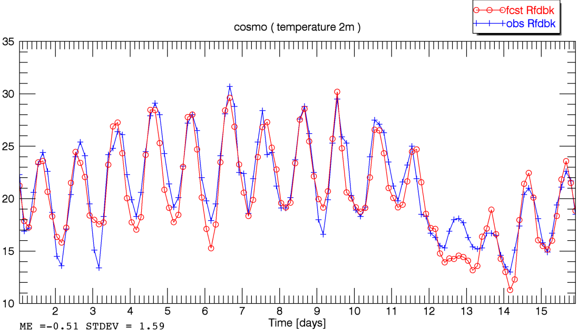
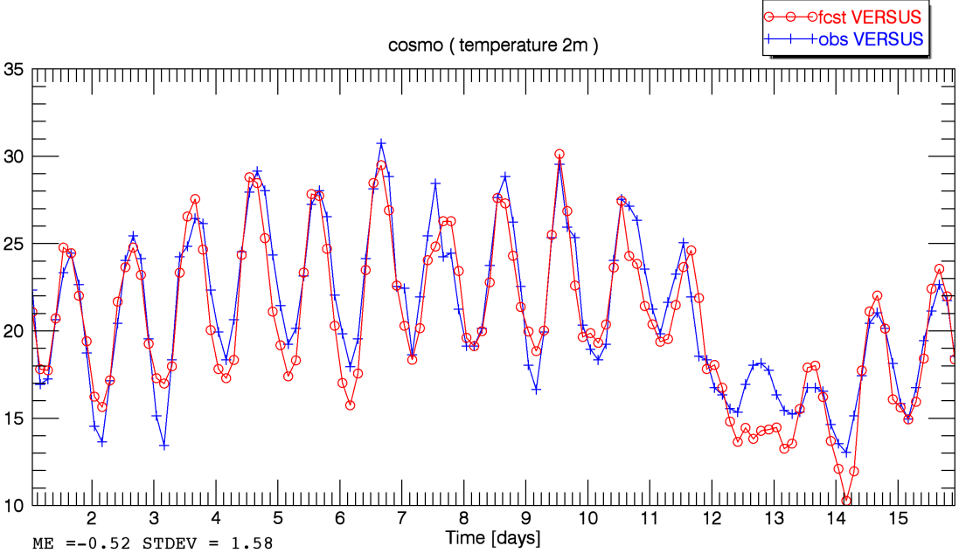
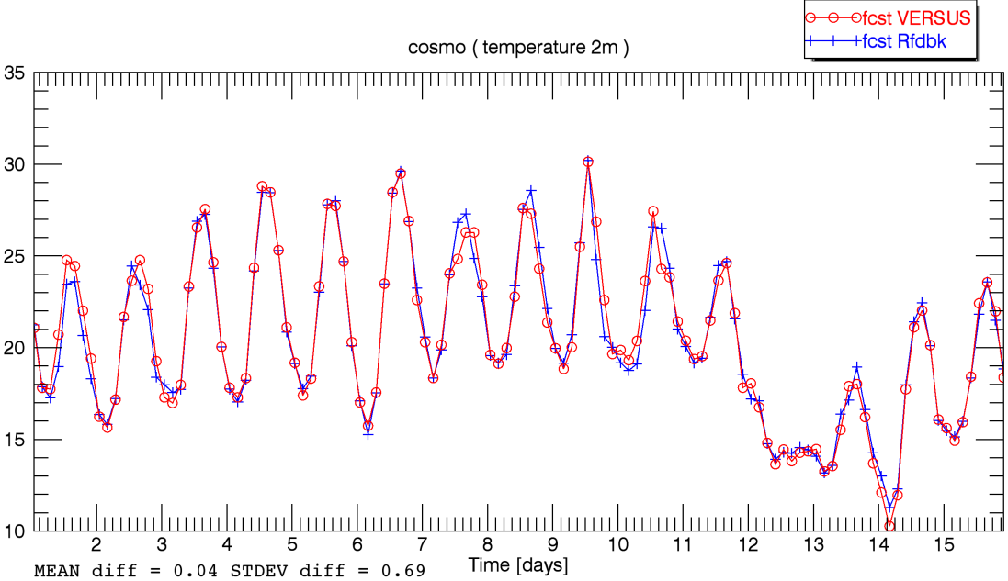
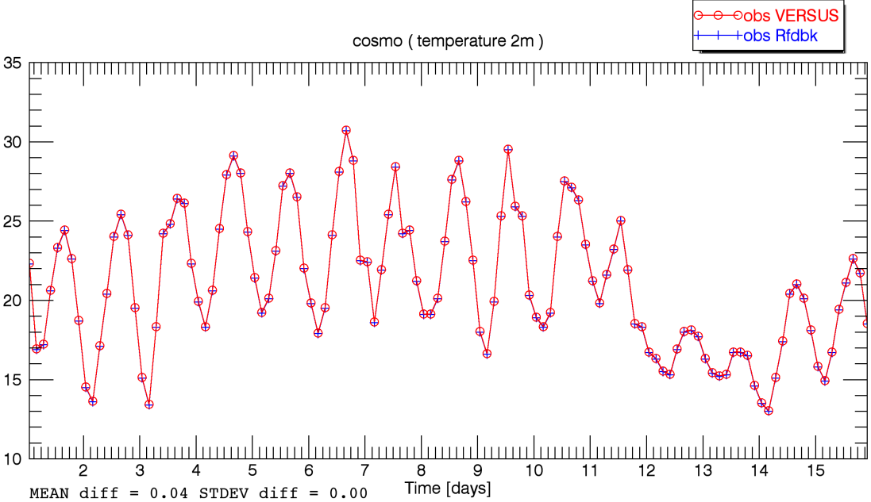
COSMO-D2 (T_2M) fcst Rfdbk < --- > obs Rfdbk fcst Rfdbk < --- > obs VERSUS
fcst VERSUS < --- > fcst Rfdbk obs VERSUS < --- > obs Rfdbk

Slide 27
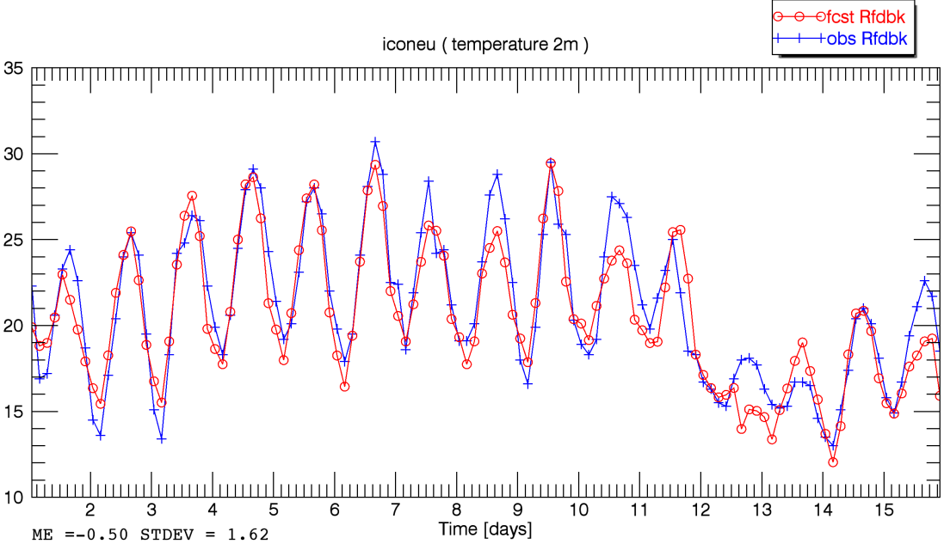
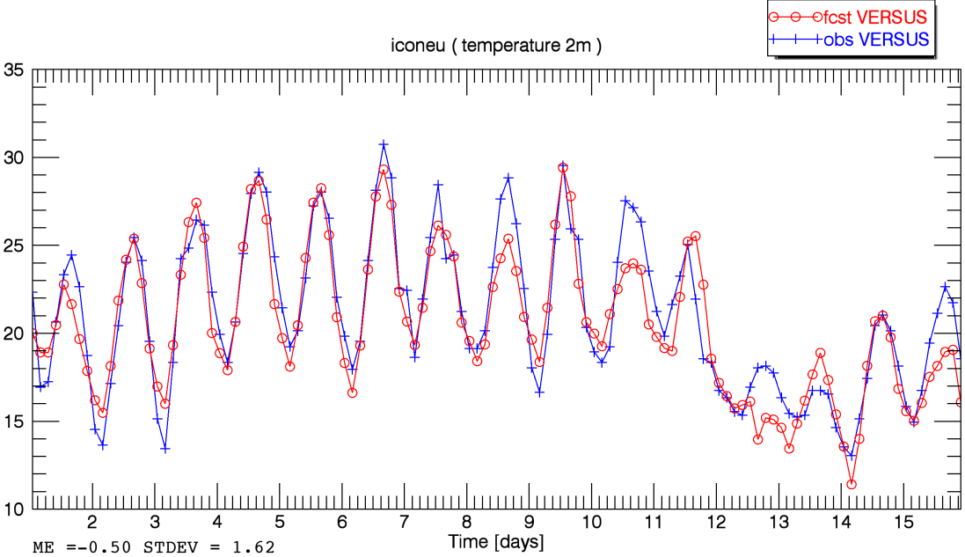
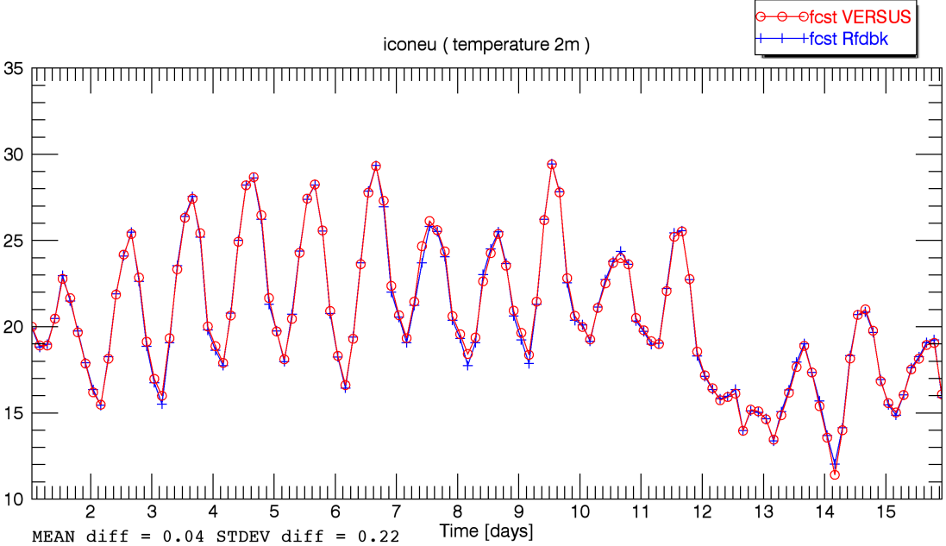
ICONEU (T_2M) fcst Rfdbk < --- > obs Rfdbk fcst Rfdbk < --- > obs VERSUS
fcst VERSUS < --- > fcst Rfdbk obs VERSUS < --- > obs Rfdbk

Slide 28
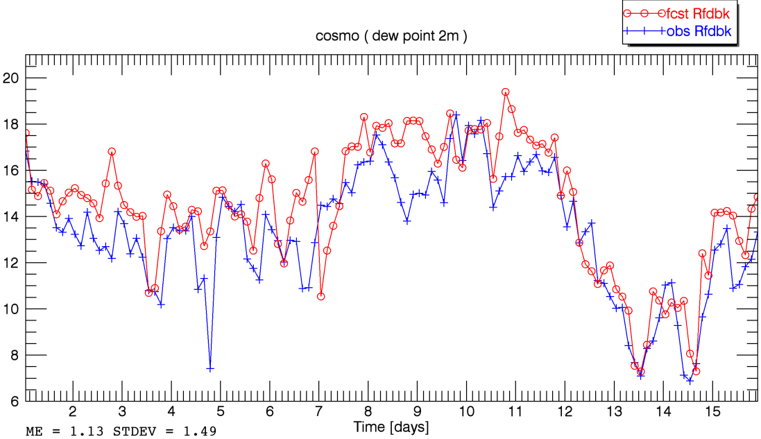
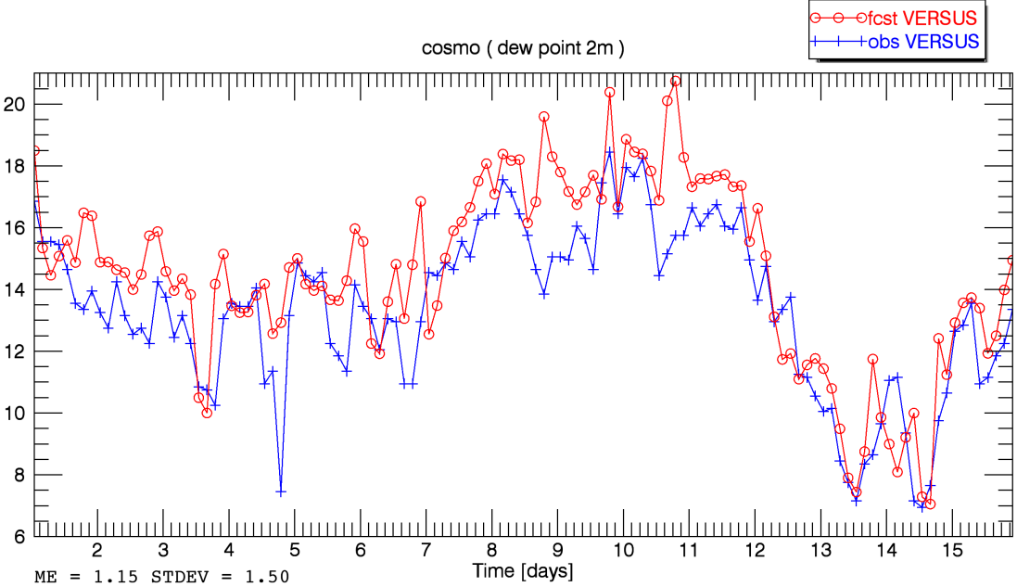
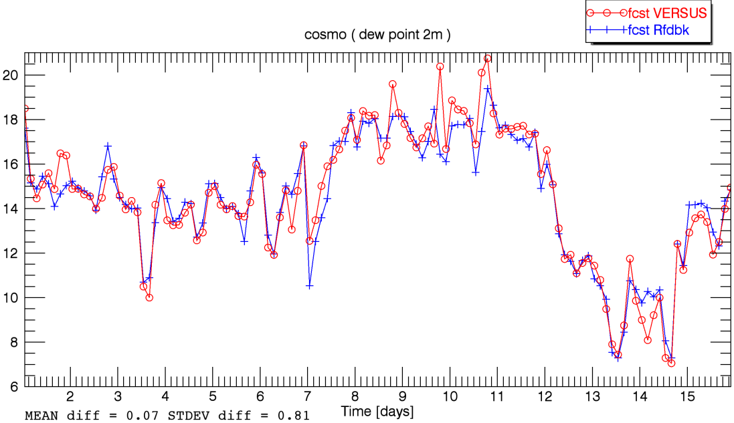
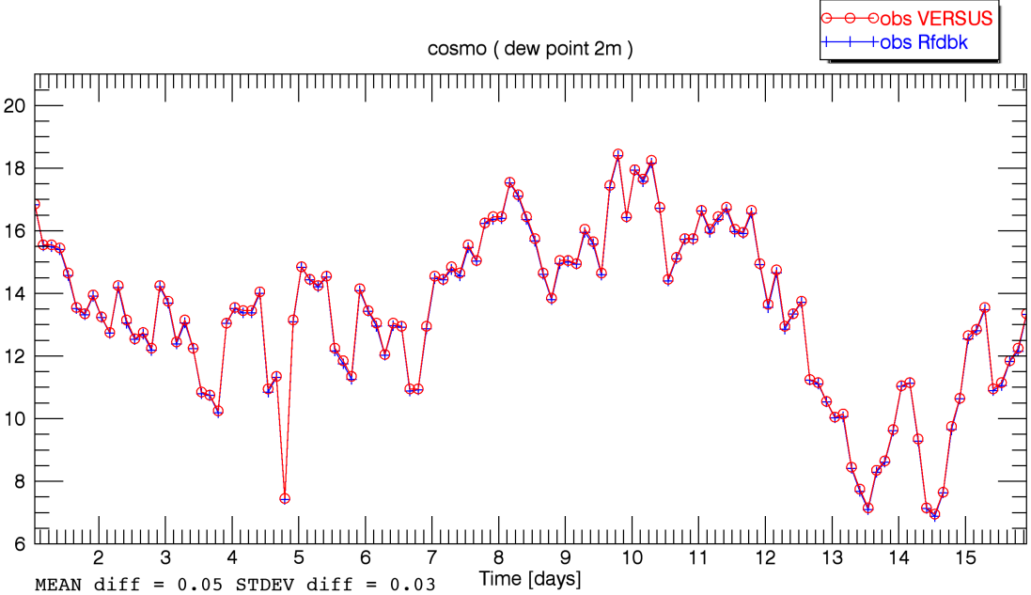
COSMO-D2 (TD_2M) fcst Rfdbk < --- > obs Rfdbk fcst Rfdbk < --- > obs VERSUS
fcst VERSUS < --- > fcst Rfdbk obs VERSUS < --- > obs Rfdbk

Slide 29
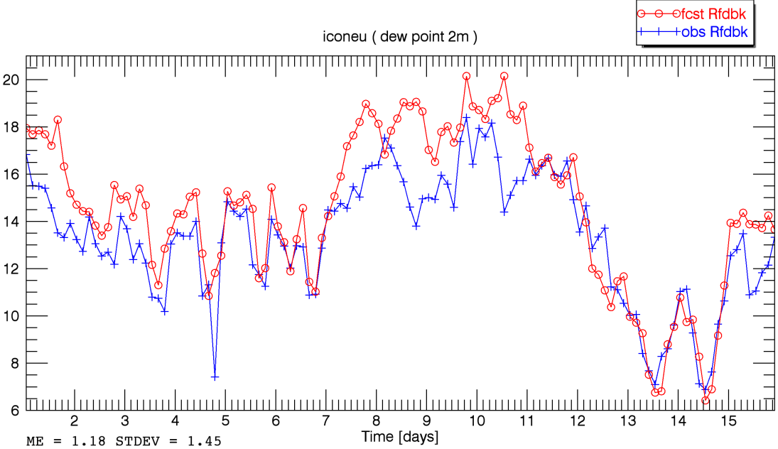
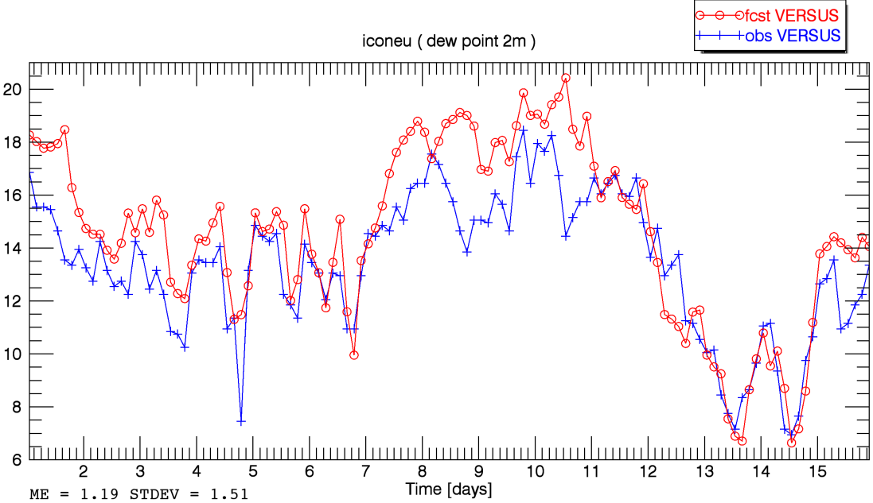
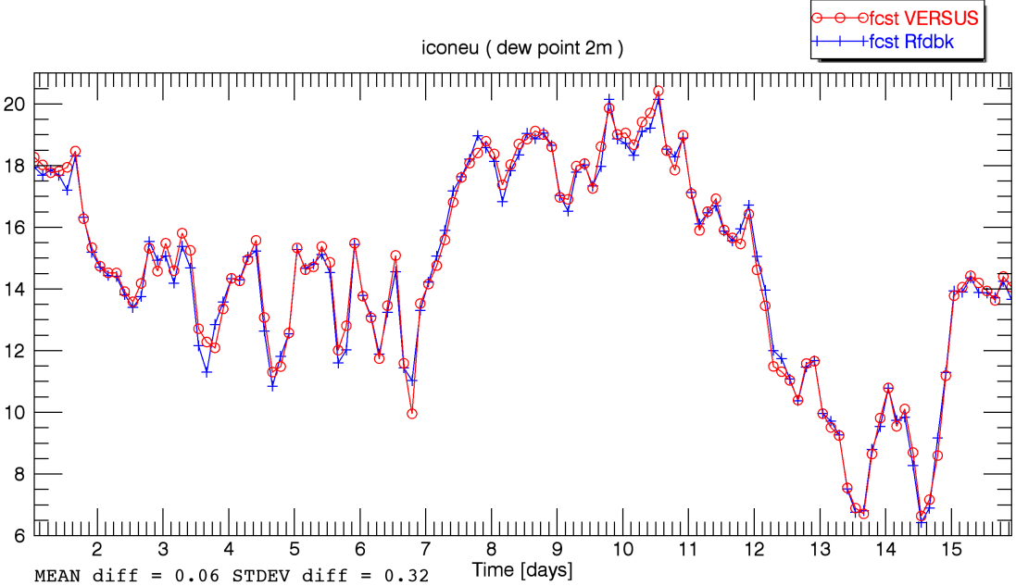
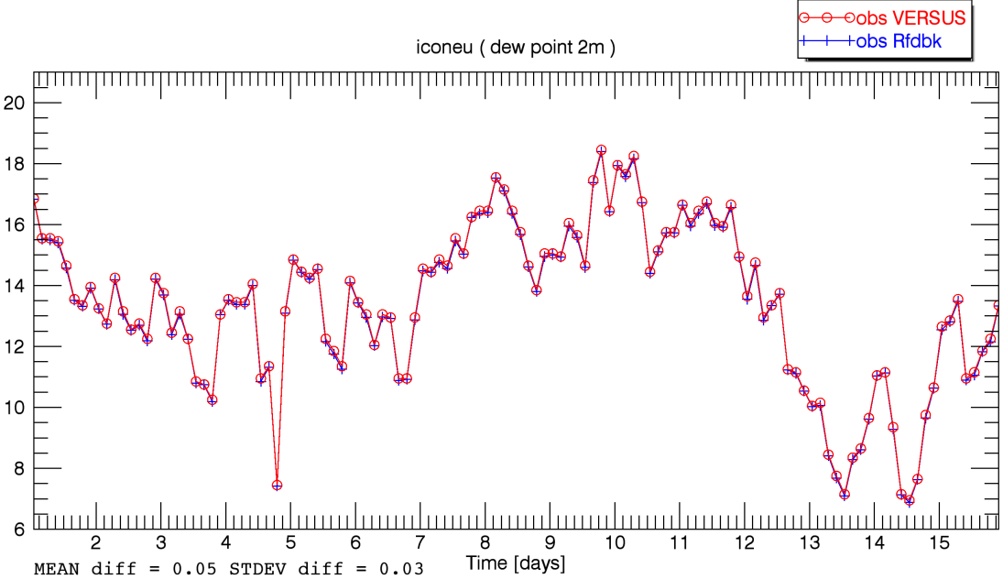
ICONEU (TD_2M) fcst Rfdbk < --- > obs Rfdbk fcst Rfdbk < --- > obs VERSUS
fcst VERSUS < --- > fcst Rfdbk obs VERSUS < --- > obs Rfdbk

Slide 30
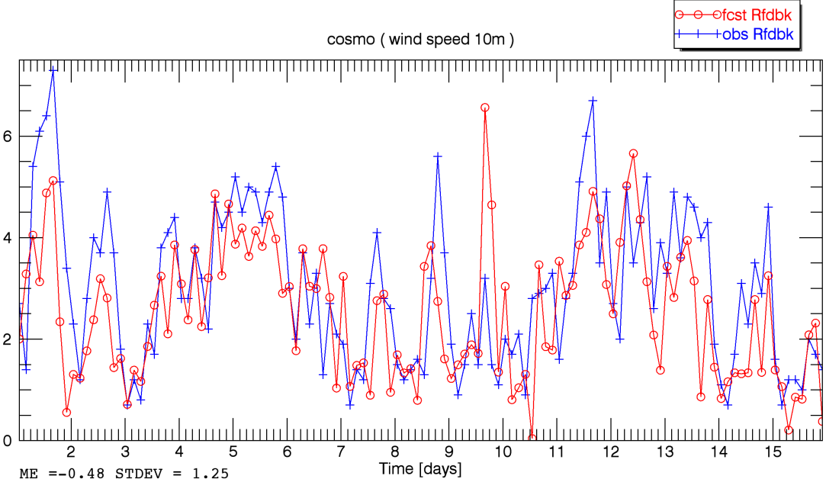
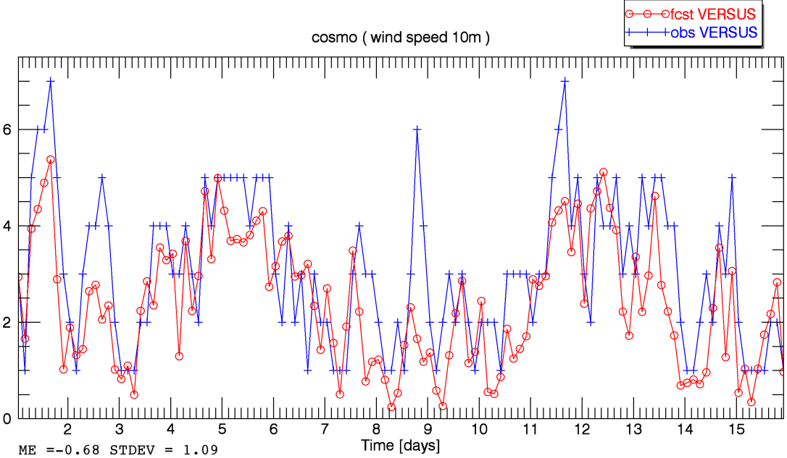
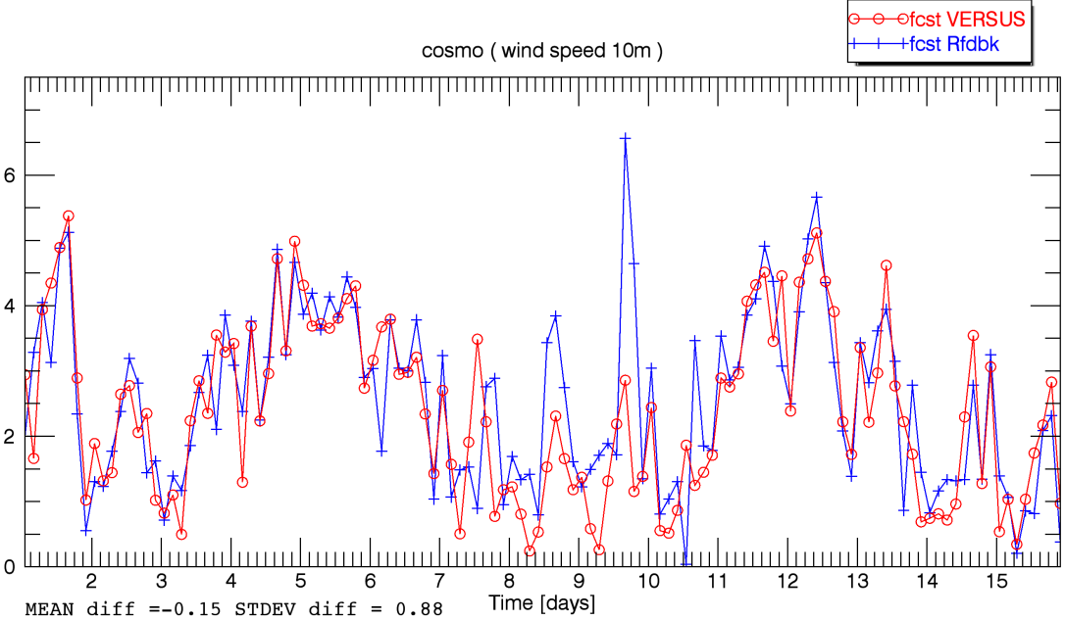
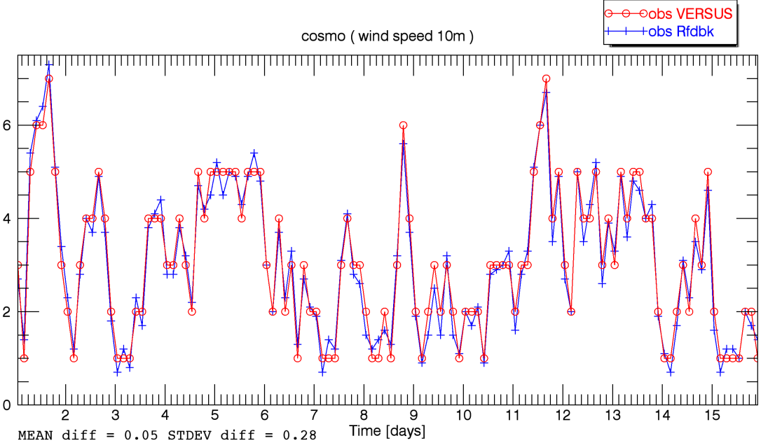
COSMO-D2 (wind speed) fcst Rfdbk < --- > obs Rfdbk fcst Rfdbk < --- > obs VERSUS
fcst VERSUS < --- > fcst Rfdbk obs VERSUS < --- > obs Rfdbk

Slide 31
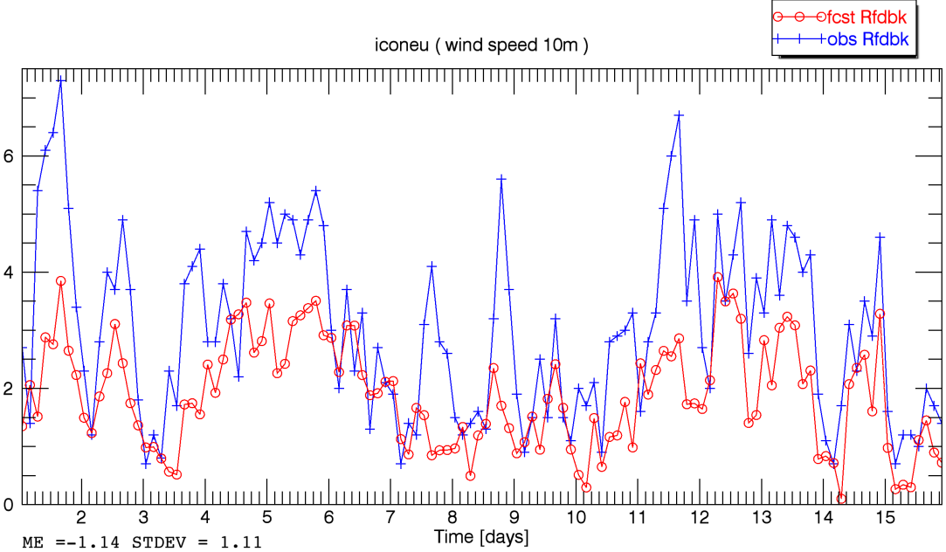
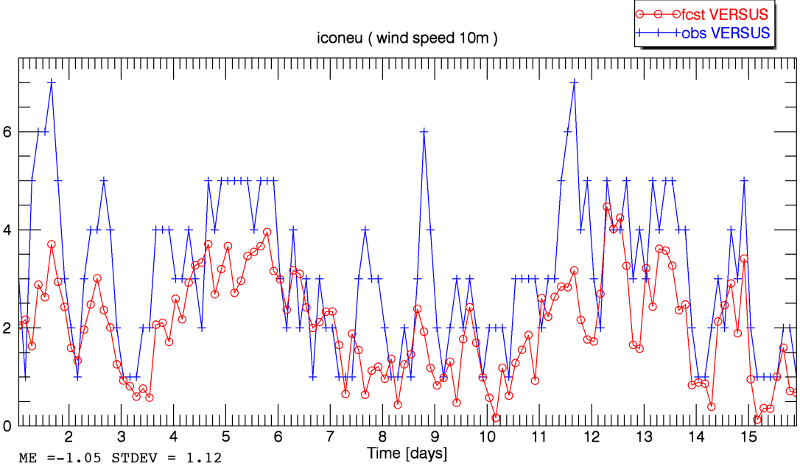
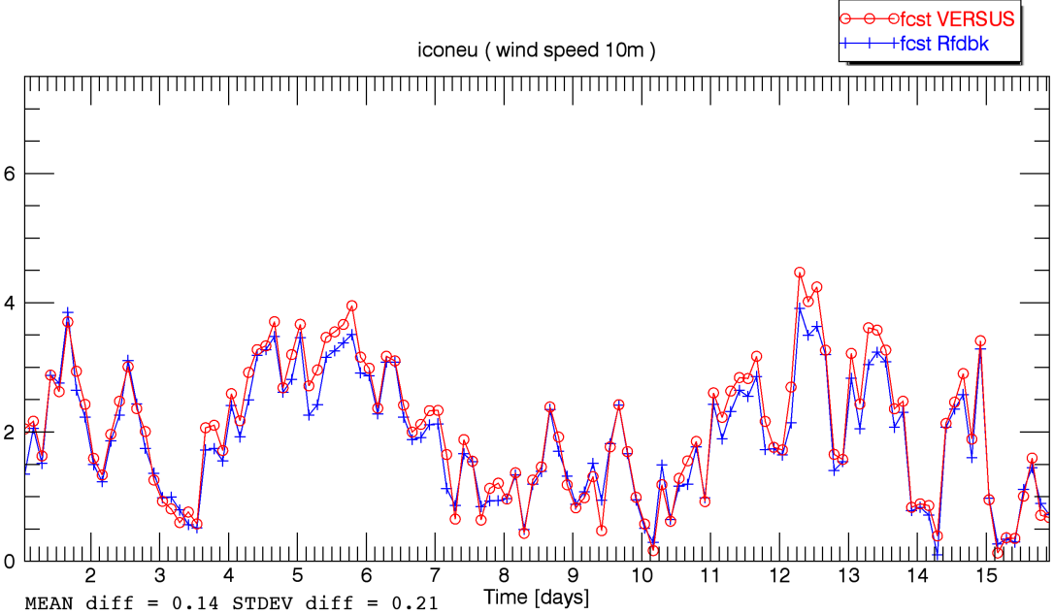
ICONEU (wind speed) fcst Rfdbk < --- > obs Rfdbk fcst Rfdbk < --- > obs VERSUS
fcst VERSUS < --- > fcst Rfdbk obs VERSUS < --- > obs Rfdbk

Slide 32
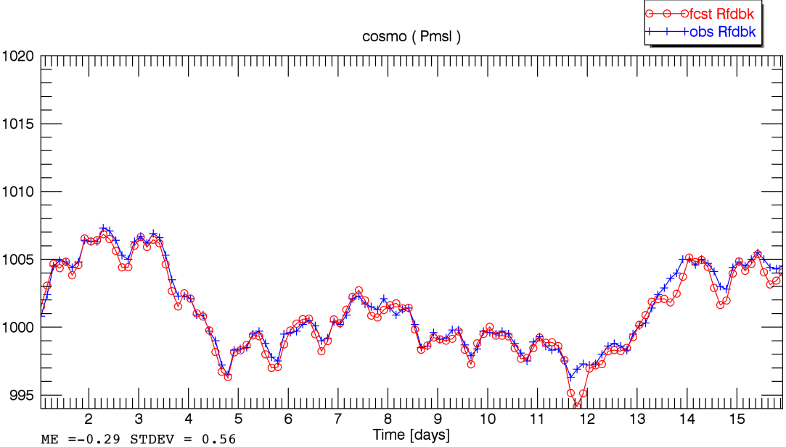
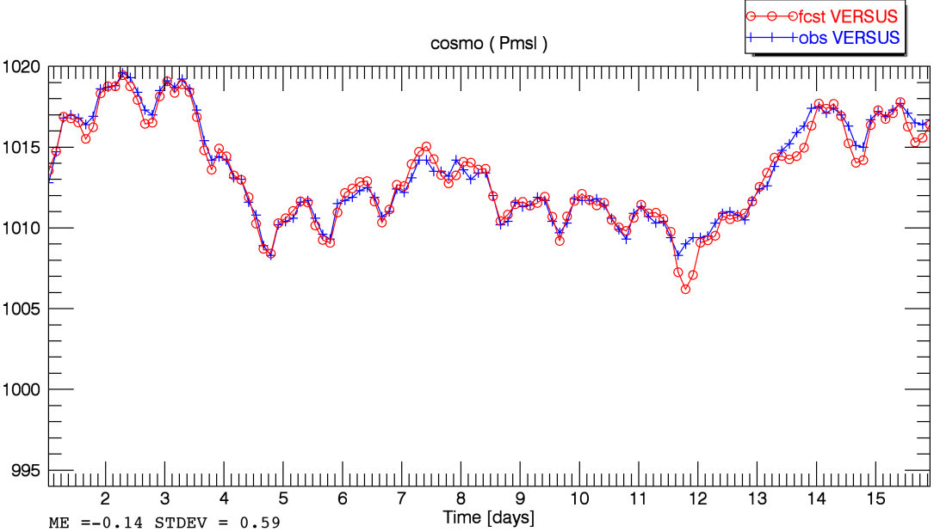
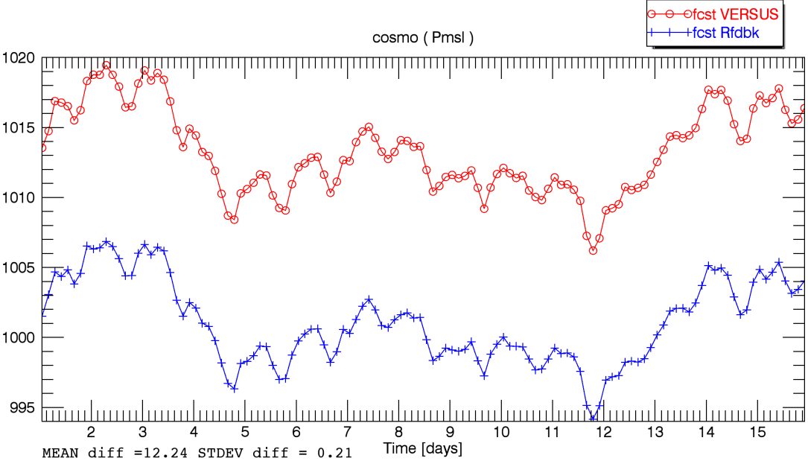
COSMO-D2 (ps,pmsl) fcst Rfdbk < --- > obs Rfdbk fcst Rfdbk < --- > obs VERSUS
fcst VERSUS < --- > fcst Rfdbk obs VERSUS < --- > obs Rfdbk

Slide 33
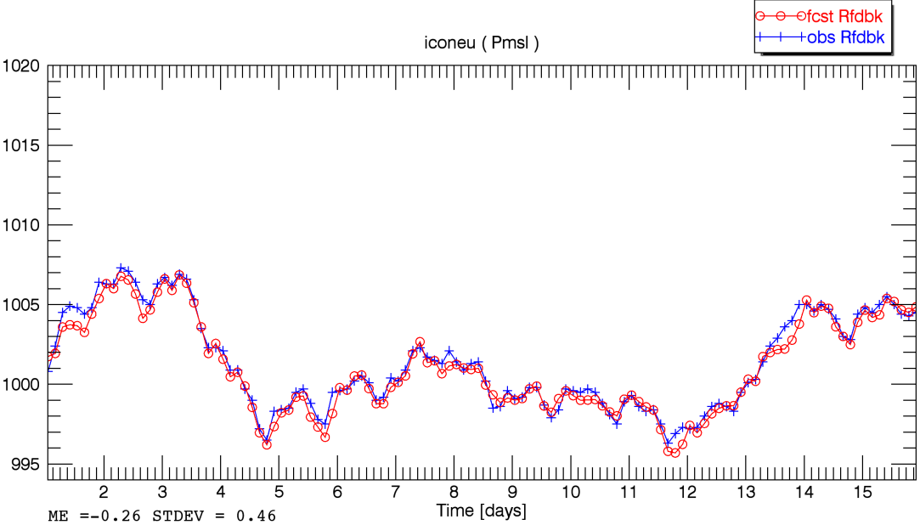
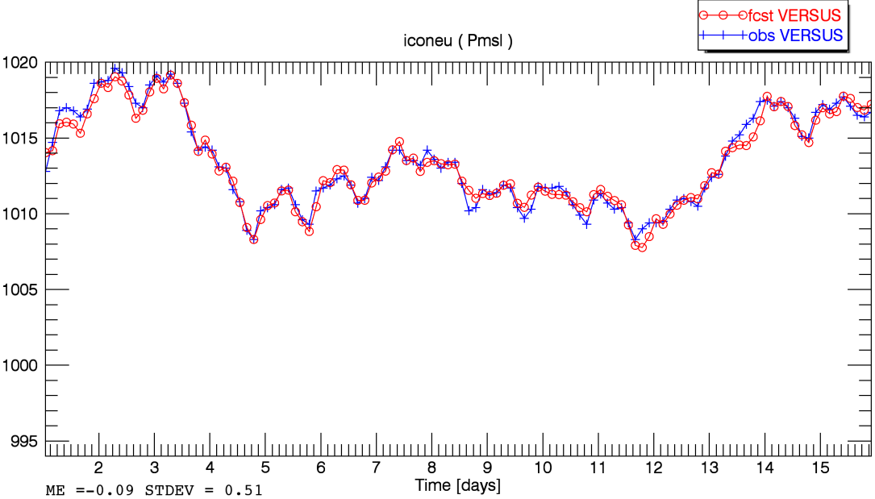
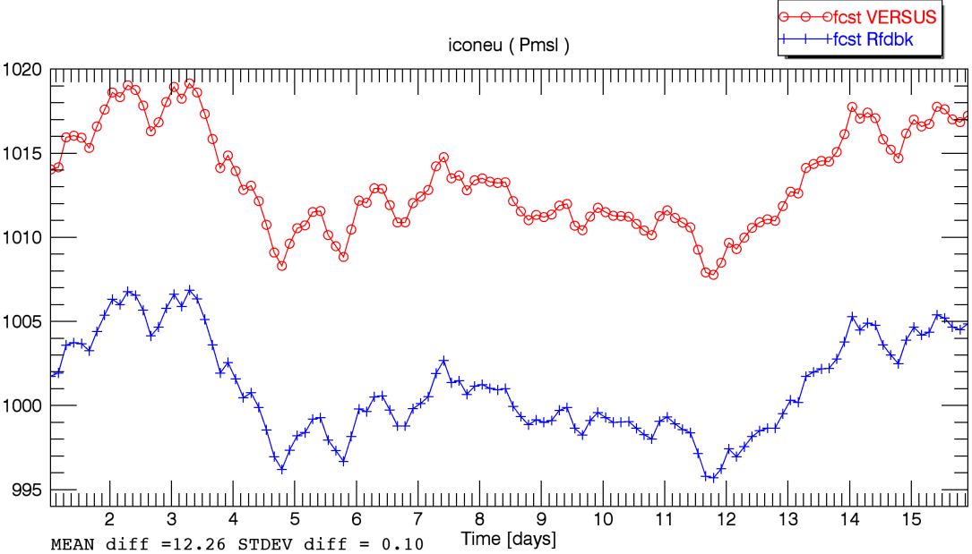
ICONEU (ps,pmsl) fcst Rfdbk < --- > obs Rfdbk fcst Rfdbk < --- > obs VERSUS
fcst VERSUS < --- > fcst Rfdbk obs VERSUS < --- > obs Rfdbk

Slide 34
Summary: mean differences and standard dev. for fcsts and obs betweenVERSUS/Rfdbk
T_2M | COSMO-D2 fcst | ICONEU fcst | COSMO-D2 / ICONEU obs
mean diff (VERSUS-Rfdbk) | 0.04 K | 0.04 K | 0.04 K
stdev (VERSUS-Rfdbk) | 0.69 K | 0.22 K | 0 K➔ const. Bias
TD_2M | COSMO-D2 fcst | ICONEU fcst | COSMO-D2 / ICONEU obs
mean diff (VERSUS-Rfdbk) | 0.07 K | 0.06 K | 0.05 K
stdev (VERSUS-Rfdbk) | 0.81 K | 0.21 K | 0.03 K
wind speed | COSMO-D2 fcst | ICONEU fcst | COSMO-D2 / ICONEU obs
mean diff (VERSUS-Rfdbk) | - 0.15 m/s | 0.14 m/s | 0.05 m/s
stdev (VERSUS-Rfdbk) | 0.88 m/s | 0.21 m/s | 0.28 m/s
ps, pmsl | COSMO-D2 fcst | ICONEU fcst | COSMO-D2 / ICONEU obs
mean diff (VERSUS-Rfdbk) | 12.24 hPa | 12.20 hPa | 12.09 hPa
stdev (VERSUS-Rfdbk) | 0.21 hPa | 0.10 hPa | 0.20 hPa

Slide 35
Reasons for different verification results with VERSUS/Rfdbk
Summary
same station list leads to a different number of used observations because of
different quality control of the observation data
different observation data base (ECMWF/DWD)
(probably) different periods of observations are used for a verification date
VERSUS/Rfdbk use different methods to interpolate the forecasts to the observation site
small differences in the observation data ( caused by ?)
wind speed has only integer accuracy in the observation data of ECMWF

Slide 36
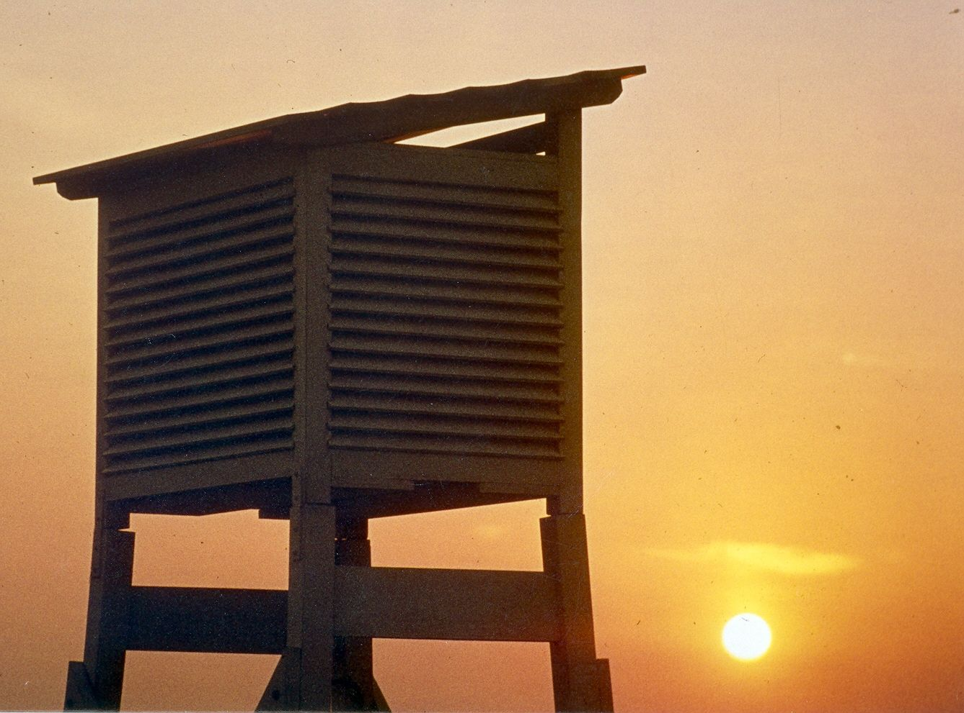
Thank you for your attention

