Slide 1
Performance Rose using COSMO CP wind data
Maria Stefania Tesini
General Meeting
Saint Petersburg, Russia 3-7 September 2018

Slide 2
Motivation
“During GM 2018, a new representation of wind speed/dir performance was presented by Maria Stefania and it was agreed that it will be tested through CP activity this year”

Slide 3
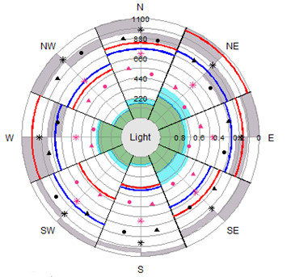
The “performance-rose”
Is is diagram in which scores and type of errors of wind forecast are summarized according to directions

Slide 4
The “performance-rose” How it works
winds (fcst and obs) are categorized in 4 classes according to wind speed
Light: ws<10 Knots
Light-Moderate: 10≤ ws < 20 Knots
Moderate: 20≤ ws < 30 Knots
Strong: ≥30 Knots
For each class a separate plot is done

Slide 5
The “performance-rose” How it works
Blue line is the observed frequency of the specific speed-class in each direction
Red line is the forecast frequency of the specific speed-class in each direction
The number of events can be read on the radial scale (frequency axis), increasing outward from the center
The Frequency Bias can be easily deduced by relative position of blue and red line
Red outer → overestimation
Blue outer → underestimation

Slide 6
The “performance-rose” How it works
Other scores from contingency tables (POD, SR, TS) are plotted as symbols
Their values can be read on the radial scale (score axis)
Perfect score 1 is in the innermost ring
The colors of the symbols represent 2 type of events:
Black: the yes event is defined by speed class and direction correctly forecast at the same time
Pink: the yes event is defined by speed class correctly forecast, but direction is considered correct even if differs by one octant

Slide 7
The “performance-rose” How it works
Colored sectors represents how model predicts the reference speed class in each direction, being the direction correct
Green: speed class is correctly forecast
Cyan: speed is underestimated of 1 class ( e.g. the forecast is “Light-Moderate” but the observation is “Moderate”)
Yellow: speed is overestimated of 1 class ( e.g. the forecast is “Light-Moderate” but the observation is “Light”)
The number of events of each sector can be deduced using the radial scale of the frequency axis.

Slide 8
The “performance-rose” How it works
The gray half-sectors represents the number of forecast in each direction that are “nearly” correct in direction, being the intensity correct
Half sector on the left means forecast is shifted of 1 octant clock-wise (e.g. if the fcst is NE, the obs in N)
Half sector on the right means forecast is shifted counterclok-wise (e.g. if the fcst is E, obs is SE)
The number of events can be deduced using the reverse radial scale of the frequency axis (starting from the outermost circle)

Slide 9
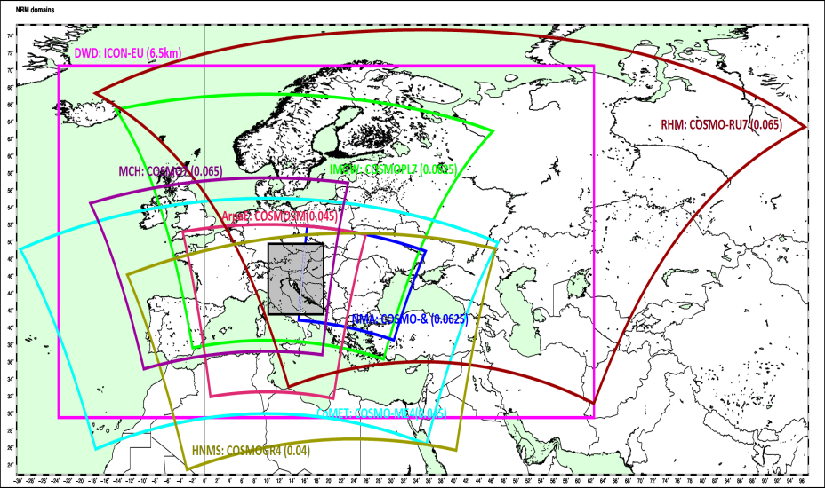
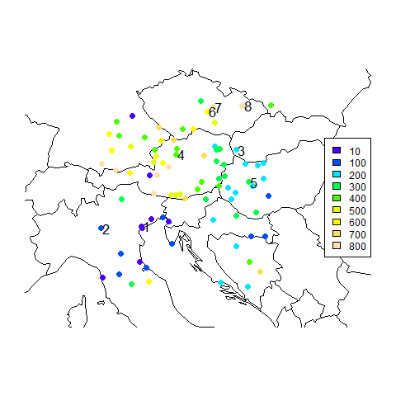
Selected Stations
Common Area 1
Selected stations:
 | code | name | height
1 | 16105 | VENEZIA TESSERA | 6
2 | 16088 | BRESCIA/GHEDI | 97
3 | 11816 | BRATISLAVA-LETISKO | 134
4 | 11012 | KREMSMUENSTER | 390
5 | 12830 | VESZPREM/SZENTKIRALYSZABADJA | 281
6 | 11659 | PRIBYSLAV | 536
7 | 11683 | SVRATOUCH | 740
8 | 11766 | CERVENA U LIBAVE | 753
Since model interpolation on station 11766 was not available for all participating members it was skipped

Slide 10
Models
COSMO-5M (Arpae)
COSMO-PL (IMGW)
COSMO-GR4 (HNMS)
ICON-EU (DWD)
COSMO-DE /D2 (DWD)

Slide 11
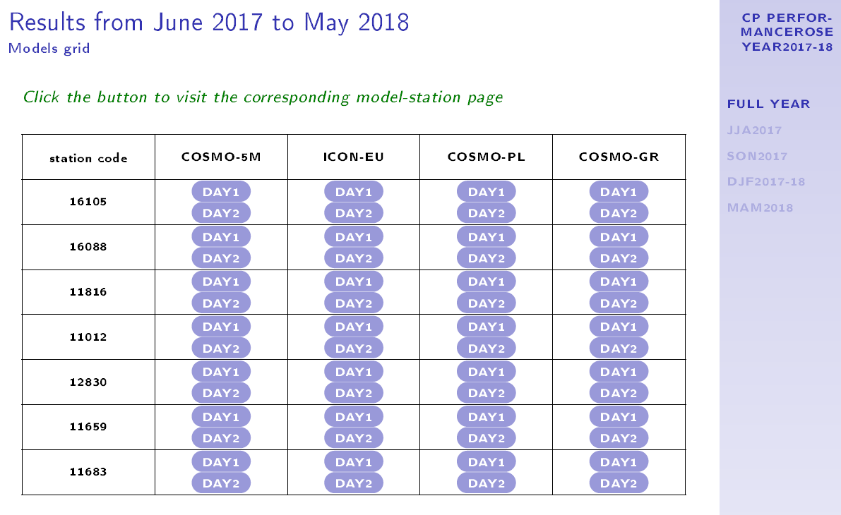
Data processing and plots
5 models
2 forecast day
7 stations
4 seasons
4 plots for each “perfrose diagram”
1344 plots!!
1 summary of the year (only 4 models!)
It is impossible to show in this presentation all the results, but you can find all the plot in a pdf document: cp_report_2017-2018.pdf

Slide 12
Preliminary remarks
The aims of the performance rose is to provide end-user with an effective feedback on model forecast, trying to answer the question of the user himself
The performance rose was implemented considering a specific subdivision in wind speed classes
According to this implementation of the PerfRose, what questions can be interesting for “COMMON PLOTS” users?

Slide 13
Example of question (1)
Results of Arpae verification of COSMO-5M and COSMO-I2 show that 10 m wind speed in mountain stations is generally underestimated.
Do other COSMO models have the same behaviour?

Slide 14
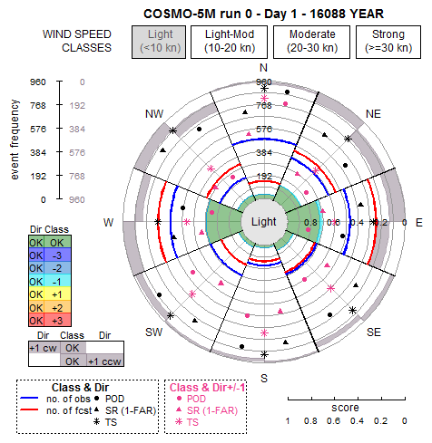
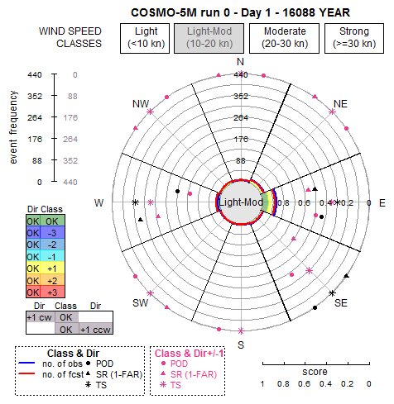
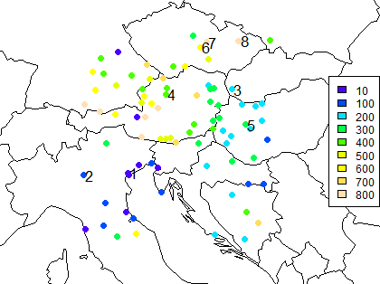
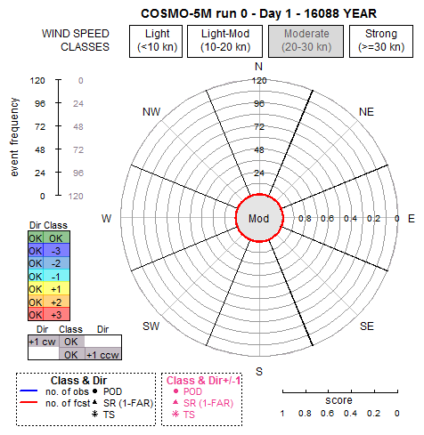
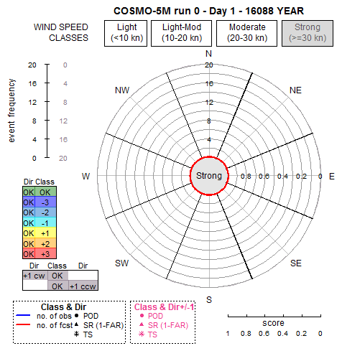
Station: 16088 BRESCIA
Height: 97 m
Period: 1 Year of data from June 2017 to May 2018
Model: COSMO-5M
Run:00
Forecast Day: 1
Step: 3 hr

Slide 15
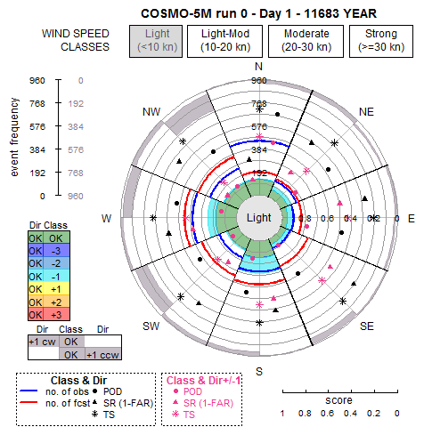
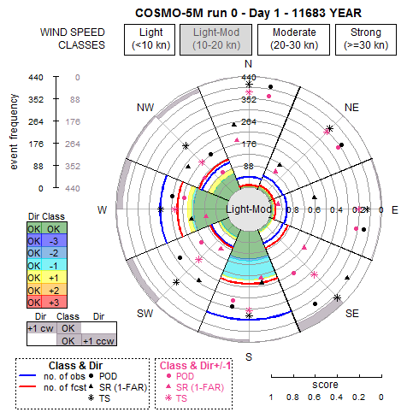
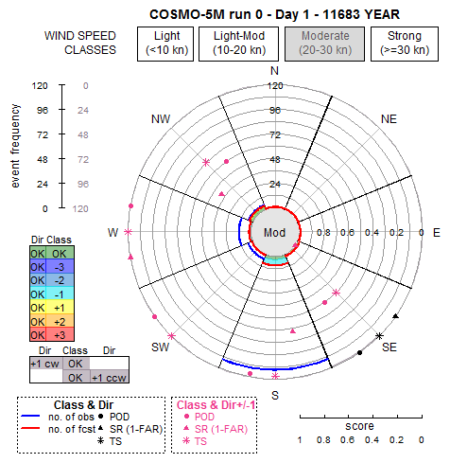
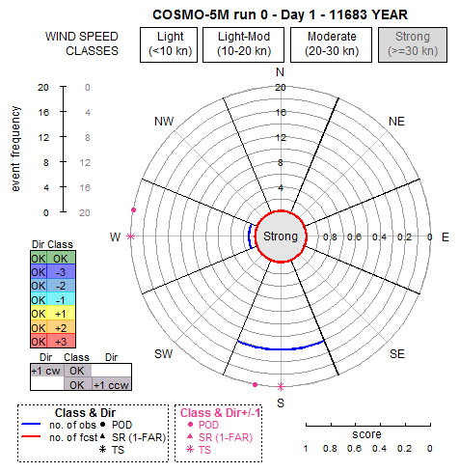
Station: 11683
SVRATOUCH
Height: 740 m
Period: 1 Year of data from June 2017 to May 2018
Model: COSMO-5M
Run:00
Forecast Day: 1
Step: 3 hr

Slide 16
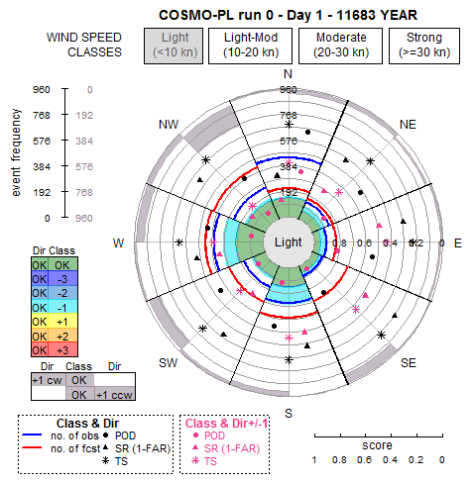
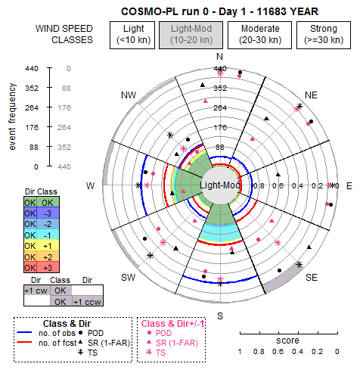
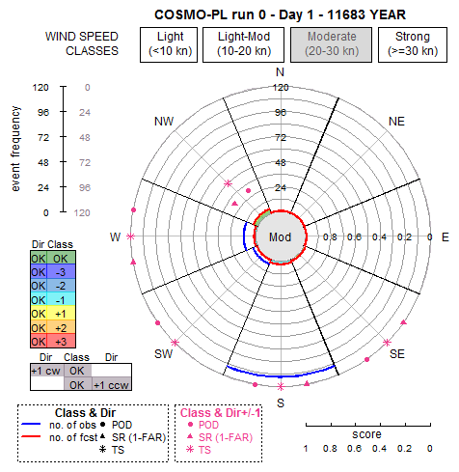
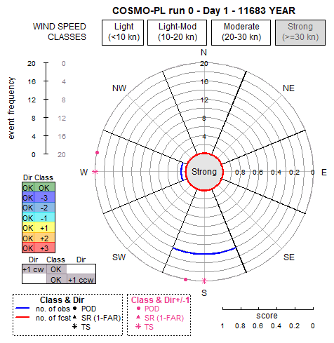
Station: 11683
SVRATOUCH
Height: 740 m
Period: 1 Year of data from June 2017 to May 2018
Model: COSMO-PL
Run:00
Forecast Day: 1
Step: 3 hr

Slide 17
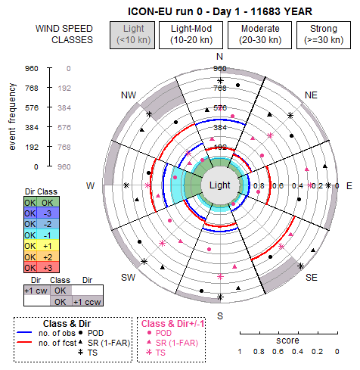
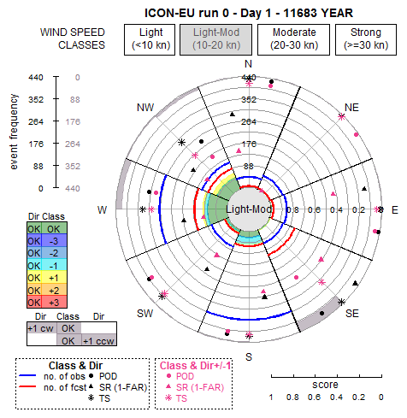
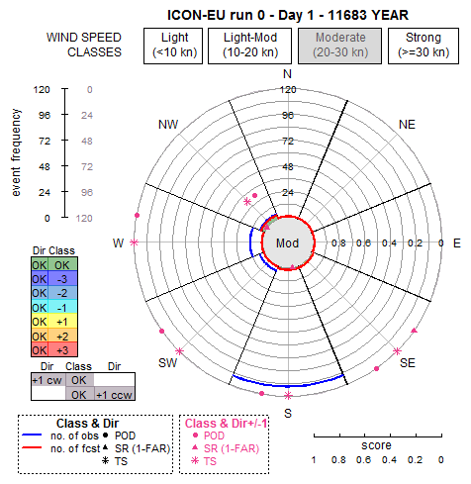
Station: 11683
SVRATOUCH
Height: 740 m
Period: 1 Year of data from June 2017 to May 2018
Model: ICON-EU
Run:00
Forecast Day: 1
Step: 3 hr

Slide 18
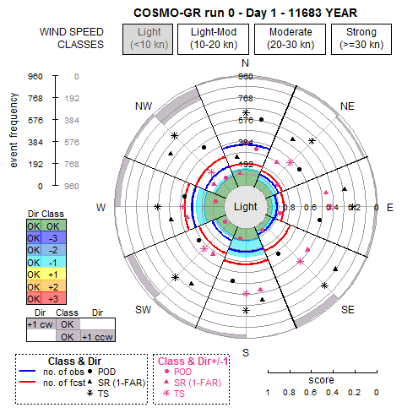
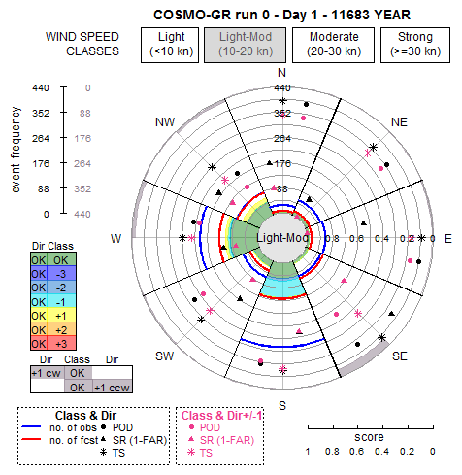
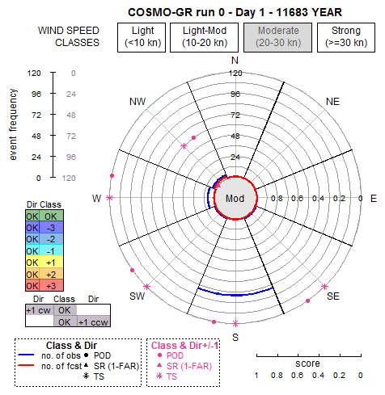
Station: 11683
SVRATOUCH
Height: 740 m
Period: 1 Year of data from June 2017 to May 2018
Model: COSMO-GR
Run:00
Forecast Day: 1
Step: 3 hr

Slide 19
Example of question (1)
Results of Arpae verification of COSMO-5M and COSMO-I2 show that 10 m wind speed in mountain stations is generally underestimated.
Do other COSMO models have the same behaviour?
YES, they all tend to underestimate 10 m wind speed
Probably 10 m wind speed is not the correct parameter to use to forecast wind in mountain stations

Slide 20
Example of question (2)
If you have to issue a wind warning for tomorrow, can you trust in the second day of forecast or not?
Are there significant differences in model performance between forecast DAY 1 and DAY 2?

Slide 21
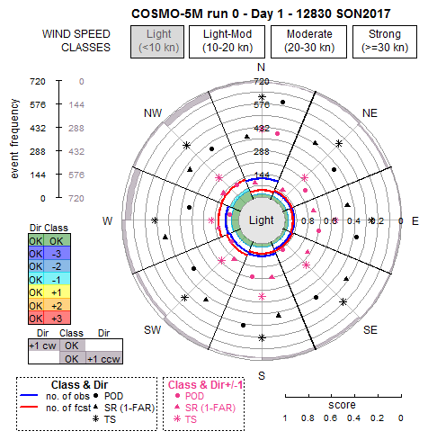
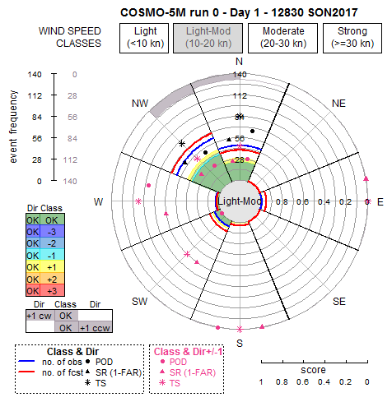
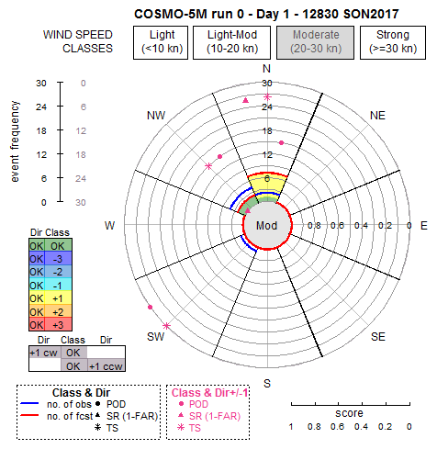
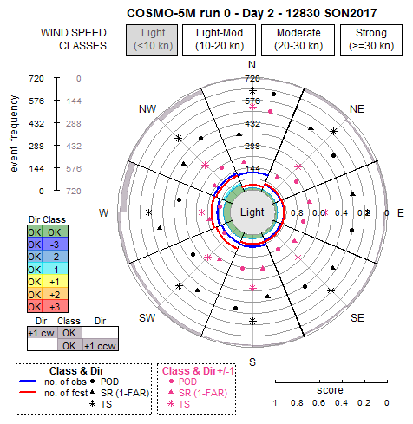
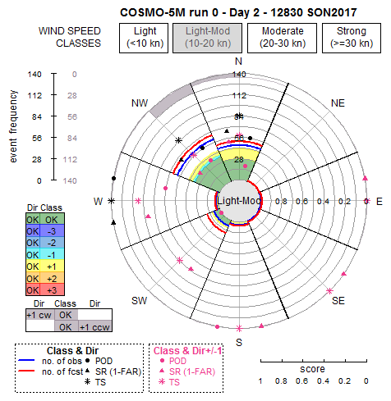
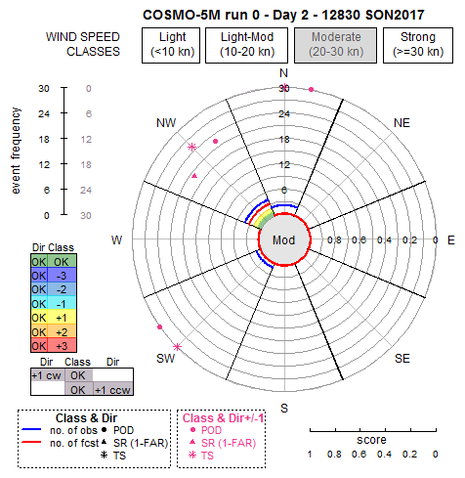
SON2017 – 12830: COSMO-5M
DAY 1
DAY 2

Slide 22
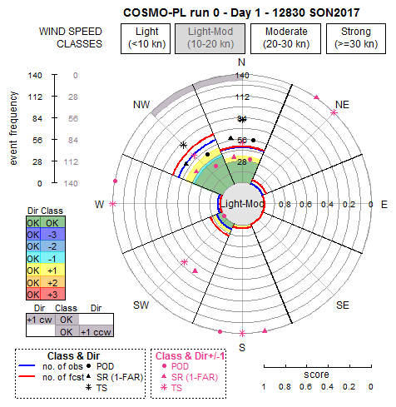
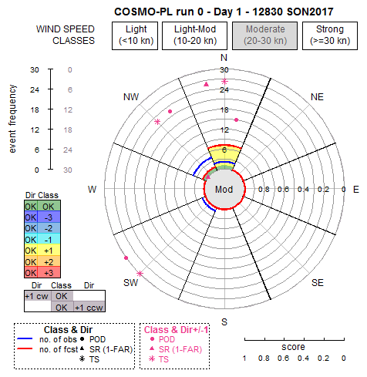
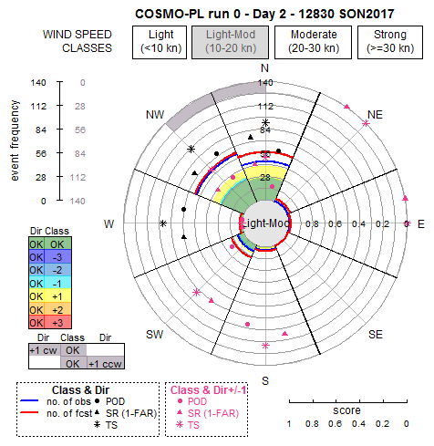
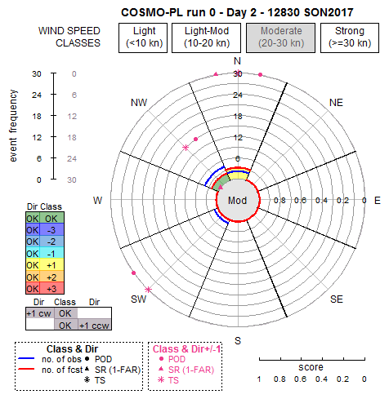
SON2017 – 12830: COSMO-PL
DAY 1
DAY 2

Slide 23
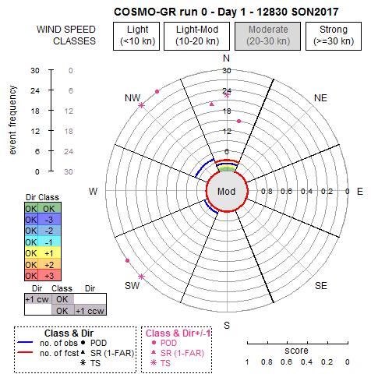
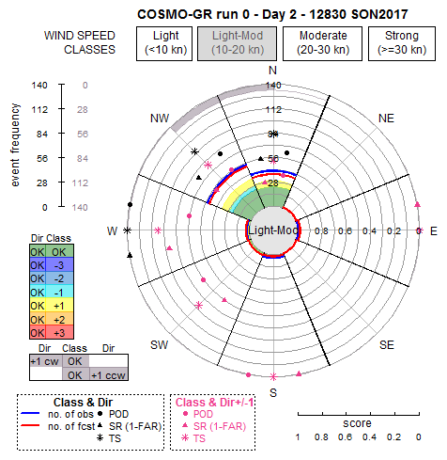
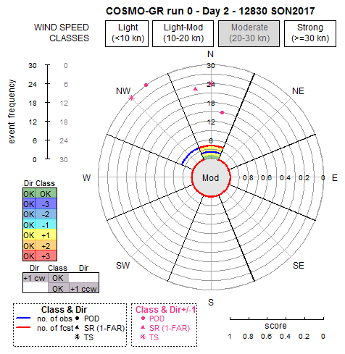
SON2017 – 12830: COSMO-GR
DAY 1
DAY 2

Slide 24
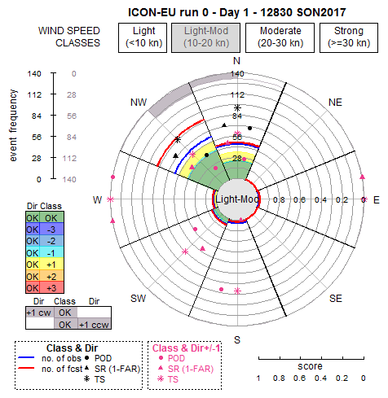
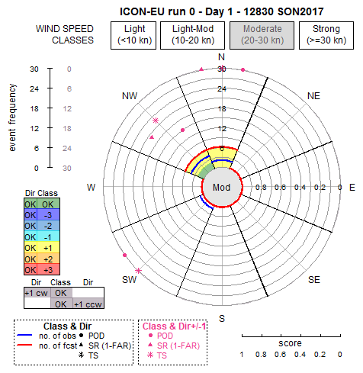
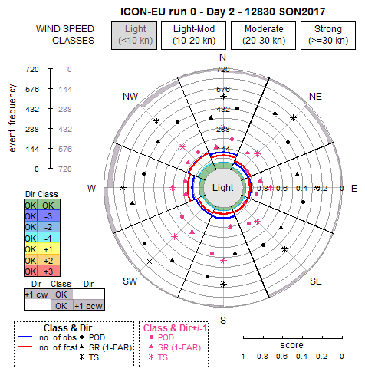
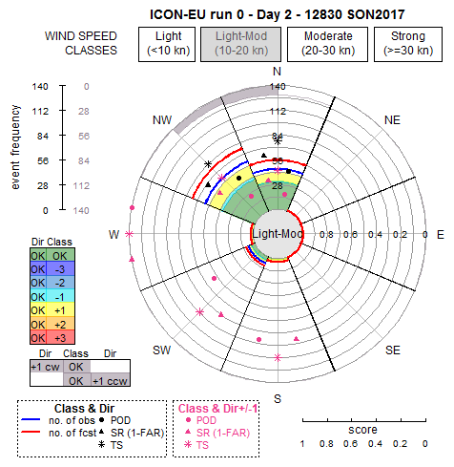
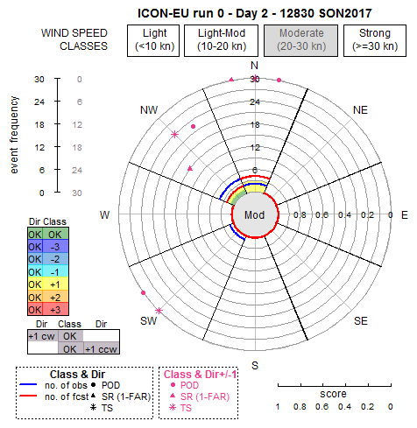
SON2017 – 12830: ICON-EU
DAY 1
DAY 2

Slide 25
Example of question (2)
If you have to issue a wind warning for tomorrow, can you trust in the second day of forecast or not?
Are there significant differences in model performance between forecast DAY 1 and DAY 2?
Of course yes, generally DAY1 is better than DAY2 but there are also cases in which scores in one wind direction improve but worsen in another one

Slide 26
Example of question (3)
Are there differences between a model and its driving model?
Using the available date we can check in particular COSMO-DE respect to ICON-EU ?
(information by Ulrich Pflueger)

Slide 27
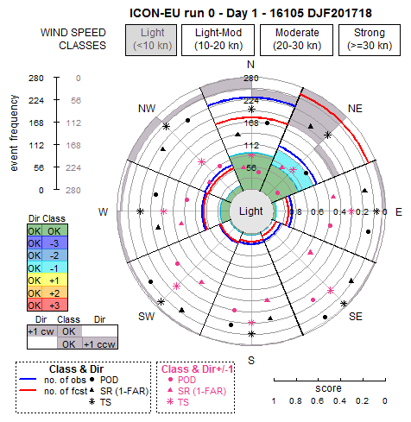
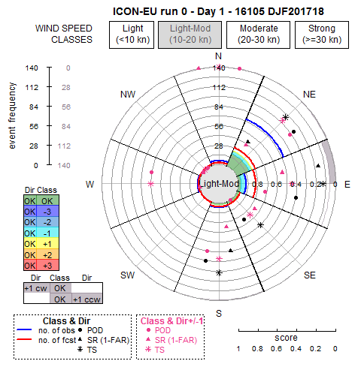
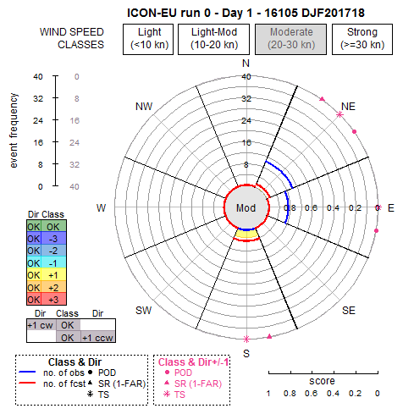
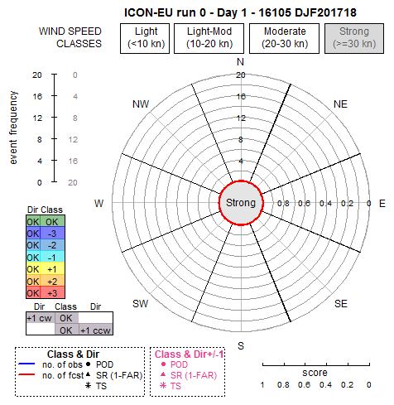
Station: 16105
VENEZIA
Height: 6 m
Period: DJF2017/18
Model: ICON-EU
Run:00
Forecast Day: 1
Step: 3 hr

Slide 28
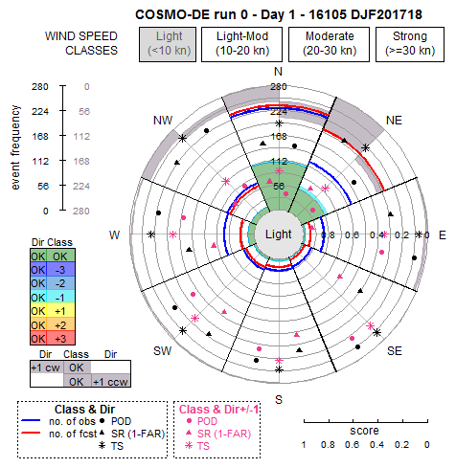
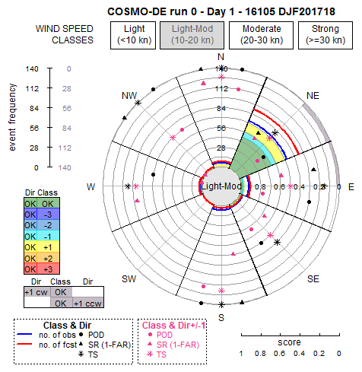
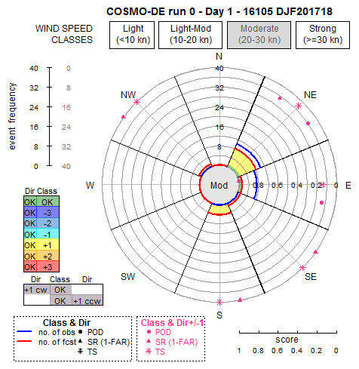
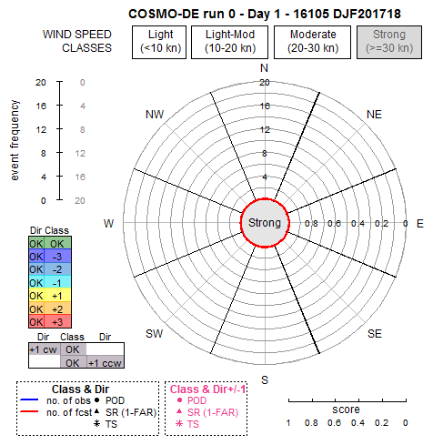
Station: 16105
VENEZIA
Height: 6 m
Period: DJF2017/18
Model: COSMO-DE
Run:00
Forecast Day: 1
Step: 3 hr

Slide 29
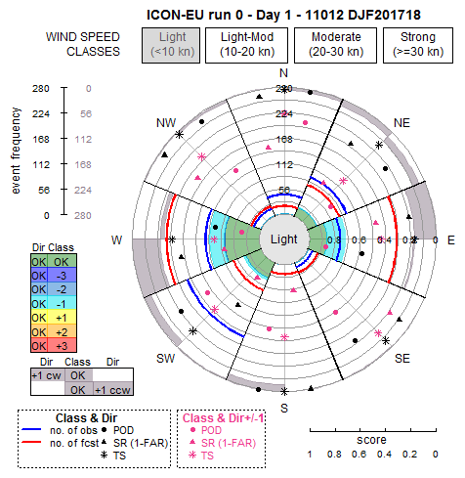
Station: 11012
KREMUENSTER
Height: 390 m
Period: DJF2017/18
Model: ICON-EU
Run:00
Forecast Day: 1
Step: 3 hr

Slide 30
Station: 11012
KREMUENSTER
Height: 390 m
Period: DJF2017/18
Model: COSMO-DE
Run:00
Forecast Day: 1
Step: 3 hr

Slide 31
Example of question (3)
Are there differences between a model and its driving model?
Using the available date we can check in particular COSMO-DE respect to ICON-EU ?
Yes, but also in this case the differences depend on the station, and in the same station the performances are different considering different wind direction and speed class

Slide 32
Conclusion
P-R is a summary diagram of the behaviour of a model in a specific station, according to the rules defined for the implementation (mainly dependent on wind speed classes)
But it is difficult to generalize and summarize the results when we compare models in different stations or even in the same station

Slide 33
Final reflection
How the high variability in scores pointed out by the P-R diagrams influence the results of classical statistic scores (e.g. RMSE)?
For example, putting together stations in which there are some prevailing directions (e.g.for topographic region) when wind speed overcame a thresholds and others where the number of events are equally distributed, can make the results misleading?

Slide 34
THANKS!

