Slide 1
PostprocVeri: New postprocessing project in MeteoSwiss
Christoph Spirig, D. Cattani, J. Bhend, M. Liniger

Slide 2
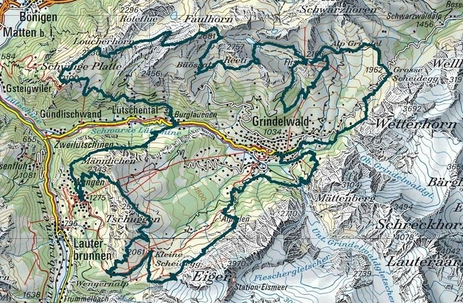
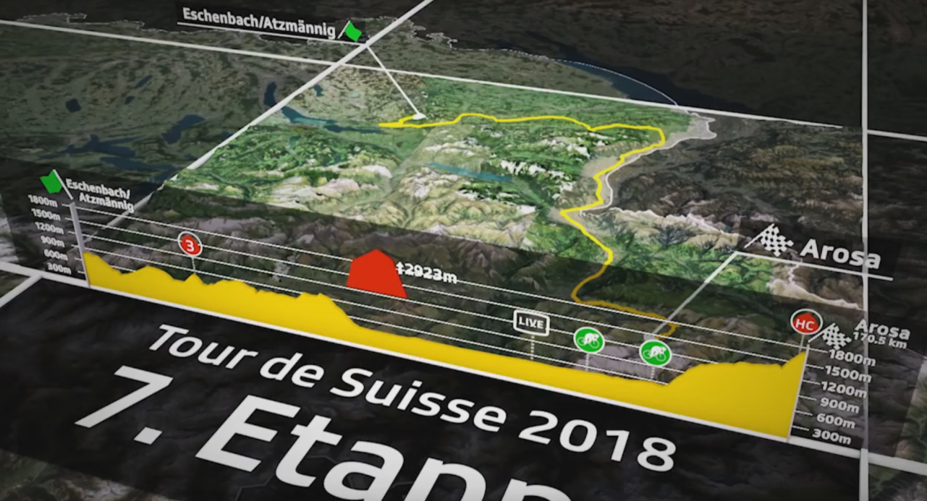
MeteoSwiss challenge is to provide accurate weather forecasts at any spatial point in Switzerland
Notes:
Vision is to provide accurate…

Slide 3
Content
Actual state
Peoject PostprocVeri
Goals of project postprocessing
Main elements
Collaborations

Slide 4
Actual state
Few postprocessing : Kalman filter, MOSMIX, on point-forecast at stations
Production : man-machine, mixing supervised values and model outputs
DMO
various tools
spec. aut. products
COSMO-1
COSMO-E
text forecasts, warnings, consulting, …
Forecaster
customers
IFS
MOS-Mix
ICON
First Guess
VAL
INCA + data4web
Modified gridded + PoI forecasts
Observations
Notes:
Limite du système, traitement complexe et source d’erreur
Basé sur man-machine, avec peu de postprocessing et par conséquence beaucoup des calculs d’interpolations spaciales basés sur peu de points avec pp

Slide 5
Project PostprocVeri
Postprocessing methods yielding spatial, probabilistic, multivariate, and seamless forecasts and also to refine the verification analysis at the forecast service of MeteoSwiss.
DMO
various tools
spec. aut. products
COSMO-1
COSMO-E
text forecasts, warnings, consulting, …
Forecaster
customers
IFS
MOS-Mix
ICON
First Guess
VAL
INCA + data4web
Modified gridded + PoI forecasts
PP
Observations
Notes:
Mean values and spread for the fct parameters
Key module not drawn in the picture is the verification which will validate each step of processing
Providing seamless fct will help the production line, by simplifying the processes with more accurate spacial fct

Slide 6
Main elements
Probabilistic postprocessing - well in line with NWP developments @ MeteoSwiss and international developments in the field of postprocessing → Ensemble postprocessing routines, aiming at delivering calibrated ensemble predictions
Spatial output given the increasing importance of local forecast information, the postprocessing approaches aim at delivering output for any surface location of interest in Switzerland.
Start with basic meteorological variables introduce postprocessing for four basic meteorological variables (temperature, precipitation, wind, and cloud cover), build up knowhow to apply to derived variables later on
COSMO and IFS ensembles limit NWP data sources to COSMO and IFS ensembles (models operationally used in today’s forecast production), but ensure applicability to other NWP models

Slide 7
Main elements
Verification Given the emphasis on postprocessing of basic parameters and provision of spatial output, the verification focuses on evaluating each step in the local forecast production chain of these parameters. Warning or impacts verification are not considered here.
Lead times below 6h Blending between observations and forecasts is not the task of PostprocVeri (but of the Nowcasting system). Nowcasting will profit from a corrected NWP output even without focus on shortest lead times.

Slide 8
Collaborations
The Project team of MeteoSwiss do not wish not develop new methods from scratch, but aims to collaborate, use know-how and experiences in PP domain.
EUMETNET program
University ETHZ
COSMO WG4

Slide 9
EUMETNET
A post-processing (PP) module in the Forecasting Programme has been put forward
Some of the activities proposed for the first phase are:
Review of the current state of PP in member states and beyond
Establish series of scientific workshops on PP
Identification of specific community-led activities to be tackled at a later stage
The module is led by Stéphane Vannitsem (RMI)

Slide 10
ETHZ collaborations
Sebastian Schemm : analysis of error stratified by weather type
ETHZ master thesis
Nino Weingart : deep learning based error correction of Numerical Weather Prediction for Switzerland,
Automatic post-processing of COSMO-1 output to predict temperature
At arbitrary point in Switzerland
Considering spatial-temporal dependencies
Including uncertainty estimation of model
Using neural network architecture

Slide 11
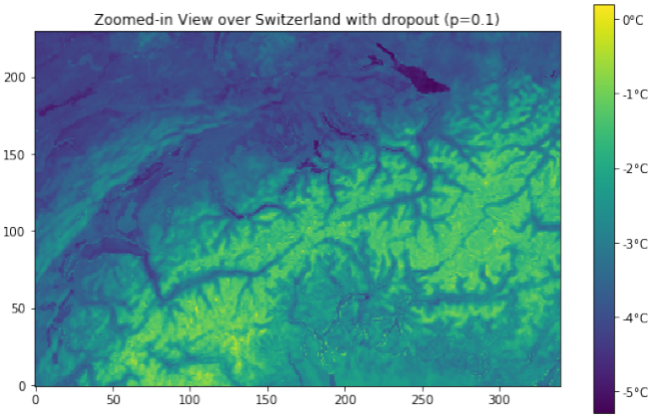
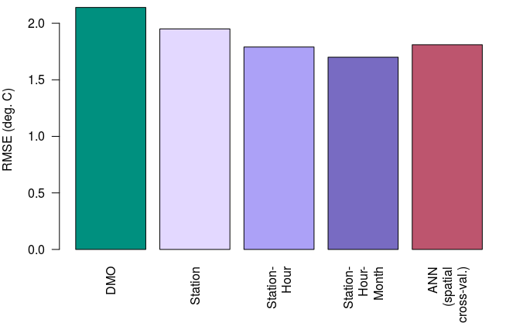
ETHZ master thesis
…but
Uncertainty information?
Data handling issues
Nino Weingart ; first results
Promising results…
Better than «simple» bias correction methods
Ability to provide spatial output
Notes:
Bitte entschuldigt die späte Antwort. Ich würde auch das linke Panel von Figur 5.8 zeigen. Daran erkennt man, wie gut der ML Ansatz im Vergleich zu den Rohdaten, und einer simplen Biaskorrektur funktioniert. Alternativ könnte man auch die Figur (basierend auf Ninos Figuren 5.10 und 5.8) zeigen. Dabei wäre es wichtig herauszustreichen, dass:
ML an unbeobachteten Standorten vergleichbar (leicht schlechter) ist wie eine simple Biaskorrektur (die so nur an beobachteten Standorten vorgenommen werden kann)
Das Potential von ML noch lange nicht ausgeschöpft ist (Prädiktorenselektion und –präprozessierung, Optimierung dropout und learning rate, methodische Weiterentwicklung wie Mitberücksichtigung der zeitlichen Abhängigkeit, etc.)

Slide 12
WG4 COSMO learning lessons, tips and receipts
Informations on COSMO postprocessing are welcome (temperature, wind, precipitation and cloudiness)
What are your experiences about ;
Predictors to be used
Methods
Error types
Have you worked on ;
Ensemble approach
Spatial outputs
Notes:
From this group of WG4 we are interested in exchanging informations

Slide 13
Interested in our developments ?
Please contact us
Project leader : Christoph.Spirig@meteoswiss.ch

