Slide 1
Recent analysis on the 10-wind forecast in Switzerland, comparing direct model output, forecasters and MOS
J. Bhend, D. Cattani, Ch. Spirig, M. Liniger

Slide 2
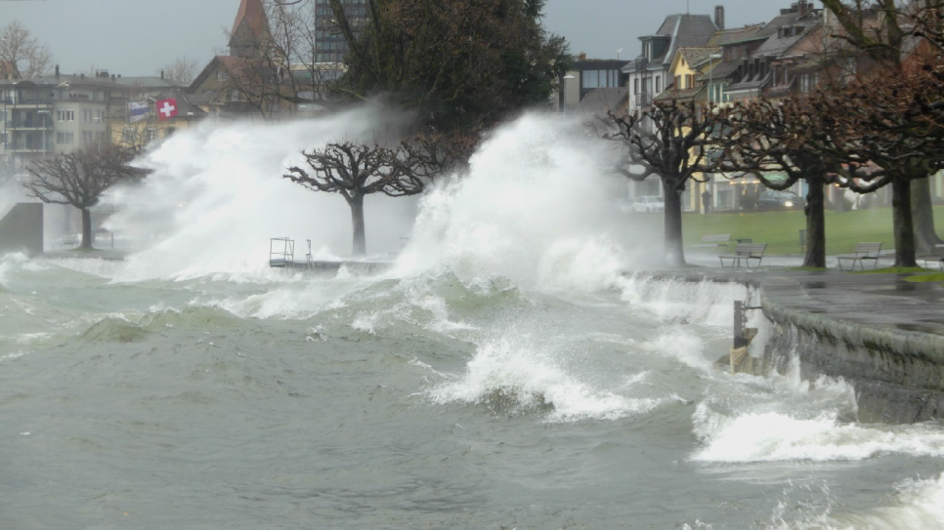
Burglind/Eleanor am Zugersee , 3rd January 2018
Notes:
Motivation of the study; performance of models with respect to MOS
Début de l’étude ;
Episode de la tempête de Burglind nous a interpellé sur la capacité de prévoir des vents forts
Partial scores of wind are since years lower, and specially in first months 2018 → how can we fct corretly gusts and mean 10m winds

Slide 3
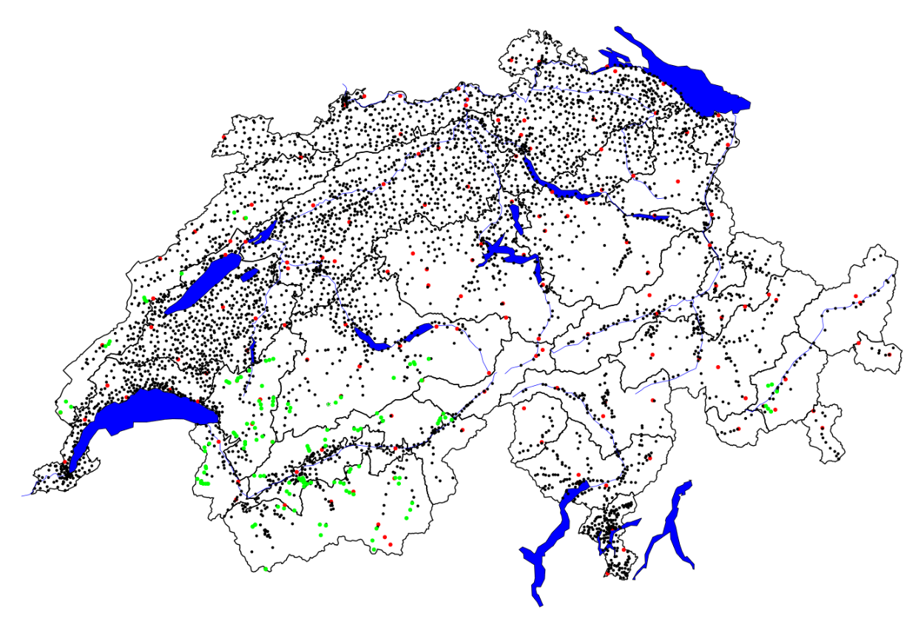
Questions
MeteoSwiss goal is to provide high quality hourly winds and gusts at ~5000 sites
Is there a potential to postprocessing ?
Is there an added-value form the forecasters ? How can we benefit of it ?
Which model is better ? COSMO-1, COSMO-e ?
How can we improve warning forecasts ?

Slide 4
content
Analyse of Burglind storm
Forecast quality
Understanding forecaster’s modification
Benefit of post-traitement
Conclusions
Notes:
Can we learn from forecasters modifications ?

Slide 5
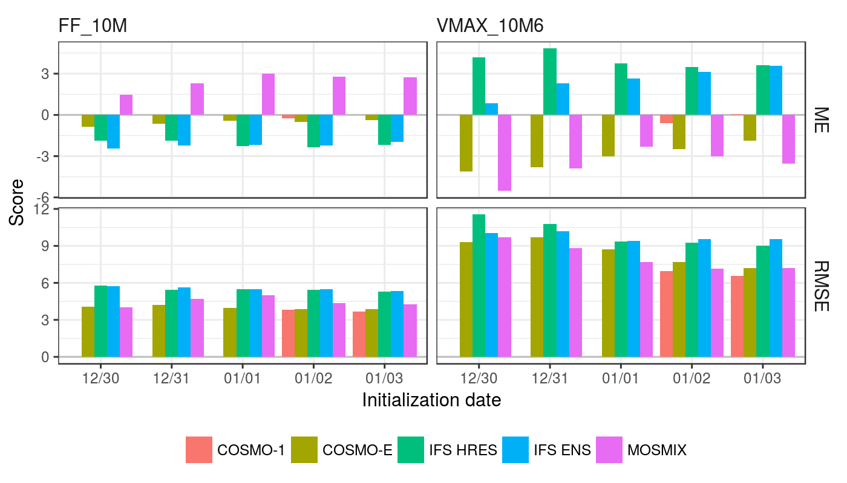
Burglind / Eleanor storm
Verification by J. Bhend internal report 2018
Notes:
180306_verifikation_mosmix_bhj.docx
Forecast for day 3 march, as function of the runs
Instead of the full distribution, this is only the mean across all stations
COSMO-E median is used

Slide 6
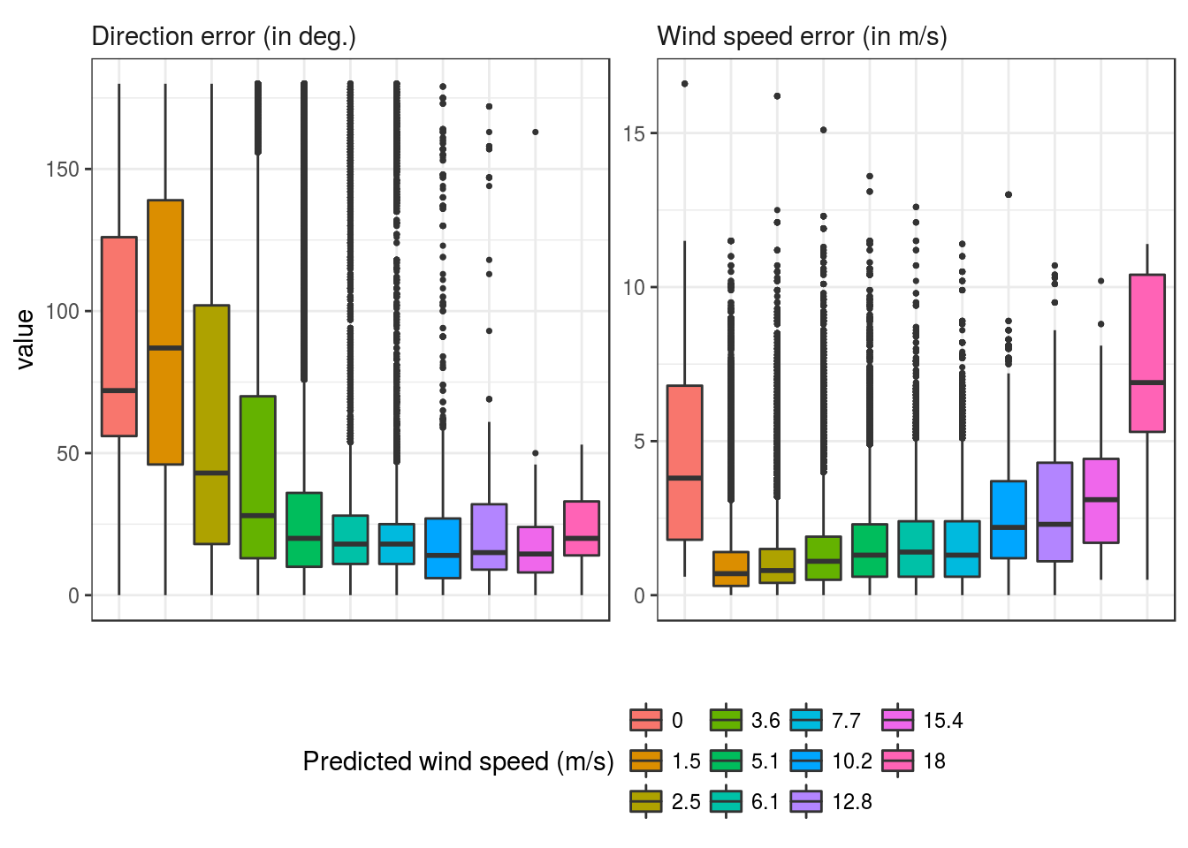
Wind forecast quality
Distribution of the error of forecasted winds as function of predicted wind speed.
Notes:
Daily values are analyzed
Look to the distribution to the errors done by forecasters by stratification according to the predicted wind speed
Only 6 reference stations used. Mean scores for increasing observed wind speed bins
~3.5 years (late 2014 to mid 2018)
All lead times, 1-5 days

Slide 7
Wind forecast quality : which measure ?
Scores based on
Speed (general public, energy, … )
Direction (aviation, NWP developers)
Euclidian distance (u,v)
VIP – speed and direction together (designed to forecaster)
Models
First Guess
Validated
Fct added value
Notes:
Daily values are analyzed
Use different scores in following because all are interesting to analyse the fct and users ….

Slide 8
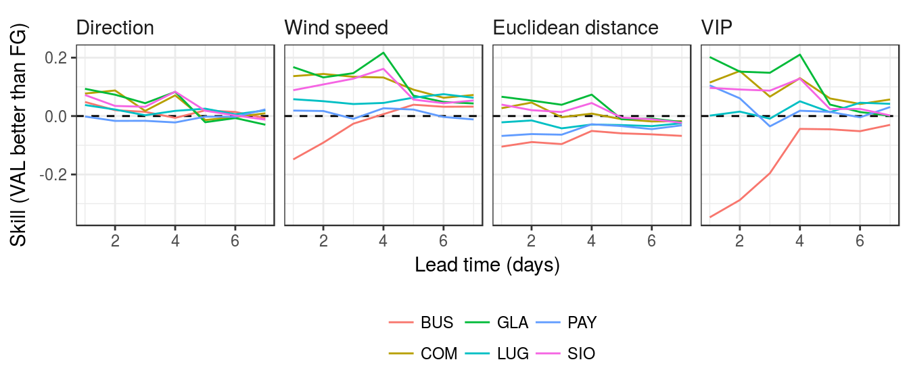
Understanding forecaster’s modification
Notes:
Maximum hourly wind speed and direction between 06 and 18 UTC

Slide 9
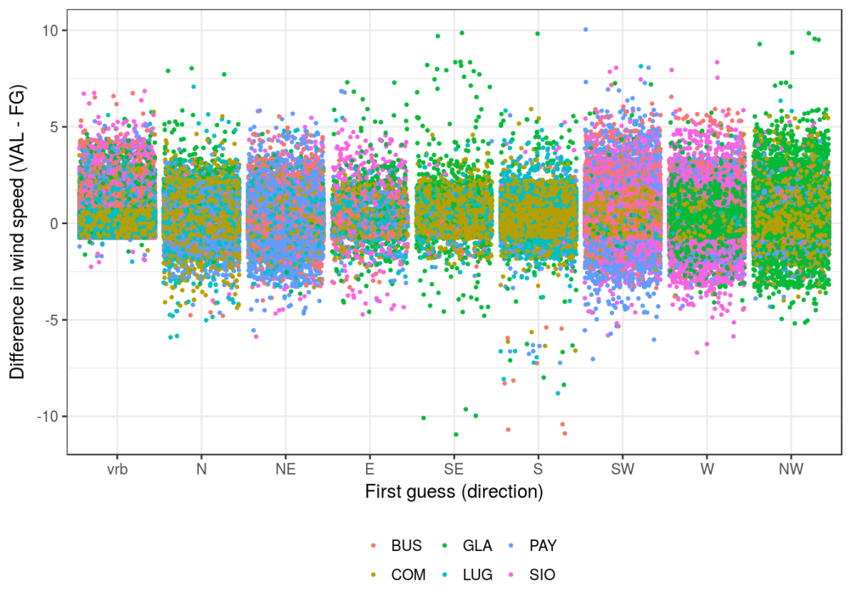
Understanding forecaster’s modification
Wind speed
Notes:
Stratification of added values with respect to the wind direction

Slide 10
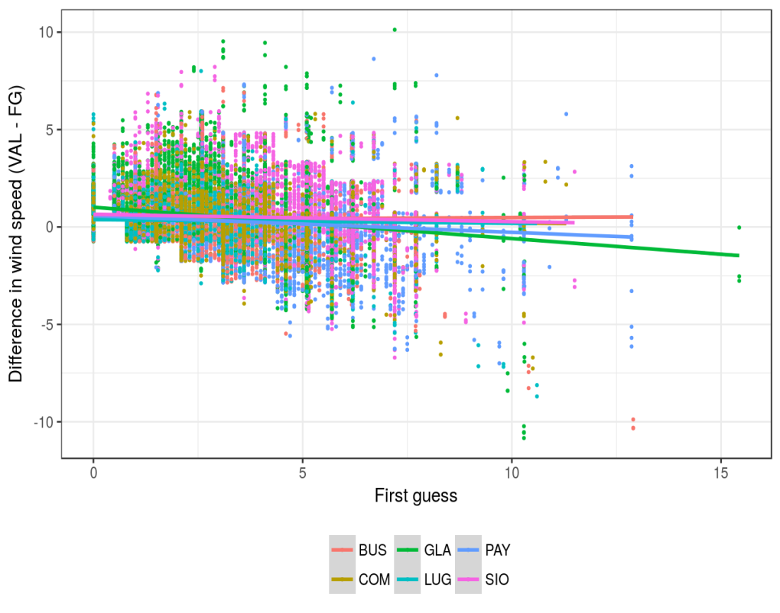
Understanding forecaster’s modification
Wind speed
Modification of wind speed appears largely random
Manual modification on average similar to simple linear regression based post-processing of wind speeds
Notes:
Analysing the corrections added by forecasters.
If it’s a biais correction that could be added on a simple traitment

Slide 11
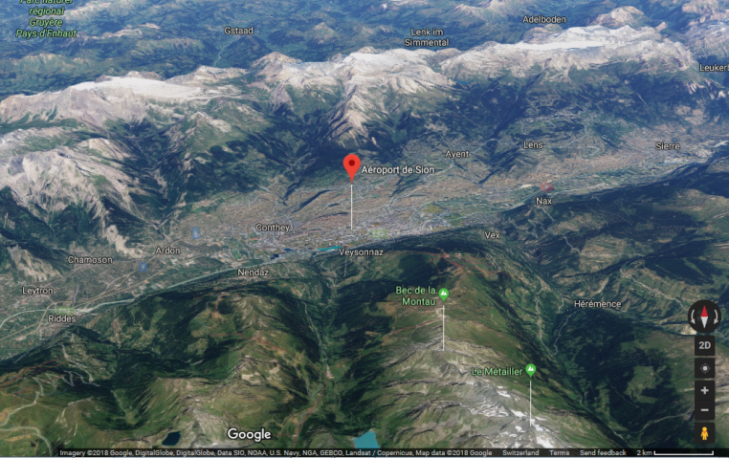
Understanding forecaster’s modification
Forecasters slightly correct wind direction towards observations
Notes:
Grey: variable = weak wind. No punishement for direction
The observed direction (in degrees) have been converted to sectors using 1.5 m/s as the cutoff for variable winds.
All the other 5 reference stations are also in the plot (but cropped).

Slide 12
COSMO-1/E and MOSMIX
COSMO-1: 03:00 UTC
COSMO-E: 00:00 UTC
MOSMIX: 04:00 UTC (based on information available at 03:00 UTC)
The evaluation covers the period from 2016/01/01 to 2017/06/31
101 SMN stations are used
Notes:
MAE
The following runs have been used:
COSMO-1: 03:00 UTC
COSMO-E: 00:00 UTC
MOSMIX: 04:00 UTC (based on information available at 03:00 UTC)
The evaluation covers the period from 2016/01/01 to 2017/06/31
101 SMN stations are used (including the 6/27 stations used for COMFORT/VIP)

Slide 13
Conclusions
Forecaster’s modification is positive, but difficult to to specify
COSMO-1,COSMO-e better than MOSMIX ?
In strong events, potential of COSMO-1, and –e is real
On large period, more stations, MOSMIX shows better scores
Potential for postprocessing on winds is important
Postprocessing should focus on the type of errors
….. postprocessing wind forecast in complex terrain is a challenge
Notes:
Forecaster’s modification learn for design of postprocessing methods
Analyse doit se poursuivre en stratifiant par force de vent, stations plaine-montagne, etc …

