Slide 1
Achievement and learnings from the PP POMPA
Xavier Lapillonne, MeteoSwiss
V. Clement³, O. Fuhrer^{1,}, C. Osuna¹, K. Osterried³, H. Vogt² , A. Walser¹ , C. Charpilloz¹, P. Spoerri³ , T. Wicky, P. Marti³, R. Scatamacchia and all PP POMPA contributors
¹MeteoSwiss, ²CSCS, ³C2SM ETH , ⁴COMET

Slide 2
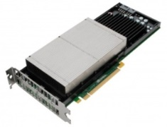
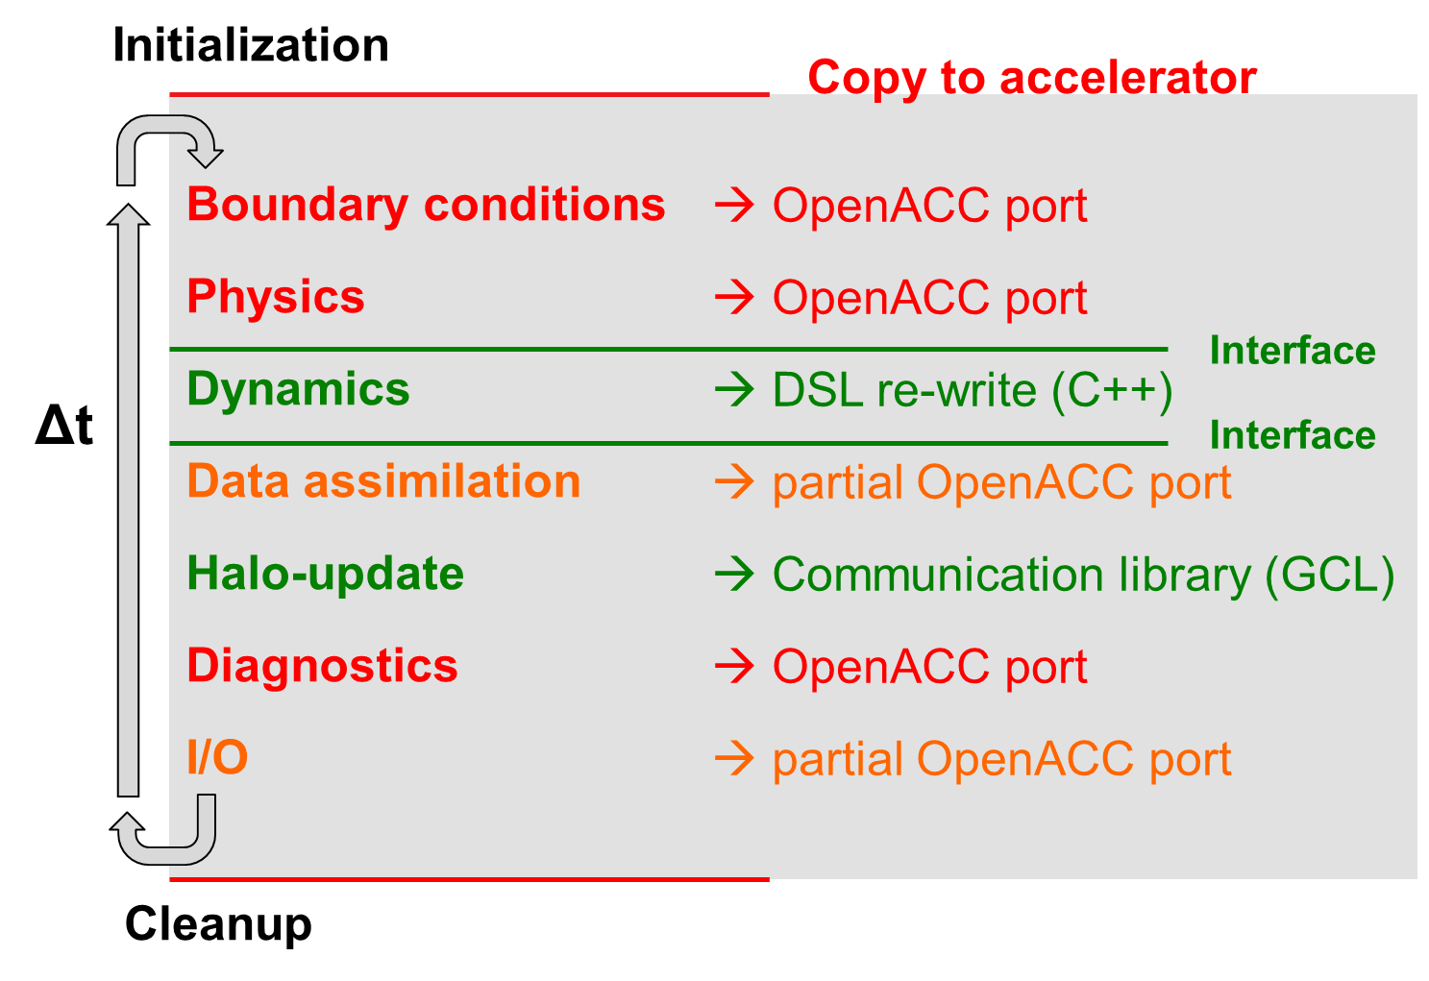
Project main achievements
Project duration 2010-2018
GPU capable version of the COSMO model
Support for single and double precision
Development of a C++ Domain Specific Library : STELLA (will be replaced with GridTools)
Performance portable implementation of the Dynamical core using STELLA library
OpenACC port of Physics, Assimilation and organization code (6000 directives)
7 publications
COSMO on GPU

Slide 3
PP POMPA Integration Status
All main developments from the POMPA priority project are completed and being reviewed and merged into the offical COSMO code
Components | Status
C++ (STELLA) dynamics | Merged
Physics: radiation, surface, sso, turbulence, microphysics, Tiedtke convection, shallow convection | Merged
Physics: Bechtold convection | On going (COMET)
Physics: Sea-ice | Not planned
Data assimilation: Nudging | Merged
Data assimilation: Latent heat nudging | Completed
Organize code | Completed
Communication (GLC : GPU-GPU) | Merged
Release of the GPU version planned for Q4 2018

Slide 4
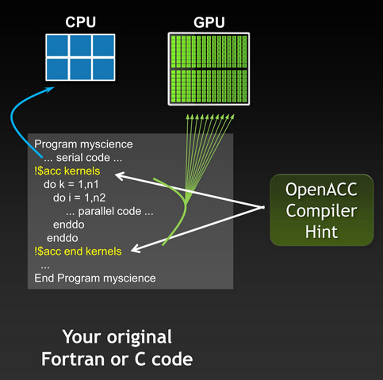
GPU porting of Bechtold scheme in COSMO
conv_cuinit.f90
Inizialization of physical fields
conv_cuascn.f90
Calculations for cloud ascents for cumulus
conv_cumaster.f90
conv_cudescn.f90
Main module: it computes the physical tendecies of the prognostic variables T, Q, U, V and tracers due to convective processes
Calculates cumulus downdraft descent
conv_cufluxtends.f90
Calculates convective fluxes in cloud and in subcloud layers.
Update of T, Q, U, V and computation of transport of chemical tracers
Developed by Riccardo Scatamacchia (COMET) in collaboration with Meteo Swiss

Slide 5
Performance results
Results for 1 COSMO-E member 2h simulation using 8 GPU sockets (Nvidia P100) or 8 CPU sockets (8 Intel Haswell CPUs with 12 cores each = 96 cores) . Measured on the Piz Daint system at CSCS with COSMO 5.5-prerelease, branch full_gpu3

Slide 6
COSMO model on heterogeneous architecture, some applications

Slide 7
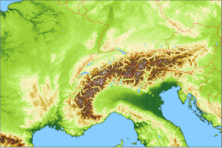
Operational setup at Meteoswiss
Running on hybrid GPU system Piz Kesch, operational since 2016
Model Operator : “No adverse consequences in terms of maintenance, stability or complexity for operations”
ECMWF-Model
9 to 18 km gridspacing
2 to 4 x per day
Provide boundary condition
COSMO-1
1.1 km gridspacing
8 x per day
1 to 2 d forecast
(production since April 2016)
COSMO-E
2.2 km gridspacing
2 x per day
5 d forecast
21 members (production since June 2016)
Ensemble data assimilation: LETKF
Notes:
Stop short presentation at this slide

Slide 8
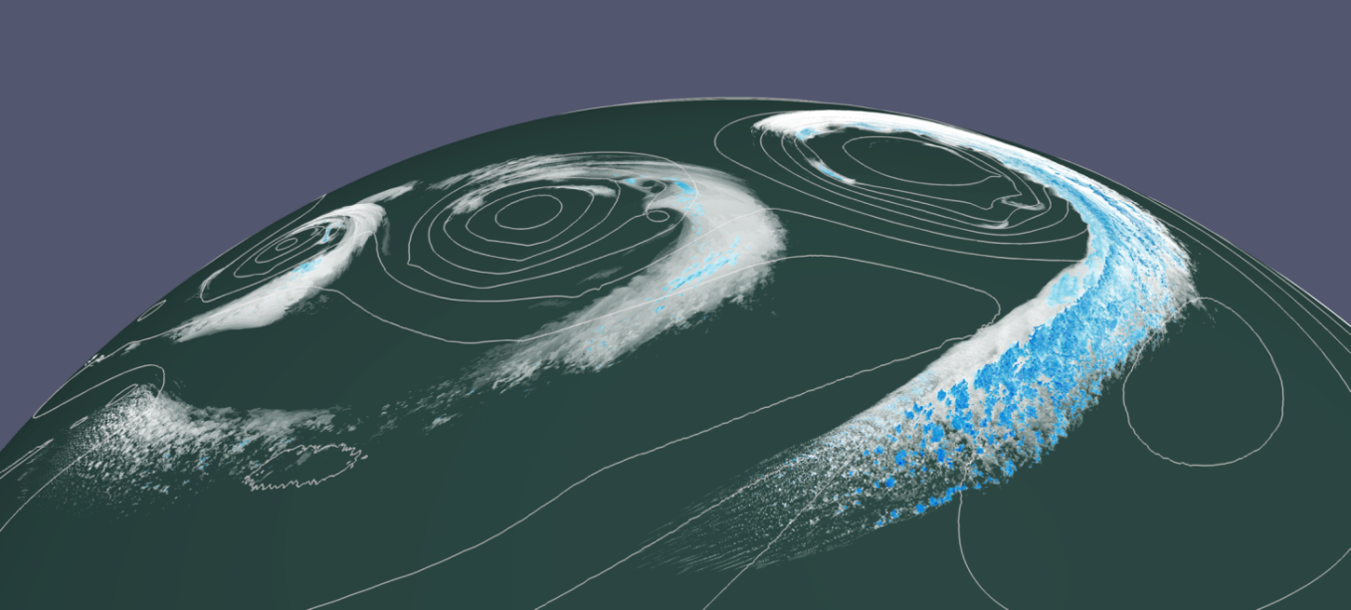
Quasi-global simulation on Piz Daint
Configuration
80°S to 80°N covering 98.4% of Earth’s surface
Regular lat/lon grid
Analytical initial condition
10 day simulation
Minimal I/O
Metric : SYPD = Simulated years per wallclock day
Visualization by Tarun Chadha (C2SM): clouds > 10⁻³ g/kg (white) and precipitation > 4 10⁻² g/kg (blue) Fuhrer et al., GMD 2018
Piz Daint
~5000 hybrid nodes with P100 GPUs (#6 Top500 6.2018)

Slide 9
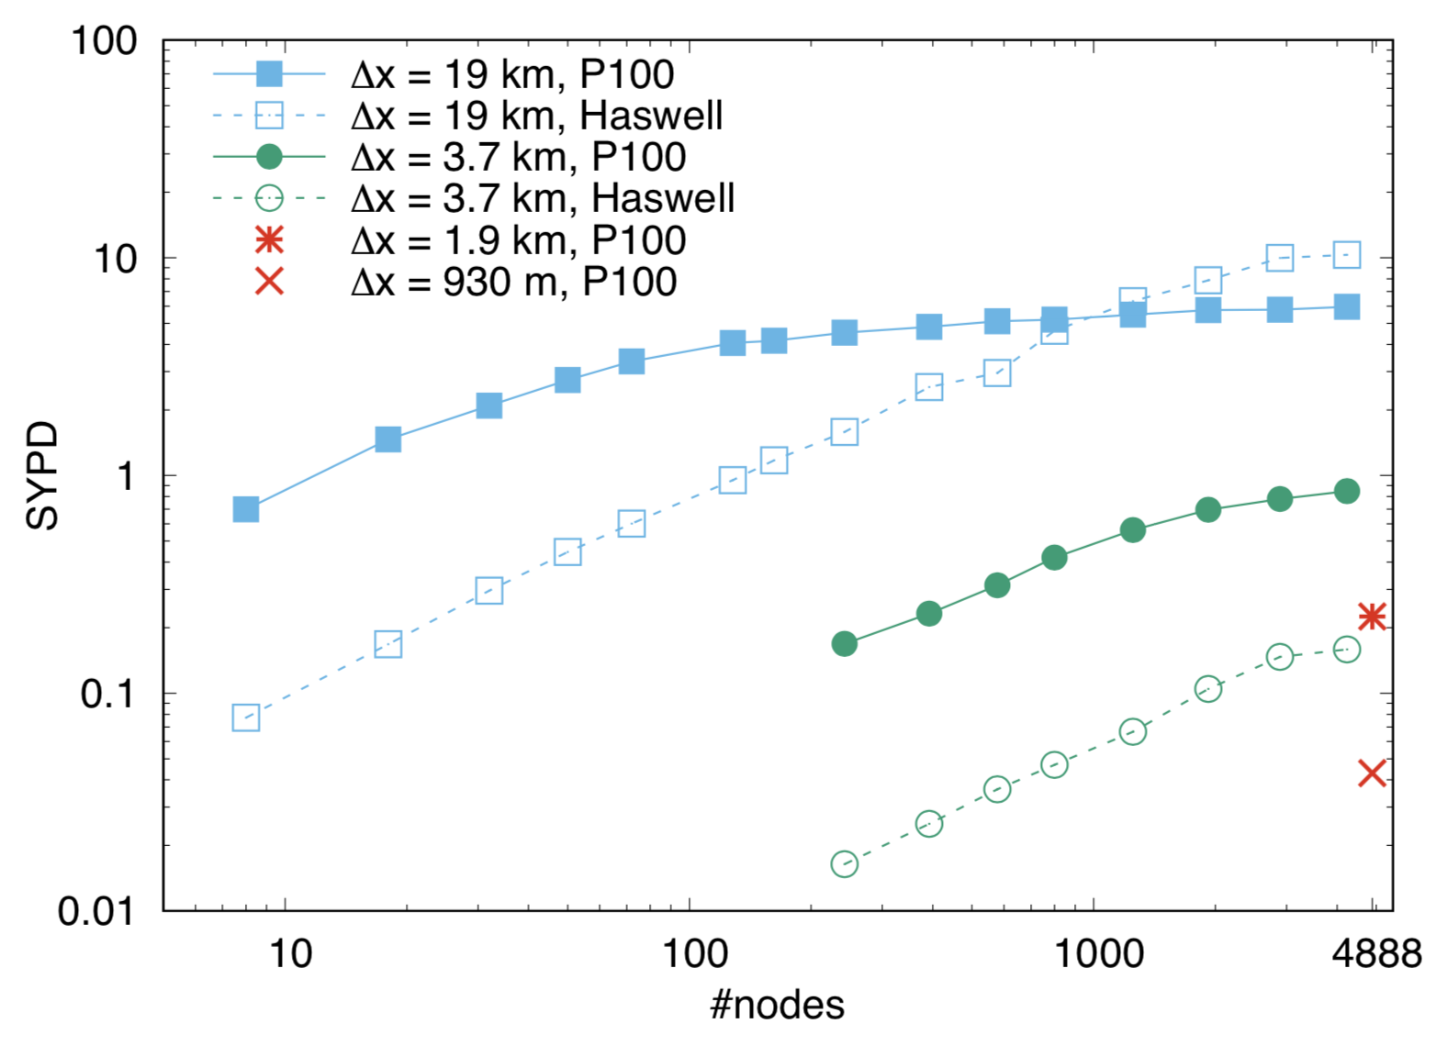
Strong scaling
Fuhrer et al., 2017, GMD, in rev.
Near-global simulations at a fixed horizontal resolution
19 km
3.7 km
0.25 SYPD
Decadal climate simulation possible
1.9 km
Still in linear scaling regime
0.93 km
too slow to be useful

Slide 10
Learnings from the GPU port and code maintenance

Slide 11
Software development tools
GPU support increase complexity of the software
The new code can also now run in single precision (in addition to double)
Improve software development process : code review with dedicated tool (github Pull Request – thanks to the SCA for using this!), design review …
Automatic on demand and nightly build and tests (Jenkins)

Slide 12
Moving target
We ported COSMO to GPU 3 times (4.18, 5.0 and 5.5)
Dificult to work with a moving target, synchorinization with model developer is very important.

Slide 13
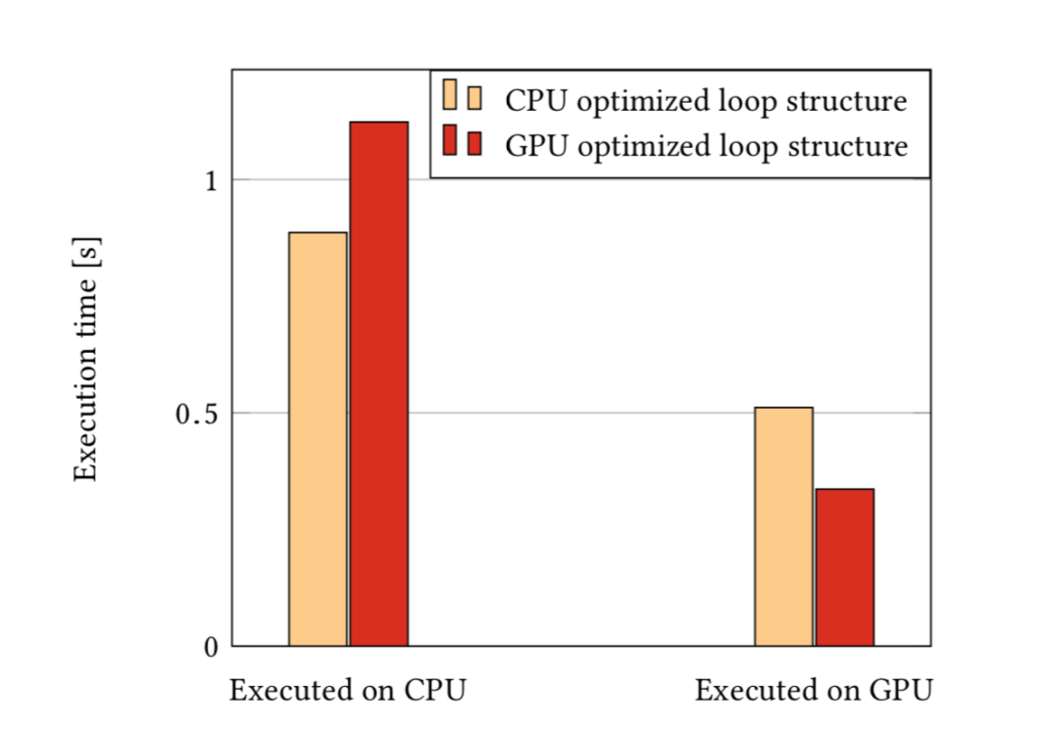
OpenACC directives
!$acc data create(a,b,c)
!$acc update device(b,c)
!$acc parallel
!$acc loop gang vector
do i=1,N a(i)=b(i)+c(i) end do
!$acc end parallel
!$acc update host(a)
!$acc end data
Incremental insertion in existing code
Ideal for porting large components – avoid GPU-CPU copy
Radiation scheme on CPU (Intel E5-2690v3 “Haswell”) and GPU (NVIDIA K80) using Fortran + OpenMP + OpenACC
May not be always performance portable : different optimal code for CPU and GPU (#ifdef ..)
Not always possible to achieve optimal performance on a given architecture (limitations)
Difficult to maintain and debug in large legacy code
What about ARM CPU, intel accelerator … ?
Lapillonne and Fuhrer, PPL, 2016
Clement et al. 2018, PASC’18, 2018

Slide 14
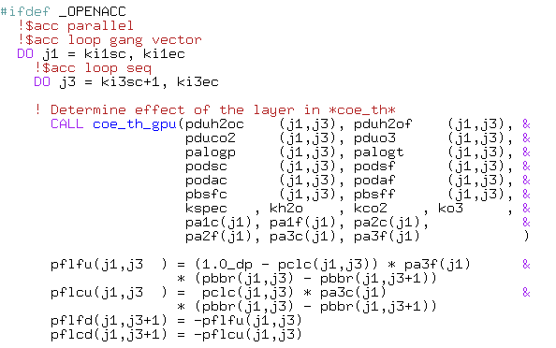
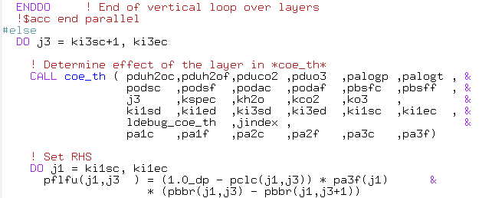
…

Slide 15
CLAW directives in COSMO
CLAW is a tool developed at MeteoSwiss/ETH to manipulate Fortran code (see IMPACT presentation)
CLAW-directives mode allow to insert code transformation in an existing code
Based on the OMNI computer from Rikken computing center in Japan
Ex: 30% performance in the turbulence on GPU, avoid large ifdef region, improve maintenance
The code still works on GPU and CPU without using CLAW
MCH will maintain CLAW directive in COSMO

Slide 16
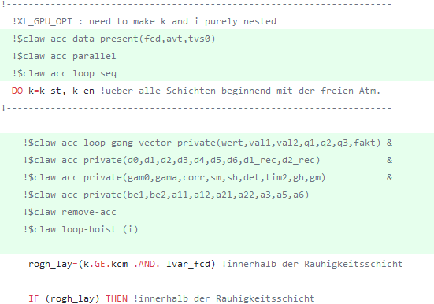
All i-loops bellow automatically replaced with a single i-loop here

Slide 17
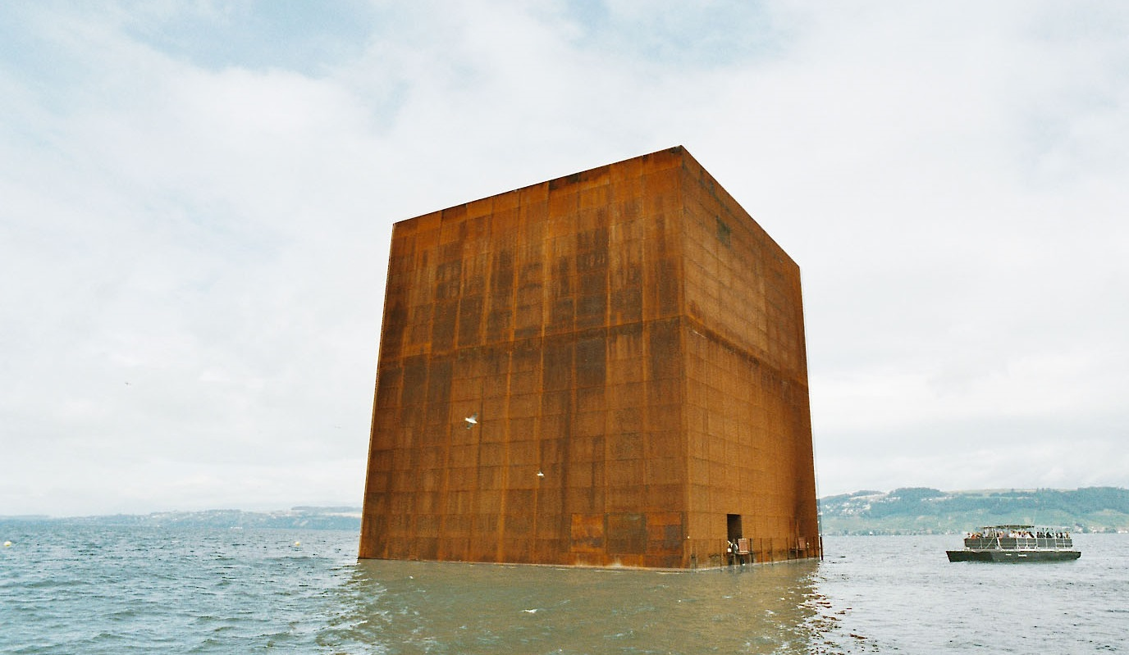
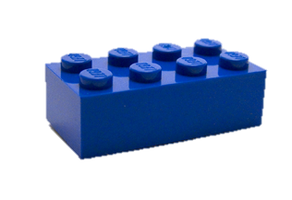
Separation of concern
Fuhrer et al. 2014 (doi: 10.14529/jsfi140103)
Gysi et al. 2015 (doi: 10.1145/2807591.2807627)
C++ / DSL rewrite
Fortran +
directives
High-level implementation
Separation of concerns
Domain-specific language
(performance portable, re-usable)

Slide 18
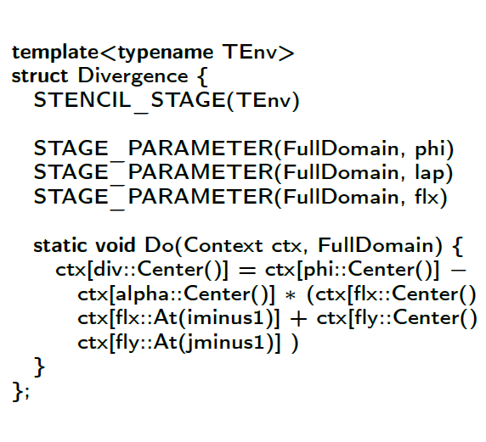
C++ embeded DSL
Separation of concerns between user code and optimized backend
Performance portable, future proof : can be extended to new architecture
Easier to maintain (e.g. unittesting)
No custom tool (rely on c++/cuda compilers)
Laplacian with Stella-DSL
Steep learning curve, domain scientist did not like the language : we now have 2 dynamical cores!
Requires consequent boiler plate codes, No reduction in LOC
Still some hardware optimization in user code (e.g. GPU caching), requires expertise
What to do next, what could we improve -> IMPACT project, discussion

Slide 19
Future plans MCH
MeteoSwiss will switch to the official COSMO version in Q4 2018
Complete GridTools implementation of the C++ Dynamic Q4 2018, proposition to integration in official code Q1 2019

Slide 20
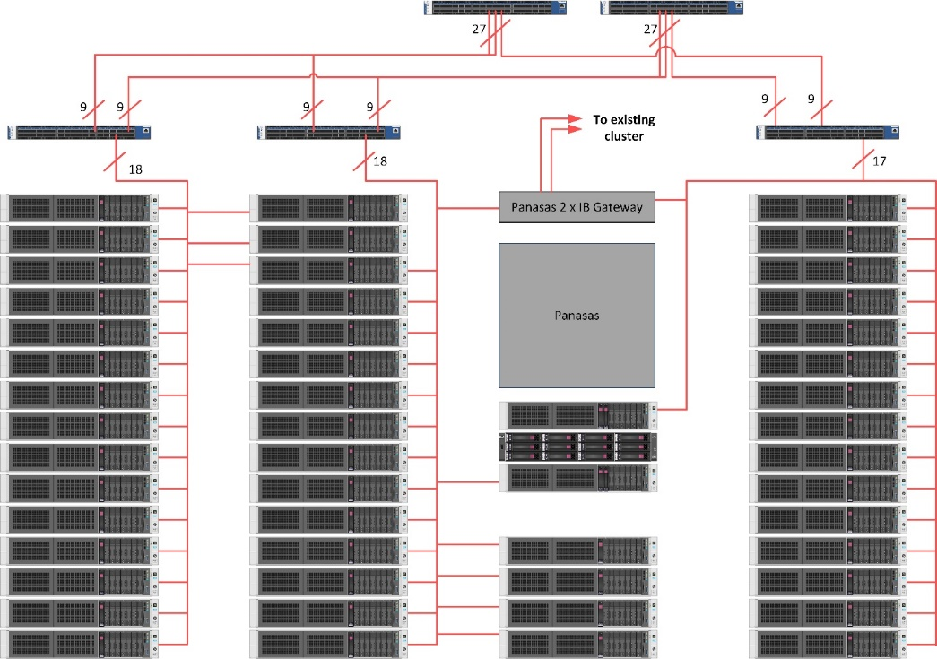
ITAF HPC facility (COMET)
Hybrid CPU/GPU (CPU Intel, GPU NVIDIA)
76x DL380 G9 Computing Nodes (2x12 Haswell cores - 64 GB)
2x DL380 G9 Management Nodes
4x PANASAS AS12 (1 Director Blade each)
6x Infiniband 36p FDR switches
152x Kepler K80 GPUs
- K80 Features:
4.75 TB RAM
240 TFLOPS peak (related to HPL Benchmark)
Next upgrade:
Opt. 1: +10 computing nodes ( +20 GPU K80)
Opt. 2: +7 computing nodes (+14 GPU v100)
+ 2 IB EDR 36p Switches
RAM upgrade to 128 GB for each node (10,75 TB)

Slide 21
Future developments
TASK | RESOURCES | COSMO-POMPA | COSMO-PRERELEASE
HPC enviroment configuration
Performance | 1 Socket CPU / GPU |  | October/November
ENS COSMO-ME (40 members) | 40 CPU nodes / 160 GPU devices |  | End November
ENS COSMO-IT (20 members) | 40 CPU nodes / 160 GPU devices |  | End November
Test cases |  |  | End December

Slide 22
Conclusions

Slide 23
Conclusions – Take home message
The COSMO model was ported to GPU using Domain Specific Language and compiler directives
Single/Double precision capabilities
Up tp 4x speed up with the new version on GPU as compare to CPU
Operational at MeteoSwiss on a GPU system since 2016
Full scale on the PiZ Daint super computer
POMPA project is formally completed since July 2018, final review and integration into official code until october 2018

Slide 25
Additional material

Slide 26
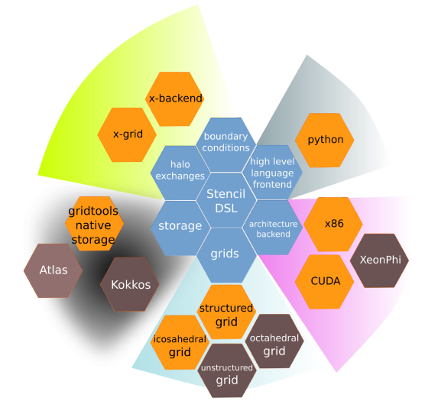
GridTools Framework
“SDK for weather and climate science”
Joint development between CSCS / MeteoSwiss / C2SM
Domain-specific for Earth system model components
Regional (production) and global grids (prototype)
Multiple APIs (C++, Python, gtclang)

Slide 27
Performance portability, why do we need abstraction ?
Directives : portable but not optimal code with single source
different optimization for different target architecture
in the dynamics difficult to achieve opt. performance
x1.3
x1.8
Possible solutions : Domain specific Language (Gridtools), abstraction, CLAW

Slide 28
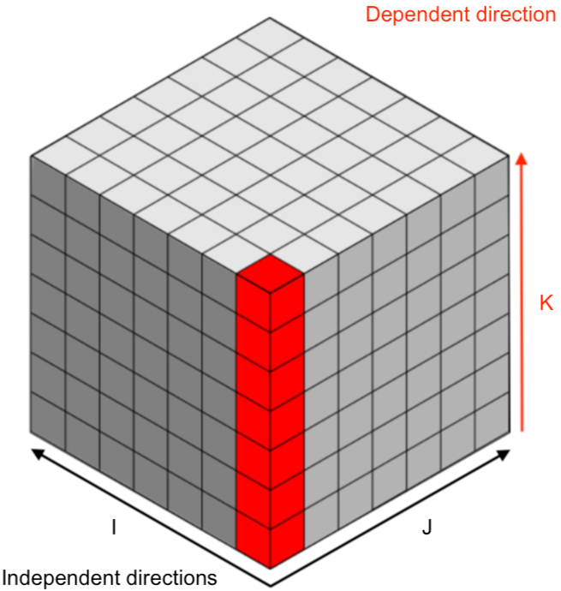
CLAW Single column abstraction approach : performance portability in the Fortran physics https://github.com/claw-project)
Separation of concerns
Domain scientists focus on their problem (1 column, 1 box)
CLAW compiler produce code for each target and directive languages

Slide 29
Claw one column example
!$claw parallelize forward
DO icol = 1, ncol
CALL lw_solver(ngpt, nlay, tau(icol,:,:))
END DO
Loop over horizontal direction generated by claw at compile time
CALL lw_solver(ngpt, nlay, tau)
SUBROUTINE lw_solver(ngpt, nlay, tau, …)
!$claw define dimension icol(1:ncol) &
!$claw parallelize
DO igpt = 1, ngpt
DO ilev = 1, nlay
tau_loc(ilev) = max(tau(ilev,igpt) …

Slide 30
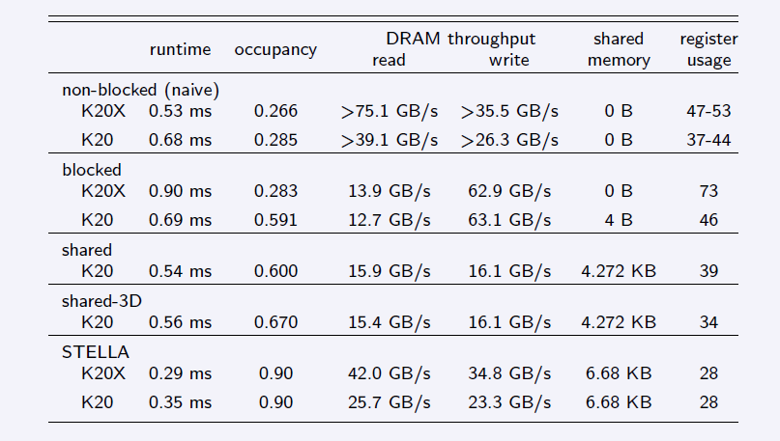
Efficiency myth
Heavily optimized code is faster than Fortran + OpenACC
(Example: 1.5x for horizontal diffusion operator)

Slide 31
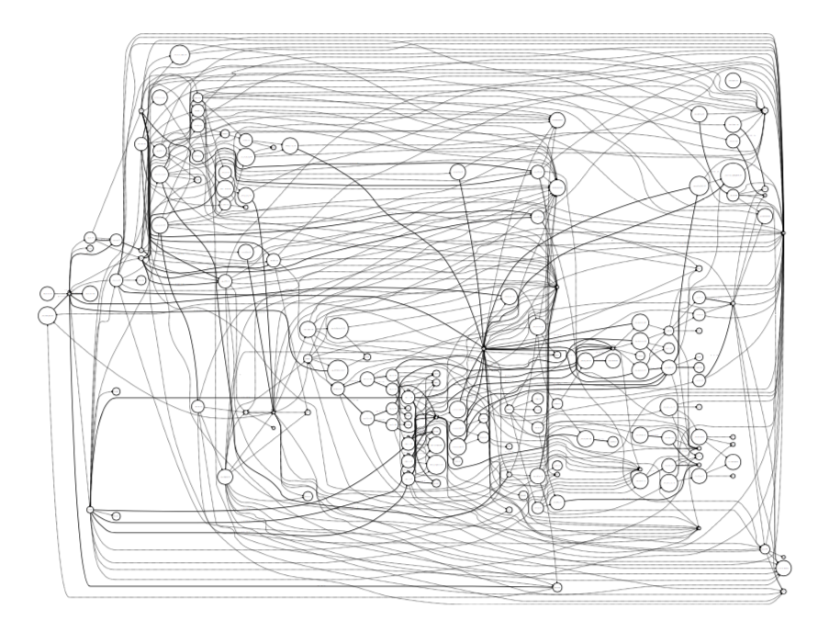
Software (Automatic optimization)
Compilers will not solve the problem!
DSL-based code can be automatically optimized for a specific hardware target
E.g. “Design of a Compiler Framework for Domain Specific Languages for Geophysical Fluid Dynamics Models” (Fabian Thüring, MSc thesis)
Example: Fast-waves solver
Graph representation of code
Rearrange for data-locality
Run independent computations in parallel

Slide 32
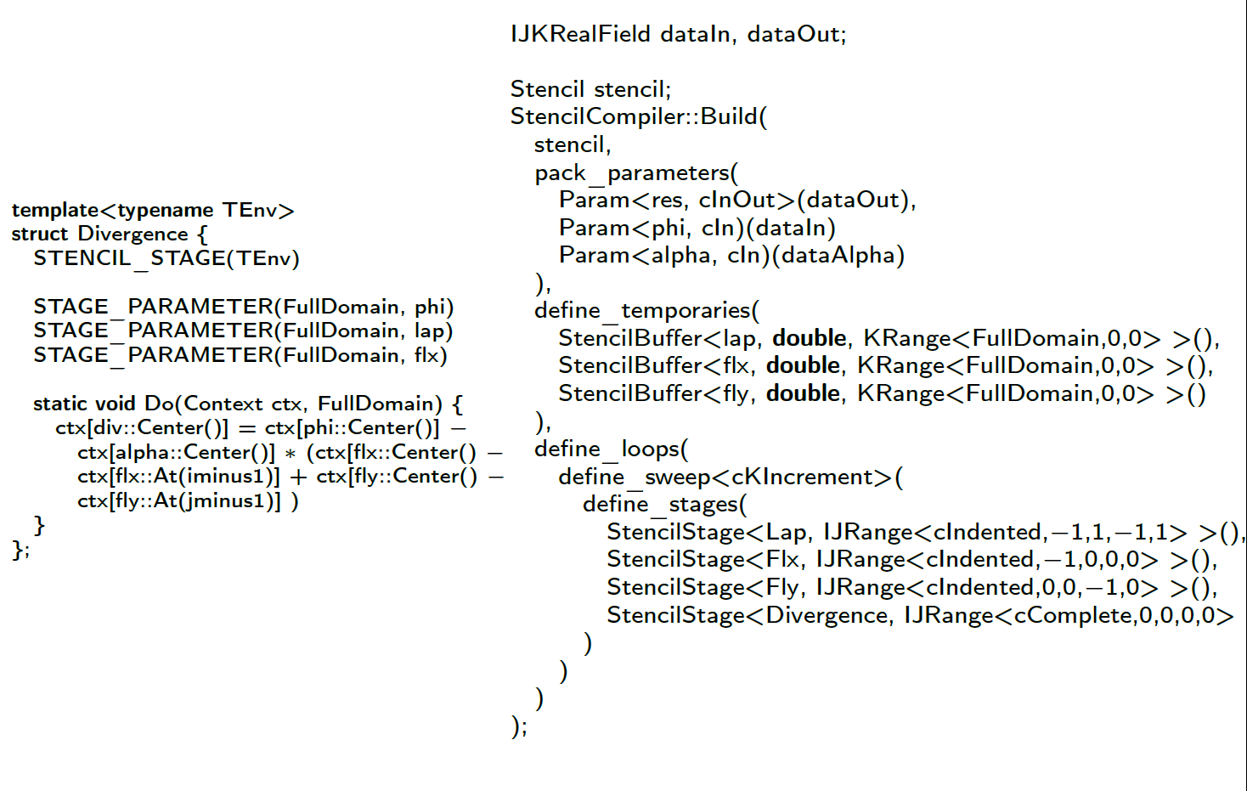
STELLA SYNTAX
Only specify neighbourhood relations and domain of application
Code for specific architecture is generated at compile time

Slide 33
COSMO quasi-global
Source: Vogt, 2017
Δx | # nodes | SYPD | MWh / SY
0.93 km | 4,888 | 0.043 | 596
1.9 km | 4,888 | 0.23 | 97.8
3.7 km | 4,888 | 0.97 | 20.8
What would it take to do a 36 year AMIP simulation?
 | Δx = 0.93 km | Δx = 1.9 km
Time to solution | 840 days | 156 days
Energy to solution | 22 GWh (0.9 M$) | 3.5 GWh (0.150 M$)
CO2eq to solution | 3’800 tons | 640 tons
$ to solution (2go.cscs.ch) | 97 M node hours → 68 M$ | 18 M node hours → 12 M$

Slide 34
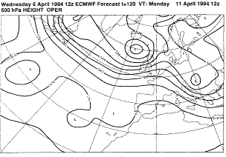
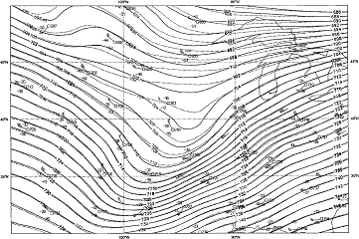
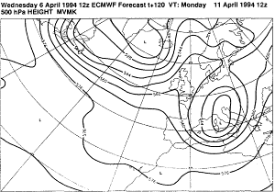
Ensemble prediction
The atmospheric system is a chaotic system: i.e. high sensitivity to initial condition
Initial conditions (dotted lines)
Operational 120 h forecast
Initial conditions (full lines)
Modified forecast

Slide 35
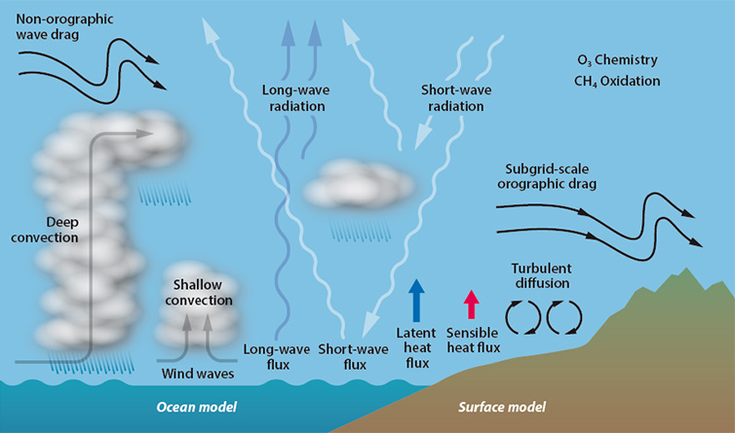
Modeling the Earth system
(source https://www.ecmwf.int/sites/default/files/medialibrary/2017-09/atmospheric-physics-754px.jpg)
Notes:
Earth system is a multi-scale, multi-physics problem.
Many different procceses act together that have to be represented in one form or another in a weather and climate model.
Formation and dissipation of different types of clouds.
Interaction of the radiation impinging from the sun, and the longwave radiation emmanating form the warm Earth.
Surface-vegation-atmosphere-transfer determining the latent, sensible fluxes of heat.
But also the effect of topogrphy on the atmosphere that acts on the momentum budget.
So let’s take for example a deep cumulus cloud…

