Slide 1
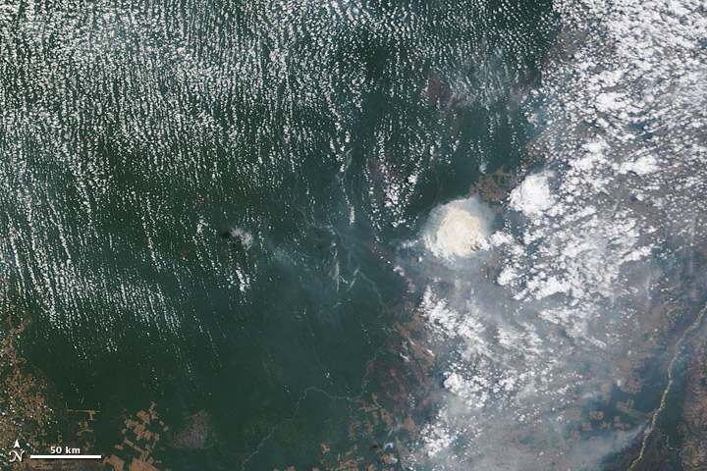
COSMO-ART
Status - Development - Application

Slide 2
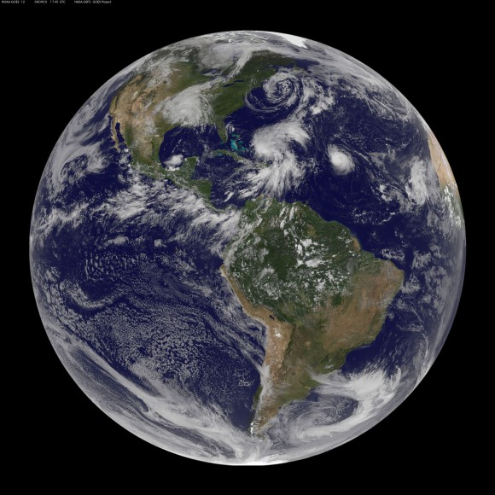

Slide 3
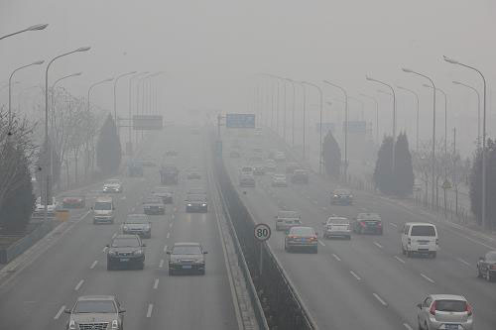
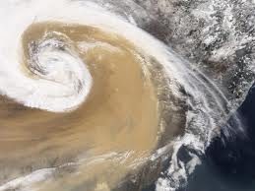
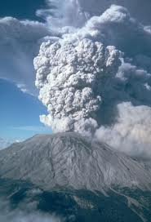
But there is more…

Slide 4
Why aerosols in operational forecasts?
Accidental releases: radioactive particles, hazardous substances
Health issues: natural and anthropogenic particles (e.g. pollen)
Visibility: volcanic ash, vegetation fires, mineral dust, secondary aerosol
Flight safety: volcanic ash, mineral dust, vegetation fires, all kind of CCN (icing)
Renewable energy: mineral dust, all kind of CCN (persistent stratus clouds)
Hydrology and high impact weather: all kind of aerosol, ongoing research
Climate: all kind of aerosol, ongoing research

Slide 5
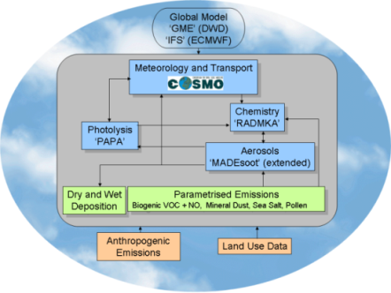
COSMO-ART: Aerosols and Reactive Trace gases
Atmospheric processes
Emissions
Gas phase chemistry
Aerosol Dynamics
Radiation and cloud formation
Vogel et al., 2009
Bangert et al., 2012

Slide 6
COSMO-ART used and further developed by:

Slide 7
Developments since last GM:
Tracer structure
COSMO-ART/M7
COMSO-ART based on COSMO 5.0
Test suite for COSMO-ART
COSMO-ART serves as the base for EU Project EXA2GREEN
Two extra days at the COSMO-CLM-ART training course

Slide 8
Data assimilation activities for COSMO-ART

Slide 9
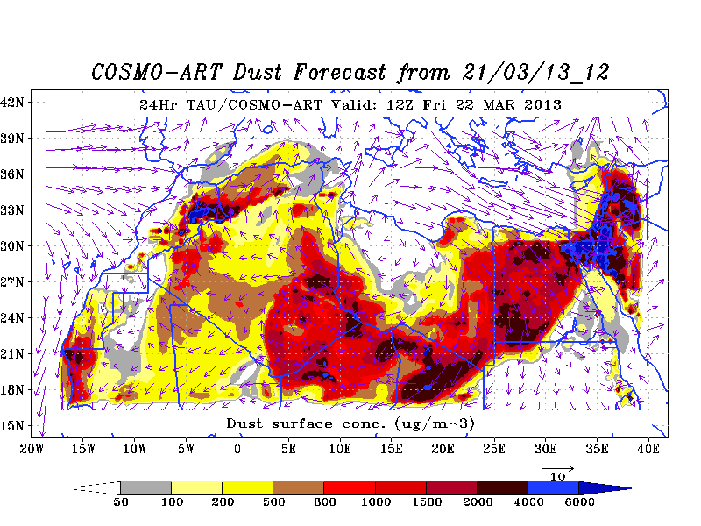
Mineral dust above the dead sea
P. Kishcha, P. Alpert

Slide 10
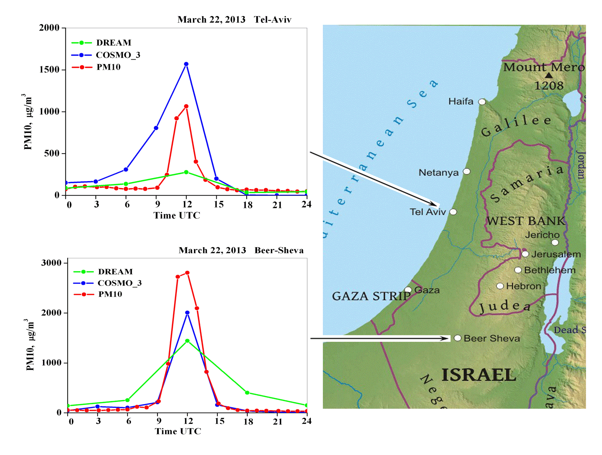
Comparisons between modeled surface concentrations and PM10 measurements on March 22, 2013

Slide 11
AOD at 550 nm wavelength 29 April, 2011
East Asian deserts
MODIS
COSMO-ART
S. Schrader
MODIS cloud mask
AOD
0.5 1.0 1.5 2.0 2.5 3.0 3.5 4.0 4.5 5.0

Slide 12
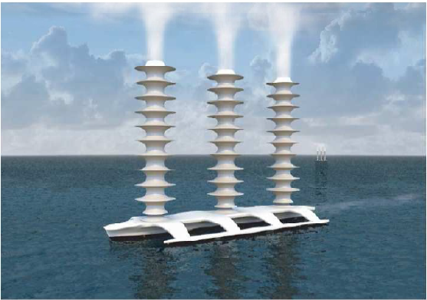
Climate Engineering

Slide 13
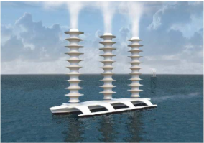
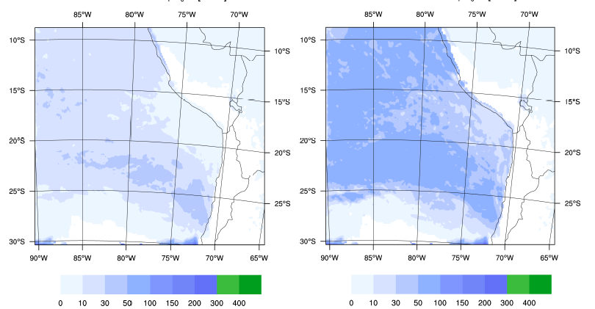
Climate Engineering

Slide 14
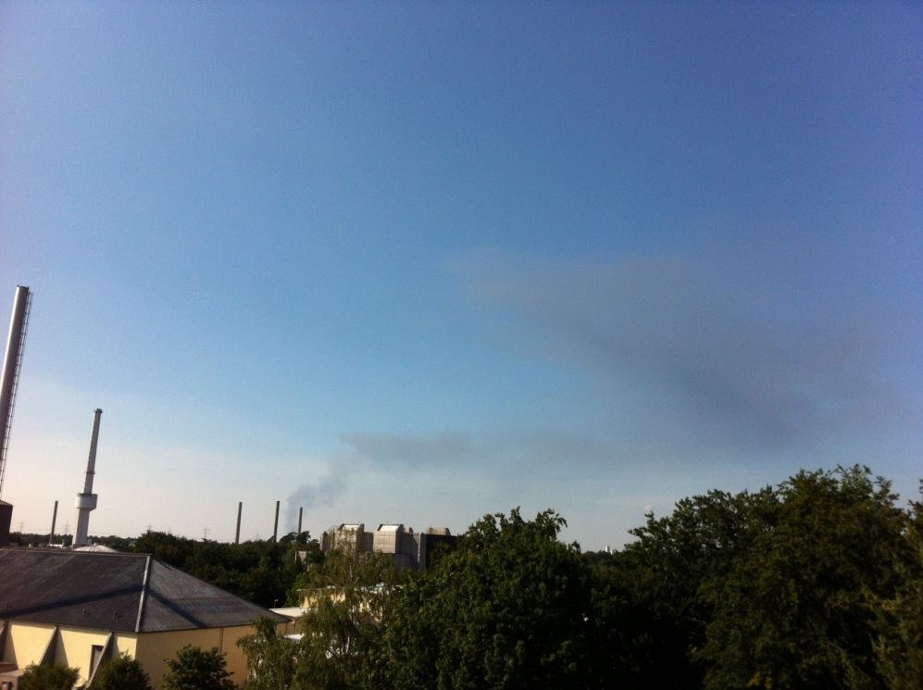
Emergency case version

Slide 15
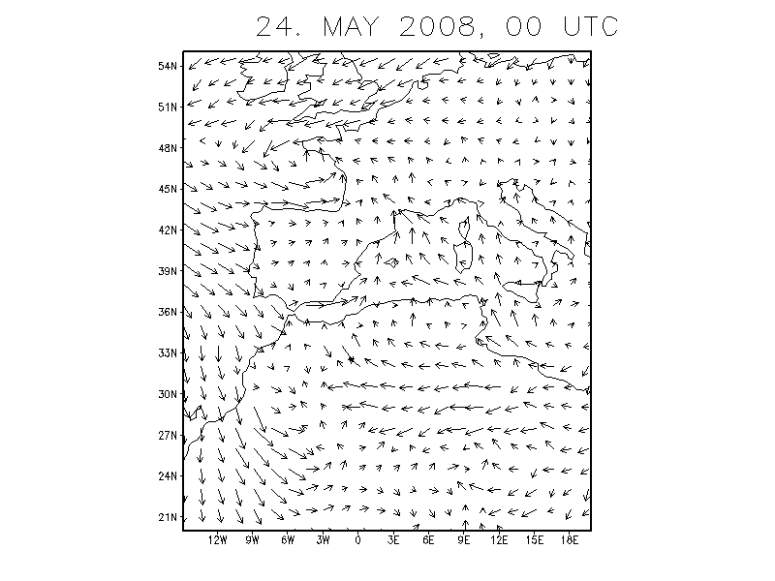
Emergency case version

Slide 16
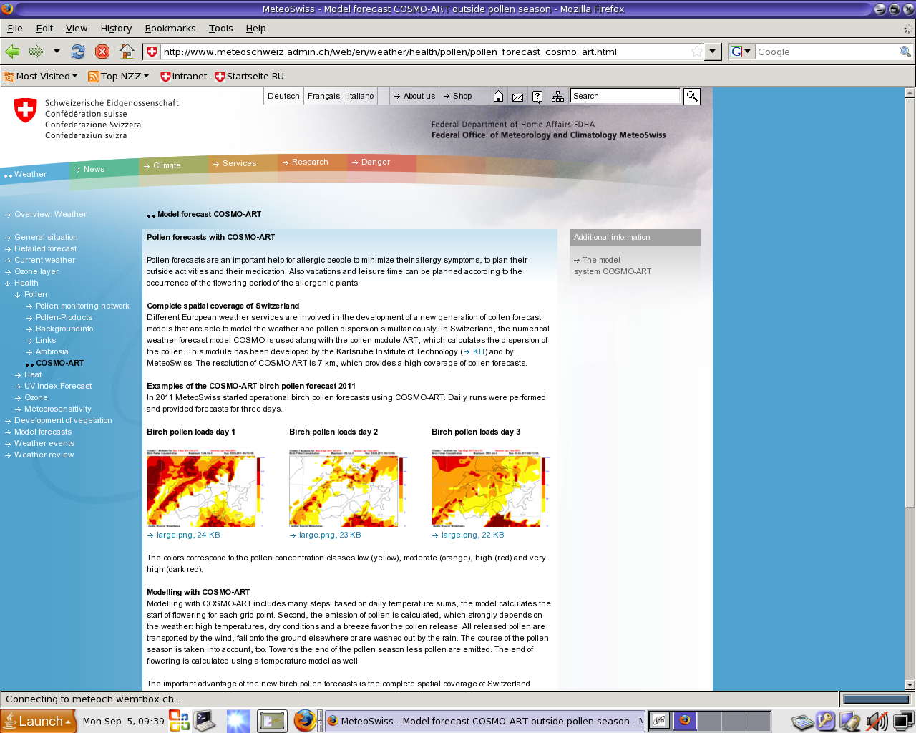
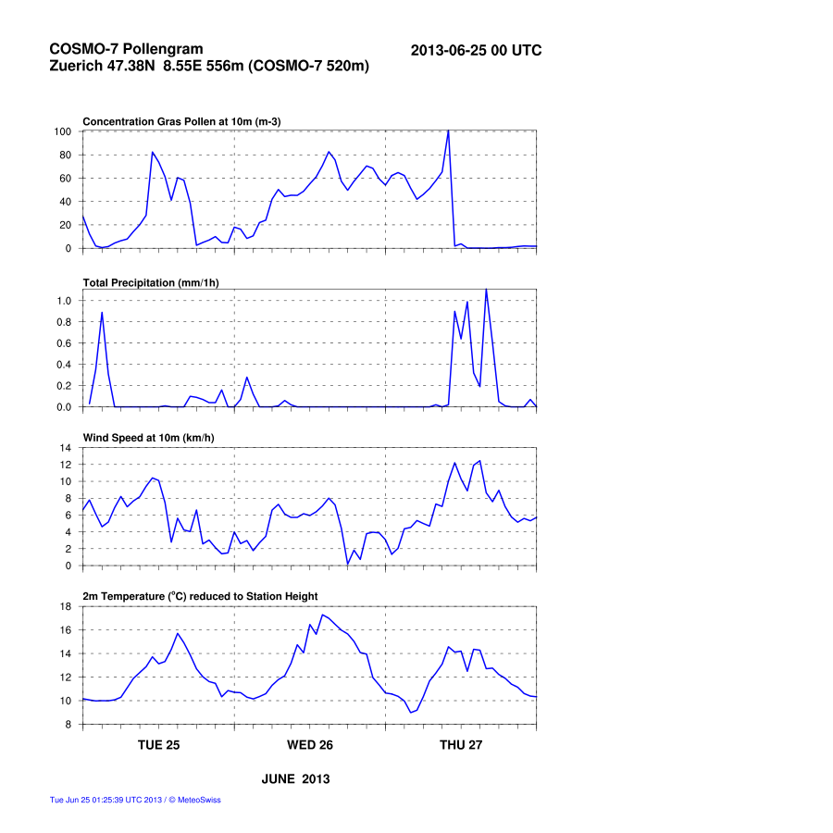
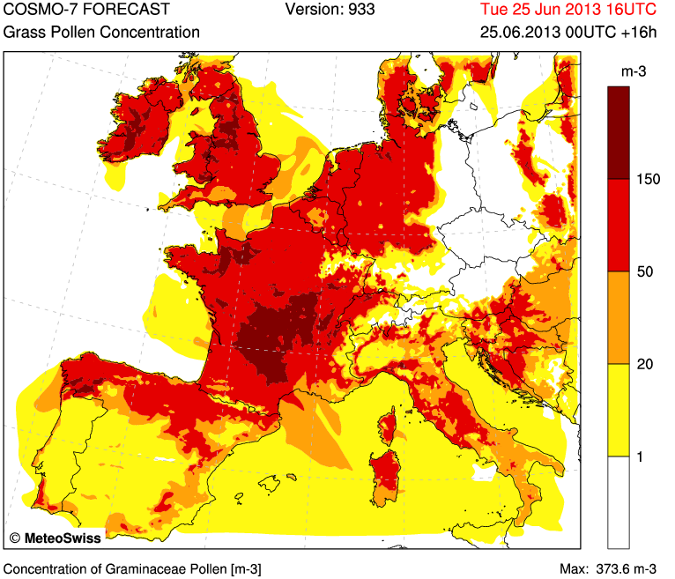
Pollengramm Zürich
pollen conc.
precipitation
wind speed
temperature

Slide 17
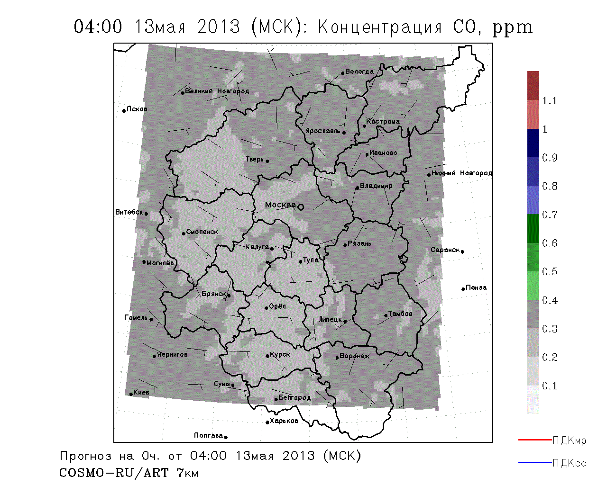
A. Revokatova

Slide 18
Verification of COSMO-ART
Ozone forecast, 1.07.2012 – 16.08.2012. Daily average values
Ozone forecast, case study (6.07.2012 – 8.07.2012)
NO2, 1.07.2012 – 16.08.2012. Daily average values

Slide 19
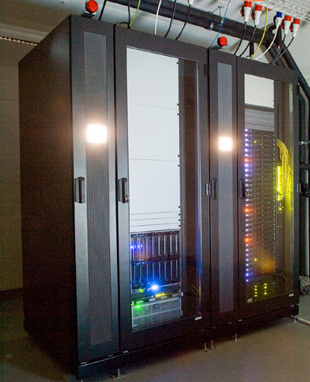
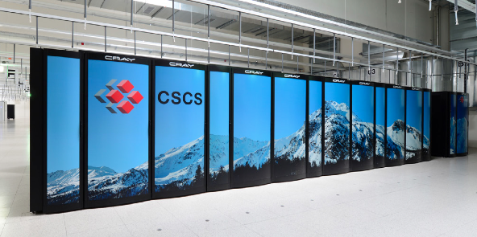
First steps to operationalization
Development on Empa cluster Ipazia
Get ECMWF IFS initial / boundary data for meteorology
Preprocess TNO/MACC emissions
Get ECMWF MACC-II initial / boundary data for chemistry
Run interpolation program INT2LM
Run COSMO-ART for EU domain
Run interpolation program INT2LM
Final implementation should run at CSCS
Run COSMO-ART for Swiss domain
Postprocess model output
Archive model output
Create timelines, graphics and model performance diagnostics

Slide 20
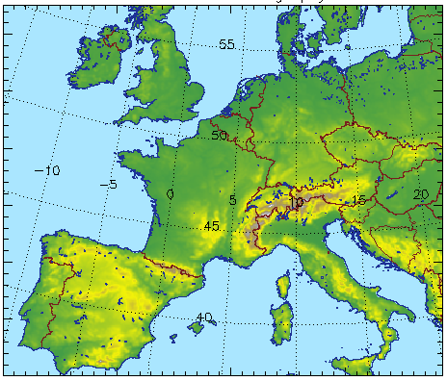
Szenario 1
Resolution 6.6 km as COSMO-7
Model domain Europe as COSMO-7
85 s elapsed time per forecast hour
In 2 hours: forecast range 85 hours
COSMO-7

Slide 21
Acknowledgement:
We acknowledge COSMO
We appreciate the support in the development of COSMO-ART:
U. Schättler, M. Baldauf, A. Seifert, U. Blahak, J. Förstner,
M. Raschendorfer
A. Pauling, K. Zink, P. Kaufmann, O. Fuhrer, A. Roche
D. Brunner, Ch. Knote
A. Revokatova
E. Athanasopoulou

Slide 22
Status of ICON-ART
Already realised:
Volcanic ash
Radioactive substances
Sea salt

Slide 23
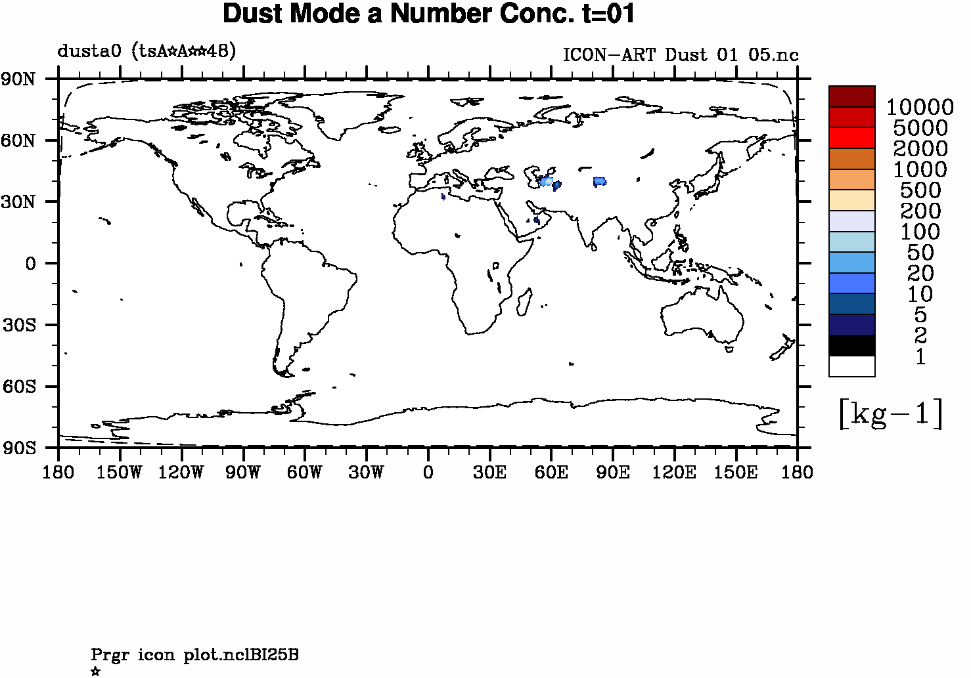
Status of ICON-ART
Mineral dust:

Slide 24
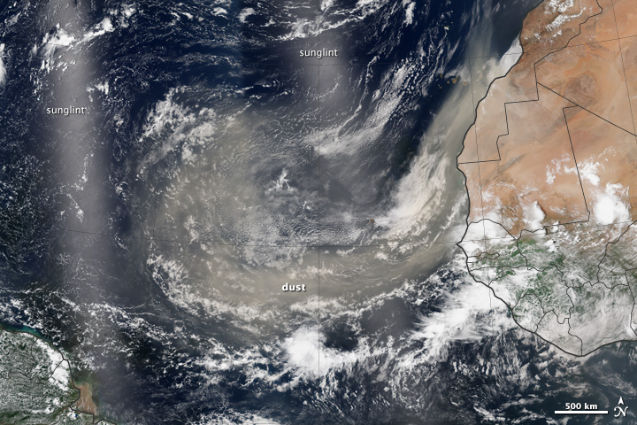
Mineral Dust observed at August 1, 2013

Slide 25
Aerosols in operational forecasts
Pollen grains: health issues
Volcanic ash: aviation
Mineral dust: visibility
Vegetation fires: health, aviation
Sea salt: cloud formation
Primary and secondary aerosols:
visibility, fog, icing, flooding, …
2013
2018

