Slide 1

COSMO STC Report
Lugano, 13th of September 2012
Philippe Steiner

Slide 2
30th STC meeting on 10th/11th Sept.
Participants:
P. Steiner (Switzerland, chair)
D. Majewski (Germany)
A. Raspanti (Italy)
T. Tzeferi (Greece)
G. Stancalie (Romania)
D. Kiktev (Russia)
M. Ziemianski (SPM)
Excused:
R. Bakowski (Poland), replaced by M. Ziemianski

Slide 3
Decisions (1)
Approved the version 1.1 of the COSMO Standards for Source Code Development (source code management)
Approved the latest version of the PP plan KENDA
Approved the task 1 and the new PP plan CORSO
Asked for a reworking of the PP plan VERSUS2
  Realistic plan to implement all necessary features
  enabling the replacement of existing tools by VERSUS
  Prepare the maintenance of VERSUS afterwards
  Setup mechanisms and train the involved people

Slide 4
Decisions taken (2)
Approved the new PP plan POMPA
  Extension until End of 2014
No prolongation of PP UTCS and PT Mire
PP CELO approved (COSMO-EULAG Operationalisation)
  PL Zbigniew Piotrowski (IMGW)
  9.2012 – 9.2016
PP CALMO approved (Calibration of COSMO Model)
  PL Antigoni Voudouri (HNMS)
  12.2012 – 12.2014
PP ConSAT (Consolidation of Surface Atmosphere Transfer) and PT NWP Test Suite discussed

Slide 5
Election of new WGC
WG3a
  Federico Grazzini stepping back after nearly 5 years
  Many thanks!
  Elected by unanimity: Matthias Raschendorfer (DWD)
WG6
  Uli Schättler stepping back after about 14 years !
  Many many thanks!
  Uli Schättler remains SCA for COSMO
  Elected by unanimity: Massimo Milleli (ARPA-Piemonte)
Officially in charge from the 15th of September 2012 on

Slide 6
Licensing of COSMO Software
Currently 6 licensees
6 more candidates (3 very concretely from June 2013 on)
About 20 additional candidates for free license
Very good support done by A. Smalla (DWD), C. Barbu and R. Dumidrache (NMA)
Time consuming activity because of the lack of good computer (and quite often insufficient English language) skill of the new COSMO users.
New COSMO installations in more than 4 countries and interventions in total in 17 countries during 2012.

Slide 7
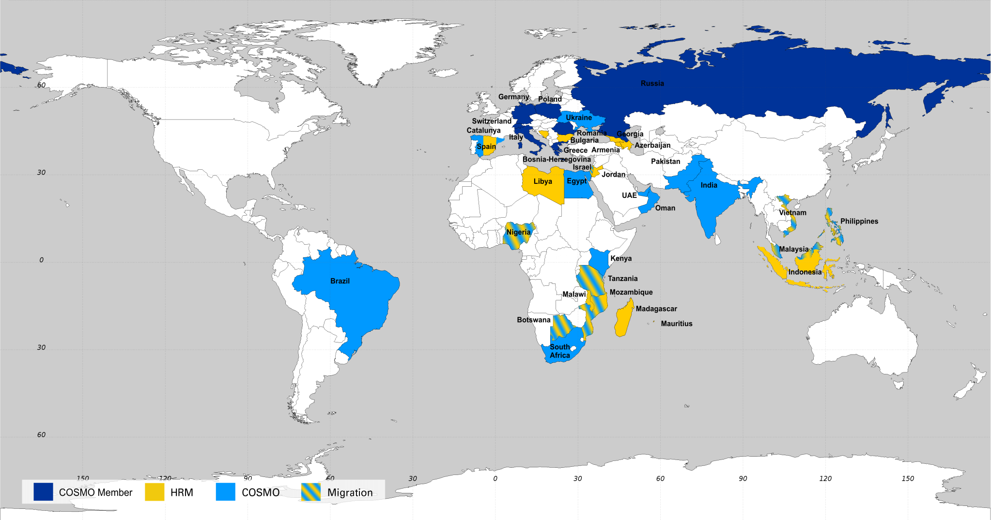
Map of model distribution until 2012

Slide 8
Licensing of COSMO Software
Standard contracts have been agreed:
Licensing contract for COSMO for developing countries
(to be issued beginning of 2013)
Licensing contract for Fieldextra for developing countries
Licensing contracts for INT2LM for EUMETNET members
Licensing contract for Fieldextra for EUMETNET members
  (both for the implementation of Interoperability)

Slide 9
New candidate to COSMO
Formal application of Israel Meteorological Service to COSMO received the 7th of August 2012
Approval of the directors needed to start the official two years period as applicant

Slide 10
Funded COSMO activities
Money from the licenses is dedicated to support the work COSMO in funding, e.g.:
  visits to COSMO partner (e.g. within a PP/PT)
  invitation of experts to COSMO meetings/conferences
  participation of COSMO scienstists to conferences
Review of the funded activities showed that the expected effect to intensify the exchanges is insufficient!
Don’t forget to make (good) use of this possibility!

Slide 11
Strategy of COSMO member for the next years

Slide 12


DWD Strategy 2012 - 2020
Four strategic tasks in the Forecasting Strategy
Centralisation / automation (partly) of production of severe weather warnings
Integrated forecasting system for nowcasting and very short range forecasting
Leading aviation service in Europe
Support to renewable energy production

Slide 13
DWD Strategy 2012 - 2020
19 tasks in Numerical Modelling Strategic Concept, e.g.
Task 1: COSMO-DE-EPS
Task 2: ICON-EPS
Task 4: ICON development
Task 5: Shared physics library for ICON and COSMO model
Task 6: Regional version of ICON together with COSMO / CLM
Task 13: Ensemble data assimilation
Task 14: Further development of operational NWP system
Task 12: Integrated forecasting system
Task 19: Forecasts in the field of renewable energy

Slide 14
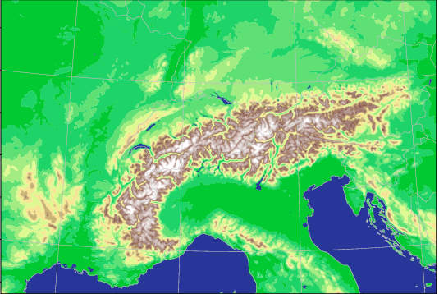

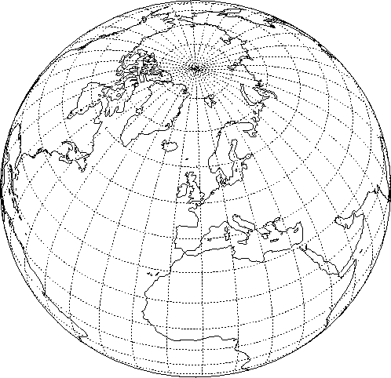
Strategy of MeteoSwiss
Project COSMO-NExT 2012-2015
Boundary conditions: VarEPS
20km
2x daily
Boundary conditions: IFS
10km
4x daily
COSMO-E: 2x daily 5 days forecasts
2.2 km grid size (convection permitting) 21 ensemble members
COSMO-1: 8x daily 24 hours forecasts
1 km grid size (convection permitting)
Notes:
Um lokale Vorhersagen zu machen, verwendet man ein 3-stufiges Verfahren:
Zuerst ein globales Modell, das das Verhalten der Atmosphäre auf dem ganzen Globus vorhersagt. Dazu wird die Kugel mit einem Gitternetz überzogen, dessen Maschenweite ca. 16km beträgt.
Auf einem Ausschnitt über Europa wird die Prognose auf einem Gitter mit 6.6km Maschen verfeinert (COSMO-7).
Über dem Alpenbogen wird ein Netz mit 2.2km Machenweite aufgespannt (COSMO-2). Damit erhält man viel mehr Details, wie z.B. die Alpentäler.
Das jeweils eingebettete Modell braucht die Vorhersagen des übergeordneten an den Rändern (Ein- und Ausströmen der Luft).
Faustregel: eine 24h Vorhersage muss in 30‘ erstellt werden können, damit sie nützlich ist. Je enger die Maschen, desto grösser der Rechenaufwand, deshalb die immer kleineren Gebiete.

Slide 15
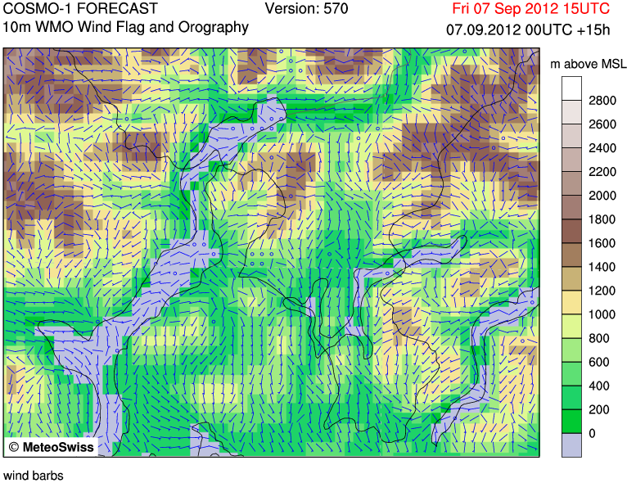
Current Status
New machine at CSCS providing development capacity
Continuous assimilation (nudging) & daily forecast COSMO-1
First setup of KENDA (COSMO-2, identical members)

Slide 16
Italian NWP Strategy
Reorganization of Italian Meteorogical Service
as National Distributed Meteorological service:
Sinergy of existing resources to optimise them:
  Air Force Met Service,
  Civil Protection,
  Regional Met services

Slide 17
Italian NWP Strategy
Now operational:
DA with LETKF based on HRM on Euro-Atlantic area
COSMO-ME 7km, 00 & 12UTC runs up to +78
(DA interpolation from LETKF)
COSMO-IT 2.8km, 00 & 12UTC runs up to +24 (nudging)
Operational near future:
DA with LETKF based on COSMO on European area,
optimisation of resources converging to DA with KENDA
COSMO-ME 7km, 4 runs/day up to +72 / +48 interm. runs (DA from LETKF)
COSMO-IT 2.8km, 4 runs/day up to +21 (nudging)
(or possibily Rapid update cycle with 8 runs/day)

Slide 18
Italian NWP Strategy
Under the hypothesis of CNMCA Supercomputer upgrade
(actually 15 Tflops)
probably based on hybrid machines CPU/GPU
Operational next years:
EPS system based on LETKF and COSMO-ME 7km 2 runs/day on Mediterranean area as high resolution EPS
EPS system based on COSMO-IT 2.8km, 2 runs/day runs on Italian area as very high resolution EPS
In strict collaboration with ARPA Bologna

Slide 19
Strategy at HNMS
Use of COSMO not only for operational weather forecasts but is also applied for:
Marine forecasts for small routes between Greek islands
WAVE model
Support of research institutes and Greek authorities
Post processing products for Hellenic Air Force
(icing, turbulences etc)
Strategy for future work:
COSMO-ART
COSMO-CLM
COSMO-LEPS (to become forecaster-friendly within HNMS)
FIELDEXTRA
Improve quality/quantity of data for assimilation

Slide 20
Strategy at HNMS
Status of COSMO-ART
Model successfully compiled and ready to be used,
initially only for research purposes.
A memorandum with NOA about to be established
(National Observatory of Athens)
NOA will provide data to HNMS
(emissions of pollutants, area -point sources characteristics,…) and HNMS will perform simulations (past cases)

Slide 21
Strategy of IMGW
Current status:
Model runs:
  COSMO 7km with data assimilation, 4 times per day
  COSMO 2.8 km, 2 times per day
Additional tools:
  Sea wave model (WW3) based COSMO-7km output
  Dispersion model of volcanic ashes based on COSMO-7km
  Soaring forecasts (end of test phase)
  (predictions of conditions for gliders based on COSMO-2.8km) …
21
Instytut Meteorologii i Gospodarki Wodnej – PIB
Notes:
Hardware: Intel Xeon-based Linux cluster, 256 cores (32 nodes of two 4-core X5570 CPUs), over 2.5 TFLOPS
21
Instytut Meteorologii i Gospodarki Wodnej - Państwowy Instytut Badawczy

Slide 22
Strategy of IMGW
Hardware Plans (2012/2013)
Plans for a new Linux cluster
to test, develop and run models at high resolution
(7, 2.8 km and higher)
About 50 TFlops sustainable, scalable up to over 100TFlops
Model(s) development (for 2013 onwards):
Soil model with implementation of soil data assimilation
Resolution increased up to 1km,
possibly in quasi-operational mode, preferably over mountains
Start implementation of convection-resolving EPS
22
Instytut Meteorologii i Gospodarki Wodnej – PIB
Notes:
22
Instytut Meteorologii i Gospodarki Wodnej - Państwowy Instytut Badawczy

Slide 23
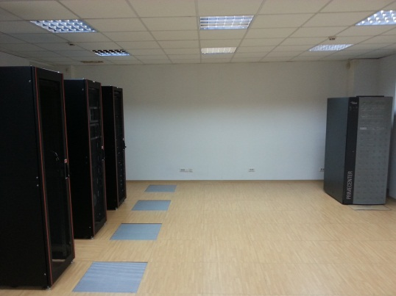
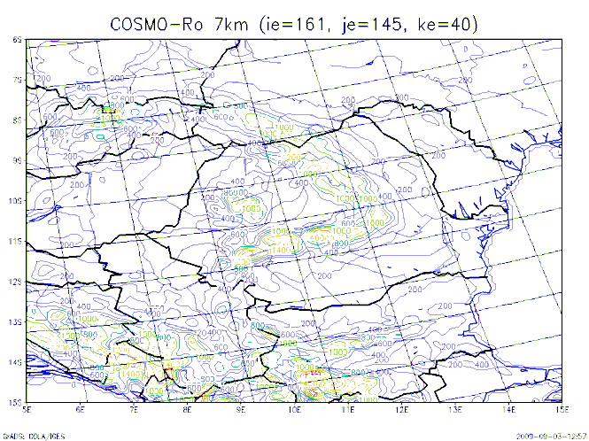
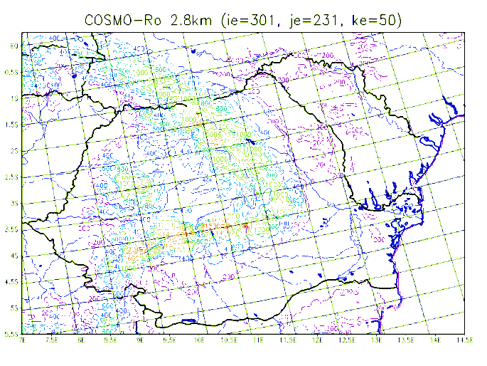
Operations at NMA
COSMO 4.18 – starting from July 2012
COSMO 7 km
nudging data assimilation
for synop (AOF format)
two runs/ day (00 & 12UTC)
COSMO 2,8 km resolution
no data assimilation
one run per day (00 UTC)

Slide 24
Plans at NMA
For operational activities
Implementation of BUFR2NETCDF software and advanced testing for SYNOP;
Testing BUFR2NETCDF for TEMP and PILOT data;
Data assimilation for TEMP and PILOT data;
Preparing radar data and converting into GRIB format for data assimilation
Implementation of COSMO-ART (already done) for regional pollutant transport and air quality monitoring
Preparing the emission files with help from KIT colleagues for operational use
In consortium COSMO:
Further participation in support activities, KENDA and VERSUS
Possible participation in PT NWP test suite

Slide 25
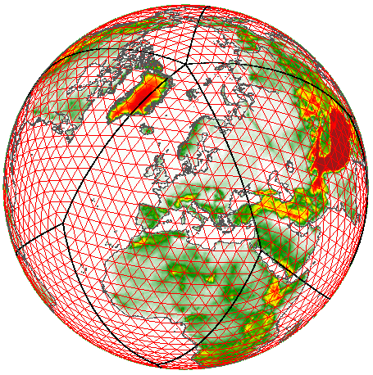

SYSTEM COSMO-RU
COSMO-RU2 Δx =2.2 km
Domain: 900 km * 1000 km
Grid: 420*470 * 50
Step: 2.2 км
Time step: 15 c
Forecast: 24 h
Cores: 400
COSMO-RU7 Δx = 7 km
Domain: 4900 km * 4340 km
Grid: 700*620 * 40
Step: 7 km
Time step: 40 c
Forecast: 78 h
Cores: 800
GME: initial and boundary data
COSMO-RUsib Δx =14 km
GME Δx = 20 km
Domain: 5000 km * 3500 km
Grid: 360*250 * 40
Step: 14 km
Time step: 80 c
Forecast: 78 h
Cores: 48
Grid: 1 474 562 * 60
Step: 20 km
Time step: 70 c
Forecast: 7 days
Гидрометеорологический центр Россиb

Slide 26
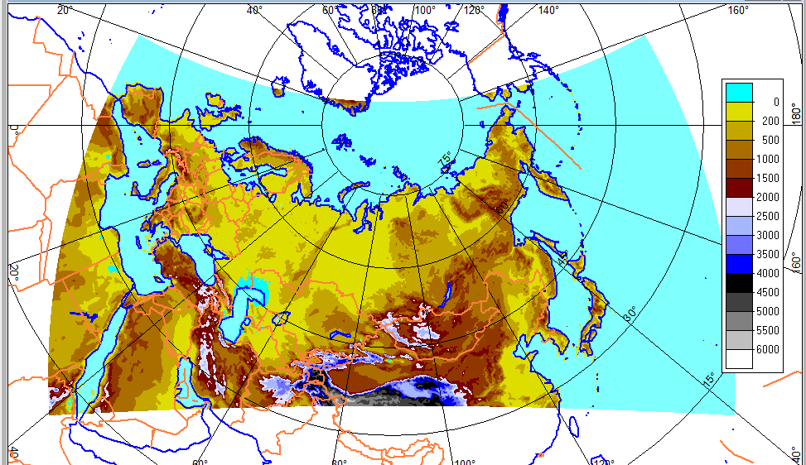
Plans at RHM
2013: New domain for COSMO-RU data assimilation with grid step 6.6 km (2000x1000x40). This COSMO configuration will provide initial data for various nested model configurations

Slide 27
Plans at RHM
Numerical aspects
contribute to the development of 1km –resolution COSMO model system in the course of preparations to Sochi 2014
Physical aspects
contribute to development of parameterizations:
  PBL (aspects of steady stratification)
  Land-surface (mire and forests)
  microphysics scheme
  modification of parameterizations for 1-km resolution
provide Valday hydrological observations for SRNWP data pool
Verification:
contribute to development of VERSUS
implement radar data use in forecast verification
develop the object-oriented methods for mesoscale products

Slide 28
Plans at RHM
Ensemble prediction:
contribute to WG7 activity
develop the mesoscale EPS in the course of preparations to Sochi Games
Applications
develop graphical tools for dissemination of COSMO products to all forecasting centers of Russia
prepare the climatological COSMO version for the MSU supercomputer (computer “CHEBYCHEV”, staff of MSU) and to participate on CLM Community activities
develop commercial applications
Potential new aspect:
possible membership of RHM in ECMWF

Slide 29
15 Resources in strategic areas
Stategic areas for the future development of COSMO:
  Robust dynamical core for very high horizontal resolutions and mountainous terrain
  High-resolution regional ensemble forecasting
  Data assimilation for convective-scale ensemble forecasting
  Physical parameterizations for convective-scale forecasting (atmosphere and surface)
  Efficient use of the next generation computer architectures
Expertise in COSMO assessed and deficiencies identified
Input for strategic development of the COSMO members
Discussion in progress

