Slide 1



Weather type Dependent Verification
in Italy
Adriano Raspanti
Maria Stefania Tesini
Notes:
1

Slide 2
summary
Subjective classification at IMS
COSMO-MED verification against synop stations:
  2m Temperature
  10 m Wind speed
  Cloud cover
  Total Precipitation (6h)
COSMO-MED,COSMO-I7,COSMO-I2,ECMWF against high resolution raingauges:
  Total Precipitation (24h)
Notes:
2

Slide 3
summary
Subjective classification at IMS
COSMO-MED verification against synop stations:
  2m Temperature
  10 m Wind speed
  Cloud cover
  Total Precipitation (6h)
COSMO-MED,COSMO-I7,COSMO-I2,ECMWF against high resolution raingauges:
  Total Precipitation (24h)
Notes:
3

Slide 4
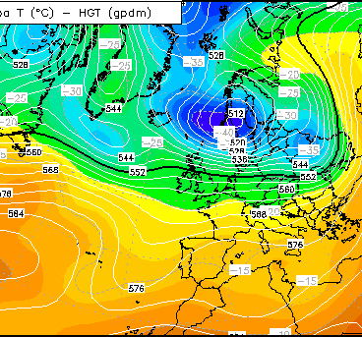
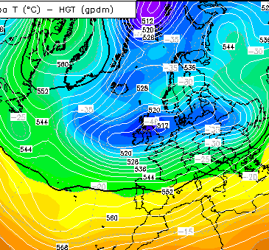
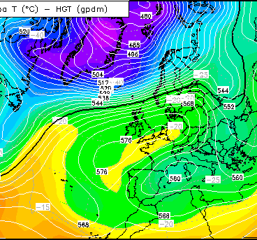
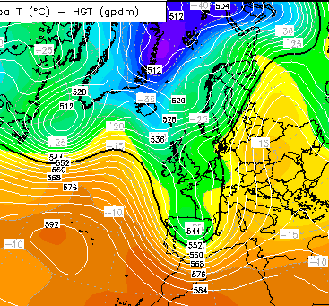
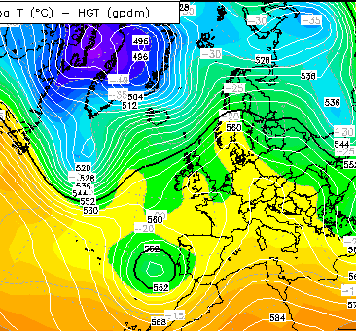
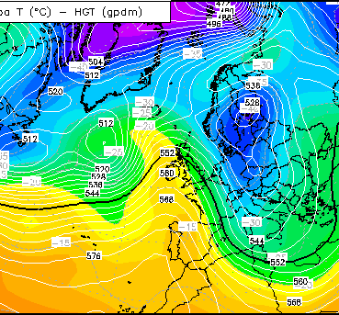
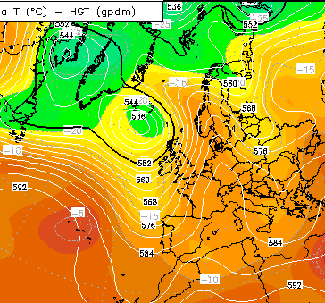
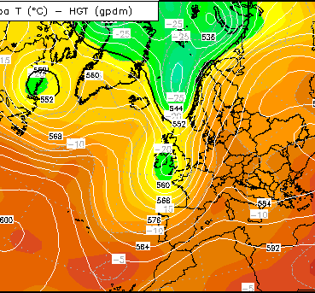
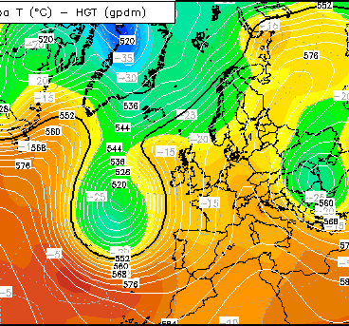
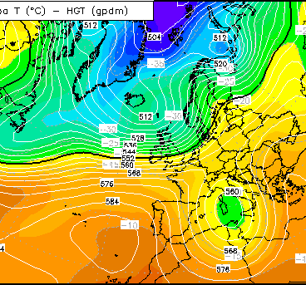
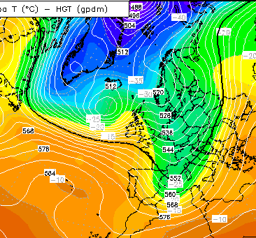
Subjective Classification at IMS
1
2
3
4
5
6
7
8
9
10
11
Notes:
4

Slide 5
Subjective Classification at IMS
Notes:
5

Slide 6
summary
Subjective classification at IMS
COSMO-MED verification against synop stations:
  2m Temperature
  10 m Wind speed
  Cloud cover
  Total Precipitation (6h)
COSMO-MED,COSMO-I7,COSMO-I2,ECMWF against high resolution raingauges:
  Total Precipitation (24h)
Notes:
6

Slide 7
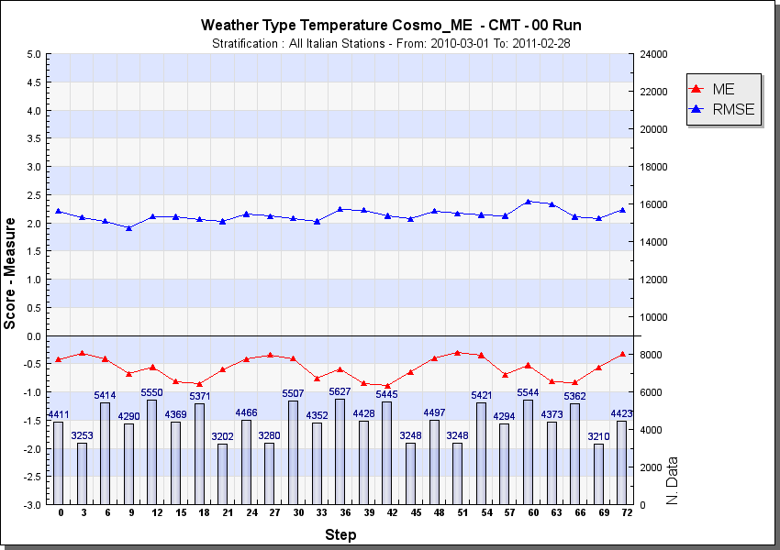
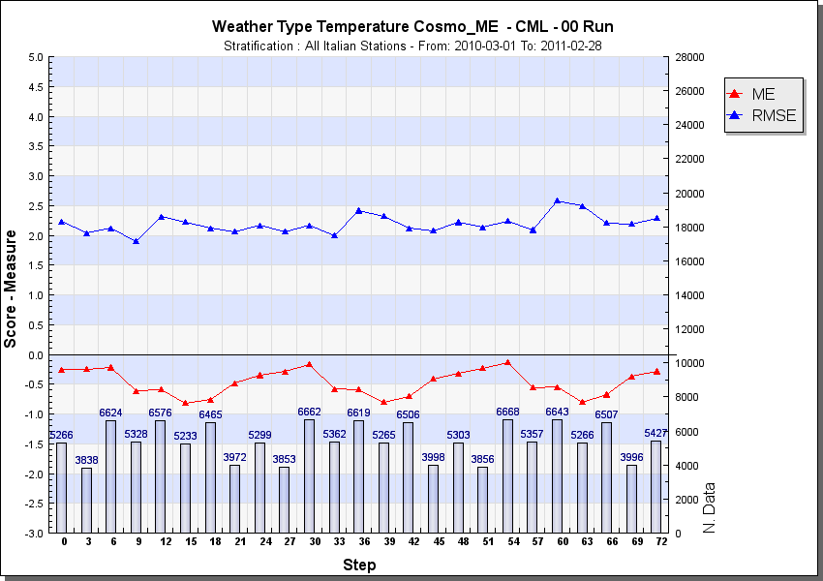
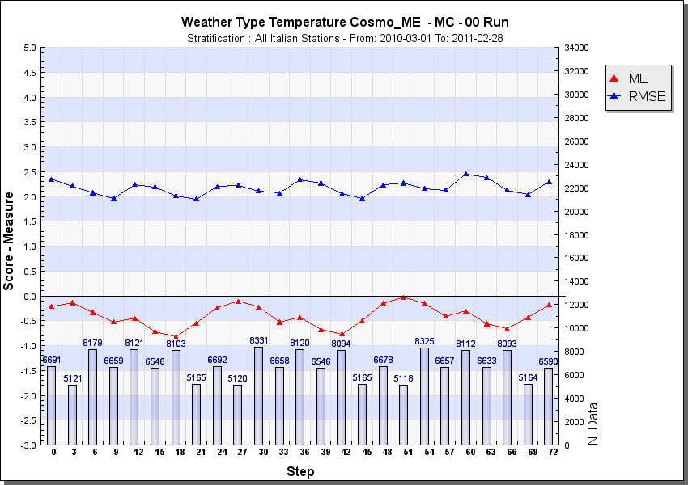
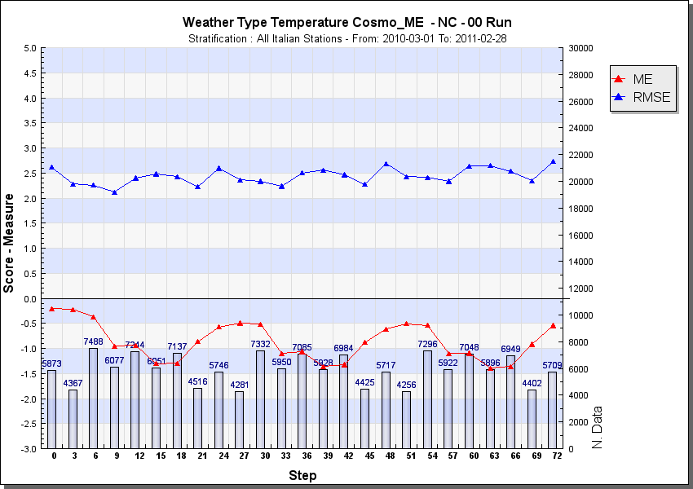
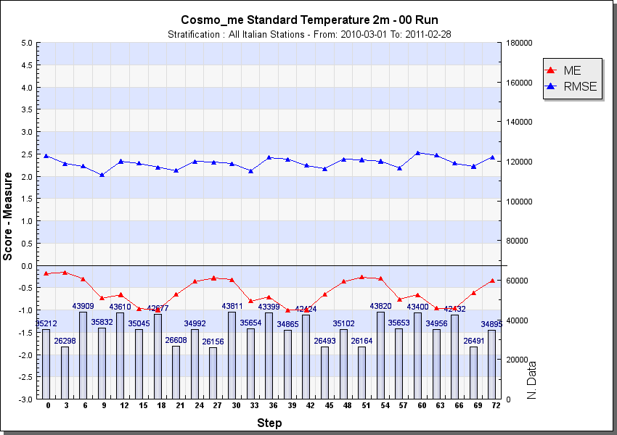
CMT
CML
Temperature
MC
NC
All cases
Negative bias for all cases. Improvement for CMT and CML in RMSE
Notes:
7

Slide 8
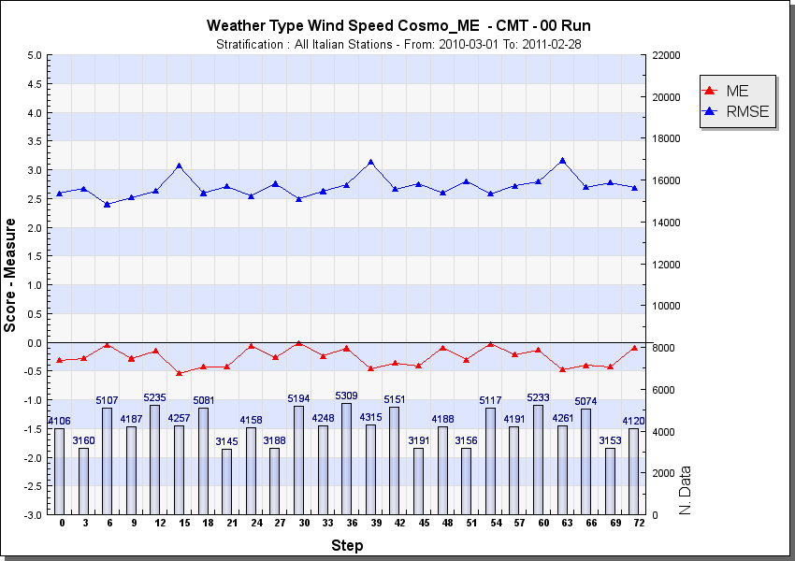
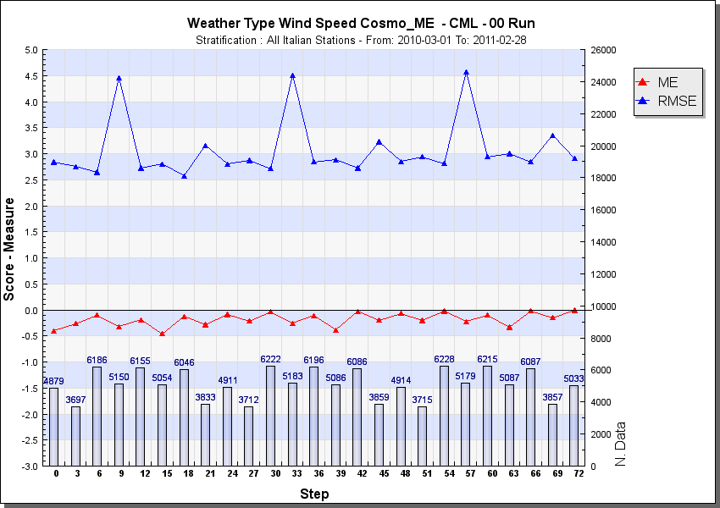
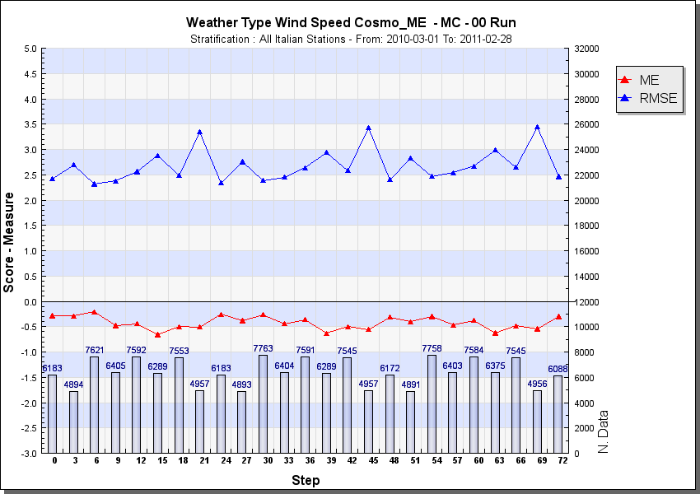
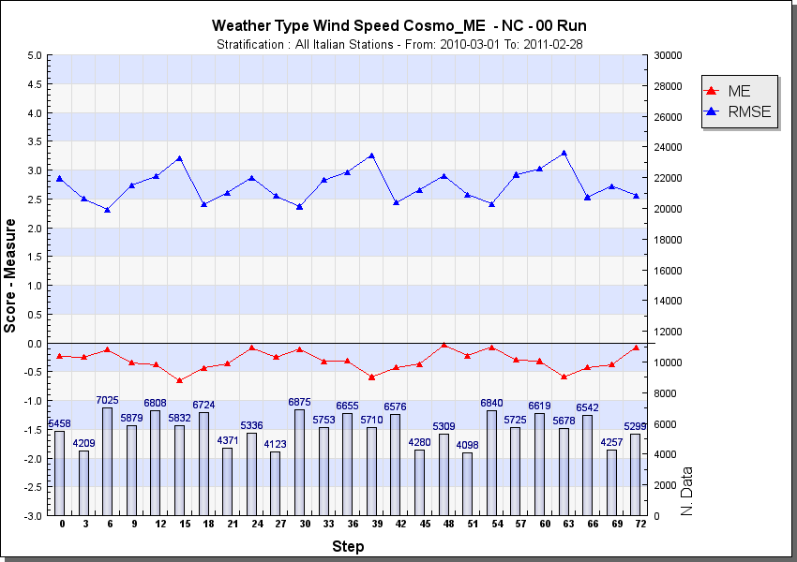
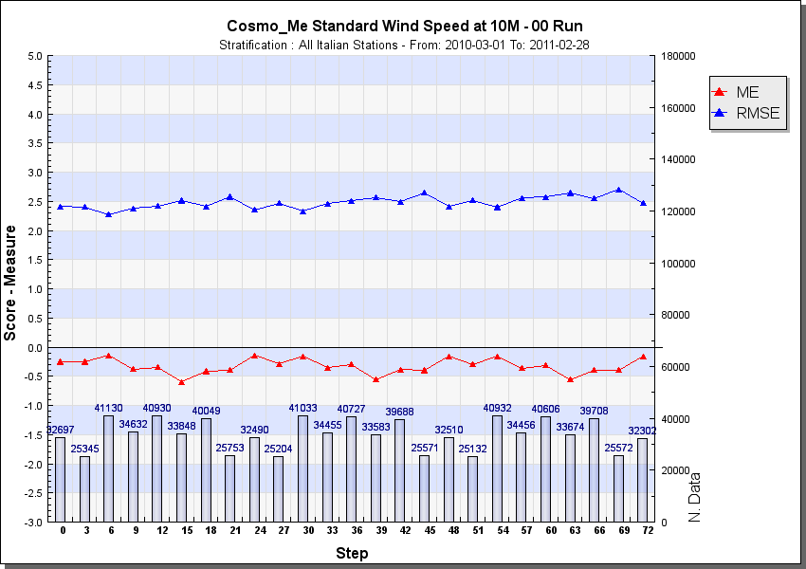
CMT
CML
WIND SPEED
MC
NC
All cases
No clear differences
Notes:
8

Slide 9
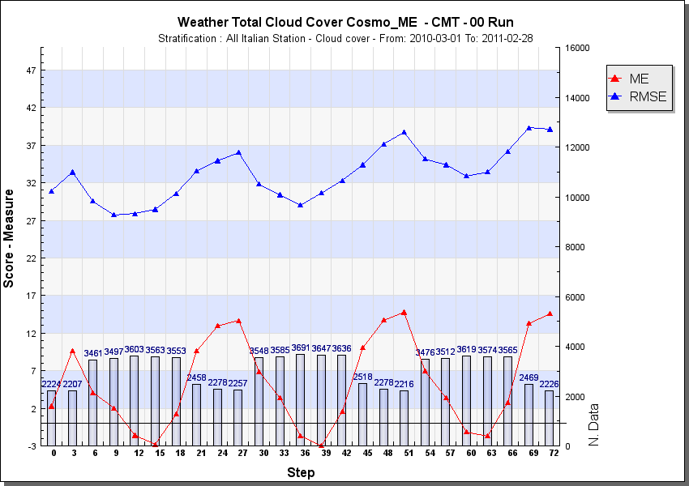
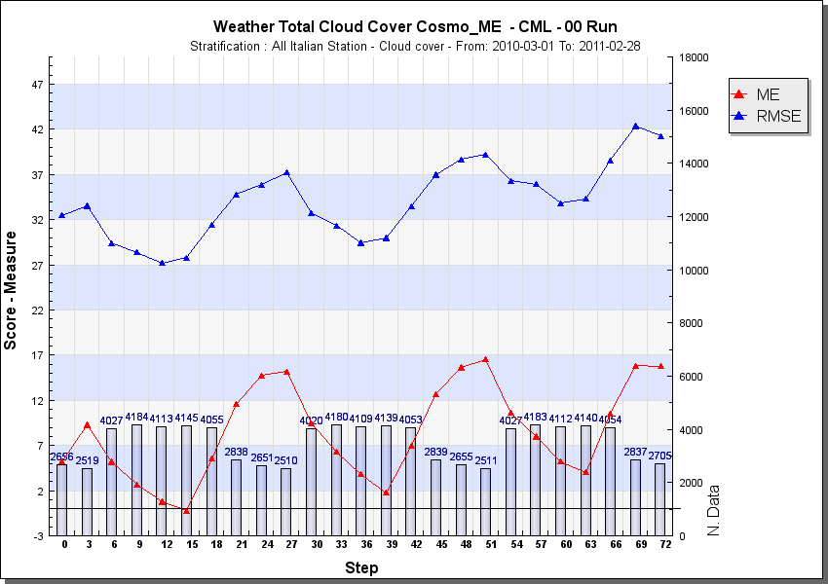
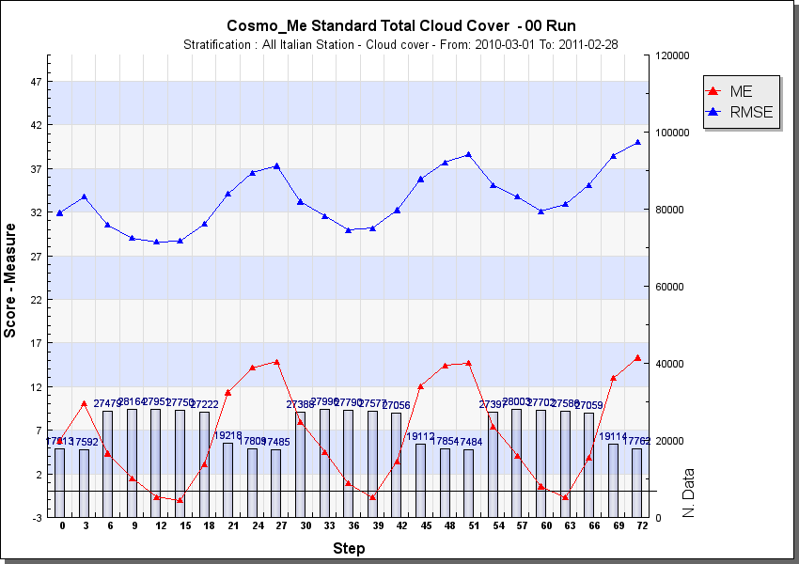
CMT
CML
Total Cloud Cover
All cases
Less overestimation for CMT. Almost no difference in RMSE or MAE
Notes:
9

Slide 10
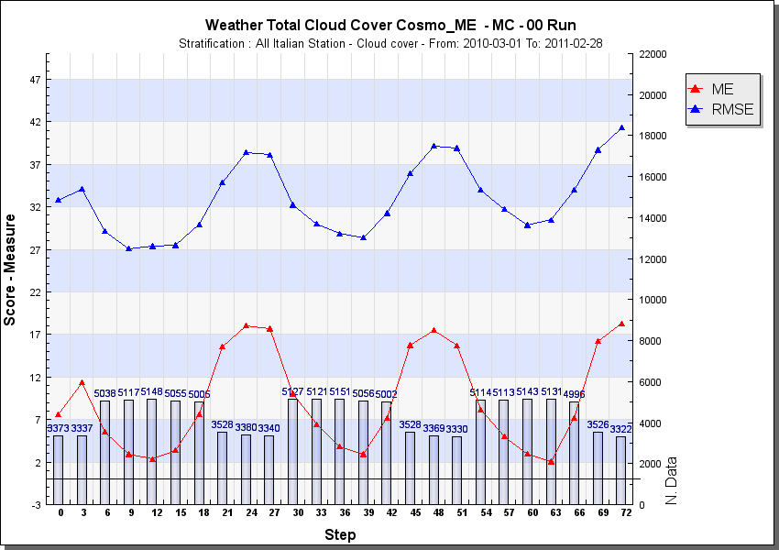
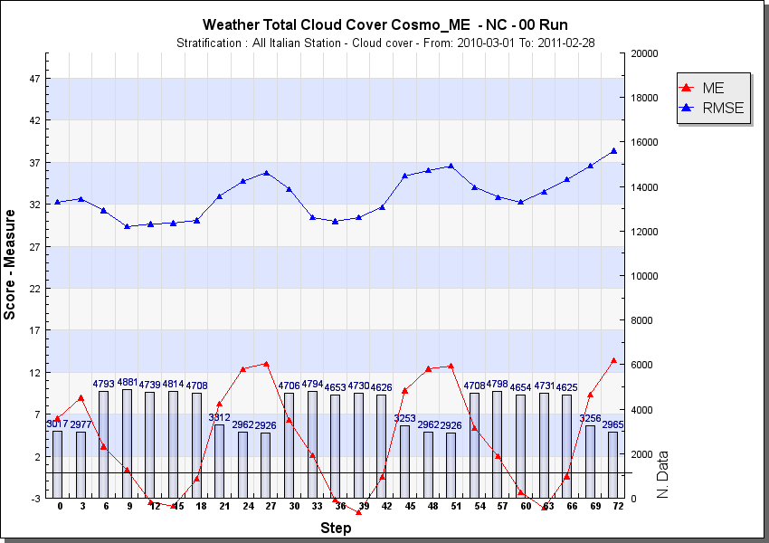
MC
NC
Total Cloud Cover
All cases
Improvement in bias for NC and worsening for MC. RMSE the same
Notes:
10

Slide 11
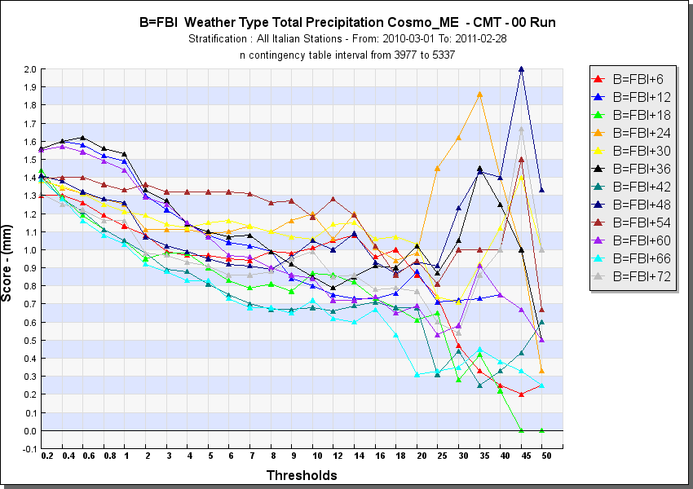
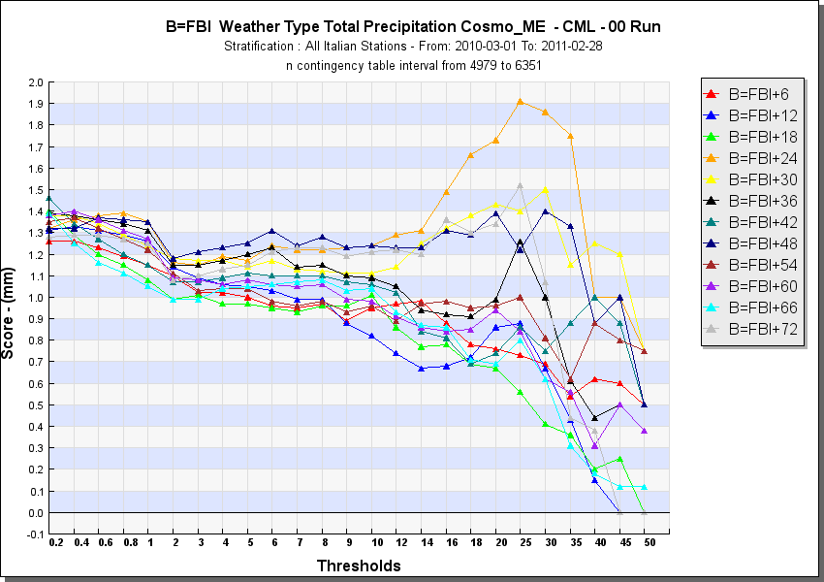
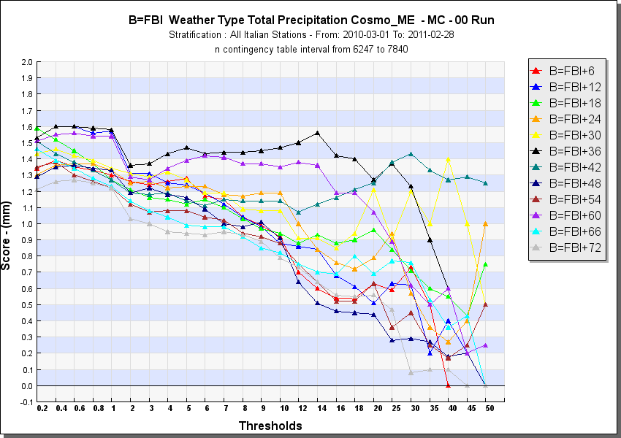
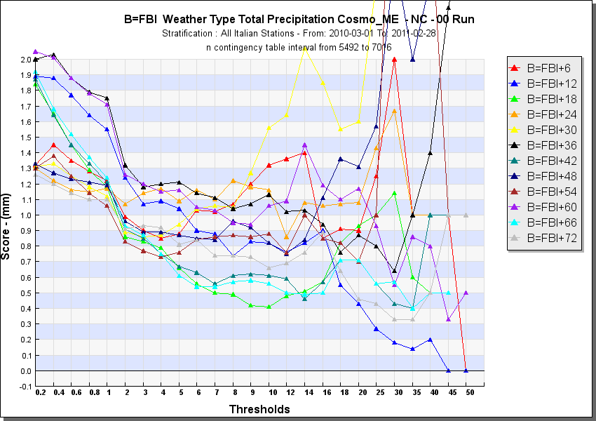
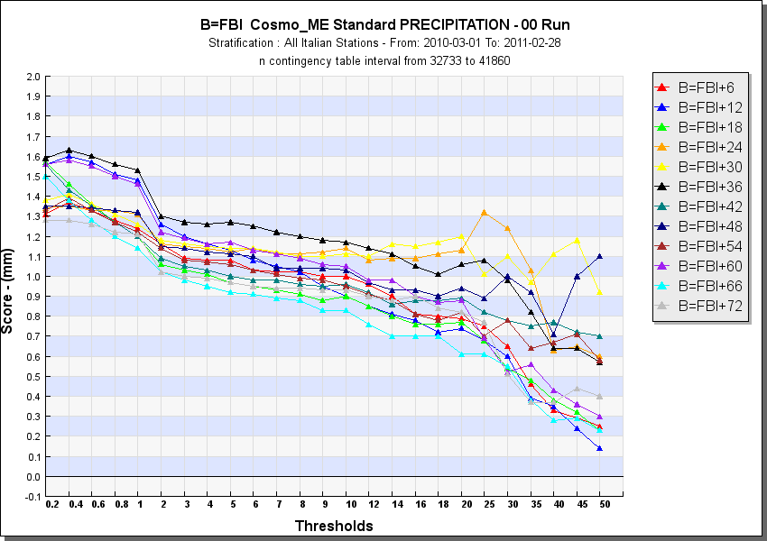
CMT
CML
FBI = 1
FBI = 1
TP 06H FBI
MC
NC
FBI = 1
FBI = 1
FBI = 1
All cases
Less overestimation for CML case and bias around 1 for many thresholds. Higher overestimation for NC
Notes:
11

Slide 12
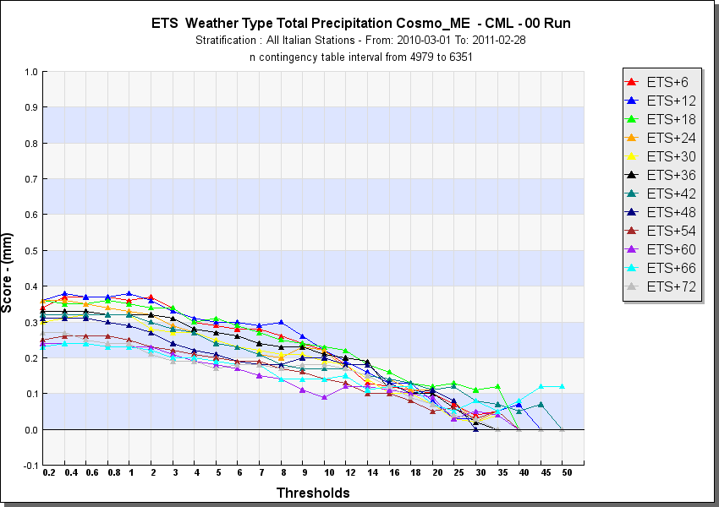
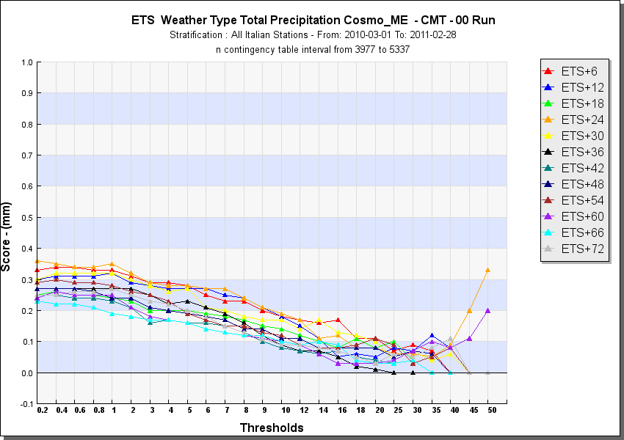
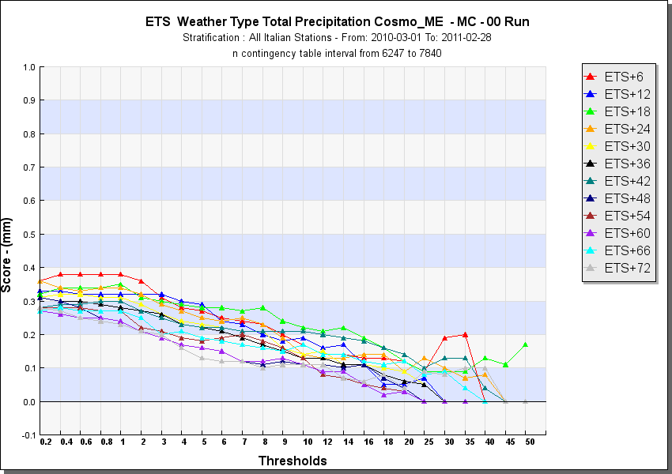
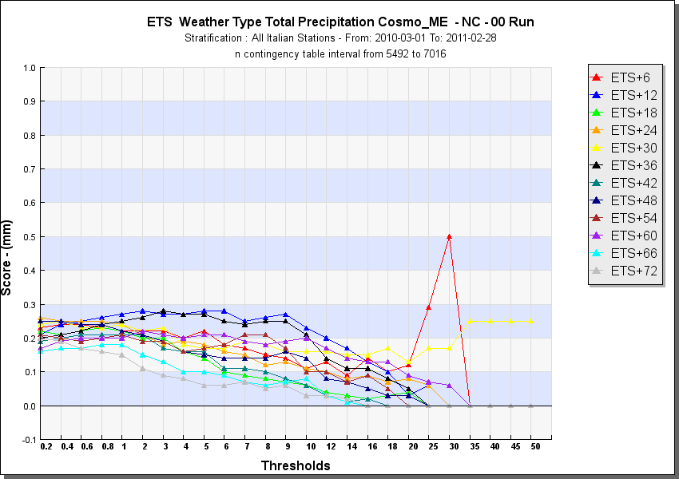
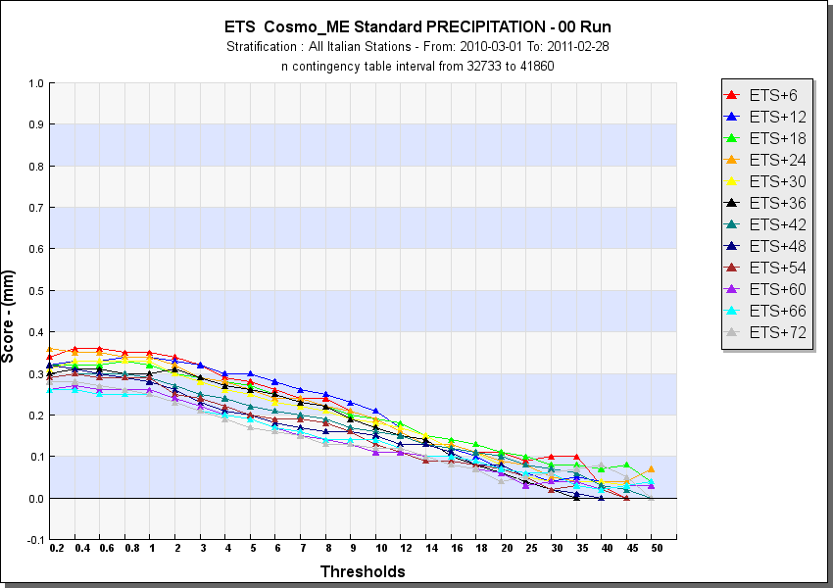
CML
CMT
TP 06H ETS
MC
NC
All cases
Worse or similar ETS for NC, MC and CMT. Slightly better for CML
Notes:
12

Slide 13
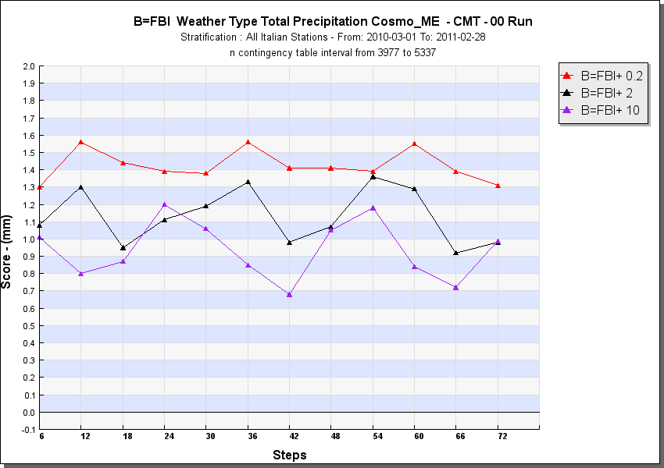
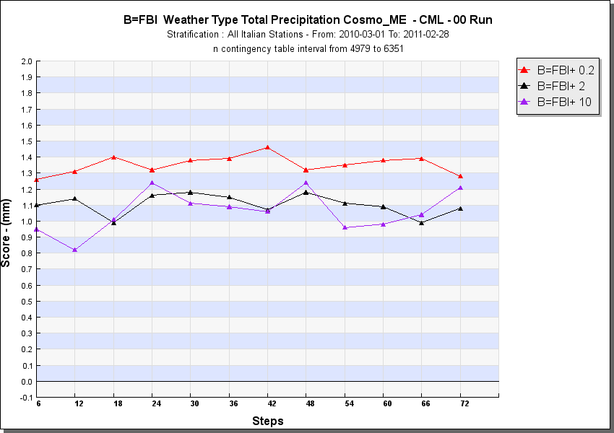
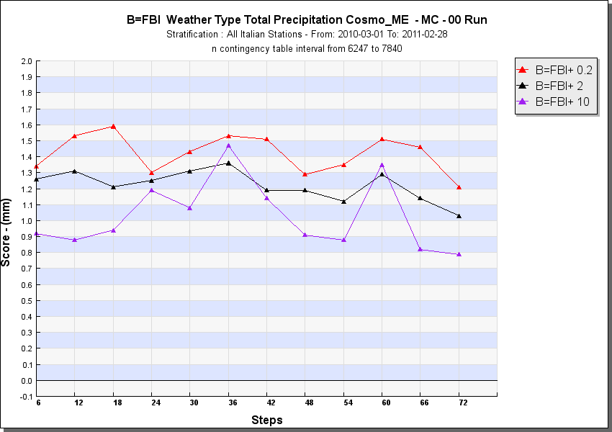
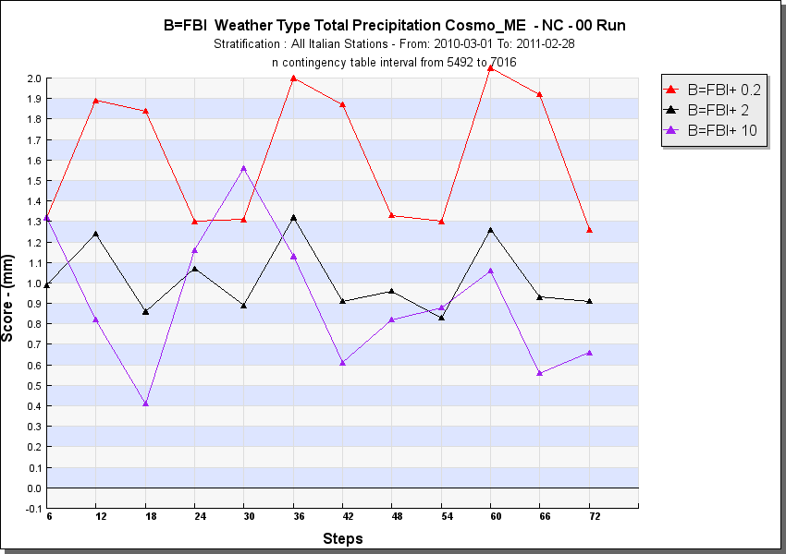
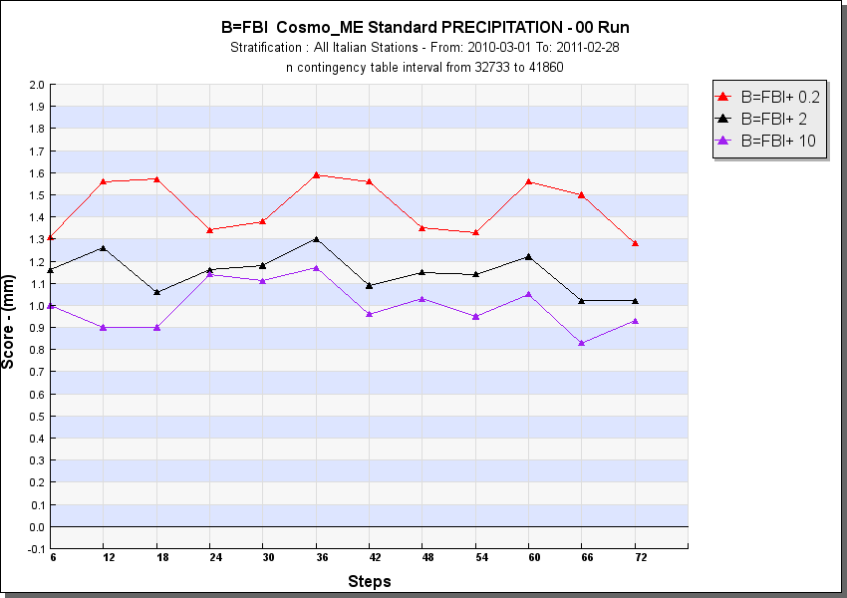
CMT
CML
FBI = 1
FBI = 1
TP 06H FBI
MC
NC
FBI = 1
FBI = 1
FBI = 1
All cases
Different behaviour for lower and higher thresholds
Notes:
13

Slide 14
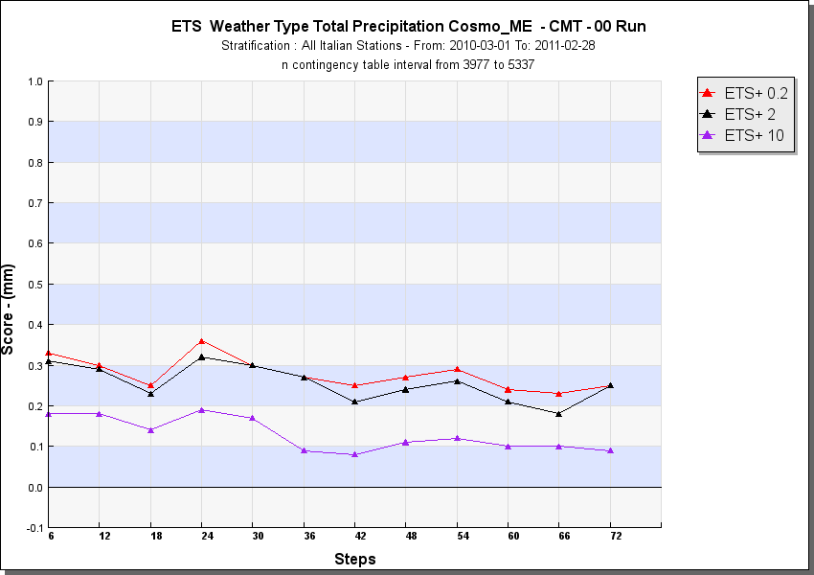
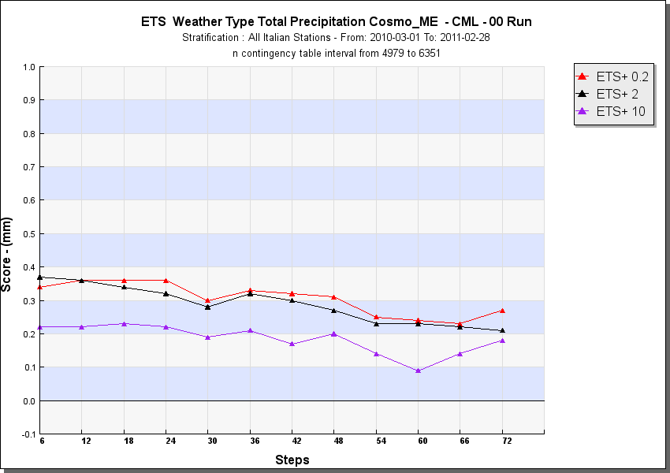
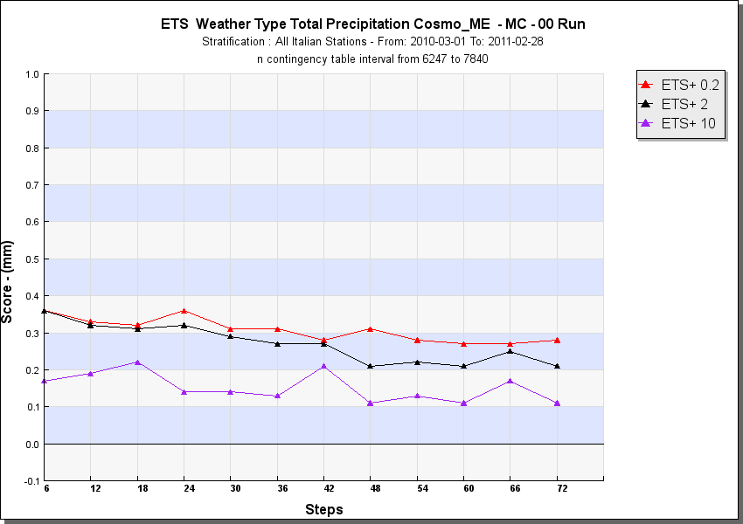
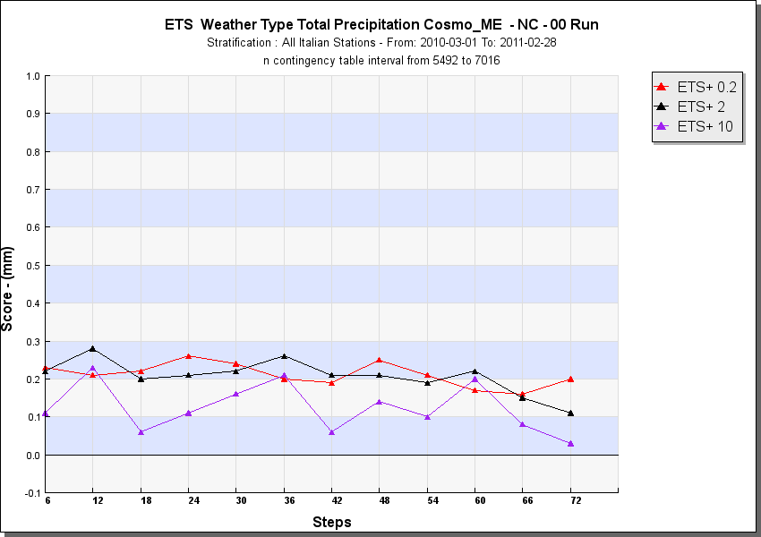
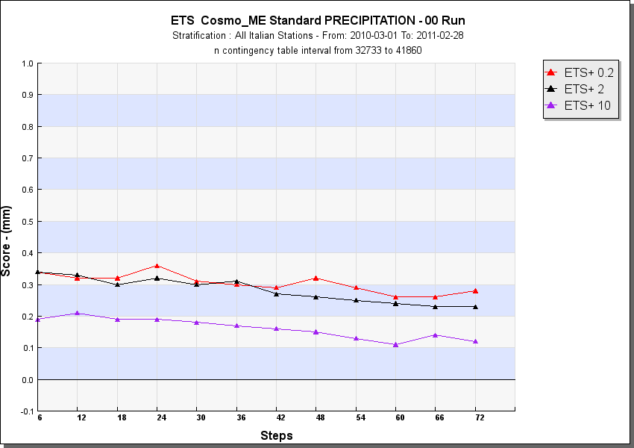
CMT
CML
TP 06H ETS
MC
NC
All cases
Worse or similar ETS for NC, MC and CMT. Slightly better for CML
Notes:
14

Slide 15
summary
Subjective classification at IMS
COSMO-MED verification against synop stations:
  2m Temperature
  10 m Wind speed
  Cloud cover
  Total Precipitation (6h)
COSMO-MED,COSMO-I7,COSMO-I2,ECMWF against high resolution raingauges:
  Total Precipitation (24h)
Notes:
15

Slide 16
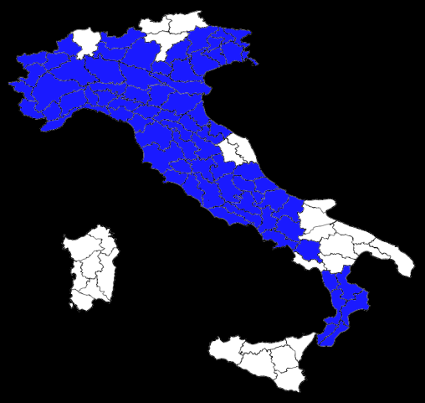
For each weather type category:
 | Day 1 | Day 2 | … | Day n
Area 1
Area 2
…
Area 96
Σ
Scores for the selected category
Daily
scores
Mean / Median value of precipitation
Notes:
16

Slide 17
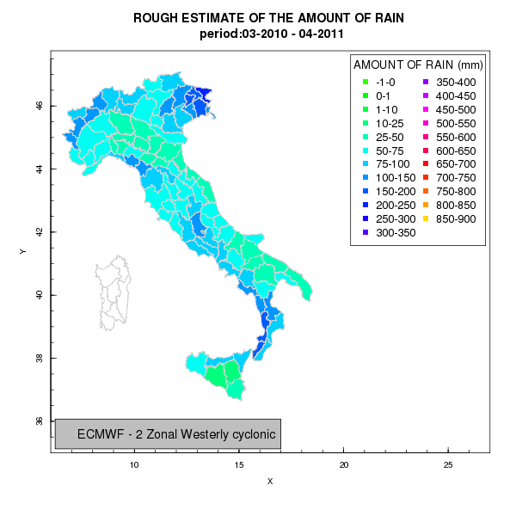
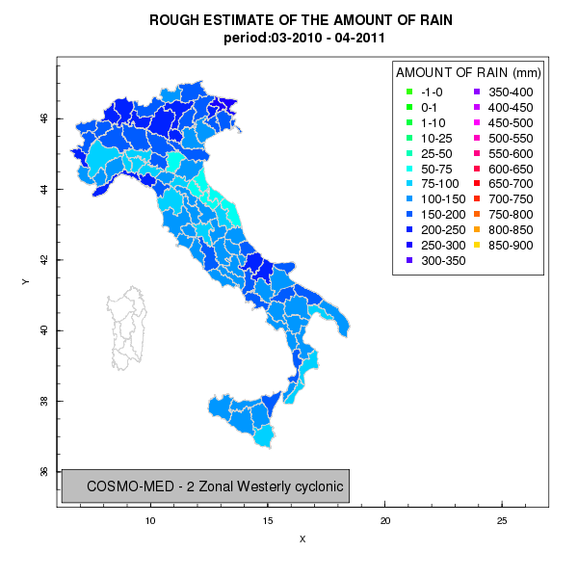
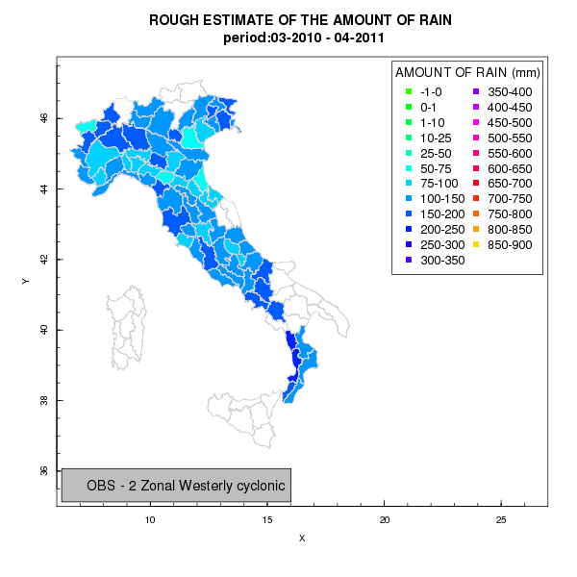




2-Zonal Westerly
cyclonic
Notes:
17

Slide 18






4-Meridional
cyclonic
Notes:
18

Slide 19






6-Northerly
cyclonic
Notes:
19

Slide 20






7-Northerly
anticyclonic
Notes:
20

Slide 21






8-Central Mediterranean
High
Notes:
21

Slide 22






9-Central Mediterranean
Ridge
Notes:
22

Slide 23






10-Central Mediterranean
Low
Notes:
23

Slide 24






11-Central Mediterranean
Trough
Notes:
24

Slide 25
 | 2 ZWC | 4 MC | 6 NC | 7 NA | 8 CMH | 9 CMR | 10 CML | 11 CMT | ALL
WEST ALPS | innn | hhhh | hhnh | hhni | hnnh | hhhh | hhhn | hhin | hhnR
EAST ALPS | nnhn | nhhn | nhnh | nhin | inhh | nhhh | nnnn | hnin | nRRR
NORTH WEST | iini | hhnn | hnih | hhnn | nnnn | nhnn | hhhn | nnii | RRRR
PO VALLEY | iini | hhni | niii | hhnh | nhhh | nhhn | nnni | hnnn | RRnR
NORTH APPEN | innn | nhnn | nnnn | hnhn | nhhh | nhhh | nhhh | nnii | RRRR
SOUTH APPEN | iihi | iiii | inin | nini | iiii | inin | inhh | nnnn | iRRR
TIRRENIAN COST | iihi | nini | niii | nnin | nnnn | hnnh | hnhi | niii | RRRR
ADRIATIC COAST | inni | nnnn | nhnn | hnnn | nnnn | nnnn | ninn | niii | Rnnn
SOUTH | nnnn | niii | hiin | hiin | nnnn | nhnn | inhh | niih | nRRR
Globally | iRnn | RRRR | RRRR | hRRn | nnnR | RhRR | RRhR | nRiR
ECMWF COSMO-I7 COSMO-MED COSMO-I2
h overestimation i understimation n almost correct R variable behaviour
Notes:
25

Slide 26
Some considerations on the rough estimate of the amount of rain
The dataset does not cover equally all the territory so the results are just an indication
It is very difficult to asses the behavior of models in a particular synoptic situation over all the italian region due to complex orography
In each area models behave in a different way according to the synoptic situation
Notes:
26

Slide 27






Small dots = daily scores
Big dots = scores over the days in each category
All cases
Notes:
27

Slide 28





Small dots = daily scores
Big dots = scores over the days in each category
All cases
Notes:
28

Slide 29





Small dots = daily scores
Big dots = scores over the days in each category
All cases
Notes:
29

Slide 30
Some considerations on models performances
At low threshold (e.g. 1 mm/24h)
  Cosmo Models perform well in cyclonic situations (CLM,CMT,MC) – high TS and BIAS ≈1
  but some difficulties in NC
  ECMWF is strongly biased
  In anticyclonic situation COSMO-MED and ECMWF are better in terms of POD but they tend to overestimate the number of events
At higher thresholds (e.g. 5 m/24h and 10 mm/24h)
  COSMO-I7 and I2 miss the anticyclonic situation (except MA )
  still good performance for all models for the cyclonic situation (except for NC)
  ECMWF reduces the BIAS SCORE
Note the different scores for each day of a selected category!!
Notes:
30

Slide 31
Conclusion
Synoptic verification of COSMO-MED did not point out significant differences between the selected category
High resolution verification showed differences in the behavior of models over italian regions, according to weather type category, but the results are difficult to interpret
The good news is that models are able to reproduce more or less all the type of weather!!
Notes:
31

Slide 32
Thanks for your attention
Notes:
32

